Slide 1
Status Admin Module
Spring MVC Redesign
(Draft)

Slide 2
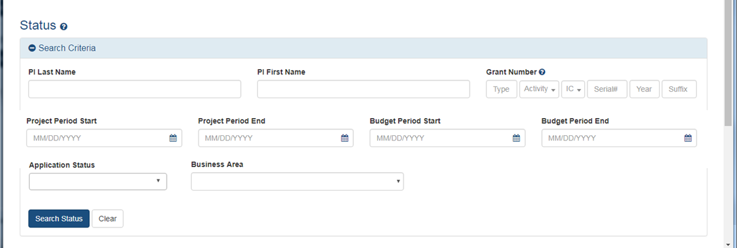
Main Search

Slide 3
Main Search – By Business Area

Slide 4
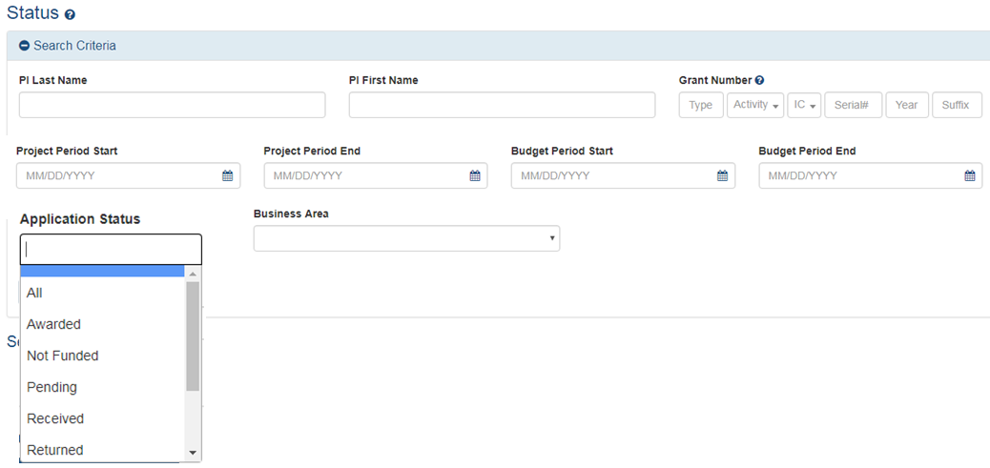
Main Search – By Application/Award Status

Slide 5
Advanced Search/Filter

Slide 6
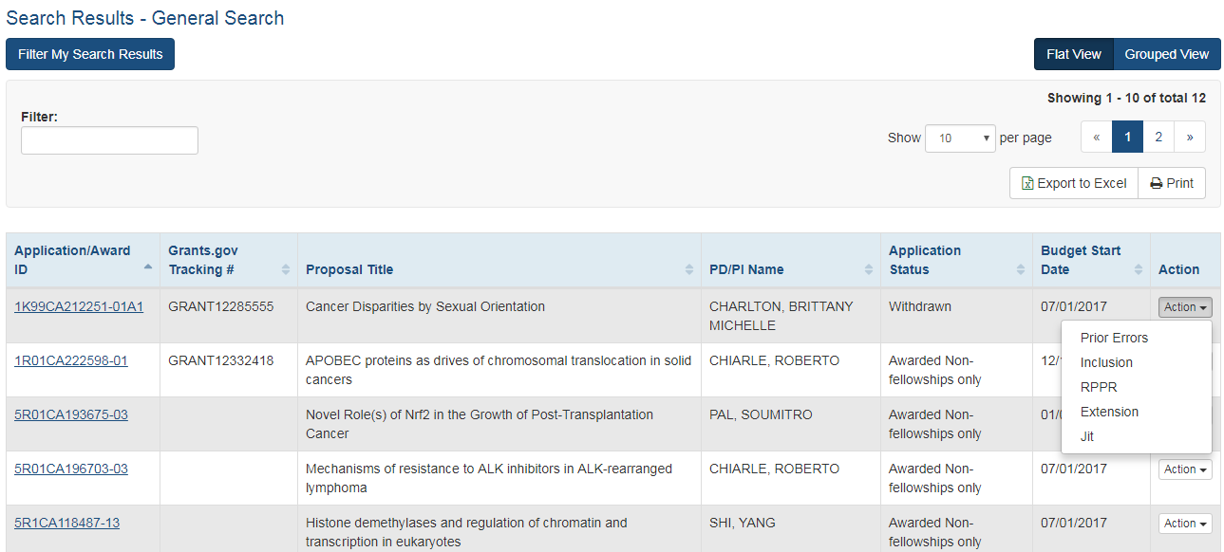
Proposed Search Results - Actions

Slide 7
Proposed Search Results – Flat View

Slide 8
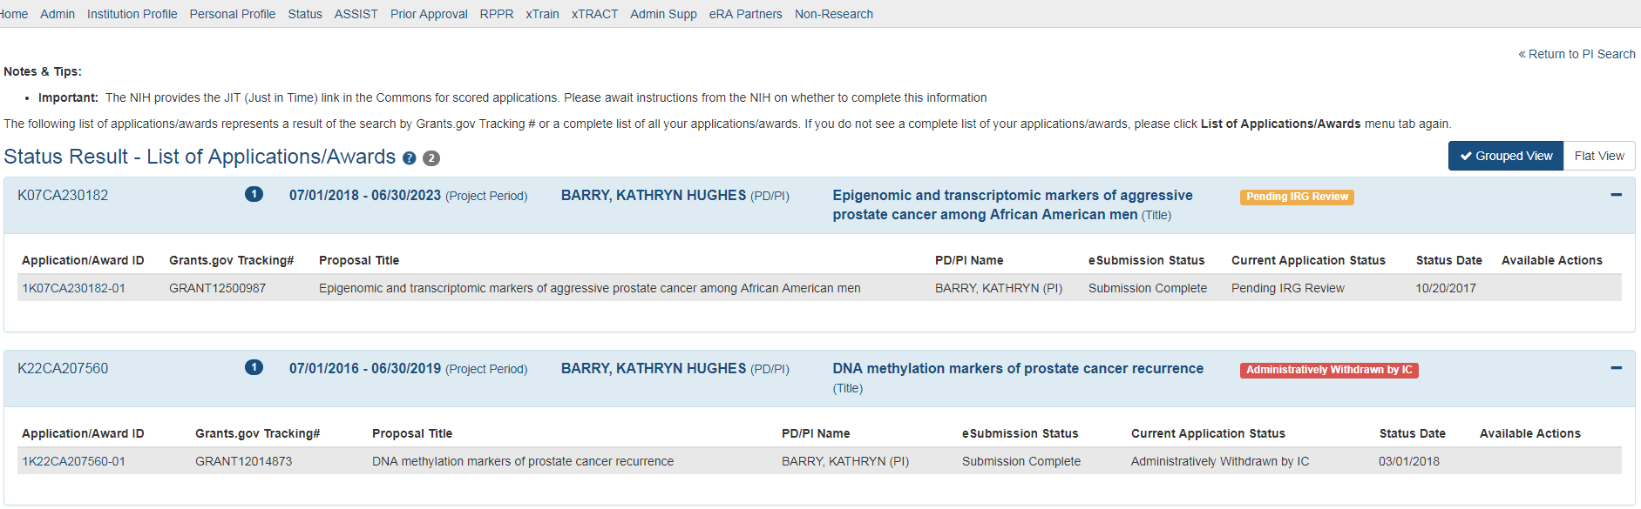
Search Results – Grouped View

Slide 9
Project Logistics & Feedback – Business Question
What is the first thing you do when you accessing Status? What do you perform a search for?
While creating a query for the search, what search parameters do you use specific for the search you are in (Pending Progress report, General search, etc..)?
If you would have a choice of the default data set that would be presented to you by the system when you come in, what would this data set consist of?
In each search, what search parameters are used the most and the least
Do you use the Status module more based on business area (RPPR, Inclusion, Closeout), Person’s Name or based on IC?
Would you like to have an ‘End’ or an ‘Or’ on the filter page between the business areas?
Do we need to retain School and Hierarchy search parameters currently located on some searches?

Slide 10
Project Logistics & Feedback - Administrative
Requesting CWG members participation on a biweekly basis starting late May. Need names and email address of volunteers.
30 minutes WebEx session to run through what was developed, ask any related questions on UI and business flow.

Slide 11
General Search

Slide 12
JUST IN TIME

Slide 13
Pending Progress Report

Slide 14
Recently Awarded

Slide 15
Recent/Pending eSubmissions

Slide 16
Close out

Slide 17
Change of Institution

Slide 18
Pending Human Subject Action/Pending Inclusion Action

Slide 19
Reassign Award

Slide 20
Non Research Continuations

Slide 21
ESI Eligibility

