Slide 1




NIH eRA Workshop:
Grant Application Preparation & Submission
October 2018
electronic Research Administration (eRA)
OER, OD, National Institutes of Health
San Francisco, CA

Slide 2

Your Workshop Team
Sheri Cummins
  Office of Extramural Research (OER) Communications & Outreach
  Chief, Grants Information
  cumminss@od.nih.gov
Laurie Roman
  Electronic Research Administration (eRA)
  Customer Relationship Manager
  laura.roman@nih.gov

Slide 3
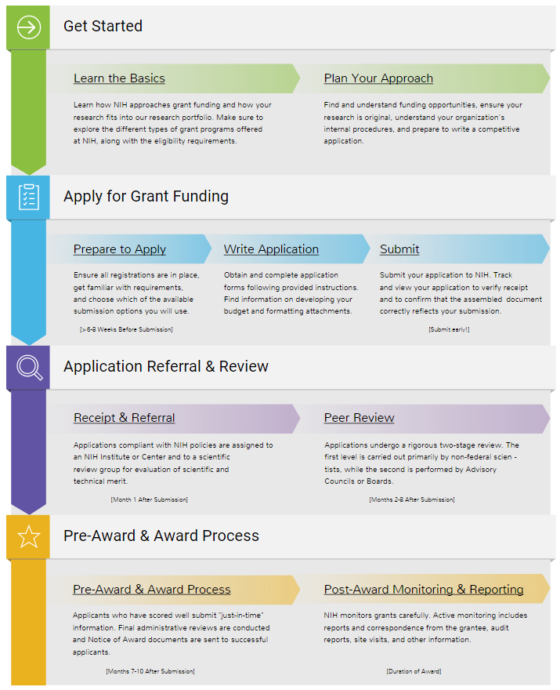

Today’s Topics
Prepare to Apply
  Systems & Roles
  Registrations
  Understanding Funding Opportunity Announcements
    Explore a sample FOA
  Types of Applications
  Submission Options
  Software
  Submission Policies
    Sample scenarios
Application Process Step-by-step
  Avoid the “gotchas” activity
Finding Help & Resources
Wrap-up

Slide 4
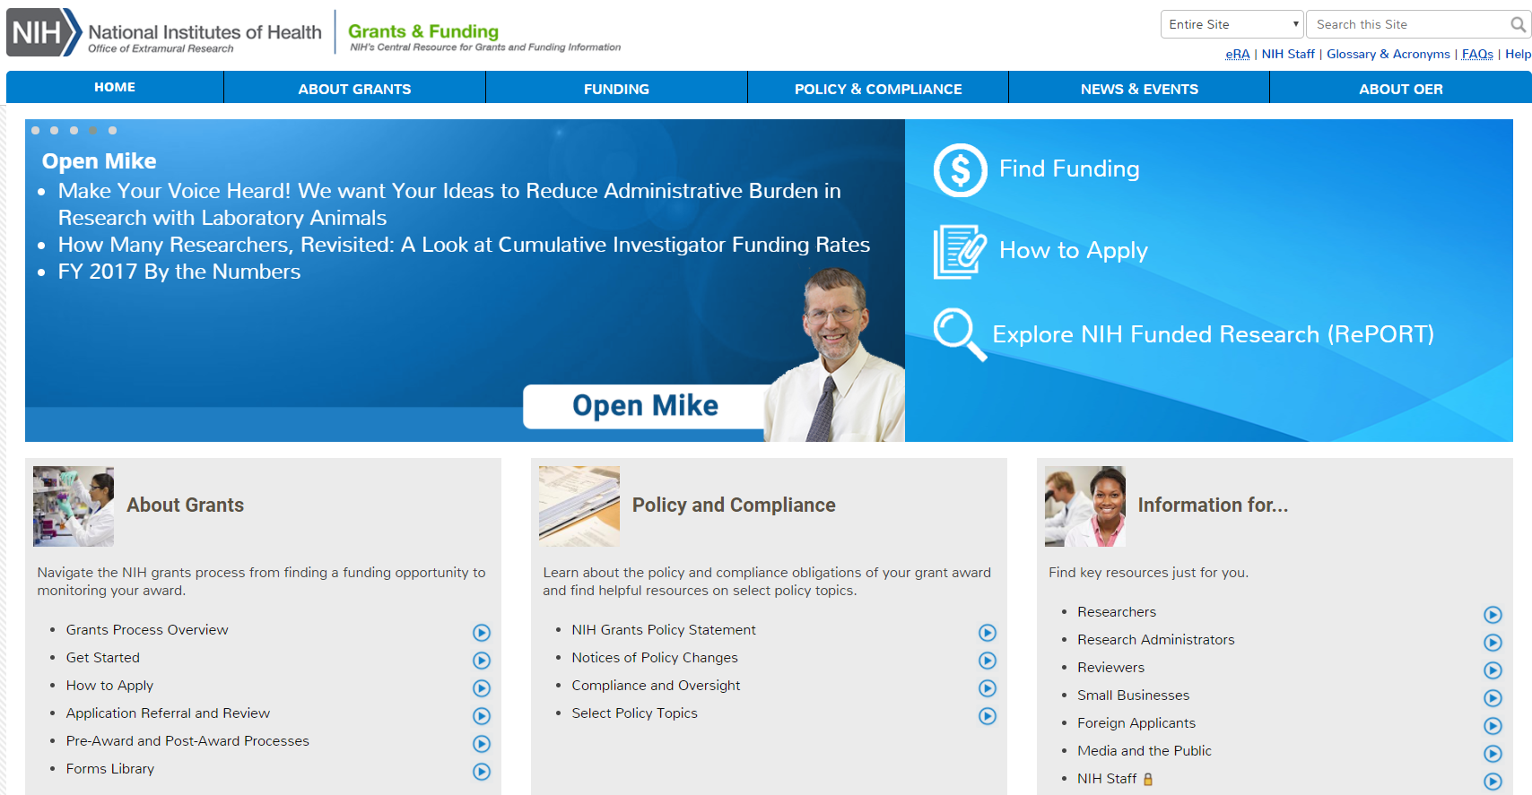
NIH Grants & Funding
How to Apply- Application Guide
https://grants.nih.gov

Slide 5
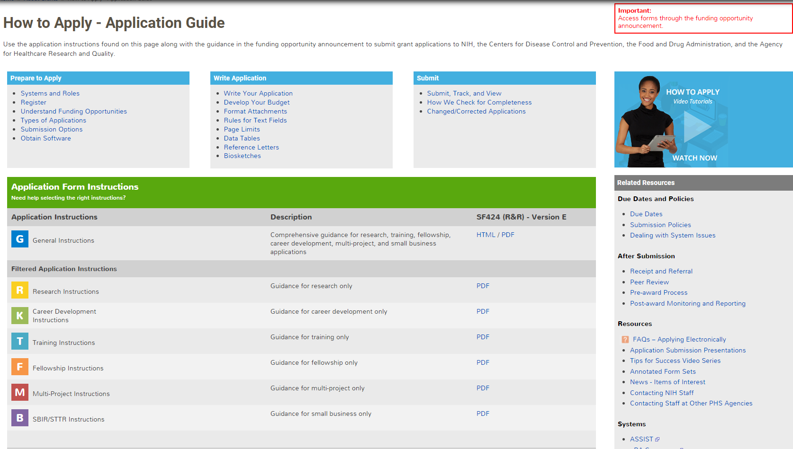
How to Apply – Application Guide
General Application Process Information
Form Instructions
Resources

Slide 6
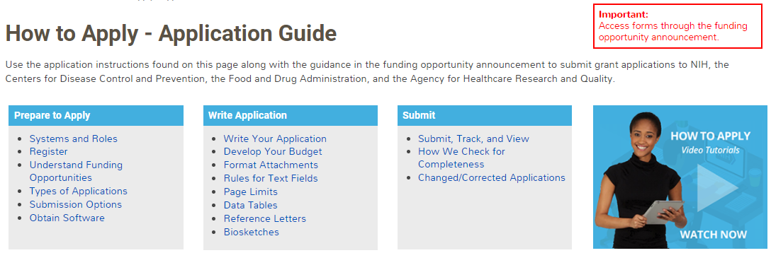
Before Jumping Into the Application Process,
Let’s Cover Some Basics

Slide 7
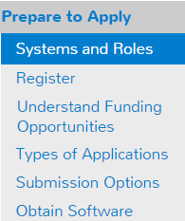


Understand Key Systems & Roles
Grants.gov
eRA Commons
E-Business Point of Contact (EBiz POC)
Authorized Organization Representative (AOR)
Signing Official (SO)
Principal Investigator (PI)
https://grants.nih.gov/grants/how-to-apply-application-guide/prepare-to-apply-and-register/key-systems-and-roles.htm

Slide 8
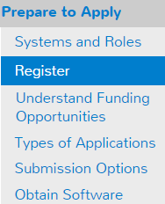


Organization Registration
Your organization must be registered in multiple systems to submit.
Start early – can take 6 weeks!
DUNS – provides unique organization identifier
SAM (System for Award Management) – needed to do business with government
  Requires annual renewal
Grants.gov – required to submit grants
eRA Commons – required to do business with NIH
SBA (Small Business Administration) – required
for SBIR/STTR applications
https://grants.nih.gov/grants/how-to-apply-application-guide/prepare-to-apply-and-register/registration/org-representative-registration.htm

Slide 9
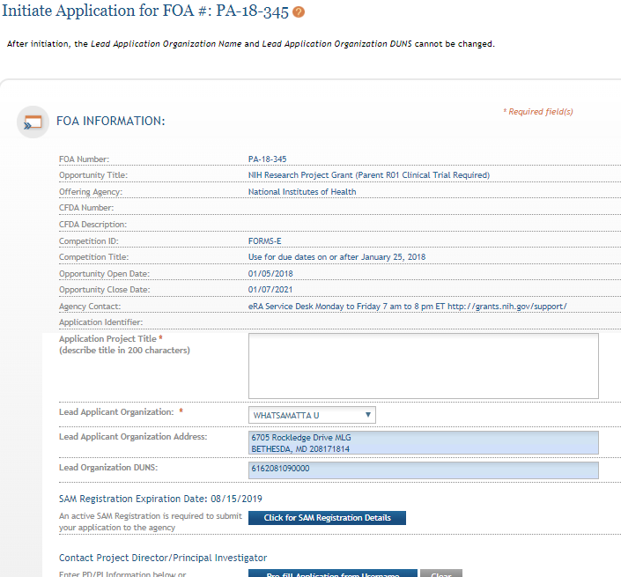
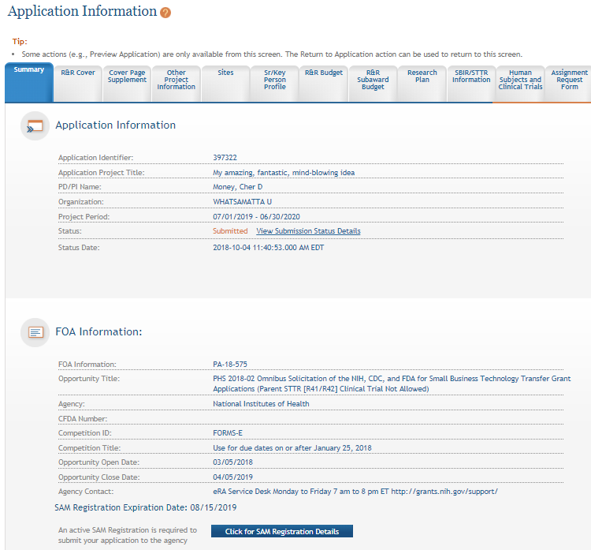
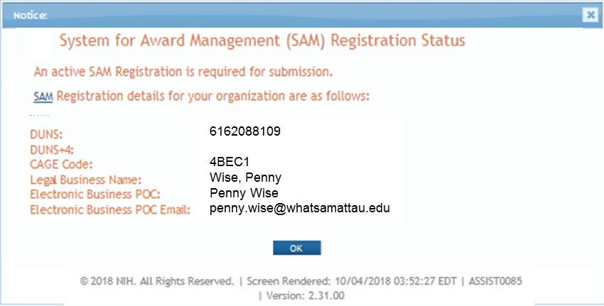
Visibility of SAM Registration Status in ASSIST
Initiate Screen
Application Information Screen

Slide 10
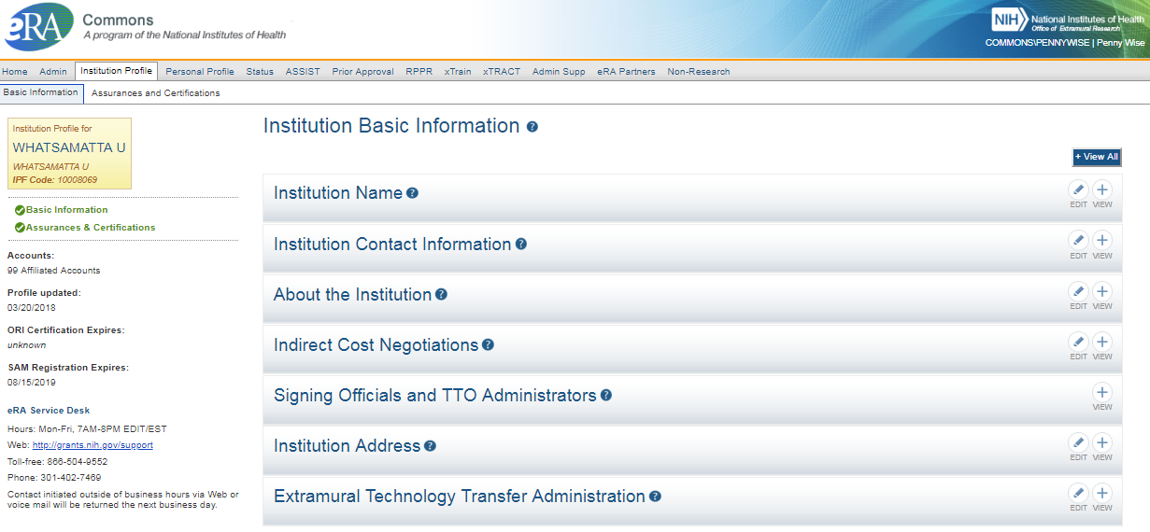
Visibility of SAM Registration Status in eRA Commons

Slide 11

Individual eRA Commons Registrations
Who needs an eRA Commons account?
  At least one Signing Official (SO)
  Project Director/Principal Investigator (PD/PI) and any multiple-PD/PIs
  Component leads on a multi-project application
  Sponsor on a fellowship application (NOT-OD-14-129 – August 2014)
  Candidates for diversity and re-entry supplements
  Primary mentor identified on individual mentored career development applications (NOT-OD-16-082 – March 2016)
  Anyone doing data entry in ASSIST
  If awarded, additional individuals may need accounts for reporting purposes
https://grants.nih.gov/grants/how-to-apply-application-guide/prepare-to-apply-and-register/registration/investigators-and-other-users/era-commons-user-registration.htm

Slide 12


Account - Tips
Log in to accounts prior to deadline to ensure you have access
Designate more than one Signing Official (and AOR)
Check for existing eRA Commons account before creating a new one
  Ask the person if they already have an account, or search within the Commons
    If a user already has an account with a different organization, you should affiliate the existing account with the user’s new organization
Do not mix PI and SO roles on same account
  If a person serves both roles (e.g., small business), they must have two accounts
PIs should update their eRA Commons profile prior to submitting
  E.g., info used to determine Early Stage Investigator (ESI) eligibility

Slide 13
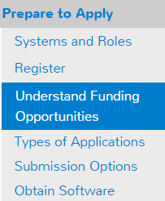
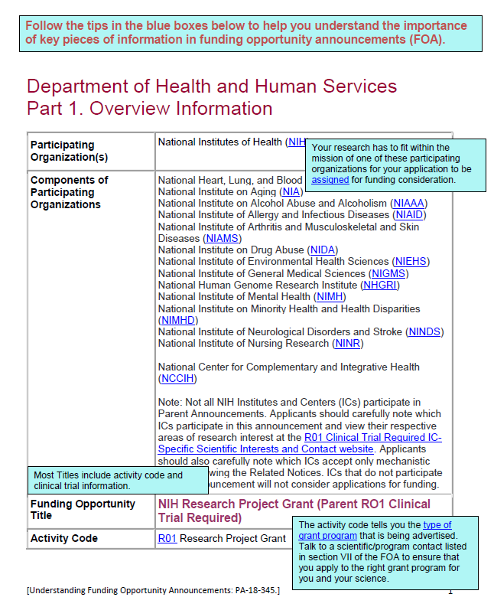


Understanding Funding Opportunities
Funding Opportunity Announcement (FOA)
  A publicly available document by which a Federal Agency makes known its intentions to award discretionary grants or cooperative agreements, usually as a result of competition for funds.
Take a tour of an Annotated FOA
  https://grants.nih.gov/grants/Annotated_FOA.pdf
Let’s take a quick peek at this link.
https://grants.nih.gov/grants/how-to-apply-application-guide/prepare-to-apply-and-register/understand-funding-opportunities.htm

Slide 14

Clinical Trial Specific FOAs
NIH requires that all applications involving one or more clinical trials be submitted through a Funding Opportunity Announcement (FOA) specifically designed for clinical trials.
Improves our ability to
  identify proposed clinical trials;
  ensure key trial-specific information is submitted; and
  Uniformly apply trial-specific review criteria.
FOAs include clinical trial allowability indicator
  Section II of all FOAs
  Title of most FOAs
    If title does not include clinical trial allowability indicator, then independent clinical trials are NOT allowed
https://grants.nih.gov/policy/clinical-trials/specific-funding-opportunities.htm

Slide 15
Special Consideration for Programs Focused on Early Career Stages
Fellowship (Fs) | Training (Ts) | Career Development (Ks)
All FOAs are “Independent Clinical Trial Not Allowed” Fellows can still play an active role and gain experience in clinical trials led by a sponsor/co-sponsor as part of their research training | All FOAs are “Independent Clinical Trial Not Allowed” Appointed Trainees can still play an active role and gain experience in clinical trials led by a mentor or co-mentor | Some FOAs are “Independent Clinical Trial Not Allowed” Candidates can still play an active role and gain experience in clinical trials led by a mentor/co-mentor as part of their research career development Others are “Clinical Trial Required” Allow independent clinical trials
Why aren’t fellows and trainees allowed to lead an independent clinical trial?
Fellows and trainees may not yet possess the skills to independently lead a clinical trial and navigate all the components, complexities, and reporting requirements
Fellowship and training grants do not include sufficient research funds to support the majority, if not all types, of clinical trials

Slide 16
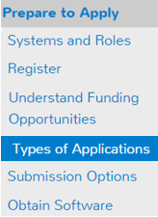
Identify Type of Application
Number Type | Stage/Description
Type 1* | New - Request for support of a project that has not yet been funded.
Type 2* | Renewal - Request for additional funding for a period subsequent to that provided by a current award.
Type 3* | Competitive Revision* – Request for additional funds to expand the scope of a current award. Administrative Supplement Revision – Request for additional funds to cover unforeseen, increased costs to carry out current award.
Type 6 | Change of Organization Status (Successor-in-Interest)
Type 7 | Change of Grantee or Training Institution
* Resubmission - Unfunded application that has been modified following initial review and resubmitted for new consideration.
https://grants.nih.gov/grants/how-to-apply-application-guide/prepare-to-apply-and-register/type-of-application-submission.htm

Slide 17
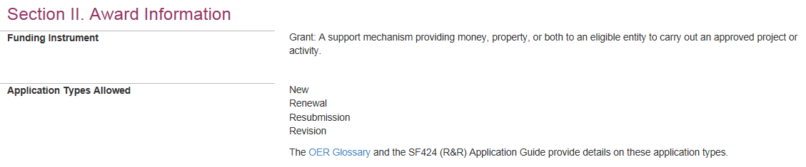
Why is knowing the type of application important?
Potential impact on…
Due dates
  E.g., If submitting to an R01 opportunity with standard due dates, “New” applications have a different due date than “Resubmission”, “Renewal” or “Revision” applications.
Ability to submit to a specific announcement
Application validations
  We enforce different rules based on your selection in the “Type of Application” field (#8) of the SF424 (R&R) form.

Slide 18
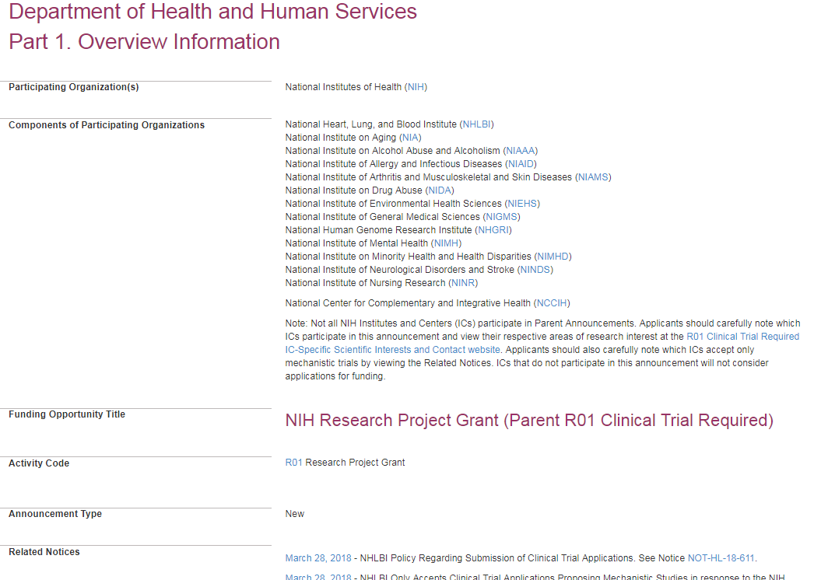

Now let’s look at an actual FOA…
PA-18-345

Slide 19
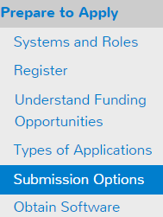




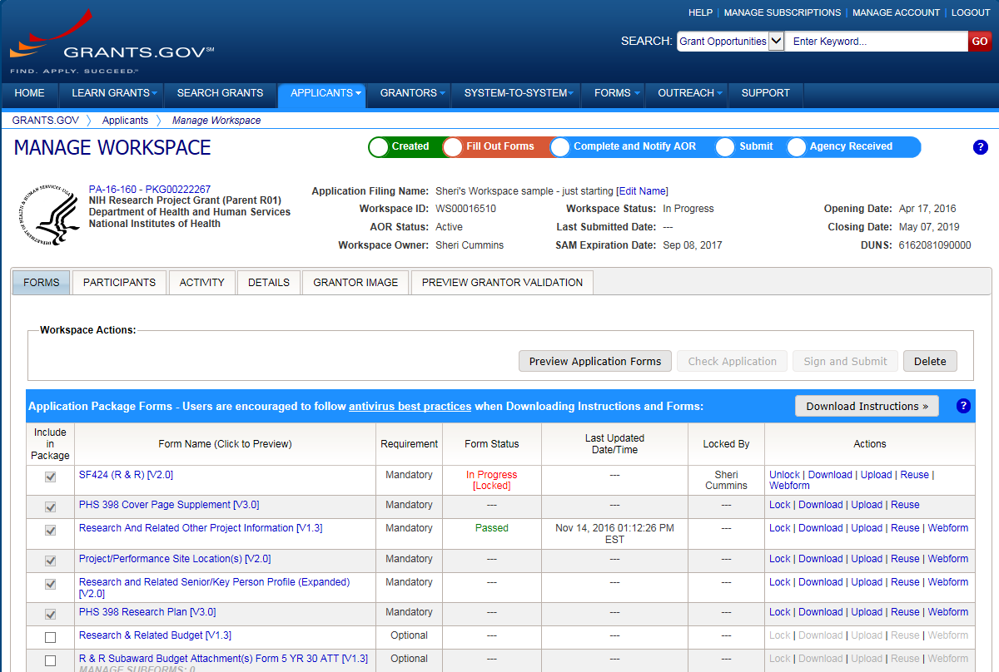




Application Submission Options
ASSIST
System-to-System
Workspace
https://grants.nih.gov/grants/how-to-apply-application-guide/prepare-to-apply-and-register/choose-a-submission-option.htm

Slide 20



Your Application will be…
Subject to the same registration requirements
Completed with the same data items
Routed through Grants.gov
Validated against the same NIH business rules
Assembled in a consistent format for review consideration
Tracked in eRA Commons
…regardless of submission option used.

Slide 21
What Submission Options are NIH Applicants Using?
Monthly Submission Method Percentages
January 2018 – June 2018
Total Submission Method Percentages
January 2018 – June 2018

Slide 22
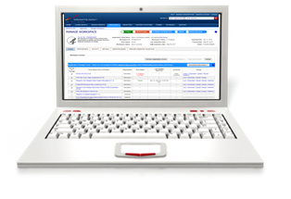

Comparison of Submission Options
NIH ASSIST
Grants.gov Workspace
Managed by NIH
Multi-user access
Leverages eRA Commons accounts
Pre-population from eRA Commons profiles
Pre-submission validations
Pre-submission preview in agency format
Track application status in a single system
Copy data to different application package
Supports all NIH competing applications
Pull study information from ClinicalTrials.gov
Integrated NIH messaging (tips, system alerts)
Managed by Grants.gov
Multi-user access
Requires additional user registrations
No pre-population from existing profiles
Pre-submission validations
Pre-submission preview in agency format
Must track application in multiple systems
Reuse forms; copy application data
Supports NIH single-project competing applications (no multi-project support)
https://grants.nih.gov/grants/how-to-apply-application-guide/prepare-to-apply-and-register/submission-options/assist.htm
https://www.grants.gov/web/grants/applicants/workspace-overview.html

Slide 23
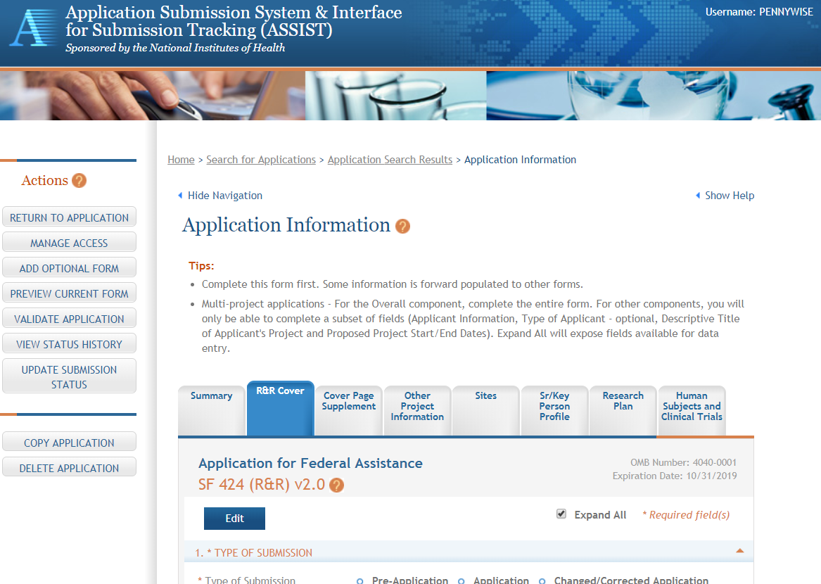
ASSIST Screen – Single-project

Slide 24
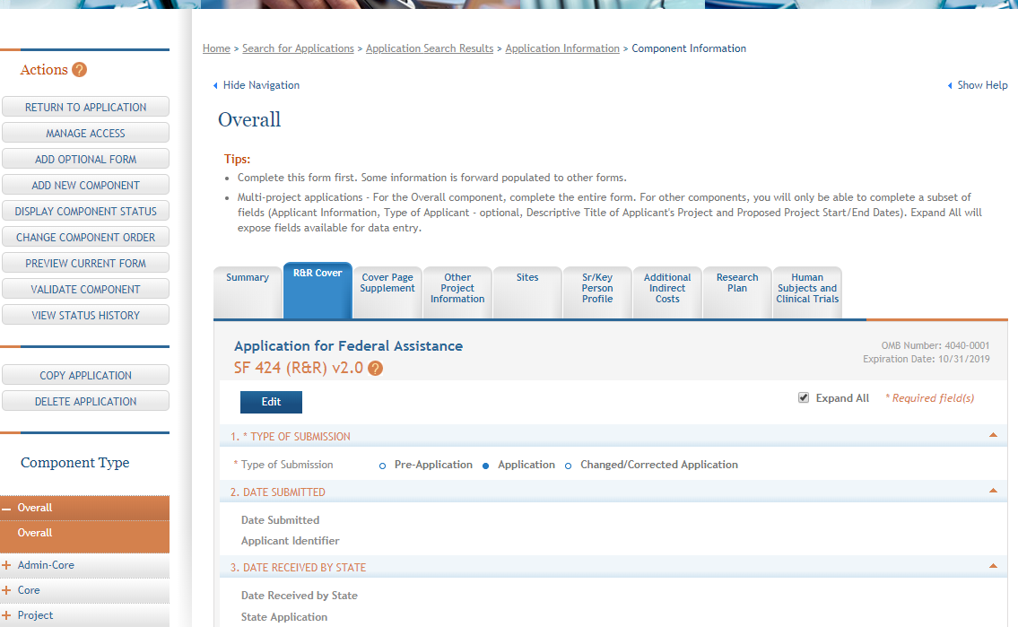
ASSIST Screen – Multi-project

Slide 25
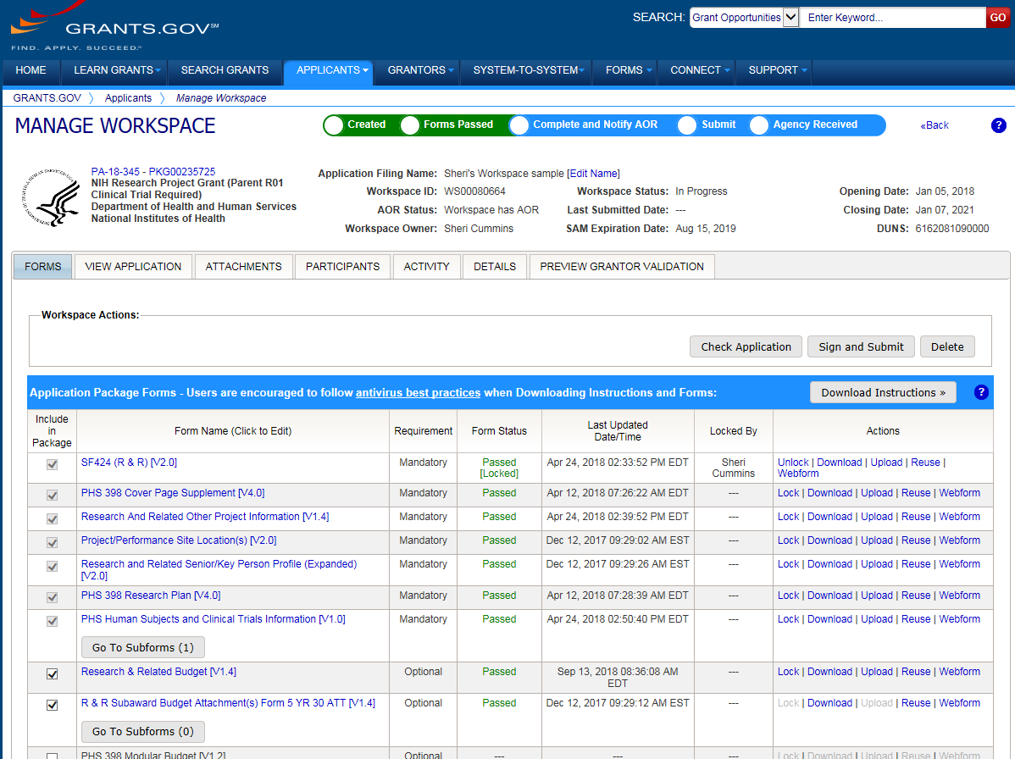
Sample Workspace Screen

Slide 26
System-to-System (S2S) Solution
Managed by institution or service provider
Typically integrate with other internal systems and databases to reduce data entry
Features vary by solution
  Examples of potential features
    Secure, on-line data entry
    Concurrent user support
    Pre-submission verification of some NIH business rules
    Pre-submission preview of assembled application image in generic or agency format
    eRA Commons application status information

Slide 27

How Do I Get to the Forms?
No universal set of application forms available for download
Form set is tailored to each type of grant program
Funding opportunity announcement directs you to the systems used to complete the forms (e.g., ASSIST, Workspace, system-to-system solution)
Tip: Accessing application forms (video) - https://www.youtube.com/watch?v=C5_mio9U0oY

Slide 28
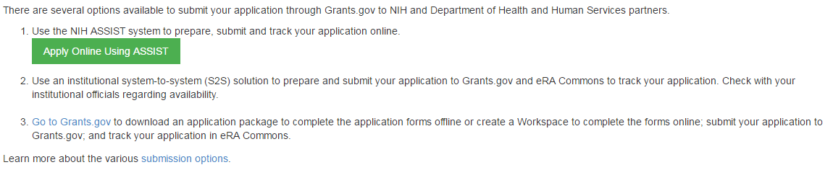
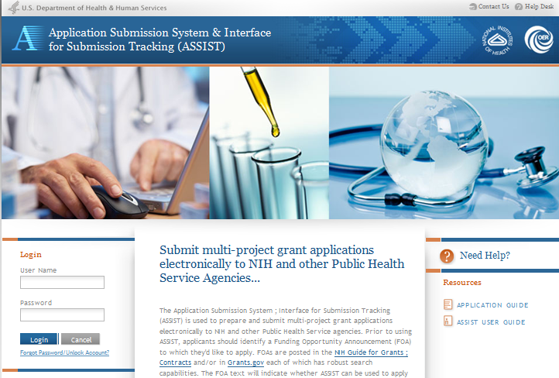
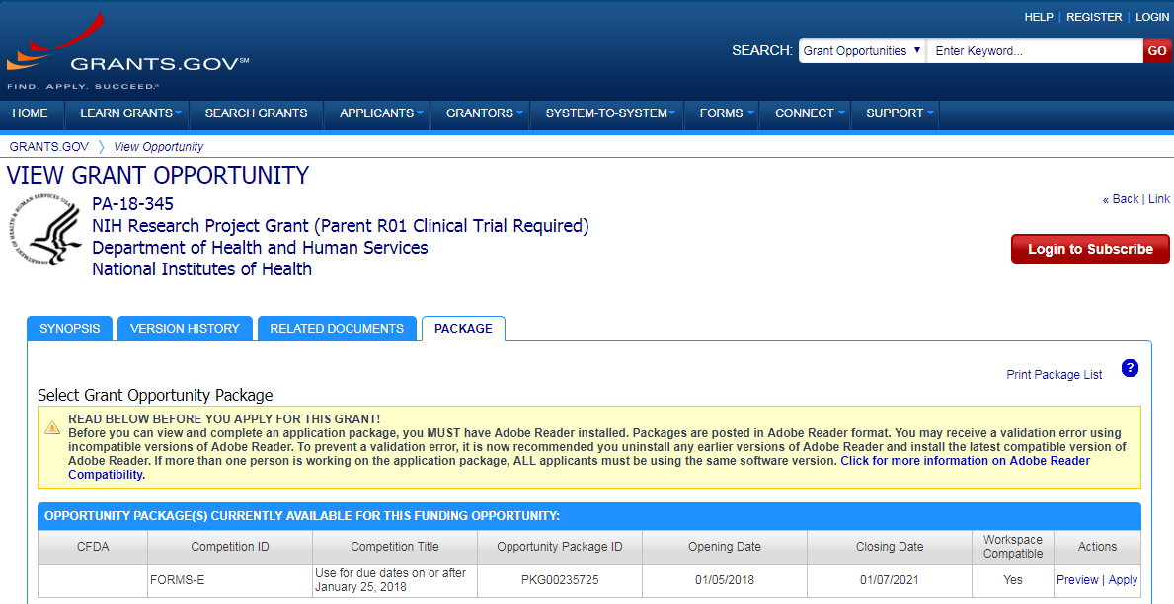
Access Application Forms via Chosen Submission Method
Excerpt from single-project FOA in NIH Guide…

Slide 29
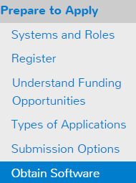

Obtain Software
Browser
  Latest versions of Internet Explorer, Mozilla Firefox and Google Chrome – fully supported & tested
  Many others work fine
Adobe Reader
  Check version compatibility if downloading individual forms in Grants.gov Workspace
    https://www.grants.gov/web/grants/support/technical-support/recommended-software.html
PDF conversion program
  All application attachments must be converted to PDF format

Slide 30
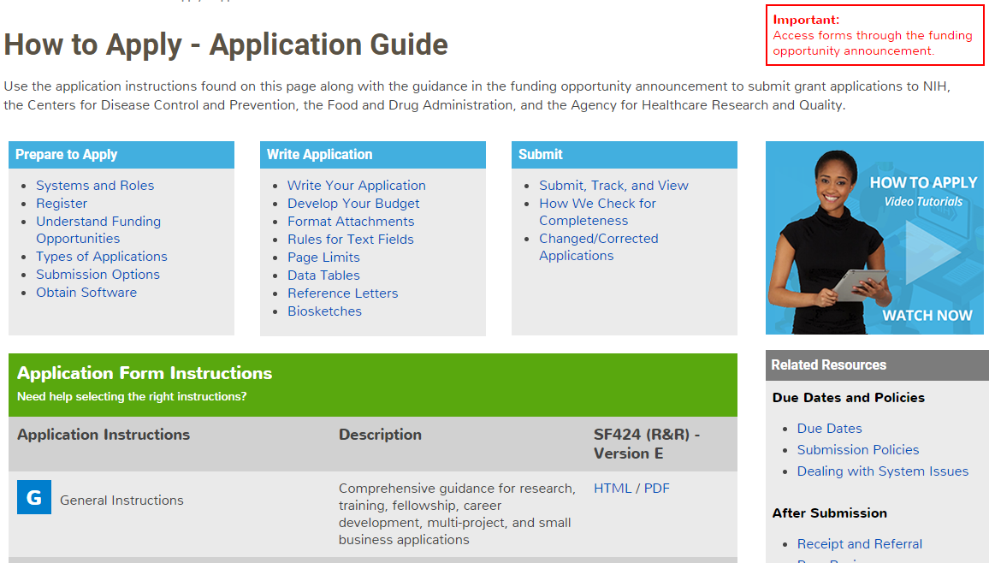
Submission Policies

Slide 31

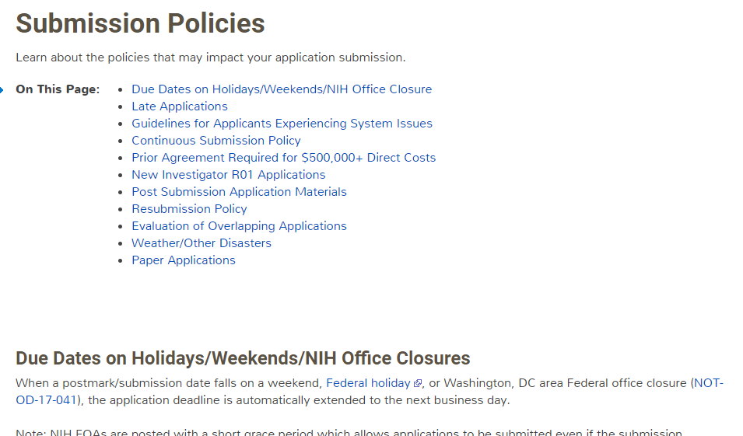

Submission Policies Page
https://grants.nih.gov/grants/how-to-apply-application-guide/due-dates-and-submission-policies/submission-policies.htm

Slide 32








Now Let’s Talk About the Application Process
Step 1: Find
Step 2: Plan
Step 3: Initiate
Step 4: Build team
Step 5: Enter data
Step 6: Finalize
Step 7: Submit
Step 8: Track

Slide 33

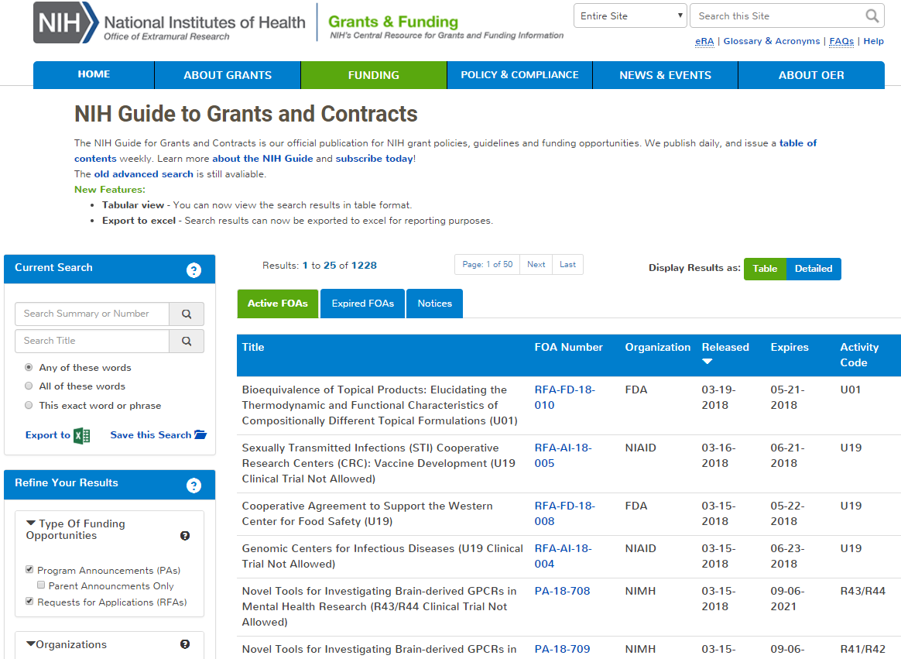
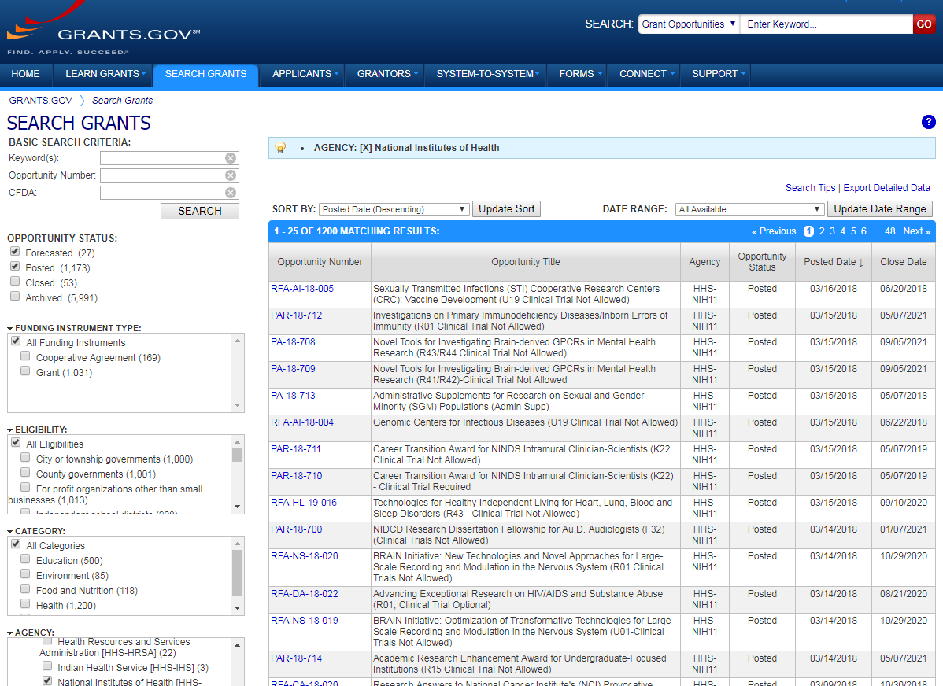

Step 1: Find an Opportunity of Interest
NIH Guide to Grants & Contracts
Grants.gov Search Grants
Each system has robust search capabilities.

Slide 34
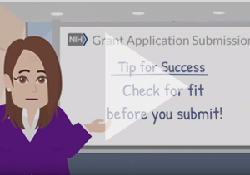
Check for fit before you submit!
Program description
  FOA Part 2, Section I Funding Opportunity Description
Participating institutes
  FOA Part 1, Participating Organizations & Components of Participating Organizations
Type of Application – New, Resubmission, Renewal, Revision
  FOA Part 2, Section II Award Information
Clinical trials allowability (for due dates on/after January 25, 2018)
  FOA Part 2, Section II Award Information
Eligibility
  FOA Part 2, Section III Eligibility Information
Tip: Check for fit, before you submit! (video) - https://www.youtube.com/watch?v=tTQSm4sQYl8&t=

Slide 35



Step 2: Plan for Your Submission
Identify team members
Verify registrations are in place and active
Choose submission method (ASSIST, Workspace, system-to-system)
Determine application preparation responsibilities
  Who will – prepare budget, gather data, create attachments, do data entry
Make sure everyone is aware of process
  Internal review & approval process
  Post-submission responsibilities
    How to deal with errors/warnings
    Who will verify application in eRA Commons?
Make a plan before you need one!

Slide 36

Step 3: Initiate Application
An application form package is posted with each FOA and accessed using your chosen submission method
Login to your submission system and initiate your application
ASSIST | Workspace
Initiate Application | Create Workspace

Slide 37

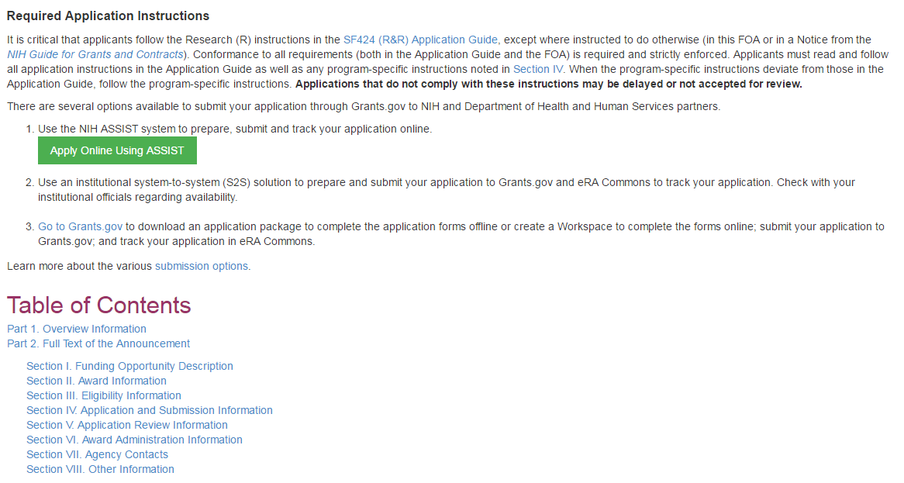
Initiate Application – ASSIST Example
Excerpt from FOA in NIH Guide…
Login with eRA Commons Username & Password

Slide 38
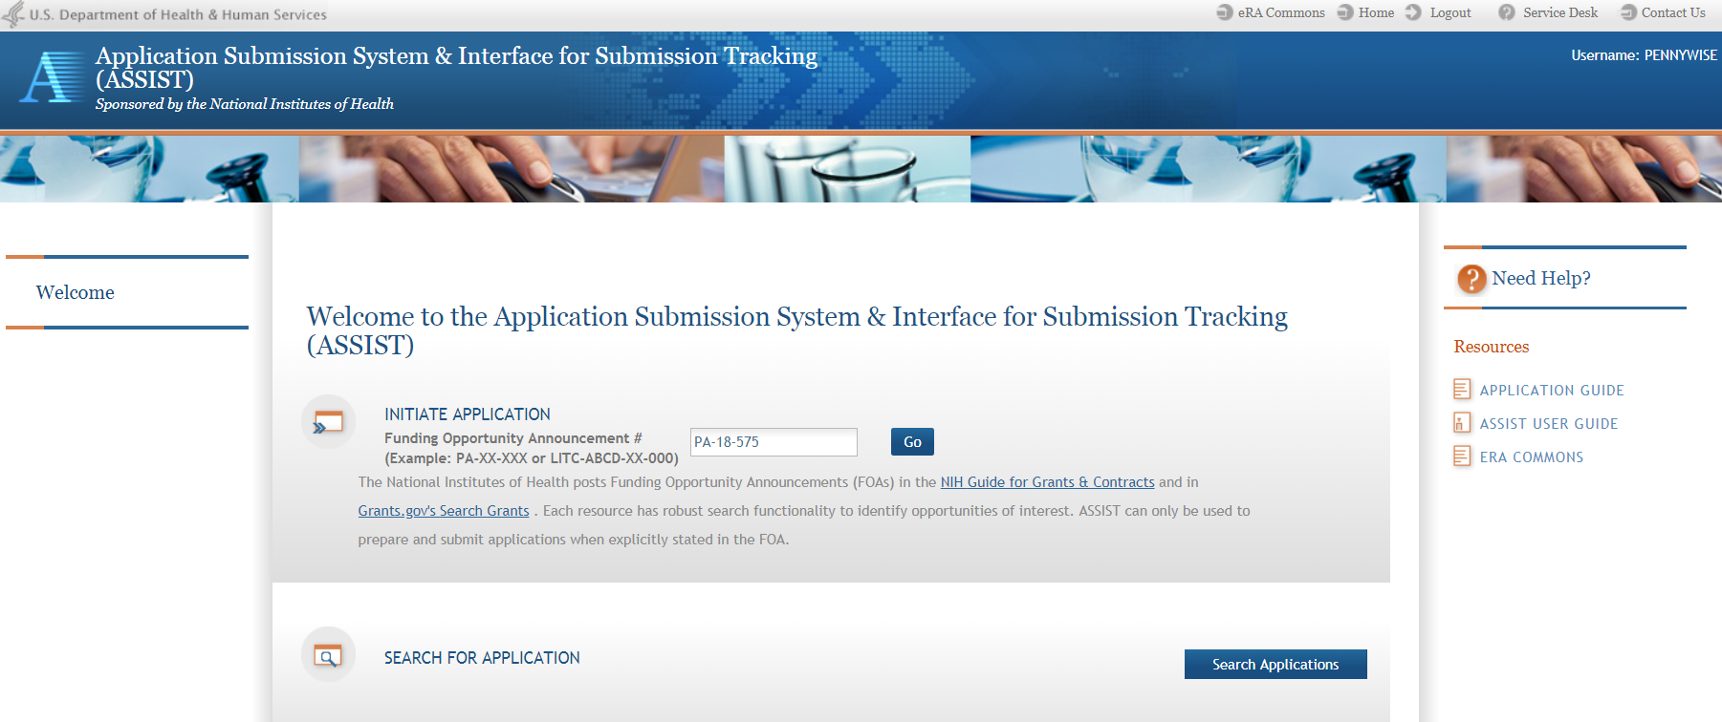
ASSIST Welcome Screen
Initiate Application
Search for Application
38

Slide 39
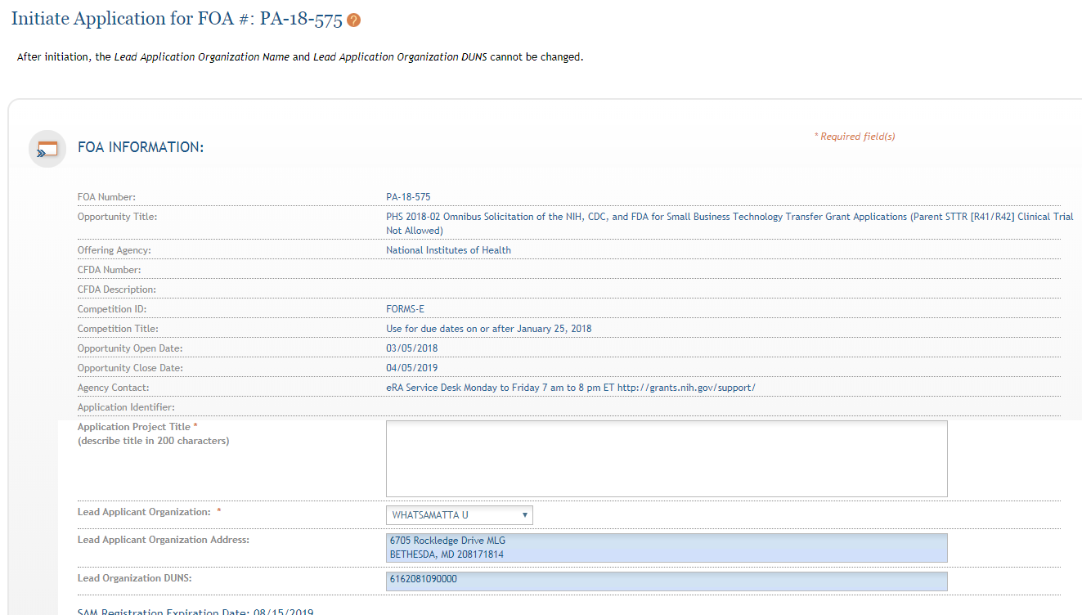
ASSIST Initiate Screen
FOA information pulled from Grants.gov
Enter Project Title
Drop-down list of organizations affiliated with your eRA Commons account
Data pre-populated from organization selection
39

Slide 40
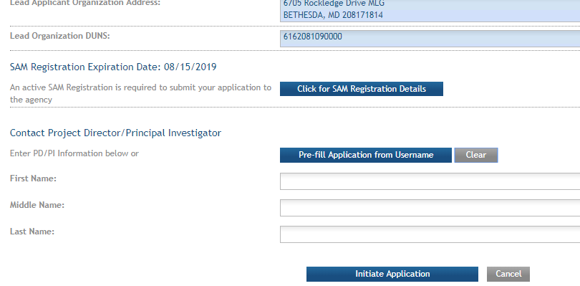
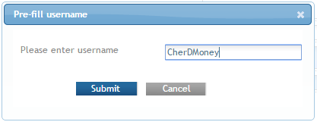
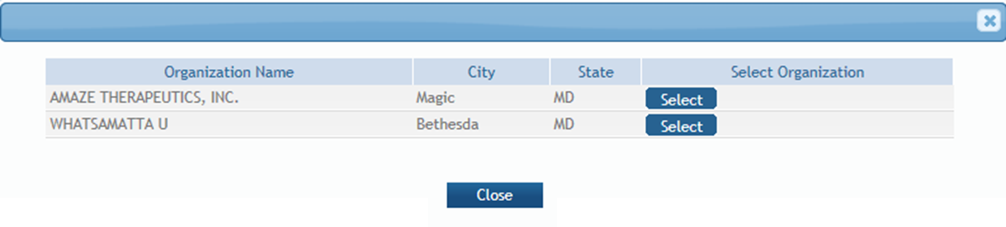
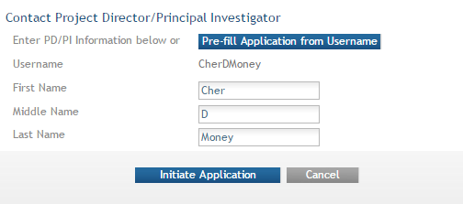
Initiate –
Pre-population
Visibility to SAM registration expiration date & details
Can manually enter PD/PI information or provide eRA Commons username to auto-populate
If multiple employment records, select appropriate record for application.

Slide 41
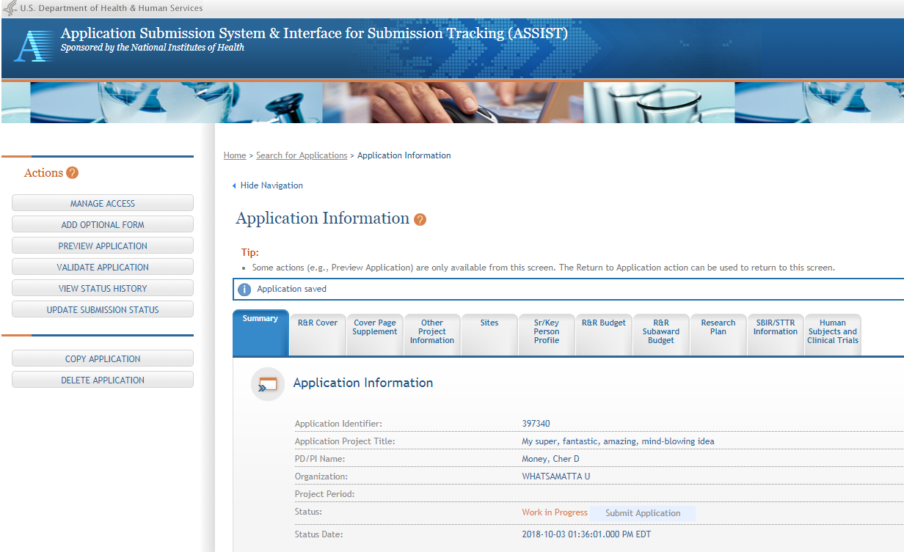
ASSIST application initiation complete
41
ASSIST messages

Slide 42

Step 4: Build Your Team
Provide application access to appropriate team members
Gather eRA Commons usernames to include in your application for the following individuals
  Project Director/Principal Investigators (PD/PIs)
  Component leads on a multi-project application
  Sponsor on a fellowship application
  Candidates for diversity and re-entry supplements
  Primary mentor on individual mentored career development application
ASSIST | Workspace
Gather eRA Commons usernames and use Manage Access to give folks access | Gather Grants.gov usernames and use Participants tab to give folks access

Slide 43

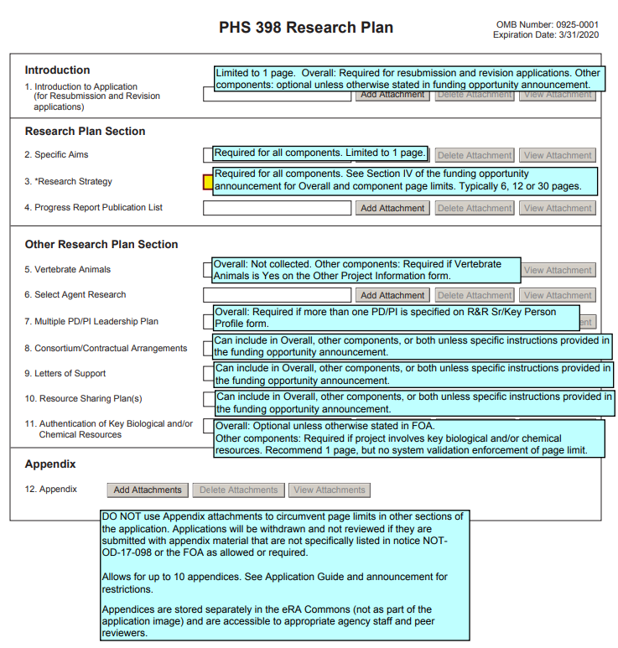
Step 5: Enter Data
Follow All Guidance
Handy Resource
Notices in NIH Guide for Grants & Contracts
Funding Opportunity Announcement
  Section IV. Application and Submission Information
How to Apply - Application Guide
Annotated form sets
Precedence / Importance
https://grants.nih.gov/grants/how-to-apply-application-guide.html

Slide 44

Application Attachments
Use simple PDF-formatted files for all attachments
  Disable security features such as password protection
Filenames must be unique within the application & 50 characters or less
Use meaningful filenames
  If FOA specifies a filename – use it!
  “Other Attachments” on R&R Other Project Information form & “Other Clinical Trial-related Attachments” on PHS Human Subjects and Clinical Trials Info form will use filename as a bookmark in the application image
Do not include headers or footers
  Section headings as part of the text (e.g., Significance, Innovation, Approach) are encouraged
Follow guidelines for fonts and margins
Follow specified page limits
https://grants.nih.gov/grants/how-to-apply-application-guide/format-and-write/format-attachments.htm

Slide 45

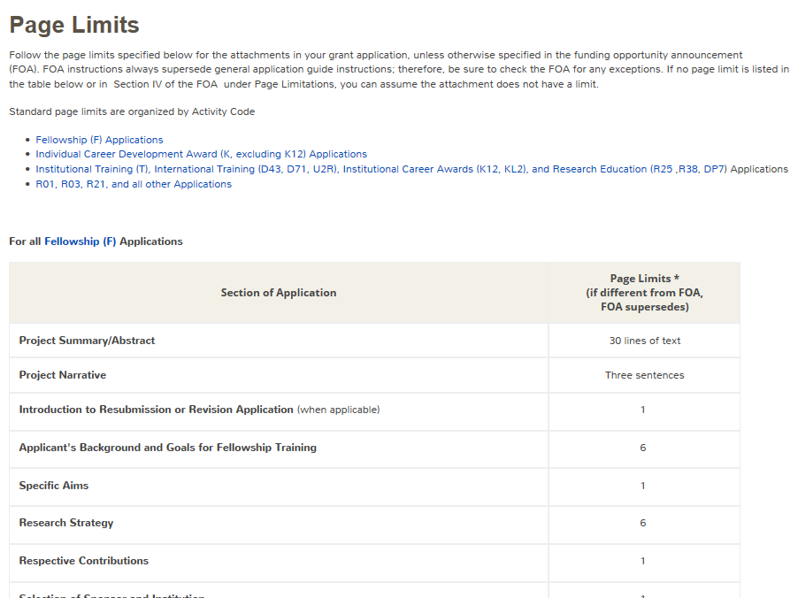
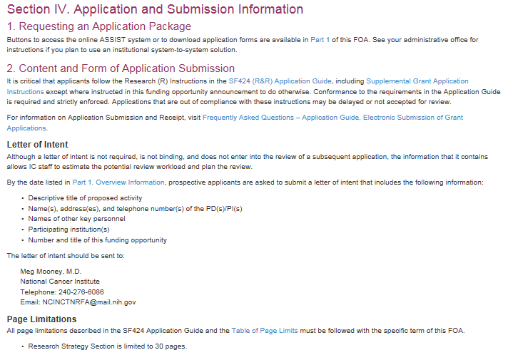
Follow Specified Page Limits
https://grants.nih.gov/grants/how-to-apply-application-guide/format-and-write/page-limits.htm

Slide 46

Text Fields
Text fields support plain text with limited manual formatting
  To format paragraphs, include a blank line between paragraphs
  To format bulleted lists, start each list item on a new line with a "list item" character, such as a hyphen (-) or an asterisk (*), followed by a space and then the item text
Much of your original formatting (font, bolding, bullets, subscript, superscript) will be lost when you cut and paste
  Take advantage of application preview features if your submission method supports them
Check application form instructions for character limits
  Spaces and punctuation count against the limit
https://grants.nih.gov/grants/how-to-apply-application-guide/format-and-write/rules-for-text-fields.htm

Slide 47


Use Format Pages
Biosketch Format Pages, Instructions and Samples
  https://grants.nih.gov/grants/forms/biosketch.htm
Data Tables
  https://grants.nih.gov/grants/forms/data-tables.htm
More (Additional Sr/Key, Additional Sites, Other Support)
  https://grants.nih.gov/grants/forms/format-pages.htm

Slide 48

Grantsmanship
Avoid jargon
Be focused - use a clear and concise writing style
Spell out acronyms the first time they are used in each application section/attachment and note the appropriate abbreviation in parentheses
Appeal to the reviewers and the funding ICs by using language that stresses the significance of your proposed work
Align your application with the review criteria to maximize impact
  FOA Section V. Application Review Information
https://grants.nih.gov/grants/how-to-apply-application-guide/format-and-write/format-attachments.htm

Slide 49
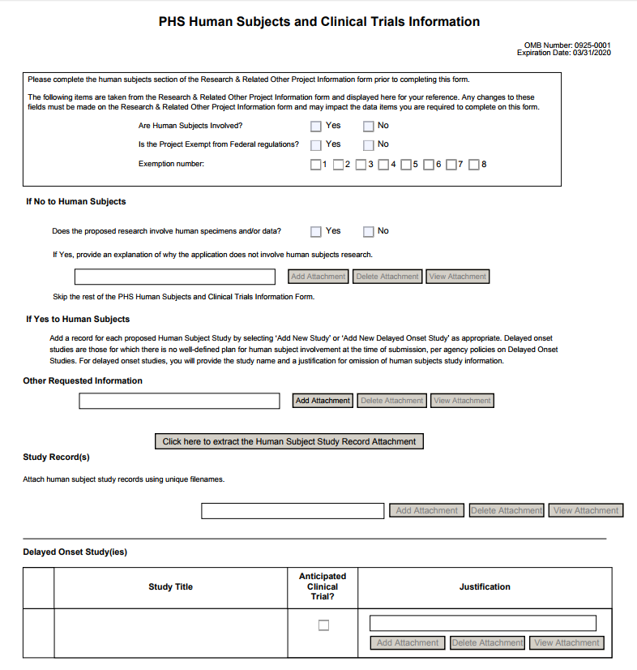
New PHS Human Subjects and Clinical Trials Information Form
Required form in most FOAs
A Walk-through of the PHS Human Subjects and Clinical Trials Information Form (video, 9 mins.)
Lots of other Clinical Trial changes
  https://grants.nih.gov/policy/clinical-trials.htm

Slide 50

Avoiding the “Gotchas”
Refer to annotated form set:
https://grants.nih.gov/grants/how-to-apply-application-guide/resources/annotated-form-sets.htm

Slide 51

Step 6: Finalize Your Application
Action | ASSIST | Workspace
6a. Run a pre-submission validation check | Validate Application | Preview Grantor Validation
6b. Generate a pre-submission image of your assembled application in the NIH format | Preview Application | Grantor Image
6c. Take any additional steps needed to prepare for submission | Update Submission Status to “Ready to Submit” | Complete and Notify AOR (optional)

Slide 52
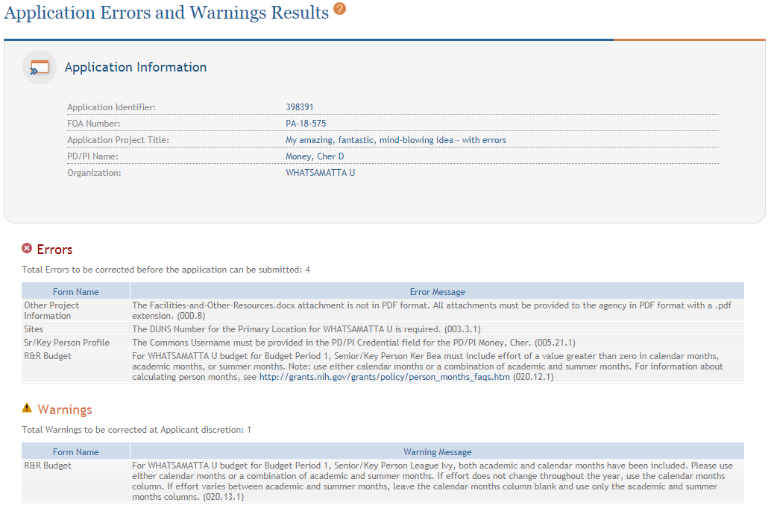
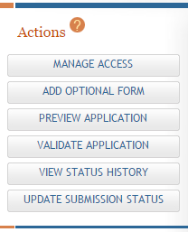
ASSIST: Validate Application
Errors and Warnings are displayed

Slide 53


Errors & Warnings
  Errors stop application processing and must be corrected
  Warnings do not stop application processing and are corrected at your discretion based on your circumstances

Slide 54
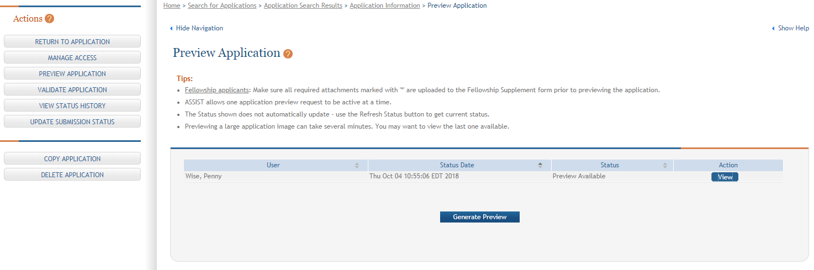
ASSIST: Preview Application
View last preview
Generate new preview

Slide 55
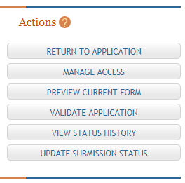
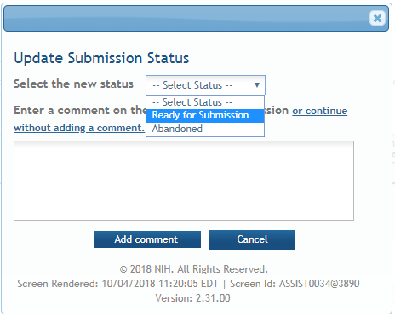
ASSIST: Update Submission Status
Select status
Enter comment to be added to status history

Slide 56

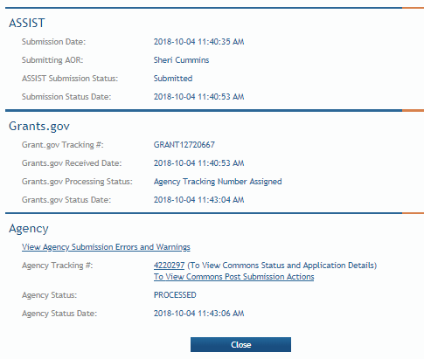
Step 7: Submit Your Application
Follow steps for your submission method
Only folks who hold Grants.gov credentials with the AOR (Authorized Organization Representative) role can submit
All NIH applications route through Grants.gov
Your Grants.gov timestamp
is used to determine
“on-time” submission
Grants.gov Tracking #
Date/Time Stamp – always recorded in Eastern Time

Slide 57
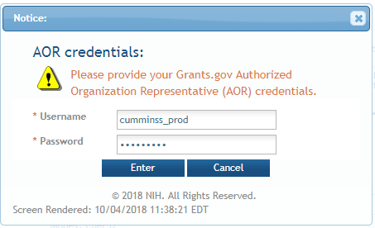
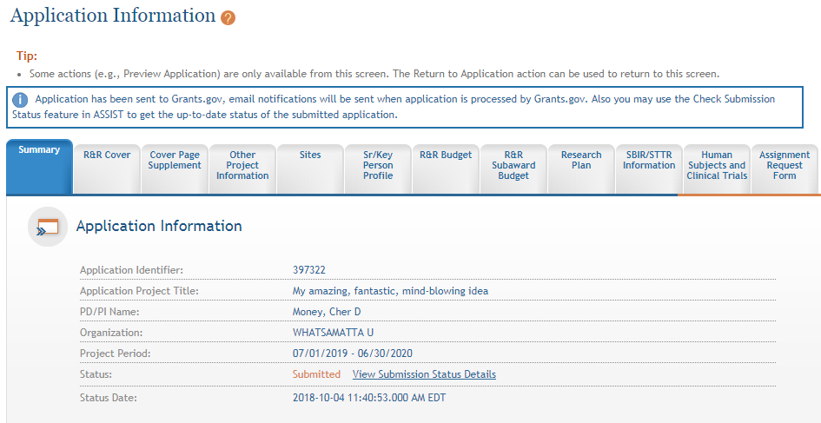
ASSIST: Submit
57
Applications are submitted from ASSIST to Grants.gov.
Enter your Grants.gov AOR credentials and click Enter.
Message will appear indicating the application was sent to Grants.gov.

Slide 58


On-time Submission
Deadline = 5 pm local time of submitting organization on the due date
  All registrations and SAM renewal must be completed before the deadline
  Application must be free of all federal system-identified errors (Grants.gov & eRA)
  NIH’s late policy does not allow corrections after the deadline
  NIH recommends submitting early to allow time to correct any unexpected errors or submission issues

Slide 59


Pop Quiz
The appropriate measurement for “early” in the context of application submission is…
Minutes
Hours
Days
Measure early on a calendar not a clock.

Slide 60


Step 8: Track Your Application
eRA Commons Status is an integral part of your submission
  Applications that pass Grants.gov validations are picked up by eRA Commons and checked against many application guide and opportunity instructions
Authorized users can check eRA Commons Status for processing results
  Signing Officials (SOs)
  Administrative Officials (AOs)
  Principal Investigators (PIs)
  Delegated Assistants (ASSTs)
E-mail notifications sent

Slide 61

Email is Unreliable – Proactively Track Application
Many email notifications are sent throughout the process
  DO NOT depend solely on email notifications
  It is YOUR responsibility to proactively check your application status in eRA Commons
  Grants.gov notifications go to email address associated with the submitting AOR’s Grants.gov account
  eRA notifications go to the three email addresses on the SF424 (R&R)
  form submitted with the application (contact, PD/PI, AOR)
https://grants.nih.gov/grants/how-to-apply-application-guide/submission-process/submit-track-view/email_notifications.htm

Slide 62



Application Checks (Validations)
We really care about the details
Multiple levels of application checks for completeness
  Grants.gov
  eRA systems
  Agency staff
Check!
Check!
Check!
https://grants.nih.gov/grants/how-to-apply-application-guide/submission-process/check-your-application.htm

Slide 63

Sample Validations
Grants.gov
eRA Systems
Agency Staff
Active System for Award Management (SAM) registration
Submitter has AOR role for DUNS on application
Submission made to active opportunity and application package
Virus check
Filenames include only appropriate characters
Fields required by agency, but not required federal-wide
  R&R Sr/Key form
    Credential for PD/PIs
    Organization name for all sr/key
    Biosketch for all sr/key
  Performance Site form
    DUNS for primary site
Attachments in PDF format
Adherence to page limits in our Table of Page Limits
All appropriate attachments included
Fit with NIH/Institute mission
Eligibility
“Overstuffing”
On-time submission
Adherence to funding opportunity announcement specific instructions
Font and margin guidelines
Simultaneous review of essentially same application

Slide 64

Application Assembled & Posted in eRA Commons
Once an error-free application is received by NIH, the eRA system will:
  Assemble the grant application image
  Insert headers (PI name) and footers (page numbers) on all pages
  Generate Table of Contents and bookmark important sections
  Post the assembled application image in the PD/PI’s eRA Commons account
  Send notifications

Slide 65


View Application Image (e-Application)
The e-Application in eRA Commons is the same document seen by NIH staff and reviewers.
e-Application does NOT include:
Cover Letter
Appendices
Assignment Request form
Tip: If you can’t view it, we can’t review it! (video) - https://www.youtube.com/watch?v=fb5kjM8fIeU

Slide 66
Application Viewing Window
Applicants have two (2) business days to view the assembled application image before the application automatically moves forward for further processing
SO can Reject application within viewing window to prevent it
from moving forward to NIH staff
  Can submit a Changed/Corrected application before the submission deadline
  We cannot resurrect a rejected application
ASSIST | Workspace
View Submission Status Details link | Must login to eRA Commons directly and access the application’s detailed status screen
https://public.era.nih.gov/commons

Slide 67

Submission Complete!
If you don’t reject within the two business day viewing window, the application automatically moves forward for further processing at NIH
Any subsequent application changes are subject to the NIH policy on late submission of grant applications and the NIH policy on post-submission application materials

Slide 68

Finding Help
Help Desks
On-line resources & Web sites

Slide 69
Help Desks
eRA Service Desk
Grants.gov Contact Center
Web: https://grants.nih.gov/support/
Phone: 1-866-504-9552
Hours : Mon-Fri, 7a.m. to 8 p.m. ET
Toll-free: 1-800-518-4726
Hours : 24x7 (Except Federal Holidays)
Email : support@grants.gov
Resources: https://www.grants.gov/web/grants/support.html

Slide 70

Online Resources & Websites
NIH Grants and Funding
https://grants.nih.gov/grants/oer.htm
How to Apply – Application Guide
https://grants.nih.gov/grants/how-to-apply-application-guide.htm
Annotated form set
https://grants.nih.gov/grants/how-to-apply-application-guide/resources/annotated-form-sets.htm
Preparing Your Application Using ASSIST
https://grants.nih.gov/grants/how-to-apply-application-guide/prepare-to-apply-and-register/submission-options/assist.htm
Get Started on Your Workspace Application
https://www.grants.gov/web/grants/applicants/workspace-overview.html

Slide 71

Stay Connected – Subscribe to Listservs
Electronic Research Administration News (eRA-Information-L)
  Used by NIH to notify the community of information related to eRA Commons, ASSIST & eSubmission.
NIH Guide to Grants and Contracts (NIHTOC-L)
  Weekly email with a summary of all NIH Guide announcements published during the week, called the Current Weekly Table of Contents (TOC).
NIH Extramural Nexus (EXTRAMURALNEXUS)
  Provides regular updates on NIH grants policies and activities that
  impact the entire grants community.
https://grants.nih.gov/news/subscribe-and-follow/listservs_and_rss.htm

Slide 72

Questions?

