Slide 1
NIH eRA Workshop: Grant Application Preparation & Submission
May 2018
electronic Research Administration (eRA)
OER, OD, National Institutes of Health
Washington, DC

Slide 2
Your Workshop Team
Sheri Cummins
Office of Extramural Research (OER) Communications & Outreach Chief, Grants Information
cumminss@od.nih.gov
Laurie Roman
Electronic Research Administration (eRA) Customer Relationship Manager
laura.roman@nih.gov

Slide 3
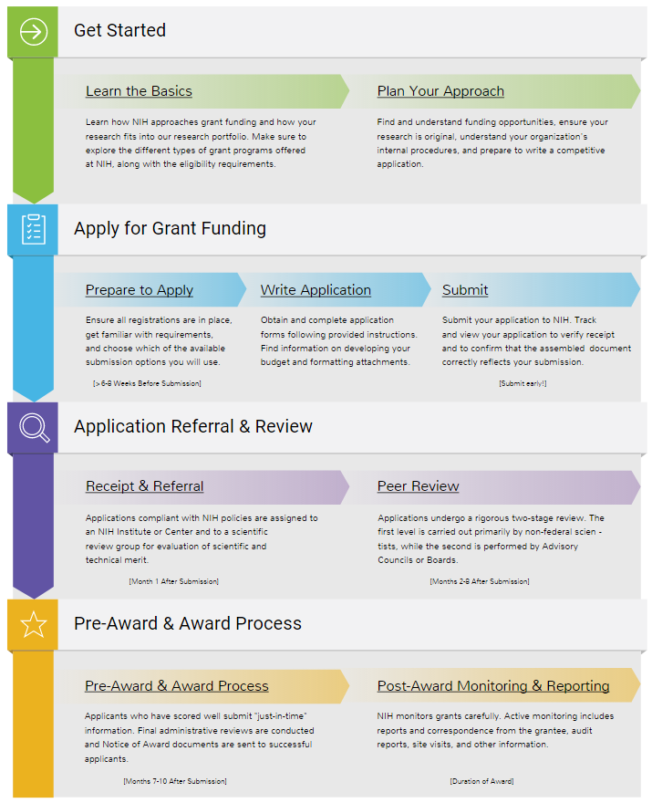
Today’s Topics
Prepare to Apply
Systems & Roles
Registrations
Understanding Funding Opportunity Announcements
Types of Applications
Submission Options
Software
Application Process Step-by-step
Avoiding the “gotchas” (using Annotated Form Set)
Submission Process Demo (using ASSIST)
Wrap-up

Slide 4
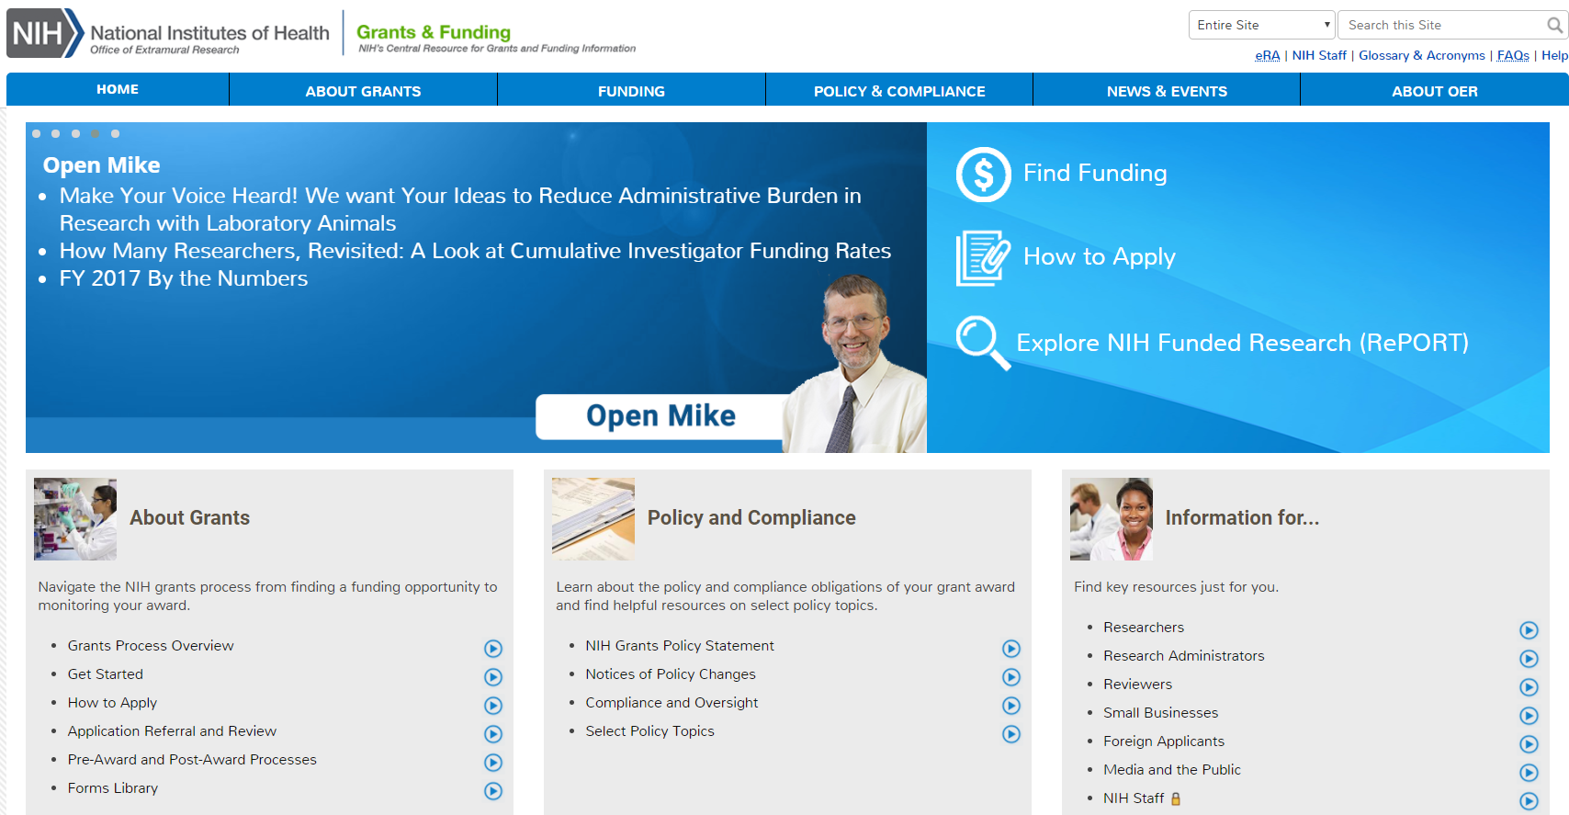
NIH Grants & Funding
How to Apply- Application Guide
http://grants.nih.gov

Slide 5
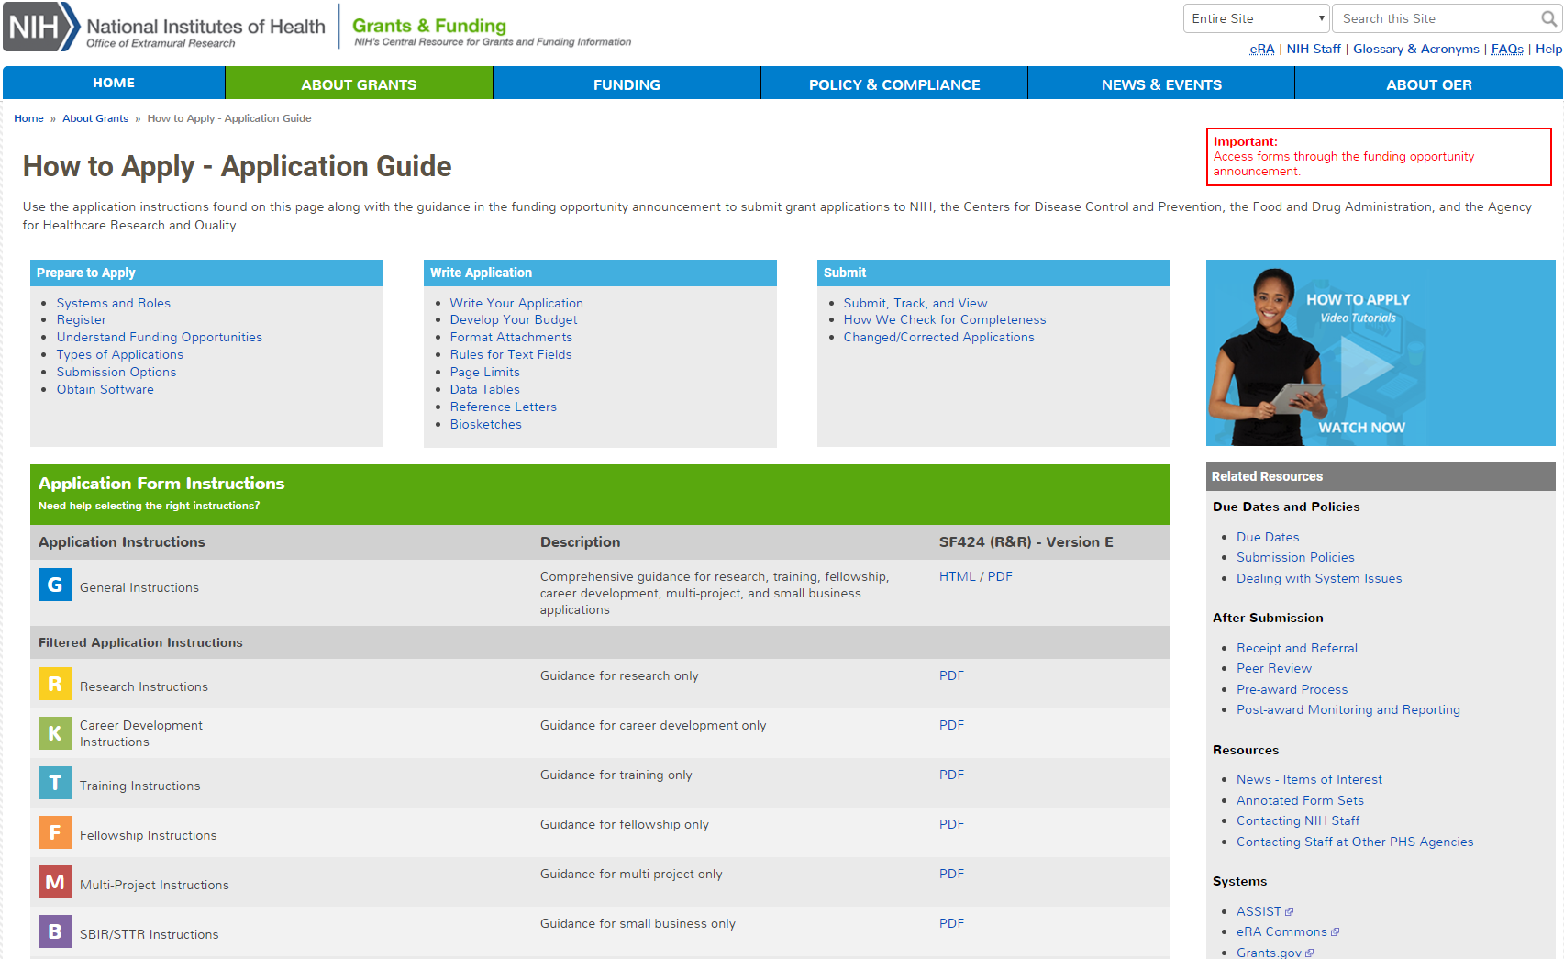
How to Apply – Application Guide
General Application Process Information
Form Instructions
Resources

Slide 6
Before Jumping Into the Application Process, Let’s Cover Some Basics

Slide 7
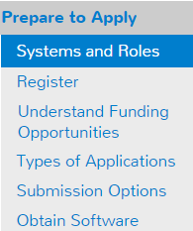
Understand Key Systems & Roles
Grants.gov
eRA Commons
E-Business Point of Contact (EBiz POC)
Authorized Organization Representative (AOR)
Signing Official (SO)
Principal Investigator (PI)
http://grants.nih.gov/grants/how-to-apply-application-guide/prepare-to-apply-and-register/key-systems-and-roles.htm

Slide 8
Signing Official (SO)
During Commons registration, an applicant organization designates a Signing Official (SO)
SO has authority to legally bind the organization in grants administration matters
Equivalent signature authority to the Authorized Organization Representative (AOR) in Grants.gov
SO is responsible for:
maintaining institutional information
submitting documents that require signature authority to act on behalf of the organization
managing accounts (or authorizing others to do so)

Slide 9
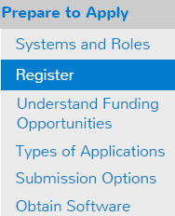
Organization Registration
Your organization must be registered in multiple systems to submit. Start early – can take 6 weeks!
DUNS – provides unique organization identifier
SAM (System for Award Management) – needed to do business with government
Requires annual renewal
Grants.gov – required to submit grants
eRA Commons – required to do business with NIH
SBA (Small Business Administration) – required for SBIR/STTR applications
http://grants.nih.gov/grants/how-to-apply-application-guide/prepare-to-apply-and-register/registration/org-representative-registration.htm

Slide 10
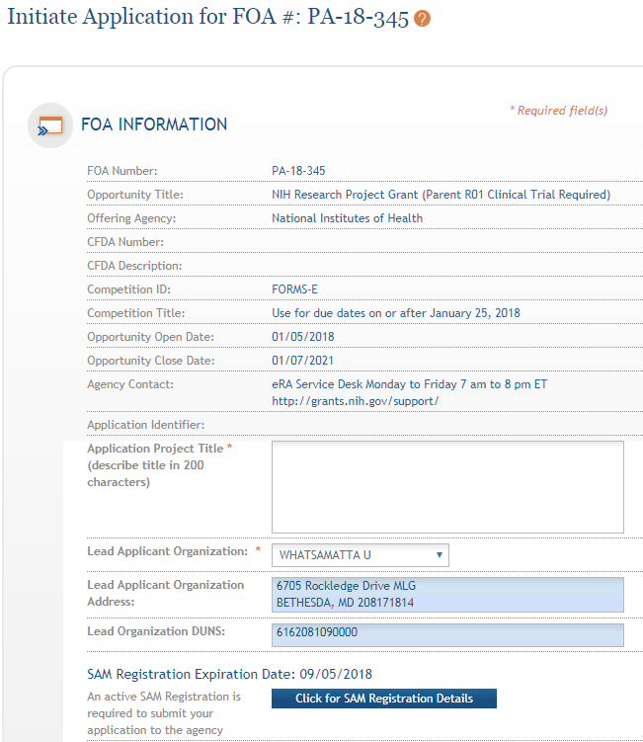
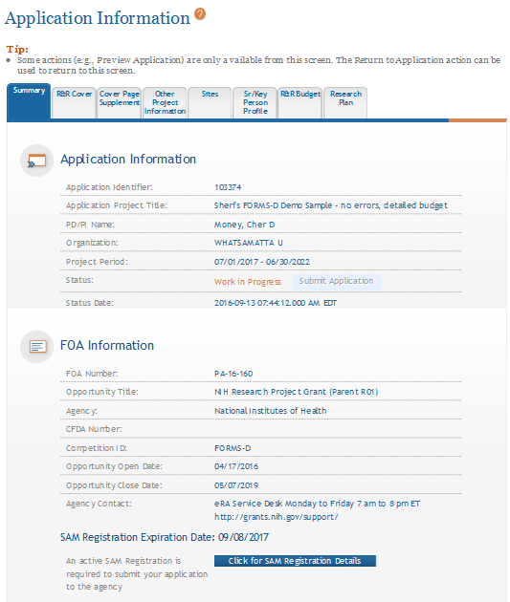
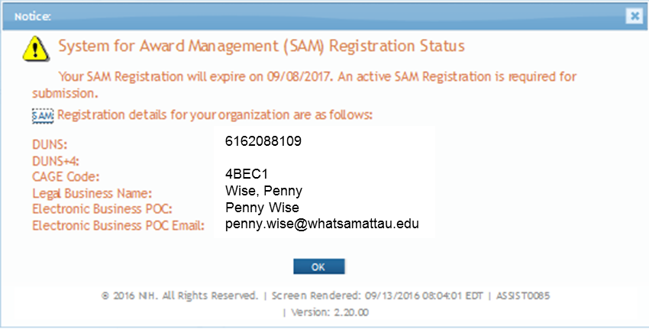
Visibility of SAM Registration Status in ASSIST
Initiate Screen
Application Information Screen

Slide 11
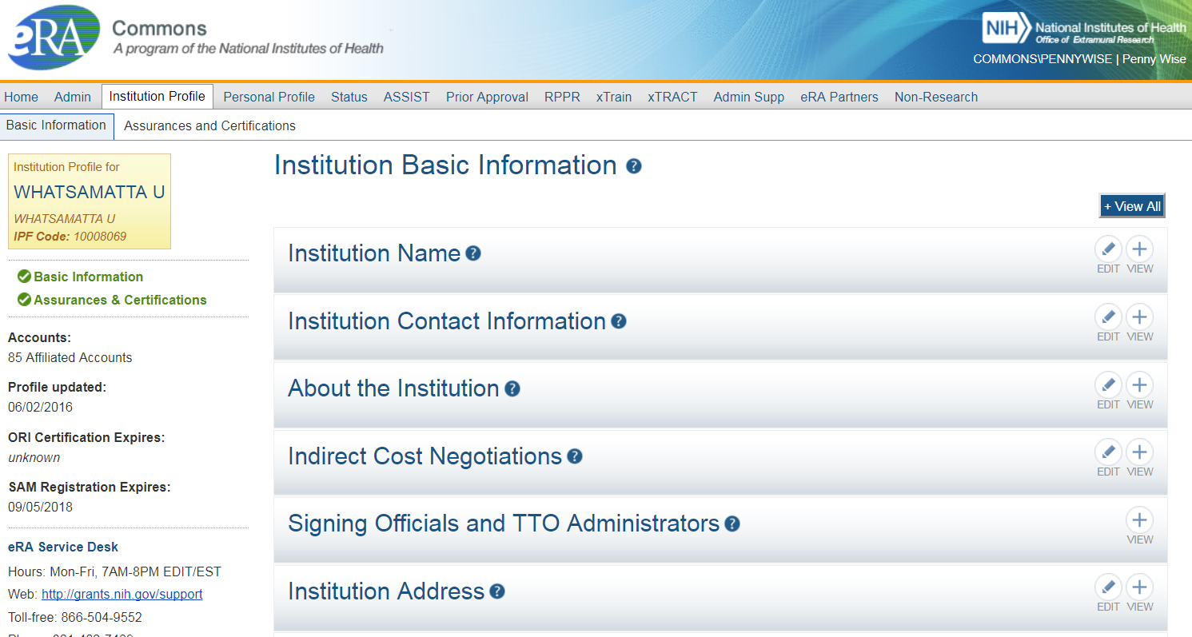
Visibility of SAM Registration Status in eRA Commons

Slide 12
Individual eRA Commons Registrations
Who needs an eRA Commons account?
At least one Signing Official (SO)
Project Director/Principal Investigator (PD/PI) and any multiple-PD/PIs
Component leads on a multi-project application
Sponsor on a fellowship application (NOT-OD-14-129 – August 2014)
Candidates for diversity and re-entry supplements
Primary mentor identified on individual mentored career development applications (NOT-OD-16-082 – March 2016)
Anyone doing data entry in ASSIST
If awarded, additional individuals may need accounts for reporting purposes
http://grants.nih.gov/grants/how-to-apply-application-guide/prepare-to-apply-and-register/registration/investigators-and-other-users/era-commons-user-registration.htm

Slide 13
Account - Tips
Log in to accounts prior to deadline to ensure you have access
Designate more than one Signing Official (and AOR)
Check for existing eRA Commons account before creating a new one
Ask the person if they already have an account, or search within the Commons
If a user already has an account with a different organization, you should affiliate the existing account with the user’s new organization
Do not mix PI and SO roles on same account
If a person serves both roles (e.g., small business), they must have two accounts
PIs should update their eRA Commons profile prior to submitting
E.g., info used to determine Early Stage Investigator (ESI) eligibility

Slide 14
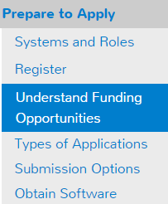
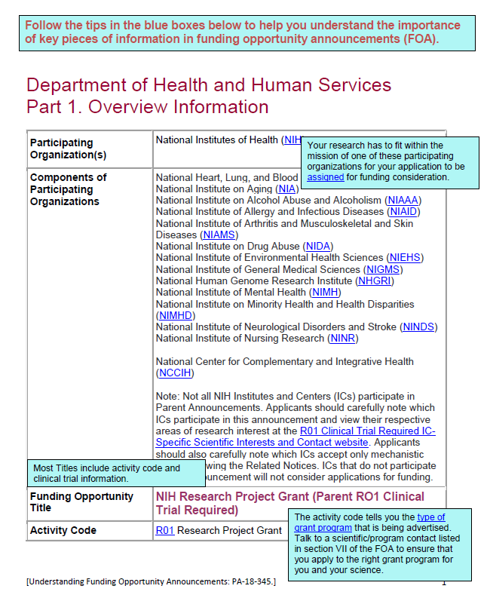
Understanding Funding Opportunities
Funding Opportunity Announcement (FOA)
A publicly available document by which a Federal Agency makes known its intentions to award discretionary grants or cooperative agreements, usually as a result of competition for funds.
Take a tour of an Annotated FOA
https://grants.nih.gov/grants/Annotated_FOA.pdf
Let’s take a quick peek at this link.
https://grants.nih.gov/grants/how-to-apply-application-guide/prepare-to-apply-and-register/understand-funding-opportunities.htm

Slide 15
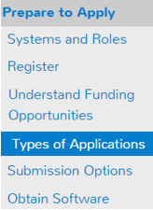
Identify Type of Application
Number Type | Stage/Description
Type 1* | New - Request for support of a project that has not yet been funded.
Type 2* | Renewal - Request for additional funding for a period subsequent to that provided by a current award.
Type 3* | Competitive Revision* – Request for additional funds to expand the scope of a current award. Administrative Supplement – Request for additional funds to cover unforeseen, increased costs to carry out current award.
Type 6 | Change of Organization Status (Successor-in-Interest)
Type 7 | Change of Grantee or Training Institution
* Resubmission - An unfunded application that has been modified following initial review and resubmitted for new consideration.
http://grants.nih.gov/grants/how-to-apply-application-guide/prepare-to-apply-and-register/type-of-application-submission.htm

Slide 16
Why is knowing the type of application important?
Potential impact on…
Due dates
E.g., If submitting to an R01 opportunity with standard due dates, “New” applications have a different due date than “Resubmission”, “Renewal” or “Revision” applications.
Ability to submit to a specific announcement
Application validations
We enforce different rules based your selection in the “Type of Application” field (#8) of the SF424 (R&R) form.

Slide 17
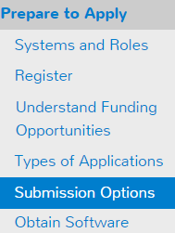
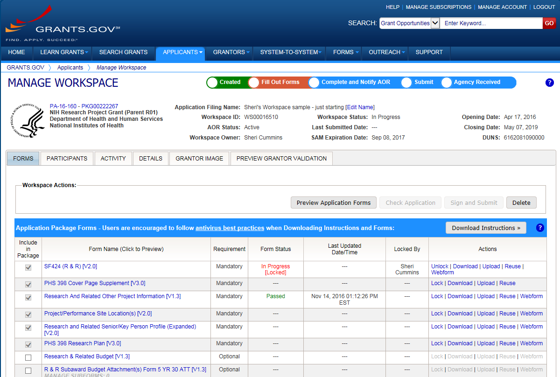
Application Submission Options
ASSIST
System-to-System
Workspace
http://grants.nih.gov/grants/how-to-apply-application-guide/prepare-to-apply-and-register/choose-a-submission-option.htm

Slide 18
Your Application will be…
Subject to the same registration requirements
Completed with the same data items
Routed through Grants.gov
Validated against the same NIH business rules
Assembled in a consistent format for review consideration
Tracked in eRA Commons
…regardless of submission option used.

Slide 19
What Submission Options are NIH Applicants Using?
Monthly Submission Method Percentages March 2017-February 2018
Total Submission Method Percentages March 2017-February 2018

Slide 20
ASSIST
Managed by NIH
Features
Multi-user access
Leverages eRA Commons accounts
Pre-population from eRA Commons profiles
Pre-submission validations
Pre-submission preview in agency format
Track application status in a single system
Copy data to different application package
Supports all NIH competing applications
Pull study information from ClinicalTrials.gov
Integrated NIH messaging (tips, system alerts)
https://grants.nih.gov/grants/how-to-apply-application-guide/prepare-to-apply-and-register/submission-options/assist.htm

Slide 21
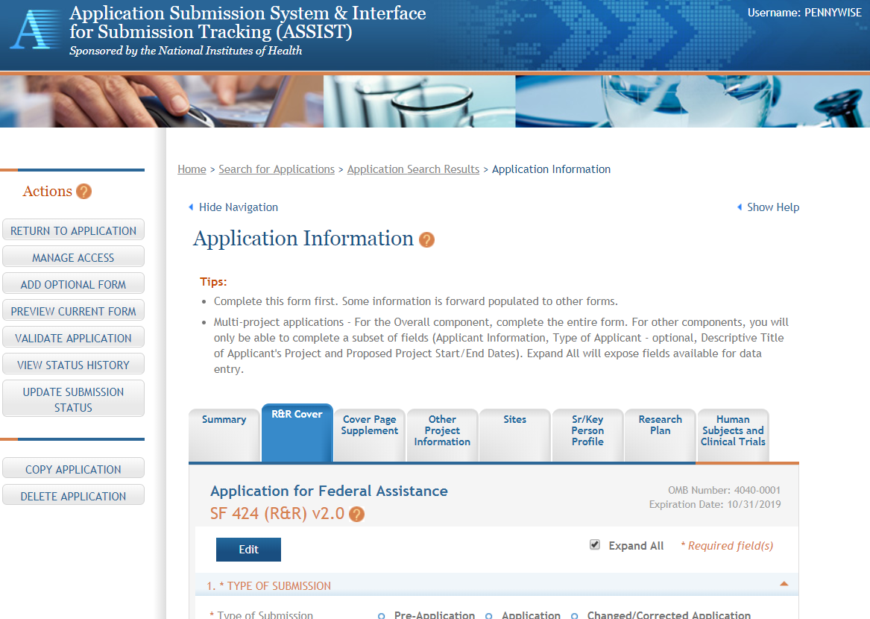
ASSIST Screen – Single-project

Slide 22
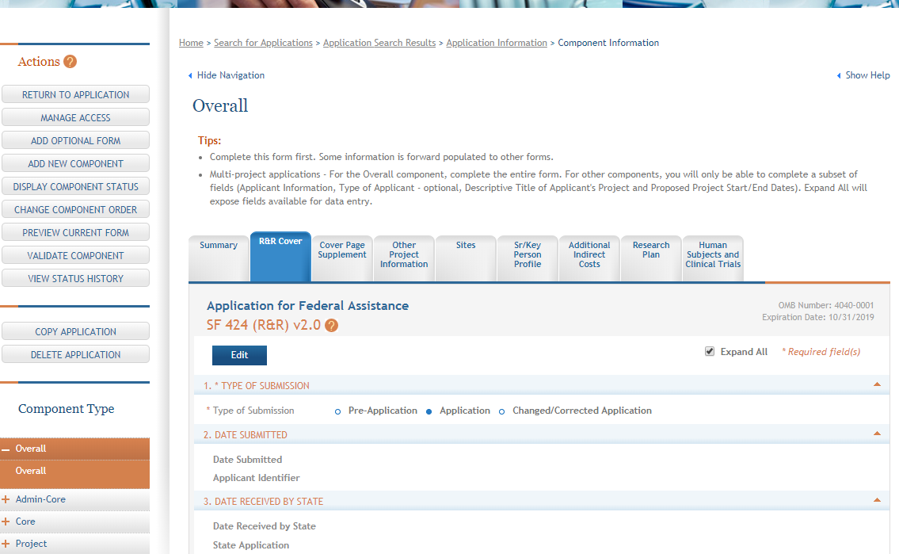
ASSIST Screen – Multi-project

Slide 23
System-to-System (S2S) Solution
Managed by institution or service provider
Typically integrate with other internal systems and databases to reduce data entry
Features vary by solution
Examples of potential features
Secure, on-line data entry
Concurrent user support
Pre-submission verification of some NIH business rules
Pre-submission preview of assembled application image in generic or agency format
eRA Commons application status information

Slide 24
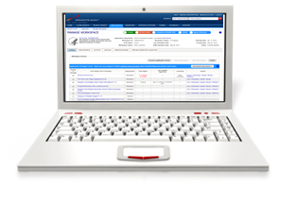
Grants.gov Workspace
Managed by Grants.gov
Features
Multi-user access
Requires additional user registrations
No pre-population from existing profiles
Pre-submission validations
Pre-submission preview in agency format
Must track application in multiple systems
Reuse forms; copy application data
Supports NIH single-project competing applications (no multi-project support)
https://www.grants.gov/web/grants/applicants/workspace-overview.html

Slide 25
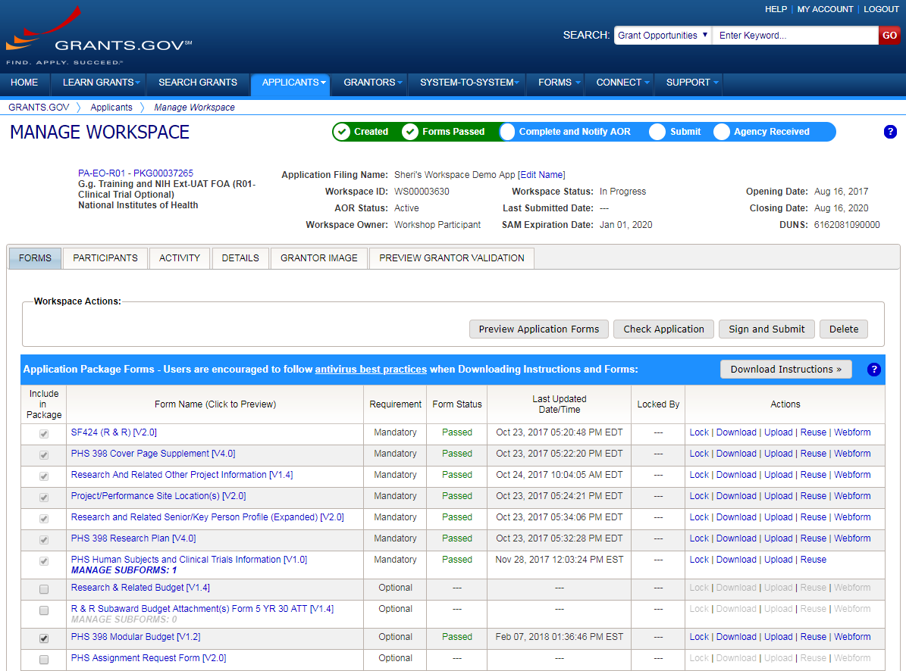
Sample Workspace Screen

Slide 26
How Do I Get to the Forms?
There is NOT a universal set of application forms that can be downloaded from our forms library or websites and submitted for any opportunity
You must use the application form package attached to your funding opportunity announcement
Each application form package includes the customized subset of forms supported by NIH which are needed for that opportunity
Application forms are accessed using your chosen submission method

Slide 27
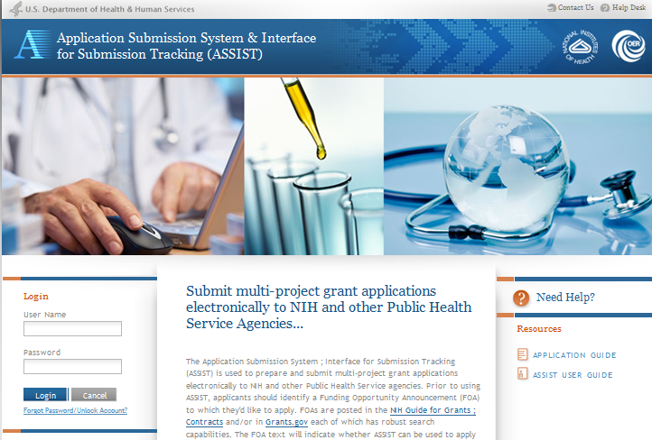
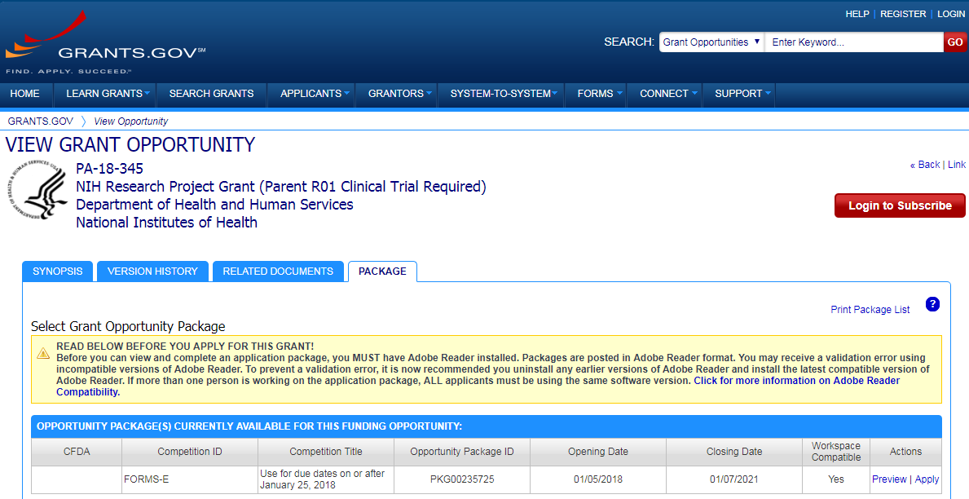
Access Application Forms via Chosen Submission Method
Excerpt from single-project FOA in NIH Guide…

Slide 28
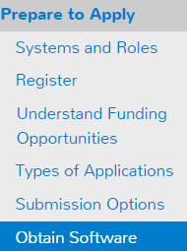
Obtain Software
Browser
Latest versions of Internet Explorer, Mozilla Firefox and Google Chrome – fully supported & tested
Many others work fine
Adobe Reader
Versions compatible with Grants.gov downloadable forms
http://www.grants.gov/web/grants/support/technical-support/recommended-software.html
PDF conversion program
All application attachments must be converted to PDF format

Slide 29
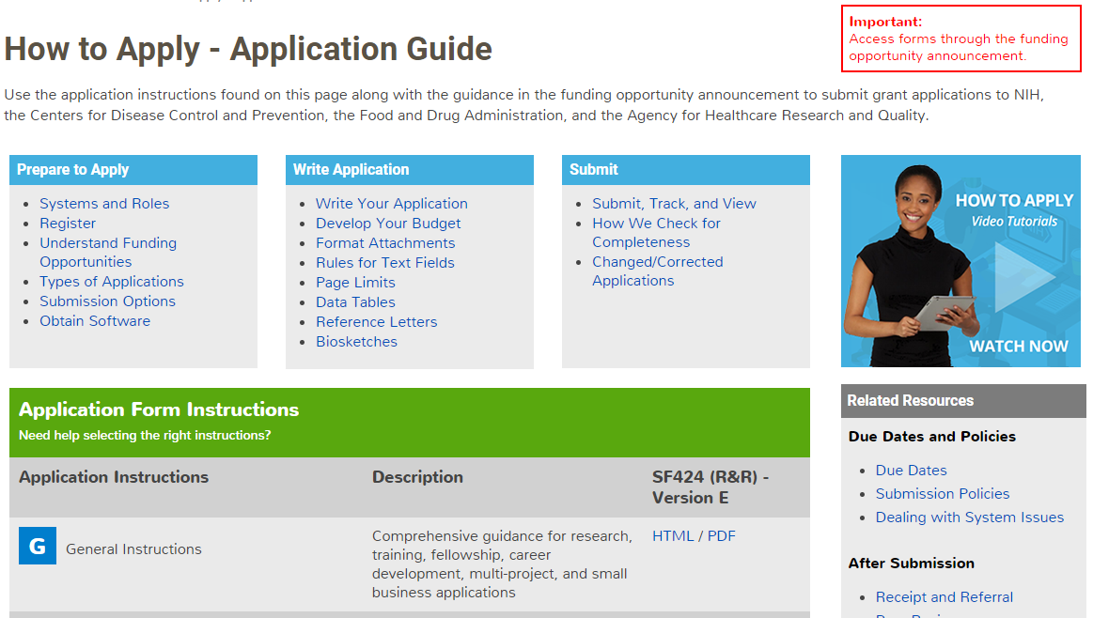
Submission Policies

Slide 30
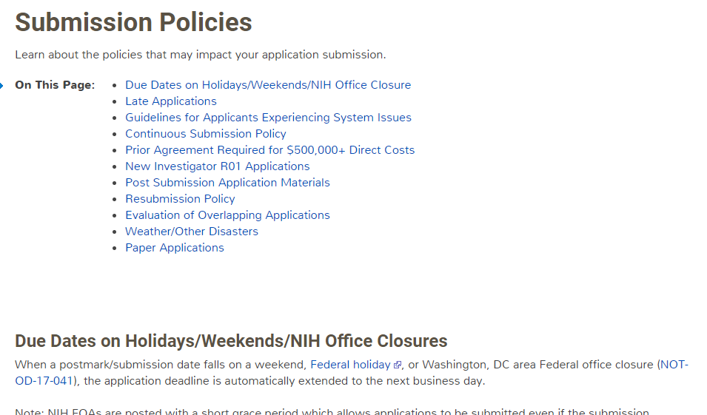
Submission Policies Page
https://grants.nih.gov/grants/how-to-apply-application-guide/due-dates-and-submission-policies/submission-policies.htm

Slide 31
Now Let’s Talk About the Application Process
Step 1: Find
Step 2: Plan
Step 3: Initiate
Step 4: Build team
Step 5: Enter data
Step 6: Finalize
Step 7: Submit
Step 8: Track

Slide 32
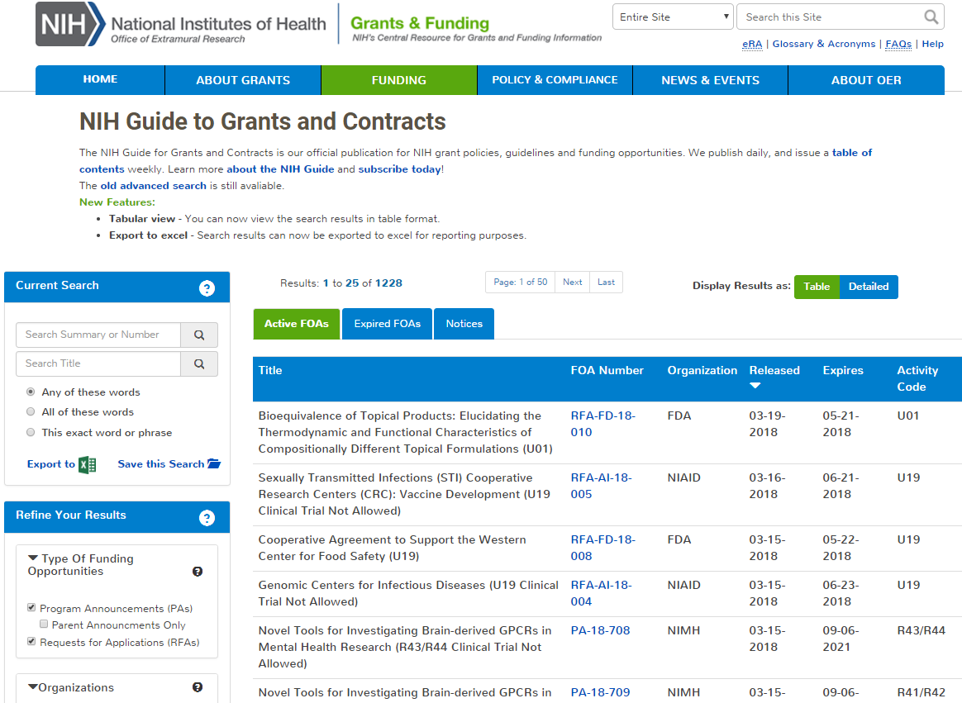
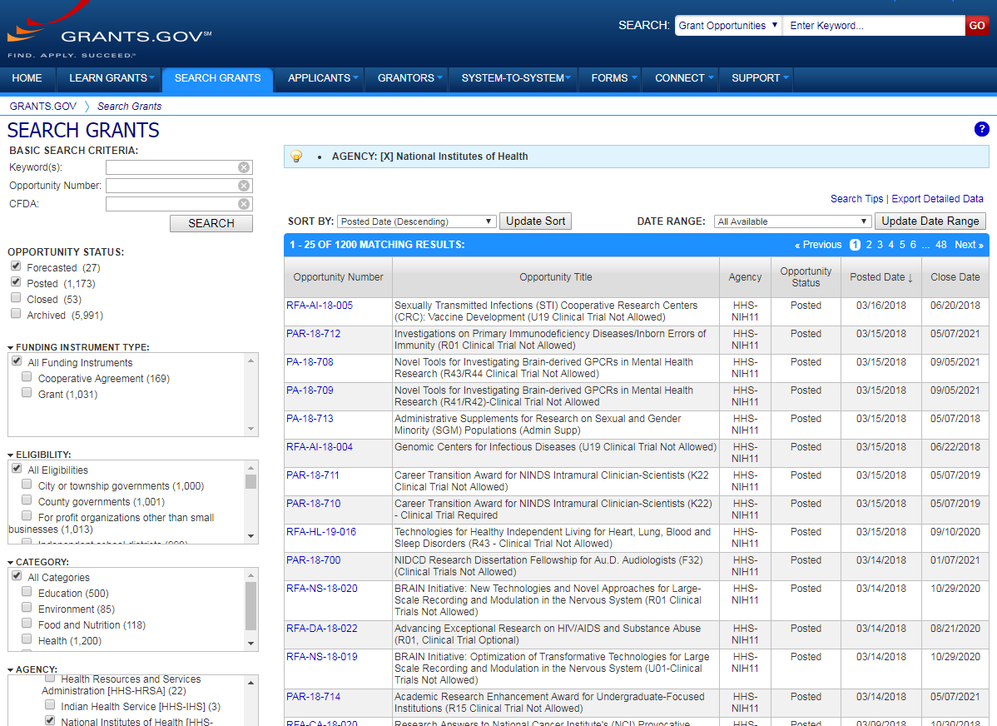
Step 1: Find an Opportunity of Interest
NIH Guide to Grants & Contracts
Grants.gov Search Grants
Each system has robust search capabilities.

Slide 33
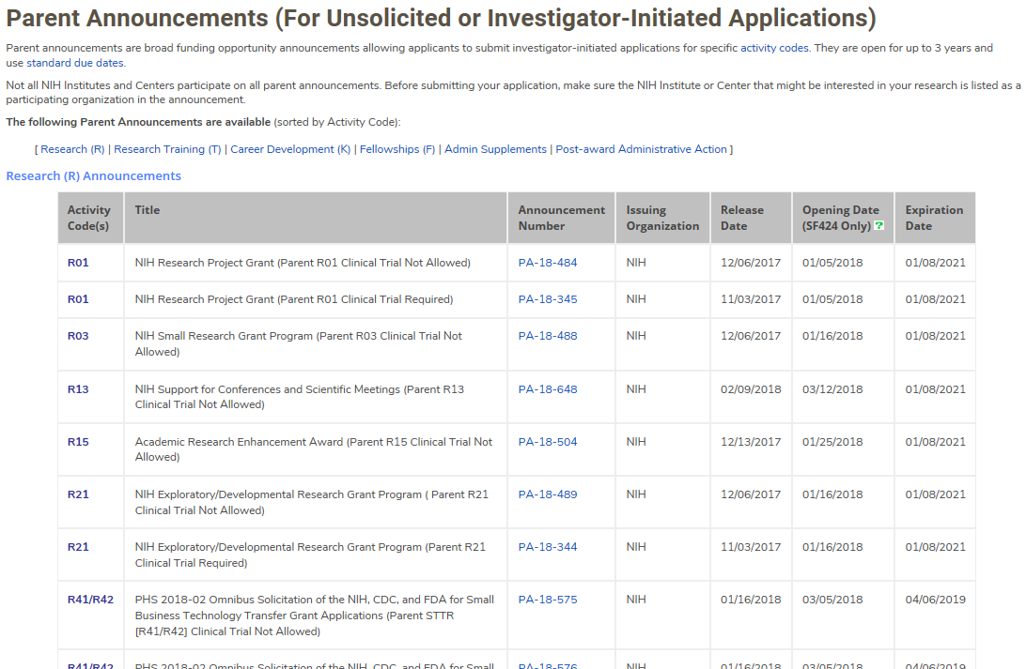
Parent FOAs
Broad announcements allowing applicants to propose research on unsolicited topics.
Select Parent FOA for your chosen grant program (i.e. R01, R03, R21, etc.).
Not all institutes participate on all parents.
http://grants.nih.gov/grants/guide/parent_announcements.htm

Slide 34
Clinical Trial Specific FOAs
NIH requires that all applications involving one or more clinical trials be submitted through a Funding Opportunity Announcement (FOA) specifically designed for clinical trials.
Improves our ability to
identify proposed clinical trials;
ensure that key trial-specific information is submitted; and
Uniformly apply trial-specific review criteria.
FOAs include clinical trial allowability indicator
https://grants.nih.gov/policy/clinical-trials/specific-funding-opportunities.htm

Slide 35
Clinical Trial Allowability Indicator in FOA Title
An indication of clinical trial allowability appears in the title of most new FOAs
Examples:
NIH Research Project Grant (Parent R01 Clinical Trial Not Allowed)
NIH Research Project Grant (Parent R01 Clinical Trial Required)
Administrative Supplements to Existing NIH Grants and Cooperative Agreements (Admin Supp – Clinical Trial Optional)

Slide 36
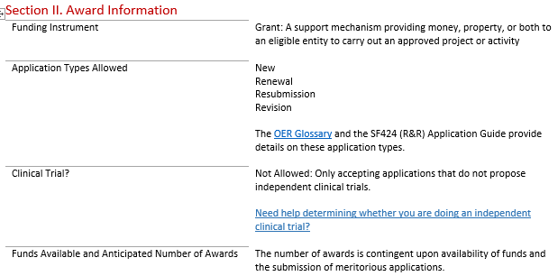
Clinical Trial Allowability Indicator in FOA Section II
Section II of each FOA includes one of these statements
Not allowed: Only accepting applications that do not propose clinical trials
Required: Only accepting applications that propose clinical trial(s)
Optional: Accepting applications that either propose or do not propose clinical trial(s)

Slide 37
Clinical Trial Indicator - Fellowship FOAs
All Fellowship FOAs are identified as “Clinical Trial Not Allowed” since they don’t support independent clinical trials
Fellows can still play an active role and gain experience in clinical trials led by a sponsor/co-sponsor as part of their research training

Slide 38
Clinical Trial Indicator – Training FOAs
All Training FOAs (except D43 and K12) will be identified as “Clinical Trial Not Allowed” since they support the training program as a whole
Appointed Trainees can still play an active role and gain experience in clinical trials led by a mentor or co-mentor
PHS Human Subjects and Clinical Trials Information form NOT included in most training form packages

Slide 39
Clinical Trial Indicator – Career Development FOAs
Some Career Development FOAs will be identified as “Clinical Trial Not Allowed” when they do not support independent clinical trials
Candidates can still play an active role and gain experience in clinical trials led by a mentor/co-mentor as part of their research career development
Career Development FOAs that support independent clinical trials will be marked “Clinical Trial Required”

Slide 40
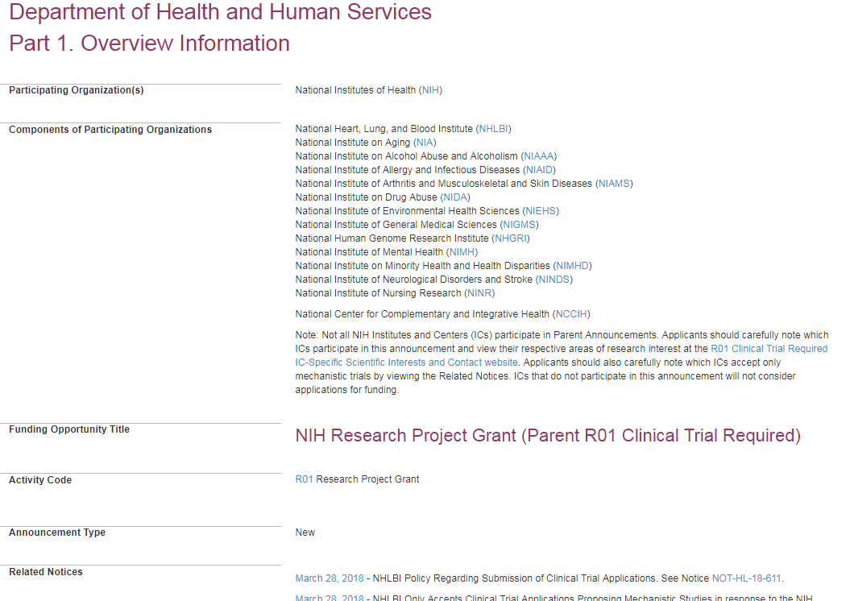
Let’s take a peek at an actual FOA…
PA-18-345

Slide 41
Check for fit before you submit!
Program description
FOA Part 2, Section I Funding Opportunity Description
Participating institutes
FOA Part 1, Participating Organizations & Components of Participating Organizations
Type of Application – New, Resubmission, Renewal, Revision
FOA Part 2, Section II Award Information
Clinical trials allowability (for due dates on/after January 25, 2018)
FOA Part 2, Section II Award Information
Eligibility
FOA Part 2, Section III Eligibility Information

Slide 42
Step 2: Plan for Your Submission
Identify team members
Verify registrations are in place and active
Choose submission method (ASSIST, Workspace, system-to-system)
Determine application preparation responsibilities
Who will – prepare budget, gather data, create attachments, do data entry
Make sure everyone is aware of process
Internal review & approval process
Post-submission responsibilities
How to deal with errors/warnings
Who will verify application in eRA Commons?
Make a plan before you need one!

Slide 43
Step 3: Initiate Application
An application form package is posted with each FOA and accessed using your chosen submission method
Login to your submission system and initiate your application
ASSIST | Workspace
Initiate Application | Create Workspace

Slide 44
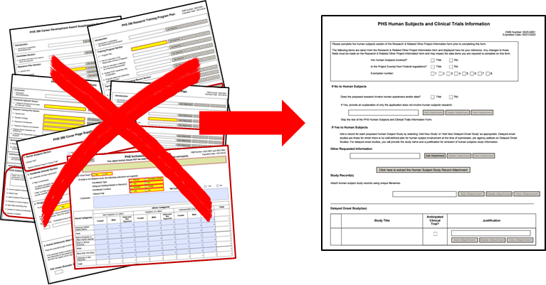
FORMS-E
All NIH applications must now use application form packages with a “FORMS-E” Competition ID.
Updated application form packages
Significant changes in approach for collecting human subjects and clinical trial information
New PHS Human Subjects and Clinical Trials Information form
Consolidates form fields currently scattered across multiple forms
Expands clinical trial data collection to improve oversight
Uses structured data fields to lead you through key requirements
Grants.gov changes to R&R Budget and SBIR/STTR Information forms
Do I Have the Right Form Version For My Application?
Describes what a “Competition ID” (e.g., FORMS-D, FORMS-E) and how to identify what forms were used for an in-progress or submitted application
FORMS-E: https://grants.nih.gov/grants/guide/notice-files/NOT-OD-17-062.html

Slide 45
Step 4: Build Your Team
Provide application access to appropriate team members
Gather eRA Commons usernames to include in your application for the following individuals
Project Director/Principal Investigators (PD/PIs)
Component leads on a multi-project application
Sponsor on a fellowship application
Candidates for diversity and re-entry supplements
Primary mentor on individual mentored career development application
ASSIST | Workspace
Gather eRA Commons usernames and use Manage Access to give folks access | Gather Grants.gov usernames and use Participants tab to give folks access

Slide 46
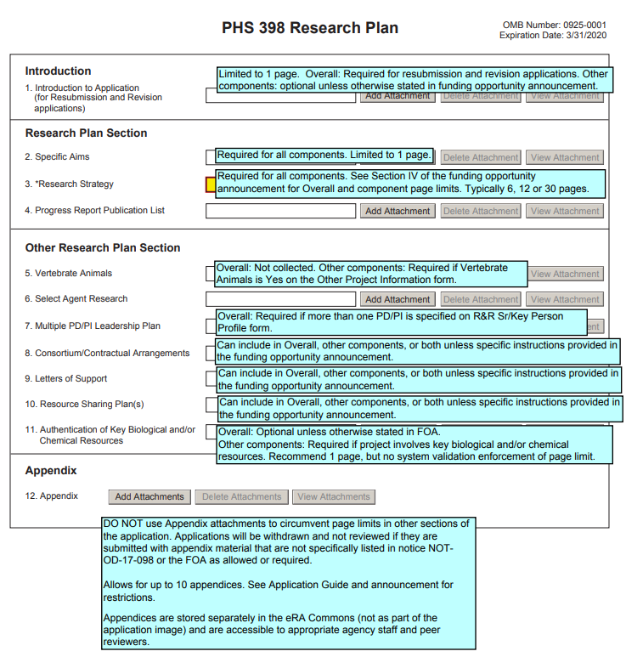
Step 5: Enter Data
Follow All Guidance
Handy Resource
Notices in NIH Guide for Grants & Contracts
Funding Opportunity Announcement
Section IV. Application and Submission Information
How to Apply - Application Guide
Annotated form sets
Precedence / Importance
https://grants.nih.gov/grants/how-to-apply-application-guide.html

Slide 47
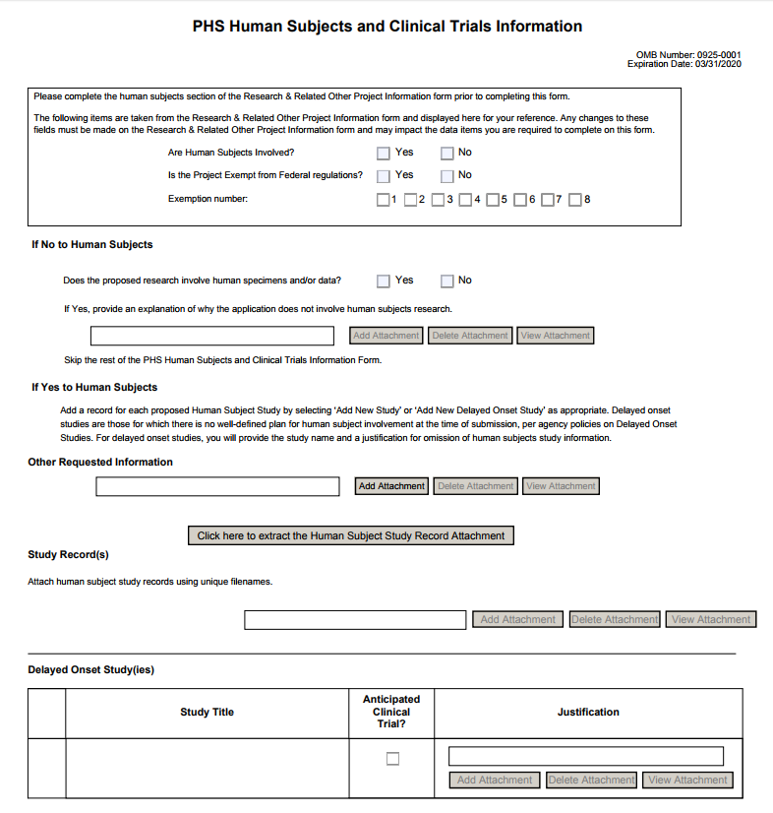
New PHS Human Subjects and Clinical Trials Information Form
Required form in most FOAs
A Walk-through of the PHS Human Subjects and Clinical Trials Information Form (video, 9 mins.)
Lots of other Clinical Trial changes
https://grants.nih.gov/policy/clinical-trials.htm

Slide 48
Application Attachments
Use simple PDF-formatted files for all attachments
Disable security features such as password protection
Filenames must be unique within the application & 50 characters or less
Use meaningful filenames
If FOA specifies a filename – use it!
“Other Attachments” on R&R Other Project Information form & “Other Clinical Trial-related Attachments” on PHS Human Subjects and Clinical Trials Info form will use filename as a bookmark in the application image
Do not include headers or footers
Section headings as part of the text (e.g., Significance, Innovation, Approach) are encouraged
Follow guidelines for fonts and margins
Follow specified page limits
http://grants.nih.gov/grants/how-to-apply-application-guide/format-and-write/format-attachments.htm

Slide 49
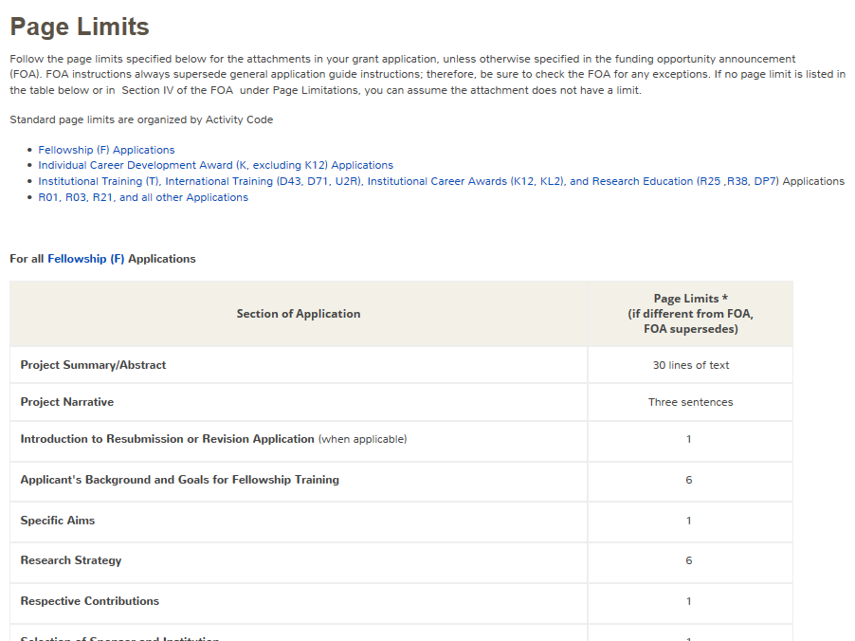
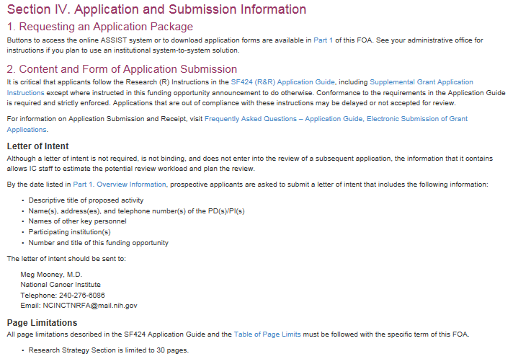
Follow Specified Page Limits
https://grants.nih.gov/grants/how-to-apply-application-guide/format-and-write/page-limits.htm

Slide 50
Text Fields
Text fields support plain text with limited manual formatting
To format paragraphs, include a blank line between paragraphs
To format bulleted lists, start each list item on a new line with a "list item" character, such as a hyphen (-) or an asterisk (*), followed by a space and then the item text
Much of your original formatting (font, bolding, bullets, subscript, superscript) will be lost when you cut and paste
Take advantage of application preview features if your submission method supports them
Check application form instructions for character limits
Spaces and punctuation count against the limit
https://grants.nih.gov/grants/how-to-apply-application-guide/format-and-write/rules-for-text-fields.htm

Slide 51
Use Format Pages
Biosketch Format Pages, Instructions and Samples
https://grants.nih.gov/grants/forms/biosketch.htm
Data Tables
https://grants.nih.gov/grants/forms/data-tables.htm
More (Additional Sr/Key, Additional Sites, Other Support)
https://grants.nih.gov/grants/forms/format-pages.htm

Slide 52
Grantsmanship
Avoid jargon
Be focused - use a clear and concise writing style
Spell out acronyms the first time they are used in each application section/attachment and note the appropriate abbreviation in parentheses
Appeal to the reviewers and the funding ICs by using language that stresses the significance of your proposed work
Align your application with the review criteria to maximize impact
FOA Section V. Application Review Information
http://grants.nih.gov/grants/how-to-apply-application-guide/format-and-write/format-attachments.htm

Slide 53
Step 6: Finalize Your Application
Action | ASSIST | Workspace
6a. Run a pre-submission validation check | Validate Application | Preview Grantor Validation
6b. Generate a pre-submission image of your assembled application in the NIH format | Preview Application | Grantor Image
6c. Take any additional steps needed to prepare for submission | Update Submission Status to “Ready to Submit” | Complete and Notify AOR (optional)

Slide 54
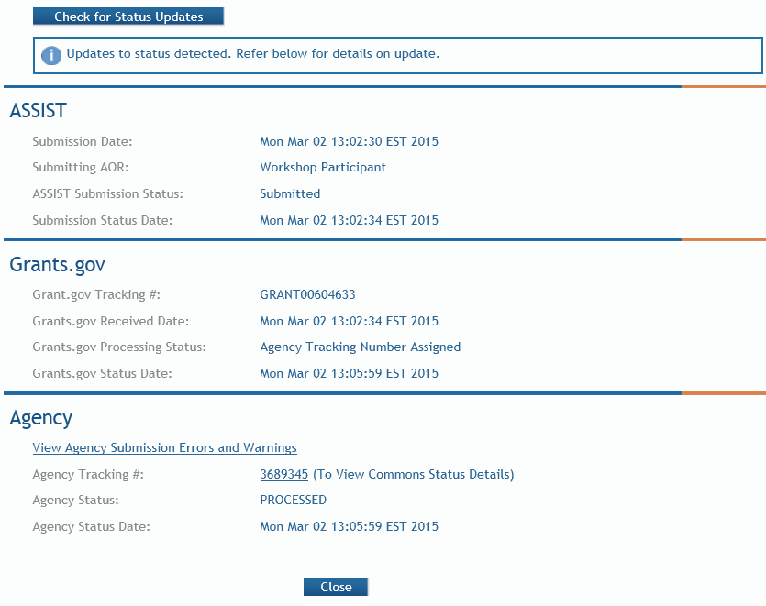
Step 7: Submit Your Application
Follow steps for your submission method
Only folks who hold Grants.gov credentials with the AOR (Authorized Organization Representative) role can submit
All NIH applications route through Grants.gov
Your Grants.gov timestamp is used to determine “on-time” submission
Grants.gov Tracking #
Date/Time Stamp – always recorded in Eastern Time

Slide 55
On-time Submission
Deadline = 5 pm local time of submitting organization on the due date
All registrations and SAM renewal must be completed before the deadline
Application must be free of all federal system-identified errors (Grants.gov & eRA)
NIH’s late policy does not allow corrections after the deadline
NIH recommends submitting early to allow time to correct any unexpected errors or submission issues

Slide 56
Pop Quiz
The appropriate measurement for “early” in the context of application submission is…
Minutes
Hours
Days
Measure early on a calendar not a clock.

Slide 57
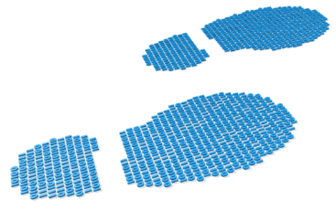
Step 8: Track Your Application
eRA Commons Status is an integral part of your submission
Applications that pass Grants.gov validations are picked up by eRA Commons and checked against many application guide and opportunity instructions
Authorized users can check eRA Commons Status for processing results
Signing Officials (SOs)
Administrative Officials (AOs)
Principal Investigators (PIs)
Delegated Assistants (ASSTs)
E-mail notifications sent

Slide 58
Email is Unreliable – Proactively Track Your Application
Many email notifications are sent throughout the process
DO NOT depend solely on email notifications
It is YOUR responsibility to proactively check your application status in eRA Commons
Grants.gov notifications go to email address associated with the submitting AOR’s Grants.gov account
eRA notifications go to the three email addresses on the SF424 (R&R) form submitted with the application (contact, PD/PI, AOR)
https://grants.nih.gov/grants/how-to-apply-application-guide/submission-process/submit-track-view/email_notifications.htm

Slide 59
Application Checks (Validations)
We really care about the details
Multiple levels of application checks for completeness
Grants.gov
eRA systems
Agency staff
Check!
Check!
Check!
https://grants.nih.gov/grants/how-to-apply-application-guide/submission-process/check-your-application.htm

Slide 60
Sample Validations
Grants.gov
eRA Systems
Agency Staff
Active System for Award Management (SAM) registration
Submitter has AOR role for DUNS on application
Submission made to active opportunity and application package
Virus check
Filenames include only appropriate characters
Fields required by agency, but not required federal-wide
R&R Sr/Key form
Credential for PD/PIs
Organization name for all sr/key
Biosketch for all sr/key
Performance Site form
DUNS for primary site
Attachments in PDF format
Adherence to page limits in our Table of Page Limits
All appropriate attachments included
Fit with NIH/Institute mission
Eligibility
“Overstuffing”
On-time submission
Adherence to funding opportunity announcement specific instructions
Font and margin guidelines
Simultaneous review of essentially same application

Slide 61
Errors & Warnings
Corrective submissions must be made BEFORE the submission deadline and overwrite previous submissions
Errors stop application processing and must be corrected
Warnings do not stop application processing and are corrected at your discretion based on your circumstances

Slide 62
Submitting a Changed/Corrected Application
Return to submission system to make corrections to form data
ASSIST – change status to Work in Progress to edit forms
Workspace – Workspace AOR or Owner must Reopen the Workspace to edit forms
Update SF424 (R&R) form
Check “Changed/Corrected” as “Type of Submission”
Enter “Previous Grants.gov Tracking ID” (e.g., GRANT12345678) in field 4c
Submit the entire Changed/Corrected application back through Grants.gov before the deadline
Corrective submission overwrite previous submission
Track submission through to eRA Commons
NOTE: Reviewers do not see applicant warnings, nor can they tell how many submission attempts were needed to complete the submission process
https://grants.nih.gov/grants/how-to-apply-application-guide/submission-process/changed-corrected-application.htm

Slide 63
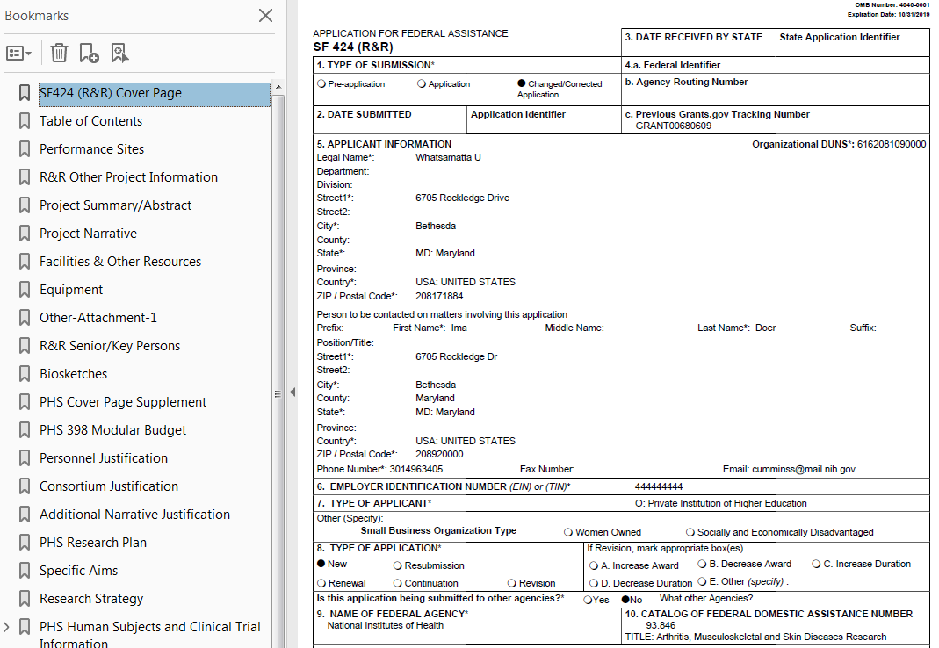
Application Assembled & Posted in eRA Commons
Once an error-free application is received by NIH, the eRA system will:
Assemble the grant application image
Insert headers (PI name) and footers (page numbers) on all pages
Generate Table of Contents and bookmark important sections
Post the assembled application image in the PD/PI’s eRA Commons account
Send notifications

Slide 64
Application Viewing Window
Applicants have two (2) business days to view the assembled application image before the application automatically moves forward for further processing
SO can Reject application within viewing window to prevent it from moving forward to NIH staff
Can submit a Changed/Corrected application before the submission deadline
We cannot resurrect a rejected application
ASSIST | Workspace
View Submission Status Details link | Must login to eRA Commons directly and access the application’s detailed status screen
http://public.uat.era.nih.gov/commons

Slide 65
View Application Image (e-Application)
The e-Application in eRA Commons is the same document seen by NIH staff and reviewers.
If you can’t VIEW it, we can’t REVIEW it!

Slide 66
Submission Complete!
If you don’t reject within the two business day viewing window, the application automatically moves forward for further processing at NIH
Any subsequent application changes are subject to the NIH policy on late submission of grant applications and the NIH policy on post-submission application materials

Slide 67
Finding Help
Help Desks
On-line resources & Web sites

Slide 68
Help Desks
eRA Service Desk
Grants.gov Contact Center
Web: http://grants.nih.gov/support/
Phone: 1-866-504-9552
Hours : Mon-Fri, 7a.m. to 8 p.m. ET
Toll-free: 1-800-518-4726
Hours : 24x7 (Except Federal Holidays)
Email : support@grants.gov
Resources: http://www.grants.gov/help/help.jsp

Slide 69
Online Resources & Websites
How to Apply – Application Guide http://grants.nih.gov/grants/how-to-apply-application-guide.htm
Annotated form set http://grants.nih.gov/grants/how-to-apply-application-guide/resources/annotated-form-sets.htm
ASSIST public.era.nih.gov/assist
Online help era.nih.gov/erahelp/ASSIST/
eRA ASSIST Training page: http://era.nih.gov/era_training/assist.cfm

Slide 70
Stay Connected – Subscribe to Listservs
Electronic Research Administration News (eRA-Information-L)
Used by NIH to notify the community of information related to eRA Commons, ASSIST & eSubmission.
NIH Guide to Grants and Contracts (NIHTOC-L)
Weekly email with a summary of all NIH Guide announcements published during the week, called the Current Weekly Table of Contents (TOC).
NIH Extramural Nexus (EXTRAMURALNEXUS)
Provides regular updates on NIH grants policies and activities that impact the entire grants community.
https://grants.nih.gov/news/subscribe-and-follow/listservs_and_rss.htm

Slide 71
Avoiding the “Gotchas”
Refer to annotated form set:
http://grants.nih.gov/grants/how-to-apply-application-guide/resources/annotated-form-sets.htm

Slide 72
Process Demo
Although we will use ASSIST to walk through the process, the submission steps are common to all systems.
ASSIST screens will be leveraged for post-submission updates to human subjects information and used by all awardees. If you use Workspace or system-to-system, you may still want to watch.
Process Step | Actions
Step 1: Find | N/A
Step 2: Plan | N/A
Step 3: Initiate | Initiate Application
Step 4: Build Team | Search, Manage Access
Step 5: Enter Data | Navigation, screen validations, pre-population
Step 6: Finalize | Validate Application, Preview Application, Update Submission Status
Step 7: Submit | Submit
Step 8: Track | View Submission Status Details

Slide 73
Questions?

