Slide 1
eRA Commons Working Group (CWG) Account Management System Redesign May 12, 2015
electronic Research Administration (eRA)
OER, OD, National Institutes of Health

Slide 2
Agenda
Account Management System (AMS) Redesign
What will change?
New Look and Feel – eRA UI Elements
Proposed Streamline Workflows
Questions

Slide 3
AMS Consolidation Redesign
Extend the current AMS functions to support NIH and other agency accounts that are currently handled in the other system.
Enhance current AMS to be a tool with better usability.

Slide 4
What will Change?
New Look and Feel
- eRA User Interface Standard

Slide 5
What will Change (cont’d)?
Proposed Streamline Workflows
- Create Account without Search
- Improved Role Assignment Function
- Consolidated Actions on Search Result screen
- Provide Report function

Slide 6
Proposed Streamline Workflow – Create Account
Create Account

Slide 7
Proposed Streamline Workflow – Current Create Account Process
User needs to perform search prior to creating account to prevent duplicate account creation
System brings user back to Search Result page for further action once the account creation is completed

Slide 8
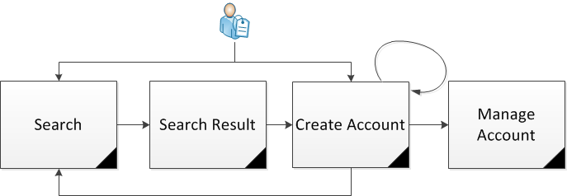
Proposed Streamline Workflow – Proposed Create Account Flow
Search Screen will remain to be the landing screen when entering AMS
User has the capability to create account without searching
Based on the data statistics, most users are searching without criteria to get to the Create Account screen
Same validations will be provided to prevent duplicate account creation
After account creation is completed, user is able to
Continue create another account
Manage the newly created account
Go back to Search Page perform search

Slide 9
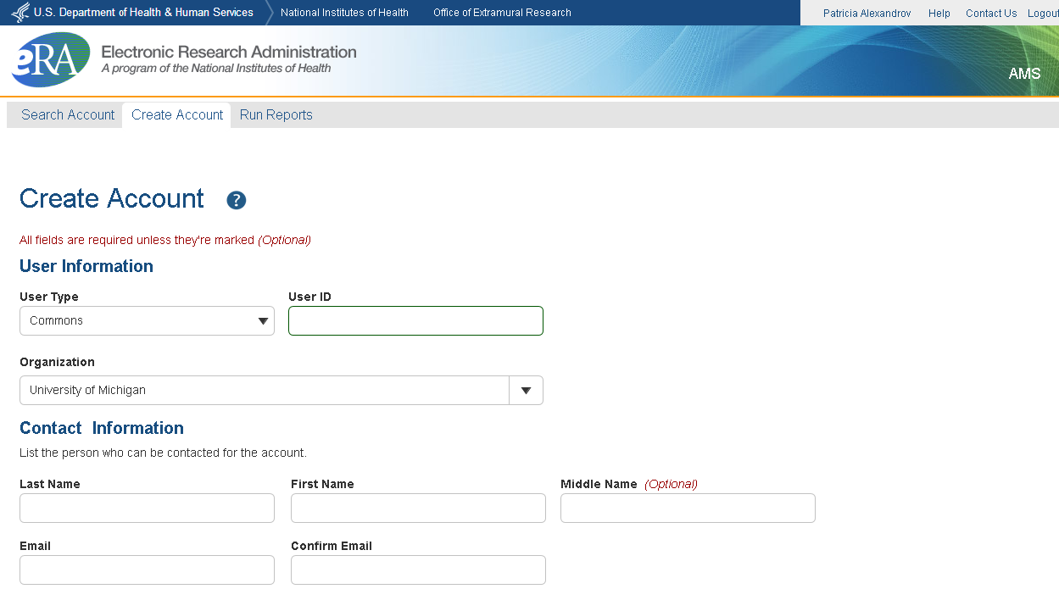
Proposed Streamline Workflow – Proposed Create Account Flow (Cont’d)

Slide 10
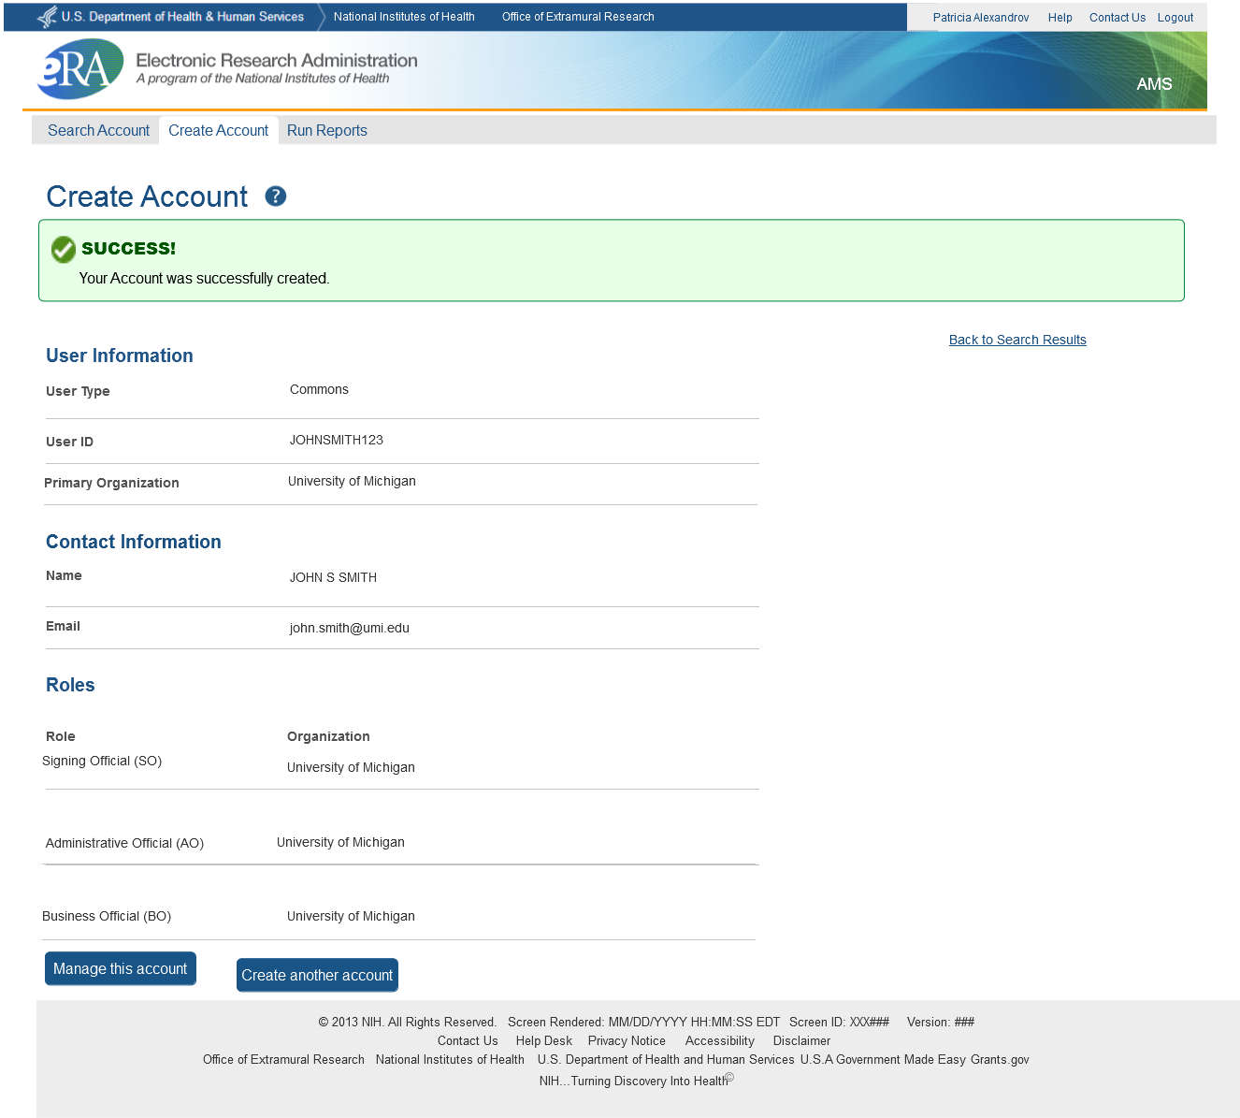
Proposed Streamline Workflow – Proposed Create Account Flow (Cont’d)

Slide 11
Proposed Streamline Workflow – Assign Roles
Assign Roles

Slide 12
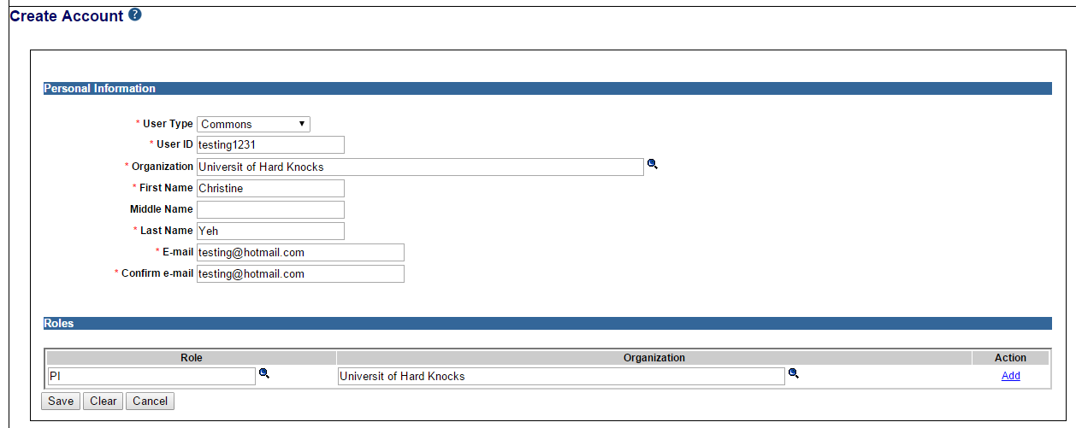
Proposed Streamline Workflow – Current Assign Roles Process
It is confusing to the first time user how to assign a role during the account creation

Slide 13
Proposed Streamline Workflow – Proposed Assign Roles Flow
System provides
a clear indicator for role assignment
capability to multiple role selections for one organization
capability to remove the selected roles
Development URL:
https://public.dev.era.nih.gov/ams

Slide 14
Proposed Streamline Workflow – Search
Search Account

Slide 15
Proposed Streamline Workflow – Search
Default to Search Outside Your Organization (including user’s own organization)
Capability to provide view funding & profile information for verification
Question:
Should the system provide View Profile Information without viewing any PII data capability?
Should the View Funding information be icons or as part of the Action drop down?

Slide 16
Proposed Streamline Workflow – Search (cont’d)
3. Consolidated Actions on Search Result Page depending on the user’s privileges and account status
 | Current AMS |  | New AMS (Proposed)
Account Status | Actions Displayed on Search Result | Action Displayed on Manage/View/Affiliate/Un-affiliate Account | Actions Displayed on Search Result | Action Displayed on Manage Account
Active | View Funding Information Un-affiliate Edit (Manage Account) View | Add Roles Un-affiliate Edit Email Reset Password | View Funding Information View Profile Information View/Manage Account | Add Roles Edit Email Un-affiliate Reset Password
Active (Outside my Org.) | View Funding Information Create Affiliation | Create Affiliation Edit Email | View Funding Information View Profile Information View/Manage Account | Create Affiliation Edit Email
Pending | View Funding Information Resend Email | N/A | View Funding Information View Profile Information Resend Email | N/A
Not Affiliate (Profile Only) | View Funding Information Create Account | N/A | View Funding Information View Profile Information Create Account | N/A

Slide 17
Proposed Streamline Workflow – Report
Run Report

Slide 18
Proposed Streamline Workflow – Report Proposed Flow
System provides the Report feature:
List of account with Profile Incompletion
List of account with Role Selection
Question: Currently user searches account with particular roles in the Search Screen. Can this function be replaced as a Report if no further action is taken on the returned accounts?

Slide 19
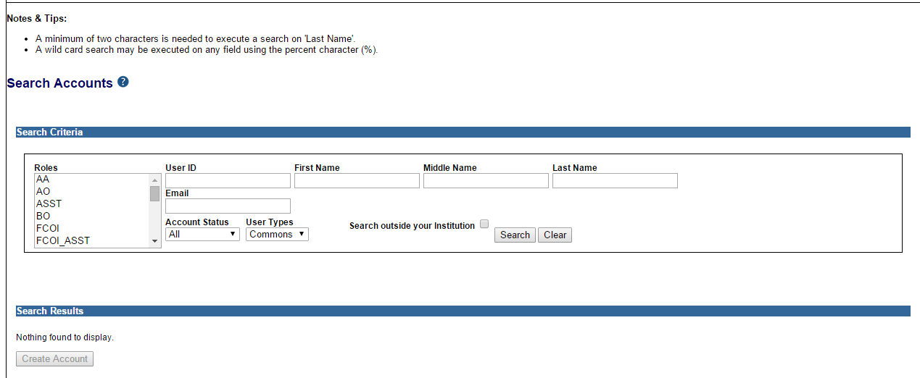
Proposed Streamline Workflow – Current Function
Current Search screen in AMS

Slide 20
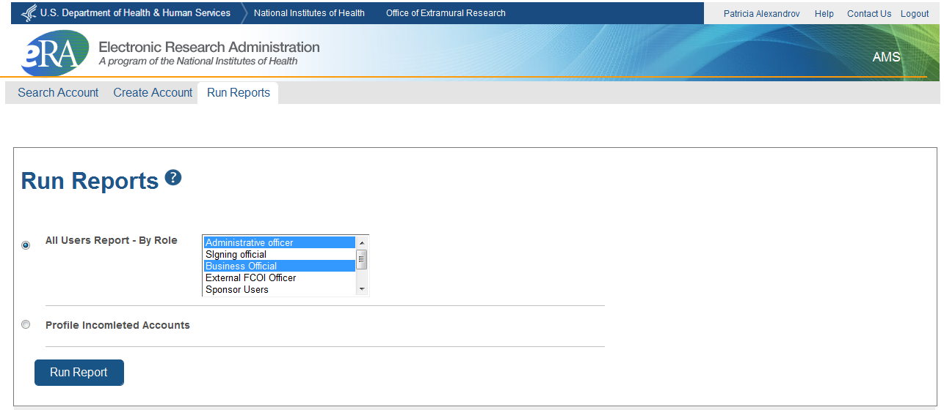
Proposed Streamline Workflow –Run Report Proposed Flow

Slide 21
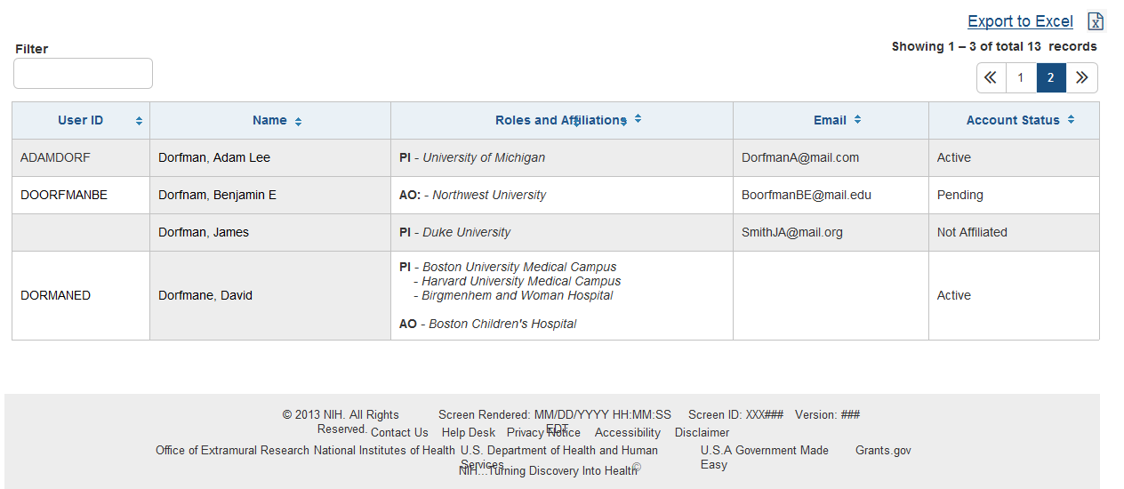
Proposed Streamline Workflow –Run Report Proposed Flow (Cont’d)

Slide 22
Questions?
Questions??

