Slide 1



NIH eRA Workshop Day eRA Commons Account Administration & Post-submission Processing
October 2018
electronic Research Administration (eRA)
OER, OD, National Institutes of Health

Slide 2
Your Workshop Team
Scarlett Gibb
  eRA Customer Relationship Manager, eRA Commons
Joe Schumaker
  eRA Communications and Outreach

Slide 3
eRA Commons
What is era Commons?

Slide 4

What is eRA Commons?
The eRA Commons is an online interface where grant applicants, grantees and federal staff can access and share administrative information related to grant applications and awarded research grants.
Applications
eSubmission Errors/Warnings
Assurances
Assembled Application Image
Certifications
Review Assignment
Profile Data
Priority Score
Progress Reports
Summary Statement
Financial Reports
Notice of Award
Invention Reports
Training Tables
Post-award Correspondence
Training Appointment Actions
HSS Data/Integration
ORCID ID

Slide 5





eRA Partners eRA Commons used by more than NIH

Slide 6
eRA Commons Status Screen

Slide 7
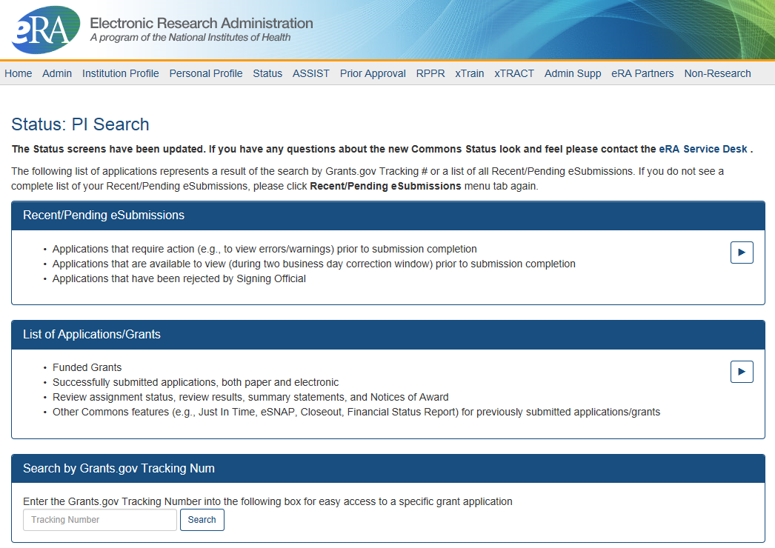
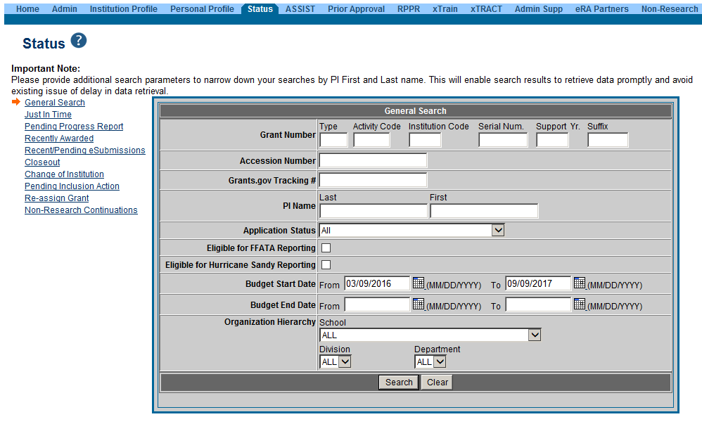
PI & SO Status Views
Principal Investigators can view their Recent/Pending eSubmissions or List of Applications/Grants.
Signing Officials can search/view all submissions for their institution.

Slide 8
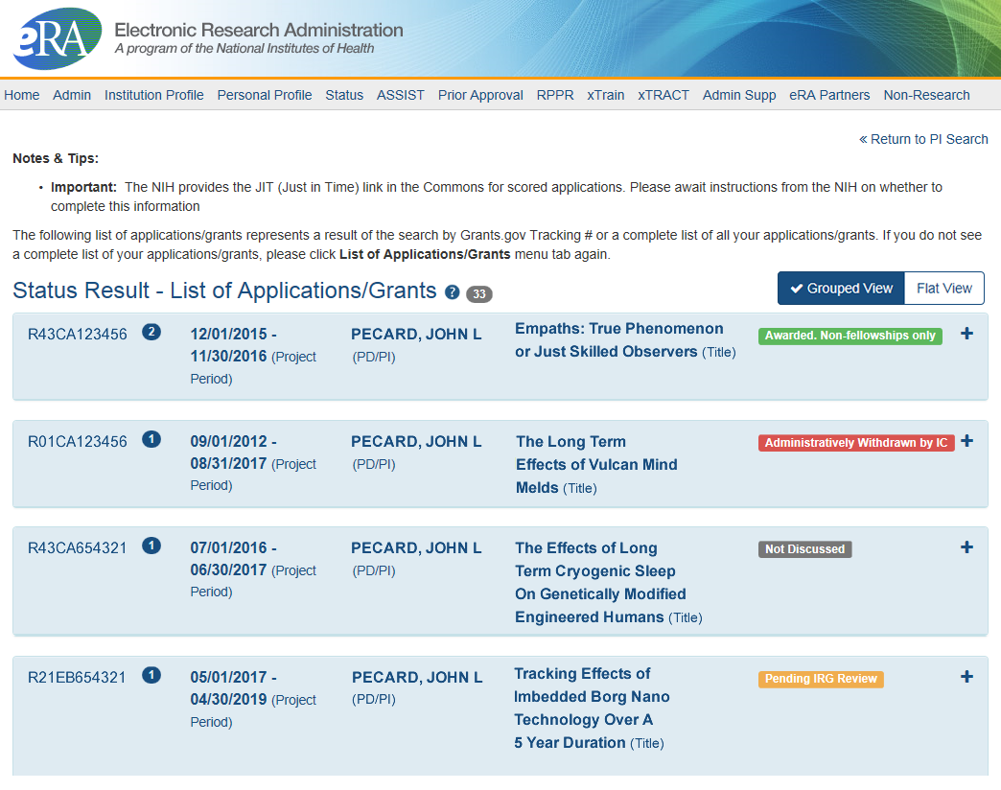
Status Result from General Search for PI
Click anywhere in the blue to get to more information, then select the Application ID link to view detailed status information for that particular application.

Slide 9
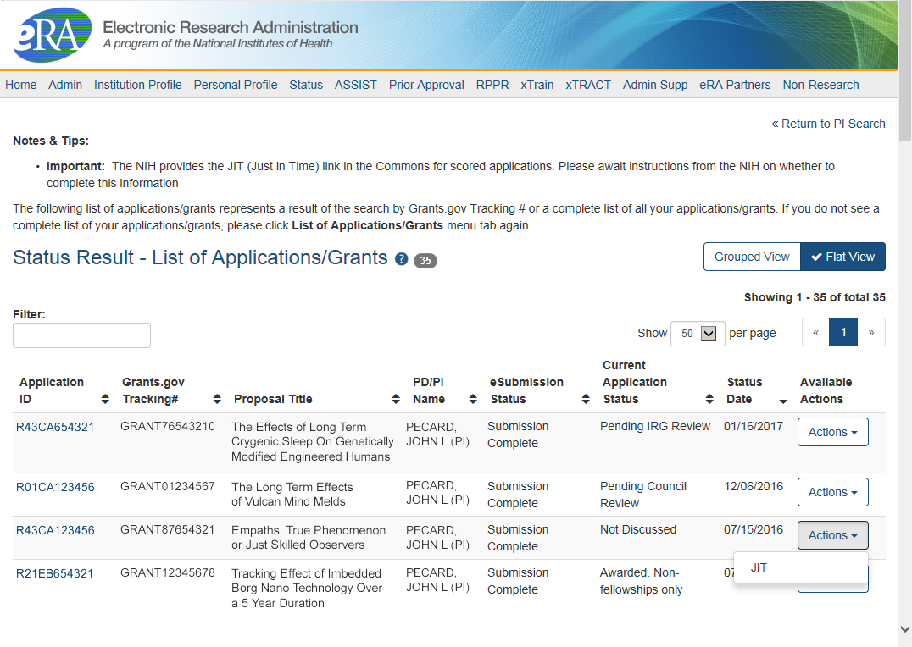
Status Result from General Search for PI
(flat view)
Flat view is more similar to the old view

Slide 10

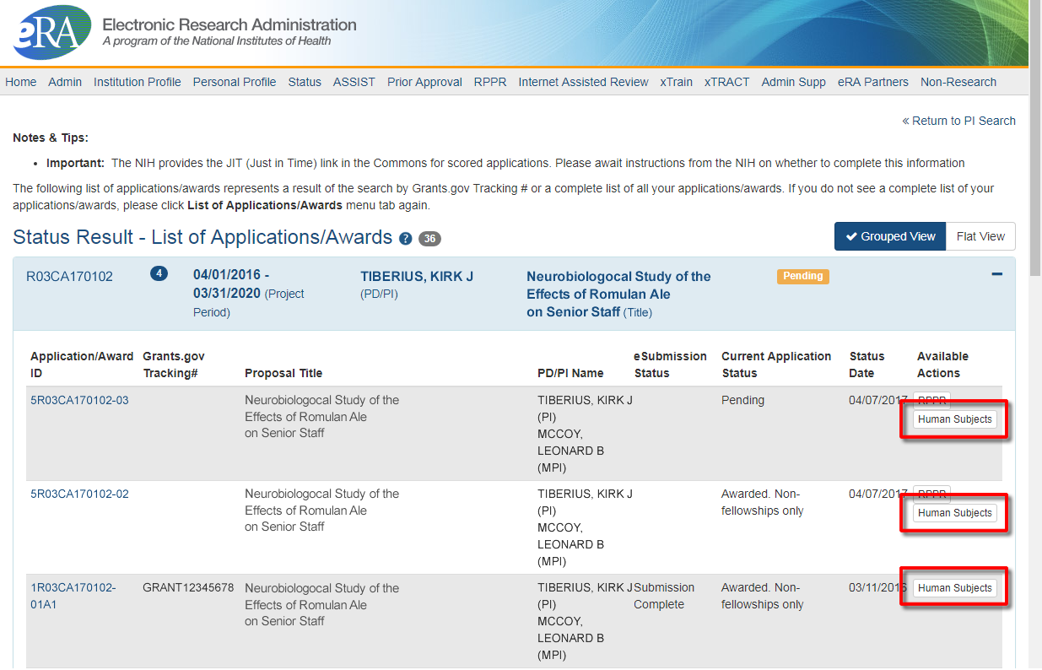
New Human Subjects Link in PI Status View
Principal Investigators can access Human Subjects System (HSS) via the Action button

Slide 11
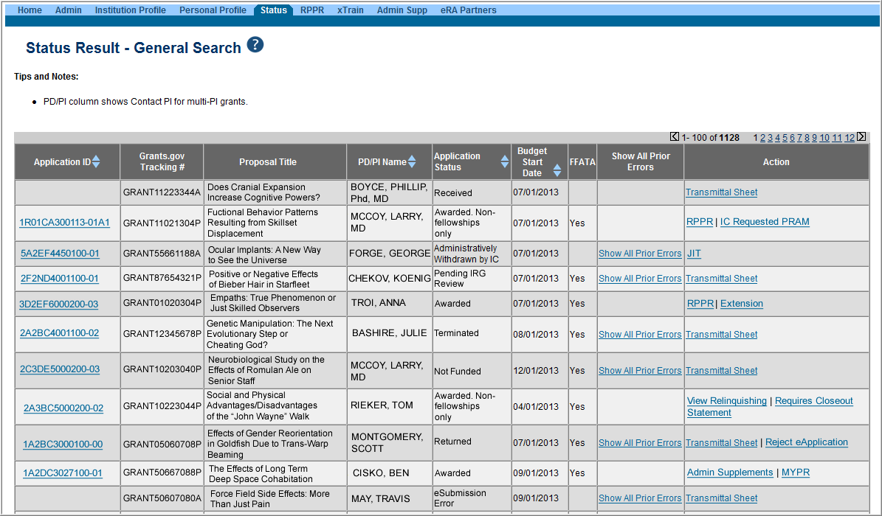
Status Result from General Search for SO
Select the Application ID link to view detailed status information for that particular application.

Slide 12
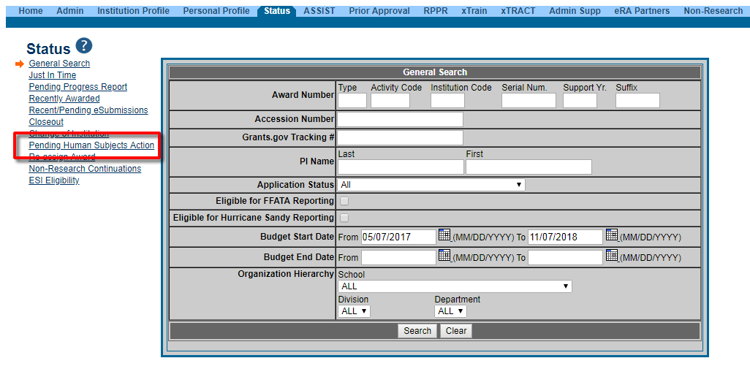
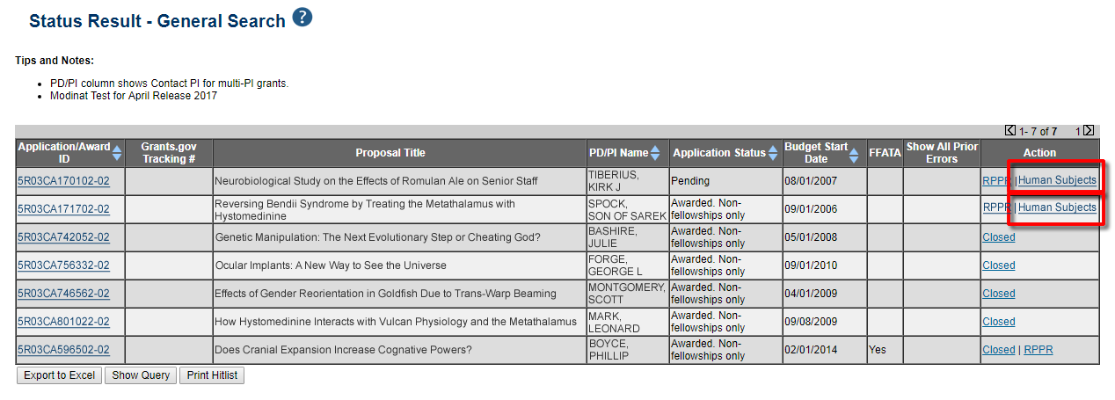
New Human Subjects Link in SO Status View
Signing Officials can search/view for Pending Human Subjects data, and will connect with HSS via link in the Action column.

Slide 13
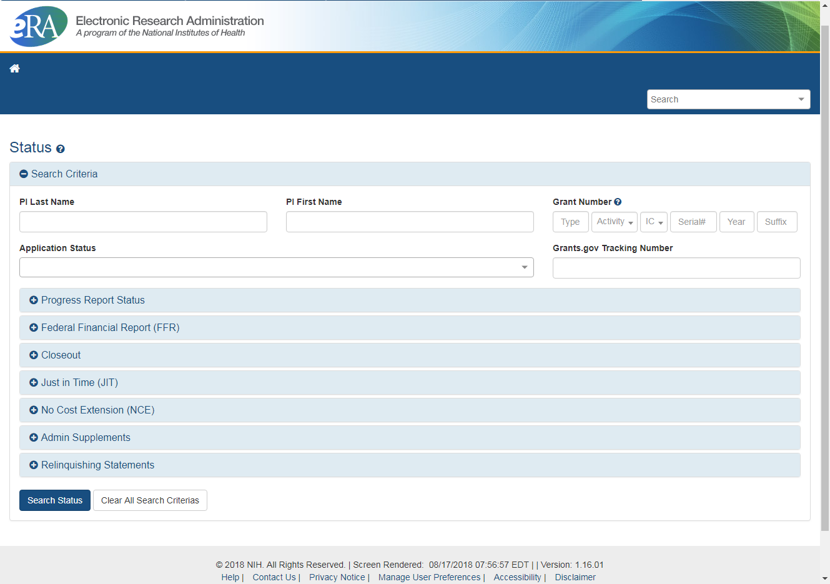
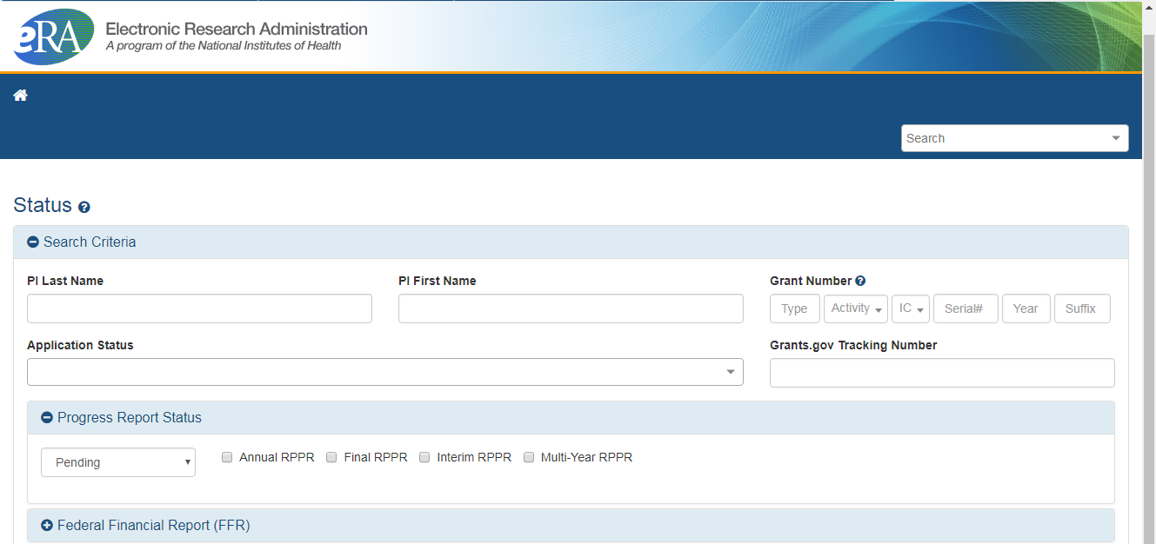
Coming Soon-
New SO Status Search Screen (tentative)

Slide 14
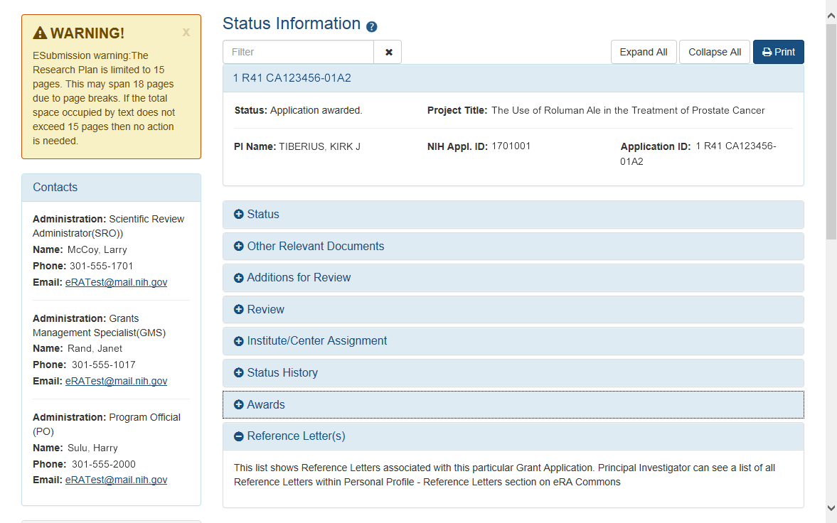
New Status Information Screen
Provides warnings
Control Buttons
Text Filter
All tiles open by default.
eRA Contacts

Slide 15
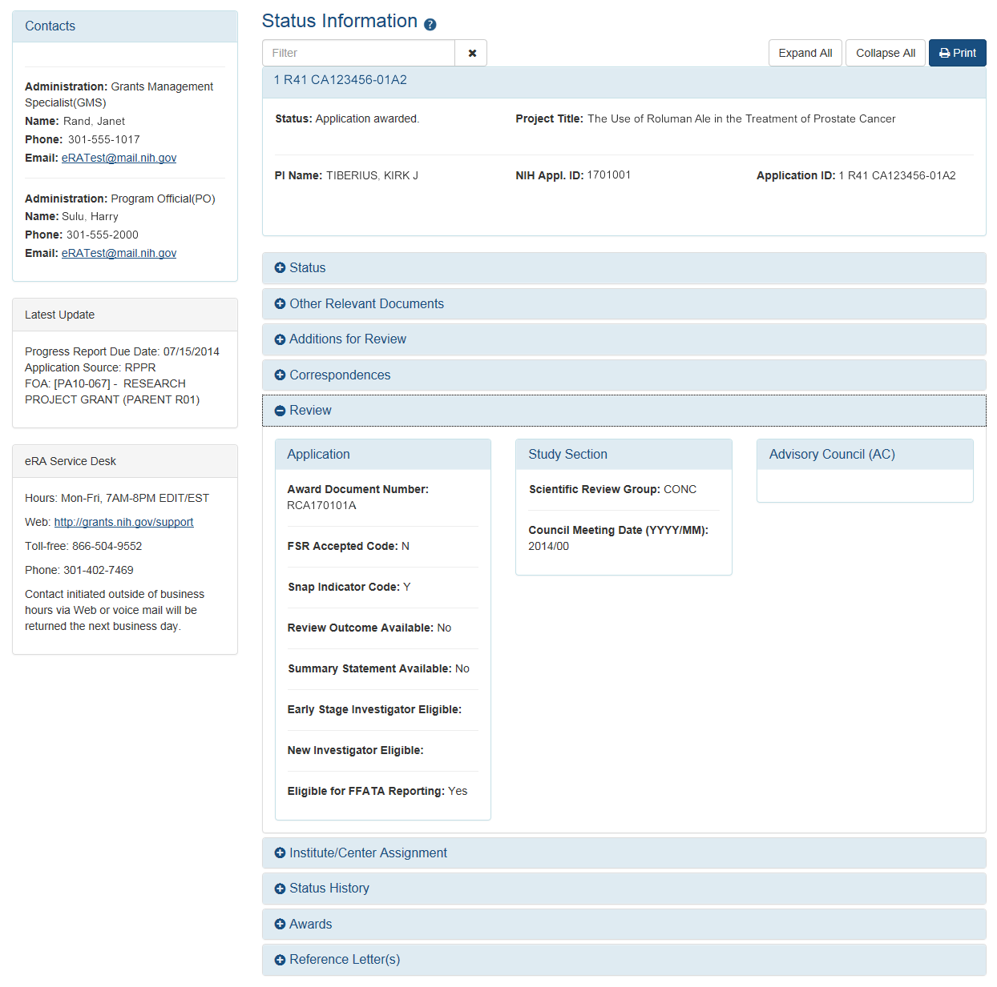
Verifying ESI & NI Application Status
Reflects a snapshot of Early Stage Investigator (ESI) and New Investigator status at time of application submission.
Early Established Investigator (EEI) status maybe included in the future.

Slide 16
Reference Letters
NOT part of the application through Grants.gov
Submitted directly by the referee through eRA Commons
Commons registration not required
Can be submitted in advance of application submission
Due by the application submission deadline
Applicants can track the submission of reference letters in the Commons, but cannot view the actual letter
Fellowship reference letters no longer have a required format – just a letter
Some NIH grant programs require the submission of reference letters in addition to the grant application (e.g., Mentored Career Development program)

Slide 17
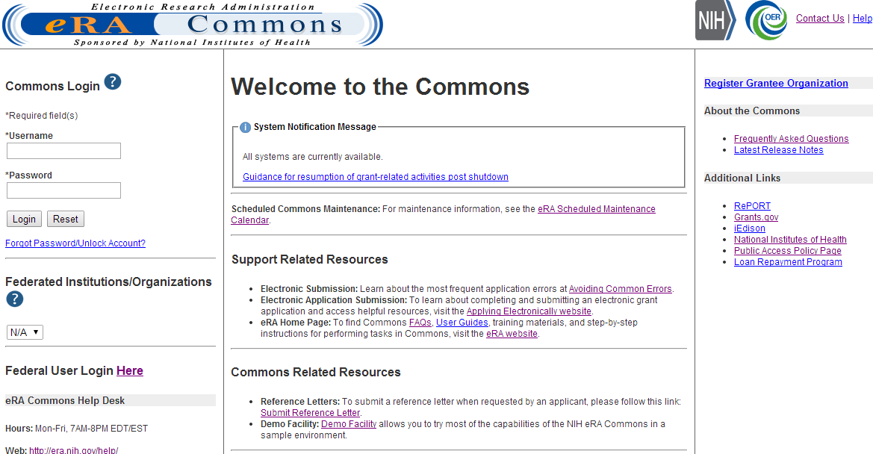
Reference Letters Links
Referees do not need to login to Commons to submit.

Slide 18
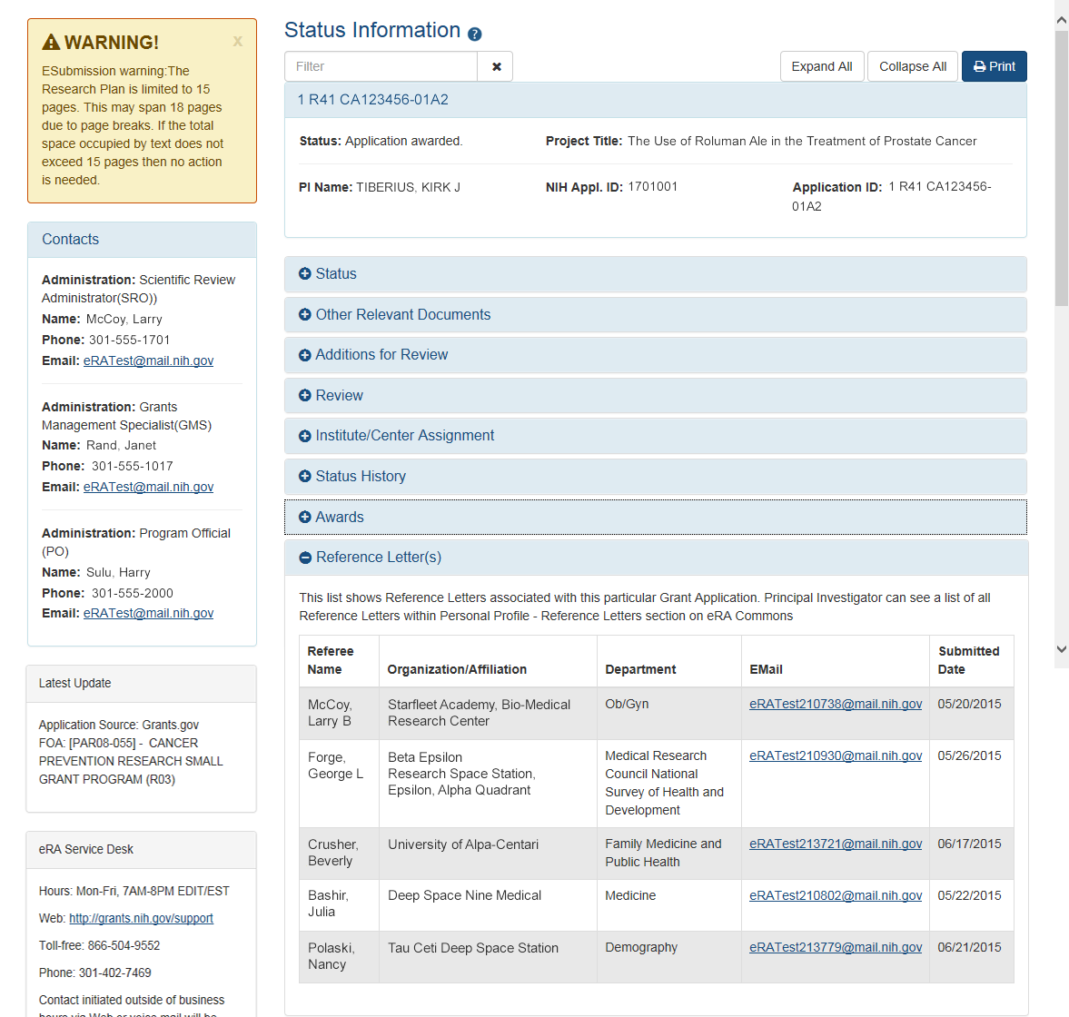
Reference Letters Status Information

Slide 19

Reference Letter Resources
Frequently Asked Questions
  http://grants.nih.gov/grants/ElectronicReceipt/faq_full.htm
Submitting Reference Letters through eRA Commons (Demo)
  http://era.nih.gov/era_training/tutorials/NIH_Reference_Letter/NIH Reference Letter.htm

Slide 20
Identifying NIH Contacts
Contacts are updated as the application moves through the different stages of processing.

Slide 21
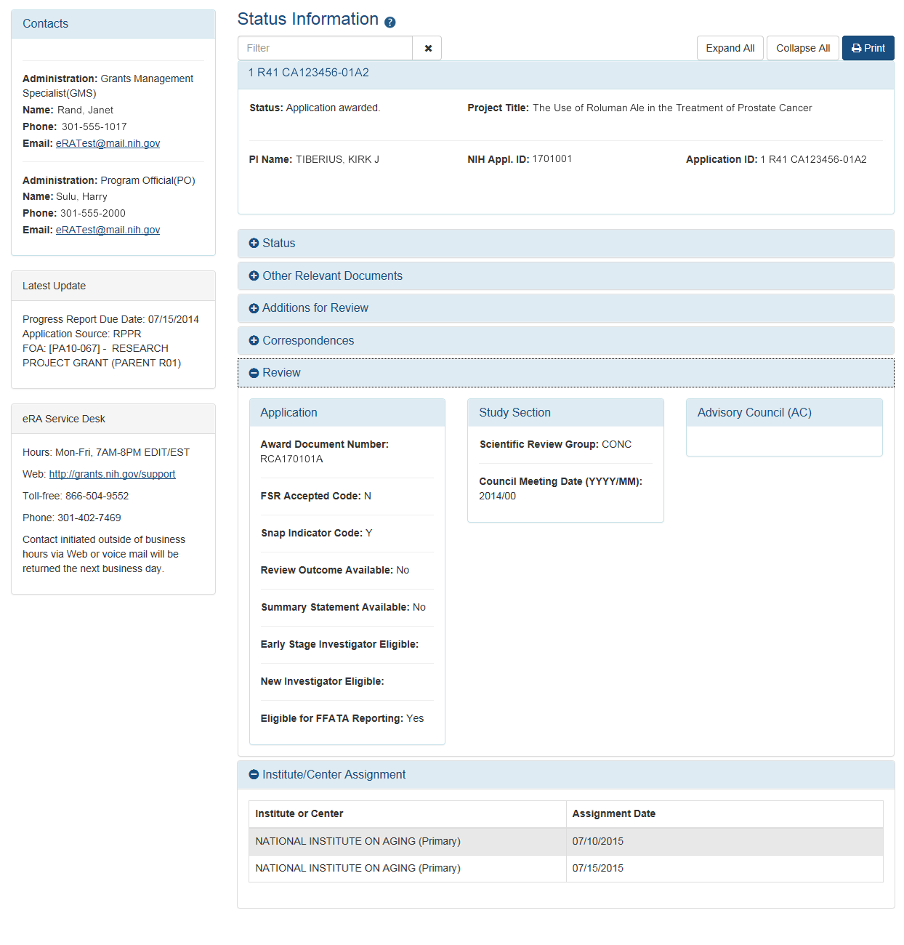
Check Review Assignments
Study Section assignment
Institute or Center assignment

Slide 22
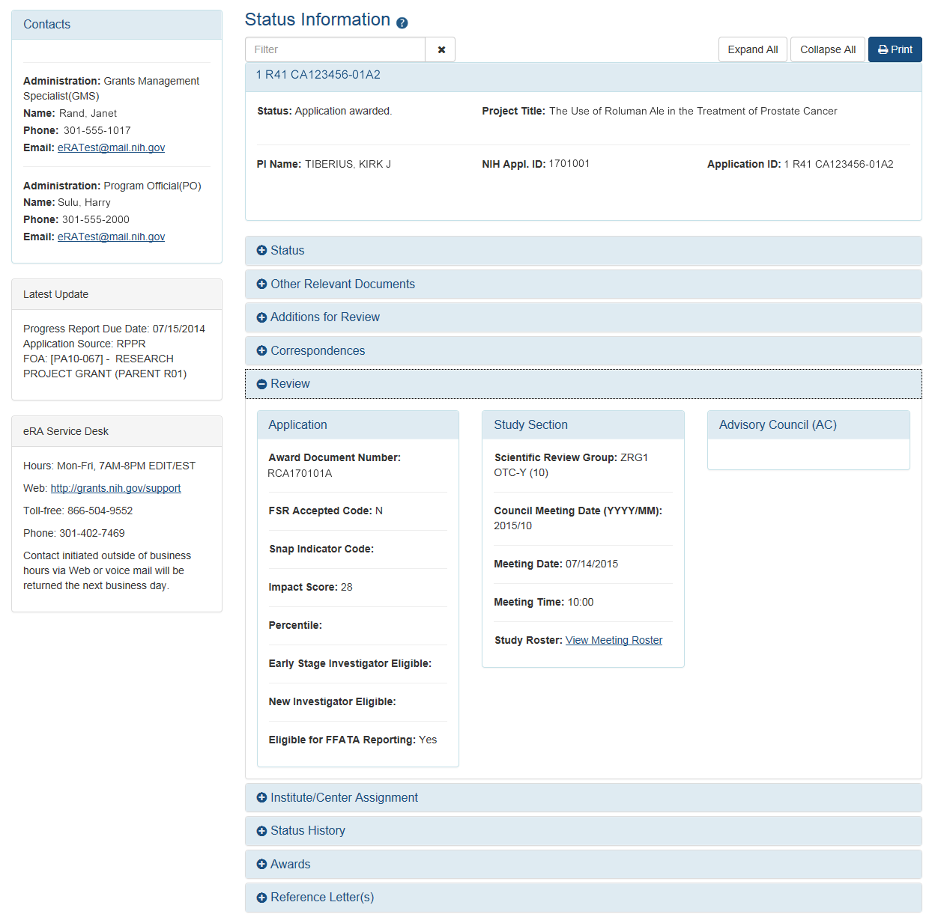
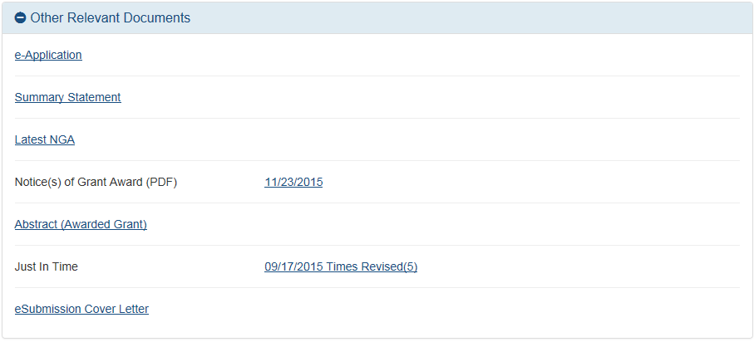
Check Review Outcomes
Only the PI sees the Summary Statement and Scores

Slide 23
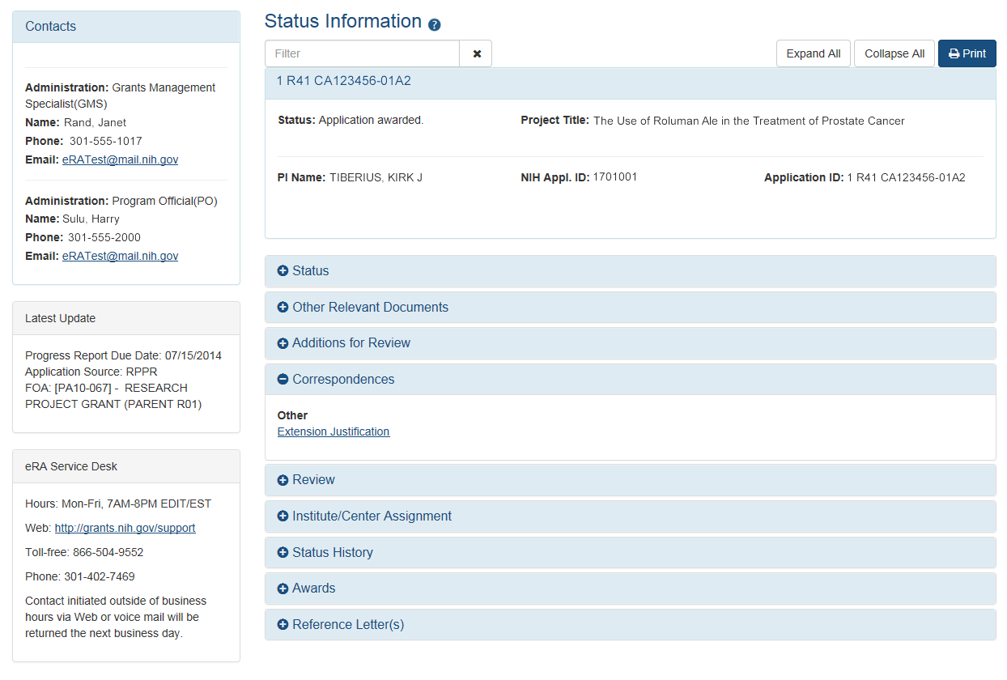
Viewing Referral and Review Correspondence
NIH Referral and Review staff can post correspondence for the application.

Slide 24
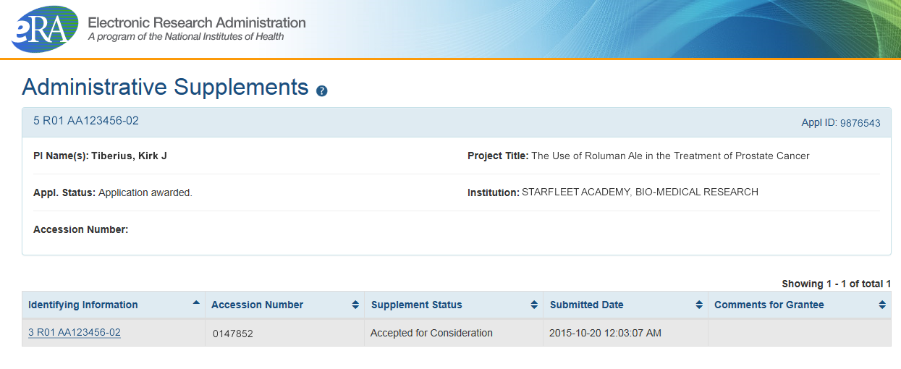
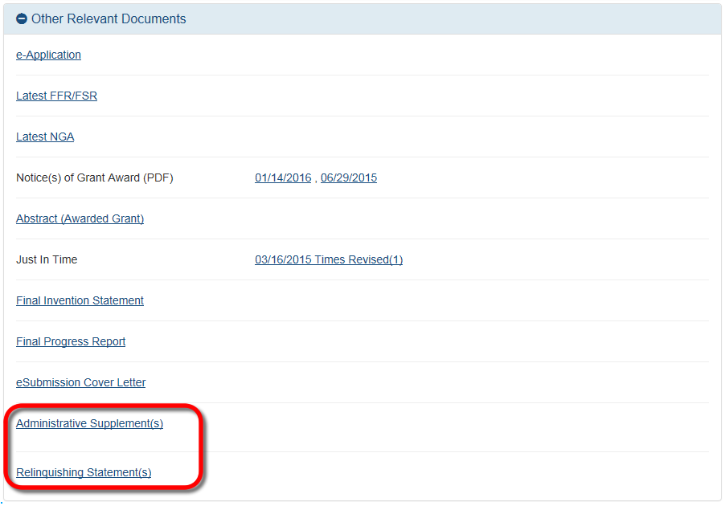
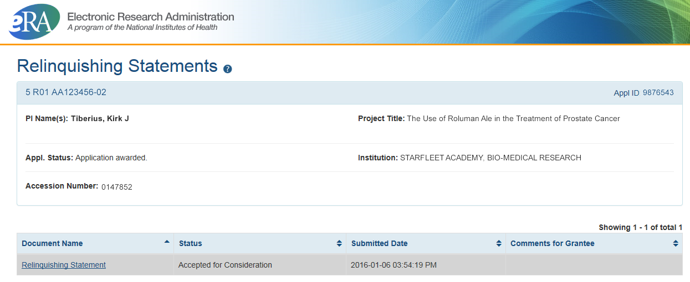
Other Relevant Documents Screens

Slide 25
Notice of Award (NoA)
Contains or refers to all terms and conditions of the grant
Is posted in the Other Relevant Documents section of the Status Information page
Official document notifying the grantee and others that a grant has been awarded

Slide 26
eRA Commons
Account Administration
Account Management

Slide 27

Signing Official (SO)
During Commons registration, an applicant organization designates a Signing Official (SO)
  SO has authority to legally bind the organization in grants administration matters
  Equivalent to the Authorized Organization Representative (AOR) in Grants.gov
  SO is responsible for:
    maintaining institutional information
    submitting documents that require signature
    authority to act on behalf of the organization
    managing accounts

Slide 28
Signing Official (SO) & Managing Accounts
Signing Officials (and Account Administrators) have a responsibility to ensure duplicate accounts are not created for users.
  Users with Scientific roles should only have one (1) eRA Commons account for their entire career
    NIH needs to track funded researchers
    Used for reviewers to determine Continuous Submission status
    Used to determine New/Early Stage Investigator status
  Before creating new accounts, search across all eRA Commons accounts using AMS
  For more information, see:
    https://era.nih.gov/news_and_events/era-item-Oct2017.htm

Slide 29
Account Management - Reports
Account Management System (AMS) includes a report feature.
  Search by role or multiple roles
  Limited to users only at your institution
  Unlike other search features with a limit of 500 hits, there is no limit to number of users returned in report search
  Result can be exported as a spread sheet or PDF document

Slide 30
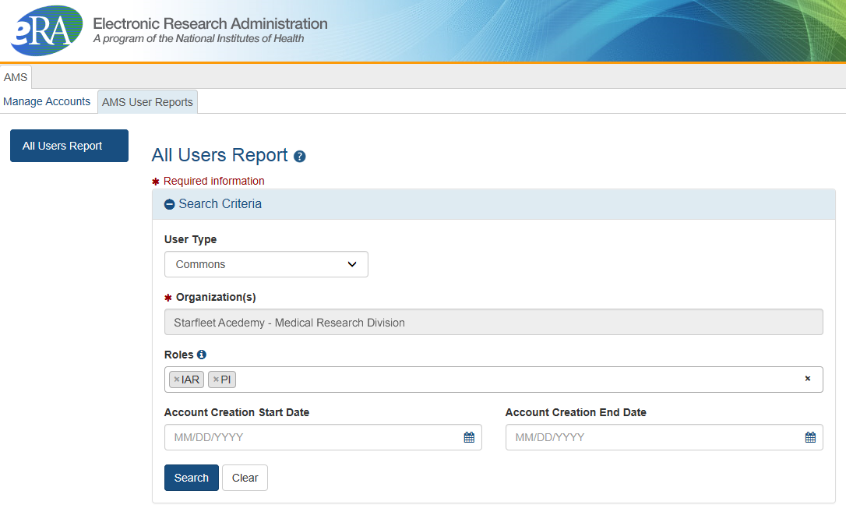
Account Management – Reports Search
Search on one eRA Commons role or multiple roles

Slide 31
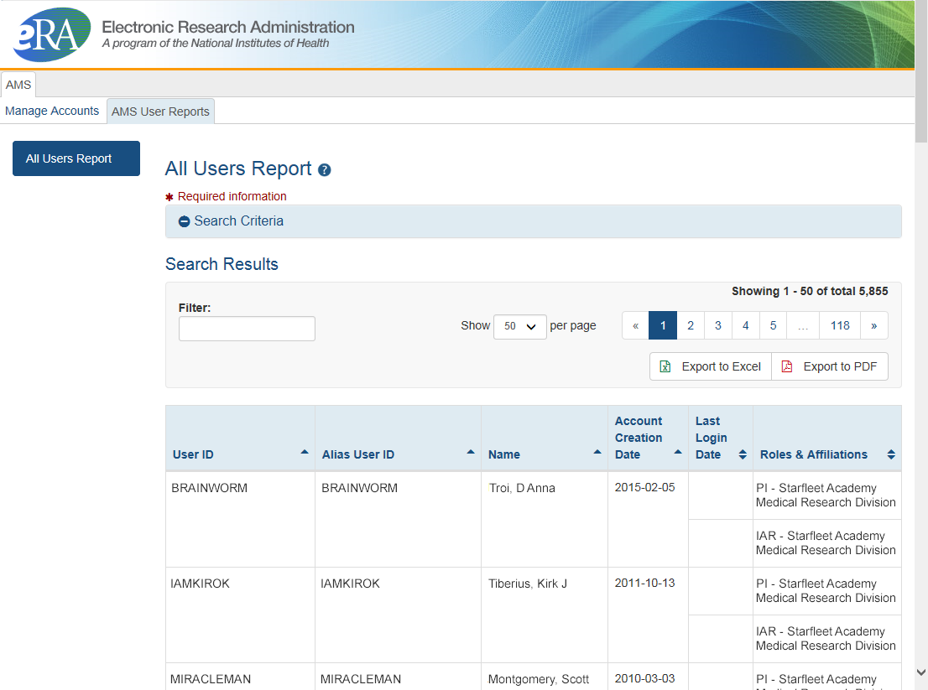
Account Management – Search Results
View and export options
Scarlett

Slide 32

Account - Tips
Designate more than one Signing Official
  Certain Commons actions can only be taken by users with the SO role and you will want a back-up
Administrators should always check to see if a user already has a Commons account before creating a new account with a scientific role
  Ask the person if they already have an account, or search within the Commons
    If a user already has an account with a different organization,
    the SO should affiliate the existing account with the user’s
    new organization

Slide 33
Account Passwords
Password policy:
  http://era.nih.gov/files/NIH_eRA_Password_Policy.pdf
  Passwords must:
  Contain at least eight (8) characters: no more than 16; no blank spaces
  Contain a combination of at least 3 of the following:
    Upper case letters
    Lower case letters
    Numbers, not at beginning or end of the password
    Special characters: ! # $ % - _ = + < >
    The following special characters are NOT allowed: @ ^ & ( ) | " \ ' { } [ ] : ; ` ? , . /
    Not contain username
  Not be reused within eight (8) years, 24 password cycles
  Be changed every 120 days

Slide 34
eRA Commons Roles
The functions that a user can perform in the Commons are based on the role(s) assigned to his or her Commons account
Full, printable list of eRA Commons roles:
  http://era.nih.gov/files/eRA_Commons_Roles.pdf
  Updated 08/2018!

Slide 35

Roles
IAR
PI
AA
FSR
SO
AO
Administrative
  AA – Account Administrator
  AO – Administrative Official
  ASST – Assistant
  BO – Business Official
  SO – Signing Official
  ASSIST Access Maintainer Role
Scientific
  Graduate Student
  IAR – Internet Assisted Review
  PI - Principal Investigator
  Post-Doc
  Project Personnel
  Scientist
  Sponsor
  Trainee
  Undergraduate
Other
  FCOI (Financial Conflict of Interest)
  FCOI_ASST
  FCOI_VIEW
  FSR (Financial Status Reporter)
  PACR (Public Access Compliance Reporting)
  OLAW (Reporting Animal Welfare)
NEWEST!
Permits user to manage access to all ASSIST applications in their institution.

Slide 36
Role - Tips
Can’t combine scientific roles with administrative or other roles on the same account
  Other combinations are fine (e.g., PI and IAR; AO and FSR)
  A person needing both scientific and administrative roles should have two separate accounts (one for scientific roles and another for other roles)

Slide 37
Resources
Four Tutorial Videos on Registration and Account Creation
  Institutional Registration: How to Register an Institution (Updated 04/09/2018)
  How Signing Officials (SOs) Create Accounts
  How Trainees Get Accounts
  Access all the eRA Videos at:
  http://era.nih.gov/era_training/era_videos.cfm

Slide 38
eRA Commons
Account Administration
Delegations

Slide 39

Delegations
Progress Report
Sponsor
Status
Personal Profile
Submit
xTrain
eRA Commons allows users to give other users permission to do specific actions on their behalf

Slide 40
Delegations Chart
Type (Name) | By | To | What it does
Progress Report | SO, AA, AO | PI on behalf of a PI | Enables the delegated PI to work on progress reports of another PI – includes Interim and Final RPPR, and HSS requests
Progress Report | PI | User within Institution with ASST or AO role | Enables the authorized user to work on progress reports for the PI – includes Interim and Final RPPR, and HSS requests
Sponsor | SO, AA (on behalf of Sponsor) | ASST | Allows the ASST to access the xTrain module
Status | PI | ASST | Allows the ASST to work with the Status module
PPF | All Users | User within Institution | Enables another user to edit someone else's personal profile
Submit | SO | PI | Enables the PI to submit RPPR and MYPR reports – now needed for PI if they are to submit Interim RPPR, Final RPPR, and HSS Data
xTrain | PI, Sponsor | ASST | Enables the ASST to work with the xTrain module and xTRACT

Slide 41
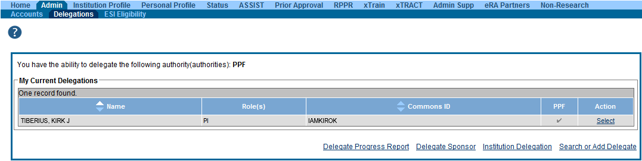
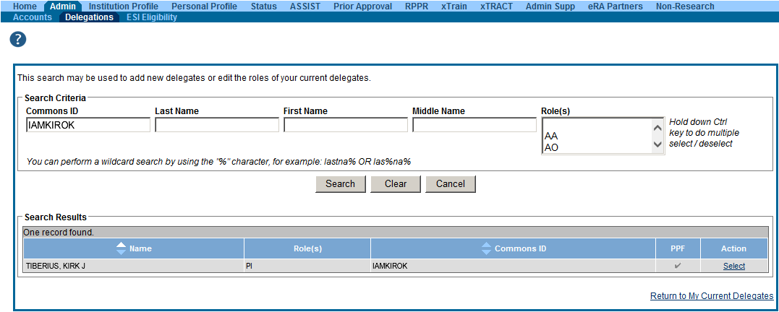
Delegation (SO)

Slide 42
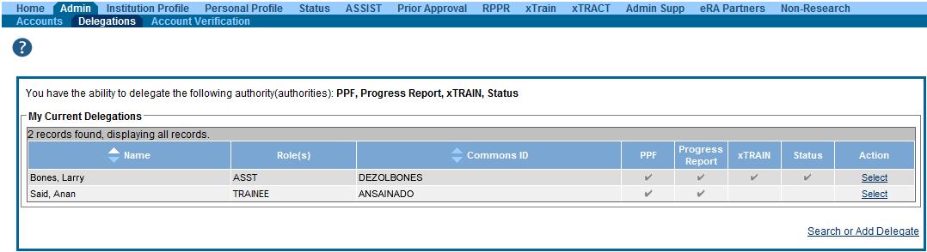
Delegation Menu (PI)

Slide 43
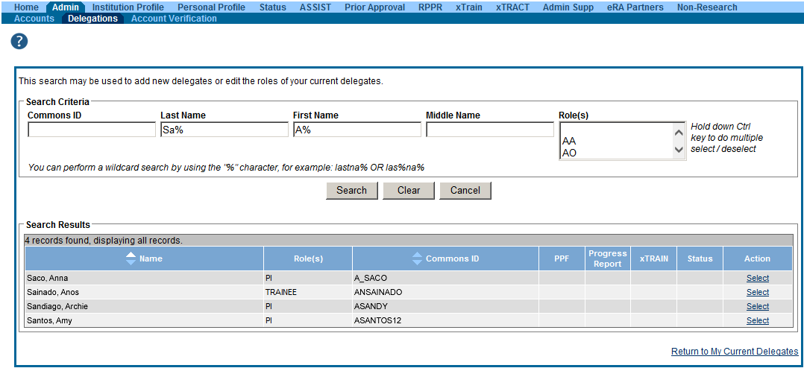
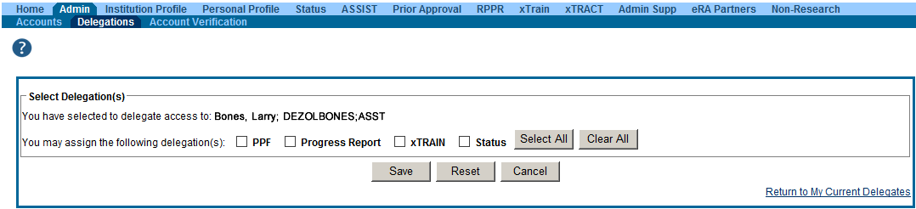
Delegation Selection (PI)

Slide 44
eRA Commons
Profiles
Institutional Profiles (Ipf)
&
Personal Profiles (PPF)

Slide 45

Institutional Profile File (IPF)
Each organization establishes and maintains their organization’s profile data
Depending on their role, users can view and/or update Institution Profile information
  Only SOs can edit IPF information
  IPF displayed as a read-only page for users with all other Commons roles
  Includes two sections: Basic and Assurances & Certifications
Central repository for registered organization information
Terminology Check:
‘Organization’ = ‘Institution’ = ‘Entity’

Slide 46
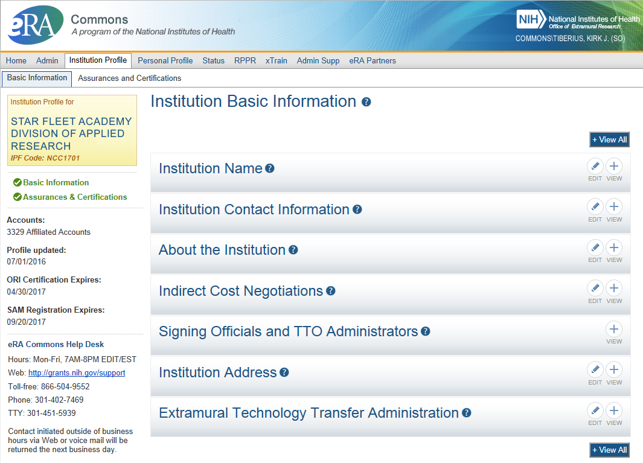
IPF - Basic
Basic: general information about the institution
  Name, address, Institution Contact information, list of Signing Officials, etc.
Only SOs can edit Institution Profile
SAM Registration Expiration

Slide 47
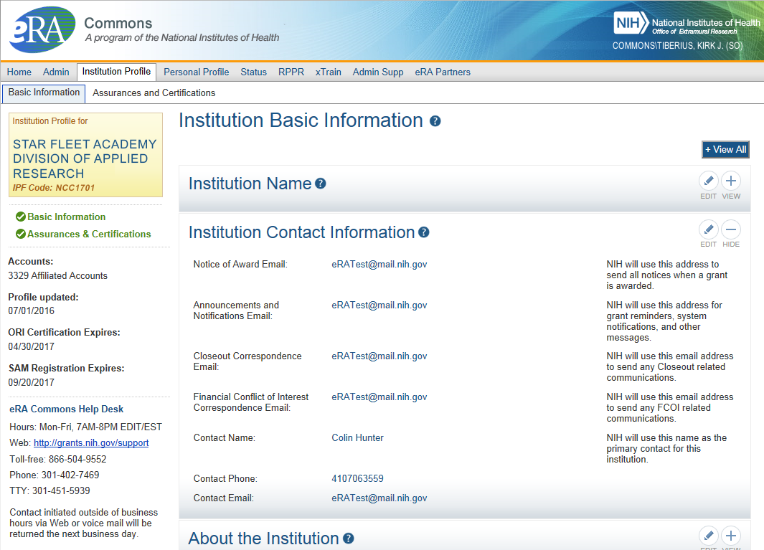
IPF – Institution Contacts
Newer
Contact
Fields:
Closeout Correspondence
FCOI Correspondence

Slide 48
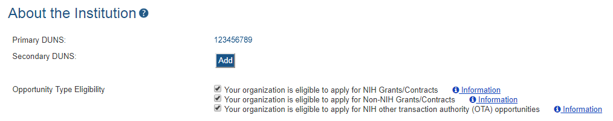

IPF – DUNS
“”
Changes to Institution Basic Information Section
New fields coming soon…
  To support Other Transaction Authority funding opportunities
  To summarize your institution’s eligibility to submit to the different types of opportunities

Slide 49
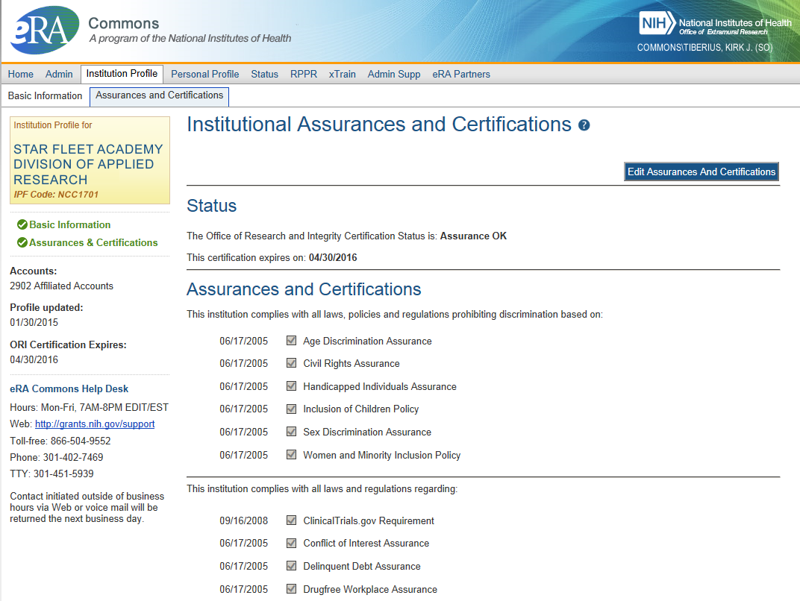
IPF – Assurances and Certifications
Assurances and Certifications: data elements that comprise assurance/certification information about an institution
  List of certifications
  (e.g., Financial Conflict of
  Interest, Human Subjects
  Research, Vertebrate
  Animals, etc.)

Slide 50
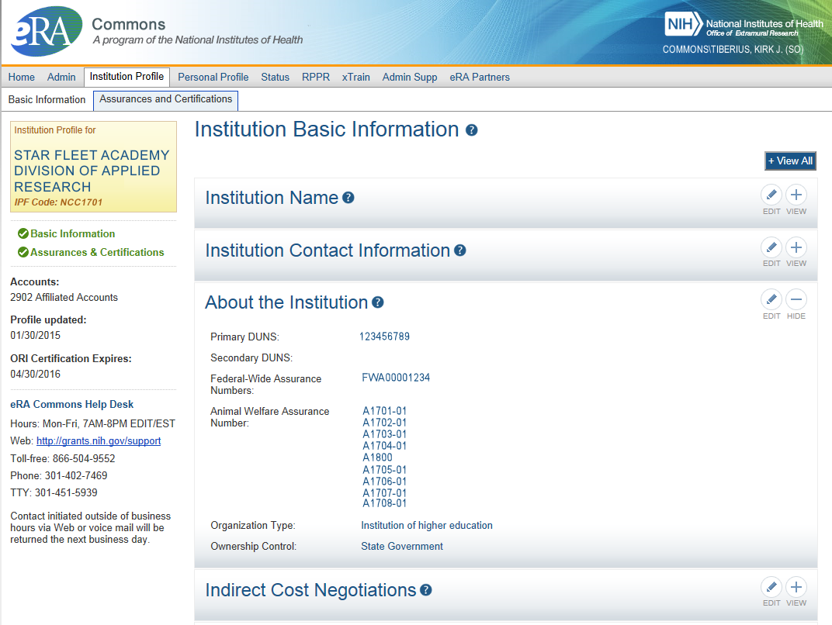
IPF – OLAW
Integration with Office of Laboratory Animal Welfare’s (OLAW) Animal Assurance Number
  IPF will pull OLAW’s
  Animal Assurance Number
  Under the About the
  Institution tile
  Will also update:
    Animal Subject Code
    IACUC Date
  New # Format
  Can not be edited via IPF

Slide 51
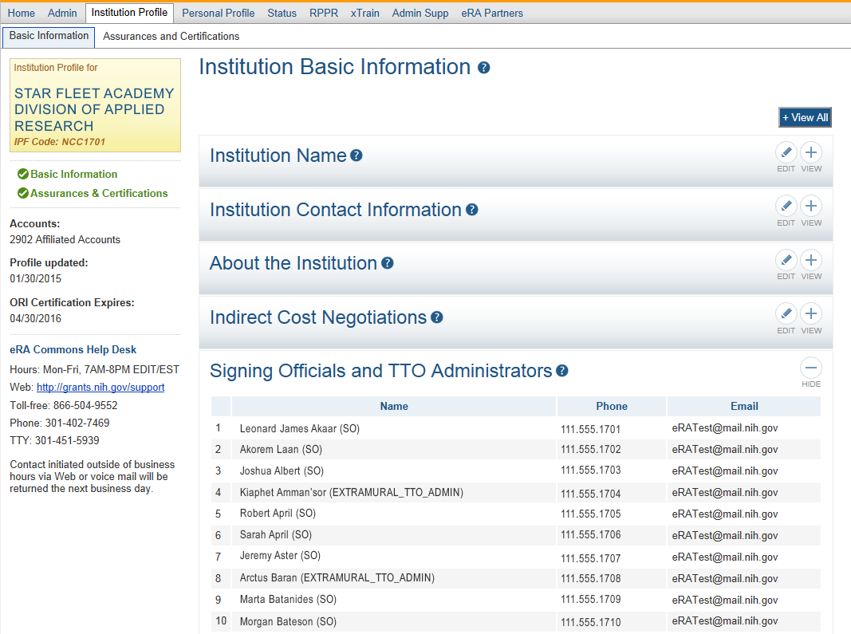
IPF Sections
Signing
Officials
&
Technology Transfer Officers
(TTO)

Slide 52



Personal Profile (PPF)
Individual Commons users are responsible for keeping their profile information accurate
Includes information such as:
  Name
  Demographics (important for Trainees)
  Employment history (important for COI)
  Education (important for NSI & ESI)
  Reference Letters
  Publications
Very few staff members at NIH have access to change information (for emergencies only)
Central repository for individual user information

Slide 53
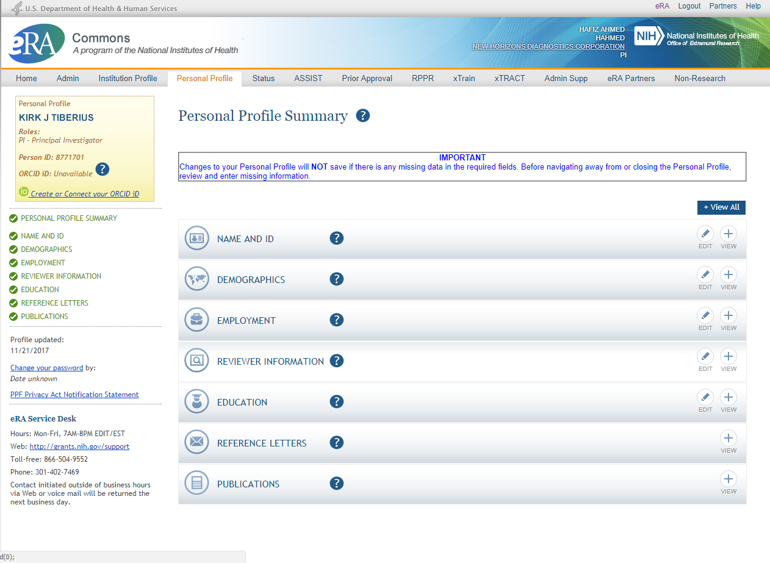
Personal Profile

Slide 54
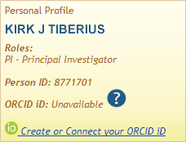
New on the Personal Profile
ORCID ID (Open Researcher and Contributor ID)
a personal digital identifier that distinguishes every researcher
a new link to access ORCID.org added to the Personal Profile.
Allows principal investigators to create an ORCID ID to link to their Commons account, so that their publications can be linked to their grants.

Slide 55

Personal Profile Information is used to…
Verify information submitted in grant applications
Send you agency notifications
Complete aggregate reporting
Determine eligibility for Early Stage Investigator (ESI) and Early Established Investigator (EEI) status
Determine a reviewer’s eligibility for the Continuous Submission application submission policy

Slide 56

Terminology Check
New Investigator
  A PD/PI who has not previously competed successfully as a PD/PI for a substantial independent research award.
    See: http://grants.nih.gov/grants/new_investigators/index.htm
Early Stage Investigator (ESI)
  An individual who has completed their terminal research degree or end of post-graduate clinical training, whichever date is later, within the past 10 years and who has not previously competed successfully as PD/PI for a substantial NIH independent research award.
Early Established Investigator (EEI)
  An individual who is within 10 years of receiving their first substantial, independent competing NIH R01 equivalent research award as an ESI.
    See: https://grants.nih.gov/policy/early-investigators/index.htm
Continuous Submission
  As a way of recognizing their service to NIH, reviewers with substantial review service are permitted to submit their research grant applications (R01, R21, or R34) on a continuous basis and to have those applications undergo initial peer review in a timely manner.
    See: http://grants.nih.gov/grants/peer/continuous_submission.htm

Slide 57

PPF- Tips
Each year, on the anniversary of the date the account was created, you will receive a reminder email to make sure your profile is up-to-date and accurate.
When you change your password, you will be automatically redirected to the Personal Profile tab—take a moment to review and update your information
Be especially diligent about keeping your email addresses current
  Email addresses are used to retrieve forgotten passwords and for communicating grants-related information

Slide 58
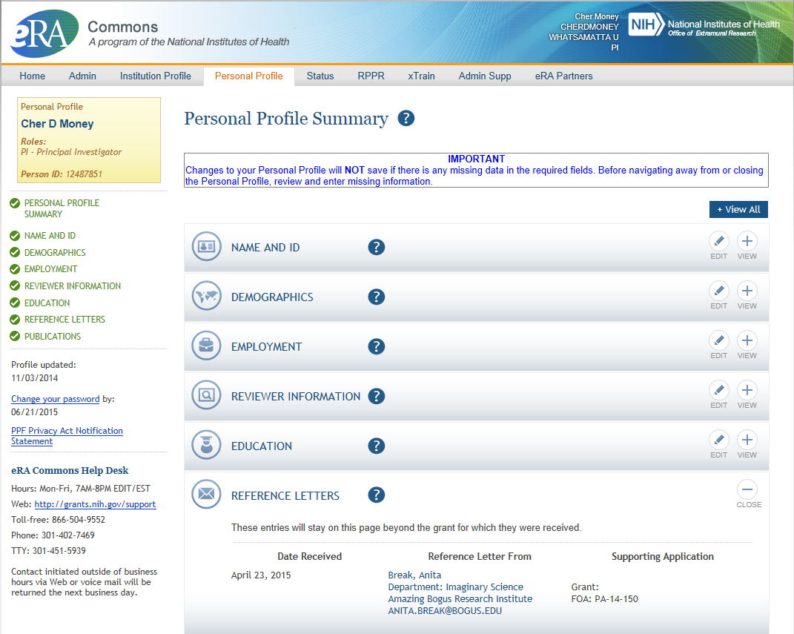
PPF – Reference Letters
Tracking Reference letters
  Shown in Profile
  Can see:
    When it was submitted
    Who submitted it
    What grant it is linked to
  Cannot see the actual
  letter

Slide 59
Key eRA Commons
Features
Prior approval requests
Via
erA Commons

Slide 60
Prior Approval
eRA now supports four activities for Prior Approval Requests.
  Request for No Cost Extension (NCE)
  Request for withdrawal of an application
  Carryover
  Request for Change of PD/PI
Prior Approval is the process in which an applicant or grantee must have written approval by an authorized official to undertake a certain activity.

Slide 61
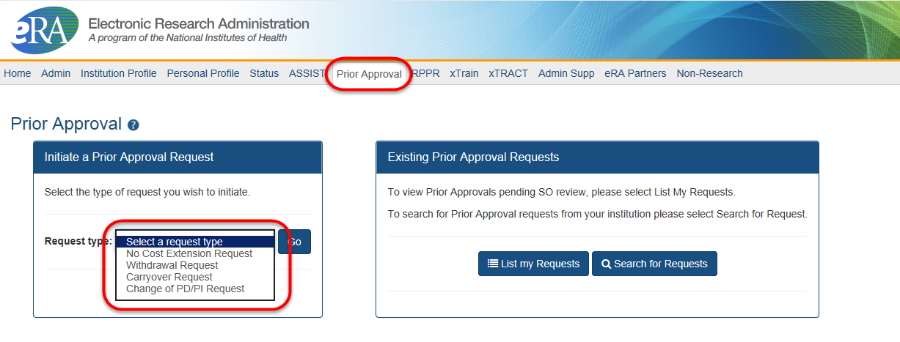
Prior Approval Tab
New navigation tab, Prior Approval
Select the type of request and click Go
List my Requests will display all Prior Approval requests pending Signing Official submission
Search for Request will allow a Signing Official to search for all Prior Approval requests.

Slide 62
Prior Approval – NCE
No-Cost Extension (NCE)
  An extension of time to a project period and/or budget period to complete the work of the grant under that period, without additional Federal funds or competition

Slide 63
Prior Approval – No Cost Extension: When?
When is a grant eligible for a NCE through Prior Approval?
  When you have already used a NCE under expanded authority and you are within 90 days of the project end date.
  When you are not under expanded authority and you are within 90 days of the project end date.
  When the project end date has expired and has not been closed or has not entered unilateral closeout, whichever comes first.

Slide 64
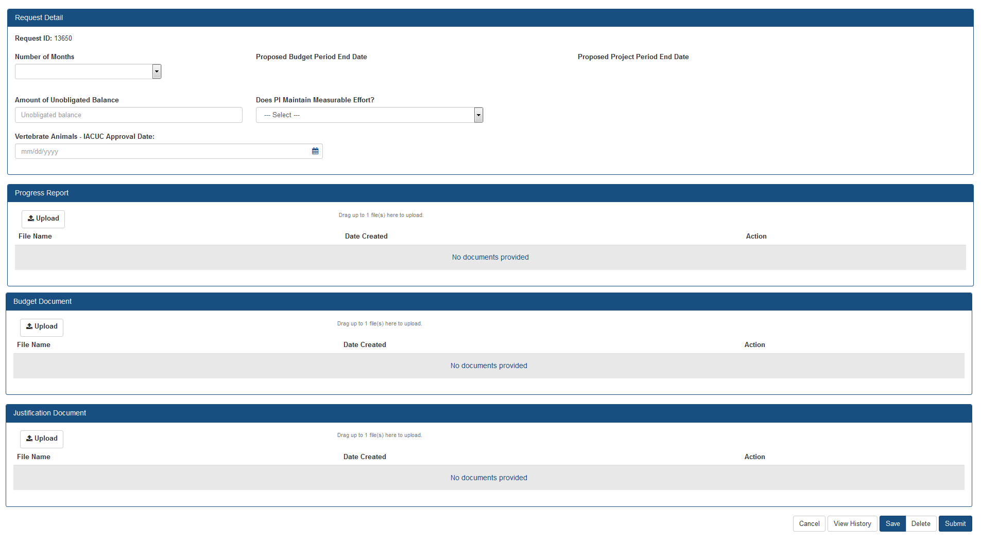
Prior Approval – No Cost Extension Screen
Select number of months, system will calculate proposed end dates.
Only PDF files may be uploaded.
One per each field, not exceeding 5MB.
For more information regarding the desired content of these fields, please contact you Grants Management Specialist.

Slide 65
Prior Approval – Withdrawal
An application that has been removed for consideration of award by the Signing Official/Authorized Organization Representative.
  Initiation of a Withdrawal Request can be done by either the Principal Investigator (PI) or Signing Official (SO)
  Screen supports justification (required) and supporting documents (max 10)
  Only the Signing Official can submit the request
  Signing Officials can search for requests for their institution
  Automatic notifications to the SO and PI upon approval

Slide 66
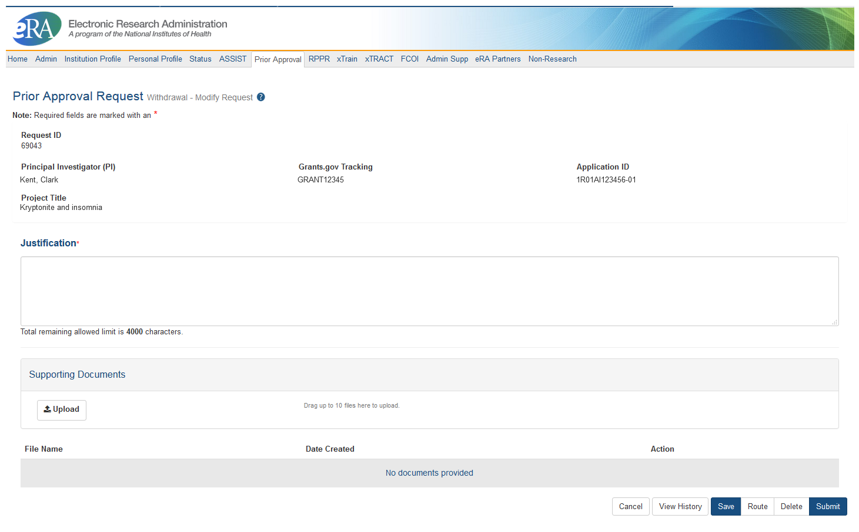
Prior Approval – Withdrawal Request

Slide 67
Prior Approval – Change of PD/PI
Request for an Institution to change the Program Director (PD) or Principal Investigator (PI) on an award.
  Only a Signing Official (SO) can initiate and submit this type of request.
  Request can only be made for a grant year that is currently awarded and in the budget period.
  Biosketch and Other Support documents (PDFs only) are required with the submission when adding a new PD/PI.
  1 PDF for each document requested, each not exceed 5 MB in size

Slide 68
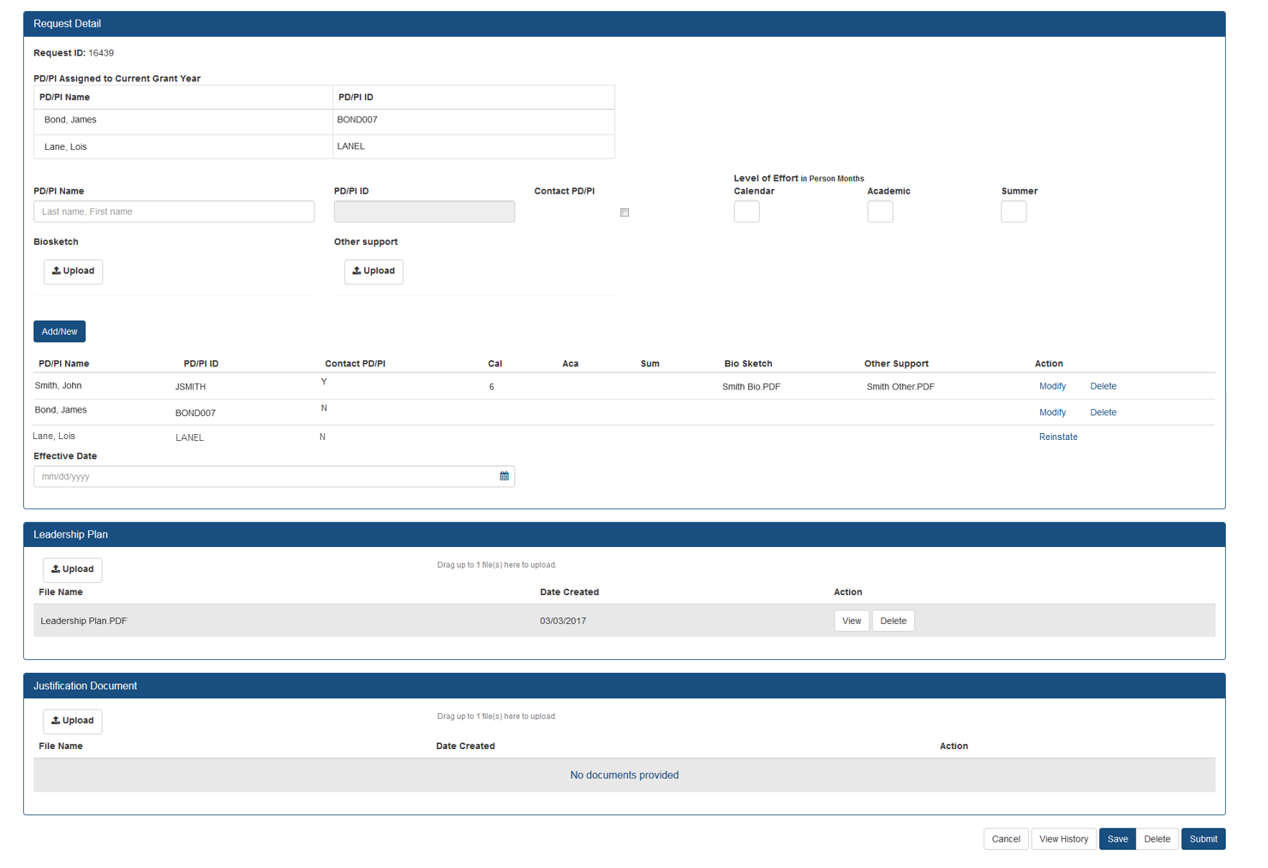
Prior Approval – Change of PD/PI
Screen
The current Principal Investigator(s) (PD/PI) will be displayed.
Select Modify to upload documents, update contact PD/PI Flag and provide level of effort.
You may choose to remove a PD/PI from the grant.
“”
If a PD/PI is on the current grant year and is accidently flagged for removal, you may reinstate them.
Leadership Plan PDF is required if the request will result in a multi-PD/PI grant.

Slide 69
Prior Approval – Carryover
Request for an Institution to Carryover funds for a grant without expanded authority.
  Only a Signing Official (SO) can initiate and submit this type of request.
  Request can only be made for a grant year that is currently awarded and in the budget period.
  SO must provide the unobligated funds to be carried over.
  Explanation of unobligated funds, Budget Justification and Scientific Justification must be submitted in PDF format, each not exceed 5 MB in size.
  If the grant is in the last year, and the project period end date has passed, the grantee will need to request a No Cost Extension to submit a Carryover request.

Slide 70
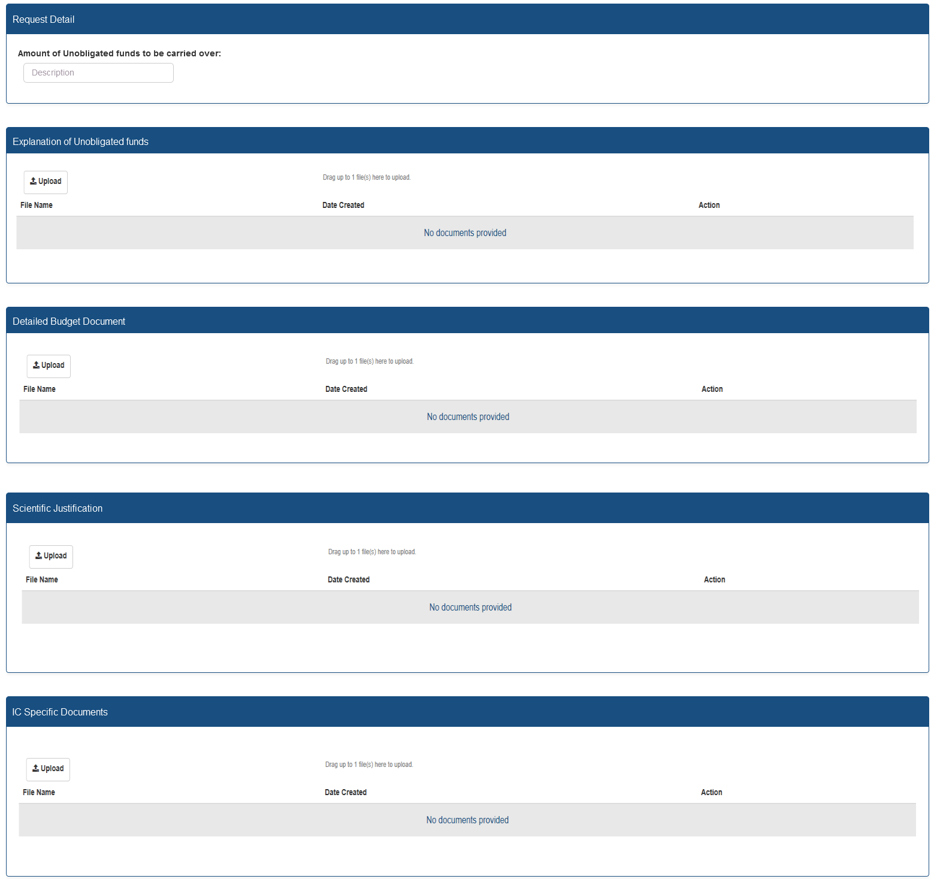
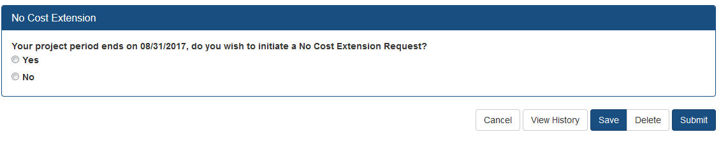
Prior Approval – Carryover Screen
Enter unobligated funds to be carried over
Only PDF files may be uploaded.
One per each field, not exceeding 5MB.
For more information regarding the desired content of these fields, please contact you Grants Management Specialist.
If the grant is eligible for a No Cost Extension, the user will have the option to initiate a No Cost Extension.

Slide 71

Prior Approval – Resources
NIH eRA Items of Interest Articles
  https://era.nih.gov/news_and_events/era_item_February_2017.htm
Video Tutorials
  Withdrawal of an Application
  Change of PD/PI
  No-Cost Extension
  Carryover
  https://era.nih.gov/era_training/era_videos.cfm

Slide 72
Key eRA Commons
Features
Submitting Just-in-time (JIT)
Information Upon NIH Request

Slide 73
Just-In-Time (JIT)
Applicants should never submit JIT info until specifically requested to do so by NIH. A JIT link or request from NIH are not indications that a grant award will be made.
  Other Support File, Budget Upload, Other Upload, Institutional Review Board (IRB) Date, Human Subject Education
  PD/PI can save info in Commons, but only SO can submit JIT info to NIH
  Must be PDF format
Allows an applicant organization to submit additional grant application information after the completion of the peer review, and prior to funding.

Slide 74
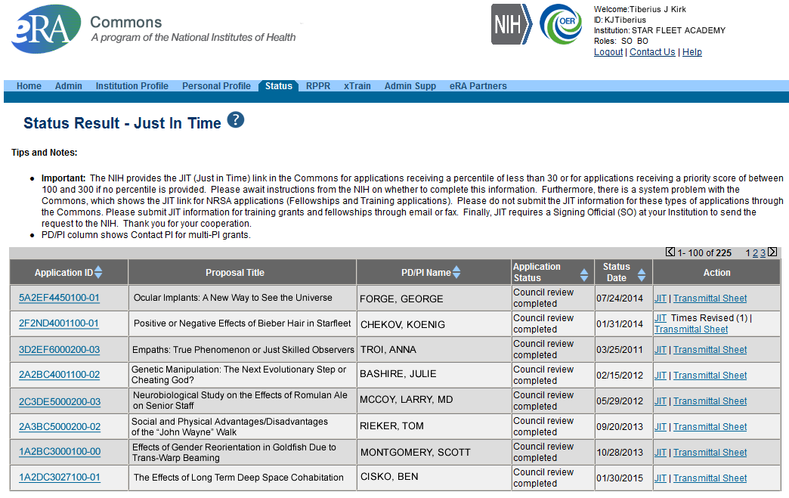
JIT Link on Status Result Screen (SO View)
Select JIT link

Slide 75
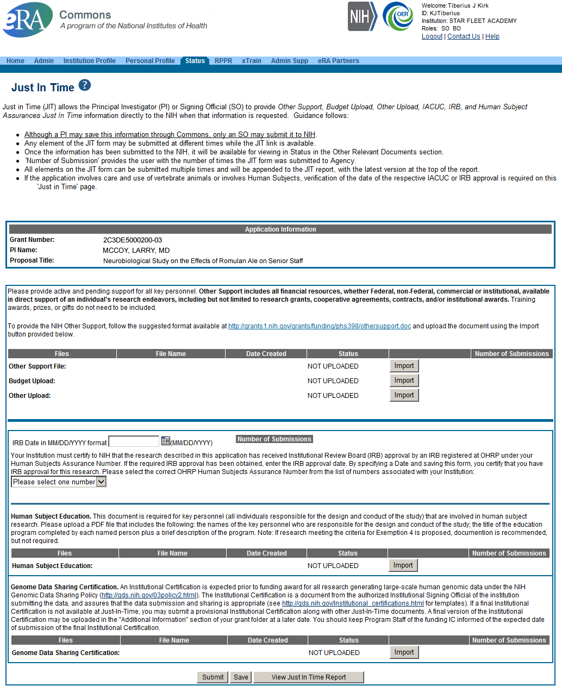
Just-In-Time (SO View)
PDF document with Other Support documentation is required. Use the Import button to begin the upload.
IRB Approval Date should be within the last 12 months.

Slide 76
Key eRA Commons
Features
Submitting a No Cost Extension (NCE)
Via Status Screen

Slide 77
NCE
Only SOs can submit the NCE notification
May be submitted no earlier than 90 days before end of project and no later than project end date
Can request extension of 1-12 months, in one-month increments
E-mail notification sent to NIH Grants Management staff when SO processes the extension
Electronically submit a notification to exercise one-time authority to extend without funds the final budget period of a project period of a grant.

Slide 78

Extension link in Status screen

Slide 79
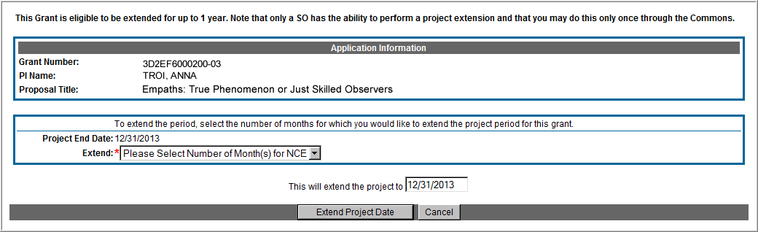
Extension Screen
Choose an extension of 1 to 12 months.
New calculated project end date

Slide 80
Expanded Authority – You Get Just One
No Cost Extension (NCE) part of ‘expanded authorities’
Can only extend once without express approval
Increasing trend of extending in the middle of the project period (i.e. end of year 2 of 5 year grant)
  If this is done, the Extension link will NOT appear 90 days from end of project end-date
  If in need of an NCE, submit Prior Approval NCE request
See June’s 2015 eRA Items of Interest for more:
  https://era.nih.gov/news_and_events/era_item_June_2015.htm#expanded

Slide 81
Key eRA Commons
Features
Submitting Administrative Supplements
(Type 3s)
Using eRA Commons

Slide 82
Administrative Supplements
Requested additional costs must be within the scope of the peer reviewed and approved project
Streamlined eRA Commons process¹
  Commons pre-populates much of the data needed for request from awarded grant
A request for additional funds during a current project period to provide for an increase in costs due to unforeseen circumstances.
¹Available for single-project activity codes for which competing applications are submitted through Grants.gov.

Slide 83
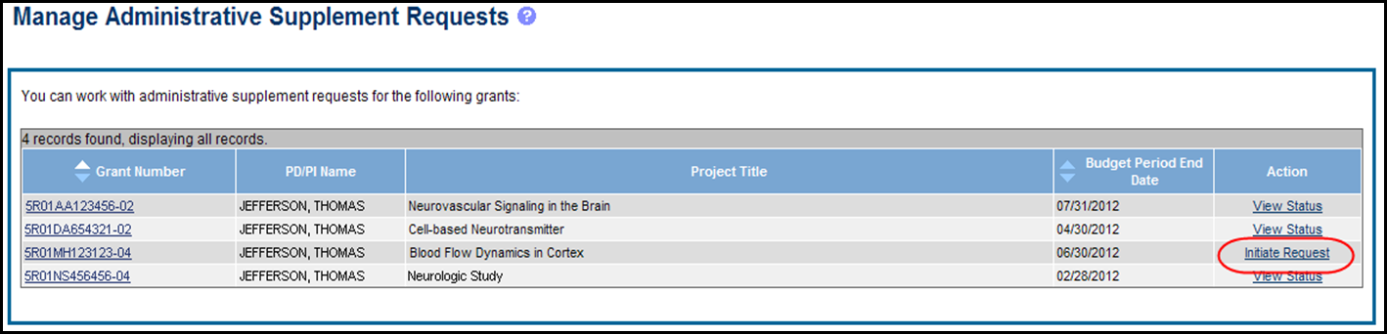
Admin. Supplement Requests – Initiate Request
Starting an Administrative Supplement request in Commons you must find eligible grant and Initiate Request

Slide 84
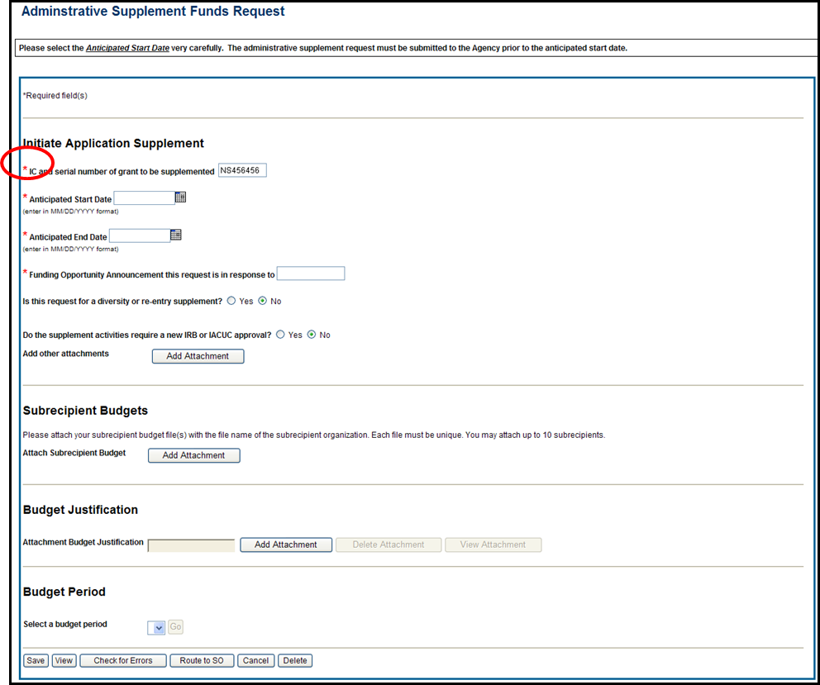
Admin. Supplement Requests – Required Fields
Complete Form – Required Fields are indicated with red asterisk

Slide 85
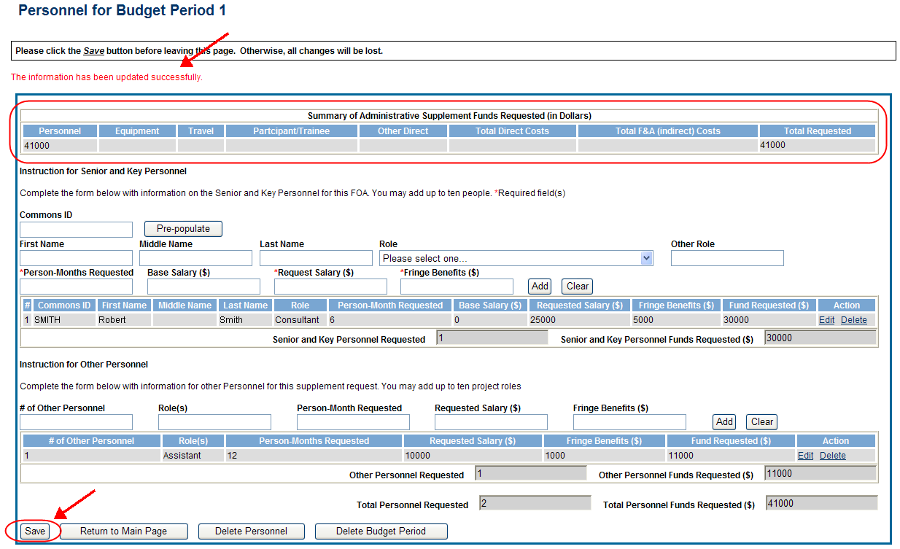
Admin. Supplement Requests – Budget Period
For each Budget Period enter appropriate sections:
  Personnel, Equipment, Travel, Participant/Trainee, Other Direct, Total F&A (Indirect) Costs
Total Requested will be calculated automatically

Slide 86
Admin. Supplement Requests - Resources
Resources:
  eRA Commons Administrative Supplement Module User Guide
    http://era.nih.gov/files/eRA_Commons_Admin-Supp_UG.pdf
  Administrative Supplements (Type 3s) Frequently Asked Questions
    http://era.nih.gov/commons/faq_commons.cfm

Slide 87
Admin. Supplement Requests– Grants.gov
Parent Announcement page has general use FOAs
  http://grants.nih.gov/grants/guide/parent_announcements.htm#adminsupp
  NIH Institutes can also post FOAs for administrative supplements targeting specific programs
When completing package…
  Follow all FOA-specific instructions
  Carefully choose appropriate application package
  Use Revision as the Application Type (SF424 RR, item #8)
  Include IC and Serial number of awarded grant as the Federal Identifier (SF424 RR, item #4a)

Slide 88
Admin. Supplement Requests– Grants.gov con’t
Similar submission process as competing applications, except:
  Many of the NIH business rule validations for competing applications are not enforced
  Required forms may vary from competing applications for the same activity code
    Modular budget forms not an option; must use detailed R&R Budget forms
    No cover letters
  After the two-day viewing window the request bypasses Receipt & Referral and goes directly to Grants Management staff for consideration
    Move to Admin Supp Status tab in Commons

Slide 89
Key eRA Commons
Features
Research Performance
Progress Report (RPPR)

Slide 90

RPPR
Describes scientific progress, identify significant changes, report on personnel, and describe plans for the subsequent budget period or year.
  http://grants.nih.gov/grants/rppr/
Progress Report Additional Material (PRAM) functionality available for publication compliancy explanations and additional information requested by grants management staff.
Annual progress report to document grantee accomplishments and compliance with terms of award.
Hello, RPPR!

Slide 91
RPPR & Human Subjects System (HSS)
HSS is the electronic system to manage human subjects and clinical trials information.
Allows principal investigators and signing officials to access and update all the human subjects and clinical trials data associated with their grants in one place.
  update participant information
  enrollment information
  inform NIH of ClinicalTrials.gov registration
  and revise other human subjects-related information as necessary, just-in-time for award or after a grant award is made.

Slide 92
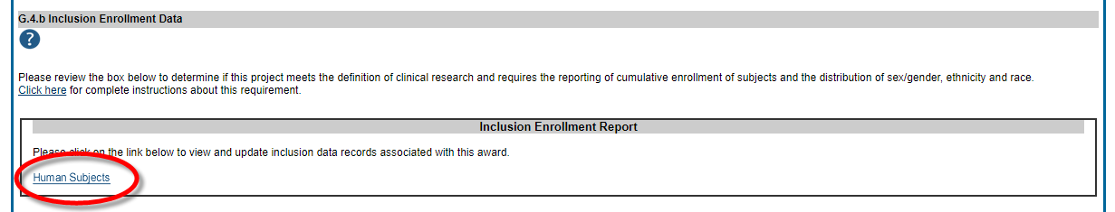
RPPR & Accessing HSS
The most common use of the Human Subjects System is for updates needed to the RPPR
You will find the Human Subjects link in Section G.4.b Inclusion Enrollment Data of the RPPR
The human subjects link is visible only for NIH applications and grants involving human subjects.

Slide 93

RPPR Menu Screen

Slide 94
RPPR Data Entry
Initiation of RPPR by
  Principal Investigator
  ASST with the RPPR Delegation
RPPR sections
  Cover Page
  Accomplishments
  Products
  Participants
  Impact
  Changes
  Special Reporting
  Budget (non-SNAP)
Watch for character limits in data entry fields
Ensure uploads are in PDF format
When completing data tables remember to click ‘Add/New’

Slide 95

Sample RPPR Screen

Slide 96
RPPR – Complex, Multi-Project
Submitting progress reports for complex, multi-project grants
  After RPPR is initiated, PI will need to identify if RPPR should contain components.
  RPPR should have the same structure as the originally submitted application.
  Some sections are not available on Overall component (i.e. Budget)
  Some sections are not available on component level (i.e. Participants and Publications are reported on Overall)

Slide 97

RPPR – Multi-Year RPPR
MYRPPR
  Multi Year Progress Reports now use RPPR format
  Link available under the Action Column in Status

Slide 98
Progress Report Additional Materials (PRAM)
The PRAM feature provides a means for the grantee to enter, review, route, and submit information to agency following the submission of an RPPR.
  Public Access (PA) PRAM - Generated automatically after an RPPR is submitted with publications that are not compliant with Public Access Policy
  IC (Agency) Requested PRAM – Only available if requested by the Grants Management Specialist (GMS)
PD/PI can enter the PRAM, but can only submit it if they are delegated with Submit Progress Report authority. Otherwise, only the SO can submit the PRAM to Agency.

Slide 99


Progress Report Additional Materials (PRAM) Link

Slide 100
Format for PA PRAM
Public Access (PA) PRAM will require an attachment.
  The PA PRAM will no longer contain a free form text box.
  Using My NCBI the institution will need to generate a PDF of their reported publications showing their compliance.
  For instructions on generating the report please see:
    http://www.nlm.nih.gov/pubs/techbull/nd12/nd12_myncbi_pdf.html

Slide 101
RPPR – Budgets
Submitting progress reports with budgets
  R&R budget and PHS 398 budgets are now available for Non-SNAP RPPR.
  If presented with an option of budget forms, the type that was submitted with the application should be used.
    PHS 398 Budget is available only on training grants.
  Help for R&R Budget and PHS 398 Budget forms can be found in the SF424 R&R User Guides.

Slide 102
Feature RPPR Publications
When selecting/deselecting publications for RPPR submissions
  Users will see a gold lock icon next to those publications added to their grant into NIHMS.
  Users see a silver lock icon for publications that have been reported on a previous RPPR.
  Neither can be removed on the RPPR, both need manual intervention.
  To delete a publication with a gold lock, users will need to contact the NIHMS help desk through their web form, which is accessible at http://www.nihms.nih.gov/.
  To delete a publication with a silver lock please contact the PublicAccess@nih.gov

Slide 103
Key eRA Commons
Features
Wrapping up the ‘Paperwork’ with Closeout
Scarlett

Slide 104
Closeout
Closeout items include:
  Final Research Performance Progress Report (FRPPR)
  Federal Financial Report (FFR)
  Final Invention Statement
NIH automatically marks the grant “ready for close out,” making the link appear in Commons when:
  The project period end date has passed, and
  No Typ2 application has been submitted
Electronically submit required Closeout documents for grants in Closeout status

Slide 105
Closeout Capabilities
Identify expiring and terminating grants
Request and track required closeout documents
Track submission of boxed archived paper grant records at the Federal Record Center (FRC)

Slide 106

New Closeout Search screen provides additional search criteria

Slide 107

Search screen shows grants that are Closed or Requires Closeout

Slide 108
New! Interim Research Performance Progress Report (IRPPR)
Effective February 9, 2017
  If the recipient organization has submitted a Competing Renewal application (Type 2) on or before the date by which a Final Research Performance Progress Report (Final-RPPR) would be required for the current competitive segment, then submission of an "Interim RPPR" via eRA Commons is now required.

Slide 109
IRPPR vs FRPPR
(Interim vs Final RPPR)
I-RPPR
  The Interim RPPR link will made available to the SO and the PI in the Status screen when a grant is eligible for submission of a Competing Renewal application.
  Only Section D.1 of Participants is required
  Sections F: Changes and Section H: Budget are not part of the Interim RPPR
  Section I: Outcomes is new. Section I is required for the Interim RPPR
F-RPPR
  The Final RPPR is only available as part of the Closeout process and the Process Final RPPR link only appears on the Closeout Status screen.
  Only Section D.1 of Participants is required
  Sections F: Changes and Section H: Budget are not part of the Final RPPR
  Section I: Outcomes is new. Section I is required for the Final RPPR

Slide 110
Interim RPPR Scenarios
Since a renewal application is competitive, there is no guarantee it will be funded. Therefor the following scenarios should be noted:
Completing Renewal Application Status | Action
Not submitting a Competing Renewal application | Submit a Final RPPR no later than 120 days from the project period end date
Submitting a Competing Renewal application | Submit an Interim RPPR no later than 120 days from the project period end date
 | Funded | Not Funded
 | The Interim RPPR is accepted as the annual RPPR | The Interim RPPR is accepted as the Final RPPR

Slide 111
Permissions for
F-RPPR and I-RPPR
  Interim and Final RPPR work in the same manner as the old Final Progress Report (FPR).
  Both SOs and PIs can initiate
  They can also route the report back and forth for review and edits. All of this done without the need to delegate any authority.
  If an ASST has been delegated Progress Report Authority they will be able to initiate, edit and route.
  SO may submit, PI will need Submit delegation to submit

Slide 112

RPPRs: Who Can Do What?

Slide 113

Selecting Interim RPPR
  Select Interim RPPR link from Status search results (SO view shown)

Slide 114


Initiate Interim RPPR
  Select Initiate from the Interim RPPR Menu screen
  Select Edit from the Interim RPPR Menu screen

Slide 115



Initiate Final Research Performance Progress Report (FRPPR)
The Final RPPR has the same permissions and delegations as the Final Progress Report (FPR). Both SOs and PIs can initiate or submit to agency.

Slide 116

I-RPPR and F-RPPR Sections
Similar navigation tabs as the annual RPPR.
A new section called Outcomes has been added.

Slide 117

Outcomes
Information in Outcomes will be publically available. It should be written as a high level and in plain language.

Slide 118
Closeout – Outcomes Requirements
A new section of the RPPR specifically designed to be made publicly available by the agency (analogous to the abstract in the competing application)
Reporting in the Outcomes section is limited (by the federal-wide RPPR format) to 8,000 characters
The Outcomes should provide a concise summary of the findings of the award written in lay language for the general public
In an effort to increase transparency NIH will make the Outcomes data available in RePORTER

Slide 119

Requesting/ Receiving Revised Project Outcomes
Requests for revised project outcomes for F-RPPR and I-RPPR will be made by the PO and submitted by the recipient using the applicable additional material functionality (FRAM or IRAM)
  Note: The full automation for the Additional Material functionality for the I-RPPR was implemented in mid-September
Both modules will be enhanced in order to capture revised project outcomes in a format that could be reported out to the public
Scarlett

Slide 120

Project Outcomes Resources
There has been some confusion as to what constitutes an effective Project Outcome.
Please see the following resources for more information
  Sample Project Outcomes Summary – RPPR
    https://grants.nih.gov/grants/rppr/sample_project_outcomes_RPPR.htm
Items of Interest, November 2017
  Technical Jargon? Not for Project Outcomes
    https://era.nih.gov/news_and_events/era-item-Nov2017.htm

Slide 121

Closeout – Final Report Additional Materials
(FRAM)
FRAM works in same manner as PRAM in RPPR
Awarding IC sets status to FRAM Requested
Awarding IC triggers email for requested information to the SO & PI
The FRAM Update link appears in Action column

Slide 122

Closeout – Final Report Additional Materials
(FRAM) in Other Relevant Documents
Specifics about the FRAM request can also be found in Other Relevant
Documents section of the Status Information screen.

Slide 123

Closeout – Interim Report Additional Materials
(IRAM) Link
IRAM works in same manner as PRAM in for RPPR
Awarding IC sets status to IRAM Requested
Awarding IC triggers email for requested information to the SO & PI
The IRAM Update link appears in Action column

Slide 124

Closeout – Interim Report Additional Materials
(IRAM) Screen
As with the RPPR, a PD/PI (or Contact PI, in the case of multiple PIs) can enter the IRAM. However, only the SO can submit an IRAM to the agency.

Slide 125
Federal Financial Report (FFR)
FFRs must be submitted in eRA Commons via the FFR/FSR module
  Cash transaction data still submitted via Payment Management System
FSR role for users who have the authority to view, enter data, and submit an FFR on behalf of institution
Allows grantees to electronically submit a statement of expenditures associated with their grant to NIH via eRA Commons.

Slide 126
FFR
Annual FFR due date: For non-SNAPs, FFR must be submitted within 120 days of the calendar quarter in which the budget period ends
Final FFR due date: based on the Project Period End Date (PPED):
  Pending Status: If the FFR is not submitted and it is within 120 days of the PPED
  Due Status: If the FFR is not submitted and it is between the PPED and 120 days past the PPED
  Late: If the FFR is not submitted and it is more than 120 days past the PPED

Slide 127

FFR/FSR Screen

Slide 128

FFR/FSR Link
The Grant Number is a hyperlink that will take you to the FFR/FSR form.

Slide 129
FFR Details Screen
Clicking the hyperlinked grant number opens the FFR Details screen, which displays:
  FFR Status:
    Received, Accepted, Rejected, In Review, or Revision Pending
  Available Actions:
    Accepted status: View or Create New
    Rejected status: View or Create New
    Received status: View or Correct
    Revision Pending status: View or Edit
    In Review status: View

Slide 130

Completing the FFR
As current year entries are completed, calculations are done automatically.

Slide 131

Submission of a FFR
Once FFR/FSR is Submitted, Latest FSR status changes to Received
If a mistake is made on the FFR and the status has changed to In Review, the institution should contact the eRA Service Desk to determine who the OFM staff is that is assigned by the NIH Institute/Center to resolve the issue.

Slide 132
FFR Related – Policy Notices
NOT-OD-14-103
  Revised Timeline for Administrative Changes to NIH Domestic Awards to Transition to Payment Management System Subaccounts
  http://grants.nih.gov/grants/guide/notice-files/NOT-OD-14-103.html
NOT-OD-14-093
  Administrative Changes to NIH Domestic Awards Transition to Payment Management System Subaccounts
  http://grants.nih.gov/grants/guide/notice-files/NOT-OD-14-093.html
NOT-OD-14-084
  NIH Updating Grant Closeout Policies and Procedures to Align with New HHS Requirements
  http://grants.nih.gov/grants/guide/notice-files/NOT-OD-14-084.html

Slide 133


Closeout – Final Invention Statement
If inventions are to be reported, the specific inventions must be listed.
Either the PI or the SO can start the process, but the SO must verify the report before submitting it to the agency.
If Yes is selected, Add Invention screen appears.

Slide 134


Closeout – Add Invention
Verify saved inventions.
Remove any that do not apply.
Add any that are missing.
Select Verify.
Select OK.

Slide 135

Closeout – Awaiting SO Verification
Status of Final Invention Statement is changed to Awaiting SO Verification. SO can now verify and submit.

Slide 136
Closeout – Policy Notices
Guide Notice NOT-OD-14-084
  NIH Updating Grant Closeout Policies and Procedures to Align with New HHS Requirements
  http://grants.nih.gov/grants/guide/notice-files/NOT-OD-12-152.html
Closeout FAQs
  http://grants.nih.gov/grants/closeout/faq_grants_closeout.htm

Slide 137
Key eRA Commons
Features
Reporting
Financial Conflict Of Interest
(FCOI)

Slide 138
FCOI
Initiate and prepare a FCOI report
Submit the report, any necessary supporting documents, and comments (optional) to the agency
Search and view previously submitted FCOI reports (those submitted via Commons only)
Edit or rescind submitted reports (rescinding involves agency involvement)
Access the history of actions
Initiate, prepare, and submit FCOI notification and supporting documents electronically to NIH

Slide 139
FCOI Account Administration
Signing Official at the institution can assign appropriate roles to Commons users to manage the FCOI process for the institution
  FCOI role
    Multiple people at the institution can have the FCOI role
    Only users with FCOI role can submit FCOI reports to the agency
  FCOI ASST role
    Allows user to help with data entry and completion of FCOI reports
  FCOI View-only role
    Allows user to see FCOI reports but cannot edit them

Slide 140
FCOI History
Integrated with NIH’s internal FCOI tracking system
Internal FCOI users can request additional information and rescind notifications
  Notification to institution made from internal FCOI system and also is reflected in Commons FCOI history

Slide 141

Initiating FCOI Notification
System provides Contact PD/PI name after initial save. Provides additional info to check that the correct grant # is entered.
System will pull the latest Support Year of the grant.

Slide 142

Search for Existing FCOI
Can search by FCOI #, Grant #, or Name of Investigator with Conflict. Provides list of awarded grants for this institution with previously created FCOI notifications.
Available actions
Links to FCOI History

Slide 143

FCOI Edit
Fields are pre-populated
Significant Financial Interest (SFI)
Conflict Management Plan
Key Elements of Management Plan
Other Supporting Documents

Slide 144
FCOI – What’s New?
Changes to the FCOI module made in April 2014
  The link to the FCOI report is now available 75 days prior to the report’s due date
  The FCOI report link is now available the day after the grantee activates a No Cost Extension (NCE)

Slide 145
Finding Help
Service Desks
On-line resources &Web sites

Slide 146
Help Desks
eRA Commons
Service Desk
Grants.gov Contact
Center
Web:
  https://grants.nih.gov/support/index.html
  Phone: 1-866-504-9552
Hours : Mon-Fri, 7a.m. to 8 p.m. ET
Toll-free: 1-800-518-4726
Hours : 24x7 (Except Federal Holidays)
Email : support@grants.gov
Help Resources: https://www.grants.gov/web/grants/support.html

Slide 147

Web Sites
eRA Commons:
  https://commons.era.nih.gov/commons/
Electronic Research Administration:
http://era.nih.gov/
How to Apply – Application Guide: http://grants.nih.gov/grants/how-to-apply-application-guide.htm
NIH About Grants:
http://grants.nih.gov/grants/oer.htm

Slide 148
Key eRA Commons
Features
Appendices for xTrain and xTRACT

Slide 149
Key eRA Commons
Features xTrain

Slide 150
What is xTrain?
xTrain is an application that allows program directors/principal investigators, university administrators, and trainees to electronically prepare and submit PHS 2271 Statement of Appointment Forms (2271) and PHS 416-7 Termination Notices (TN) associated with institutional research training grants, institutional career development awards, individual fellowships, and research education awards.
Agency staff also uses xTrain to review and process the appointments and termination notices that are submitted electronically.

Slide 151


Example Work Flow in xTrain
PD/PI or ASST completes and routes form to the Trainee for electronic signature.
PD/PI or ASST
TRAINEE
Trainee fills out required information and routes the form back to PD/PI
PD/PI reviews form and routes it to BO
Routing captures the user’s electronic signature.
BO routes form to Agency
BO
Agency

Slide 152

View Trainee Roster
Locate trainees to be appointed to the grant.
Available actions for the appointment.
Status hyperlink will take you to the routing history.

Slide 153

Appointment Form (2271)
Required by Training Grants (T) and Career Development Grants (K/R).
Initiated by PD/PI or ASST.
Must be electronically signed by the Trainee/ Appointee.
Prepopulates Trainee’s information, such as Prior NRSA Support and Address.
Submitted by PD/PI.
F grants do not use the 2271.
Address is populated from the Trainee’s PPF
Stipend level amounts are dictated by the Fiscal Year of the appointment.

Slide 154

Termination Form
The PD/PI, ASST, BO may initiate a TN at any time for a Training (T) grant.
The PD/PI, SPONSOR or BO may initiate a TN at any time for a Fellowship (F).
The PD/PI or ASST may initiate a TN at any time for a Career (K/R) grant.
The BO must submit the TN for T and F grants. PD/PI submits the TN for K/R grants.
A Business Official must be selected from the dropdown.
If a Trainee leaves the appointment early, modify the Termination Date.
Stipend may only be modified if the Termination Date is changed.

Slide 155
Key eRA Commons
Features xTRACT

Slide 156
What is xTRACT?
The Extramural Trainee Reporting And Career Tracking (xTRACT) system is a module in the eRA Commons that allows applicants, grantees, and assistants to create research training tables for NIH progress reports and institutional training grant applications.
Because xTRACT is integrated with eRA Commons, some training data will be prepopulated in the system, including trainee names, selected characteristics, institutions, grant numbers, and subsequent NIH and other HHS awards.
In addition, xTRACT allows institutions to create profiles for participating faculty that do not require access to eRA Commons, create institutional programs, and non-NIH funding sources; which can be retrieved for future use.

Slide 157

Prepare for a New Application
You may create Programs, define non-NIH Funding Sources, and update Person data that can be reused for other RTDs.
xTRACT also populates data based on a person’s grants, and personal profile.
Users may upload data, such as Participating Students, to xTRACT using tab-delimited files.
The PD/PI that initiated the RTD will be marked as Contact PI.

Slide 158

Prepare RTD for the RPPR
If you have previously created RTDs for this grant, xTRACT will prompt you to copy the previous RTD data.
The RPPR RTD requires the following data:
Participating Trainees.
Program Statistics.

Slide 159

RTD for RPPR
Once the RTD is finalized, the PDF containing the applicable training tables may be uploaded to the RPPR.
RPPR question B4 now has an additional PDF upload for K12, KL2, R90, RL9, T15, T32, T34, T35, T37, T90, TL1, KM1 activity codes.
Grantees should provide training tables to the second upload as applicable.
Other information should be provided to the first upload.

Slide 160
Notice of Transition to the xTRACT System for Preparing Research Training Data Tables
Notice Number: NOT-OD-18-133 (https://grants.nih.gov/grants/guide/notice-files/NOT-OD-18-133.html )
Beginning with RPPRs due on or after October 1, 2019 and applications submitted for due dates on or after January 25, 2020, NIH and AHRQ anticipate that they will mandate that required training data tables submitted with T32, TL1, T90/R90, and T15 applications and progress reports be created via the xTRACT system. System validations in Grants.gov and the RPPR module will check to ensure that tables were created via xTRACT, and applications and RPPRs that are not in compliance will be rejected.

Slide 161

Thank you

