Slide 1
NIH Regional Seminar Interacting Electronically with NIH: Post-Submission
October 2018
electronic Research Administration (eRA)
OER, OD, National Institutes of Health

Slide 2
Your Workshop Team
Scarlett Gibb
eRA Customer Relationship Manager, eRA Commons
Joe Schumaker
eRA Communications and Outreach

Slide 3
eRA Commons
What is era Commons?

Slide 4
What is eRA Commons?
The eRA Commons is an online interface where grant applicants, grantees and federal staff can access and share administrative information related to grant applications and awarded research grants.
Applications
eSubmission Errors/Warnings
Assurances
Assembled Application Image
Certifications
Review Assignment
Profile Data
Priority Score
Progress Reports
Summary Statement
Financial Reports
Notice of Award
Invention Reports
Training Tables
Post-award Correspondence
Training Appointment Actions
HSS Data/Integration
ORCID ID

Slide 5
eRA Commons Status Screen

Slide 6
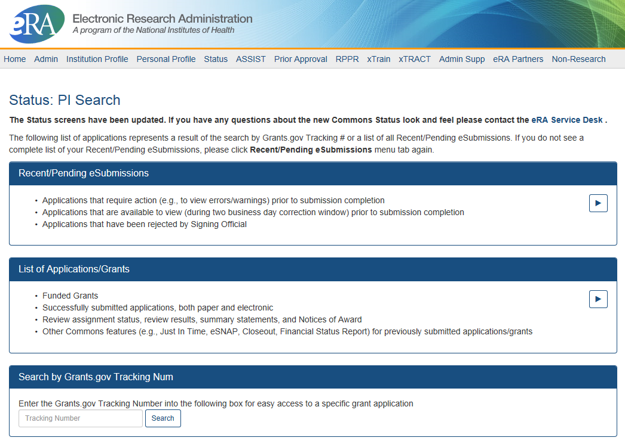
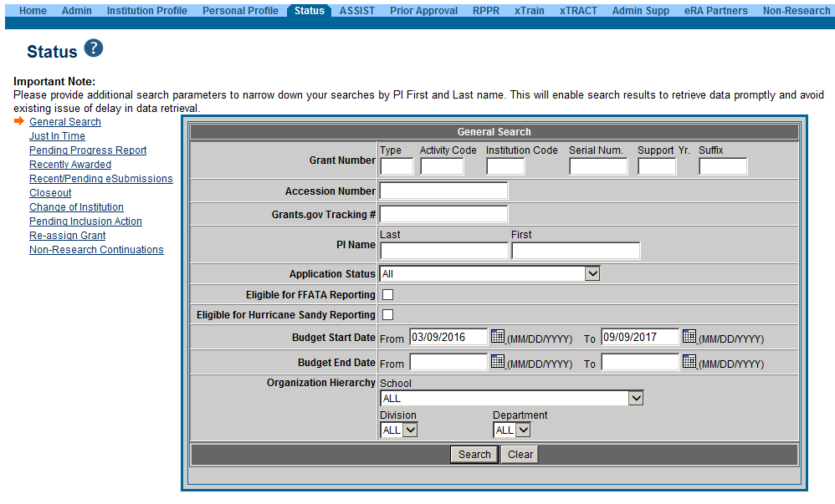
PI & SO Status Views
Principal Investigators can view their Recent/Pending eSubmissions or List of Applications/Grants.
Signing Officials can search/view all submissions for their institution.

Slide 7
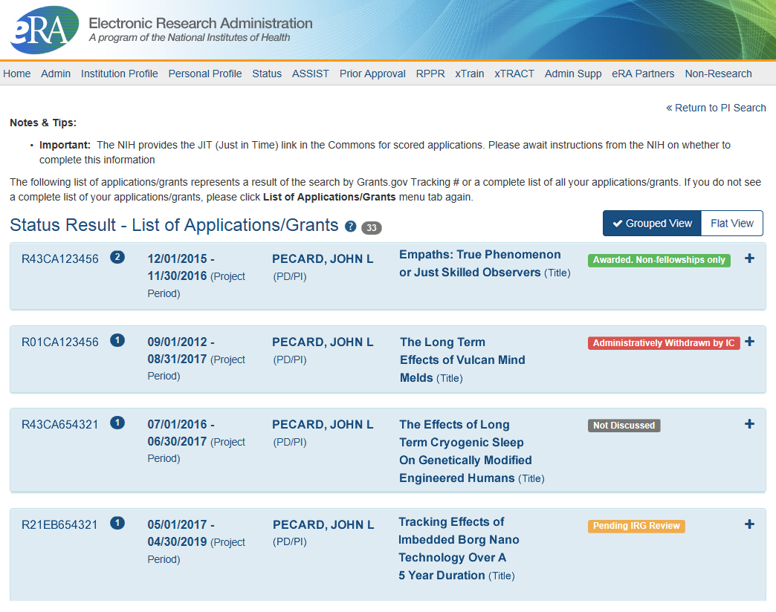
Status Result from General Search for PI
Click anywhere in the blue to get to more information, then select the Application ID link to view detailed status information for that particular application.

Slide 8
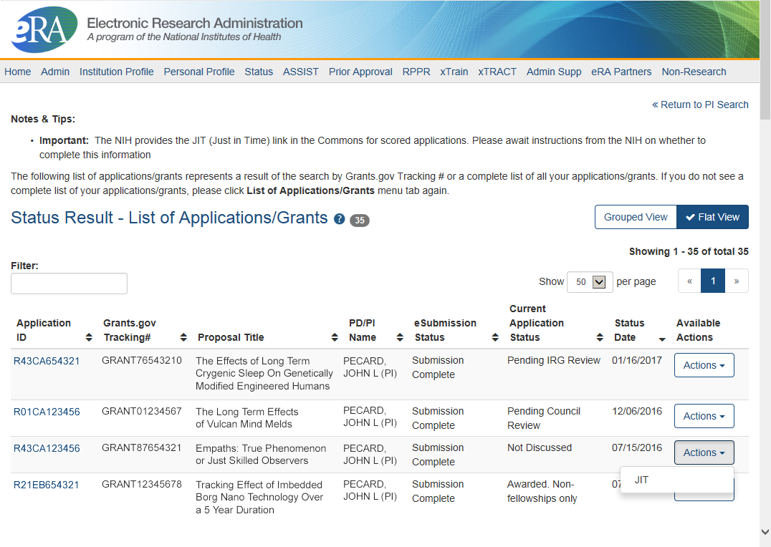
Status Result from General Search for PI (flat view)
Flat view is more similar to the old view

Slide 9
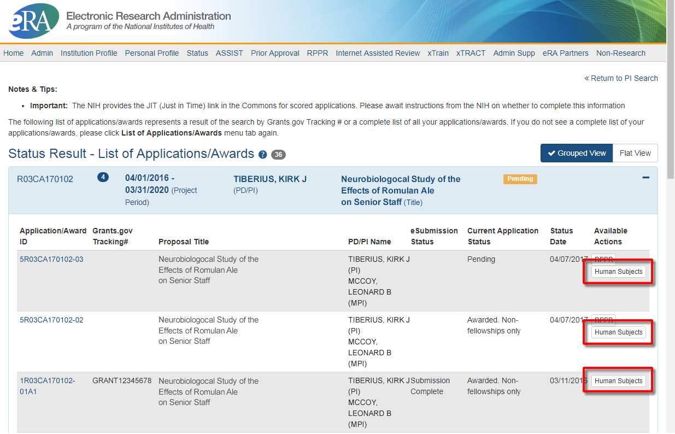
New Human Subjects Link in PI Status View
Principal Investigators can access Human Subjects System (HSS) via the Action button

Slide 10
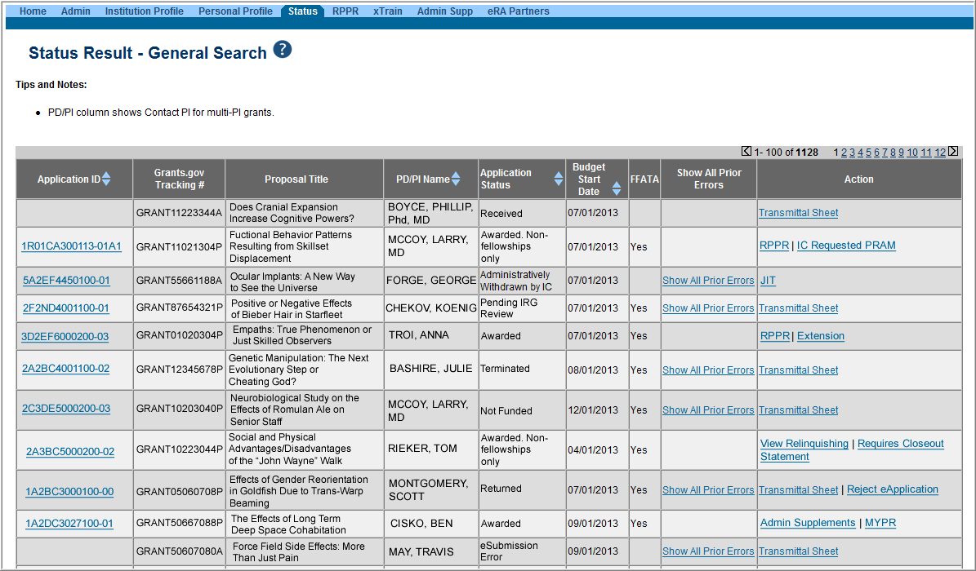
Status Result from General Search for SO
Select the Application ID link to view detailed status information for that particular application.

Slide 11
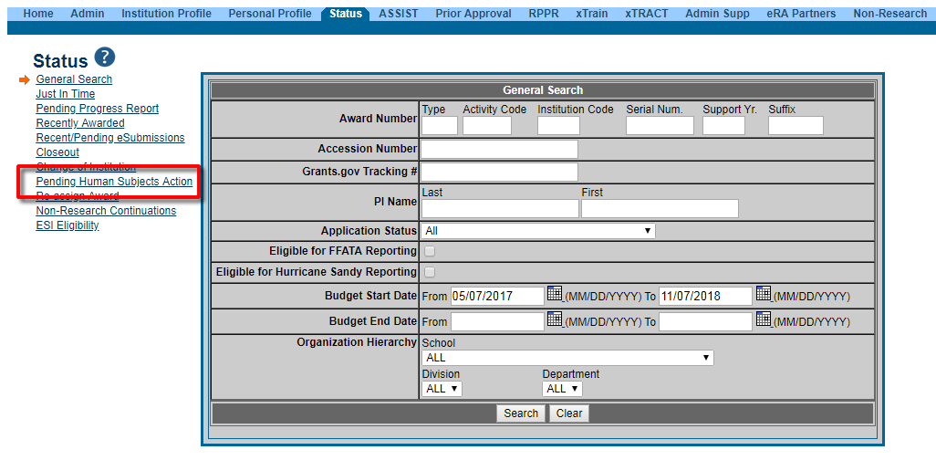
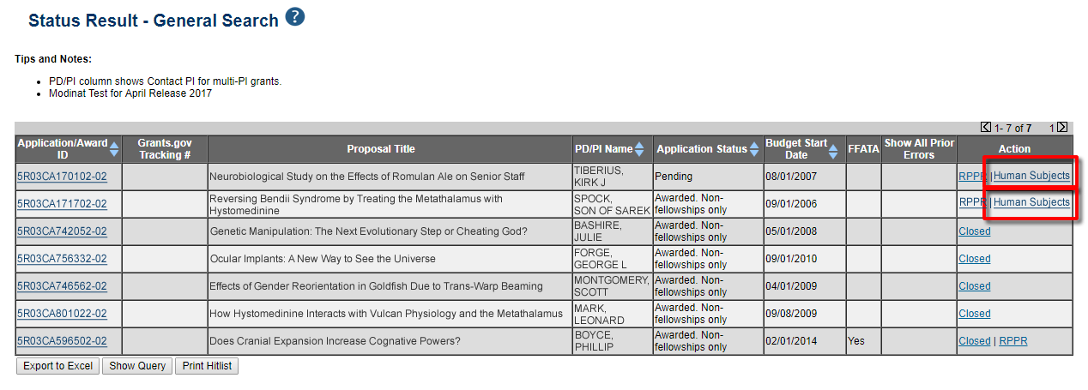
New Human Subjects Link in SO Status View
Signing Officials can search/view for Pending Human Subjects data, and will connect with HSS via link in the Action column.

Slide 12
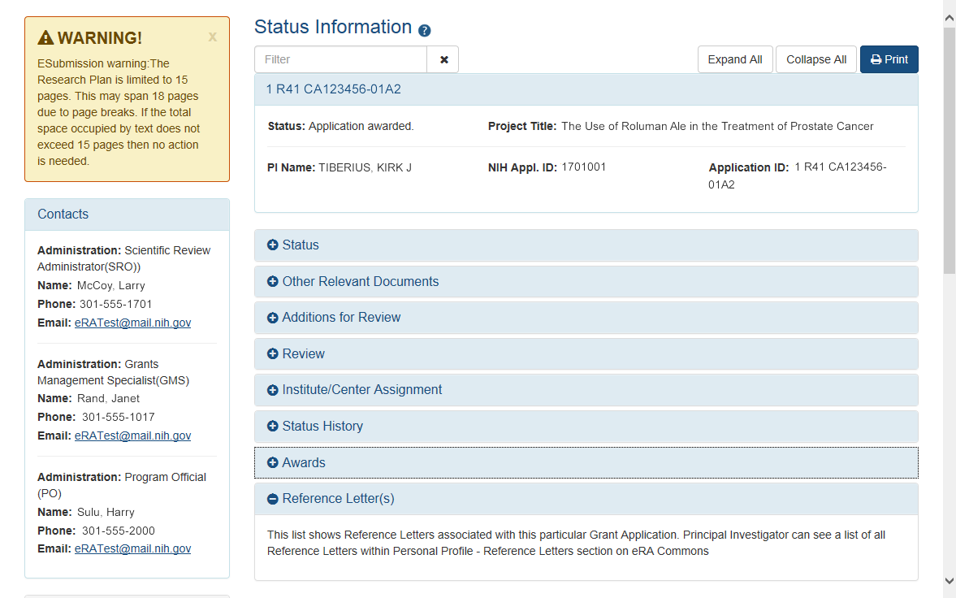
New Status Information Screen
Provides warnings
Control Buttons
Text Filter
All tiles open by default.
eRA Contacts

Slide 13
Reference Letters
NOT part of the application through Grants.gov
Submitted directly by the referee through eRA Commons
Commons registration not required
Can be submitted in advance of application submission
Due by the application submission deadline
Applicants can track the submission of reference letters in the Commons, but cannot view the actual letter
Fellowship reference letters no longer have a required format – just a letter
Some NIH grant programs require the submission of reference letters in addition to the grant application (e.g., Mentored Career Development program)

Slide 14
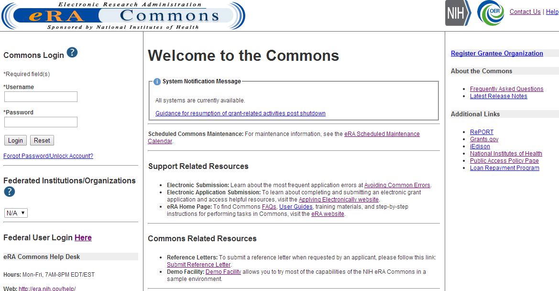
Reference Letters Links
Referees do not need to login to Commons to submit.

Slide 15
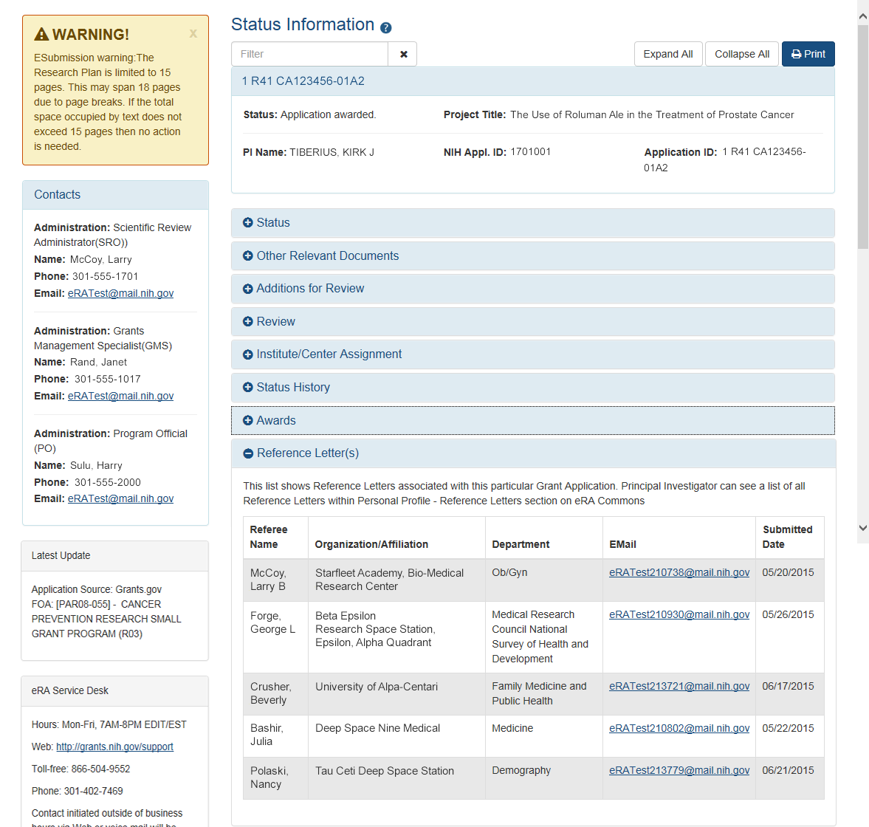
Reference Letters Status Information

Slide 16
Reference Letter Resources
Frequently Asked Questions
http://grants.nih.gov/grants/ElectronicReceipt/faq_full.htm
Submitting Reference Letters through eRA Commons (Demo)
http://era.nih.gov/era_training/tutorials/NIH_Reference_Letter/NIH Reference Letter.htm

Slide 17
eRA Commons Account Administration Account Management

Slide 18
Signing Official (SO)
During Commons registration, an applicant organization designates a Signing Official (SO)
SO has authority to legally bind the organization in grants administration matters
Equivalent to the Authorized Organization Representative (AOR) in Grants.gov
SO is responsible for:
maintaining institutional information
submitting documents that require signature authority to act on behalf of the organization
managing accounts

Slide 19
Signing Official (SO) & Managing Accounts
Signing Officials (and Account Administrators) have a responsibility to ensure duplicate accounts are not created for users.
Users with Scientific roles should only have one (1) eRA Commons account for their entire career
NIH needs to track funded researchers
Used for reviewers to determine Continuous Submission status
Used to determine New/Early Stage Investigator status
Before creating new accounts, search across all eRA Commons accounts using AMS
For more information, see:
https://era.nih.gov/news_and_events/era-item-Oct2017.htm

Slide 20
Account - Tips
Designate more than one Signing Official
Certain Commons actions can only be taken by users with the SO role and you will want a back-up
Administrators should always check to see if a user already has a Commons account before creating a new account with a scientific role
Ask the person if they already have an account, or search within the Commons
If a user already has an account with a different organization, the SO should affiliate the existing account with the user’s new organization

Slide 21
Account Passwords
Password policy:
http://era.nih.gov/files/NIH_eRA_Password_Policy.pdf
Passwords must:
Contain at least eight (8) characters: no more than 16; no blank spaces
Contain a combination of at least 3 of the following:
Upper case letters
Lower case letters
Numbers, not at beginning or end of the password
Special characters: ! # $ % - _ = + < >
The following special characters are NOT allowed: @ ^ & ( ) | " \ ' { } [ ] : ; ` ? , . /
Not contain username
Not be reused within eight (8) years, 24 password cycles
Be changed every 120 days

Slide 22
eRA Commons Roles
The functions that a user can perform in the Commons are based on the role(s) assigned to his or her Commons account
Full, printable list of eRA Commons roles:
http://era.nih.gov/files/eRA_Commons_Roles.pdf
Updated 08/2018!

Slide 23
Roles
IAR
PI
AA
FSR
SO
AO
Administrative
AA – Account Administrator
AO – Administrative Official
ASST – Assistant
BO – Business Official
SO – Signing Official
ASSIST Access Maintainer Role
Scientific
Graduate Student
IAR – Internet Assisted Review
PI - Principal Investigator
Post-Doc
Project Personnel
Scientist
Sponsor
Trainee
Undergraduate
Other
FCOI (Financial Conflict of Interest)
FCOI_ASST
FCOI_VIEW
FSR (Financial Status Reporter)
PACR (Public Access Compliance Reporting)
OLAW (Reporting Animal Welfare)
NEWEST!
Permits user to manage access to all ASSIST applications in their institution.

Slide 24
Role - Tips
Can’t combine scientific roles with administrative or other roles on the same account
Other combinations are fine (e.g., PI and IAR; AO and FSR)
A person needing both scientific and administrative roles should have two separate accounts (one for scientific roles and another for other roles)

Slide 25
eRA Commons Account Administration Delegations

Slide 26
Delegations
Progress Report
Sponsor
Status
Personal Profile
Submit
xTrain
eRA Commons allows users to give other users permission to do specific actions on their behalf

Slide 27
Delegations Chart
Type (Name) | By | To | What it does
Progress Report | SO, AA, AO | PI on behalf of a PI | Enables the delegated PI to work on progress reports of another PI – includes Interim and Final RPPR
Progress Report | PI | User within Institution | Enables the authorized user to work on progress reports for the PI – includes Interim and Final RPPR
Sponsor | SO, AA (on behalf of Sponsor) | ASST | Allows the ASST to access the xTrain module
Status | PI | ASST | Allows the ASST to work with the Status module
PPF | All Users | User within Institution | Enables another user to edit someone else's personal profile
Submit | SO | PI | Enables the PI to submit RPPR and MYPR reports – now needed for PI if they are to submit Interim and Final RPPR
xTrain | PI, Sponsor | ASST | Enables the ASST to work with the xTrain module and xTRACT

Slide 28
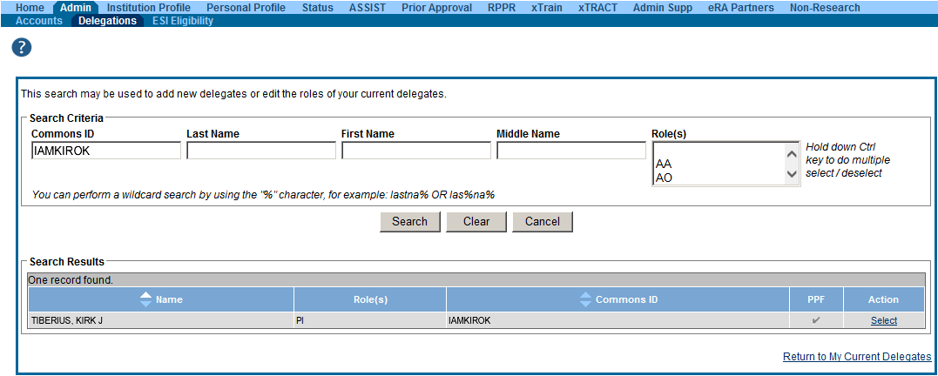
Delegation (SO)

Slide 29
Delegation Menu (PI)

Slide 30
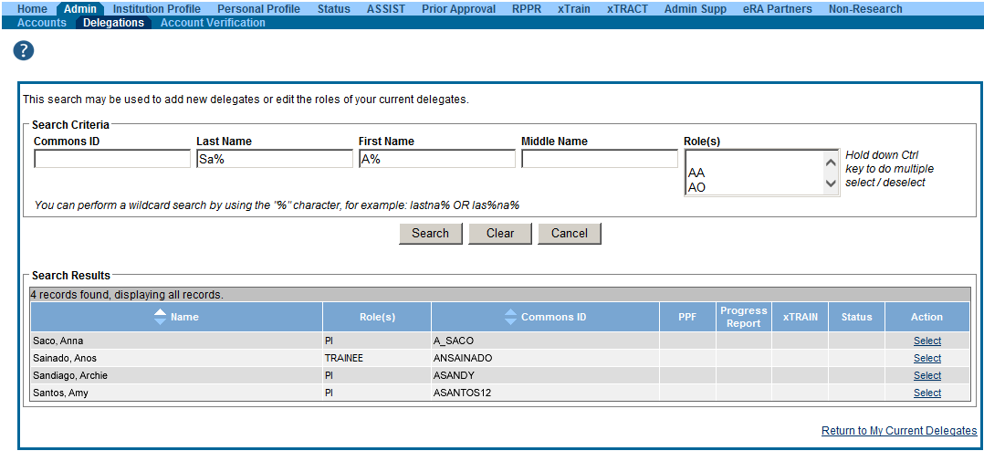
Delegation Selection (PI)

Slide 31
eRA Commons Profiles
Institutional Profiles (Ipf)
&
Personal Profiles (PPF)

Slide 32
Institutional Profile File (IPF)
Each organization establishes and maintains their organization’s profile data
Depending on their role, users can view and/or update Institution Profile information
Only SOs can edit IPF information
IPF displayed as a read-only page for users with all other Commons roles
Includes two sections: Basic and Assurances & Certifications
Central repository for registered organization information
Terminology Check: ‘Organization’ = ‘Institution’ = ‘Entity’

Slide 33
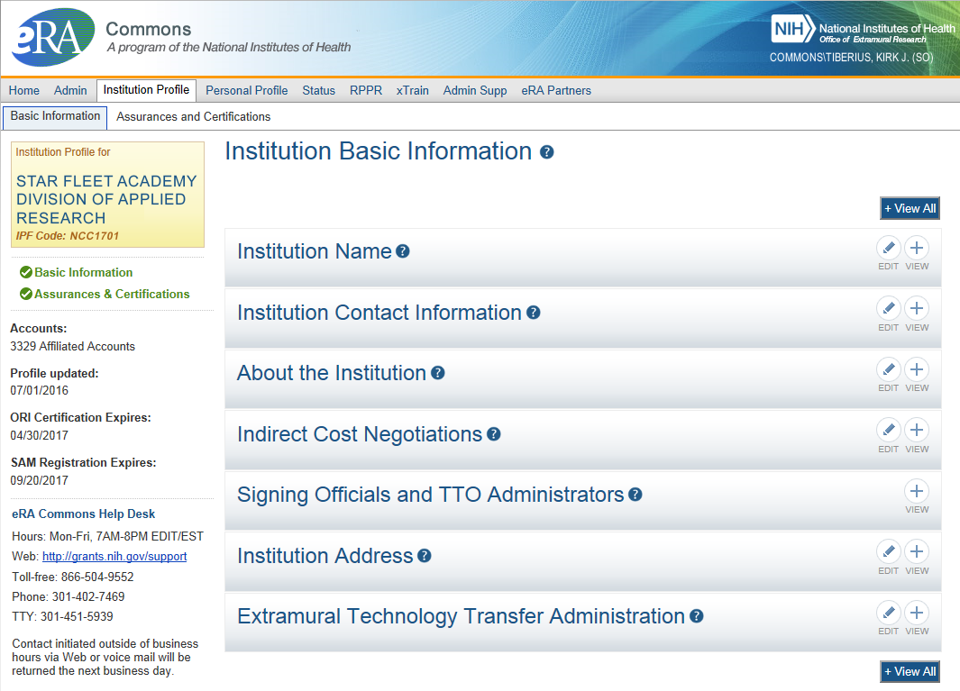
IPF - Basic
Basic: general information about the institution
Name, address, Institution Contact information, list of Signing Officials, etc.
Only SOs can edit Institution Profile
SAM Registration Expiration

Slide 34
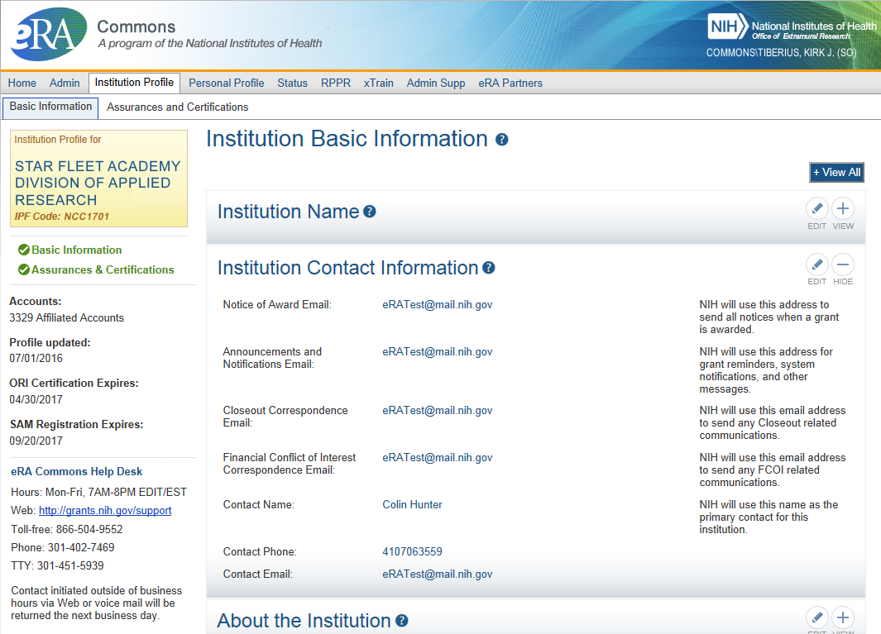
IPF – Institution Contacts
Newer
Contact
Fields:
Closeout Correspondence
FCOI Correspondence

Slide 35
IPF – DUNS
“”
Changes to Institution Basic Information Section
New fields coming soon…
To support Other Transaction Authority funding opportunities
To summarize your institution’s eligibility to submit to the different types of opportunities

Slide 36
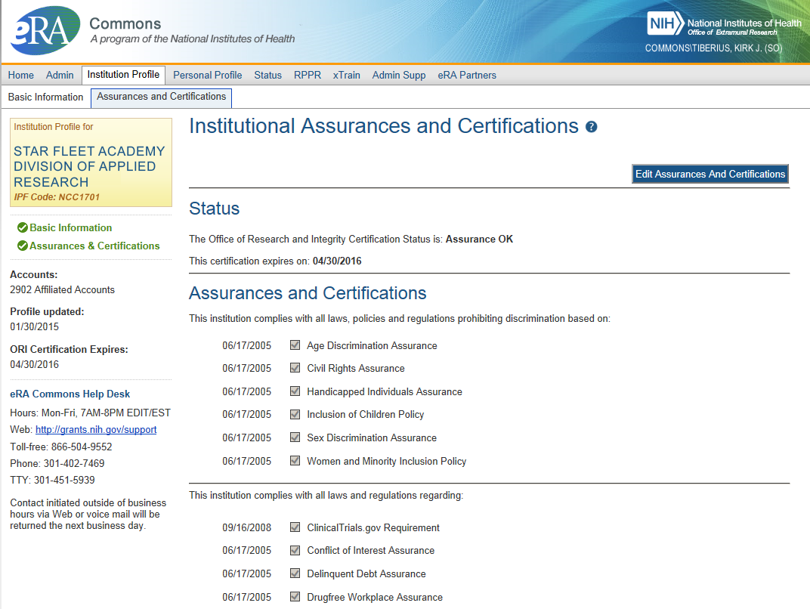
IPF – Assurances and Certifications
Assurances and Certifications: data elements that comprise assurance/certification information about an institution
List of certifications (e.g., Financial Conflict of Interest, Human Subjects Research, Vertebrate Animals, etc.)

Slide 37
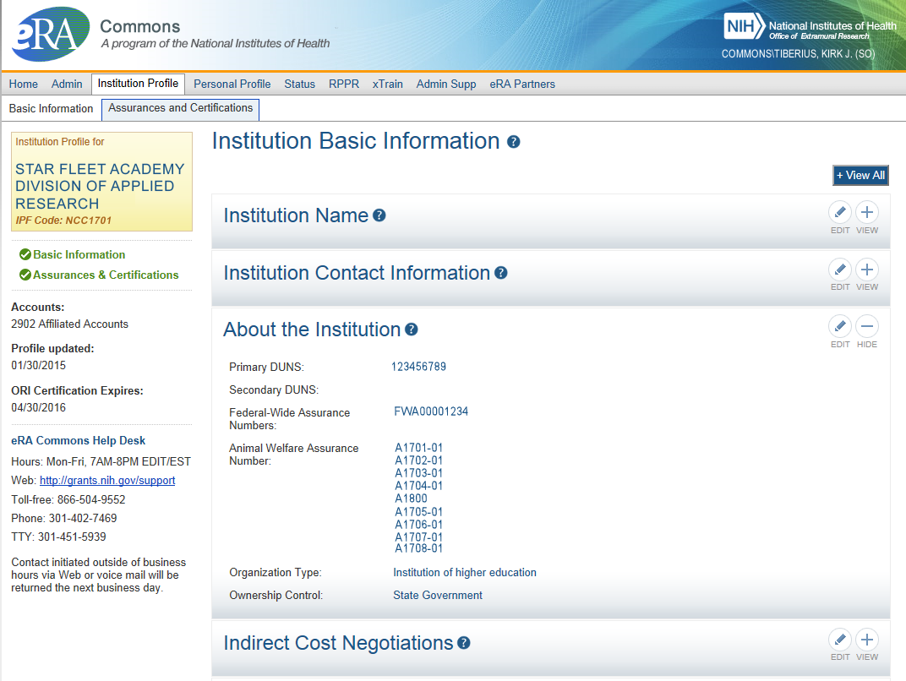
IPF – OLAW
Integration with Office of Laboratory Animal Welfare’s (OLAW) Animal Assurance Number
IPF will pull OLAW’s
Animal Assurance Number
Under the About the
Institution tile
Will also update:
Animal Subject Code
IACUC Date
New # Format
Can not be edited via IPF

Slide 38
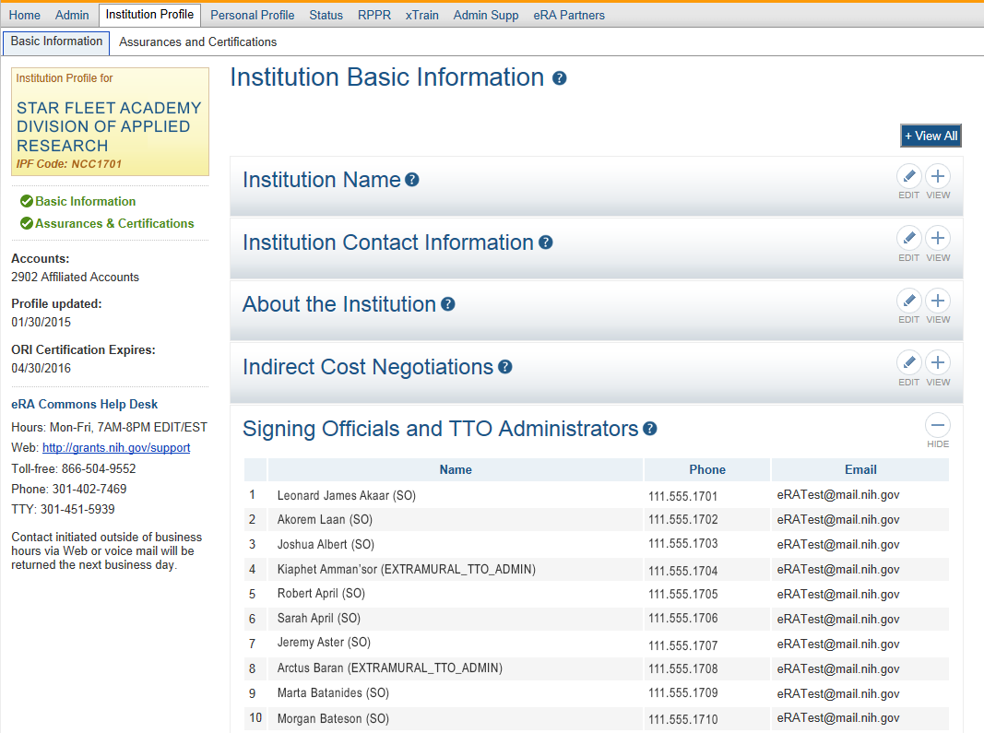
IPF Sections
Signing
Officials
&
Technology Transfer Officers
(TTO)

Slide 39
Personal Profile (PPF)
Individual Commons users are responsible for keeping their profile information accurate
Includes information such as:
Name
Demographics (important for Trainees)
Employment history (important for COI)
Education (important for NSI & ESI)
Reference Letters
Publications
Very few staff members at NIH have access to change information (for emergencies only)
Central repository for individual user information

Slide 40
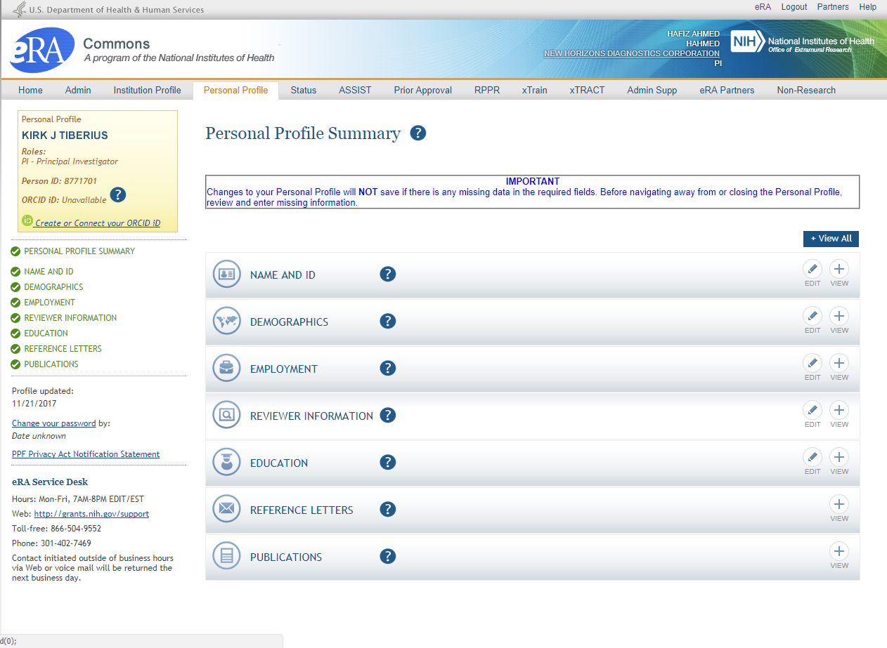
Personal Profile

Slide 41
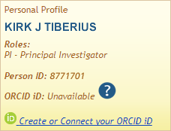
New on the Personal Profile
ORCID ID (Open Researcher and Contributor ID)
a personal digital identifier that distinguishes every researcher
a new link to access ORCID.org added to the Personal Profile.
Allows principal investigators to create an ORCID ID to link to their Commons account, so that their publications can be linked to their grants.

Slide 42
Personal Profile Information is used to…
Verify information submitted in grant applications
Send you agency notifications
Complete aggregate reporting
Determine eligibility for Early Stage Investigator (ESI) and Early Established Investigator (EEI) status
Determine a reviewer’s eligibility for the Continuous Submission application submission policy

Slide 43
Terminology Check
New Investigator
A PD/PI who has not previously competed successfully as a PD/PI for a substantial independent research award.
See: http://grants.nih.gov/grants/new_investigators/index.htm
Early Stage Investigator (ESI)
An individual who has completed their terminal research degree or end of post-graduate clinical training, whichever date is later, within the past 10 years and who has not previously competed successfully as PD/PI for a substantial NIH independent research award.
Early Established Investigator (EEI)
An individual who is within 10 years of receiving their first substantial, independent competing NIH R01 equivalent research award as an ESI.
See: https://grants.nih.gov/policy/early-investigators/index.htm
Continuous Submission
As a way of recognizing their service to NIH, reviewers with substantial review service are permitted to submit their research grant applications (R01, R21, or R34) on a continuous basis and to have those applications undergo initial peer review in a timely manner.
See: http://grants.nih.gov/grants/peer/continuous_submission.htm

Slide 44
PPF- Tips
Each year, on the anniversary of the date the account was created, you will receive a reminder email to make sure your profile is up-to-date and accurate.
When you change your password, you will be automatically redirected to the Personal Profile tab—take a moment to review and update your information
Be especially diligent about keeping your email addresses current
Email addresses are used to retrieve forgotten passwords and for communicating grants-related information

Slide 45
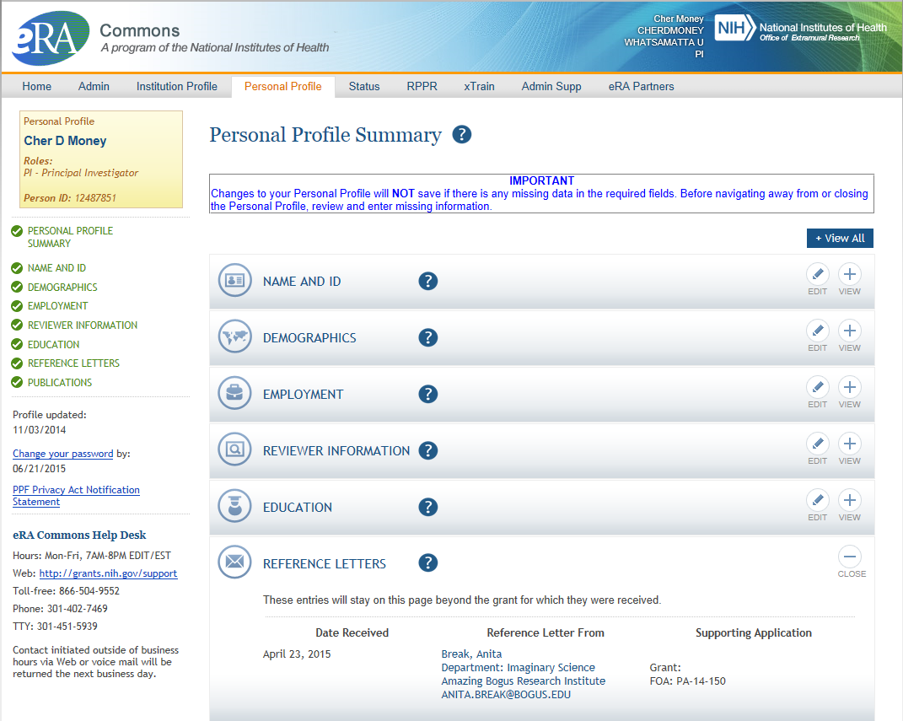
PPF – Reference Letters
Tracking Reference letters
Shown in Profile
Can see:
When it was submitted
Who submitted it
What grant it is linked to
Cannot see the
actual letter

Slide 46
Key eRA Commons Features Submitting Just-in-time (JIT) Information Upon NIH Request

Slide 47
Just-In-Time (JIT)
Applicants should never submit JIT info until specifically requested to do so by NIH. A JIT link or request from NIH are not indications that a grant award will be made.
Other Support File, Budget Upload, Other Upload, Institutional Review Board (IRB) Date, Human Subject Education
PD/PI can save info in Commons, but only SO can submit JIT info to NIH
Must be PDF format
Allows an applicant organization to submit additional grant application information after the completion of the peer review, and prior to funding.

Slide 48
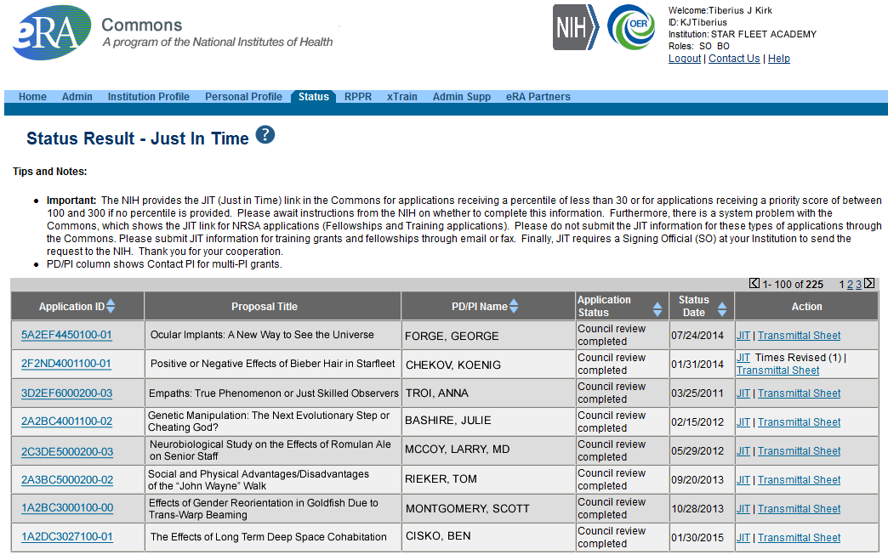
JIT Link on Status Result Screen (SO View)
Select JIT link

Slide 49
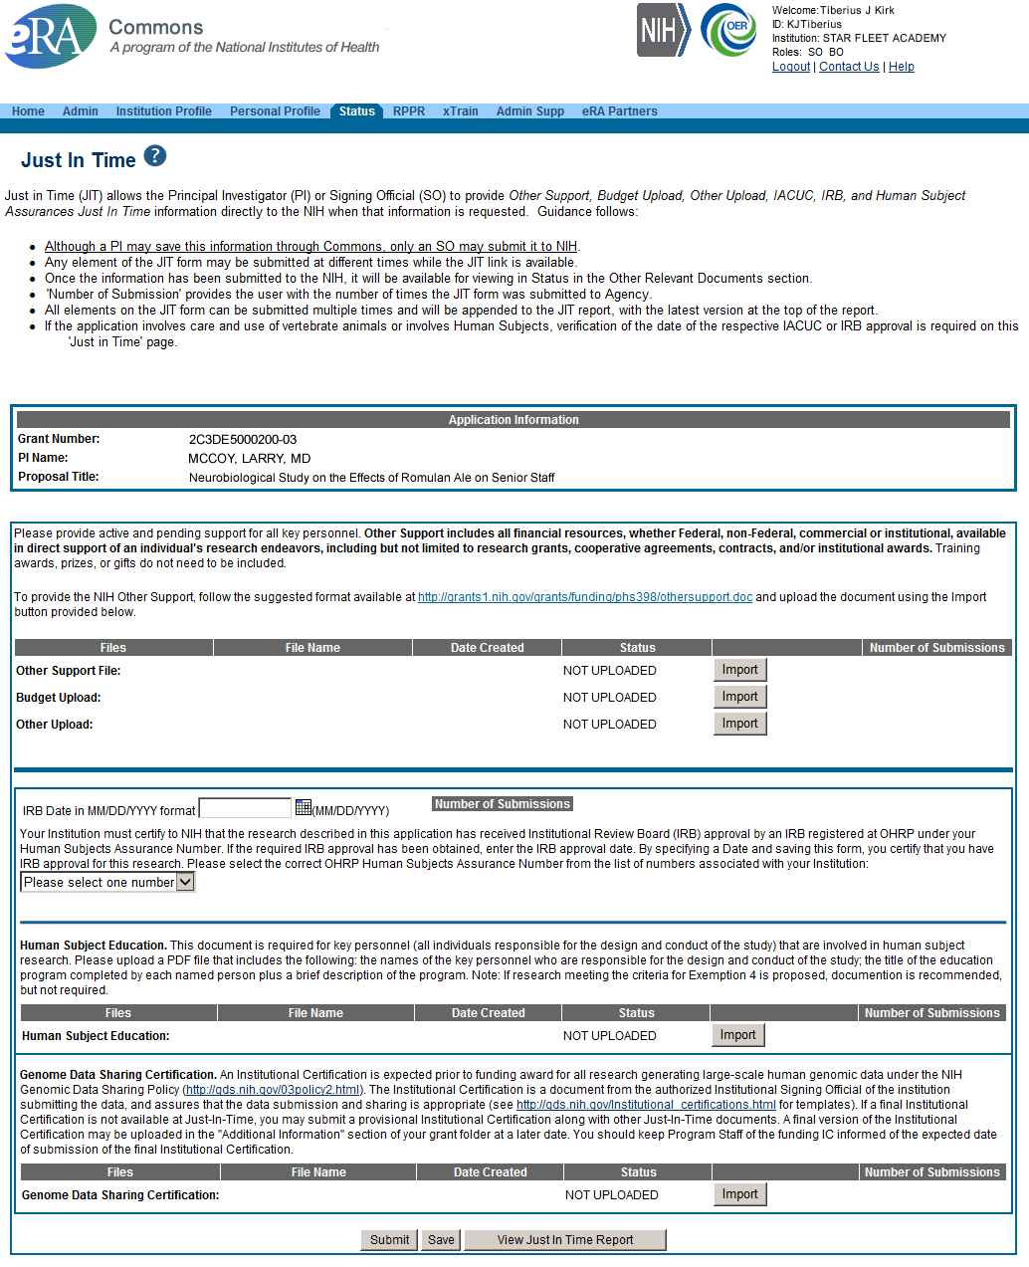
Just-In-Time (SO View)
PDF document with Other Support documentation is required. Use the Import button to begin the upload.
IRB Approval Date should be within the last 12 months.

Slide 50
Key eRA Commons Features Submitting a No Cost Extension (NCE) Via Status Screen

Slide 51
NCE
Only SOs can submit the NCE notification
May be submitted no earlier than 90 days before end of project and no later than project end date
Can request extension of 1-12 months, in one-month increments
E-mail notification sent to NIH Grants Management staff when SO processes the extension
Electronically submit a notification to exercise one-time authority to extend without funds the final budget period of a project period of a grant.

Slide 52
Extension link in Status screen

Slide 53
Extension Screen
Choose an extension of 1 to 12 months.
New calculated project end date

Slide 54
Expanded Authority – You Get Just One
No Cost Extension (NCE) part of ‘expanded authorities’
Can only extend once without express approval
Increasing trend of extending in the middle of the project period (i.e. end of year 2 of 5 year grant)
If this is done, the Extension link will NOT appear 90 days from end of project end-date
If in need of an NCE, submit Prior Approval NCE request
See June’s 2015 eRA Items of Interest for more:
https://era.nih.gov/news_and_events/era_item_June_2015.htm#expanded

Slide 55
Key eRA Commons Features Submitting Administrative Supplements (Type 3s) Using eRA Commons

Slide 56
Administrative Supplements
Requested additional costs must be within the scope of the peer reviewed and approved project
Streamlined eRA Commons process¹
Commons pre-populates much of the data needed for request from awarded grant
A request for additional funds during a current project period to provide for an increase in costs due to unforeseen circumstances.
¹Available for single-project activity codes for which competing applications are submitted through Grants.gov.

Slide 57
Admin. Supplement Requests – Initiate Request
Starting an Administrative Supplement request in Commons you must find eligible grant and Initiate Request

Slide 58
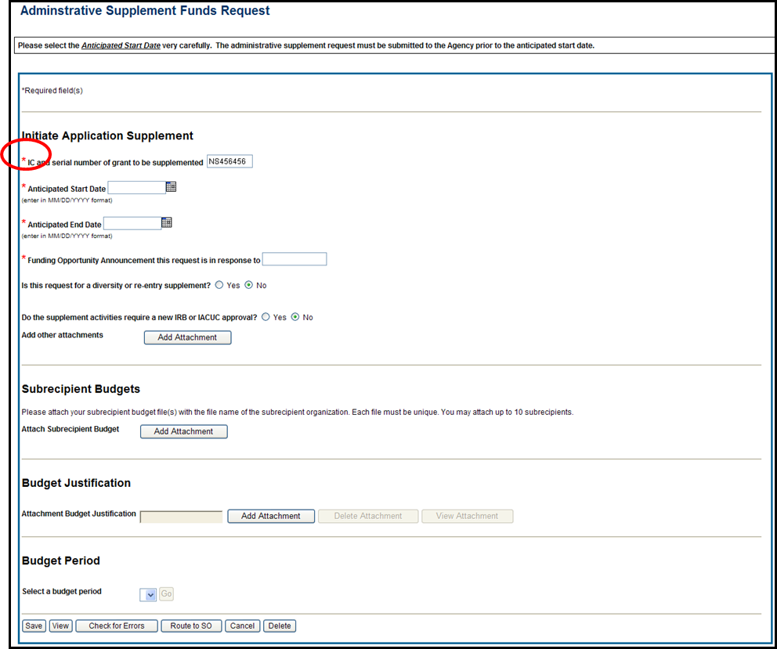
Admin. Supplement Requests – Required Fields
Complete Form – Required Fields are indicated with red asterisk

Slide 59
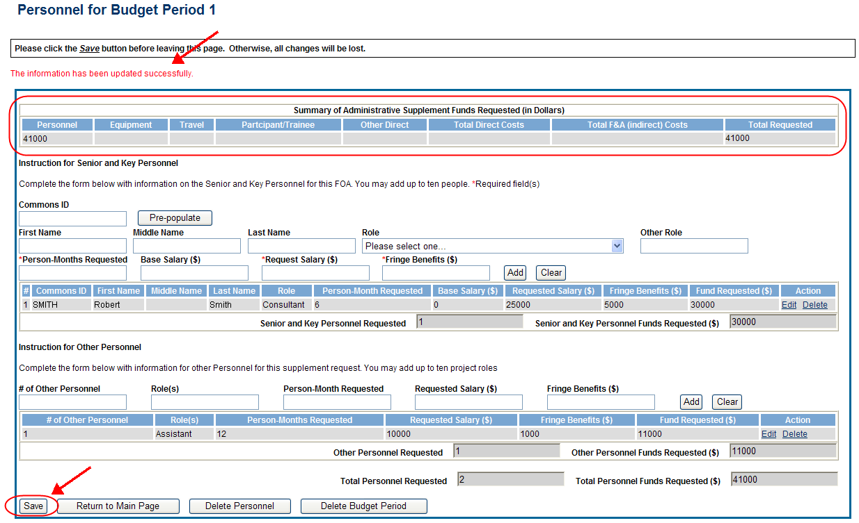
Admin. Supplement Requests – Budget Period
For each Budget Period enter appropriate sections:
Personnel, Equipment, Travel, Participant/Trainee, Other Direct, Total F&A (Indirect) Costs
Total Requested will be calculated automatically

Slide 60
Admin. Supplement Requests - Resources
Resources:
eRA Commons Administrative Supplement Module User Guide
http://era.nih.gov/files/eRA_Commons_Admin-Supp_UG.pdf
Administrative Supplements (Type 3s) Frequently Asked Questions
http://era.nih.gov/commons/faq_commons.cfm

Slide 61
Key eRA Commons Features Research Performance Progress Report (RPPR)

Slide 62
RPPR
Describes scientific progress, identify significant changes, report on personnel, and describe plans for the subsequent budget period or year.
http://grants.nih.gov/grants/rppr/
Now available for all SNAP and non-SNAP progress reports.
Progress Report Additional Material (PRAM) functionality available for publication compliancy explanations and additional information requested by grants management staff.
Annual progress report to document grantee accomplishments and compliance with terms of award.
Hello, RPPR!

Slide 63
RPPR & Human Subjects System (HSS)
HSS is the electronic system to manage human subjects and clinical trials information.
Allows principal investigators and signing officials to access and update all the human subjects and clinical trials data associated with their grants in one place.
update participant information
enrollment information
inform NIH of ClinicalTrials.gov registration
and revise other human subjects-related information as necessary, just-in-time for award or after a grant award is made.

Slide 64
RPPR & Accessing HSS
The most common use of the Human Subjects System is for updates needed to the RPPR
You will find the Human Subjects link in Section G.4.b Inclusion Enrollment Data of the RPPR
The human subjects link is visible only for NIH applications and grants involving human subjects.

Slide 65
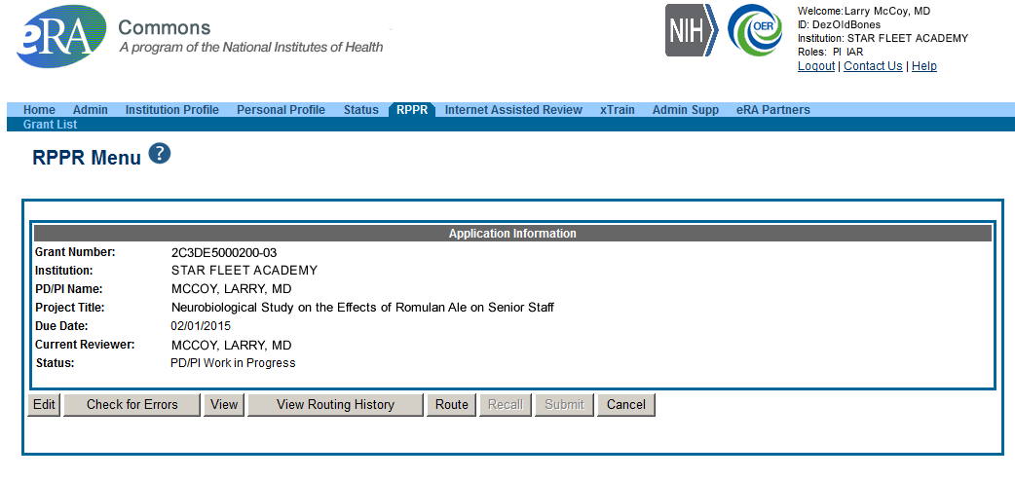
RPPR Menu Screen

Slide 66
RPPR Data Entry
Initiation of RPPR by
Principal Investigator
ASST with the RPPR Delegation
RPPR sections
Cover Page
Accomplishments
Products
Participants
Impact
Changes
Special Reporting
Budget (non-SNAP)
Watch for character limits in data entry fields
Ensure uploads are in PDF format
When completing data tables remember to click ‘Add/New’

Slide 67
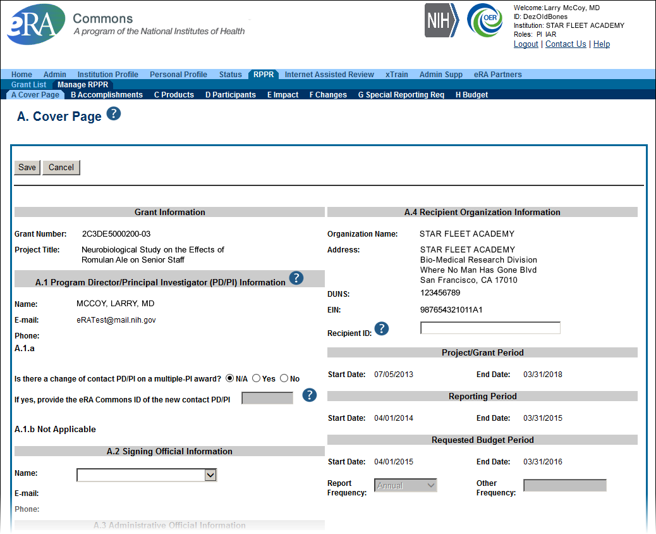
Sample RPPR Screen

Slide 68
RPPR – Complex, Multi-Project
Submitting progress reports for complex, multi-project grants
After RPPR is initiated, PI will need to identify if RPPR should contain components.
RPPR should have the same structure as the originally submitted application.
Some sections are not available on Overall component (i.e. Budget)
Some sections are not available on component level (i.e. Participants and Publications are reported on Overall)

Slide 69
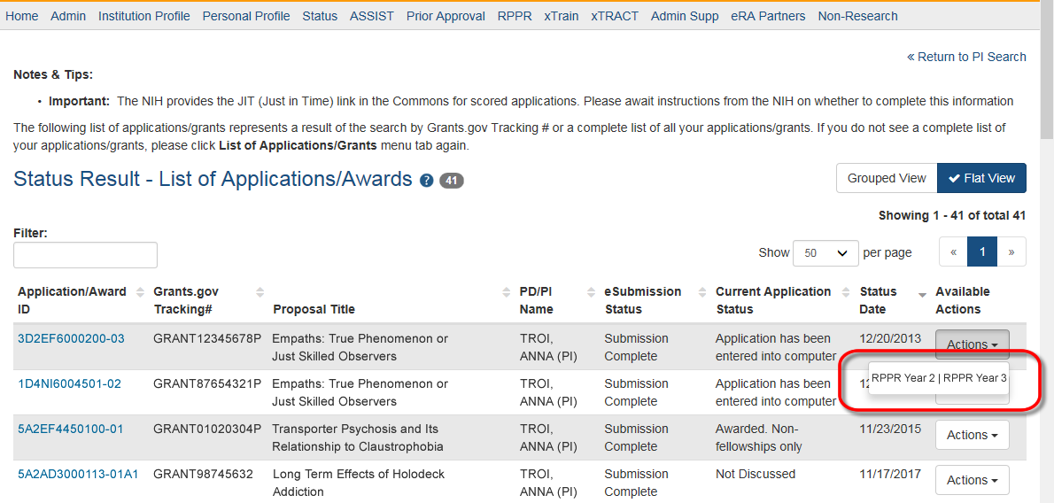
RPPR – Multi-Year RPPR
MYRPPR
Multi Year Progress Reports now use RPPR format
Link available under the Action Column in Status

Slide 70
Progress Report Additional Materials (PRAM)
The PRAM feature provides a means for the grantee to enter, review, route, and submit information to agency following the submission of an RPPR.
Public Access (PA) PRAM - Generated automatically after an RPPR is submitted with publications that are not compliant with Public Access Policy
IC (Agency) Requested PRAM – Only available if requested by the Grants Management Specialist (GMS)
PD/PI can enter the PRAM, but can only submit it if they are delegated with Submit Progress Report authority. Otherwise, only the SO can submit the PRAM to Agency.

Slide 71
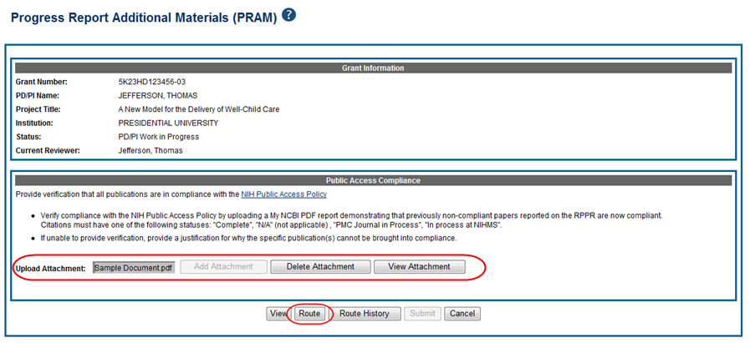
Progress Report Additional Materials (PRAM) Link

Slide 72
Format for PA PRAM
Public Access (PA) PRAM will require an attachment.
The PA PRAM will no longer contain a free form text box.
Using My NCBI the institution will need to generate a PDF of their reported publications showing their compliance.
For instructions on generating the report please see:
http://www.nlm.nih.gov/pubs/techbull/nd12/nd12_myncbi_pdf.html

Slide 73
RPPR – Budgets
Submitting progress reports with budgets
R&R budget and PHS 398 budgets are now available for Non-SNAP RPPR.
If presented with an option of budget forms, the type that was submitted with the application should be used.
PHS 398 Budget is available only on training grants.
Help for R&R Budget and PHS 398 Budget forms can be found in the SF424 R&R User Guides.

Slide 74
Feature RPPR Publications
When selecting/deselecting publications for RPPR submissions
Users will see a gold lock icon next to those publications added to their grant into NIHMS.
Users see a silver lock icon for publications that have been reported on a previous RPPR.
Neither can be removed on the RPPR, both need manual intervention.
To delete a publication with a gold lock, users will need to contact the NIHMS help desk through their web form, which is accessible at http://www.nihms.nih.gov/.
To delete a publication with a silver lock please contact the PublicAccess@nih.gov

Slide 75
Key eRA Commons Features Wrapping up the ‘Paperwork’ with Closeout

Slide 76
Closeout
Closeout items include:
Final Research Performance Progress Report (FRPPR)
Federal Financial Report (FFR)
Final Invention Statement
NIH automatically marks the grant “ready for close out,” making the link appear in Commons when:
The project period end date has passed, and
No Typ2 application has been submitted
Electronically submit required Closeout documents for grants in Closeout status

Slide 77
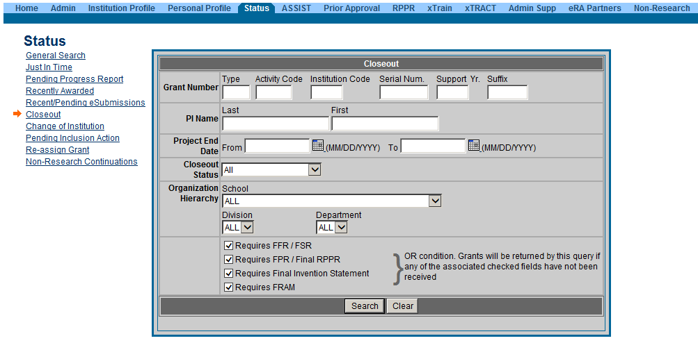
New Closeout Search screen provides additional search criteria

Slide 78
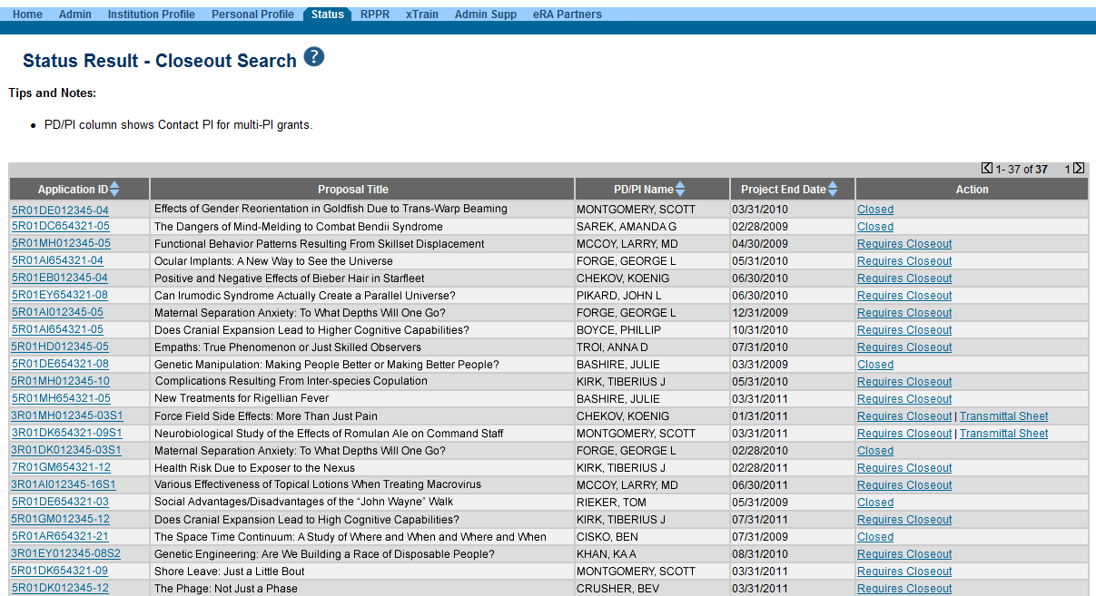
Search screen shows grants that are Closed or Requires Closeout

Slide 79
IRPPR vs FRPPR (Interim vs Final RPPR)
I-RPPR
The Interim RPPR link will made available to the SO and the PI in the Status screen when a grant is eligible for submission of a Competing Renewal application.
Only Section D.1 of Participants is required
Sections F: Changes and Section H: Budget are not part of the Interim RPPR
Section I: Outcomes is new. Section I is required for the Interim RPPR
F-RPPR
The Final RPPR is only available as part of the Closeout process and the Process Final RPPR link only appears on the Closeout Status screen.
Only Section D.1 of Participants is required
Sections F: Changes and Section H: Budget are not part of the Final RPPR
Section I: Outcomes is new. Section I is required for the Final RPPR

Slide 80
Interim RPPR Scenarios
Since a renewal application is competitive, there is no guarantee it will be funded. Therefor the following scenarios should be noted:
Completing Renewal Application Status | Action
Not submitting a Competing Renewal application | Submit a Final RPPR no later than 120 days from the project period end date
Submitting a Competing Renewal application | Submit an Interim RPPR no later than 120 days from the project period end date
 | Funded | Not Funded
 | The Interim RPPR is accepted as the annual RPPR | The Interim RPPR is accepted as the Final RPPR

Slide 81
Permissions for F-RPPR and I-RPPR
Interim and Final RPPR work in the same manner as the old Final Progress Report (FPR).
Both SOs and PIs can initiate
They can also route the report back and forth for review and edits. All of this done without the need to delegate any authority.
If an ASST has been delegated Progress Report Authority they will be able to initiate, edit and route.
SO may submit, PI will need Submit delegation to submit

Slide 82
RPPRs: Who Can Do What?

Slide 83
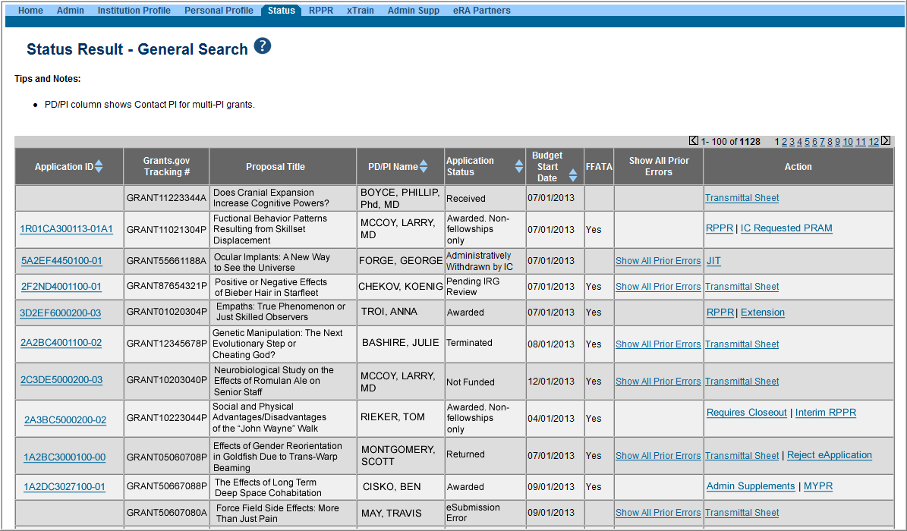
Selecting Interim RPPR
Select Interim RPPR link from Status search results (SO view shown)

Slide 84
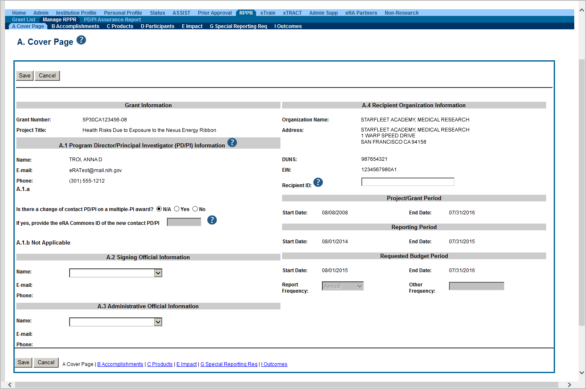
IRPPR and FRPPR Sections
Similar navigation tabs as the annual RPPR.
A new section called Outcomes has been added.

Slide 85
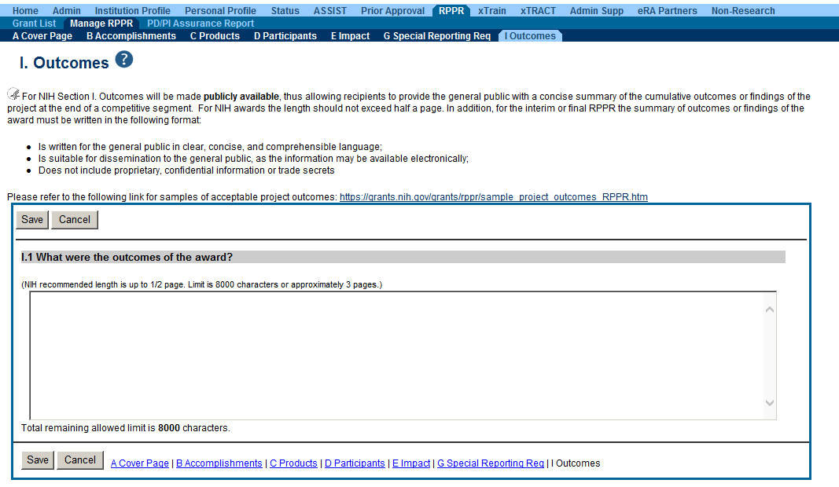
Outcomes
Information in Outcomes will be publically available. It should be written as a high level and in plain language.

Slide 86
Closeout – Outcomes Requirements
A new section of the RPPR specifically designed to be made publicly available by the agency (analogous to the abstract in the competing application)
Reporting in the Outcomes section is limited (by the federal-wide RPPR format) to 8,000 characters
The Outcomes should provide a concise summary of the findings of the award written in lay language for the general public
In an effort to increase transparency NIH will make the Outcomes data available in RePORTER

Slide 87
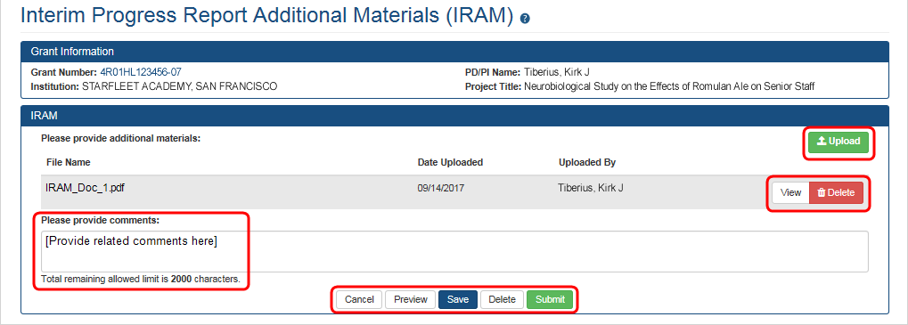
Requesting/ Receiving Revised Project Outcomes
Requests for revised project outcomes for F-RPPR and I-RPPR will be made by the PO and submitted by the recipient using the applicable additional material functionality (FRAM or IRAM)
Note: The full automation for the Additional Material functionality for the I-RPPR was implemented in mid-September
Both modules will be enhanced in order to capture revised project outcomes in a format that could be reported out to the public
Scarlett

Slide 88
Project Outcomes Resources
There has been some confusion as to what constitutes an effective Project Outcome.
Please see the following resources for more information
Sample Project Outcomes Summary – RPPR
https://grants.nih.gov/grants/rppr/sample_project_outcomes_RPPR.htm
Items of Interest, November 2017
Technical Jargon? Not for Project Outcomes
https://era.nih.gov/news_and_events/era-item-Nov2017.htm

Slide 89
Closeout – Final Report Additional Materials (FRAM)
FRAM works in same manner as PRAM in RPPR
Awarding IC sets status to FRAM Requested
Awarding IC triggers email for requested information to the SO & PI
The FRAM Update link appears in Action column

Slide 90
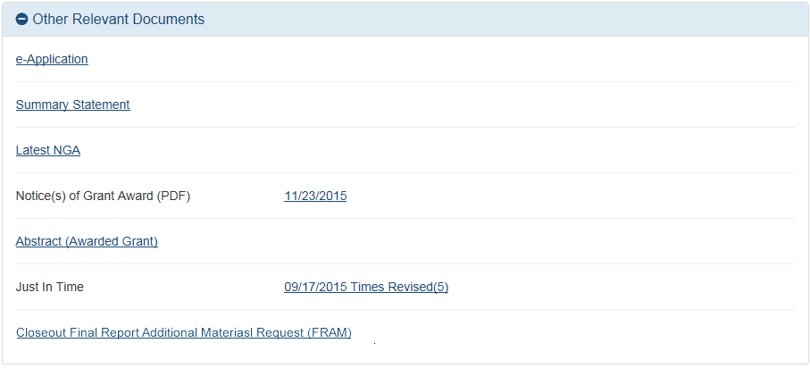
Closeout – Final Report Additional Materials (FRAM) in Other Relevant Documents
Specifics about the FRAM request can also be found in Other Relevant
Documents section of the Status Information screen.

Slide 91
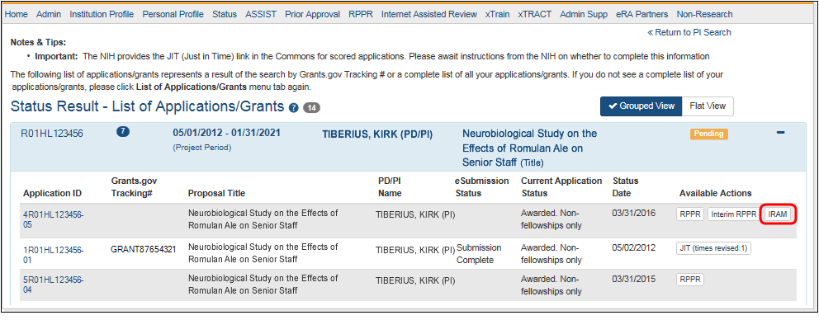
Closeout – Interim Report Additional Materials (IRAM) Link
IRAM works in same manner as PRAM in for RPPR
Awarding IC sets status to IRAM Requested
Awarding IC triggers email for requested information to the SO & PI
The IRAM Update link appears in Action column

Slide 92
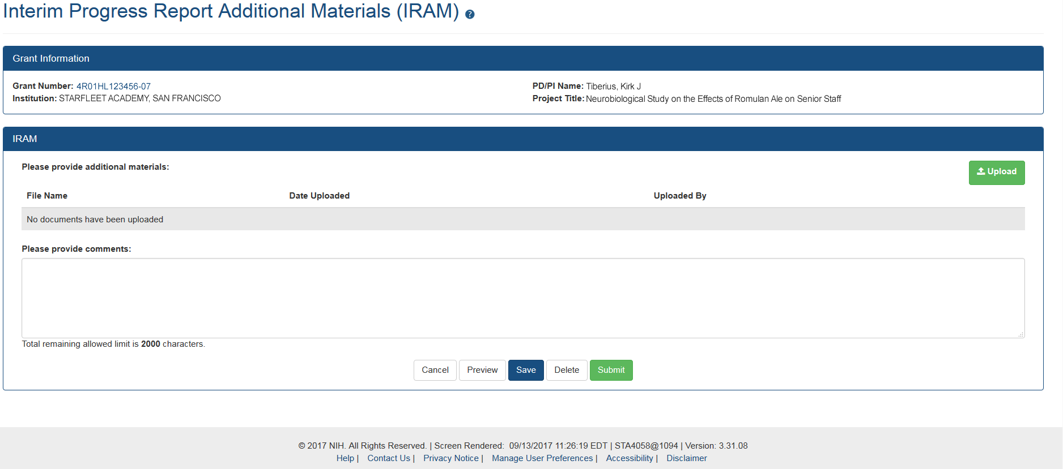
Closeout – Interim Report Additional Materials (IRAM) Screen
As with the RPPR, a PD/PI (or Contact PI, in the case of multiple PIs) can enter the IRAM. However, only the SO can submit an IRAM to the agency.

Slide 93
Federal Financial Report (FFR)
FFRs must be submitted in eRA Commons via the FFR/FSR module
Cash transaction data still submitted via Payment Management System
FSR role for users who have the authority to view, enter data, and submit an FFR on behalf of institution
Allows grantees to electronically submit a statement of expenditures associated with their grant to NIH via eRA Commons.

Slide 94
FFR
Annual FFR due date: For non-SNAPs, FFR must be submitted within 120 days of the calendar quarter in which the budget period ends
Final FFR due date: based on the Project Period End Date (PPED):
Pending Status: If the FFR is not submitted and it is within 120 days of the PPED
Due Status: If the FFR is not submitted and it is between the PPED and 120 days past the PPED
Late: If the FFR is not submitted and it is more than 120 days past the PPED

Slide 95
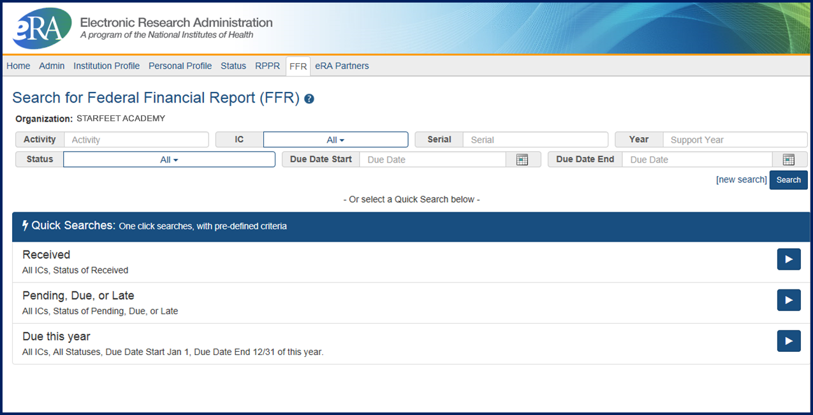
FFR/FSR Screen

Slide 96
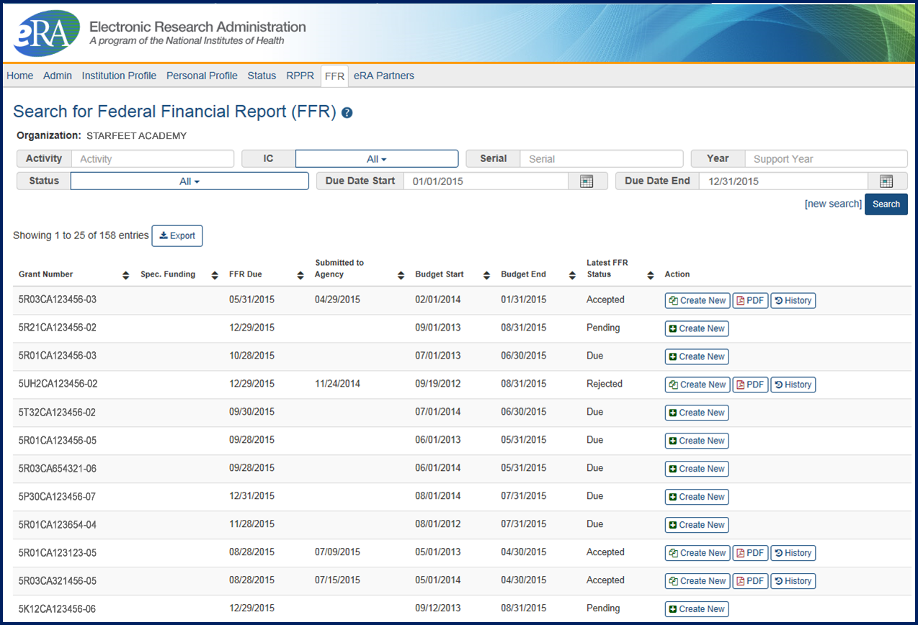
FFR/FSR Link
The Grant Number is a hyperlink that will take you to the FFR/FSR form.

Slide 97
FFR Related – Policy Notices
NOT-OD-14-103
Revised Timeline for Administrative Changes to NIH Domestic Awards to Transition to Payment Management System Subaccounts
http://grants.nih.gov/grants/guide/notice-files/NOT-OD-14-103.html
NOT-OD-14-093
Administrative Changes to NIH Domestic Awards Transition to Payment Management System Subaccounts
http://grants.nih.gov/grants/guide/notice-files/NOT-OD-14-093.html
NOT-OD-14-084
NIH Updating Grant Closeout Policies and Procedures to Align with New HHS Requirements
http://grants.nih.gov/grants/guide/notice-files/NOT-OD-14-084.html

Slide 98
Closeout – Final Invention Statement
If inventions are to be reported, the specific inventions must be listed.
Either the PI or the SO can start the process, but the SO must verify the report before submitting it to the agency.
If Yes is selected, Add Invention screen appears.

Slide 99
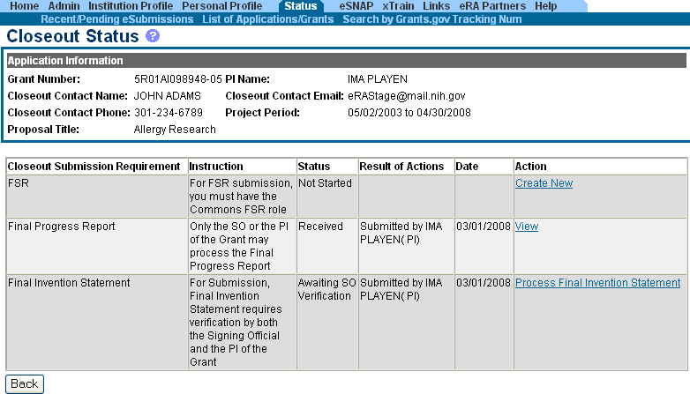
Closeout – Awaiting SO Verification
Status of Final Invention Statement is changed to Awaiting SO Verification. SO can now verify and submit.

Slide 100
Closeout – Policy Notices
Guide Notice NOT-OD-14-084
NIH Updating Grant Closeout Policies and Procedures to Align with New HHS Requirements
http://grants.nih.gov/grants/guide/notice-files/NOT-OD-12-152.html
Closeout FAQs
http://grants.nih.gov/grants/closeout/faq_grants_closeout.htm

Slide 101
Finding Help
Service Desks
On-line resources &Web sites

Slide 102
Help Desks
eRA Commons
Service Desk
Grants.gov Contact Center
Web:
https://grants.nih.gov/support/index.html
Phone: 1-866-504-9552
Hours : Mon-Fri, 7a.m. to 8 p.m. ET
Toll-free: 1-800-518-4726
Hours : 24x7 (Except Federal Holidays)
Email : support@grants.gov
Help Resources: https://www.grants.gov/web/grants/support.html

Slide 103
Web Sites
eRA Commons:
https://commons.era.nih.gov/commons/
Electronic Research Administration:
http://era.nih.gov/
How to Apply – Application Guide: http://grants.nih.gov/grants/how-to-apply-application-guide.htm
NIH About Grants:
http://grants.nih.gov/grants/oer.htm

Slide 104
Thank you

