Slide 1



Interacting Electronically with NIH
Post-submission Processing
May 2017
electronic Research Administration (eRA)
OER, OD, National Institutes of Health

Slide 2
Your Workshop Team
Scarlett Gibb
  eRA Customer Relationship Manager, eRA Commons
Joe Schumaker
  eRA Communications and Outreach

Slide 3
eRA Commons Status
What is era Commons?
Scarlett

Slide 4
What is eRA Commons?
The eRA Commons is an online interface where grant applicants, grantees and federal staff can access and share administrative information related to grant applications and awarded research grants.
Applications
Prior Approval
eSubmission Errors/Warnings
Inclusion Data
Assembled Application Image
Training Tables
Certifications & Assurances
Profile Data
Review Assignment
Progress Reports
Priority Score
Closeout Processes
Summary Statement
Financial Reports
Notice of Award
Invention Reports
Training Appointment Actions
Post-award Correspondence
Scarlett

Slide 5
What’s New in eRA Commons
Prior Approval
Scarlett

Slide 6
Prior Approval
eRA now supports four activities for Prior Approval Requests.
  Request for withdrawal of an application
  Request for No Cost Extension (NCE)
  Request for Change of PD/PI
  Request to exceed $500K in direct cost for any year
Prior Approval is the process in which an applicant or grantee must have written approval by an authorized official to undertake a certain activity.
Scarlett

Slide 7
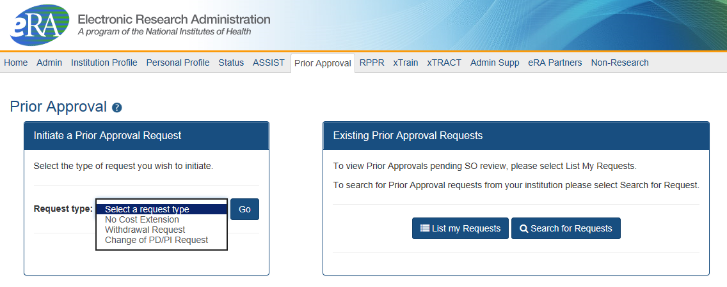
Prior Approval – Withdrawal Request
New navigation tab, Prior Approval
Initiation of a Withdrawal Request can be done by either the Principal Investigator (PI) or Signing Official (SO)
Screen supports justification (required) and supporting documents (max 10)
Only the Signing Official can submit the request
Signing Officials can search for requests for their institution
Automatic notifications to the SO and PI upon approval
Scarlett

Slide 8
Prior Approval – No Cost Extension: When?
When is a grant eligible for a NCE through Prior Approval?
  When you have already used a NCE under expanded authority and you are within 90 days of the project end date.
  When you are not under expanded authority and you are within 90 days of the project end date.
  When the project end date has expired and has not been closed or has not entered unilateral closeout, whichever comes first.
Scarlett

Slide 9
Prior Approval – No Cost Extension: When Not?
When is a grant NOT eligible for a NCE through Prior Approval?
  When you have never requested a NCE under expanded authority and you are within 90 days of the project end date. In this case, the NCE will be processed normally through the Extension link in Status.
  When the grant is closed.
  When the grant is a fellowship grant.
Scarlett

Slide 10
Prior Approval – No Cost Extension: What?
What information will you need to provide?
  The NCE request form consists of 4 parts:
    Request Detail – Here you will be asked such things as the number of months you wish to extend the project end date; the amount of unobligated money still available, etc.
    Three PDF upload fields:
      Progress Report
      Budget Document
      Justification Document
Scarlett

Slide 11
Prior Approval – Change of PD/PI
Request for an Institution to change the Program Director (PD) or Principal Investigator (PI) on an award.
  Only a Signing Official (SO) can initiate and submit this type of request.
  Request can only be made for a grant year that is currently awarded and in the budget period.
  Biosketch and Other Support documents (PDFs only) are required with the submission when adding a new PD/PI.
  1 PDF for each document requested, each not exceed 5 MB in size
Scarlett

Slide 12
Prior Approval – $500K Request
Request for Direct Cost exceeding $500K for a single budget year
  PI is invited to submit the request after discussion with Program Official (PO) of the institute/center they are working with
  PI provides justification (500 characters) and supporting documents (PDF, 1o max)
  PI can submit the request to NIH, or route to SO for review (depending on their institution’s business processes)
  SO can view, and recall a request made by a PI
  If approved, notifications go to the PI and NoA address
Scarlett

Slide 13

Prior Approval – Resources
NIH eRA Items of Interest Articles
  No NCE? No Problem!
  Prior Approval Changes How PIs Change
Video Tutorials
https://era.nih.gov/era_training/era_videos.cfm#eracommons
  Withdrawal of an Application
  $500 or More Requests
  Change of PD/PI
  No Cost Extension (coming soon)
Scarlett

Slide 14
What’s New in eRA Commons Status
New Status views
Joe

Slide 15
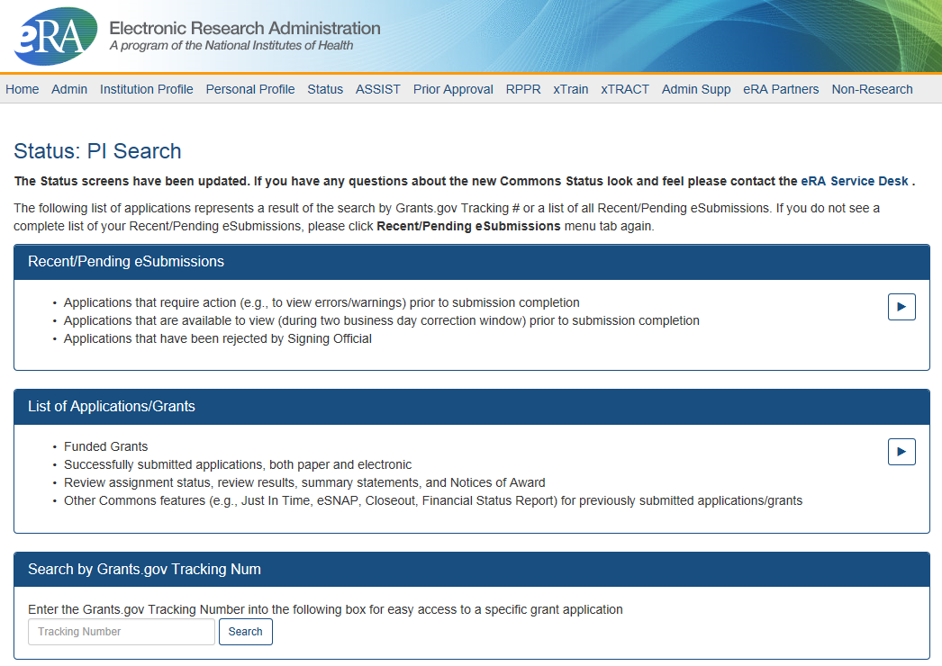
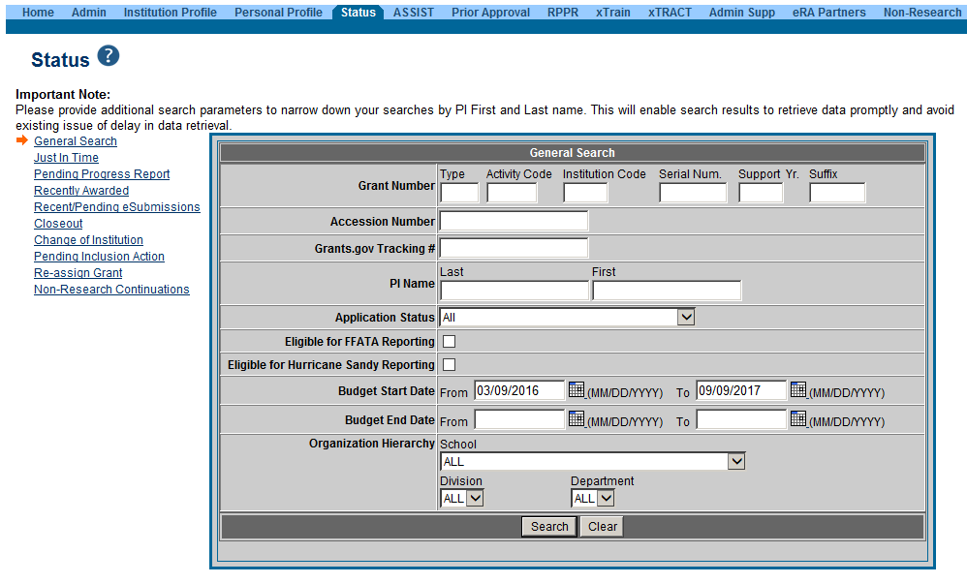
PI & SO Status Views
Principal Investigators can view their Recent/Pending eSubmissions or List of Applications/Grants.
Signing Officials can search/view all submissions for their institution.
Joe

Slide 16
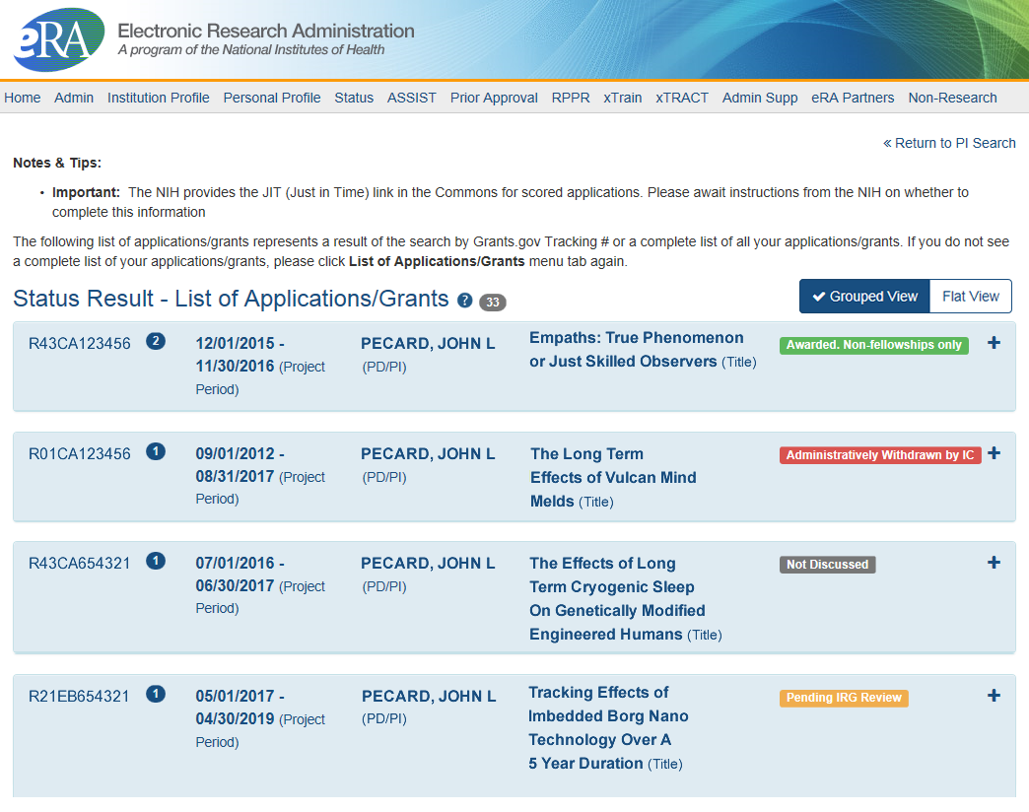
Status Result from General Search for PI
Click anywhere in the blue to get to more information, then select the Application ID link to view detailed status information for that particular application.
Joe

Slide 17
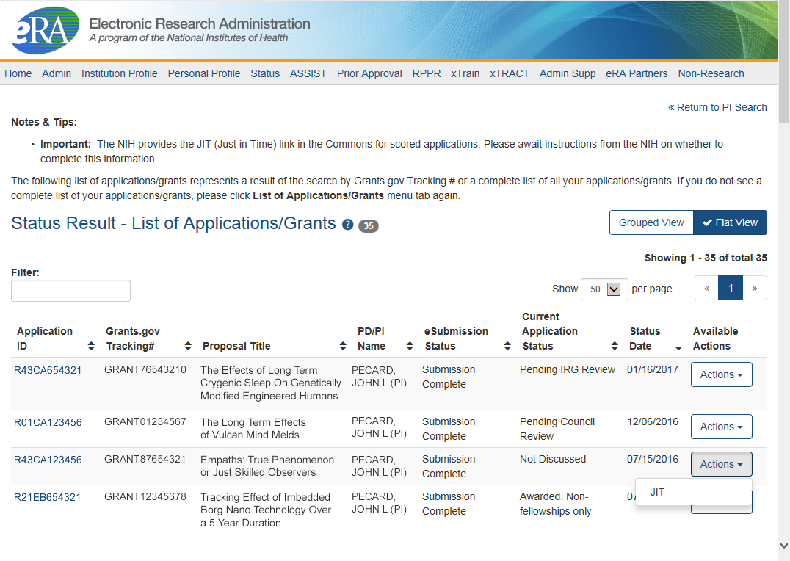
Status Result from General Search for PI
(flat view)
Flat view is more similar to the old view
Joe

Slide 18
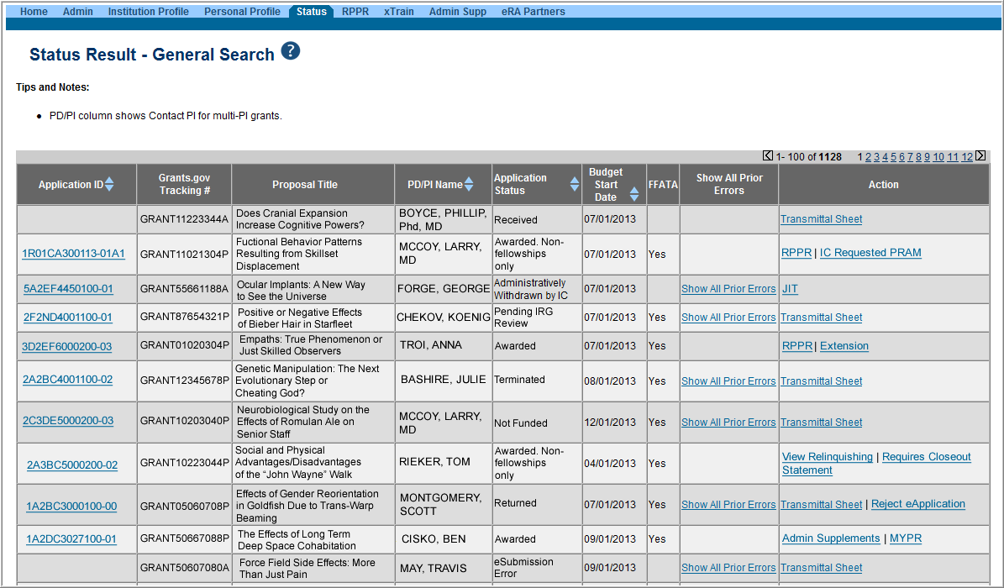
Status Result from General Search for SO
Select the Application ID link to view detailed status information for that particular application.
Joe

Slide 19
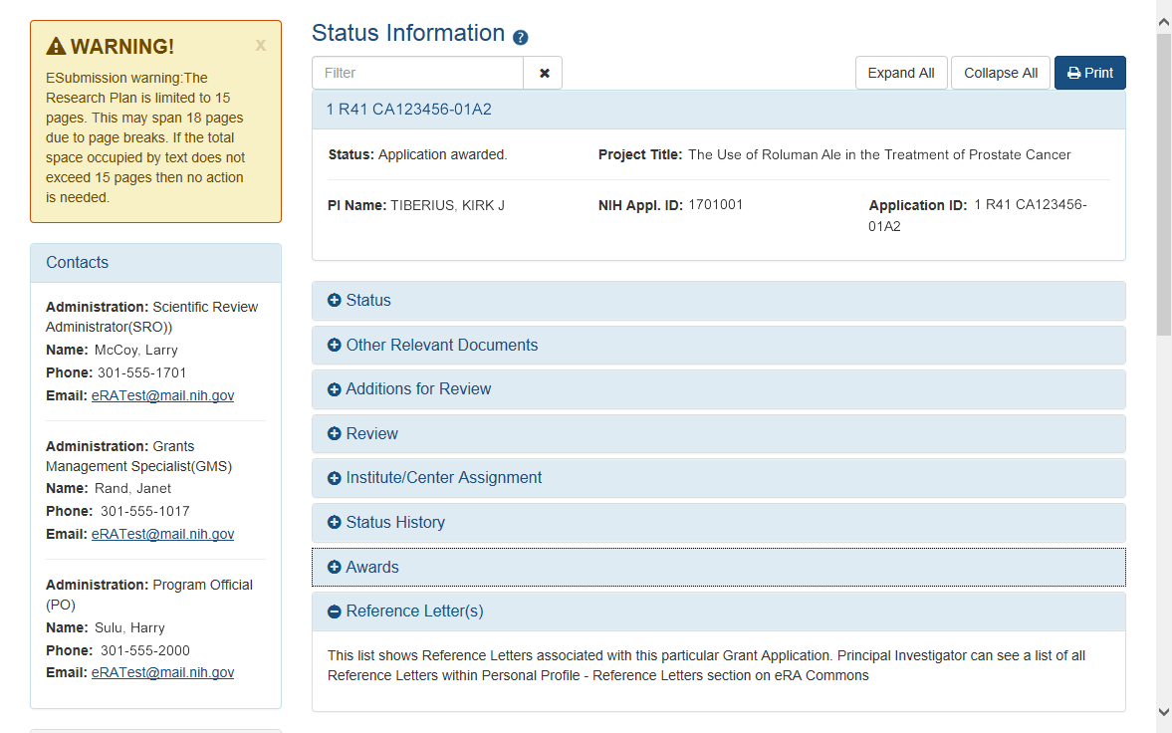
New Status Information Screen
Provides warnings
Control Buttons
Text Filter
All tiles open by default.
eRA Contacts
Joe

Slide 20
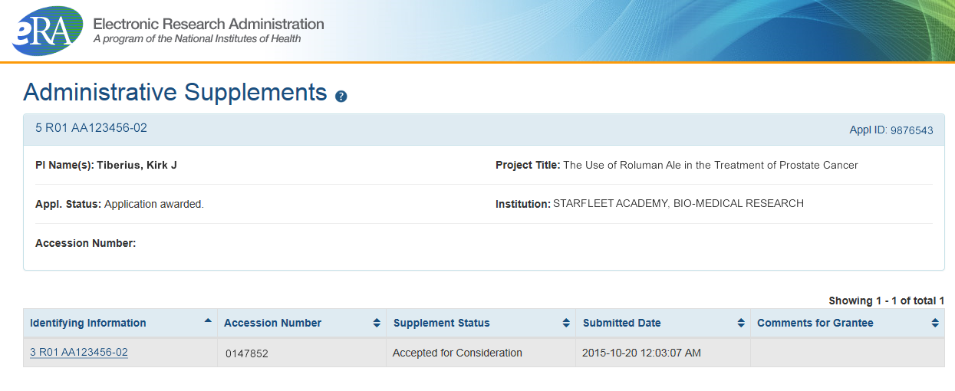
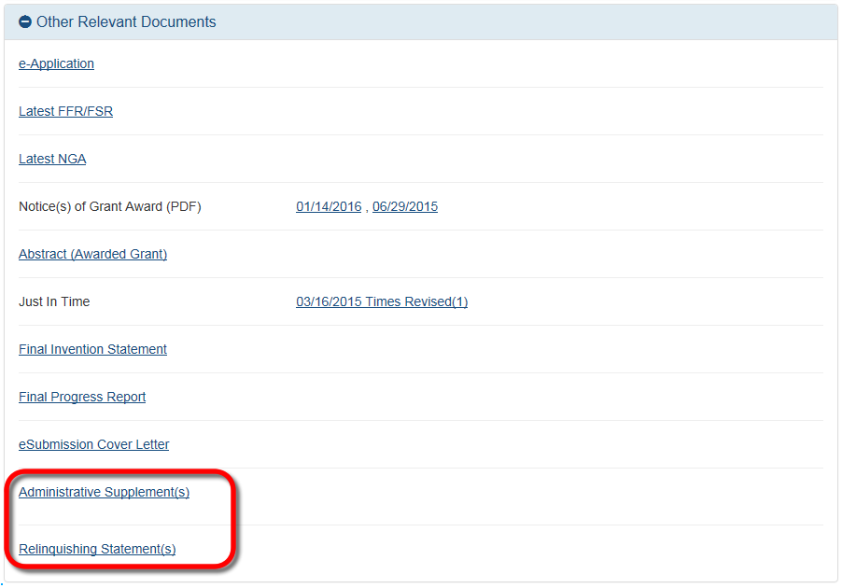
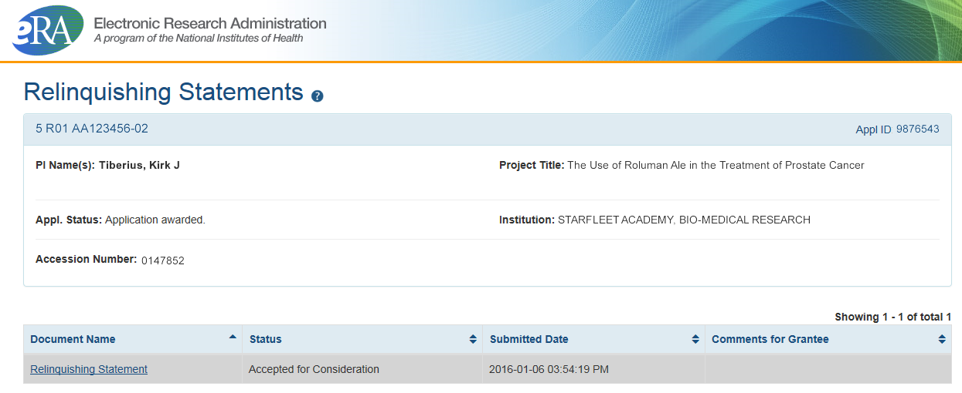
New! Other Relevant Documents Screens
Joe

Slide 21
What’s New in eRA Commons IPF
Features in
Institution Profile
Joe

Slide 22
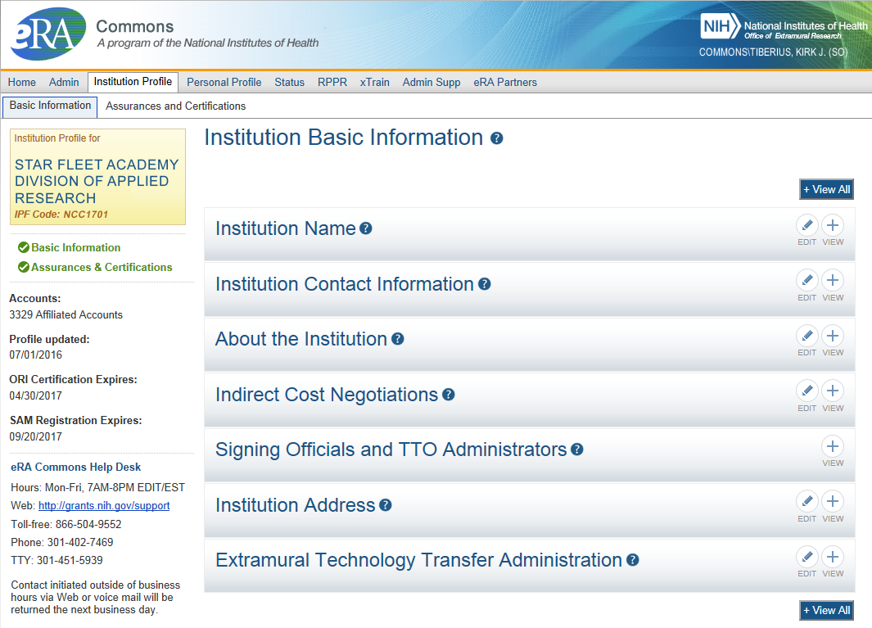
IPF - Basic
Basic: general information about the institution
  Name, address, Institution Contact information, list of Signing Officials, etc.
Only SOs can edit Institution Profile
SAM Registration Expiration
Joe

Slide 23
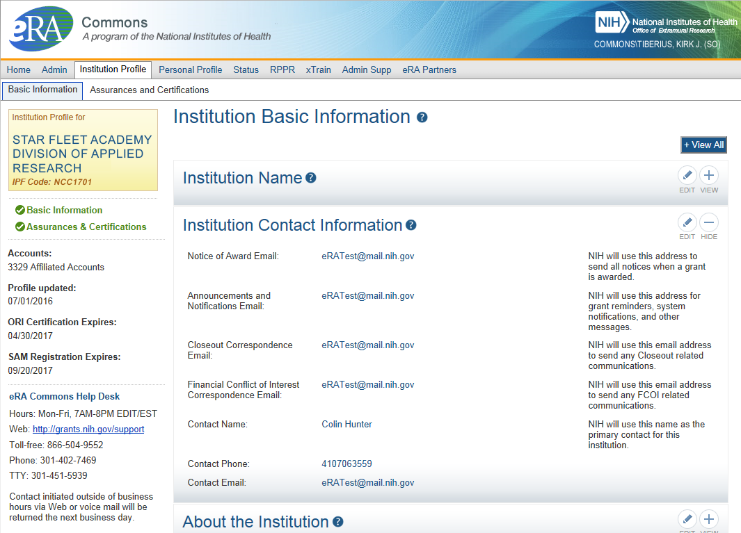
IPF – Institution Contacts
Newer
Contact
Fields:
Closeout Correspondence
FCOI Correspondence
Joe

Slide 24
Key eRA Commons
Features
Submitting Just-in-time (JIT)
information upon nih Request
Scarlett

Slide 25
Just-In-Time (JIT)
Applicants should never submit JIT info until specifically requested to do so by NIH. A JIT link or request from NIH are not indications that a grant award will be made.
  Other Support File, Budget Upload, Other Upload, Institutional Review Board (IRB) Date, Human Subject Education
  PD/PI can save info in Commons, but only SO can submit JIT info to NIH
  Must be PDF format
Allows an applicant organization to submit additional grant application information after the completion of the peer review, and prior to funding.
Scarlett

Slide 26
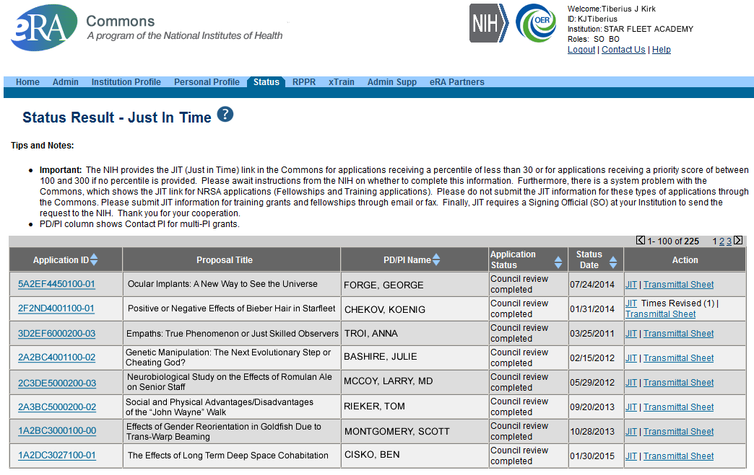
JIT Link on Status Result Screen (SO View)
Select JIT link
Scarlett

Slide 27
Key eRA Commons
Features - NCE
Submitting
a no cost extension (NCE)
Joe

Slide 28
NCE
Only SOs can submit the NCE notification
May be submitted no earlier than 90 days before end of project and no later than project end date
Can request extension of 1-12 months, in one-month increments
E-mail notification sent to NIH Grants Management staff when SO processes the extension
Electronically submit a notification to exercise one-time authority to extend without funds the final budget period of a project period of a grant.
Joe

Slide 29

Extension link in Status screen
Joe

Slide 30
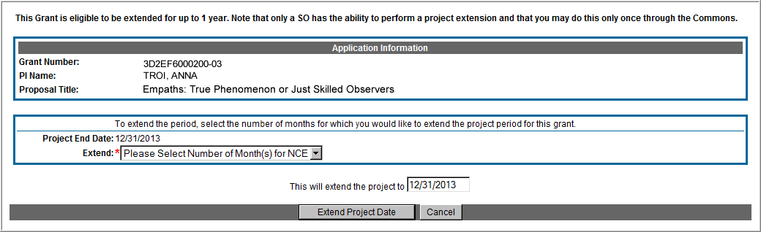
Extension Screen
Choose an extension of 1 to 12 months.
New calculated project end date
Joe

Slide 31
Expanded Authority – You Get Just One
No Cost Extension (NCE) part of ‘expanded authorities’
Can only extend once without express approval
Increasing trend of extending in the middle of the project period (i.e. end of year 2 of 5 year grant)
If this is done, the Extension link will NOT appear 90 days from end of project end-date
See June’s 2015 eRA Items of Interest for more:
  https://era.nih.gov/news_and_events/era_item_June_2015.htm#expanded
Joe

Slide 32
Key eRA Commons
Features - RPPR
Research Performance
Progress Report (rppr)
Scarlett

Slide 33

RPPR
Describes scientific progress, identify significant changes, report on personnel, and describe plans for the subsequent budget period or year.
  http://grants.nih.gov/grants/rppr/
Now available for all SNAP and non-SNAP progress reports.
Progress Report Additional Material (PRAM) functionality available for publication compliancy explanations and additional information requested by grants management staff.
Annual progress report to document grantee accomplishments and compliance with terms of award.
Hello, RPPR!
Scarlett

Slide 34
RPPR Transition Timeline
Required for SNAP and Fellowship Awards with budget start dates on or after July 1, 2013.
Required for type 5 non-SNAP progress reports as of April 24, 2014.
  Reminder: NIH Requires the Research Performance Progress Report (RPPR) for All Type 5 Progress Reports NOT-OD-15-014
Scarlett

Slide 35
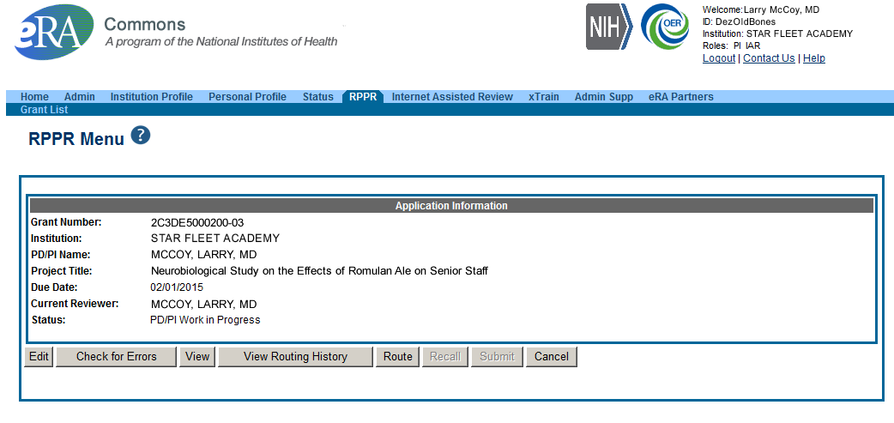
RPPR Menu Screen
Scarlett

Slide 36
RPPR Data Entry
RPPR sections
  Cover Page
  Accomplishments
  Products
  Participants
  Impact
  Changes
  Special Reporting
  Budget (non-SNAP)
Watch for character limits in data entry fields
Ensure uploads are in PDF format
When completing data tables remember to click ‘Add/New’
Scarlett

Slide 37
Progress Report Additional Materials (PRAM)
The PRAM feature provides a means for the grantee to enter, review, route, and submit information to agency following the submission of an RPPR.
  Public Access (PA) PRAM - Generated automatically after an RPPR is submitted with publications that are not compliant with Public Access Policy
  IC (Agency) Requested PRAM – Only available if requested by the Grants Management Specialist (GMS)
PD/PI can enter the PRAM, but can only submit it if they are delegated with Submit Progress Report authority. Otherwise, only the SO can submit the PRAM to Agency.
Scarlett

Slide 38
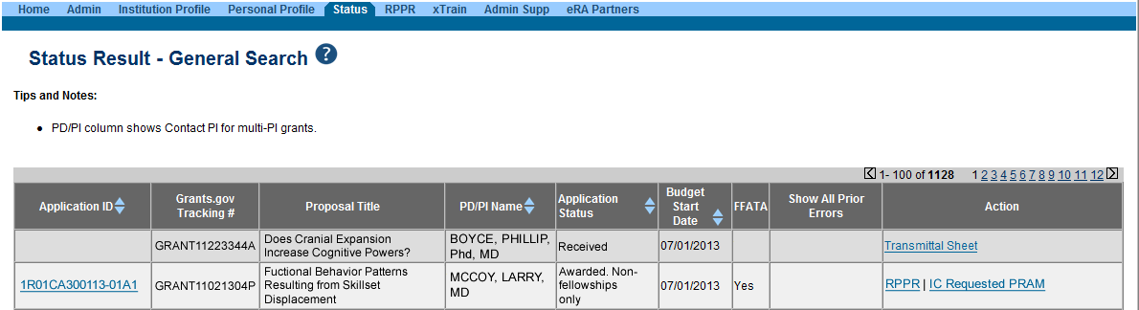
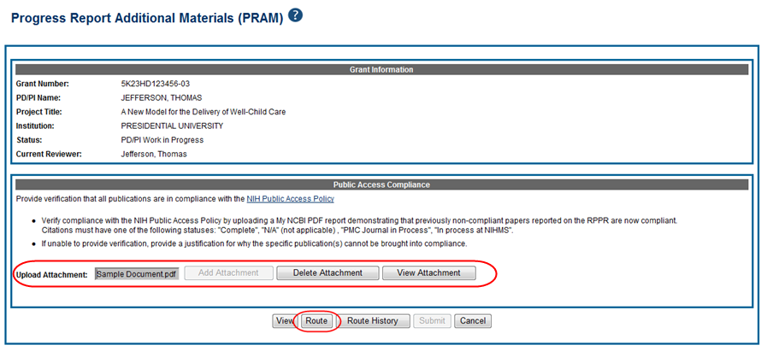
Progress Report Additional Materials - PRAM
Scarlett

Slide 39
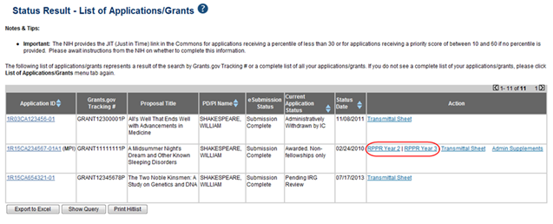
RPPR – Multi-Year RPPR
MYRPPR
  Multi Year Progress Reports now use RPPR format
  Link available under the Action Column in Status
Scarlett

Slide 40
RPPR – Budgets
Submitting progress reports with budgets
  R&R budget and PHS 398 budgets are now available for Non-SNAP RPPR.
  If presented with an option of budget forms, the type that was submitted with the application should be used.
    PHS 398 Budget is available only on training grants.
  Help for R&R Budget and PHS 398 Budget forms can be found in the SF424 R&R User Guides.
Scarlett

Slide 41
RPPR – Complex, Multi-Project
Submitting progress reports for complex, multi-project grants
  After RPPR is initiated, PI will need to identify if RPPR should contain components.
  RPPR should have the same structure as the originally submitted application.
  Some sections are not available on Overall component (i.e. Budget)
  Some sections are not available on component level (i.e. Participants and Publications are reported on Overall)
Scarlett

Slide 42
New Format for PA PRAM
Public Access (PA) PRAM will require an attachment.
  The PA PRAM will no longer contain a free form text box.
  Using My NCBI the institution will need to generate a PDF of their reported publications showing their compliance.
  For instructions on generating the report please see: http://www.nlm.nih.gov/pubs/techbull/nd12/nd12_myncbi_pdf.html
Scarlett

Slide 43
RPPR – What’s New
Use of Updated Inclusion Enrollment Format Now Required for Successful Submission of RPPR. Old formatted inclusion data results in an error.
  NOT-OD-15-078
Use of New Inclusion Management System Required as of October 17, 2014
  NOT-OD-15-005
Scarlett

Slide 44
Key eRA Commons
Features – T3
Submitting an administrative supplement
(type 3s)
Using era Commons
Joe

Slide 45
Administrative Supplements
Requested additional costs must be within the scope of the peer reviewed and approved project
Multiple submission methods available:
  SF424 (R&R) application forms & standard Grants.gov submission process¹
    Great for system-to-system users
  Streamlined eRA Commons process¹
    Commons pre-populates much of the data needed for request from awarded grant
  Paper process
A request for additional funds during a current project period to provide for an increase in costs due to unforeseen circumstances.
Joe
¹Available for single-project activity codes for which competing applications are submitted through Grants.gov.

Slide 46
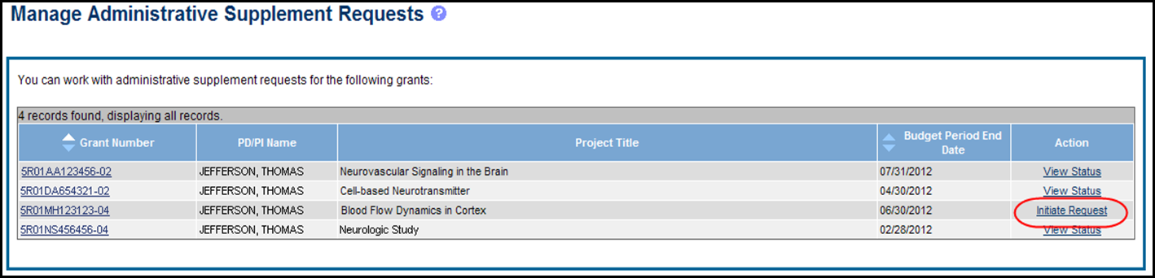
Admin. Supplement Requests - Initiate
Starting an Administrative Supplement request in Commons you must find eligible grant and Initiate Request
Joe

Slide 47
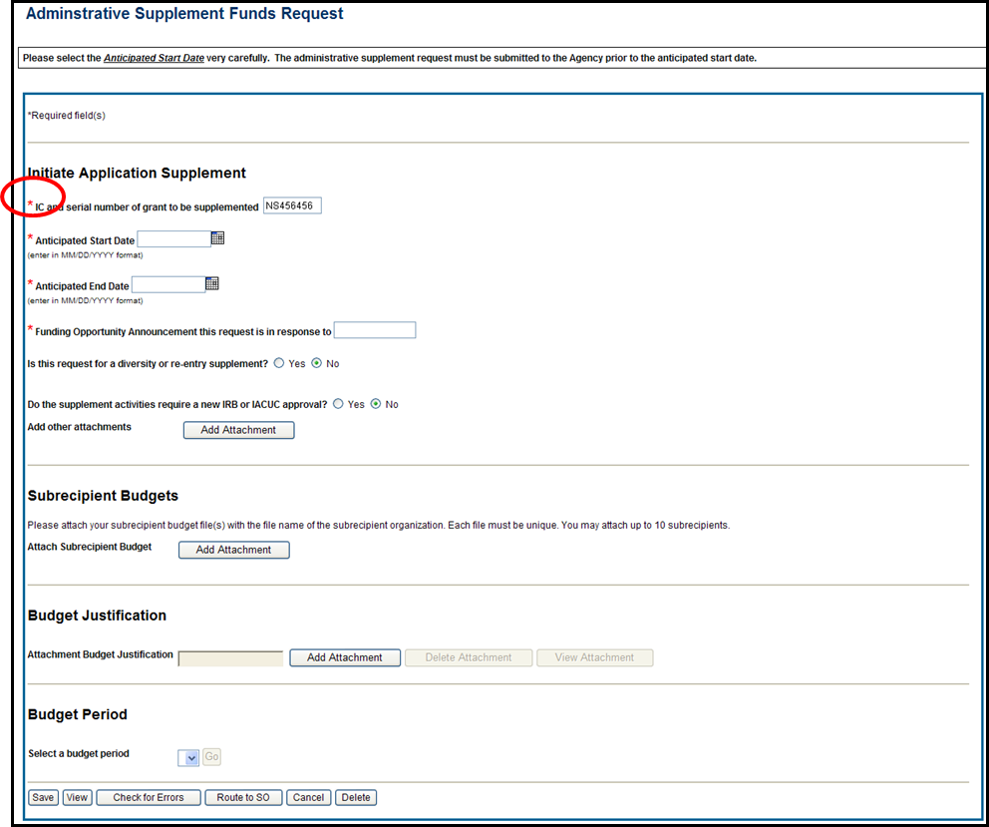
Admin. Supplement Requests – Required Fields
Complete Form – Required Fields are indicated with red asterisk
Joe

Slide 48
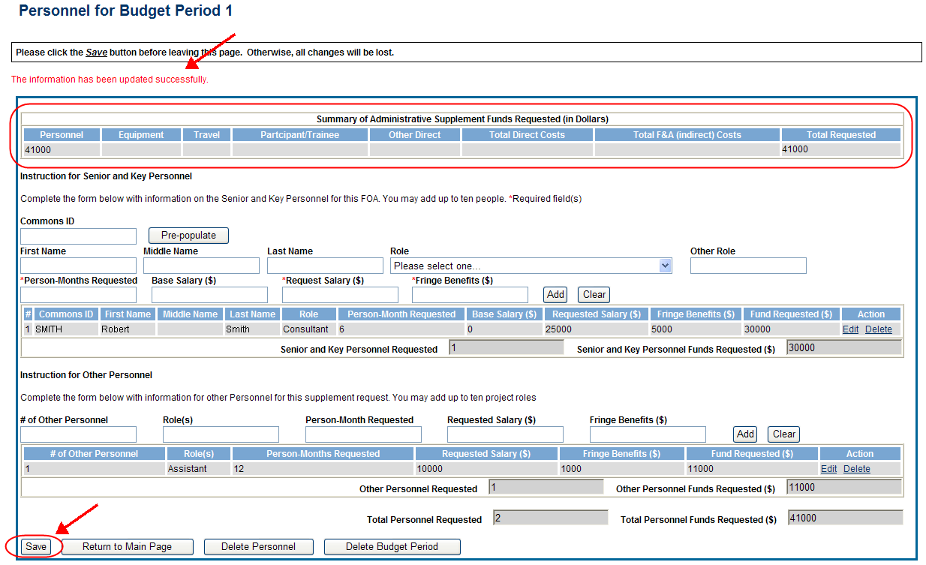
Admin. Supplement Requests - Save
For each Budget Period enter appropriate sections:
  Personnel, Equipment, Travel, Participant/Trainee, Other Direct, Total F&A (Indirect) Costs
Total Requested will be calculated automatically
Joe

Slide 49

Admin. Supplement Requests - Commons
Resources:
  eRA Commons Administrative Supplement Module User Guide
    http://era.nih.gov/files/eRA_Commons_Admin-Supp_UG.pdf
  Administrative Supplements (Type 3s) Frequently Asked Questions
    http://era.nih.gov/commons/faq_commons.cfm#XVIII
Joe

Slide 50
Key eRA Commons
Features – Relinquishing Statement
Submitting a relinquishing statement
Scarlett

Slide 51
Relinquishing Statement
Processed in eRA Commons
  To relinquish any awarded grant
Original institution
  Submits relinquishing statement
  Can select new grantee organization or enter contact information if organization is not Commons Registered
New institution
  Receives eNotification from eRA Commons
  Can view in eRA Commons
NIH Awarding Institute
  Reviews and accepts or returns for correction
PHS 3734 form
Scarlett

Slide 52
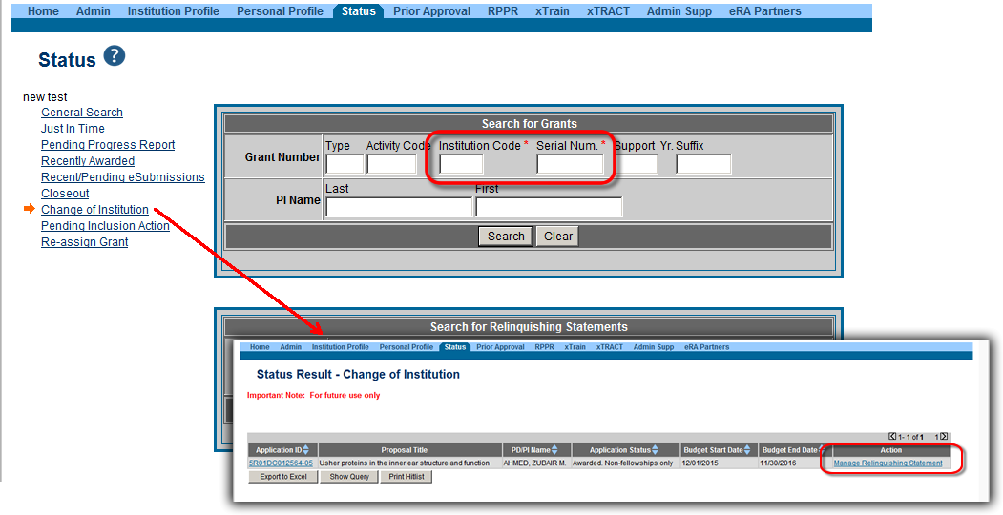
Relinquishing Statement - Search
Use Change of Institution Search
  Must provide at least the Institute Code and Serial Number as search parameters
Scarlett

Slide 53
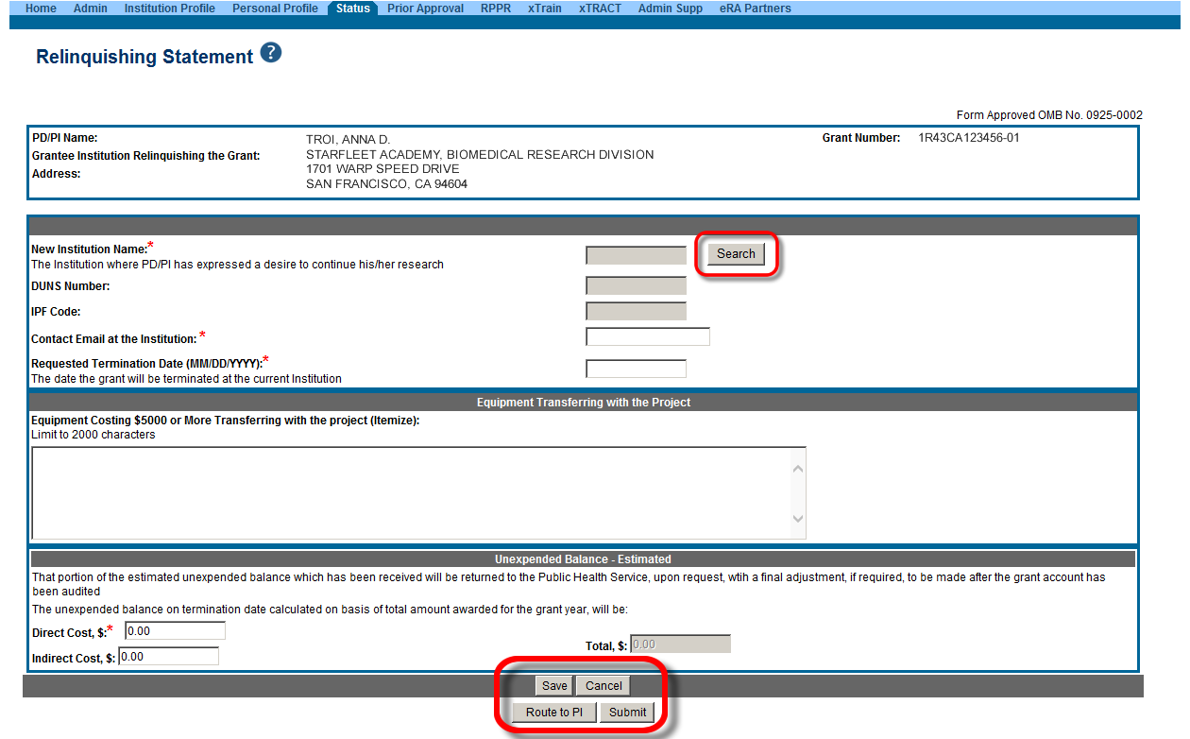
Relinquishing Statement Data Entry Screen
Change of Institution User Guide:
http://era.nih.gov/files/ccoi_userguide.pdf
Scarlett

Slide 54
Key eRA Commons
Features - T7 & T6
Change of institution (type 7)
Change of Organization status (type6)
Scarlett

Slide 55
Change of Grantee (Type 7) Requests
Request for support of a funded project that has been transferred from one grantee or training institution to another.
Also known as Change of Institution or transfer.
Scarlett

Slide 56
Change of Organization Status (Type 6) Request
Request for support of a funded project at an institution where the legal status has been changed.
Formerly known as Successor-In-Interest.
Scarlett

Slide 57

Type 6/7 Requests – Grants.gov
Available for post-award requests for single-project activity codes for which competing applications are submitted through Grants.gov
Though not yet required, applicants are encouraged to use and become familiar with the electronic option
Talk to your awarding Institute prior to submission
Scarlett

Slide 58
Type 6/7 Requests – Grants.gov Application Package
Parent Announcement page has general use FOAs
  http://grants.nih.gov/grants/guide/parent_announcements.htm#post
When completing package…
  Follow all FOA-specific instructions
  Carefully choose appropriate application package
  Use Revision as the Application Type (SF424 RR, item #8)
  Include IC and Serial number of awarded grant as the Federal Identifier (SF424 RR, item #4a)
Scarlett

Slide 59
Type 6/7 Requests & Grants.gov
Similar to competing application process, except:
  Many of the NIH business rule validations for competing applications are not enforced
  Required forms may vary from competing applications for the same activity code
    Modular budget forms not an option; must use R&R Budget forms
    Type 6
      Only a few required forms
        SF424 (R&R) cover, Other Project Information, SR/Key Information
      Optional forms vary by program
    Type 7
      Budget forms added to some Type 7 form packages (e.g., DP1, DP2, DP3)
Scarlett

Slide 60
Type 6/7 Requests – Application Viewing Window
  After the two-day viewing window the request bypasses Receipt & Referral and goes directly to Grants Management staff for consideration
    Requests move to List of Applications for PIs and General Search (for SOs) like competing applications
Scarlett

Slide 61
Re-assign Grants
The option to move a grant from one department to another within the same institution
Joe

Slide 62
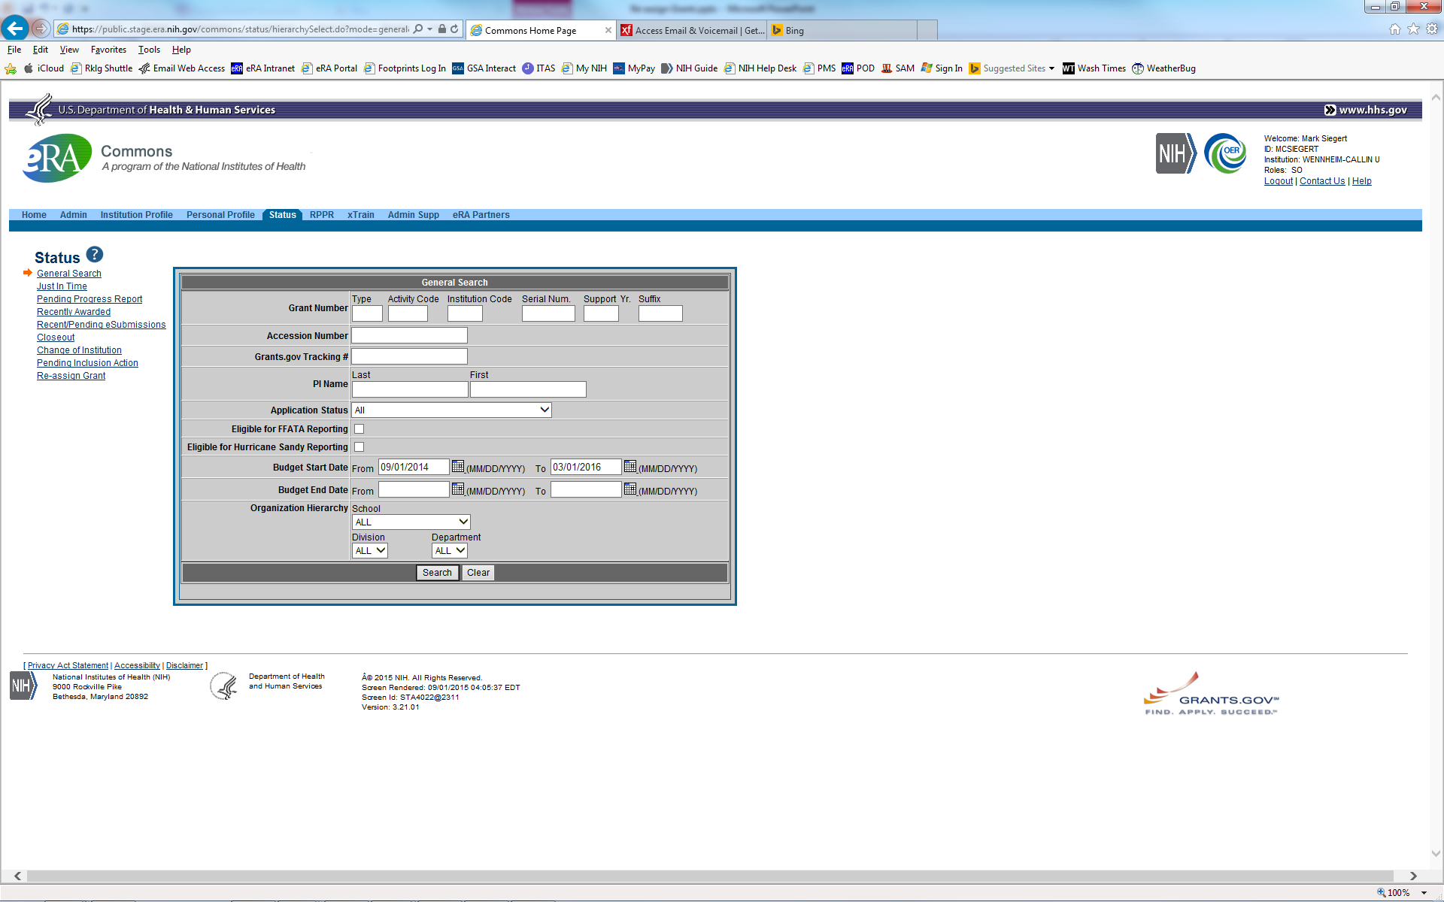
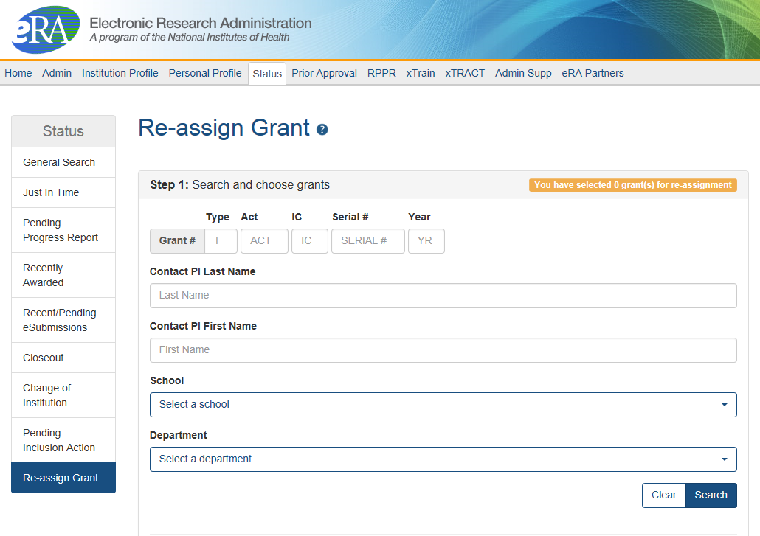
New Function on Commons Status Page
Joe

Slide 63
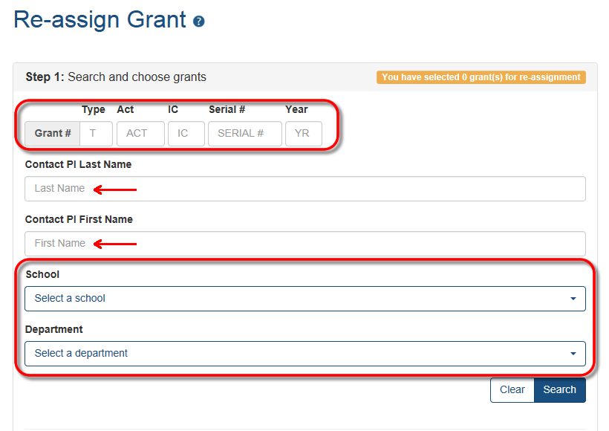
Multiple Search Options
Joe
Step 1: Select grant(s) to re-assign.

Slide 64
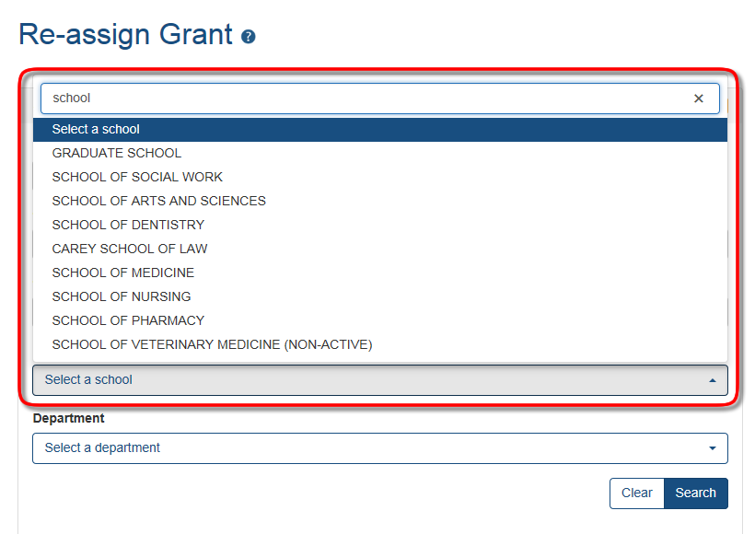
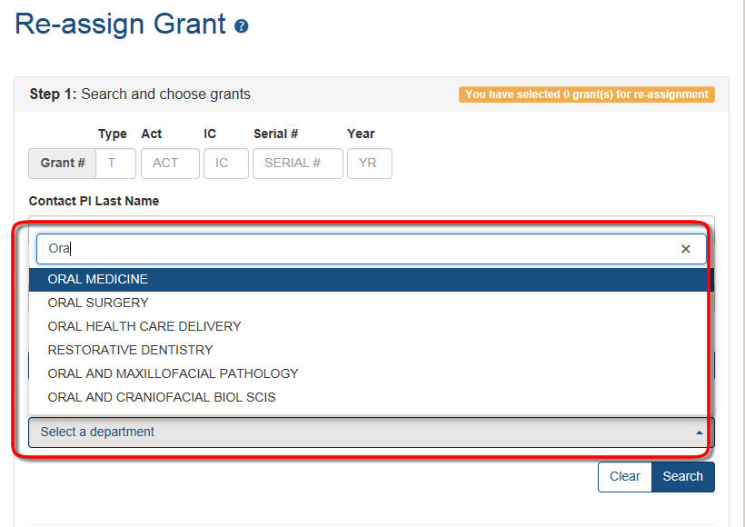
Selecting the School & Department
School drop down menu contains all active major components for the organization (School of Medicine, School of Public Health, etc.)
Department drop down will list all active departments associated with the selected School. No departments are listed if a school has not been selected.
Joe

Slide 65
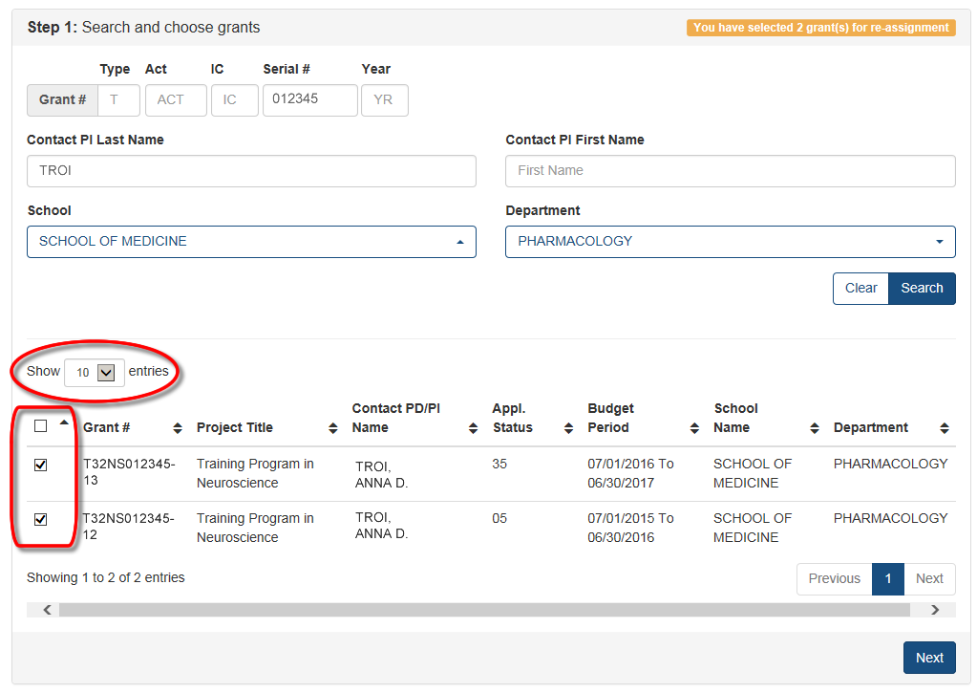
Search Results & Selecting Grants to Move
Number of entries to show in the results list can be configured.
Any or all grants in the results list can be selected to move to the same location.
Joe

Slide 66
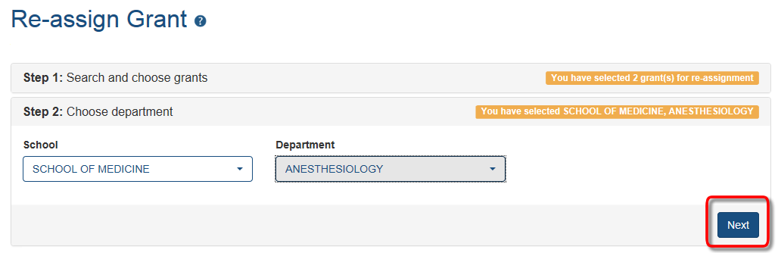
Choose the Target Assignment
Drop downs for School and Department work exactly like the search page drop downs.
Select the target School and Department and click the Next button.
Joe

Slide 67
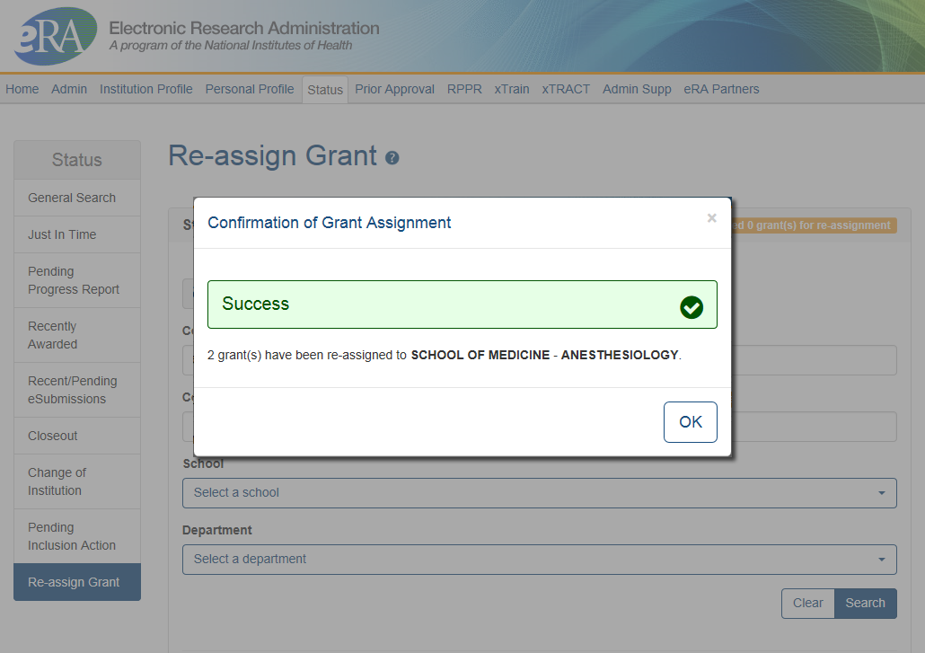
Confirmation of Grant Assignment
Grants have been re-assigned to the School of Medicine – Department of Anesthesiology.
Joe

Slide 68
Key eRA Commons
Features - Closeout
Wrapping up the ‘paperwork’ with closeout
Scarlett

Slide 69
Closeout
Closeout items include:
  Final Research Performance Progress Report (FRPPR)
  Federal Financial Report (FFR)
  Final Invention Statement
NIH must mark the grant “ready for close out” for link to appear in Commons
  Contact the Division of Central Grants Processing (DCGP) or assigned Grants Management Specialist (GMS) if link is not appearing
New!
Electronically submit required Closeout documents for grants in Closeout status
Scarlett

Slide 70
Closeout Capabilities
Identify expiring and terminating grants
Request and track required closeout documents
Track submission of boxed archived paper grant records at the Federal Record Center (FRC)
Scarlett

Slide 71
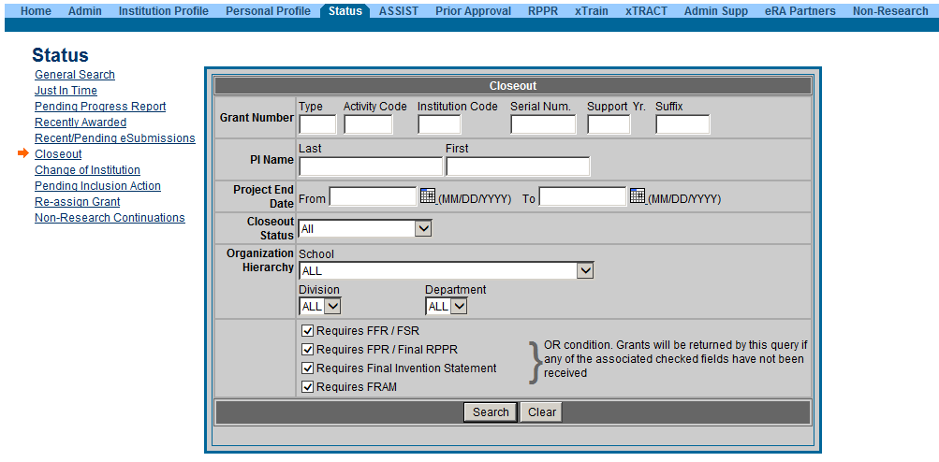
New Closeout Search screen provides additional search criteria
Scarlett

Slide 72
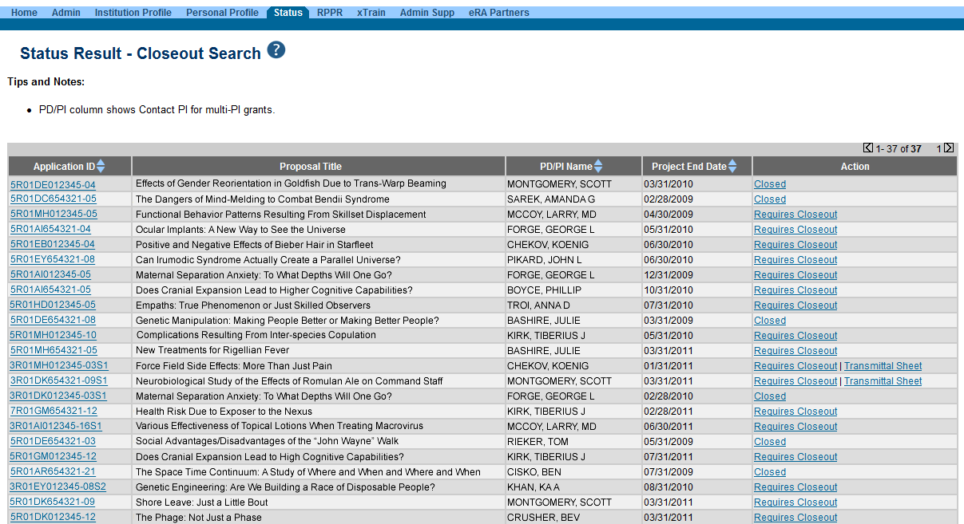
Search screen shows grants that are Closed or Requires Closeout
Scarlett

Slide 73
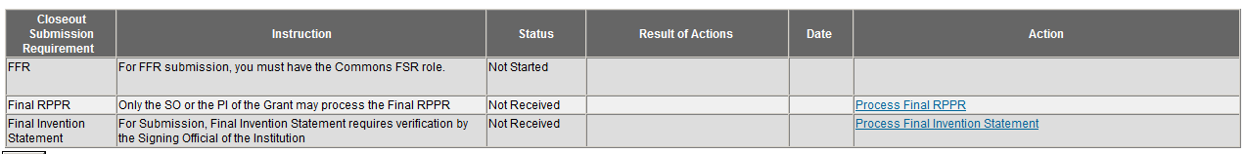
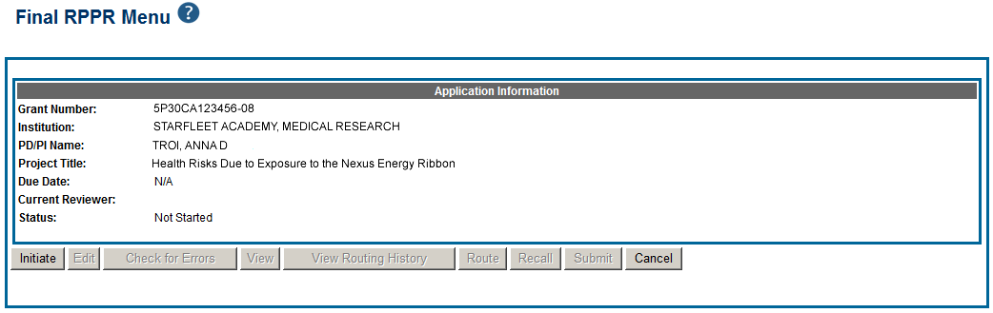
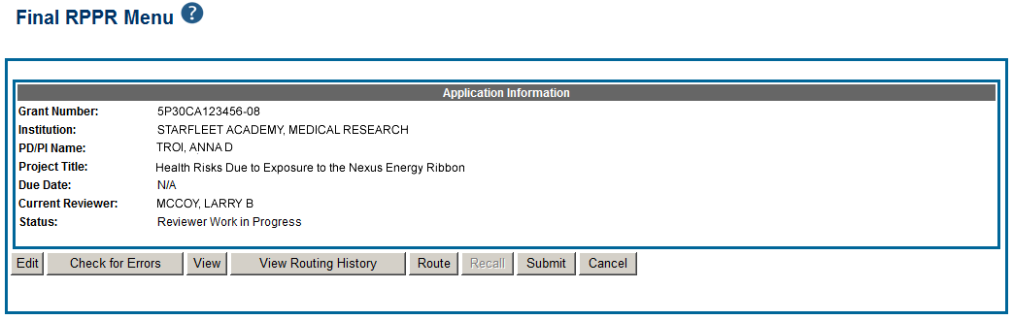
Closeout – Final Research Performance Progress Report (FRPPR)
The Final RPPR has the same permissions and delegations as the Final Progress Report (FPR). Both SOs and PIs can initiate or submit to agency.
Scarlett

Slide 74
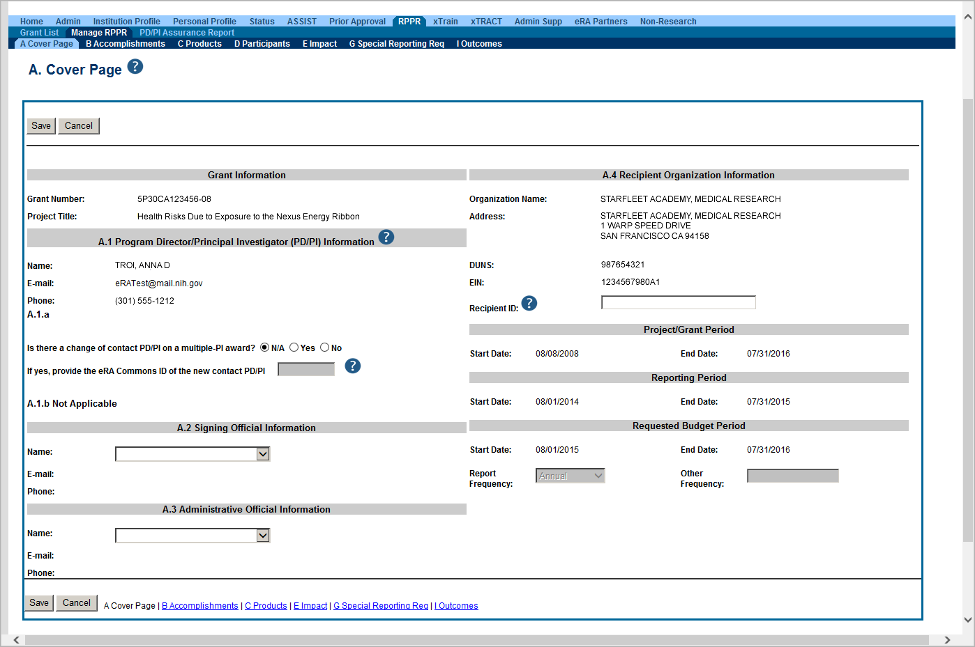
Closeout – Final Research Performance Progress Report Sections
Similar navigation tabs as the annual RPPR.
A new section called Outcomes has been added.
Scarlett

Slide 75
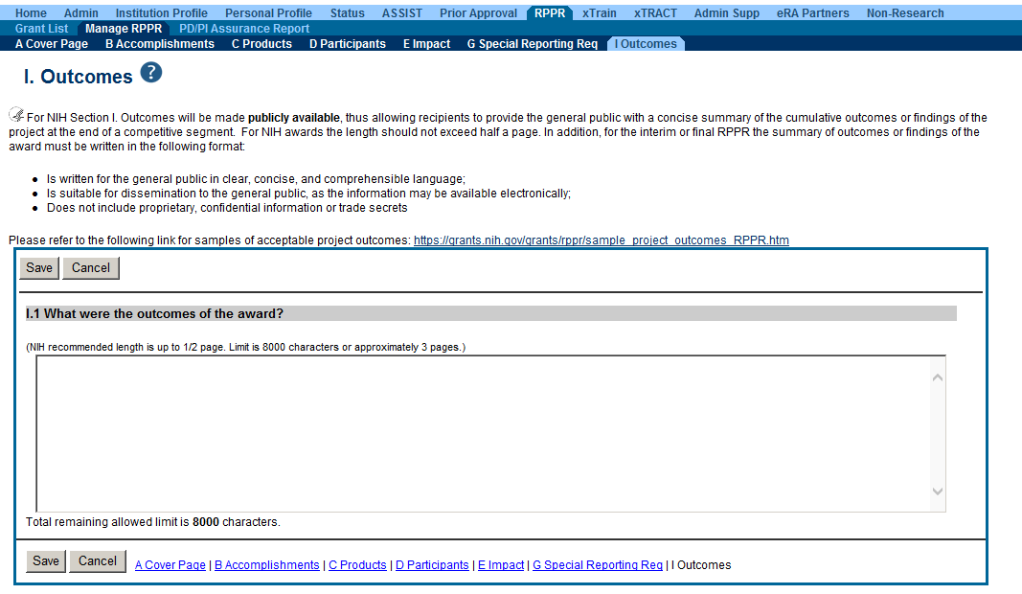
Closeout – Final Research Performance Progress Report Outcomes
Information in Outcomes will be publically available. It should be written as a high level and in plain language.
Scarlett

Slide 76
New! Interim Research Performance Progress Report (IRPPR)
Effective February 9, 2017
  If the recipient organization has submitted a Competing Renewal application (Type 2) on or before the date by which a Final Research Performance Progress Report (Final-RPPR) would be required for the current competitive segment, then submission of an "Interim RPPR" via eRA Commons is now required.
Scarlett

Slide 77
IRPPR vs FRPPR
(Interim vs Final RPPR)
IRPPR
  The Interim RPPR link will made available to the SO and the PI in the Status screen when a grant is eligible for submission of a Competing Renewal application.
  Only Section D.1 of Participants is required
  Sections F: Changes and Section H: Budget are not part of the Interim RPPR
  Section I: Outcomes is new. Section I is required for the Interim RPPR
FRPPR
  The Final RPPR is only available as part of the Closeout process and the Process Final RPPR link only appears on the Closeout Status screen.
  Only Section D.1 of Participants is required
  Sections F: Changes and Section H: Budget are not part of the Final RPPR
  Section I: Outcomes is new. Section I is required for the Final RPPR
Scarlett

Slide 78
Interim RPPR Scenarios
Since a renewal application is competitive, there is no guarantee it will be funded. Therefor the following scenarios should be noted:
Completing Renewal Application Status | Action
Not submitting a Competing Renewal application | Submit a Final RPPR no later than 120 days from the project period end date
Submitting a Competing Renewal application | Submit an Interim RPPR no later than 120 days from the project period end date
 | Funded | Not Funded
 | The Interim RPPR is accepted as the annual RPPR | The Interim RPPR is accepted as the Final RPPR
Scarlett

Slide 79
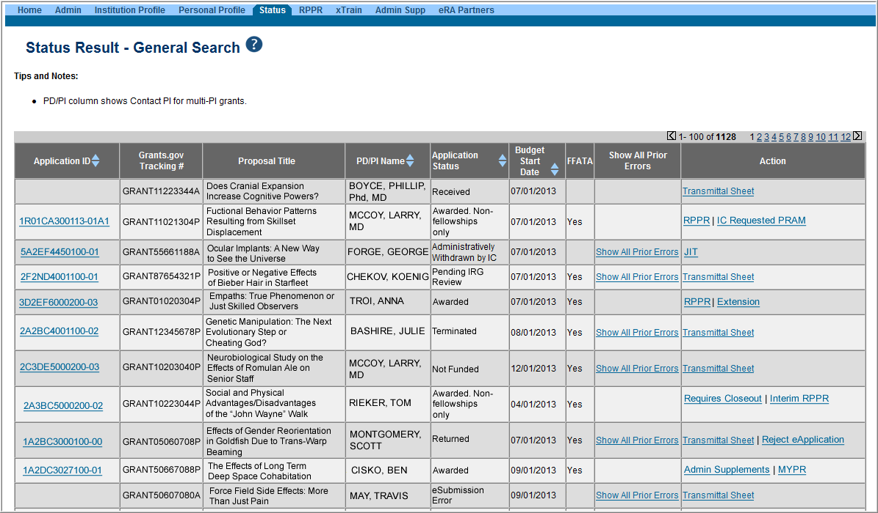
Selecting Interim RPPR
  Select Interim RPPR link from Status search results (SO view shown)
Scarlett

Slide 80
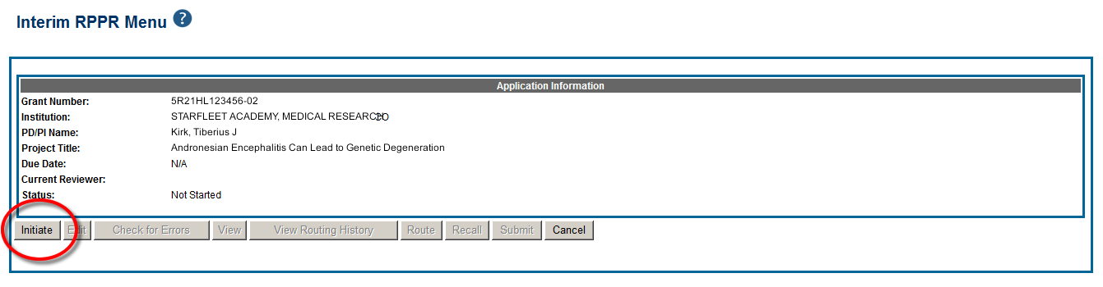
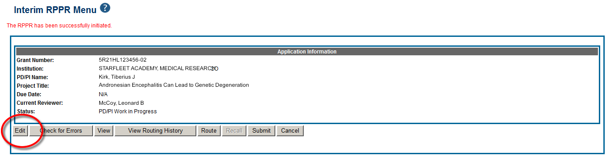
Initiate Interim RPPR
  Select Initiate from the Interim RPPR Menu screen
  Select Edit from the Interim RPPR Menu screen
Scarlett

Slide 81
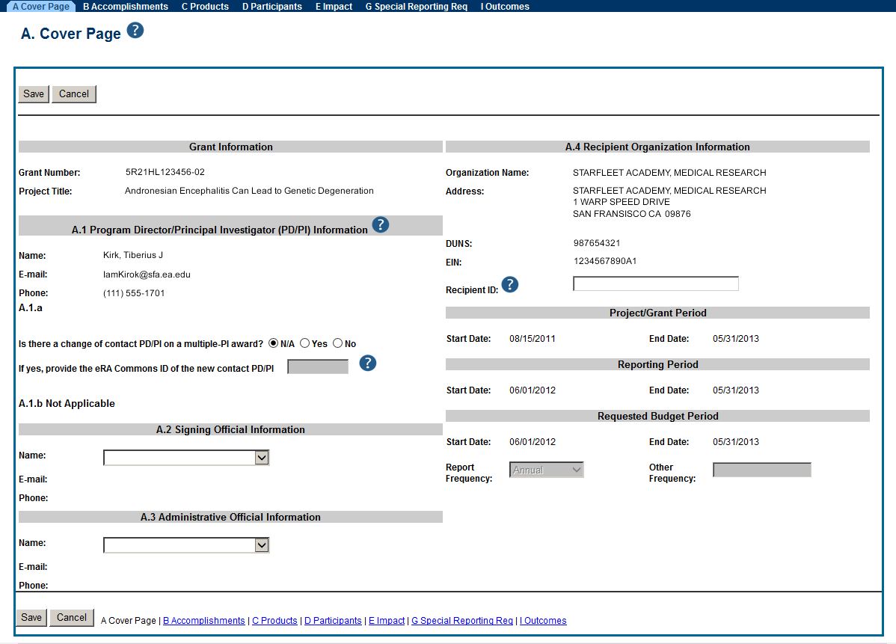
Complete Interim RPPR
  Complete each of the sections as required and Save when done.
Scarlett

Slide 82
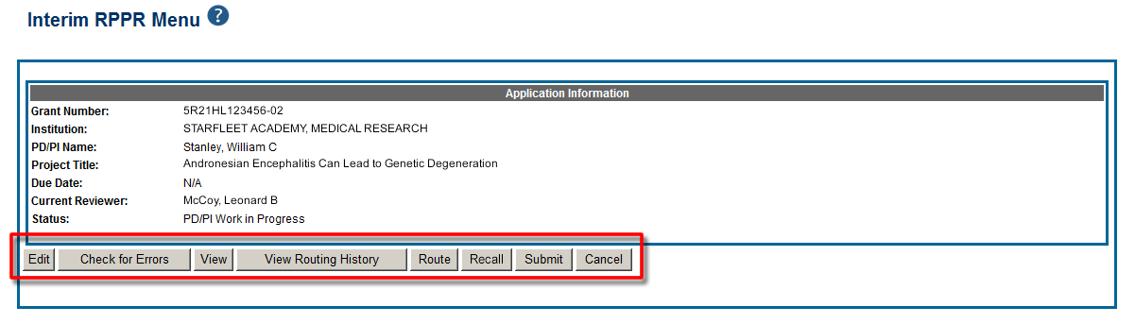
Action on Interim RPPR
  From the Interim RPPR Menu screen, there are several action buttons at the bottom that can used to complete the Interim RPPR.
Scarlett

Slide 83
Delegations and Permissions for Interim RPPR
  Interim and Final RPPR work in the same manner as the old Final Progress Report (FPR).
  Both SOs and PIs can initiate and/or submit to agency.
  They can also route the report back and forth for review and edits. All of this done without the need to delegate any authority.
  No delegations needed for the initiation and submission of either version of these RPPRs.
Scarlett

Slide 84
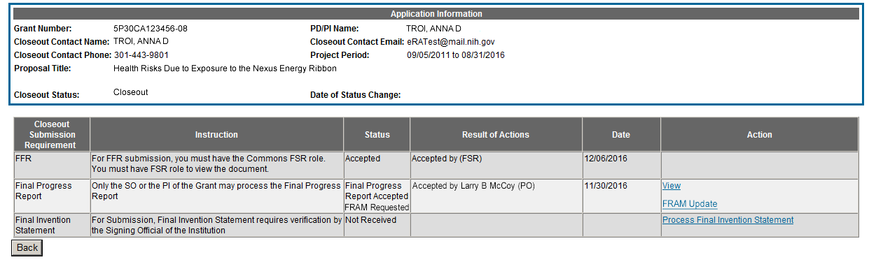
Closeout – Final Report Additional Materials
(FRAM)
FRAM works in same manner as PRAM in RPPR
Awarding IC sets status to FRAM Requested
Awarding IC triggers email for requested information to the SO & PI
The FRAM Update link appears in Action column
Scarlett

Slide 85
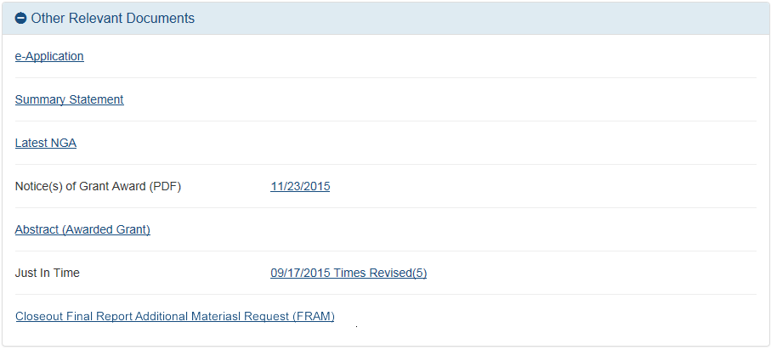
Closeout – Final Report Additional Materials
(FRAM) in Status Information
Specifics about the FRAM request can also be found in Other Relevant
Documents section of the Status Information screen.
Scarlett

Slide 86
Federal Financial Report (FFR)
FFRs must be submitted in eRA Commons via the FFR/FSR module
  Cash transaction data still submitted via Payment Management System
FSR role for users who have the authority to view, enter, and submit an FFR on behalf of institution
Allows grantees to electronically submit a statement of expenditures associated with their grant to NIH via eRA Commons.
Scarlett

Slide 87
FFR
Annual FFR due date: For non-SNAPs, FFR must be submitted within 120 days of the calendar quarter in which the budget period ends
Final FFR due date: based on the Project Period End Date (PPED):
  Pending Status: If the FFR is not submitted and it is within 120 days of the PPED
  Due Status: If the FFR is not submitted and it is between the PPED and 120 days past the PPED
  Late: If the FFR is not submitted and it is more than 120 days past the PPED
Scarlett

Slide 88
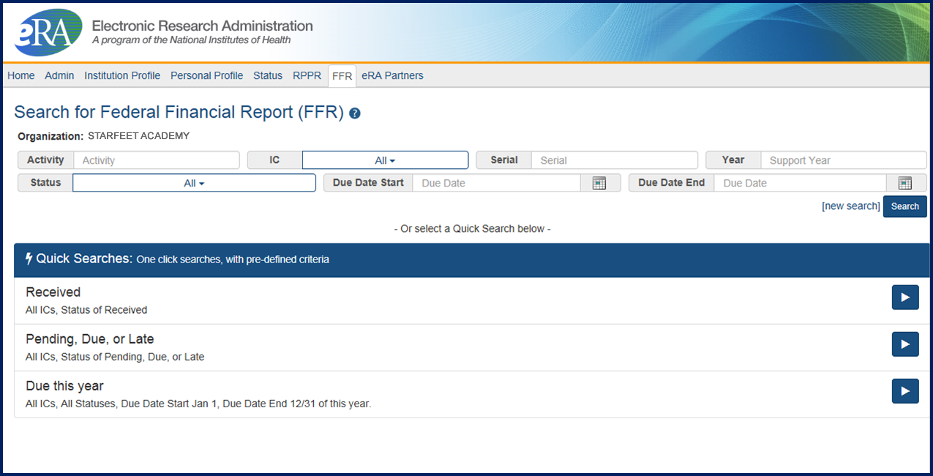
FFR/FSR Screen
Scarlett

Slide 89
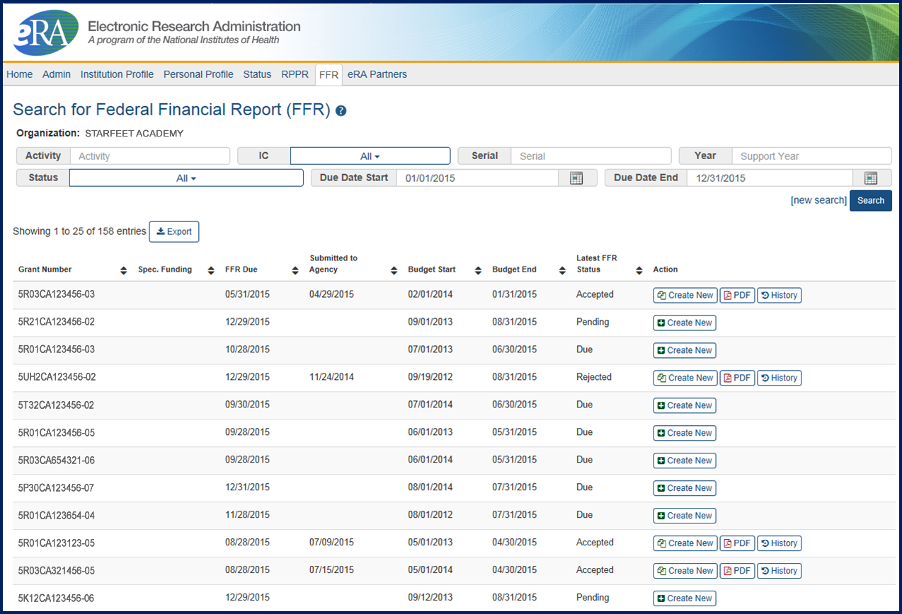
FFR/FSR Search Screen
The Grant Number is a hyperlink that will take you to the FFR/FSR form.

Slide 90
FFR Details Screen
Clicking the hyperlinked grant number opens the FFR Details screen, which displays:
  FFR Status:
    Received, Accepted, Rejected, In Review, or Revision Pending
  Available Actions:
    Accepted status: View or Create New
    Rejected status: View or Create New
    Received status: View or Correct
    Revision Pending status: View or Edit
    In Review status: View
Scarlett

Slide 91
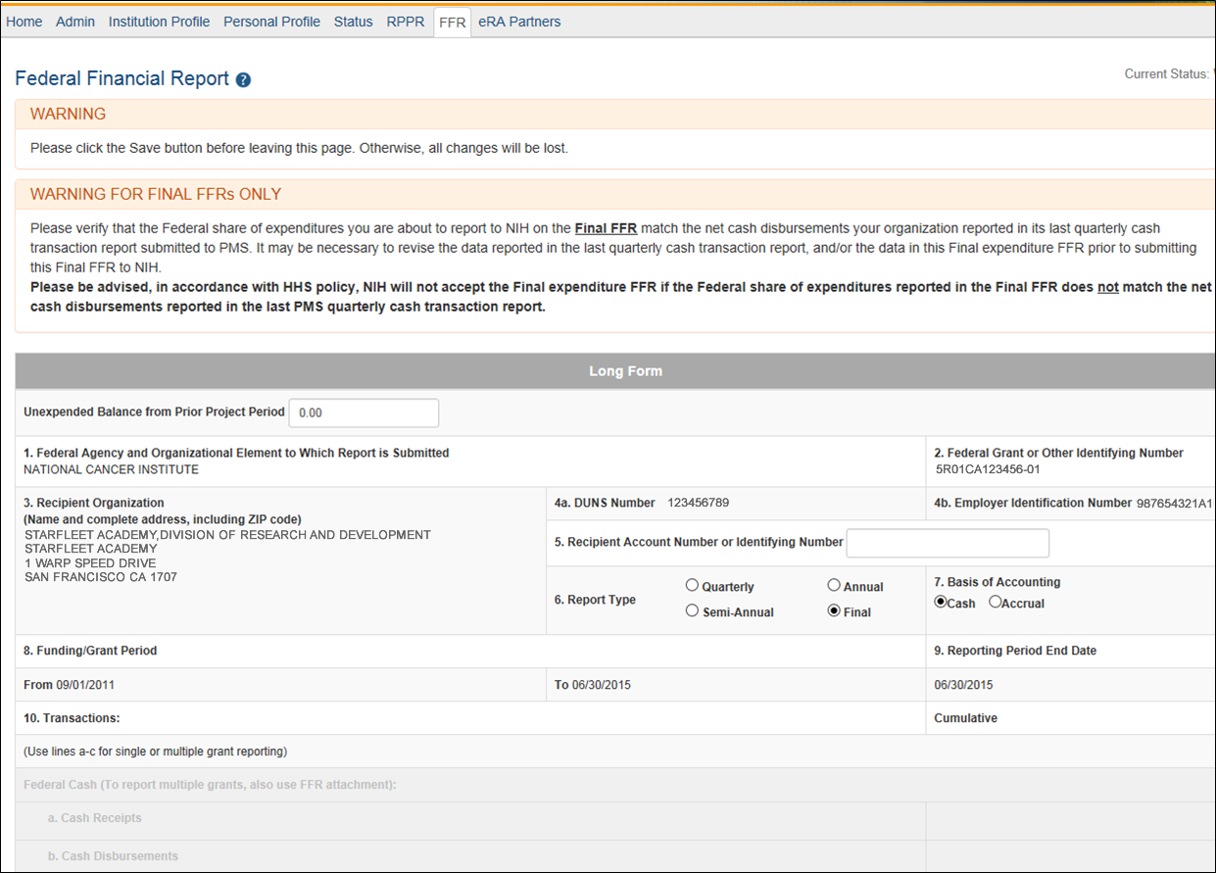
Completing the FFR
As current year entries are completed, calculations are done automatically.

Slide 92
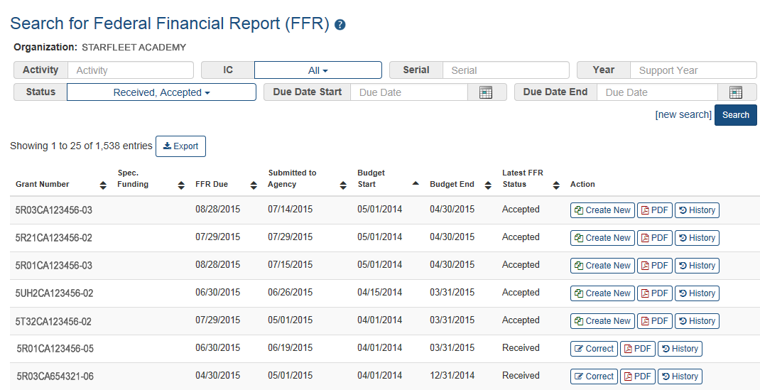
Submission of a FFR
Once FFR/FSR is Submitted, Latest FSR status changes to Received
If a mistake is made on the FFR and the status has changed to In Review, the institution should contact the eRA Service Desk to determine who the OFM staff is that is assigned by the NIH Institute/Center to resolve the issue.

Slide 93
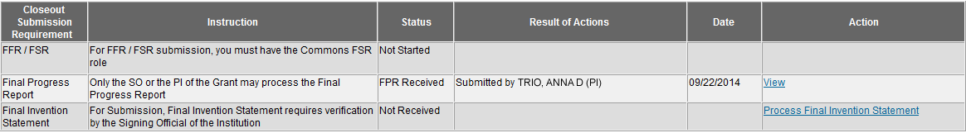

Closeout – Final Invention Statement
If inventions are to be reported, the specific inventions must be listed.
Either the PI or the SO can start the process, but the SO must verify the report before submitting it to the agency.
If Yes is selected, Add Invention screen appears.

Slide 94


Closeout – Add Invention
Verify saved inventions.
Remove any that do not apply.
Add any that are missing.
Select Verify.
Scarlett
Select OK.

Slide 95

Closeout – Awaiting SO Verification
Status of Final Invention Statement is changed to Awaiting SO Verification. SO can now verify and submit.
Scarlett

Slide 96
Closeout – Unilateral Closeout
To follow HHS Uniform Guidance, NIH will implement Unilateral Closeout on awards that do not complete Closeout reports in a timely manner
New notifications and statuses will alert grantees of impending Unilateral Closeout and what actions need to be taken or who to contact
See Guide Notice NOT-OD-14-084
http://grants.nih.gov/grants/guide/notice-files/NOT-OD-14-084.html
Scarlett

Slide 97
xTRACT
xTRACT creates research training tables for progress reports and institutional training grant applications.
Joe

Slide 98
xTRACT stands for
Extramural
Trainee
Reporting
And
Career
Tracking
Accessible via eRA Commons
  Used for Training Grants for
    RPPR Submissions
    New applications
  Can access information already in eRA Commons
  Creates Research Training Datasets (RTDs) [Training Tables]
  Tables are formatted, no manual formatting needed
  Accesible by:
    Signing Officials (SOs)
    Principal Investigators (PIs)
    Assistants (ASST)
NIH must mark the grant “ready for close out” for link to appear in Commons
  Contact the Division of Central Grants Processing (DCGP) or assigned Grants Management Specialist (GMS) if link is not appearing
Joe

Slide 99


Accessing xTRACT
Joe

Slide 100

Searching for Training Grants
Joe

Slide 101


xTRACT Navigation
Edit existing RTDs or
Initiate New RTDs
Easy step by step navigation
Advanced search features
Joe

Slide 102

Generate PDFs
Review PDFs before using
  Check for accuracy
Generate Final PDF for
  RPPR
  New Applications
  Attach as you would for manually generated PDFs
Joe

Slide 103
xTRACT Resources
Extramural Trainee Reporting And Career Tracking (xTRACT) Web Page
  https://era.nih.gov/services_for_applicants/other/xTract.cfm
Video Tutorials
  https://era.nih.gov/era_training/era_videos.cfm#xTRACT
Online Help
  https://era.nih.gov/erahelp/xtract/
FAQs
  https://era.nih.gov/commons/faq_commons.cfm#XX
User Guide
  https://era.nih.gov/files/xTRACT_userguide.pdf
Joe

Slide 104
Finding Help
Help Desks
On-line resources &Web sites

Slide 105
Service & Help Desks
eRA Service Desk
Grants.gov Contact
Center
Need Help? website
Web ticketing (preferred method of contact)
Toll-free: 1-866-504-9552
Phone: 301-402-7469
Hours: Monday-Friday (excluding Federal holidays)
Toll-free: 1-800-518-4726
Hours : 24x7 (Except Federal Holidays)
Email : support@grants.gov
Help Resources: http://www.grants.gov/web/grants/support.html

Slide 106

Web Sites
eRA Commons: https://commons.era.nih.gov/commons/
Electronic Research Administration: http://era.nih.gov/
How to Apply – Application Guide: http://grants.nih.gov/grants/how-to-apply-application-guide.htm
NIH About Grants: http://grants.nih.gov/grants/oer.htm

Slide 107

Thank you

