Slide 1




NIH eRA Workshop:
Grant Application Preparation & Submission
May 2017
electronic Research Administration (eRA)
OER, OD, National Institutes of Health
New Orleans

Slide 2

Your Workshop Team
Sheri Cummins
  Office of Extramural Research (OER) Communications & Outreach
  Chief, Grants Information
  cumminss@od.nih.gov
Laurie Roman
  Electronic Research Administration (eRA)
  Customer Relationship Manager, eSubmission
  laura.roman@nih.gov

Slide 3
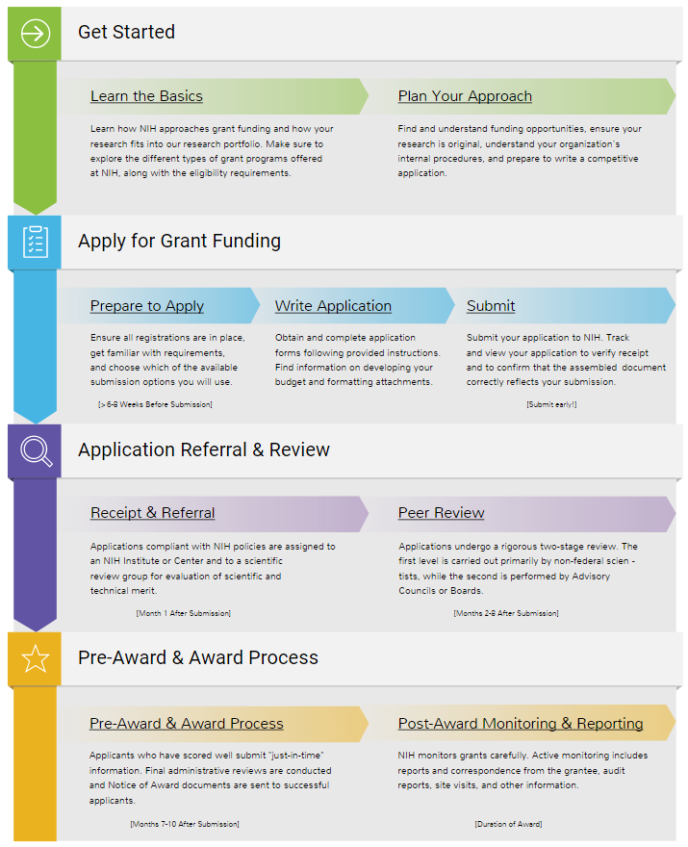

Today’s Topics
How to Apply
  Application Guide
  Prepare to Apply & Register
  Format and Write
  Submission Process
  Reference Letters
  Finding Help
Avoiding the “gotchas”
Demos
  ASSIST
  eRA Commons
Submission Policies (time permitting)
Submitting Administrative Type 3, 6 and 7 requests (time permitting)
Wrap-up

Slide 4
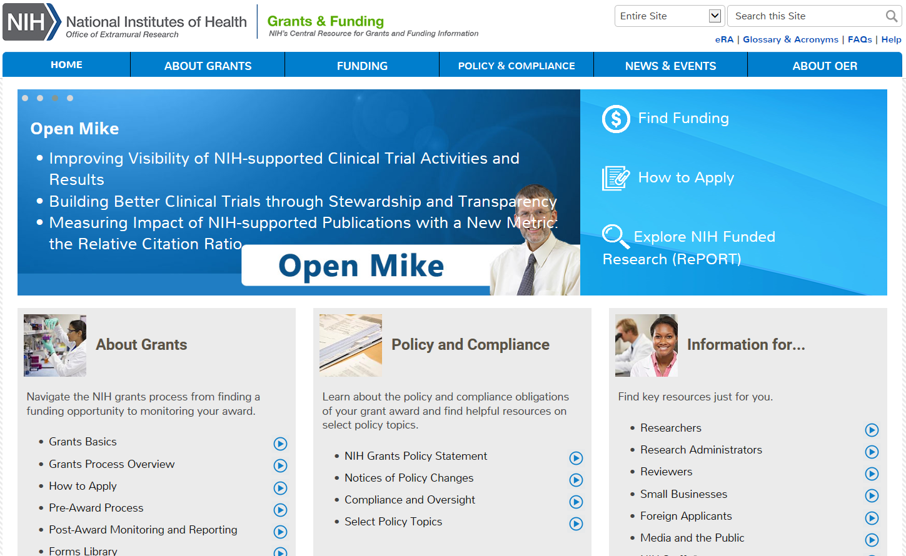
NIH Grants & Funding
How to Apply- Application Guide
http://grants.nih.gov

Slide 5
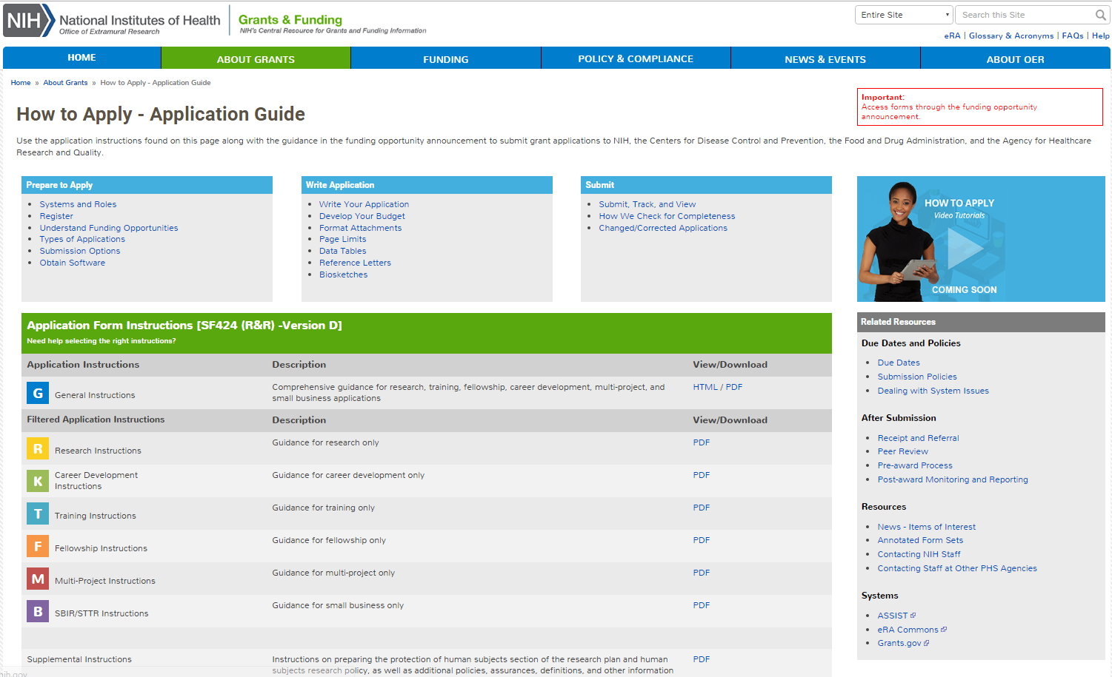
How to Apply – Application Guide
General Application Process Information
Form Instructions
Resources
http://grants.nih.gov/grants/how-to-apply-application-guide.htm

Slide 6
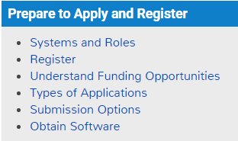

Prepare to Apply and Register

Slide 7


Make a Submission Plan
Gather team
Verify registrations are in place and active
Determine application preparation responsibilities
Make sure everyone is aware of process
  Sharing applications in progress
  Internal review & approval process
  NIH deadlines
  Internal deadlines
  Post-submission responsibilities
    How to deal with errors/warnings
    Who will verify application in eRA Commons?
Make a plan before you need one!

Slide 8


Understand Key Systems & Roles
Grants.gov
eRA Commons
E-Business Point of Contact (EBiz POC)
Authorized Organization Representative (AOR)
Signing Official (SO)
Principal Investigator (PI)
http://grants.nih.gov/grants/how-to-apply-application-guide/prepare-to-apply-and-register/key-systems-and-roles.htm

Slide 9


Multiple Organization Registrations Required
Allow a minimum of 6 weeks
to complete all registrations!
http://grants.nih.gov/grants/how-to-apply-application-guide/prepare-to-apply-and-register/registration/org-representative-registration.htm
Notes:
Dun & Bradstreet (D&B) provides a free, unique nine-digit identification number for your business/institution
Begin the process at: http://fedgov.dnb.com/webform
After obtaining your DUNS, you can begin SAM, SBA Company and eRA Commons registrations
As part of SAM registration process, you will designate an E-Business Point-of-Contact (E-Biz POC)
www.sam.gov
SAM registration and E-Biz POC needed for Grants.gov registration
Annual renewal in SAM is needed to keep Grants.gov credentials active
Grants.gov is a federal-wide portal to find and apply for Federal grant funding
Used by all 26 Federal grant-making agencies
Prior to registering in Grants.gov you must obtain a DUNS number and register in SAM
E-Biz POC approves Authorized Organization Representatives (AORs) to submit applications
No registration needed to find opportunities or download forms

Slide 10


DUNS
Dun & Bradstreet Data Universal Numbering System (DUNS)
  Begin the process at:
    http://fedgov.dnb.com/webform
After obtaining your DUNS, you can begin other registrations
  System for Award Management (SAM)
  eRA Commons
  SBA Company (small business only)
A free nine to thirteen-digit identification number issued by Dun & Bradstreet (D&B) is used to uniquely identify your business/ institution
http://fedgov.dnb.com/webform
Telephone Number:
866-705-5711

Slide 11

System for Award Management (SAM)
Designate an E-Business Point-of-Contact (E-Biz POC)
SAM registration and E-Biz POC needed for Grants.gov registration
Annual SAM renewal needed to keep Grants.gov credentials active
Register your entity (i.e., organization) to do business with the Federal Government
www.sam.gov
Telephone Numbers:
US Calls: 866-606-8220
International Calls: 334-206-7828
DSN: 866-606-8220

Slide 12

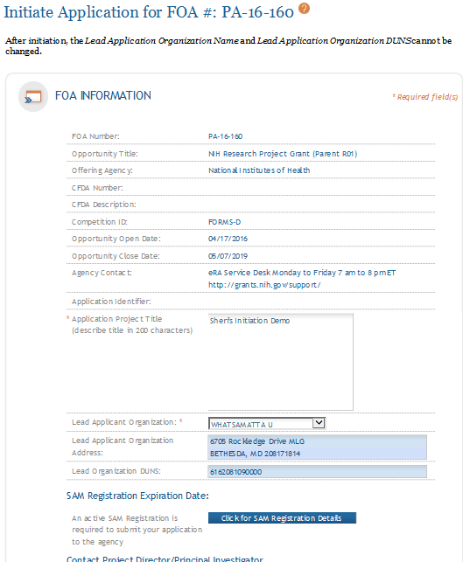
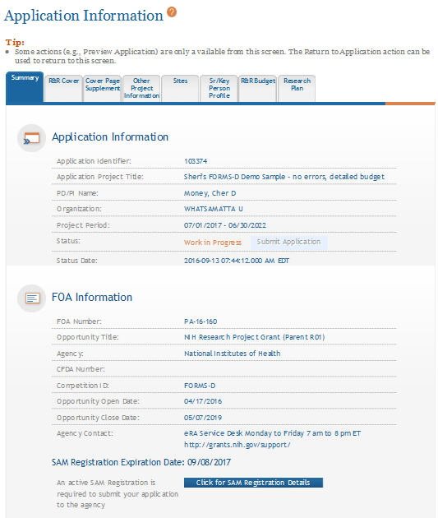
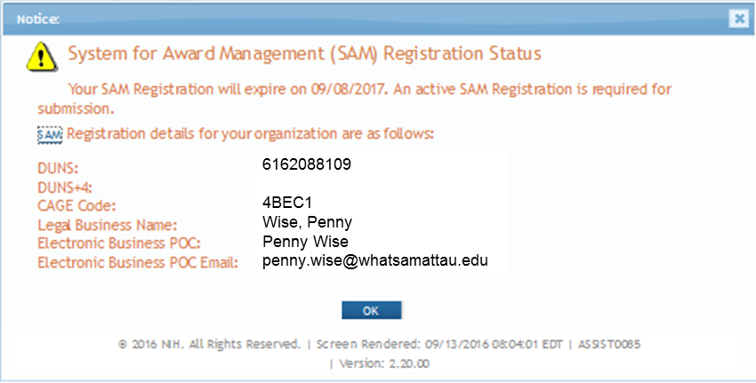
Visibility of SAM Registration Status in ASSIST
Initiate Screen
Application Information Screen

Slide 13
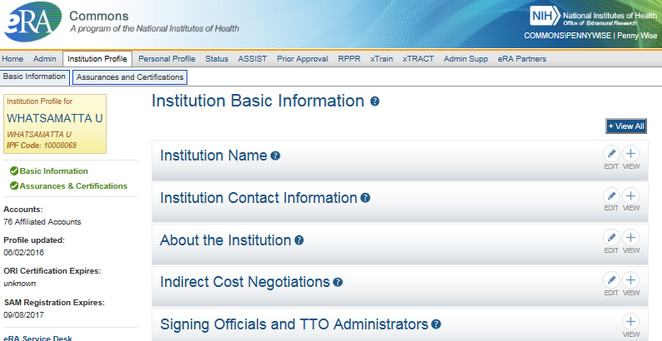
Visibility of SAM Registration Status in eRA Commons

Slide 14

Grants.gov
Used by all 26 Federal grant-making agencies
Prior to registering in Grants.gov you must obtain a DUNS number and register in SAM
E-Biz POC approves Authorized Organization Representatives (AORs) to submit applications
No registration needed to find opportunities or access forms
Federal-wide portal to find and apply for Federal grant funding
Telephone Numbers:
US Calls: 1-800-518-4726
International Calls: 606-545-5035

Slide 15

eRA Commons
  Used by NIH and a few other HHS divisions
Designate a Signing Official (SO)
  Registers or affiliates Project Directors/Principal Investigators (PD/PIs) and other users
NIH 2-week “good faith effort” for eRA Commons registration
Agency system that allows applicants, grantees and Federal staff to share application/grant information
Support:
http://grants.nih.gov/support/index.html

Slide 16

Signing Official (SO)
During Commons registration, an applicant organization designates a Signing Official (SO)
  SO has authority to legally bind the organization in grants administration matters
  Equivalent signature authority to the Authorized Organization Representative (AOR) in Grants.gov
  SO is responsible for:
    maintaining institutional information
    submitting documents that require signature
    authority to act on behalf of the organization
    managing accounts (or authorizing others to do so)

Slide 17

Individual eRA Commons Registrations
Who needs an eRA Commons account?
  At least one Signing Official (SO)
  Project Director/Principal Investigator (PD/PI) and any multiple-PD/PIs
  Component leads on a multi-project application
  Sponsor on a fellowship application (NOT-OD-14-129 – August 2014)
  Candidates for diversity and re-entry supplements
  Primary mentor identified on individual mentored career development applications (NOT-OD-16-082 – March 2016)
  Anyone doing data entry in ASSIST
  If awarded, additional individuals may need accounts for reporting purposes
http://grants.nih.gov/grants/how-to-apply-application-guide/prepare-to-apply-and-register/registration/investigators-and-other-users/era-commons-user-registration.htm

Slide 18

Account - Tips
Designate more than one Signing Official
  Certain Commons actions can only be taken by users with the SO role and you will want a back-up
Administrators should always check to see if a user already has a Commons account before creating a new account with a scientific role
  Ask the person if they already have an account, or search within the Commons
    If a user already has an account with a different organization,
    you should affiliate the existing account with the user’s
    new organization

Slide 19
Registration - Tips
Don’t combine administrative and scientific roles (e.g., SO and PI) on the same account
  Other combinations are fine
    E.g., PI and Internet Assisted Review (IAR) roles are OK together
  A person needing both the PI and SO roles should have two separate accounts - one for scientific roles (e.g., PI and IAR) and another for administrative roles (e.g., SO, AO)
PIs should update their Commons profile prior to submitting
  E.g., degree info used to determine Early Stage
  Investigator eligibility
Log in to accounts prior to deadline to ensure
you have access to the systems

Slide 20

SBA Company Registry
http://www.sbir.gov/registration
Applies to all HHS SBIR/STTR programs, including NIH, CDC, FDA, and ACF
Attach proof of registration in the Other Attachments section of the Other Project Information form
  See section IV.2 of your FOA instructions for details
All SBIR and STTR applicants are required to register with the Company Registry Database
FAQs:
http://www.sbir.gov/faq/general

Slide 21
Required Registration Summary
Registration | Organization | Individuals
DUNS | All
SAM | All | E-Biz POC*
Grants.gov | All | E-Biz POC Authorized Organization Representative (AOR)
eRA Commons | All | Signing Official (SO)* PD/PI Multi-project Component Leads Fellowship Sponsor Diversity Supplement Candidate Career Development Mentor Data Entry in ASSIST
SBA | Small Business Only
*Designated as part of organization registration

Slide 22

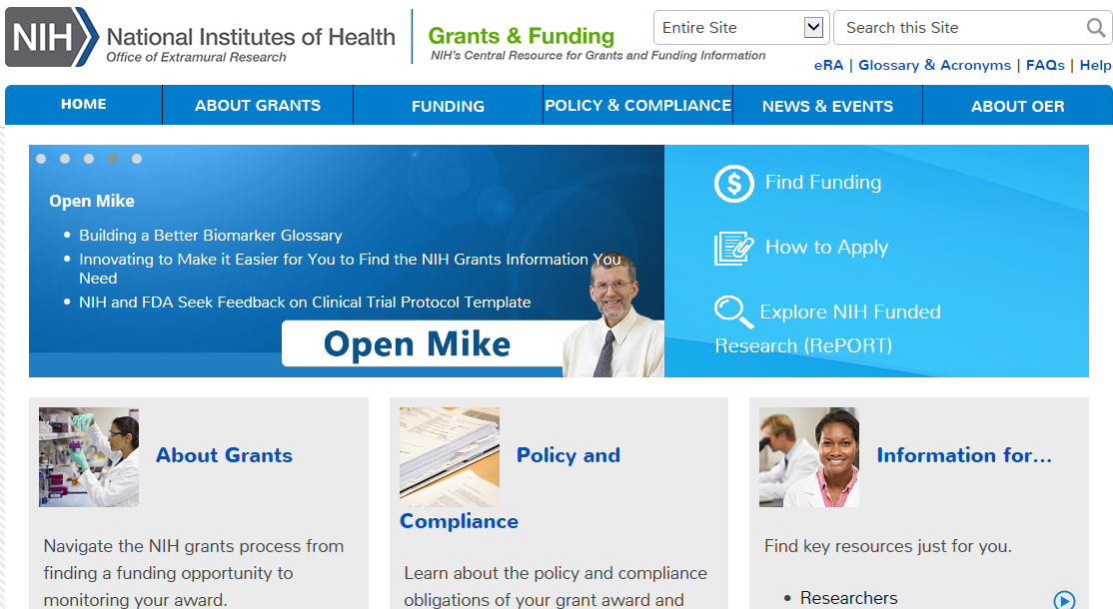
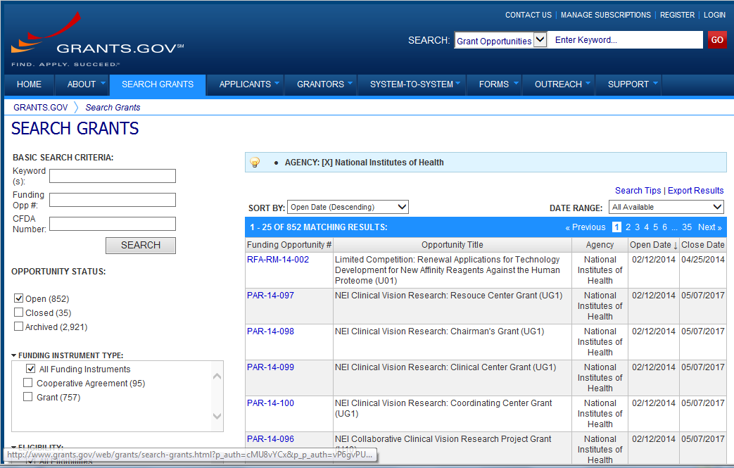

Find an Opportunity
Find Funding -
NIH Guide for Grants & Contracts
Grants.gov Search Grants
Each system has robust search capabilities.

Slide 23

Terminology Check
Funding Opportunity Announcement (FOA)
A publicly available document by which a Federal Agency makes known its intentions to award discretionary grants or cooperative agreements, usually as a result of competition for funds.
Specific types of NIH FOAs include:
  Parent Announcement
  Program Announcement (PA)
    PA with special receipt, referral, and/or review considerations (PAR)
    PA with set-aside funds (PAS)
  Request For Application (RFA)

Slide 24
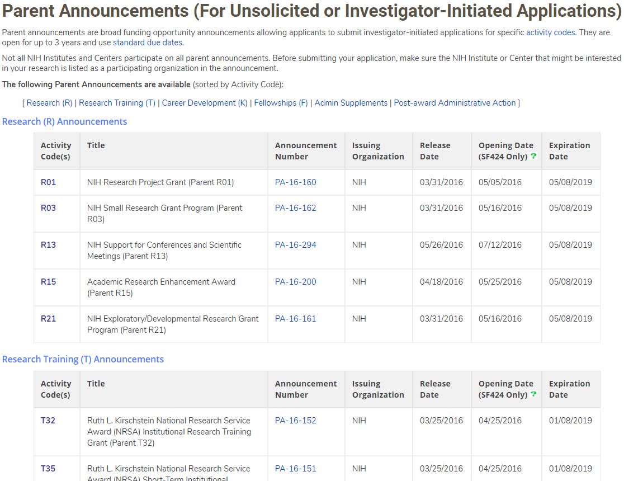
Parent FOAs
Broad announcements allowing applicants to propose research on unsolicited topics.
Select Parent FOA for your chosen grant program
(i.e. R01, R03, R21, etc.).
Not all institutes participate on all parents.
Check for fit, before you submit!
http://grants.nih.gov/grants/guide/parent_announcements.htm

Slide 25
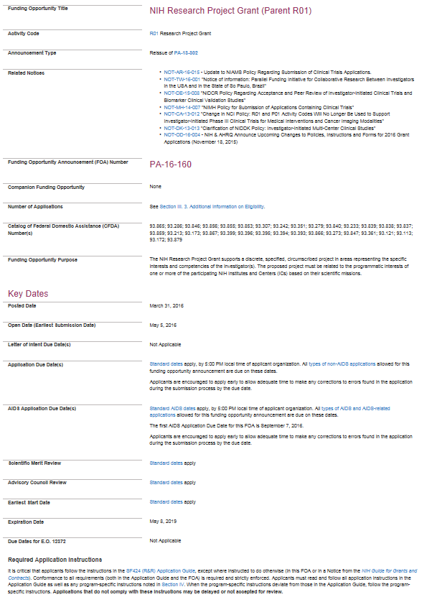
Key FOA Sections
Check for FOA updates & new policy guidance
General application due dates
Due dates specific to AIDS applications
Application Guide

Slide 26
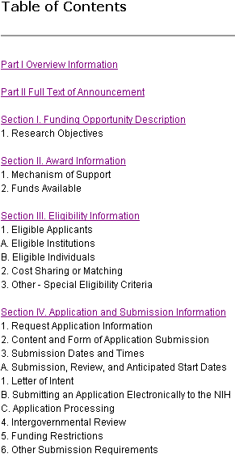
FOA-Specific Application Information
Read and follow all announcement instructions
Pay special attention to Section IV. Application and Submission Information
  Includes FOA-specific submission instructions
  Instructions in FOA supersede instructions in the application guide

Slide 27
Follow All Guidance
Notices in the NIH Guide for Grants and contracts
Funding Opportunity Announcement
  Section IV. Application and Submission Information
Application Guide
  Including Supplemental Instructions
Precedence / Importance

Slide 28
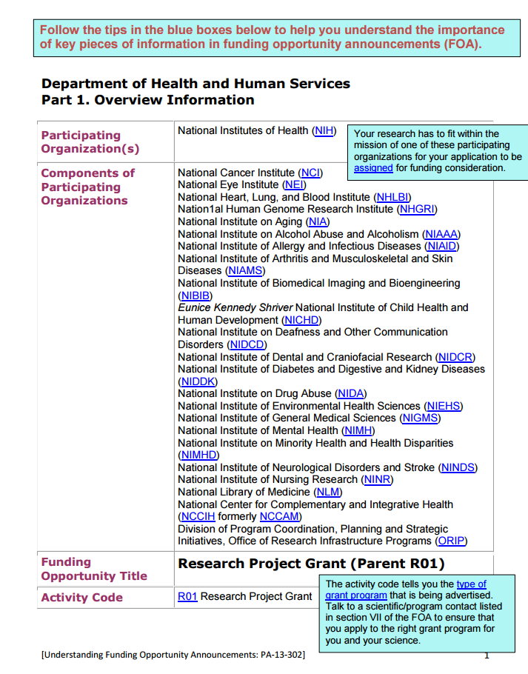
Understand Funding Opportunity Announcements
Take a tour of an annotated FOA for tips and key information
  http://grants.nih.gov/grants/Annotated_FOA.pdf
http://grants.nih.gov/grants/how-to-apply-application-guide/prepare-to-apply-and-register/find-and-understand-foas.htm

Slide 29
Identify Type of Application
Number Type | Stage/Description
Type 1* | New - Request for support of a project that has not yet been funded.
Type 2* | Renewal - Request for additional funding for a period subsequent to that provided by a current award.
Type 3* | Competitive Revision* – Request for additional funds to expand the scope of a current award. Administrative Supplement – Request for additional funds to cover unforeseen, increased costs to carry out current award.
Type 6 | Change of Organization Status (Successor-in-Interest)
Type 7 | Change of Grantee or Training Institution
* Resubmission - An unfunded application that has been modified following initial review and resubmitted for new consideration.
http://grants.nih.gov/grants/how-to-apply-application-guide/prepare-to-apply-and-register/type-of-application-submission.htm

Slide 30
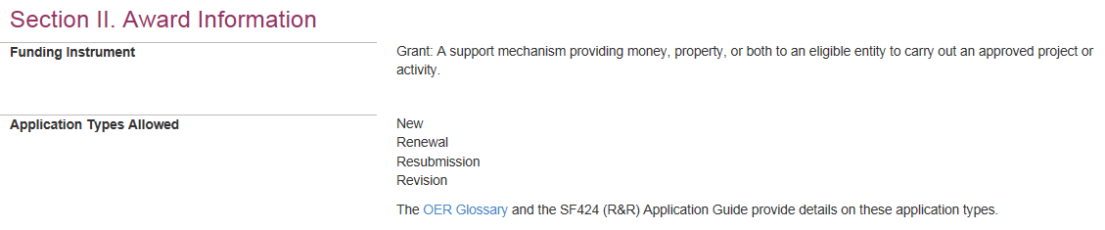
Why is knowing the type of application important?
Potential impact on…
Due dates
  E.g., If submitting to an R01 opportunity with standard due dates, “New” applications have a different due date than “Resubmission”, “Renewal” or “Revision” applications.
Ability to submit to a specific announcement
Application validations
  We enforce different rules based your selection in the “Type of Application” field (#8) of the SF424 (R&R) form.

Slide 31
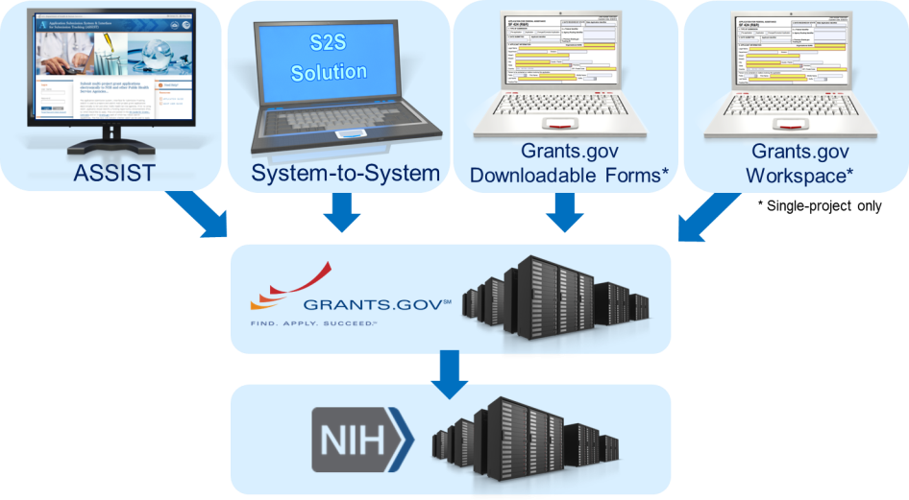
Application Submission Options
http://grants.nih.gov/grants/how-to-apply-application-guide/prepare-to-apply-and-register/choose-a-submission-option.htm

Slide 32


ASSIST
Managed by NIH
Features
  Multi-user access
  Leverages eRA Commons accounts
  Pre-population from eRA Commons profile information
  Pre-submission validations
  Pre-submission preview in agency format
  Tracking application status in a single system
  Ability to copy application data to another opportunity or to a different application package for the same opportunity
    Super handy feature during form updates!

Slide 33
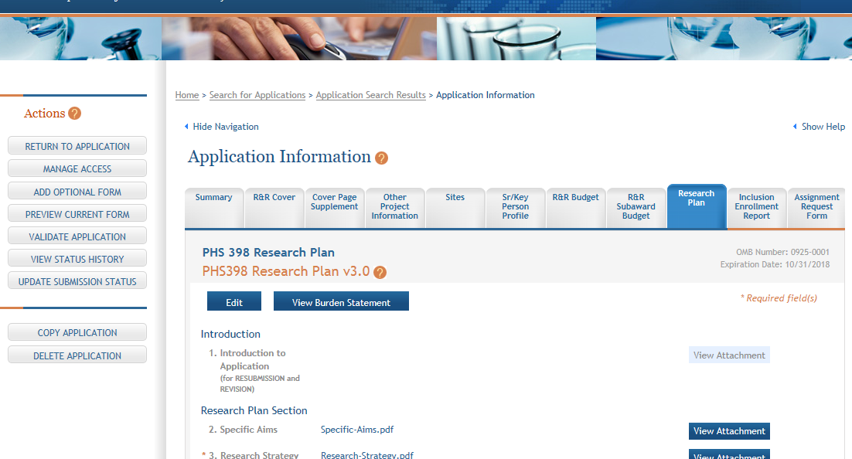
ASSIST Screen – Single-project

Slide 34
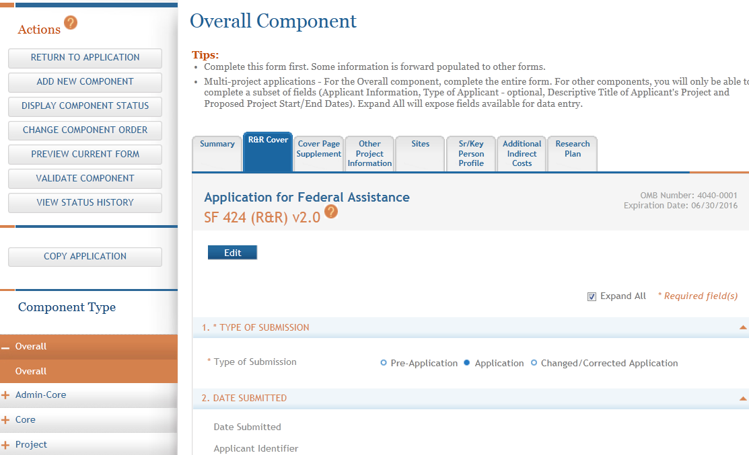
ASSIST Screen – Multi-project

Slide 35

System-to-system (S2S) Solution
Managed by institution or service provider
Typically integrate with other internal systems and databases to reduce data entry
Features vary by solution
  Examples of potential features
    Secure, on-line data entry
    Concurrent user support
    Pre-submission verification of some NIH business rules
    Pre-submission preview of assembled application image in generic or agency format
    eRA Commons application status information

Slide 36



Grants.gov downloadable forms
Managed by Grants.gov
No registration required until submission
Offline data entry
  Good when internet connectivity is unavailable or unreliable
No visibility to agency errors/warnings or application image prior to submission
Must track in multiple systems
“Stitched together” single, downloadable forms
package solution will be retired at end of 2017

Slide 37
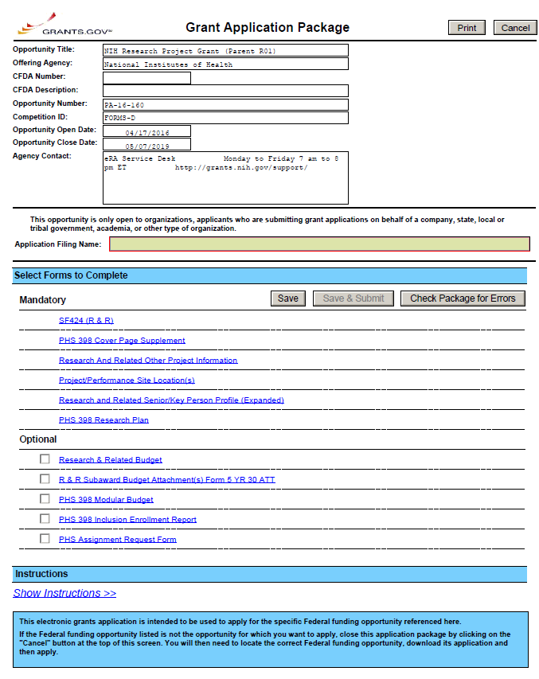
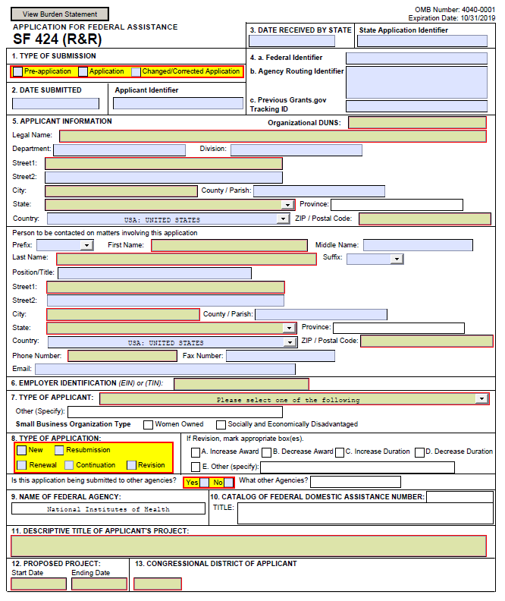
Sample Downloadable Forms

Slide 38
Grants.gov workspace
Managed by Grants.gov
Hybrid of online application management and downloadable forms
  Online forms - 2017
Forms can be completed individually by different users
Forms (same version) can be shared between applications
Option to check NIH errors/warnings and application image prior to submission
Must track in eRA Commons
Does NOT support multi-project applications
Replaces Grants.gov’s single, “stitched together”
downloadable forms model

Slide 39
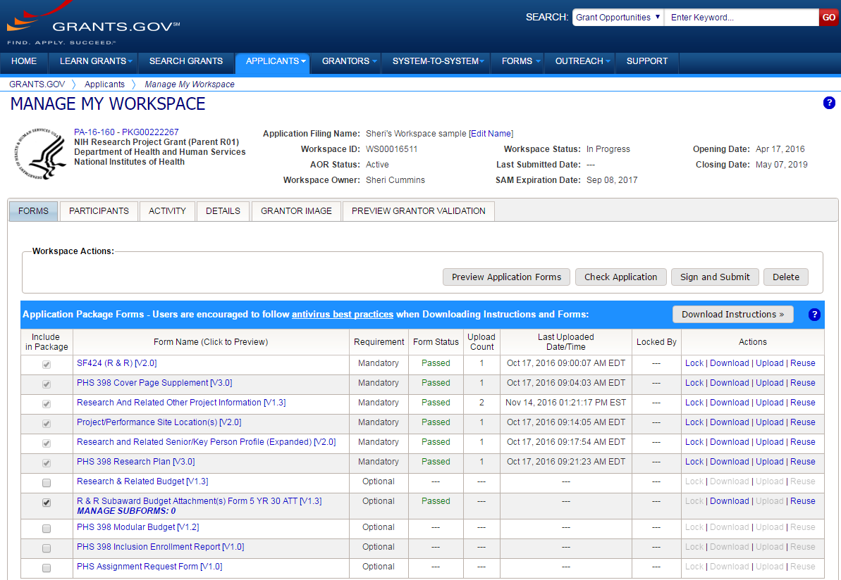
Sample Workspace Screen

Slide 40
Available Options for Application Types
Type | ASSIST | System-to-System Solution¹ | Grants.gov Down-loadable Forms | Grants.gov Workspace | eRA Commons | Paper
Single-project (SP) Competing Applications (Type 1, 2, 3) | ✓ | ✓ | ✓ | ✓
Multi-Project (MP) Competing Applications (Type 1, 2, 3) | ✓ | ✓
Administrative Supplement (Administrative Type 3) | ✓(SP) | ✓(SP) | ✓(SP) | ✓(SP) | ✓(SP) | ✓(SP, MP)
Successor-in-Interest (Administrative Type 6) | ✓(SP) | ✓(SP) | ✓(SP) | ✓(SP) |  | ✓(SP, MP)
Change of Institution (Administrative Type 7) | ✓(SP) | ✓(SP) | ✓(SP) | ✓(SP) | Relinquishing Statement | ✓(SP, MP)
¹Availability varies by applicant organization and S2S solution

Slide 41
What Submission Option Are NIH Applicants Using?

Slide 42




Your Application will be…
Subject to the same registration requirements
Completed with the same data items
Routed through Grants.gov
Validated against the same NIH business rules
Assembled in a consistent format for review consideration
Tracked in eRA Commons
…regardless of submission option used.

Slide 43
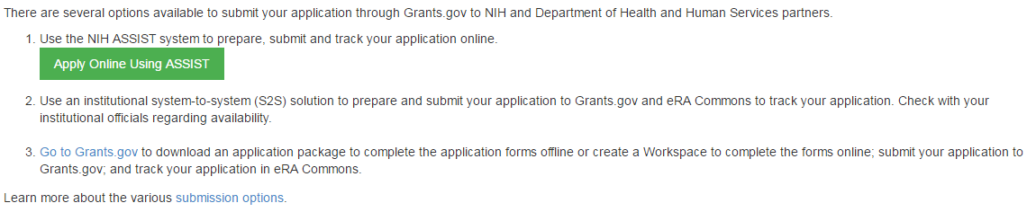
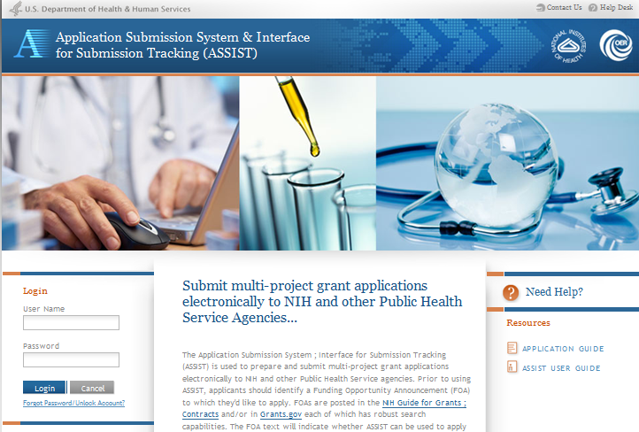
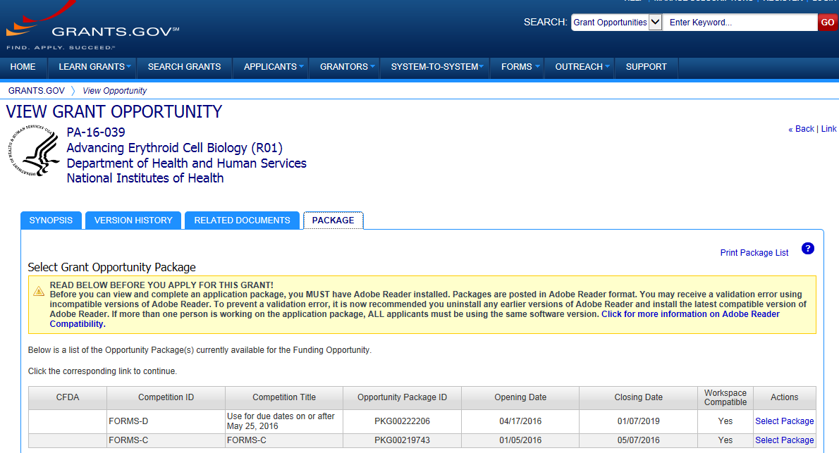
Accessing Application Forms
Excerpt from single-project FOA in NIH Guide…

Slide 44

Obtain Software
Browser
  Latest versions of Internet Explorer, Mozilla Firefox and Google Chrome – fully supported & tested
  Many others work fine
Adobe Reader
  Versions compatible with Grants.gov downloadable forms
    http://www.grants.gov/web/grants/support/technical-support/recommended-software.html
PDF conversion program
  All application attachments must be
  converted to PDF format

Slide 45

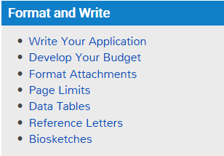
Format and Write

Slide 46

Grantsmanship
Tips for developing strong applications & budgets
  How to Apply – Application Guide site
  Institute sites
Your office of sponsored research and colleagues (especially those with review experience)
Listservs
Conferences
http://grants.nih.gov/grants/how-to-apply-application-guide/format-and-write/write-your-application.htm
http://grants.nih.gov/grants/how-to-apply-application-guide/format-and-write/develop-your-budget.htm

Slide 47
SF424 (R&R) Data Set
NIH uses the SF424 Research & Related (R&R) data set
  Owned and maintained by Grants.gov
NIH applications include:
  Forms used federal-wide
    Identified as: R&R, Research & Related
    NIH cannot build agency-specific business rules into federal-wide forms
  Forms used only by NIH and our serviced partners
    Identified as: PHS for Public Health Services

Slide 48

Agency-specific Forms
PHS 398 Career Dev. Award Supp.
PHS 398 Cover Page Supplement Form
PHS 398 Modular Budget
PHS 398 Research Plan
PHS 398 Research Training Program Plan
PHS 398 Training Budget
Training Subaward Budget Attachment Form
PHS Additional Indirect Costs
PHS Assignment Request Form
PHS Fellowship Supp. Form
PHS Inclusion Enrollment Report
  No longer used
  Rolled into new PHS Human Subjects and Clinical Trials Information form
New form packages (FORMS-E) will be posted fall 2017 for due dates on or after January 25, 2018.

Slide 49

Federal-wide Forms
SF424 (R&R)
Project/Performance Site Location(s)
R&R Other Project Info
R&R Sr/Key Person Profile (Expanded)
R&R Budget
R&R Subaward Budget Attachment
SF424C – Construction Budget
SBIR/STTR Information
New form packages (FORMS-E) will incorporate the latest versions of the forms used federal-wide, in addition to agency-specific form changes.

Slide 50

Format Attachments
Use simple PDF-formatted files
  Do not use Portfolio or similar feature to bundle multiple files into a single PDF
  Disable security (e.g., password protection, encryption)
Keep filenames to 50 characters or less
Use meaningful filenames
Do not include headers or footers
  Section headings as part of the text
  (e.g., Significance, Innovation, Approach)
  are encouraged
Follow guidelines for fonts and margins
  Updated Jan. 2017 – NOT-OD-17-030
http://grants.nih.gov/grants/how-to-apply-application-guide/format-and-write/format-attachments.htm

Slide 51
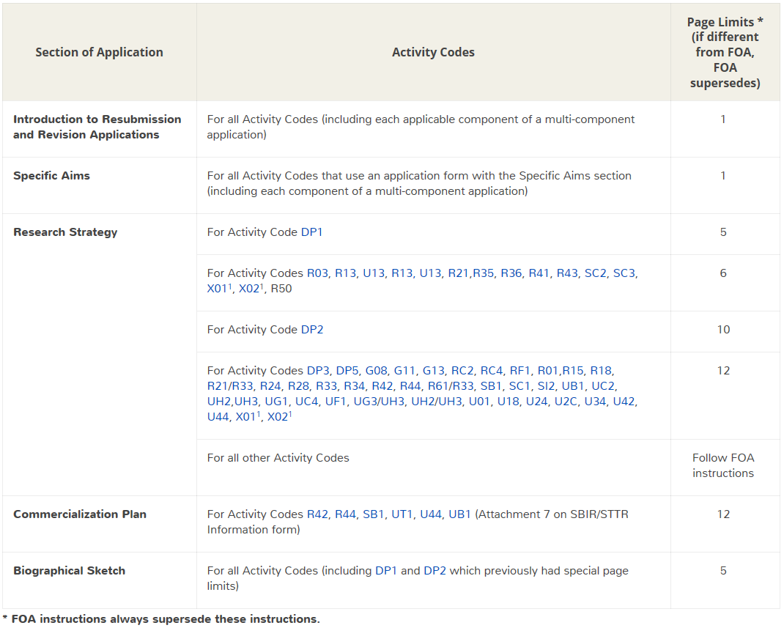

Follow Specified Page Limits
http://grants.nih.gov/grants/how-to-apply-application-guide/format-and-write/table-of-page-limits/forms-d.htm

Slide 52
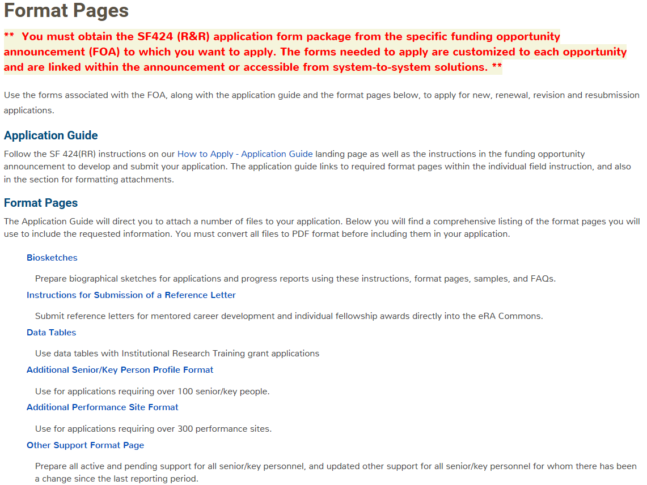


Use Format Pages
http://grants.nih.gov/grants/forms/format-pages.htm

Slide 53

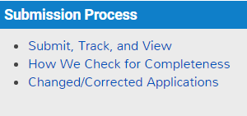

Submission Process
Submit!

Slide 54

Ready to Submit?
At this point you should have:
Verified all required registrations
Identified a funding opportunity announcement
and due date
Chosen a submission method
Prepared your application forms per the
announcement and application guide instructions
Routed your application to the person authorized to
submit (i.e. Grants.gov user with the Authorized
Organization Representative (AOR) role)

Slide 55



Submission Process - High Level
Submit
  AOR submits application to Grants.gov
Track
  Applicant tracks submission status in Grants.gov and eRA Commons
  Applicant addresses all identified errors
    Warnings addressed at applicant’s discretion
View
  Once an error-free application is received, eRA assembles an application image by combining submitted forms and attachments
    Adds: headers, footers, table of contents, bookmarks
  Applicant views assembled application image in eRA Commons
  After 2-business day application viewing window, the application moves forward to receipt and referral staff for further processing

Slide 56
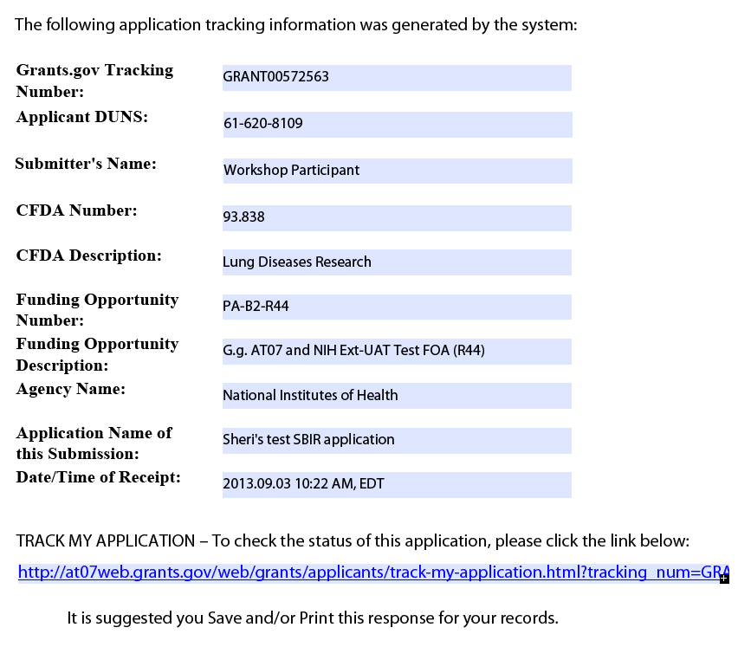
Submitting an Application
All NIH applications route through Grants.gov
Your Grants.gov timestamp
is used to determine
“on-time” submission
Grants.gov Tracking #
Date/Time Stamp – always recorded in Eastern Time

Slide 57


On-time Submission
Important reminders:
  NIH recommends submitting early to allow time for correcting any errors found during the application viewing window prior to the due date
  NIH’s late policy does not allow corrections after the due date
  All registrations and SAM renewal must be completed before the due date
Applications must be free of Grants.gov and NIH eRA errors and accepted by Grants.gov with a time stamp on or before 5:00 p.m. local time of the submitting organization on the due date.

Slide 58



Pop Quiz
The appropriate measurement for “early” in the context of application submission is…
Minutes
Hours
Days

Slide 59

Grants.gov Notifications
AOR receives Grants.gov e-mails
  Submission Receipt
    Grants.gov e-mail verifying receipt of application
  Submission Validation
    Grants.gov e-mail verifying successful submission to Grants.gov
    OR rejection due to errors
  Transmission to Agency
    E-mail sent once agency retrieves submission
    E-mail sent when agency tracking number assigned
Sent to email address on file for submitting AOR
http://grants.nih.gov/grants/ElectronicReceipt/email_notifications.htm#grants

Slide 60

Track Status in Commons
eRA Commons Status is an integral part of electronic application submission
  Applications that pass Grants.gov validations are picked up by eRA Commons and checked against many application guide and opportunity instructions
  Authorized users can check eRA Commons Status for processing results
    Signing Officials (SOs)
    Administrative Officials (AOs)
    Principal Investigators (PIs)
    Delegated Assistants (ASSTs)
  E-mail notifications sent

Slide 61
eRA Commons Notifications
eRA e-mails
  Check assembled application
  Check assembled application – Warnings only
  ACTION REQUIRED – Errors and/or Warnings
  ACTION REQUIRED– Missing or invalid eRA Commons Username (only sent to AOR/SO)
  ACTION REQUIRED– System Error
  SO has refused electronic application (rejected)
  NIH has auto-verified the application (after 2-day viewing window)
Sent to the AOR/SO, PD/PI and contact e-mails listed on SF424 (R&R) form
http://grants.nih.gov/grants/ElectronicReceipt/email_notifications.htm#grants

Slide 62

Email is Unreliable
Many email notifications are sent throughout the process
  DO NOT depend solely on email notifications, it is YOUR responsibility to proactively check your application status in eRA Commons

Slide 63



Application Checks (Validations)
We really care about the details
Multiple levels of application checks for completeness
  Grants.gov
  eRA systems
  Agency staff
Check!
Check!
Check!
https://grants.nih.gov/grants/how-to-apply-application-guide/submission-process/check-your-application.htm

Slide 64
Validations Done by Grants.gov
Examples:
  Active System for Award Management (SAM) registration
  Submitter has AOR role for DUNS on application
  Submission made to active opportunity and application package
  Virus check
  Filenames include only appropriate characters
    A-Z, a-z, 0-9, underscore, hyphen, space, period, parenthesis, curly braces, square brackets, ampersand, tilde, exclamation point, comma, semi colon, apostrophe, at sign, number sign, dollar sign, percent sign, plus sign, and equal sign

Slide 65
Validations Done by eRA Systems
Examples:
  Fields required by agency, but not required federal-wide
    R&R Sr/Key form
      Credential for PD/PIs (and a few others)
      Organization name for all sr/key
      Biosketch attachment for all sr/key (Grants.gov only enforces for PD/PI)
    Project/Performance Site Location form
      DUNS for primary site
  Attachments in PDF format
  Adherence to page limits in our Table of Page Limits (unless otherwise specified in the announcement)
  Included appropriate attachments (eRA checks many but not all)

Slide 66
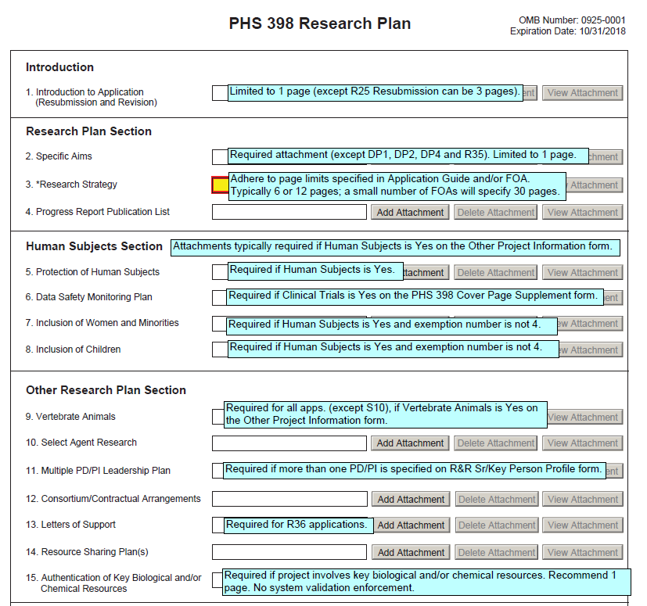
Avoiding Common Errors
Annotated form sets are a great resource to help avoid errors enforced by eRA validation checks.
Annotated form sets:
http://grants.nih.gov/grants/how-to-apply-application-guide/resources/annotated-form-sets.htm

Slide 67

Checks Done by Agency Staff
Examples:
  Fit with NIH's and participating institute’s mission
  Eligibility
  “Overstuffing” – application doesn’t include inappropriate information in attachments to get around page limits
  On-time submission
  Simultaneous review of essentially same application
  Adherence to funding opportunity announcement specific instructions
  Correct number of reference letters received by the due date (if applicable)
  Adherence to font and margin guidelines
  Agreement from institute to accept application requesting $500K or more in direct costs in any budget period

Slide 68



Corrective submissions must be made BEFORE the submission deadline and overwrite previous submissions.
Errors stop application processing and must be corrected
Warnings do not stop application processing and are corrected at the discretion of the applicant

Slide 69

Correcting Errors Found After Submission
To correct system-identified errors found after submission:
Make corrections to local copy of the application
Update SF424 (R&R) form
  Check “Changed/Corrected” as “Type of Submission”
  Enter “Previous Grants.gov Tracking ID” (e.g., GRANT12345678) in field 4c
Submit the entire Changed/Corrected application
back through Grants.gov before the deadline
Track submission through to eRA Commons
NOTE: Reviewers do not see applicant warnings, nor can they tell how many submission attempts were needed to complete the submission process

Slide 70
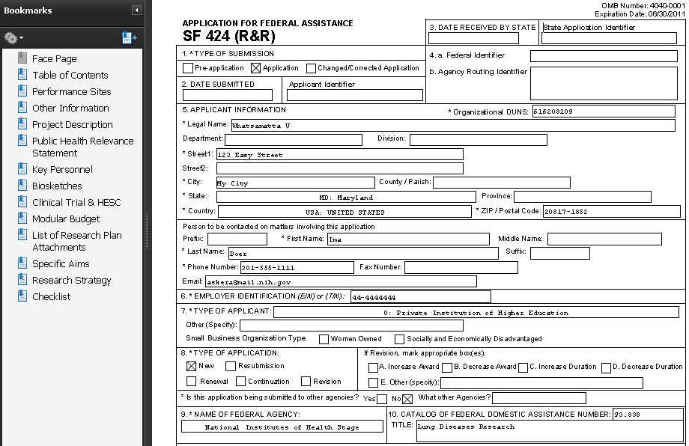
Application Assembled & Posted in eRA Commons
Once an error-free application is received by NIH, the eRA system will:
  Assemble the grant application image
  Insert headers (PI name) and footers (page numbers) on all pages
  Generate Table of Contents and bookmark important sections
  Post the assembled application image in the PD/PI’s eRA Commons account
  Send notifications

Slide 71

Application Viewing Window
Applicants have two (2) business days to view the assembled application image before the application automatically moves forward for further processing
SO can Reject application within viewing window and submit a Changed/Corrected application before the submission deadline

Slide 72
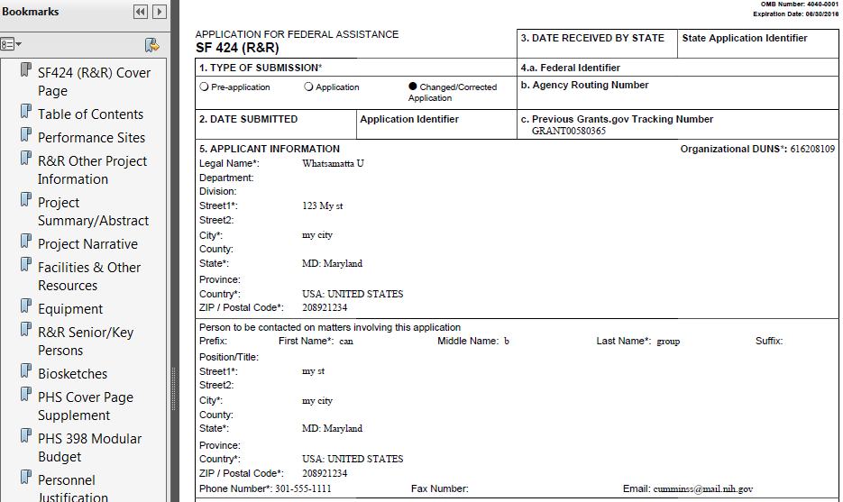
View Application Image
If you can’t VIEW it, we can’t REVIEW it!

Slide 73

Submission Complete!
If you don’t reject within the two business day viewing window, the application automatically moves forward for further processing at NIH
Any subsequent application changes are subject to the NIH policy on late submission of grant applications and the NIH policy on post-submission application materials

Slide 74





Submission Process – Submit
Grants.gov checks application and records status
AOR submits application to Grants.gov
AOR
checks status in Grants.gov
Validated
(No errors)
Application queued for agency retrieval
Rejected
with Errors
Applicant corrects application errors

Slide 75



Submission Process – Track
eRA checks application and puts status in eRA Commons
eRA system downloads application
Application image generated in eRA Commons
Applicant checks status in eRA Commons
No errors,
Warnings OK
AOR submits changed/correct application to Grants.gov and begins process again
Errors
found
Applicant makes corrections before deadline

Slide 76

Submission Process – View
Happy with
image in eRA Commons?
After 2 business days the application automatically moves forward to Receipt & Referral
Looks
good
Change
desired
Let application move forward without change
Before
deadline?
No
Which option?
SO rejects application in eRA Commons
AOR submits to Grants.gov and begins process again
Apply for
later due date
Yes
SO rejects app in eRA Commons (w/in viewing window) or withdraws app (after) & prepares changed/correct application
Make change and be subject to late policy

Slide 77

Reference Letters
Reference letters

Slide 78



Reference Letters
NOT part of the application through Grants.gov
Submitted directly by the referee through eRA Commons
Commons registration not required
Can be submitted in advance of application submission
Due by the application due date/time
Applicants can track the submission of reference letters in the Commons, but cannot view the actual letter
Some NIH grant programs require the submission of reference letters in addition to the grant application (e.g., Fellowship & Mentored Career Development programs)
https://grants.nih.gov/grants/how-to-apply-application-guide/submission-process/reference-letter.htm

Slide 79
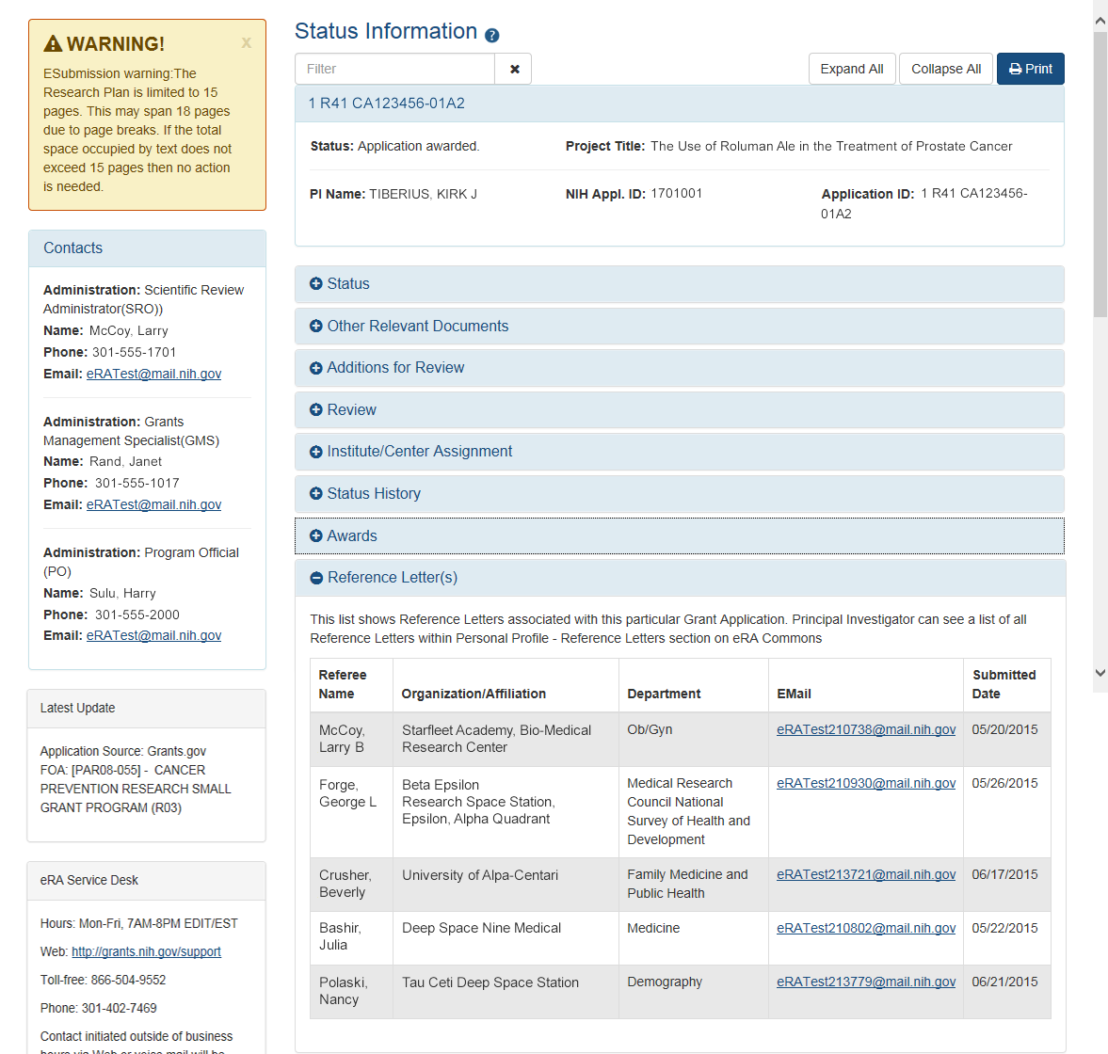
Reference Letters Attached to Application
Reference Letters

Slide 80

Finding Help
Help Desks
On-line resources & Web sites

Slide 81
Help Desks
eRA Commons Help Desk
Grants.gov Contact Center
Web: http://grants.nih.gov/support/
Phone: 1-866-504-9552
Hours : Mon-Fri, 7a.m. to 8 p.m. ET
Toll-free: 1-800-518-4726
Hours : 24x7 (Except Federal Holidays)
Email : support@grants.gov
Resources: http://www.grants.gov/help/help.jsp

Slide 82

Online Resources & Websites
How to Apply – Application Guide
http://grants.nih.gov/grants/how-to-apply-application-guide.htm
Annotated form set
http://grants.nih.gov/grants/how-to-apply-application-guide/resources/annotated-form-sets.htm
ASSIST
public.era.nih.gov/assist
Online help
era.nih.gov/erahelp/ASSIST/
eRA ASSIST Training page: http://era.nih.gov/era_training/assist.cfm

Slide 83
Stay Connected – Subscribe to Listservs
eRA-Information-L
  For administrators, principal investigators and the people that support them
  Used by NIH to notify the community of information related to eRA Commons, ASSIST and eSubmission
NIH_ESUB_SYS2SYS-L
  For technical personnel involved in system-to-system solution development and planning
  Used to exchange information related to the implementation of system-to-system solutions for grant application preparation and submission to NIH

Slide 84

Avoiding the Gotchas
Refer to annotated form set:
http://grants.nih.gov/grants/how-to-apply-application-guide/resources/annotated-form-sets.htm

Slide 85
Live ASSIST Demo
Initiate application
Manage Access
Form navigation & data entry
Pre-submission validation
Pre-submission preview
Tracking Submission Status
And More!
Slides are for notes only & content will be covered during demo.

Slide 86
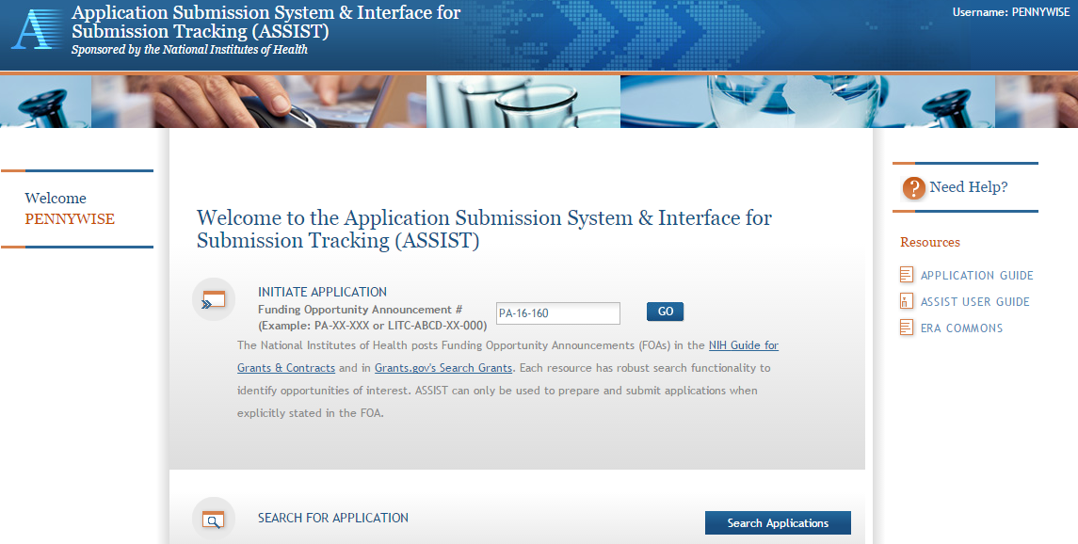
Initiate Application

Slide 87
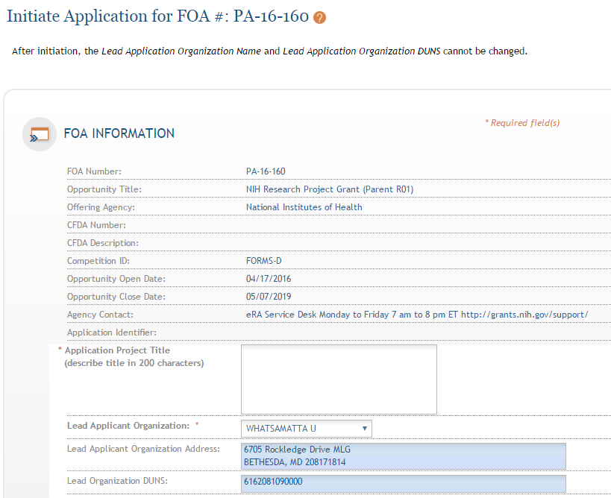
Initiate Screen
FOA information pulled from Grants.gov
Enter Project Title
Drop-down list of organizations affiliated with your eRA Commons account

Slide 88
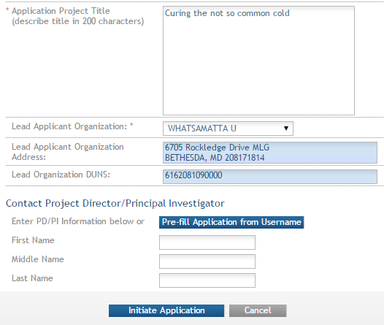
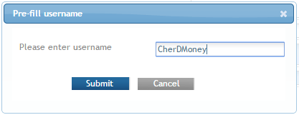
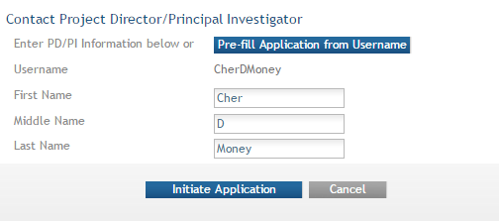
Initiate: Pre-population
Data pre-populated from organization selection
Can manually enter PD/PI information or provide
eRA Commons username to auto-populate

Slide 89
Automatic Application Access
ASSIST automatically provides application access to some individuals based on their Commons roles or role on the application
  Examples:
    Users with Commons accounts that have the Signing Official (SO) or Administrative Official (AO) role have edit access to all applications for their organization
    All PD/PIs (once eRA Commons credentials are provided) have edit access for the entire application
    User who initiates the application has edit access for the entire application
Users with ASSIST_ACCESS_MAINTAINER_ROLE can manage access for all applications at their organization
  Role must be given in eRA Commons by Signing Official

Slide 90
Manage Access
Provides ability to give anyone with a valid eRA Commons account access to an application
Automatically available to users with
  Signing Official (SO) role on eRA Commons account
  ASSIST_ACCESS_MAINTAINER_ROLE role on eRA Commons account
Available on application-by-application basis to
  ASSIST user who has been given the Access Maintainer role by an SO via the Manage Access action

Slide 91
Controlling Application Access
Application access can be controlled across these variables:
  View vs. Edit
  Budget vs. Non-budget data
  Entire application vs. specific
  components (multi-project)

Slide 92
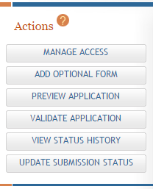
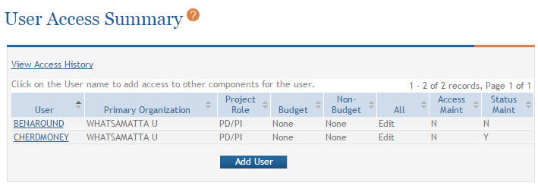
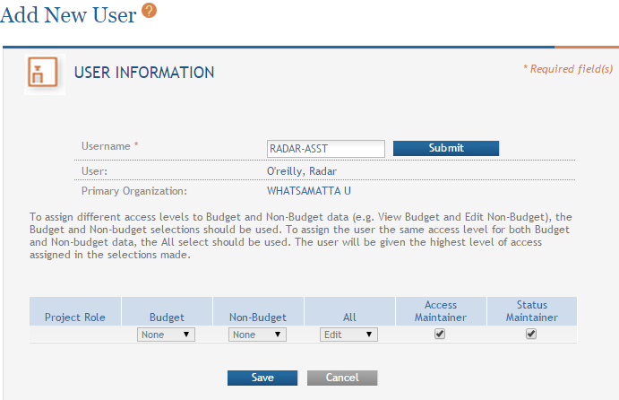
Providing Application Access to a User

Slide 93
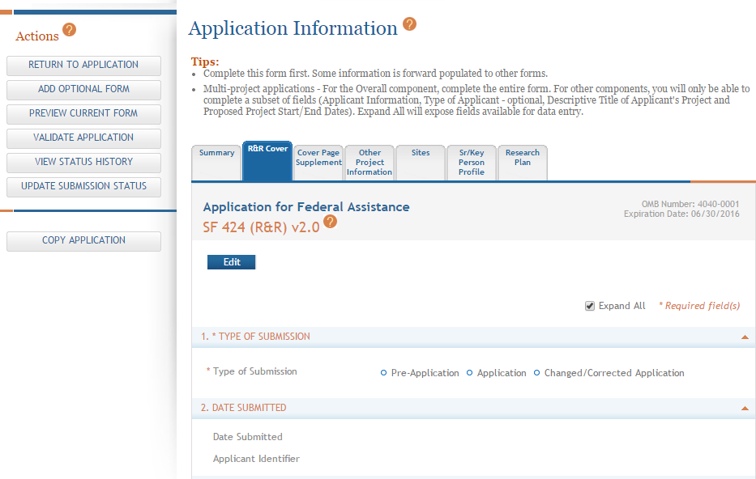
Data Entry
Click each tab to access form data entry screens
Clicking Edit blocks other users from editing form

Slide 94
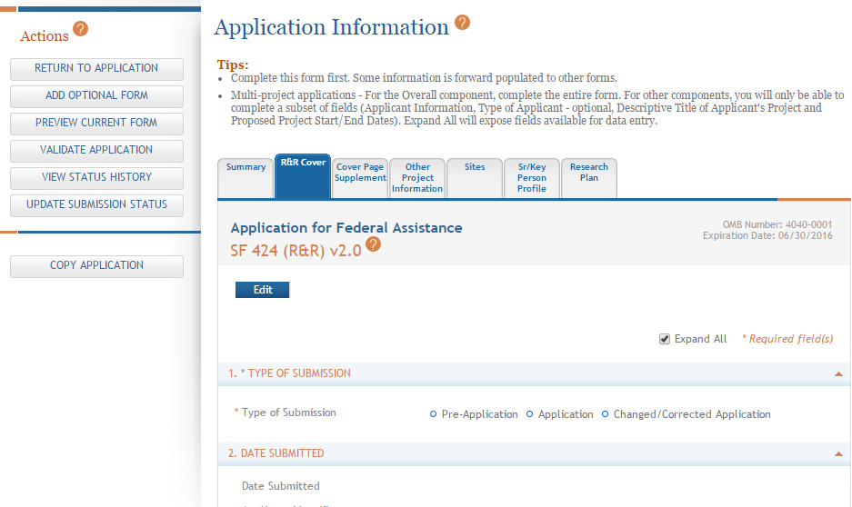
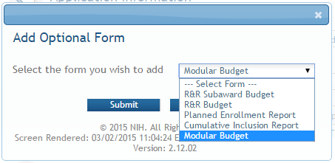
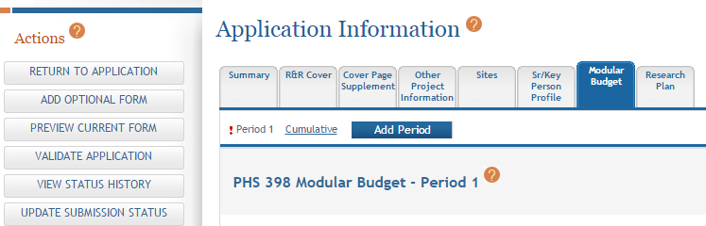
Adding Optional Forms
Select form and click Submit
The form tab is added to navigation

Slide 95
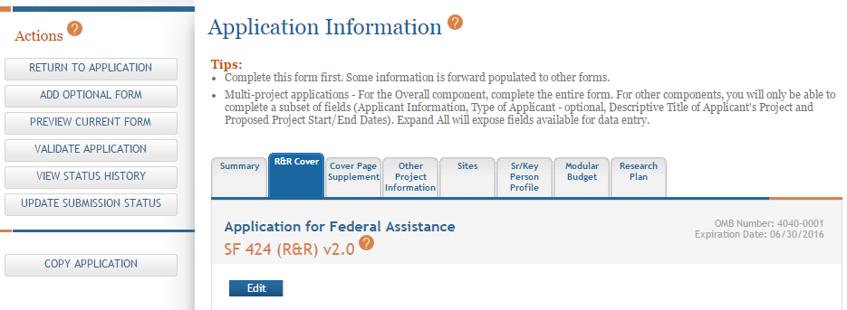
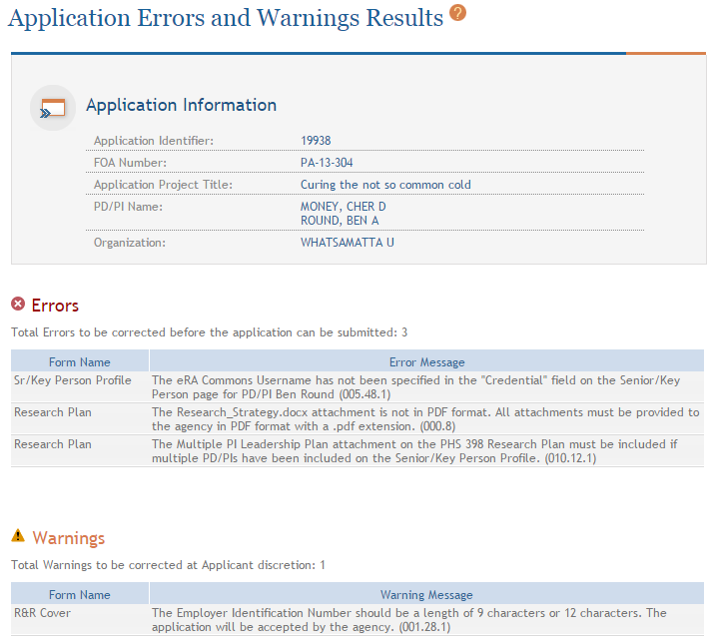
Validate Application
Errors and Warnings are displayed

Slide 96
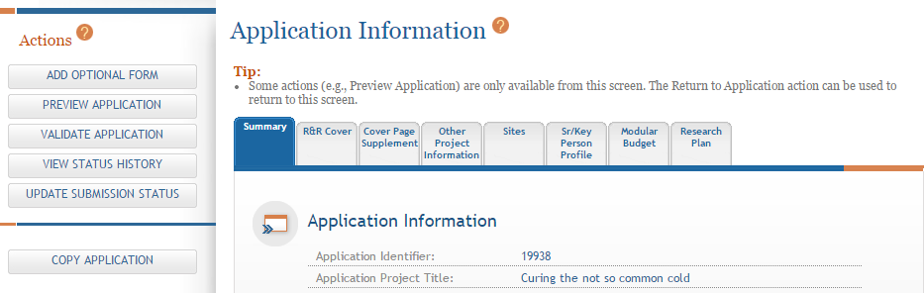
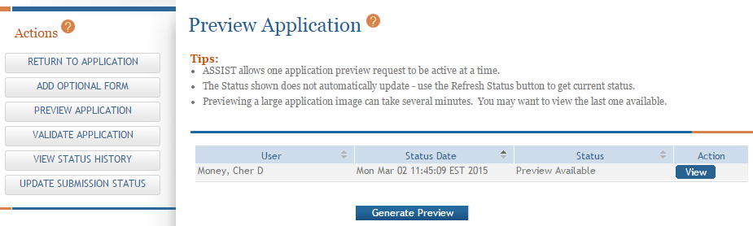
Generating Application Preview
View last preview
Generate new preview

Slide 97
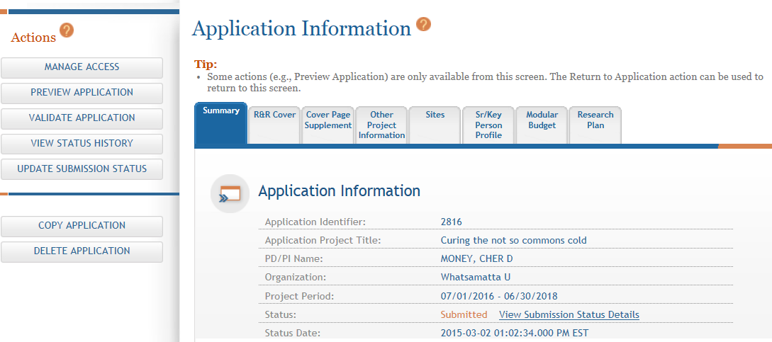
View Submission Status Details
Click View Submission Status Details

Slide 98

Tracking Submission Status
Happy path…
ASSIST = Submitted
Grants.gov = Agency Tracking Number Assigned
Agency = Processed
Agency Tracking # link brings you to the detailed status screen in eRA Commons

Slide 99

Viewing Your Application in eRA Commons
eApplication is the assembled application image reviewers and staff will see - check it carefully.
You will also want to check the
  Cover Letter,
  PHS Assignment Request Form, and
  Component Appendices
which are stored separate from the image.

Slide 100
Live eRA Commons Demo
Check for Errors & warnings
View Application image
Reject Application
Slides are for notes only & content will be covered during demo.

Slide 101

eRA Commons Login
eRA Commons: https://public.era.nih.gov/commons

Slide 102

Track Application – Commons Status
Select Recent/Pending eSubmissions
Or provide Grants.gov tracking number from confirmation screen or email notification

Slide 103


Track Application - Commons
Indicates eSubmission Error
Grants.gov tracking #

Slide 104

eRA Commons Status (PI View)
Status is Pending Verification
Application ID links to detailed status info
Status Information Screen

Slide 105
Detailed Status Information Screen
eApplication is the assembled application image reviewers and staff will see - check it carefully.
You will also want to check the
  Cover Letter,
  PHS Assignment Request Form, and
  Component Appendices
which are stored separate from the image.

Slide 106
View Application Image
TIP: Carefully review the entire application.
This is your chance to view/print the same application image that will be used by Reviewers!

Slide 107

Reject eApplication
Must have SO role
Enter Search Criteria
Click Search
Select Recent/ Pending eSubmissions

Slide 108


Reject eApplication Request
Enter comment to be sent with e-mail notification
108

Slide 109
Submission Policies
System Issues
Due Dates on Holidays & Weekends
Late policy
Post-submission Application Materials
Continuous Submission
Rules for Resubmissions
Evaluation of Overlapping Applications
Appendix Policy & “Overstuffed” Applications

Slide 110

Watch for Policy Updates
Keep an eye on the NIH Guide for Grants and Contracts for policy and process updates.
Subscribe for weekly e-mails of new postings:
http://grants.nih.gov/grants/guide/listserv.htm

Slide 111


System Issues
You must follow NIH’s standard ‘system issue’ procedure if you run into problems beyond your control that threaten your on-time submission:
  http://grants.nih.gov/grants/how-to-apply-application-guide/due-dates-and-submission-policies/guidelines-for-applicants-experiencing-system-issues.htm
NIH Guide Notice: NOT-OD-15-039
http://grants.nih.gov/grants/guide/notice-files/NOT-OD-15-039.html

Slide 112

Due Dates on Holidays & Weekends
When a submission due date falls on a weekend or Federal holiday, the application deadline is automatically extended to the next business day.

Slide 113
Late Applications
Two-week window of consideration
  See notice for exceptions
Permission is not granted in advance
Late applications are accepted only in extenuating circumstances
Cover letter describing reason for late submission required
Evaluated on a case-by-case basis
NIH Guide Notice: NOT-OD-15-039
http://grants.nih.gov/grants/guide/notice-files/NOT-OD-15-039.html

Slide 114
Natural Disasters & Other Emergencies
When your organization is closed due to natural disaster, weather or other emergency, you can document the condition in your cover letter and submit late
  Deadline extended by the number of days your organization is closed
NIH Response to Natural Disasters & Other Emergencies:
http://grants.nih.gov/grants/natural_disasters.htm

Slide 115
Post-submission Application Materials
NIH will only accept post-submission grant application materials resulting from unforeseen administrative issues for most applications
  See Guide Notice for details on acceptable and unacceptable material, exceptions, and page limits
  When exceptions do apply, materials must be received at least 30 days prior to the peer review meeting and must be sent by (or with the explicit concurrence of) the AOR
NIH Guide Notice: NOT-OD-16-130 (on/after 1/25/2017)
http://grants.nih.gov/grants/guide/notice-files/NOT-OD-16-130.html

Slide 116
Continuous Submission
Alternative submission policy for PD/PIs serving as appointed members of NIH chartered standing study sections, NIH Boards of Scientific Counselors, NIH Advisory Boards or Councils, NIH Program Advisory Committees, and/or peer reviewers who have served as regular or temporary members six times in 18 months
Applies to R01, R21, and R34 applications that would normally be received on standard application submission dates (not special receipt dates)
Continuous Submission page:
http://grants.nih.gov/grants/peer/continuous_submission.htm

Slide 117
Rules for Resubmissions
NIH allows a single Resubmission (A1)
Applicants must submit Resubmission applications (A1) within thirty-seven (37) months of the initial New, Renewal, or Revision application due date
NIH Guide Notice: NOT-OD-10-080
http://grants.nih.gov/grants/guide/notice-files/NOT-OD-10-080.html
NIH Guide Notice: NOT-OD-12-128
http://grants.nih.gov/grants/guide/notice-files/NOT-OD-12-128.html

Slide 118
Rules for Resubmissions (cont.)
Following an unsuccessful resubmission (A1) application, applicants may submit the same idea as a new (A0) application for the next appropriate new application due date
NIH Guide Notice: NOT-OD-14-074
http://grants.nih.gov/grants/guide/notice-files/NOT-OD-14-074.html
NIH Policy on Resubmission Applications page:
http://grants.nih.gov/grants/policy/amendedapps.htm

Slide 119
Evaluation of Overlapping Applications
While NIH no longer limits the number of times you can submit an application with essentially the same content and scope as an earlier unsuccessful application, it is not allowable to have overlapping applications under review at the same time.
NIH Guide Notice: NOT-OD-14-074
http://grants.nih.gov/grants/guide/notice-files/NOT-OD-14-074.html

Slide 120
Appendix Policy & “Overstuffed” Applications
Applicants must follow application guide and announcement instructions regarding appropriate appendix materials
  Most appendix material has been eliminated (NOT-OD-16-129)
  Applicants should not use the Appendix section to circumvent page limits
    In particularly egregious cases NIH has the authority to withdraw the application from review or consideration for funding
Don’t Overstuff: NOT-OD-11-080
http://grants.nih.gov/grants/guide/notice-files/NOT-OD-11-080.html
Appendix Policy: NOT-OD-16-129 http://grants.nih.gov/grants/guide/notice-files/NOT-OD-16-129.html

Slide 121
Grantee and Organizational Changes
Submitting a Change of grantee or training institution request (type 7) using grants.gov
Submitting a Change of Organization Status/Successor In Interest
(Type 6) Request using grants.gov
Submitting An Administrative Supplement Request using Grants.gov

Slide 122
Change of Grantee (Type 7) Requests
Request for support of a funded project that has been transferred from one grantee or training institution to another
Current submission options:
  Grants.gov downloadable forms
  Institutional system-to-system solutions
Also known as Change of Institution or transfer.

Slide 123
Change of Organization Status (Type 6) Request
Request for support of a funded project at an institution where the legal status has been changed
Current submission options:
  Grants.gov downloadable forms
  Institutional system-to-system solutions
Formerly known as Successor-In-Interest.

Slide 124

Type 6/7 Requests – Grants.gov
Available for post-award requests for single-project activity codes for which competing applications are submitted through Grants.gov
Though not yet required, applicants are encouraged to use and become familiar with the electronic option
Talk to your awarding Institute prior to submission

Slide 125
Type 6/7 Requests – Grants.gov
Parent Announcement page has general use FOAs
  http://grants.nih.gov/grants/guide/parent_announcements.htm#post
When completing package…
  Follow all FOA-specific instructions
  Carefully choose appropriate application package
  Use Revision as the Application Type (SF424 RR, item #8)
  Include IC and Serial number of awarded grant as the Federal Identifier (SF424 RR, item #4a)

Slide 126
Type 6/7 Requests – Grants.gov
Similar to competing application process, except:
  Many of the NIH business rule validations for competing applications are not enforced
  Required forms may vary from competing applications
    Modular budget forms not an option; must use detailed R&R Budget forms
    No cover letters
    Type 6
      Only a few required forms
        SF424 (R&R) cover, Other Project Information, SR/Key Information
      Optional forms vary by program
    Type 7
      Budget forms added to some form packages (e.g., DP1, DP2, DP3)

Slide 127
Type 6/7 Requests – Grants.gov
  After the two-day viewing window, the request bypasses Receipt & Referral and goes directly to Grants Management staff for consideration
    Requests move to List of Applications for PIs and General Search (for SOs) like competing applications

Slide 128
Administrative Supplements
Requested additional costs must be within the scope of the peer reviewed and approved project
Current submission options:
  Grants.gov downloadable forms¹
  Streamlined eRA Commons process¹
    Commons pre-populates much of the data needed for request from awarded grant
  Institutional system-to-system solutions¹
  Paper process
A request for additional funds during a current project period to provide for an increase in costs due to unforeseen circumstances.
¹Available for single-project activity codes for which competing applications are submitted through Grants.gov.

Slide 129
Admin. Supplement Requests– Grants.gov
Parent Announcement page has general use FOAs
  http://grants.nih.gov/grants/guide/parent_announcements.htm#adminsupp
  NIH Institutes can also post FOAs for administrative supplements targeting specific programs
When completing package…
  Follow all FOA-specific instructions
  Carefully choose appropriate application package
  Use Revision as the Application Type (SF424 RR, item #8)
  Include IC and Serial number of awarded grant as the Federal Identifier (SF424 RR, item #4a)

Slide 130
Admin. Supplement Requests– Grants.gov
Similar submission process as competing applications, except:
  Many of the NIH business rule validations for competing applications are not enforced
  Required forms may vary from competing applications for the same activity code
    Modular budget forms not an option; must use detailed R&R Budget forms
    No cover letters
  After the two-day viewing window the request bypasses Receipt & Referral and goes directly to Grants Management staff for consideration
    Move to Admin Supp Status tab in Commons

Slide 131

Questions?

