Slide 1



NIH eRA Workshop Day eRA Commons Account Administration & Post-submission Processing
October 2016
electronic Research Administration (eRA)
OER, OD, National Institutes of Health

Slide 2
Your Workshop Team
Scarlett Gibb
  eRA Customer Relationship Manager, eRA Commons
Joe Schumaker
  eRA Communications and Outreach

Slide 3

Busy Morning
Start
9:00
eRA Commons Status
Account Administration
Key eRA Commons Features
Final Questions & Wrap-up
Navigation | ESI & NI Status | Reference Letters
NIH Contacts | Review Assignments | Correspondence
View NoA
Create & Manage Accounts | Institutional & Personal Profiles
Reference Letters | Managing Delegations
Break
~10:30
Prior Approval | Just-In-Time (JIT)
No Cost Extension (NCE)K | RPPR
Admin Supplements | Closeout
Federal Financial Report (FFR) | Financial Conflict of Interest (FCOI)
xTrain
All Done
12:00

Slide 4
Busy Afternoon
Start
1:00
eRA Commons Status
Account Administration
Key eRA Commons Features
Final Questions & Wrap-up
Navigation | ESI & NI Status | Reference Letters
NIH Contacts | Review Assignments | Correspondence
View NoA
Create & Manage Accounts | Institutional & Personal Profiles
Reference Letters | Managing Delegations
Break
~2:30
Prior Approval | Just-In-Time (JIT)
No Cost Extension (NCE)K | RPPR
Admin Supplements | Closeout
Federal Financial Report (FFR) | Financial Conflict of Interest (FCOI)
xTrain
All Done
4:00

Slide 5
eRA Commons
What is era Commons?

Slide 6
What is eRA Commons?
The eRA Commons is an online interface where grant applicants, grantees and federal staff can access and share administrative information related to grant applications and awarded research grants.
Applications
eSubmission Errors/Warnings
Assurances
Assembled Application Image
Certifications
Review Assignment
Profile Data
Progress Reports
Priority Score
Financial Reports
Summary Statement
Invention Reports
Notice of Award
Training Appointment Actions
Post-award Correspondence

Slide 7
eRA Commons Navigation Menu
New navigation options
Joe

Slide 8
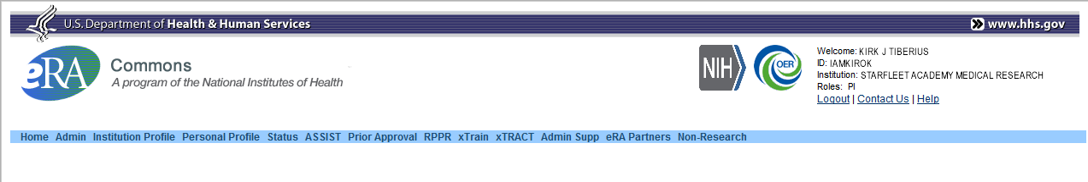
Navigation Options
Three Navigation Items Added:
  Assist: Allows quick access from Commons to Assist without the need to re-authenticate
  Prior Approval: Access to Application withdrawal requests and for processing $500K Requests
  Non-research: Currently for SAMHSA non-research awards only, but part of the overall support of non-NIH agencies using eRA Commons
Joe

Slide 9
eRA Commons Status Screen
Joe

Slide 10
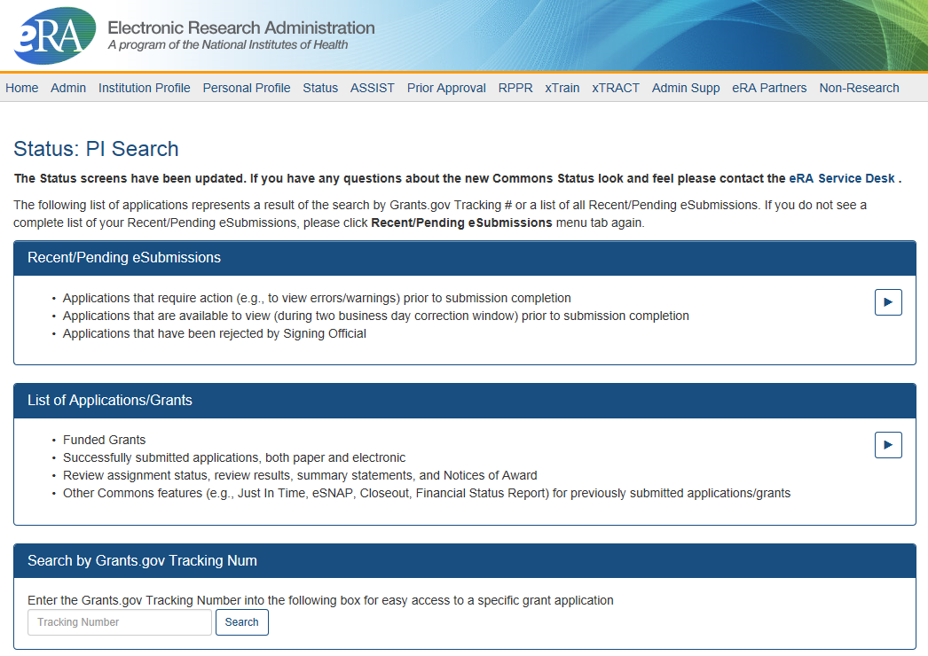
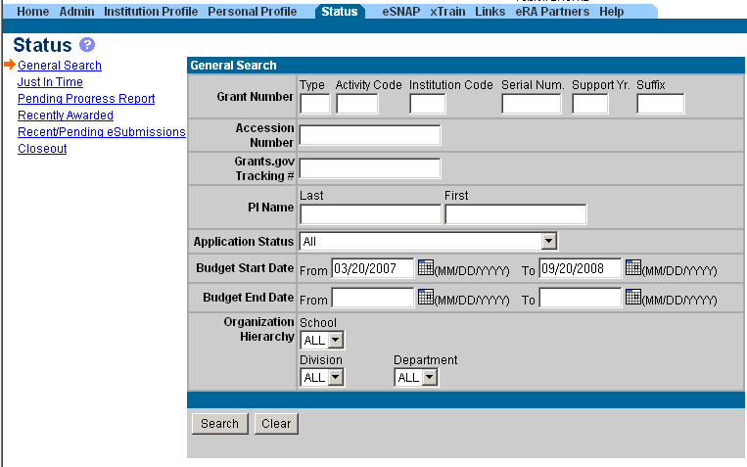
PI & SO Status Views
Principal Investigators can view their Recent/Pending eSubmissions or List of Applications/Grants.
Signing Officials can search/view all submissions for their institution.
Joe

Slide 11
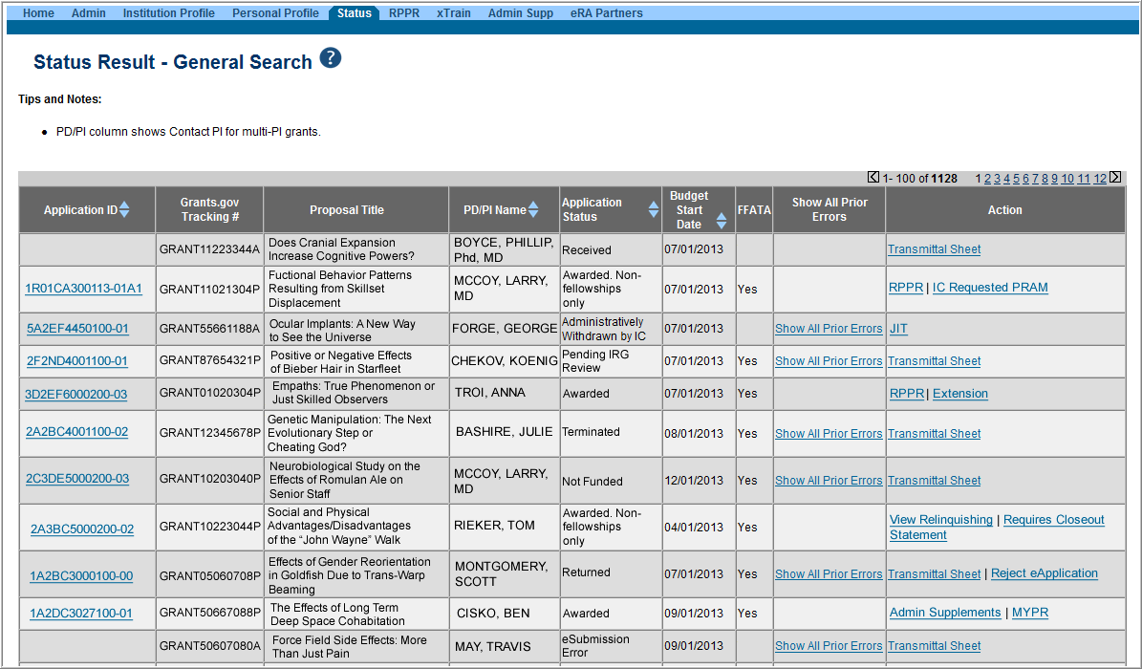
Status Result from General Search for SO
Select the Application ID link to view detailed status information for that particular application.
Joe

Slide 12
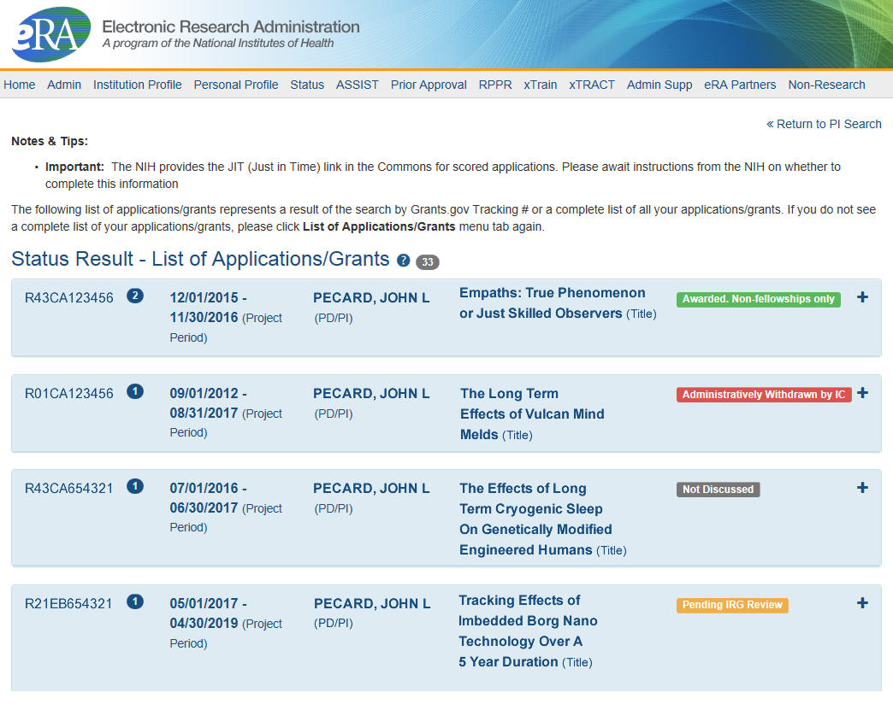
Status Result from General Search for PI
Click anywhere in the blue to get to more information, then select the Application ID link to view detailed status information for that particular application.
Joe

Slide 13
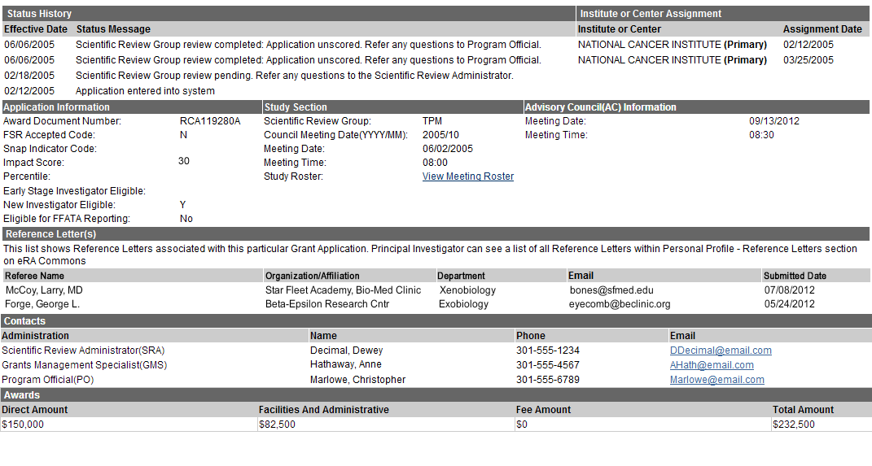
Verifying ESI & NI Application Status
Reflects a snapshot of Early Stage Investigator (ESI) and New Investigator (NI) status at time of application submission.
Joe

Slide 14
Reference Letters
NOT part of the application through Grants.gov
Submitted directly by the referee through eRA Commons
Commons registration not required
Can be submitted in advance of application submission
Due by the application submission deadline
Applicants can track the submission of reference letters in the Commons, but cannot view the actual letter
With FORMS-C, Fellowship reference letters no longer have a required format – just a letter
Some NIH grant programs require the submission of reference letters in addition to the grant application (e.g., Mentored Career Development program)
Joe

Slide 15
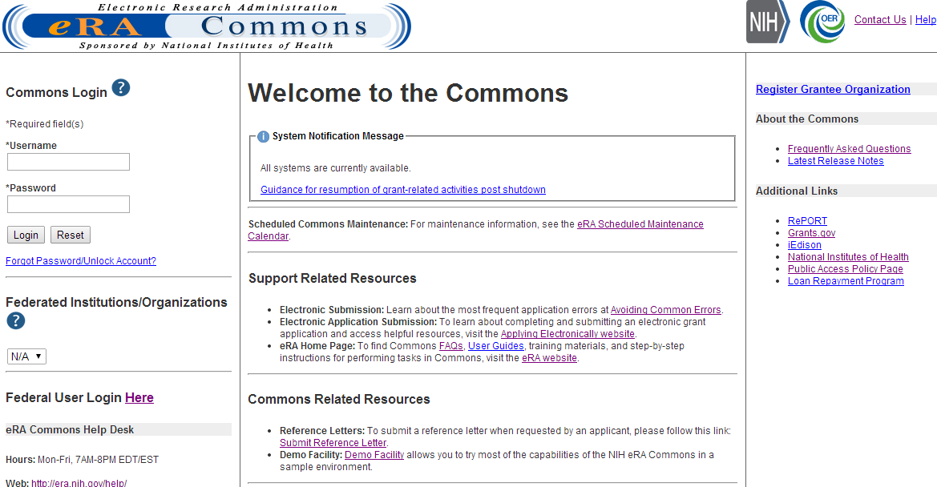
Reference Letters
Referees do not need to login to Commons to submit.
Joe

Slide 16
Reference Letters
Joe

Slide 17

Reference Letter Resources
Frequently Asked Questions
  http://grants.nih.gov/grants/ElectronicReceipt/faq_full.htm#12
Submitting Reference Letters through eRA Commons (Demo)
  http://era.nih.gov/era_training/tutorials/NIH_Reference_Letter/NIH%20Reference%20Letter.htm
Joe

Slide 18
Identifying NIH Contacts
Contacts are added as the application moves through the different stages of processing.
Joe

Slide 19
Check Review Assignments
Institute or Center assignment
Study Section assignment

Slide 20
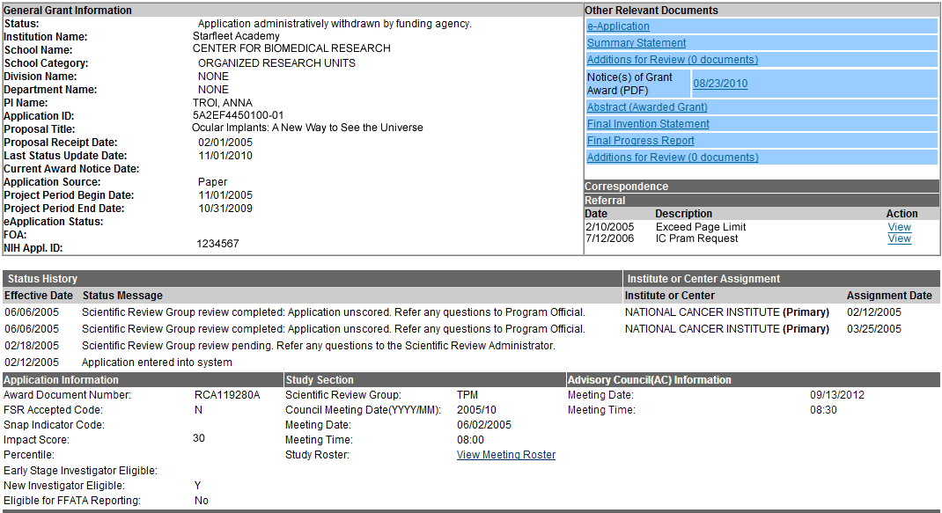
Check Review Outcomes
Only the PI can view the Summary Statement, Priority Score and Percentile Information

Slide 21
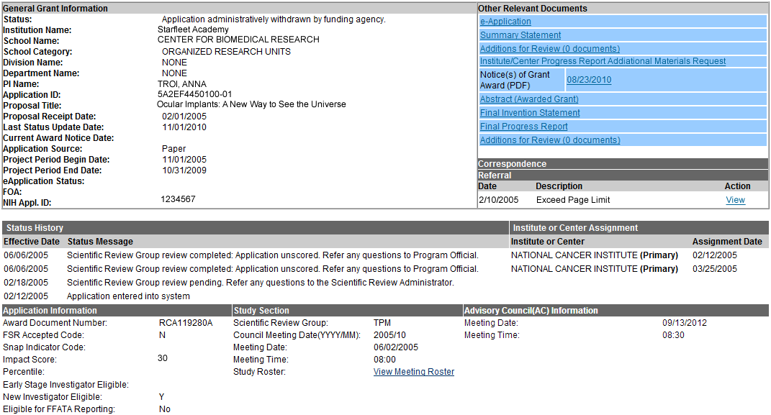
Viewing Referral and Review Correspondence
NIH Referral and Review staff can post correspondence for the application.

Slide 22
Notice of Award (NoA)
Contains or refers to all terms and conditions of the grant
Is posted in the Other Relevant Documents section of the Status Information page
Official document notifying the grantee and others that a grant has been awarded

Slide 23
eRA Commons
Account Administration
Account management
Scarlett

Slide 24

Signing Official (SO)
During Commons registration, an applicant organization designates a Signing Official (SO)
  SO has authority to legally bind the organization in grants administration matters
  Equivalent to the Authorized Organization Representative (AOR) in Grants.gov
  SO is responsible for:
    maintaining institutional information
    submitting documents that require signature
    authority to act on behalf of the organization
    managing accounts
Scarlett

Slide 25
Account Management - Reports
Account Management System (AMS) now includes a report feature.
  Search by role or multiple roles
  Limited to users only at your institution
  Unlike other search features with a limit of 500 hits, there is no limit to number of users returned in report search
  Result can be exported as a spread sheet or RDF document
Scarlett

Slide 26
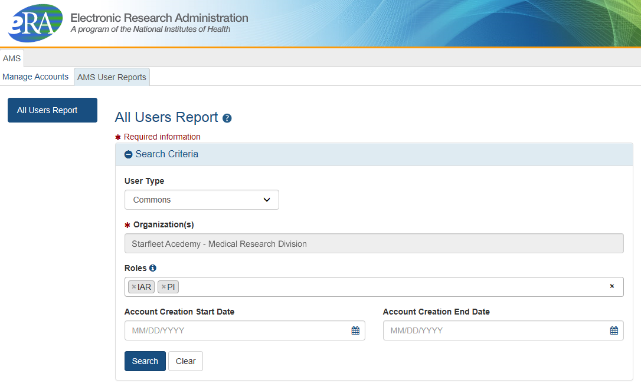
Account Management – Reports Search
Search on one eRA Commons role or multiple roles
Scarlett

Slide 27
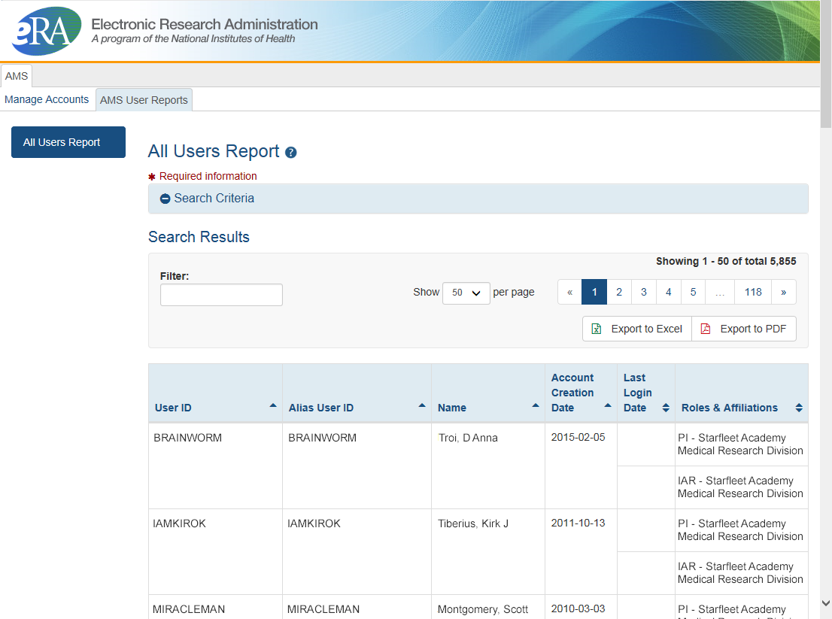
Account Management – Search Results
View and export options
Scarlett

Slide 28

Account - Tips
Designate more than one Signing Official
  Certain Commons actions can only be taken by users with the SO role and you will want a back-up
Administrators should always check to see if a user already has a Commons account before creating a new account with a scientific role
  Ask the person if they already have an account, or search within the Commons
    If a user already has an account with a different organization,
    the SO should affiliate the existing account with the user’s
    new organization
Scarlett

Slide 29
Account Passwords
Password policy:
  http://era.nih.gov/files/NIH_eRA_Password_Policy.pdf
Passwords must:
  Contain at least eight (8) characters: no more than 16; no blank spaces
  Contain a combination of at least 3 of the following:
    Upper case letters
    Lower case letters
    Numbers, not at beginning or end of the password
    Special characters: ! # $ % - _ = + < >
    The following special characters are NOT allowed: @, &, or a “period”
  Not begin or end with a number
  Not contain username
  Not be reused within one (1) year, or use last 24 passwords
  Be changed every 90 days
Scarlett

Slide 30
eRA Commons Roles
The functions that a user can perform in the Commons are based on the role(s) assigned to his or her Commons account
Full, printable list of eRA Commons roles:
  http://era.nih.gov/files/eRA_Commons_Roles.pdf
Scarlett

Slide 31

Roles
IAR
PI
AA
FSR
SO
AO
Administrative
  AA – Account Administrator
  AO – Administrative Official
  ASST – Assistant
  BO – Business Official
  SO – Signing Official
Scientific
  Graduate Student
  IAR – Internet Assisted Review
  PI - Principal Investigator
  Post-Doc
  Project Personnel
  Scientist
  Sponsor
  Trainee
  Undergraduate
Other
  FCOI (Financial Conflict of Interest)
  FCOI_ASST
  FCOI_VIEW
  FSR (Financial Status Reporter)
  PACR (Public Access Compliance Reporting)
Scarlett

Slide 32
Role - Tips
Don’t combine scientific roles with administrative or other roles on the same account
  Other combinations are fine (e.g., PI and IAR; AO and FSR)
  A person needing both scientific and administrative roles should have two separate accounts (one for scientific roles and another for other roles)
Scarlett

Slide 33
Resources
Four Tutorial Videos on Registration and Account Creation
  Institutional Registration: How to Register an Institution
  How Signing Officials (SOs) Create Accounts
  How Trainees Get Accounts
  How Scholars Register in eRA Commons
  Access all the eRA Videos at:
  http://era.nih.gov/era_training/era_videos.cfm
Scarlett

Slide 34
eRA Commons
Account Administration
Institutional Profiles (Ipf)
&
Personal Profiles (PPF)
Joe

Slide 35

Institutional Profile File (IPF)
Each organization establishes and maintains their organization’s profile data
Depending on their role, users can view and/or update Institution Profile information
  Only SOs can edit IPF information
  IPF displayed as a read-only page for users with all other Commons roles
  Includes two sections: Basic and Assurances & Certifications
Central repository for registered organization information
Terminology Check:
‘Organization’ = ‘Institution’ = ‘Entity’
Joe

Slide 36
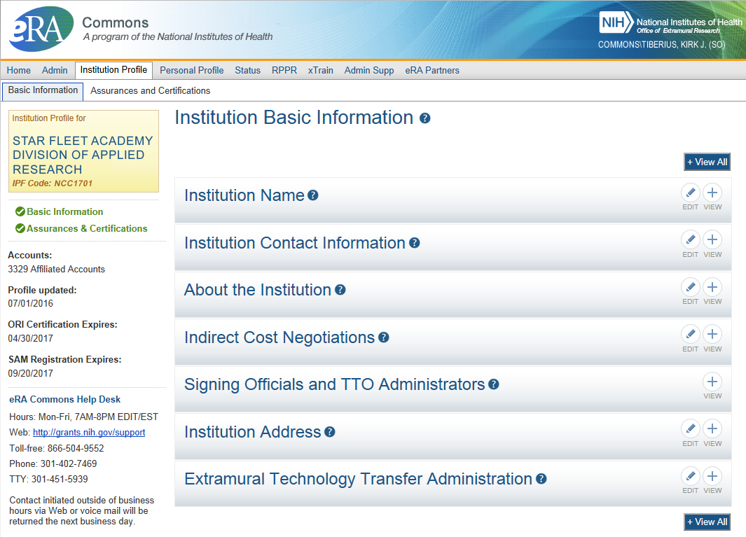
IPF - Basic
Basic: general information about the institution
  Name, address, Institution Contact information, list of Signing Officials, etc.
Only SOs can edit Institution Profile
NEW! SAM Registration Expiration
Joe

Slide 37
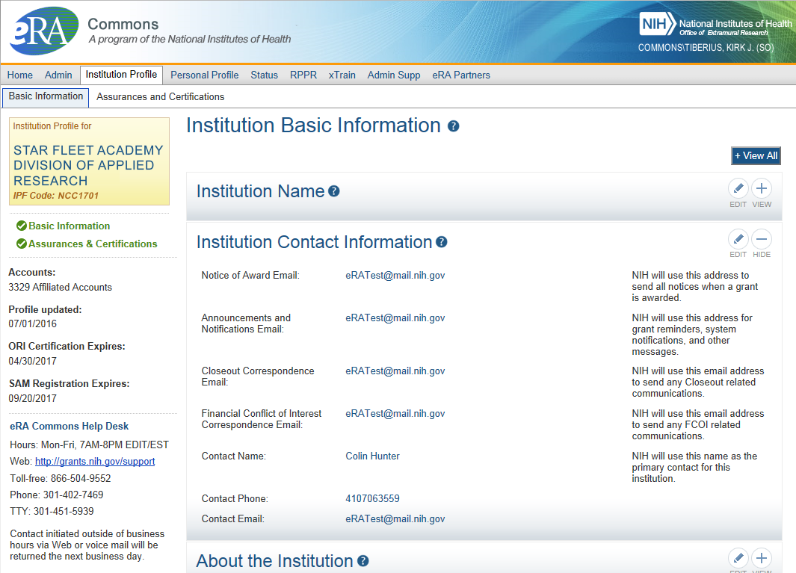
IPF – Institution Contacts
New Contact Fields:
Closeout Correspondence
FCOI Correspondence
Joe

Slide 38
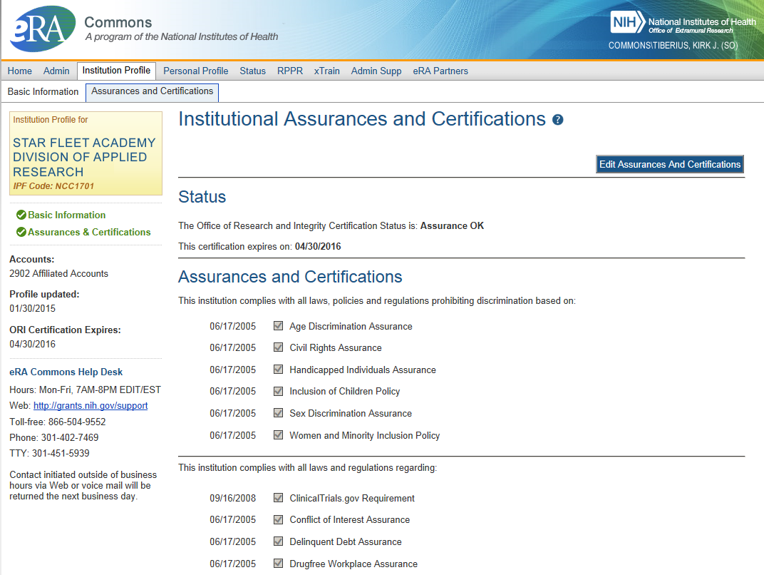
IPF – Assurances and Certifications
Assurances and Certifications: data elements that comprise assurance/certification information about an institution
  List of certifications
  (e.g., Financial Conflict of
  Interest, Human Subjects
  Research, Vertebrate
  Animals, etc.)
Joe

Slide 39
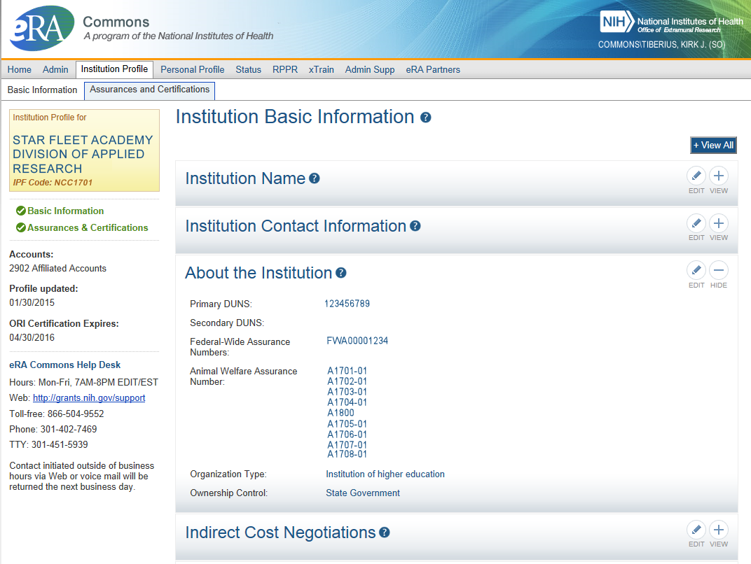
IPF – OLAW
Integration with Office of Laboratory Animal Welfare’s (OLAW) Animal Assurance Number
  IPF will pull OLAW’s
  Animal Assurance Number
  Under the About the
  Institution tile
  Will also update:
    Animal Subject Code
    IACUC Date
  New # Format
  Can not be edited via IPF
Joe

Slide 40
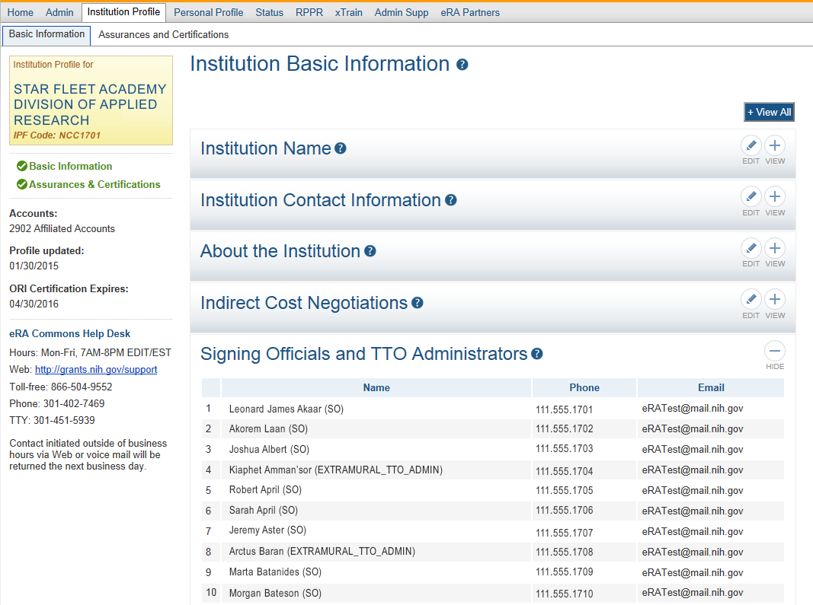
IPF Sections
Signing
Officials
Joe

Slide 41



Personal Profile (PPF)
Individual Commons users are responsible for keeping their profile information accurate
Includes information such as:
  Name
  Demographics
  Employment history
  Education
  Reference Letters
  Publications
Very few staff members at NIH have access to change information (for emergencies only)
Central repository for individual user information
Joe

Slide 42
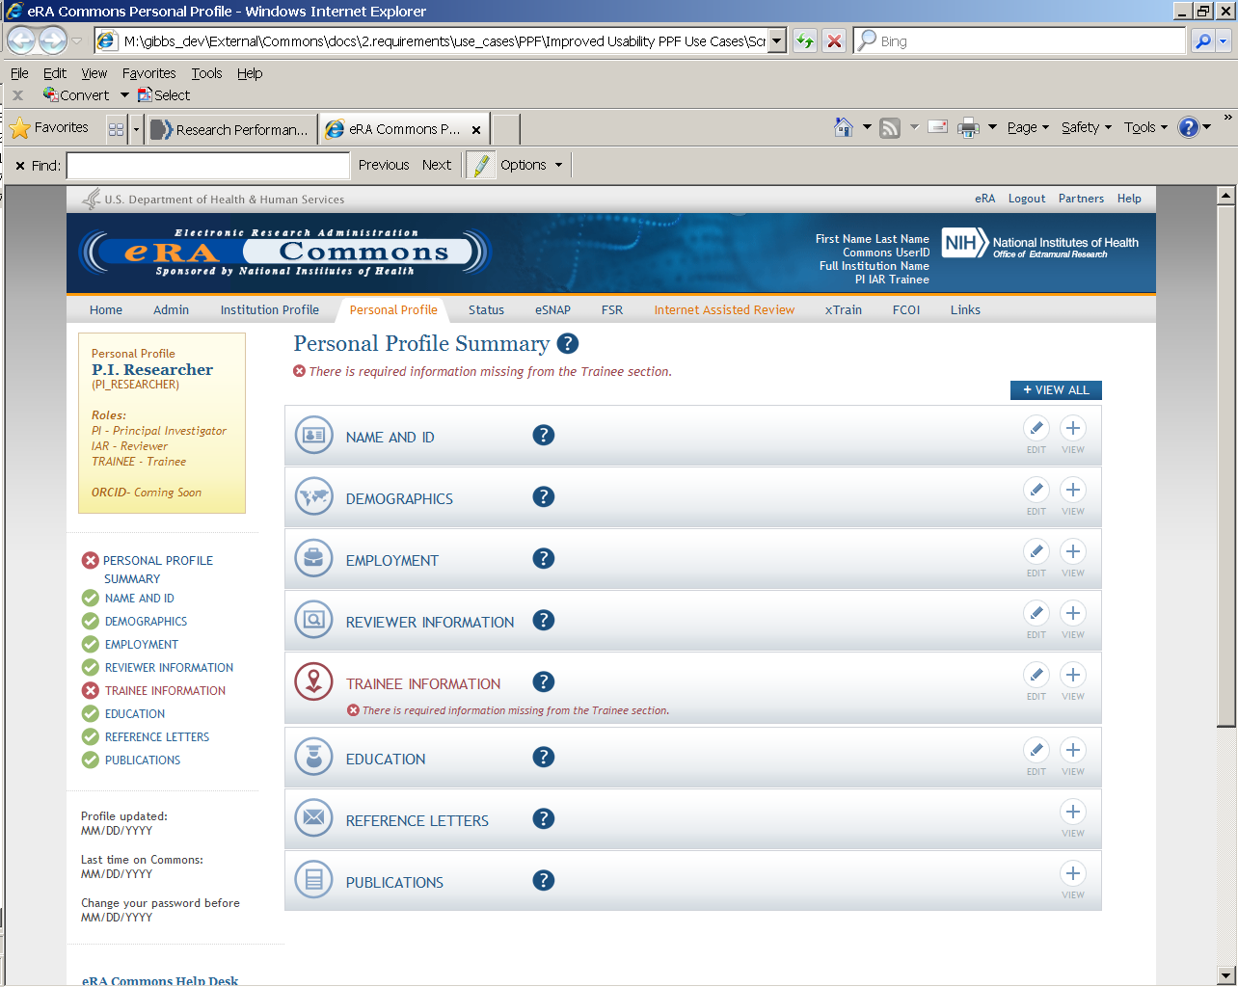
Personal Profile
Joe

Slide 43

Personal Profile Information is used to…
Verify information submitted in grant applications
Send you agency notifications
Complete aggregate reporting
Determine eligibility for Early Stage Investigator (ESI) and New Investigator (NI) status
Determine a reviewer’s eligibility for the Continuous Submission application submission policy
Joe

Slide 44

Terminology Check
New Investigator
  A PD/PI who has not previously competed successfully as a PD/PI for a substantial independent research award.
    See: http://grants.nih.gov/grants/new_investigators/index.htm
Early Stage Investigator
  An individual who is classified as a New Investigator and is within 10 years of completing his/her terminal research degree or is within 10 years of completing medical residency (or the equivalent).
Continuous Submission
  As a way of recognizing their service to NIH, reviewers with substantial review service are permitted to submit their research grant applications (R01, R21, or R34) on a continuous basis and to have those applications undergo initial peer review in a timely manner.
    See: http://grants.nih.gov/grants/peer/continuous_submission.htm
Joe

Slide 45
PPF- Tips
When you change your password, you will be automatically redirected to the Personal Profile tab—take a moment to review and update your information
Be especially diligent about keeping your email addresses current
  Email addresses are used to retrieve forgotten passwords and for communicating grants-related information
Joe

Slide 46
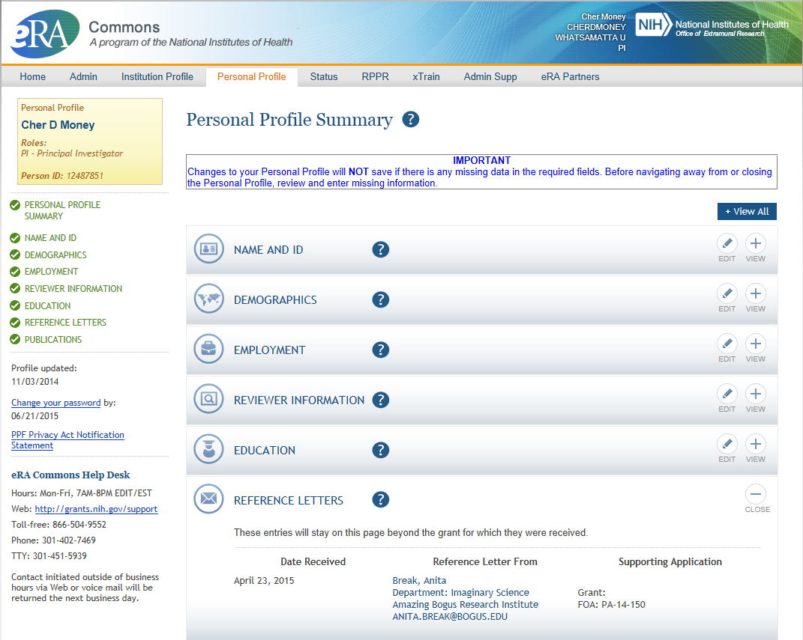
PPF – Reference Letters
Tracking Reference letters
  Shown in Profile
  Can see:
    When it was submitted
    Who submitted it
    What grant it is linked to
  Cannot see the
  actual letter
Joe

Slide 47
eRA Commons
Account Administration
Assigning
&
Managing Delegations
Scarlett

Slide 48

Delegations
Progress Report
Sponsor
Status
PPF
Submit
xTrain
eRA Commons allows users to give other users permission to do specific actions on their behalf
Scarlett

Slide 49
Delegations
Type (Name) | By | To | What it does
Progress Report | SO, AA, AO | PI on behalf of a PI | Enables the delegated PI to work on progress reports of another PI
Progress Report | PI | User within Institution | Enables the authorized user to work on progress reports for the PI
Sponsor | SO, AA (on behalf of Sponsor) | ASST | Allows the ASST to access the xTrain module
Status | PI | ASST | Allows the ASST to work with the Status module
PPF | All Users | User within Institution | Enables another user to edit someone else's personal profile
Submit | SO, BO | PI | Enables the PI to submit RPPR and MYPR reports
xTrain | PI, Sponsor | ASST | Enables the ASST to work with the xTrain module
Scarlett

Slide 50
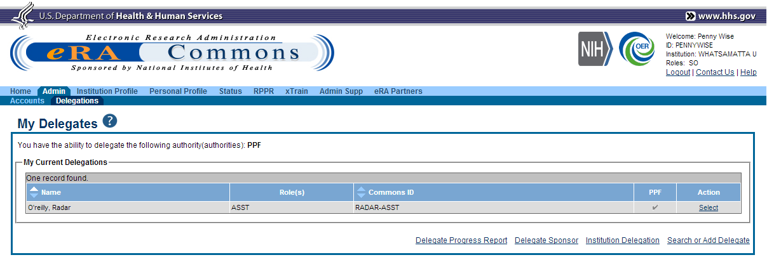
Delegation (SO)
Scarlett

Slide 51
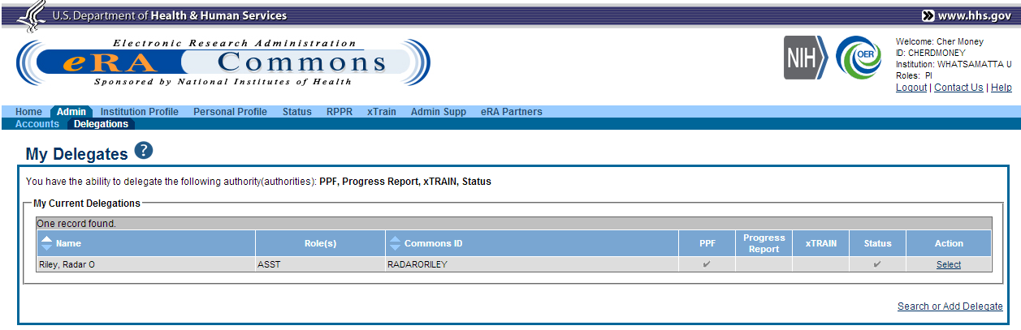
Delegation (PI)
Scarlett

Slide 52
Key eRA Commons
Features
Prior approval requests
Withdrawal
&
Direct Costs of more than $500k
($500K Requests)
Scarlett

Slide 53
Prior Approval
eRA now supports two activities for Prior Approval Requests.
  Request for withdrawal of an application
  Request to exceed $500K in direct cost for any year
Prior Approval is the process in which an applicant or grantee must have written approval by an authorized official to undertake a certain activity.
Scarlett

Slide 54
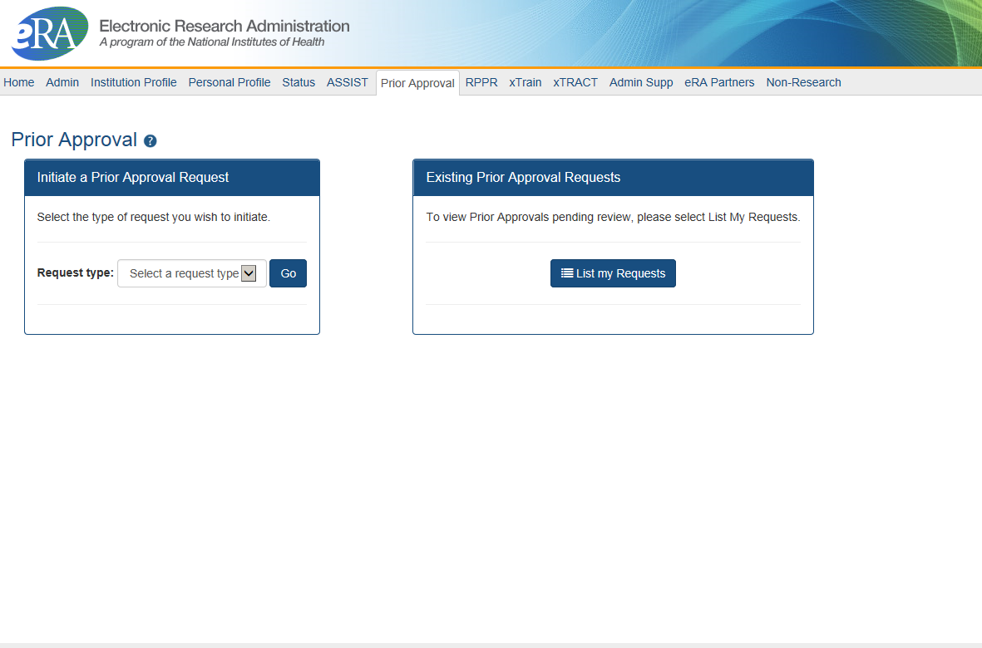

Prior Approval – Withdrawal Request
New navigation tab, Prior Approval
Initiation of a Withdrawal Request can be done by either the Principal Investigator (PI) or Signing Official (SO)
Screen supports justification (required) and supporting documents (max 10)
Only the Signing Official can submit the request
Signing Officials can search for requests for their institution
Automatic notifications to the SO and PI upon approval
Scarlett

Slide 55
Prior Approval – $500K Request
Request for Direct Cost exceeding $500K for a single budget year
  PI is invited to submit the request after discussion with Program Official (PO) of the institute/center they are working with
  PI provides justification (500 characters) and supporting documents (PDF, 1o max)
  PI can submit the request to NIH, or route to SO for review (depending on their institution’s business processes)
  SO can view, and recall a request made by a PI
  If approved, notifications go to the PI and NoA address
Scarlett

Slide 56

Prior Approval – Policy Notices
NOT-OD-16-143
  Optional Electronic Method to Request Withdrawal of Applications from Consideration for Funding
    Applicant organizations are now able to submit requests to withdraw a processed application after the two day viewing window has passed using the eRA Commons Prior Approval module.
    The Center for Scientific Review’s Division of Receipt and Referral (DRR) will review and act on all withdrawal requests.
NOT-OD-16-XXX
  Optional Electronic Method to Request of Direct Costs over $500K Applications
Scarlett

Slide 57
Key eRA Commons
Features
Submitting Just-in-time (JIT)
information upon nih Request
Scarlett

Slide 58
Just-In-Time (JIT)
Applicants should never submit JIT info until specifically requested to do so by NIH. A JIT link or request from NIH are not indications that a grant award will be made.
  Other Support File, Budget Upload, Other Upload, Institutional Review Board (IRB) Date, Human Subject Education
  PD/PI can save info in Commons, but only SO can submit JIT info to NIH
  Must be PDF format
Allows an applicant organization to submit additional grant application information after the completion of the peer review, and prior to funding.
Scarlett

Slide 59
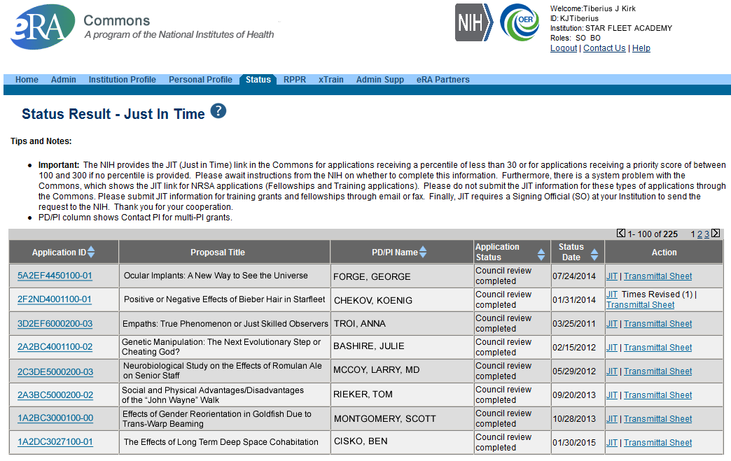
JIT Link on Status Result Screen (SO View)
Select JIT link
Scarlett

Slide 60
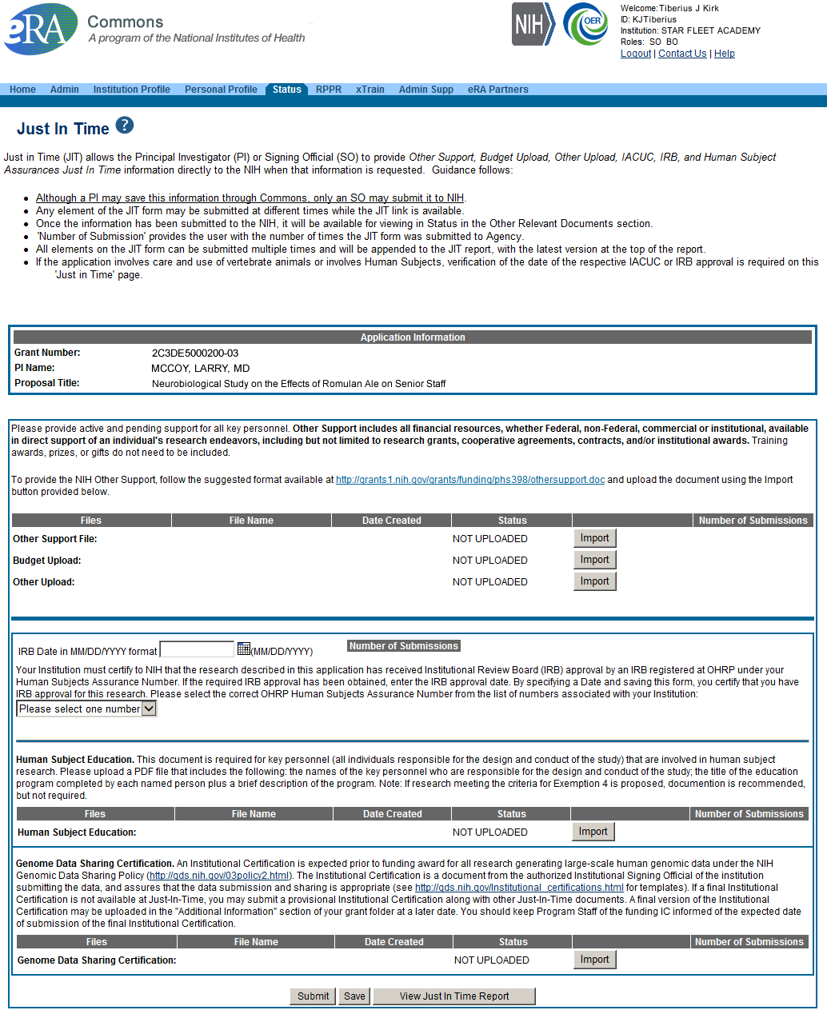
Just-In-Time (SO View)
PDF document with Other Support documentation is required. Use the Import button to begin the upload.
IRB Approval Date should be within the last 12 months.
Scarlett

Slide 61
JIT – Policy Notices
NOT-OD-12-101
  Notice of Requirement for Electronic Submission of Just-in-Time Information and Related Business Process Changes Beginning April 20, 2012
    JIT link appears for all applications within 24 hours of releasing impact scores
    Applications with impact score of 40 or less receive standard notice and request for JIT information
NOT-OD-10-120
  Revised Policy on Applicant Institution Responsibilities for Ensuring Just-in-Time Submissions are Accurate and Current Up to the Time of Award
Scarlett

Slide 62
Key eRA Commons
Features
Submitting
a no cost extension (NCE)
Joe

Slide 63
NCE
Only SOs can submit the NCE notification
May be submitted no earlier than 90 days before end of project and no later than project end date
Can request extension of 1-12 months, in one-month increments
E-mail notification sent to NIH Grants Management staff when SO processes the extension
Electronically submit a notification to exercise one-time authority to extend without funds the final budget period of a project period of a grant.
Joe

Slide 64

Extension link in Status screen
Joe

Slide 65
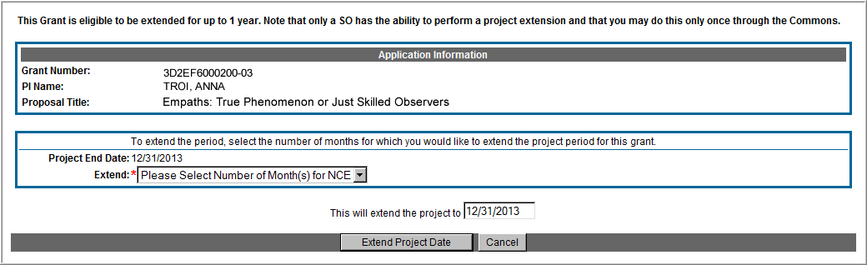
Extension Screen
Choose an extension of 1 to 12 months.
New calculated project end date
Joe

Slide 66
Expanded Authority – You Get Just One
No Cost Extension (NCE) part of ‘expanded authorities’
Can only extend once without express approval
Increasing trend of extending in the middle of the project period (i.e. end of year 2 of 5 year grant)
If this is done, the Extension link will NOT appear 90 days from end of project end-date
See June’s 2015 eRA Items of Interest for more:
  https://era.nih.gov/news_and_events/era_item_June_2015.htm#expanded
Joe

Slide 67
Key eRA Commons
Features
Research Performance
Progress Report (rppr)
Scarlett

Slide 68

RPPR
Describes scientific progress, identify significant changes, report on personnel, and describe plans for the subsequent budget period or year.
  http://grants.nih.gov/grants/rppr/
Now available for all SNAP and non-SNAP progress reports.
Progress Report Additional Material (PRAM) functionality available for publication compliancy explanations and additional information requested by grants management staff.
Annual progress report to document grantee accomplishments and compliance with terms of award.
Hello, RPPR!
Scarlett

Slide 69
RPPR Transition Timeline
Required for SNAP and Fellowship Awards with budget start dates on or after July 1, 2013.
Required for type 5 non-SNAP progress reports as of April 24, 2014.
  Reminder: NIH Requires the Research Performance Progress Report (RPPR) for All Type 5 Progress Reports NOT-OD-15-014
Scarlett

Slide 70
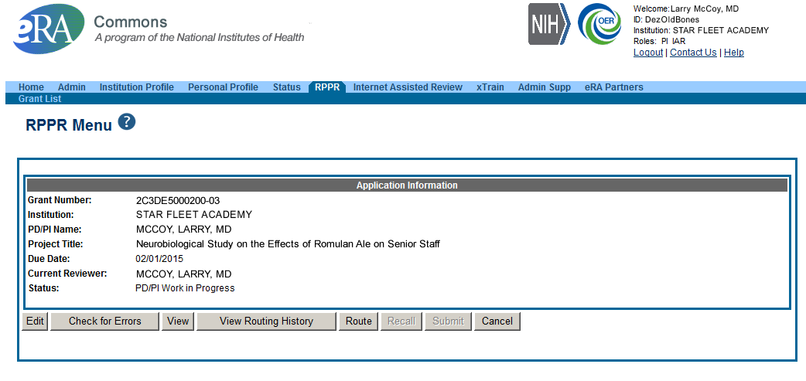
RPPR Menu Screen
Scarlett

Slide 71
RPPR Data Entry
RPPR sections
  Cover Page
  Accomplishments
  Products
  Participants
  Impact
  Changes
  Special Reporting
  Budget (non-SNAP)
Watch for character limits in data entry fields
Ensure uploads are in PDF format
When completing data tables remember to click ‘Add/New’
Scarlett

Slide 72
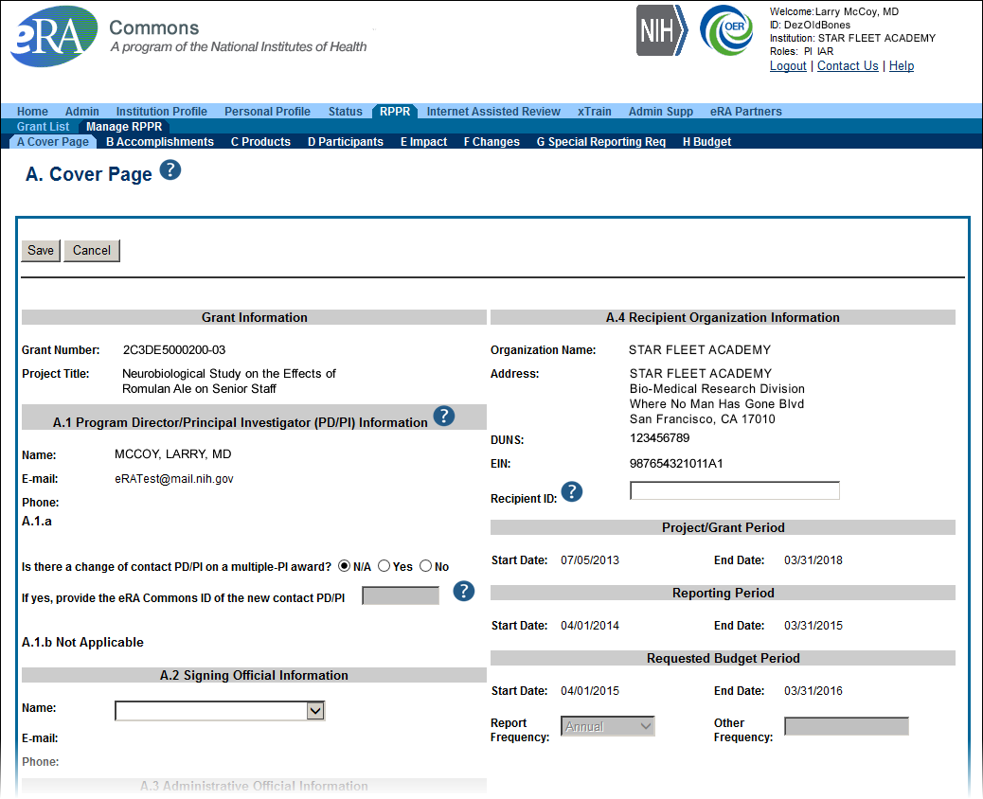
Sample RPPR Screen
Scarlett

Slide 73
Progress Report Additional Materials (PRAM)
The PRAM feature provides a means for the grantee to enter, review, route, and submit information to agency following the submission of an RPPR.
  Public Access (PA) PRAM - Generated automatically after an RPPR is submitted with publications that are not compliant with Public Access Policy
  IC (Agency) Requested PRAM – Only available if requested by the Grants Management Specialist (GMS)
PD/PI can enter the PRAM, but can only submit it if they are delegated with Submit Progress Report authority. Otherwise, only the SO can submit the PRAM to Agency.
Scarlett

Slide 74
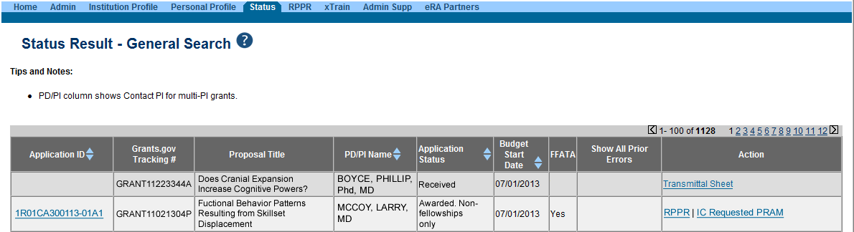
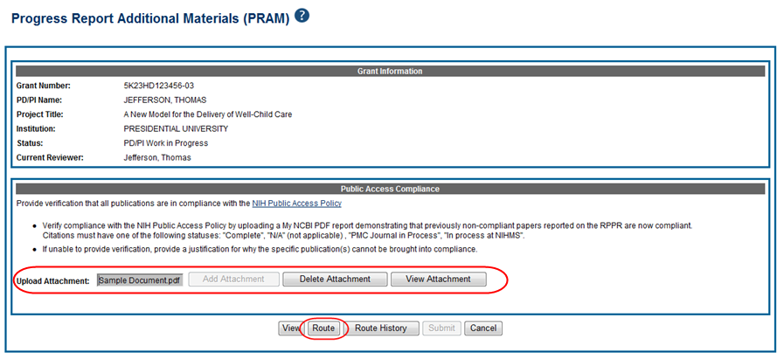
Progress Report Additional Materials (PRAM)
Scarlett

Slide 75
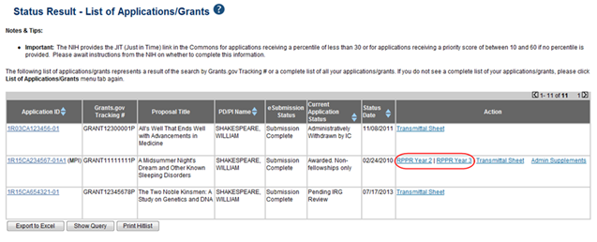
RPPR – Multi-Year RPPR
MYRPPR
  Multi Year Progress Reports now use RPPR format
  Link available under the Action Column in Status
Scarlett

Slide 76
RPPR – Budgets
Submitting progress reports with budgets
  R&R budget and PHS 398 budgets are now available for Non-SNAP RPPR.
  If presented with an option of budget forms, the type that was submitted with the application should be used.
    PHS 398 Budget is available only on training grants.
  Help for R&R Budget and PHS 398 Budget forms can be found in the SF424 R&R User Guides.
Scarlett

Slide 77
RPPR – Complex, Multi-Project
Submitting progress reports for complex, multi-project grants
  After RPPR is initiated, PI will need to identify if RPPR should contain components.
  RPPR should have the same structure as the originally submitted application.
  Some sections are not available on Overall component (i.e. Budget)
  Some sections are not available on component level (i.e. Participants and Publications are reported on Overall)
Scarlett

Slide 78
New Format for PA PRAM
Public Access (PA) PRAM will require an attachment.
  The PA PRAM will no longer contain a free form text box.
  Using My NCBI the institution will need to generate a PDF of their reported publications showing their compliance.
  For instructions on generating the report please see: http://www.nlm.nih.gov/pubs/techbull/nd12/nd12_myncbi_pdf.html
Scarlett

Slide 79
New Feature RPPR Publications
When selecting/deselecting publications for RPPR submissions
  Users will see a gold lock icon next to those publications added to their grant into NIHMS.
  Users see a silver lock icon for publications that have been reported on a previous RPPR.
  Neither can be removed on the RPPR, both need manual intervention.
  To delete a publication with a gold lock, users will need to contact the NIHMS help desk through their web form, which is accessible at http://www.nihms.nih.gov/.
  To delete a publication with a silver lock please contact the PublicAccess@nih.gov
Scarlett

Slide 80
RPPR – Policy Notices 1
Use of Updated Inclusion Enrollment Format Now Required for Successful Submission of RPPR. Old formatted inclusion data results in an error.
  NOT-OD-15-078
Use of New Inclusion Management System (IMS) Required as of October 17, 2014
  NOT-OD-15-005
Scarlett

Slide 81
RPPR – Policy Notices 2
NOT-OD-15-090
  The purpose of this guide notice is to amend instructions for reporting publications in the Research Performance Progress Report (RPPR) to ensure all publications are noted.
NOT-OD-15-014
  NIH Requires the Research Performance Progress Report (RPPR) for All Type 5 Progress Reports
NOT-OD-14-085
  Transition Plans for Reporting
  Sex/Gender, Race, and Ethnicity
  Information in Non-Competing Type 5
  Progress Reports
Scarlett

Slide 82
RPPR – Policy Notices 3
NOT-OD-14-113
  Revised Policy: Descriptions on the Use of Individual Development Plans (IDPs) for Graduate Students and Postdoctoral Researchers Required in Annual Progress Reports beginning October 1, 2014
NOT-OD-14-064
  NIH Will Open the Research Performance Progress Report (RPPR) for All Type 5 Non-SNAP Progress Reports on April 25, 2014
Scarlett

Slide 83
RPPR – Policy Notices 4
NOT-OD-14-092
  NIH Will Require the Research Performance Progress Report (RPPR) for All Type 5 Non-SNAP Progress Reports on October 17, 2014
NOT-OD-14-079
  NIH Will Open the Research Performance Progress Report (RPPR) for All Type 5 Non-SNAP Progress Reports on April 25, 2014.
NOT-OD-14-026
  NIH Will Require Use of Research
  Performance Progress Report (RPPR)
  for All Multi-Year Funded Awards
Scarlett

Slide 84
Key eRA Commons
Features
Submitting administrative supplements
(type 3s)
Using era Commons
Joe

Slide 85
Administrative Supplements
Requested additional costs must be within the scope of the peer reviewed and approved project
Multiple submission methods available:
  SF424 (R&R) application forms & standard Grants.gov submission process¹
    Great for system-to-system users
  Streamlined eRA Commons process¹
    Commons pre-populates much of the data needed for request from awarded grant
  Paper process
A request for additional funds during a current project period to provide for an increase in costs due to unforeseen circumstances.
¹Available for single-project activity codes for which competing applications are submitted through Grants.gov.

Slide 86
Admin. Supplement Requests– Grants.gov
Parent Announcement page has general use FOAs
  http://grants.nih.gov/grants/guide/parent_announcements.htm#adminsupp
  NIH Institutes can also post FOAs for administrative supplements targeting specific programs
When completing package…
  Follow all FOA-specific instructions
  Carefully choose appropriate application package
  Use Revision as the Application Type (SF424 RR, item #8)
  Include IC and Serial number of awarded grant as the Federal Identifier (SF424 RR, item #4a)
Joe

Slide 87
Admin. Supplement Requests– Grants.gov
Similar submission process as competing applications, except:
  Many of the NIH business rule validations for competing applications are not enforced
  Required forms may vary from competing applications for the same activity code
    Modular budget forms not an option; must use detailed R&R Budget forms
    No cover letters
  After the two-day viewing window the request bypasses Receipt & Referral and goes directly to Grants Management staff for consideration
    Move to Admin Supp Status tab in Commons
Joe

Slide 88
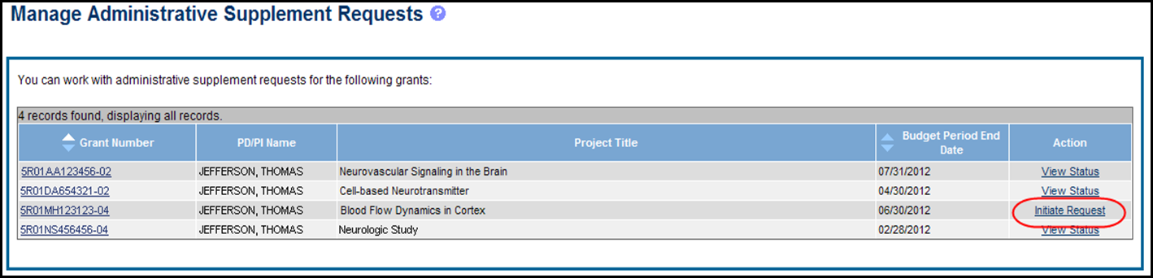
Admin. Supplement Requests - Commons
Starting an Administrative Supplement request in Commons you must find eligible grant and Initiate Request
Joe

Slide 89
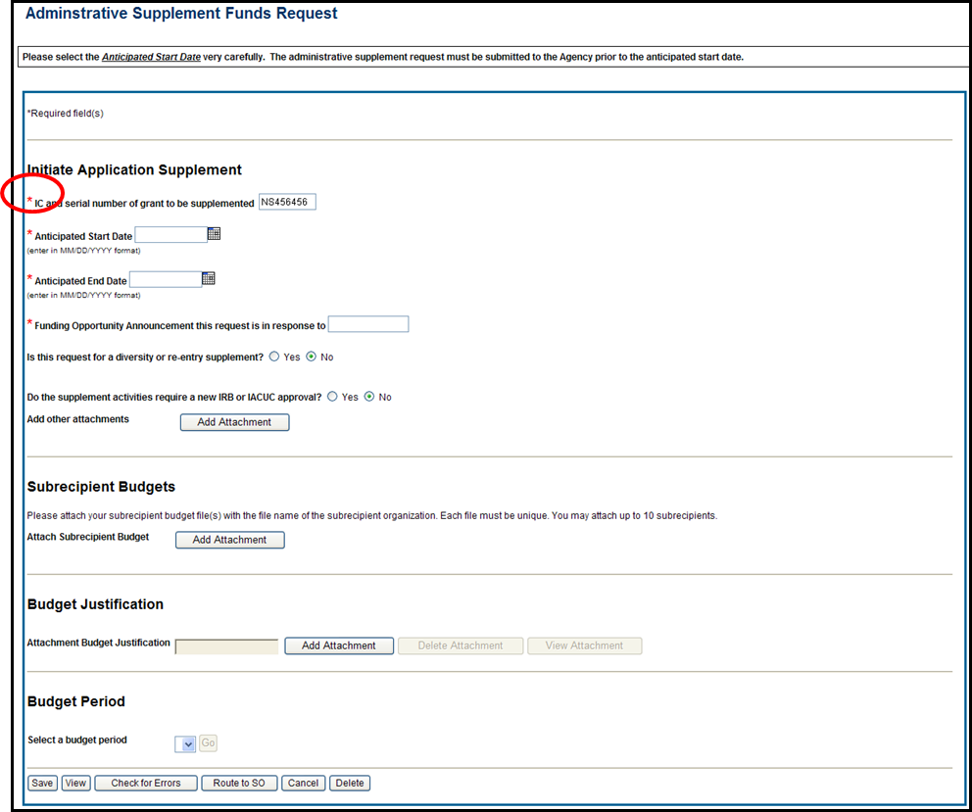
Admin. Supplement Requests - Commons
Complete Form – Required Fields are indicated with red asterisk
Joe

Slide 90
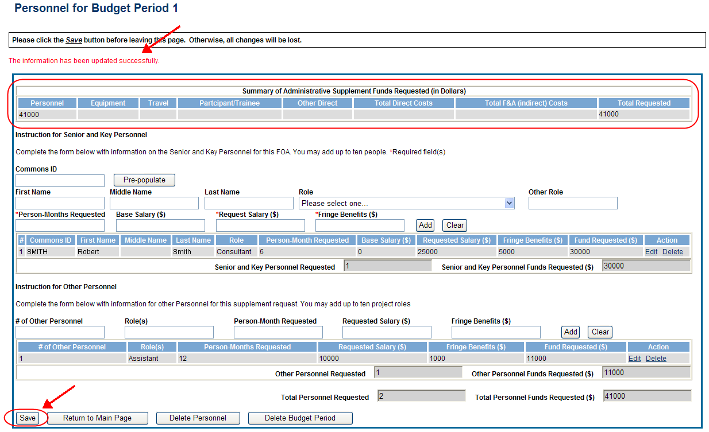
Admin. Supplement Requests - Commons
For each Budget Period enter appropriate sections:
  Personnel, Equipment, Travel, Participant/Trainee, Other Direct, Total F&A (Indirect) Costs
Total Requested will be calculated automatically
Joe

Slide 91
Admin. Supplement Requests - Commons
Resources:
  eRA Commons Administrative Supplement Module User Guide
    http://era.nih.gov/files/eRA_Commons_Admin-Supp_UG.pdf
  Administrative Supplements (Type 3s) Frequently Asked Questions
    http://era.nih.gov/commons/faq_commons.cfm#XVIII
Joe

Slide 92
Admin. Supplement – Policy Notices
NOT-OD-13-031
  Notice of an Extension of Expiration Date for PA-12-100 "Administrative Supplements for Existing NIH Grants and Cooperative Agreements (Parent Admin Supp)"
NOT-OD-12-043
  New Electronic Submission Process Now Available for Administrative Supplement Requests
NOT-OD-13-060
  Notice of Clarification of the Funded Extension Option in RFA-OD-13-199 "NIH Administrative Supplements to Recover Losses Due to Hurricane Sandy Under the Disaster Relief Appropriations Act – Non-Construction (Admin Supp)"
Joe

Slide 93
Key eRA Commons
Features
Wrapping up the ‘paperwork’ with closeout
Scarlett

Slide 94
Closeout
Closeout items include:
  Federal Financial Report (FFR)
  Final Progress Report
  Final Invention Statement
NIH must mark the grant “ready for close out” for link to appear in Commons
  Contact the Division of Central Grants Processing (DCGP) or assigned Grants Management Specialist (GMS) if link is not appearing
Electronically submit required Closeout documents for grants in Closeout status
Scarlett

Slide 95
Closeout Capabilities
Identify expiring and terminating grants
Request and track required closeout documents
Track submission of boxed archived paper grant records at the Federal Record Center (FRC)
Scarlett

Slide 96
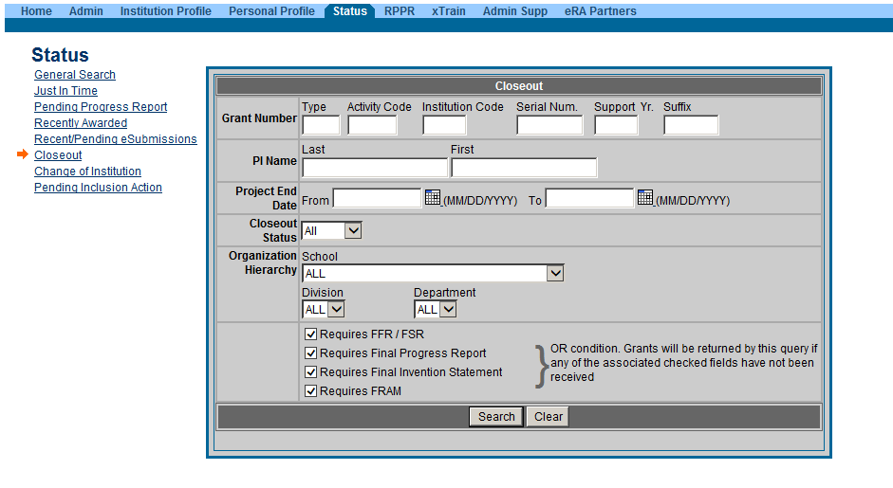
New Closeout Search screen provides additional search criteria
Scarlett

Slide 97
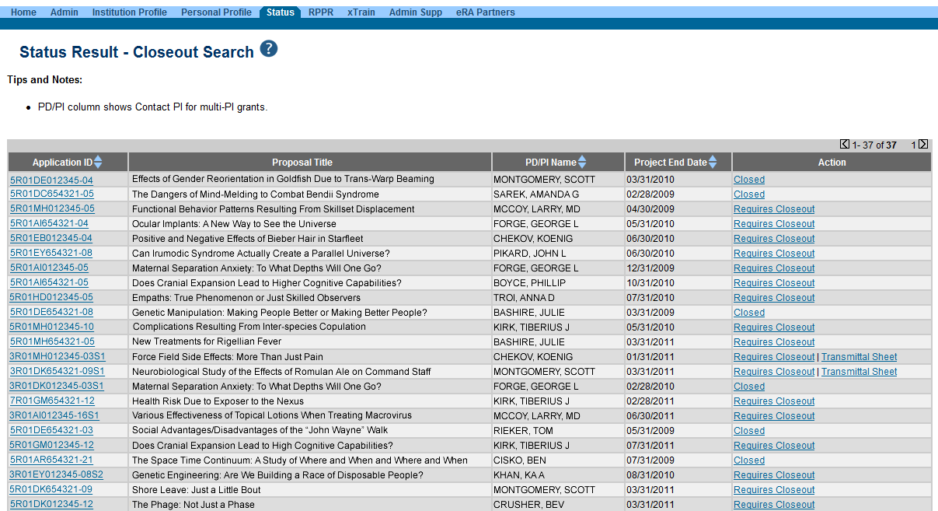
Search screen shows grants that are Closed or Requires Closeout
Scarlett

Slide 98
Federal Financial Report (FFR)
FFRs must be submitted in eRA Commons via the FFR/FSR module
  Cash transaction data still submitted via Payment Management System
FSR role for users who have the authority to view, enter, and submit an FFR on behalf of institution
Allows grantees to electronically submit a statement of expenditures associated with their grant to NIH via eRA Commons.
Scarlett

Slide 99
FFR
Annual FFR due date: For non-SNAPs, FFR must be submitted within 120 days of the calendar quarter in which the budget period ends
Final FFR due date: based on the Project Period End Date (PPED):
  Pending Status: If the FFR is not submitted and it is within 120 days of the PPED
  Due Status: If the FFR is not submitted and it is between the PPED and 120 days past the PPED
  Late: If the FFR is not submitted and it is more than 120 days past the PPED
Scarlett

Slide 100
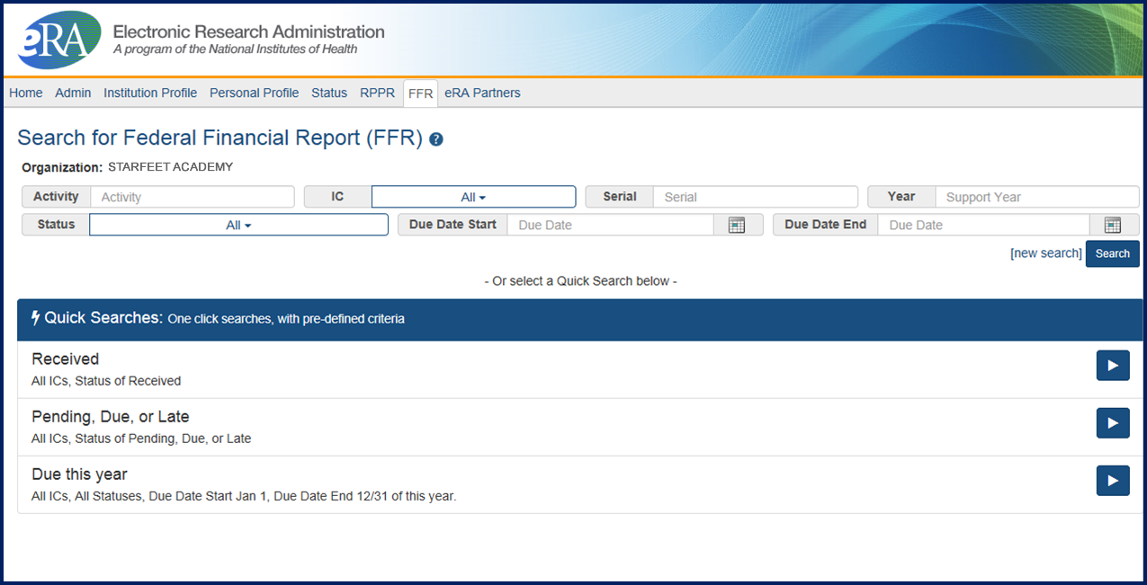
FFR/FSR Screen
Scarlett

Slide 101
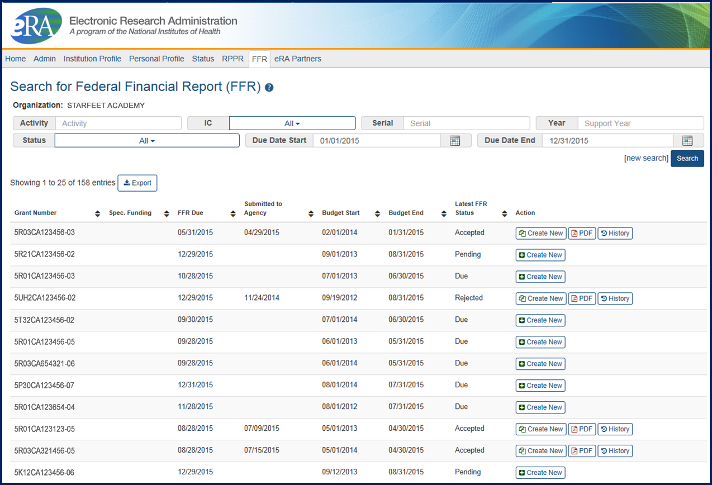
FFR/FSR Screen
Create New button will take you to the FFR/FSR form.

Slide 102
FFR Details Screen
Clicking the hyperlinked grant number opens the FFR Details screen, which displays:
  FFR Status:
    Received, Accepted, Rejected, In Review, or Revision Pending
  Available Actions:
    Accepted status: View or Create New
    Rejected status: View or Create New
    Received status: View or Correct
    Revision Pending status: View or Edit
    In Review status: View
Scarlett

Slide 103
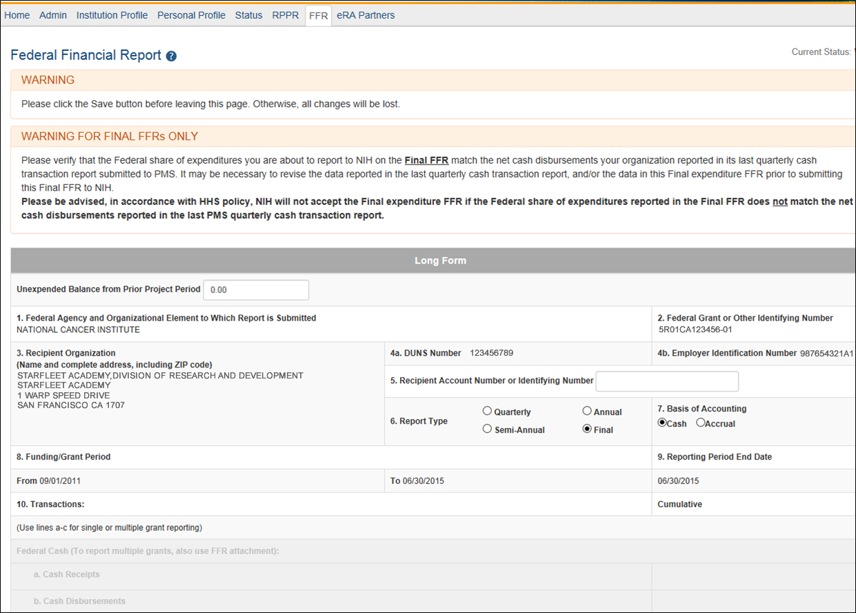
Completing the FFR
As current year entries are completed, calculations are done automatically.

Slide 104
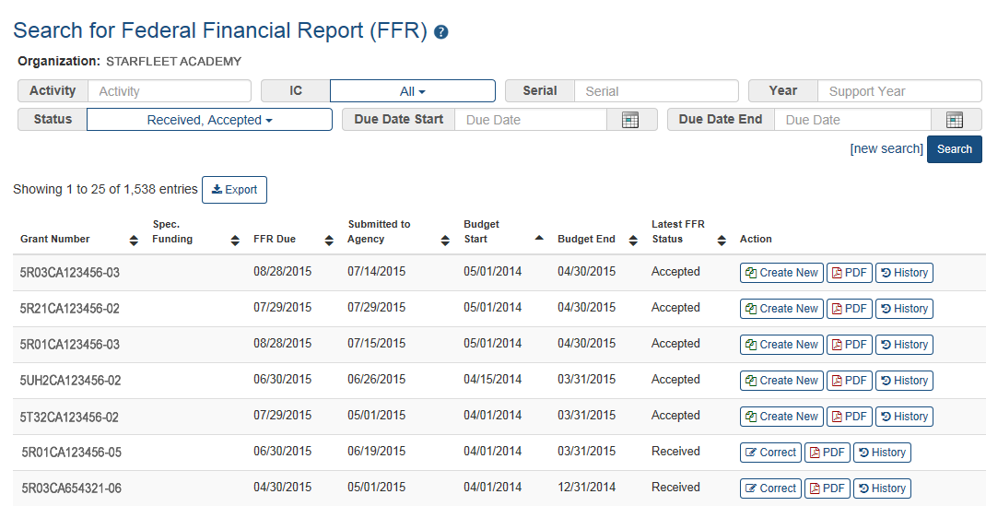
Submission of a FFR
Once FFR/FSR is Submitted, Latest FSR status changes to Received
If a mistake is made on the FFR and the status has changed to In Review, the institution should contact the eRA Service Desk to determine who the OFM staff is that is assigned by the NIH Institute/Center to resolve the issue.

Slide 105
FFR Related – Policy Notices
NOT-OD-14-103
  Revised Timeline for Administrative Changes to NIH Domestic Awards to Transition to Payment Management System Subaccounts
NOT-OD-14-093
  Administrative Changes to NIH Domestic Awards Transition to Payment Management System Subaccounts
NOT-OD-14-084
  NIH Updating Grant Closeout Policies and Procedures to Align with New HHS Requirements
Scarlett

Slide 106
FFR Related – Policy Notices
NOT-OD-13-120
  NIH Domestic Awards to Transition to Payment Management System Subaccounts in FY 2014 and FY 2015
NOT-OD-13-112
  NIH Domestic Awards to Transition to Payment Management System Subaccounts in FY 2014
Scarlett

Slide 107
FFR Related – Policy Notices
NOT-OD-13-111
  NIH to Transition Payment for Individual Fellowships at Foreign and Federal Sponsoring Institutions, and Awards to Federal Institutions to Payment Management System Subaccounts in FY 2014
NOT-OD-13-019
  Notice of Changes to Payment Management System Registration Procedures for NIH Foreign Grantees
Scarlett

Slide 108
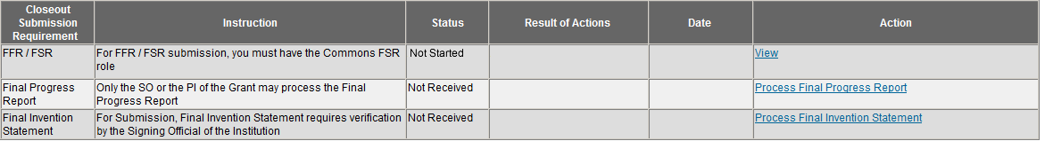
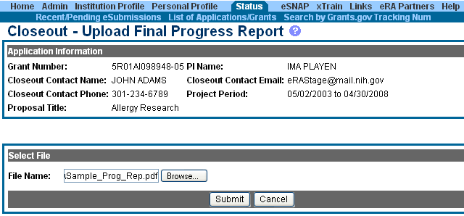
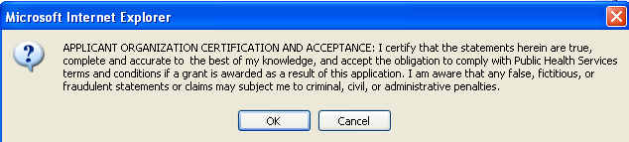
Closeout – Final Progress Report
Either the PI or the SO can create/upload the Final Progress Report.
Browse to select file for upload.
Select Submit.
Read certification information and select OK.

Slide 109
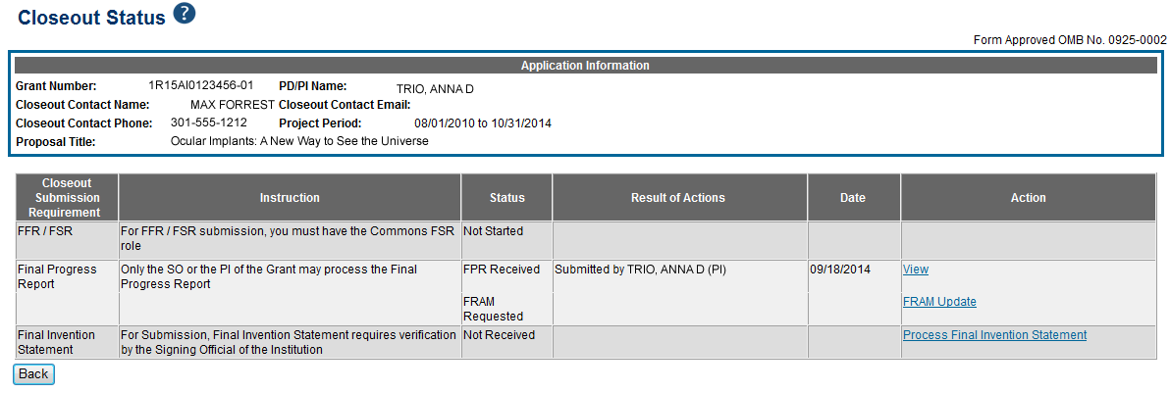
Closeout – Final Report Additional Materials
(FRAM)
FRAM works in same manner as PRAM in RPPR
Awarding IC sets status to FRAM Requested
Awarding IC triggers email for requested information to the SO & PI
The FRAM Update link appears in Action column
Scarlett

Slide 110
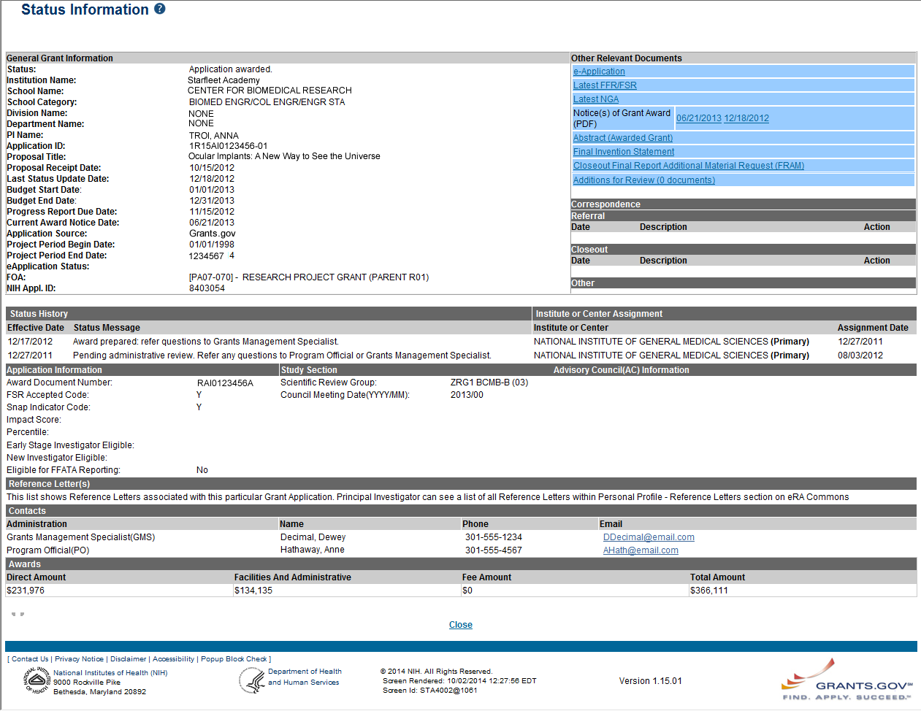
Closeout – Final Report Additional Materials
(FRAM)
Specifics about the FRAM request can also be found in Other Relevant
Documents section of the Status Information screen.

Slide 111
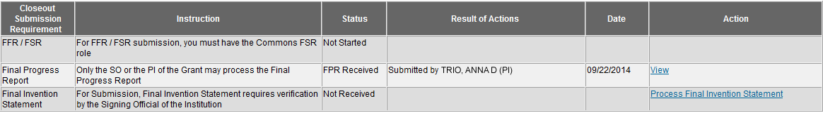
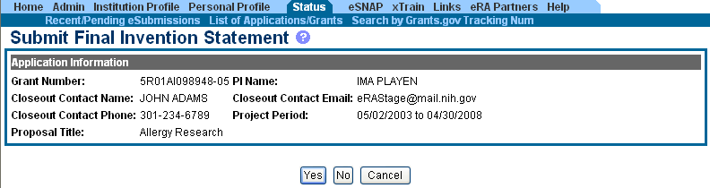
Closeout – Final Invention Statement
If inventions are to be reported, the specific inventions must be listed.
Either the PI or the SO can start the process, but the SO must verify the report before submitting it to the agency.
If Yes is selected, Add Invention screen appears.

Slide 112
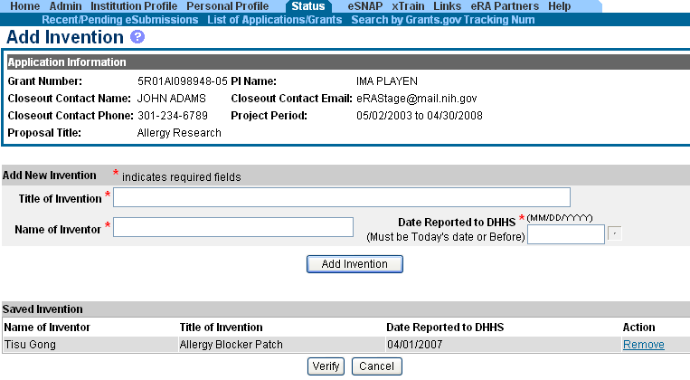
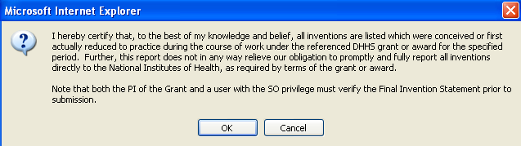
Closeout – Add Invention
Verify saved inventions.
Remove any that do not apply.
Add any that are missing.
Select Verify.
Scarlett
Select OK.

Slide 113
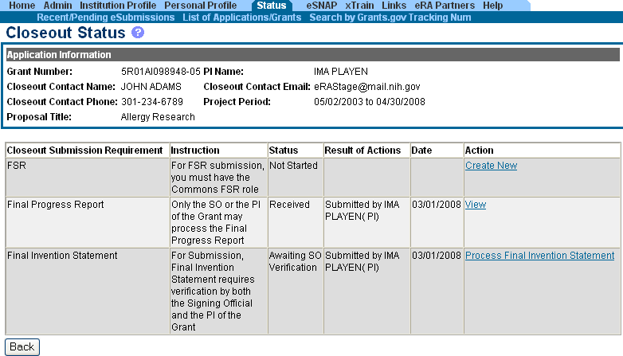
Closeout – Awaiting SO Verification
Status of Final Invention Statement is changed to Awaiting SO Verification. SO can now verify and submit.
Scarlett

Slide 114
Closeout – Policy Notices
NOT-OD-14-084
  NIH Updating Grant Closeout Policies and Procedures to Align with New HHS Requirements
Closeout FAQs
  http://grants.nih.gov/grants/closeout/faq_grants_closeout.htm
Scarlett

Slide 115
Key eRA Commons
Features
Reporting
financial conflict of interest
(FCOI)
Scarlett

Slide 116
FCOI
Initiate and prepare a FCOI report
Submit the report, any necessary supporting documents, and comments (optional) to the agency
Search and view previously submitted FCOI reports (those submitted via Commons only)
Edit or rescind submitted reports (rescinding involves agency involvement)
Access the history of actions
Initiate, prepare, and submit FCOI notification and supporting documents electronically to NIH
Scarlett

Slide 117
FCOI Account Administration
Signing Official at the institution can assign appropriate roles to Commons users to manage the FCOI process for the institution
  FCOI role
    Multiple people at the institution can have the FCOI role
    Only users with FCOI role can submit FCOI reports to the agency
  FCOI ASST role
    Allows user to help with data entry and completion of FCOI reports
  FCOI View-only role
    Allows user to see FCOI reports but cannot edit them
Scarlett

Slide 118
FCOI
Integrated with NIH’s internal FCOI tracking system
Internal FCOI users can request additional information and rescind notifications
  Notification to institution made from internal FCOI system and also is reflected in Commons FCOI history
Scarlett

Slide 119
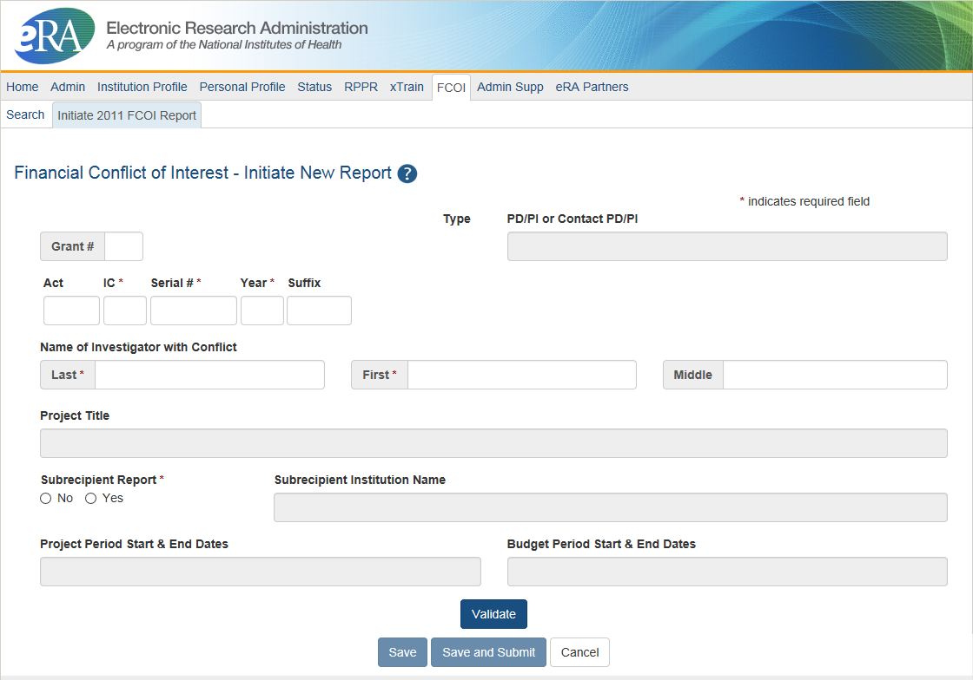
Initiating FCOI Notification
System provides Contact PD/PI name after initial save. Provides additional info to check that the correct grant # is entered.
System will pull the latest Support Year of the grant.

Slide 120
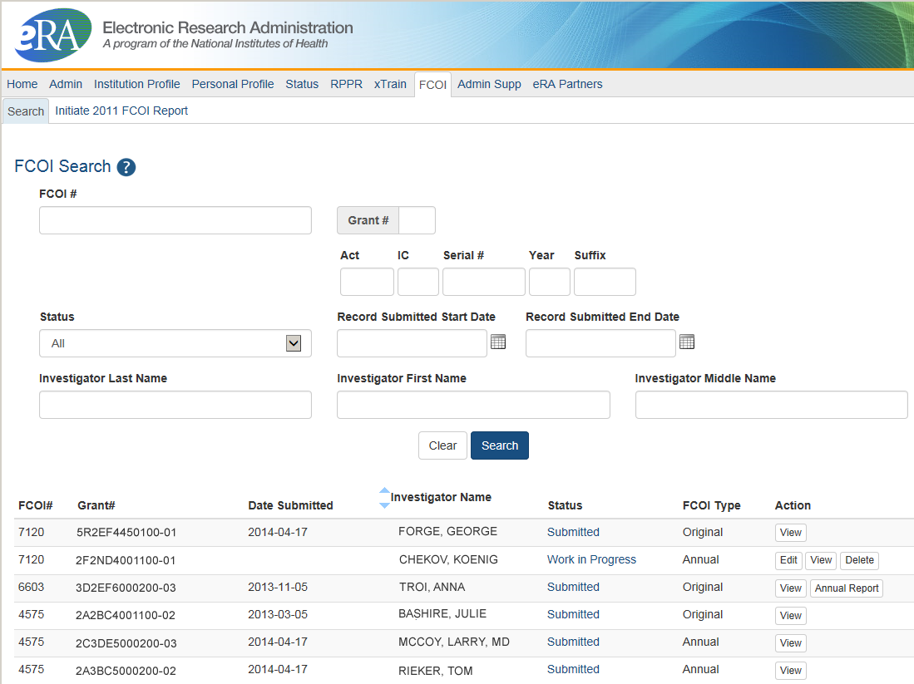
Search for Existing FCOI
Can search by FCOI #, Grant #, or Name of Investigator with Conflict. Provides list of awarded grants for this institution with previously created FCOI notifications.
Available actions
Links to FCOI History

Slide 121

FCOI Edit
Fields are pre-populated
Significant Financial Interest (SFI)
Conflict Management Plan
Key Elements of Management Plan
Other Supporting Documents

Slide 122
FCOI – What’s New?
Changes to the FCOI module made in April 2014
  The link to the FCOI report is now available 75 days prior to the report’s due date
  The FCOI report link is now available the day after the grantee activates a No Cost Extension (NCE)
Scarlett

Slide 123
FCOI– Policy Notices
NOT-OD-14-081
  Notice of NIH Improving the Financial Conflict of Interest (FCOI) Module for Submission of Financial Conflict of Interest Reports to the NIH Beginning on April 25, 2014
Scarlett

Slide 124
Key eRA Commons
Features
xTRACT creates research training tables for progress reports and institutional training grant applications.

Slide 125
xTRACT
Accessible via eRA Commons
  Used for Training Grants for
    RPPR Submissions
    New applications
  Can access information already in eRA Commons
  Creates Research Training Datasets (RTDs) [Training Tables]
  Tables are formatted, no manual formatting needed
  Accesible by:
    Signing Officials (SOs)
    Principal Investigators (PIs)
    Assistants (ASST)
NIH must mark the grant “ready for close out” for link to appear in Commons
  Contact the Division of Central Grants Processing (DCGP) or assigned Grants Management Specialist (GMS) if link is not appearing
xTRACT stands for
Extramural
Trainee
Reporting
And
Career
Tracking

Slide 126


Accessing xTRACT

Slide 127

Searching for Training Grants

Slide 128


Searching for Training Grants
Edit existing RTDs or
Initiate New RTDs
Easy step by step navigation
Advanced search features

Slide 129

Generate PDFs
Review PDFs before using
  Check for accuracy
Generate Final PDF for
  RPPR
  New Applications
  Attach as you would for manually generated PDFs

Slide 130
xTRACT Resources
Extramural Trainee Reporting And Career Tracking (xTRACT) Web Page
  https://era.nih.gov/services_for_applicants/other/xTract.cfm
Video Tutorials
  https://era.nih.gov/era_training/era_videos.cfm#xTRACT
Online Help
  https://era.nih.gov/erahelp/xtract/
FAQs
  https://era.nih.gov/commons/faq_commons.cfm#XX
User Guide
  https://era.nih.gov/files/xTRACT_userguide.pdf

Slide 131
Key eRA Commons
Features
Using xtrain to prepare and submit appointment and termination forms
Joe

Slide 132
xTrain
The use of the Commons xTrain feature is required for the electronic submission of appointment forms and termination notices related to institutional research training, fellowship, education and career development awards.
Paper forms and notices are NOT accepted
System for grantees, institution staff and agency staff to create, manage, route, submit and process appointments, reappointments, amendments, and termination notices electronically and to track the status and timing of training actions
Joe

Slide 133
xTrain User Roles
Business Official (BO):
  Similar to a Signing Official; has signature or other authority related to administering grantee institution training grants
Trainee:
  A person appointed to and supported by a training award
  Can view, update and route his or her own appointments, amendments, and terminations
Sponsor:
  A person who mentors a fellow (recipient of a fellowship award)
  Can initiate and facilitate the termination of a fellowship; can submit termination notice for foreign and federal fellowships only
ASST with Sponsor Delegation:
  Can perform functions similar to the Sponsor role, but cannot submit the fellowship termination notice to the agency
Joe

Slide 134

xTrain Trainee Roster
Appointment/Termination Source:
Paper or Electronic
Action:
2271 Form
Amend 2271
Initiate TN
Term Notice
Joe

Slide 135
xTrain Trainee Roster (continued)
Termination Status:
In Progress BO/In Progress PI
In Progress Trainee
Pending Agency Review
Accepted
Appointment Type:
New
Reappointment
Amendment
Appointment Status:
In Progress PI
In Progress Trainee
Pending Agency Review
Accepted
Terminated
View:
View 2271
View TN
View Payback
Joe

Slide 136
xTrain Help
Take advantage of on-line resources
  On-line help
  FAQs
  Training Resources
  And more…
xTrain On-line Resources:
http://era.nih.gov/grantees/manage_trainees_fellows.cfm
Joe

Slide 137
Recent xTrain Changes
BO and SO roles can search for appointments and terminations by a Trainee’s name.
From the xTrain main menu:
  Select the Search for WIP Appointments and Terminations tab to open the screen.
Joe

Slide 138
xTrain – Policy Notices
NOT-OD-12-152
  Revised Pre- and Post-Award Forms and Instructions Available
NOT-OD-11-026
  Reminder: Beginning January 1, 2011, the NIH Will Require Use of xTrain for the Electronic Submission of Appointment Forms and/or Termination Notices for Institutional Research Training and Career Awards, Individual Fellowships and Research Education Awards
Joe

Slide 139
Finding Help
Service Desks
On-line resources &Web sites

Slide 140
Help Desks
eRA Commons
Service Desk
Grants.gov Contact
Center
Web: http://grants.nih.gov/support/index.html
Phone: 1-866-504-9552
Hours : Mon-Fri, 7a.m. to 8 p.m. ET
Toll-free: 1-800-518-4726
Hours : 24x7 (Except Federal Holidays)
Email : support@grants.gov
Help Resources: http://www.grants.gov/web/grants/support.html

Slide 141

Web Sites
eRA Commons: https://commons.era.nih.gov/commons/
Electronic Research Administration: http://era.nih.gov/
Applying Electronically: http://grants.nih.gov/grants/ElectronicReceipt/
NIH About Grants: http://grants.nih.gov/grants/oer.htm

Slide 142

Thank you

