Slide 1



Interacting Electronically with NIH
Post-submission Processing
October 2016
electronic Research Administration (eRA)
OER, OD, National Institutes of Health

Slide 2
Your Workshop Team
Scarlett Gibb
  eRA Customer Relationship Manager, eRA Commons
Joe Schumaker
  eRA Communications and Outreach

Slide 3
eRA Commons Status
What is era Commons?

Slide 4
What is eRA Commons?
The eRA Commons is an online interface where grant applicants, grantees and federal staff can access and share administrative information related to grant applications and awarded research grants.
Applications
Prior Approval
eSubmission Errors/Warnings
Inclusion Data
Assembled Application Image
Training Tables
Certifications & Assurances
Profile Data
Review Assignment
Progress Reports
Priority Score
Closeout Processes
Summary Statement
Financial Reports
Notice of Award
Invention Reports
Training Appointment Actions
Post-award Correspondence

Slide 5
What’s New in eRA Commons
New navigation options

Slide 6
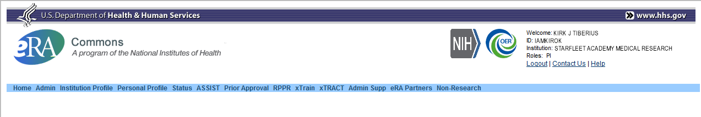
Navigation Options
Three Navigation Items Added:
  Assist: Allows quick access from Commons to Assist without the need to re-authenticate
  Prior Approval: Access to Application withdrawal requests and for processing $500K Requests
  Non-research: Currently for SAMHSA non-research awards only, but part of the overall support of non-NIH agencies using eRA Commons

Slide 7
What’s New in eRA Commons
Prior Approval

Slide 8
Prior Approval
eRA now supports two activities for Prior Approval Requests.
  Request for withdrawal of an application
  Request to exceed $500K in direct cost for any year
Prior Approval is the process in which an applicant or grantee must have written approval by an authorized official to undertake a certain activity.

Slide 9
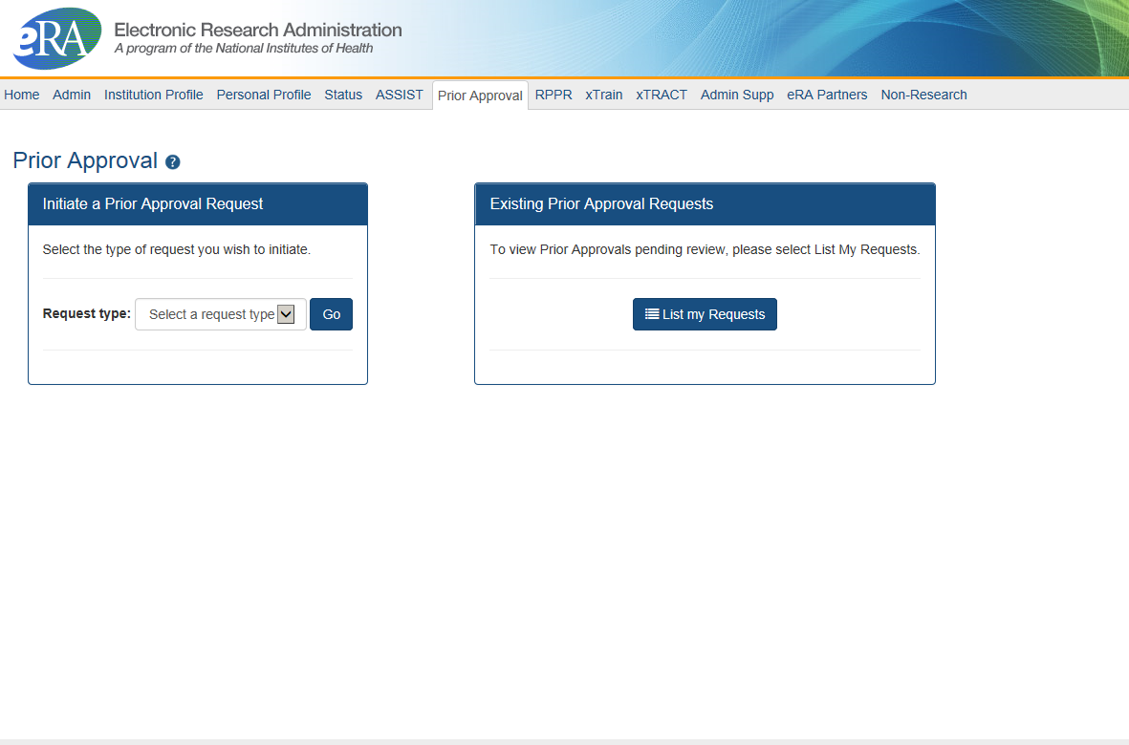

Prior Approval – Withdrawal Request
New navigation tab, Prior Approval
Initiation of a Withdrawal Request can be done by either the Principal Investigator (PI) or Signing Official (SO)
Screen supports justification (required) and supporting documents (max 10)
Only the Signing Official can submit the request
Signing Officials can search for requests for their institution
Automatic notifications to the SO and PI upon approval

Slide 10
Prior Approval – $500K Request
Request for Direct Cost exceeding $500K for a single budget year
  PI is invited to submit the request after discussion with Program Official (PO) of the institute/center they are working with
  PI provides justification (500 characters) and supporting documents (PDF, 1o max)
  PI can submit the request to NIH, or route to SO for review (depending on their institution’s business processes)
  SO can view, and recall a request made by a PI
  If approved, notifications go to the PI and NoA address

Slide 11
What’s New in eRA Commons
New PI Status view

Slide 12
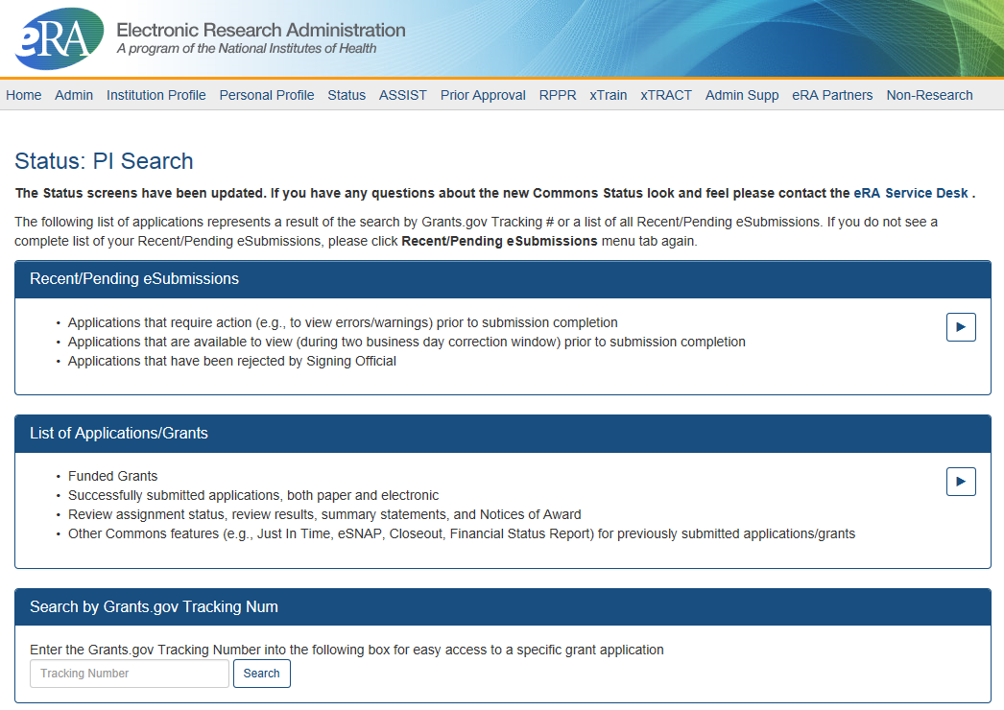
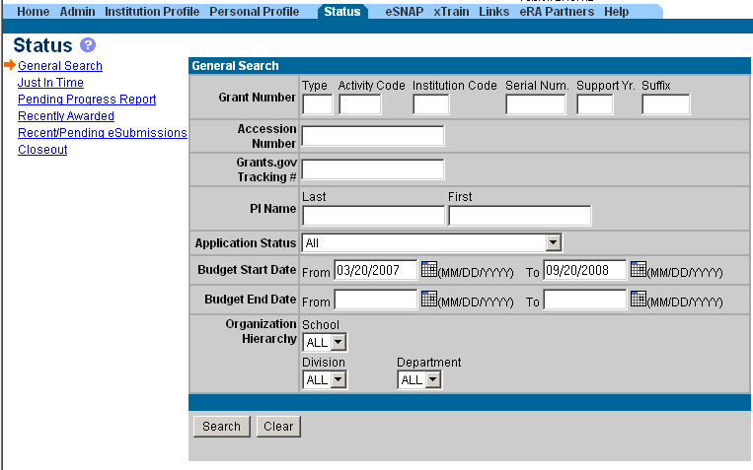
PI & SO Status Views
Principal Investigators can view their Recent/Pending eSubmissions or List of Applications/Grants.
Signing Officials can search/view all submissions for their institution.

Slide 13
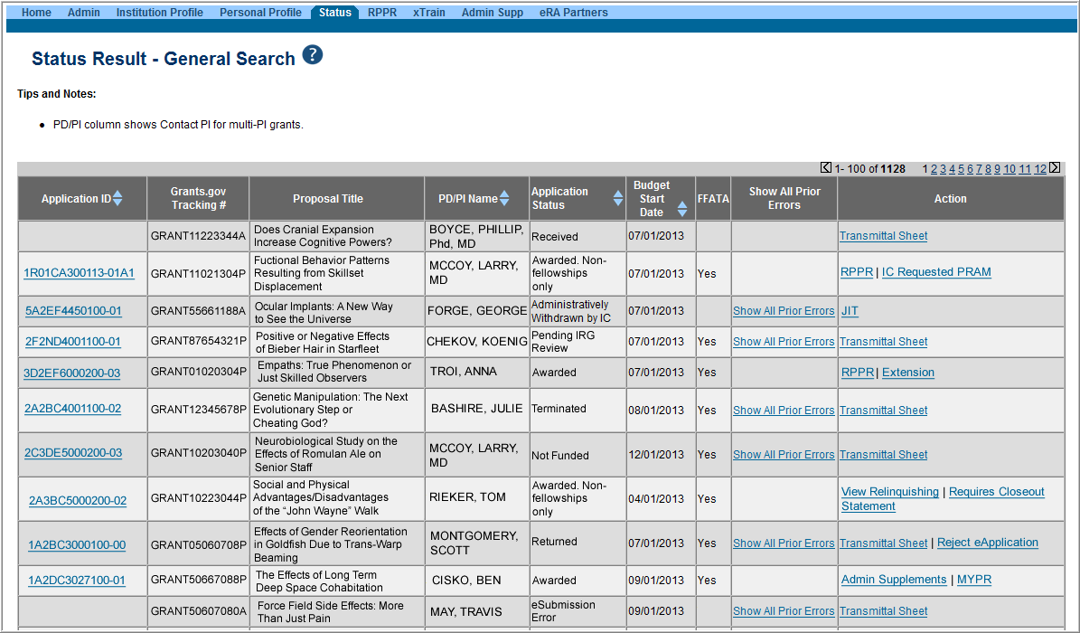
Status Result from General Search for SO
Select the Application ID link to view detailed status information for that particular application.

Slide 14
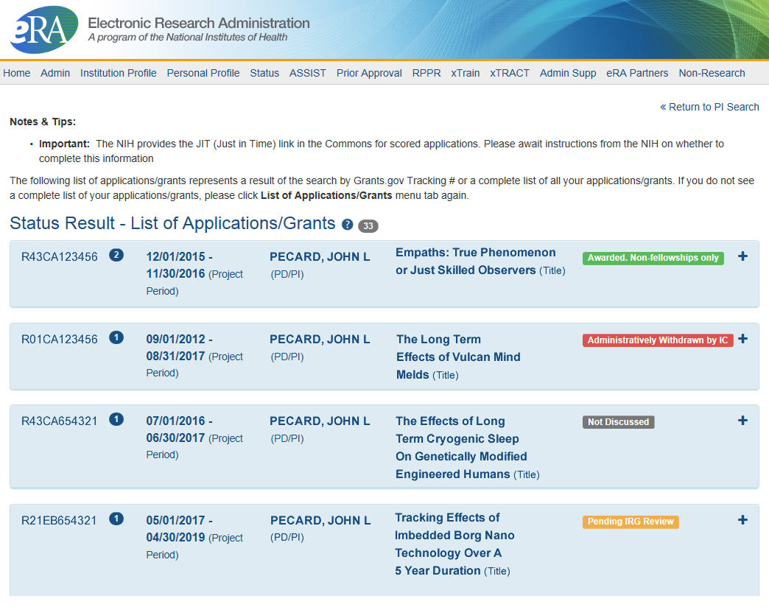
Status Result from General Search for PI
Click anywhere in the blue to get to more information, then select the Application ID link to view detailed status information for that particular application.

Slide 15
What’s New in eRA Commons
New Features in
Institution Profile

Slide 16
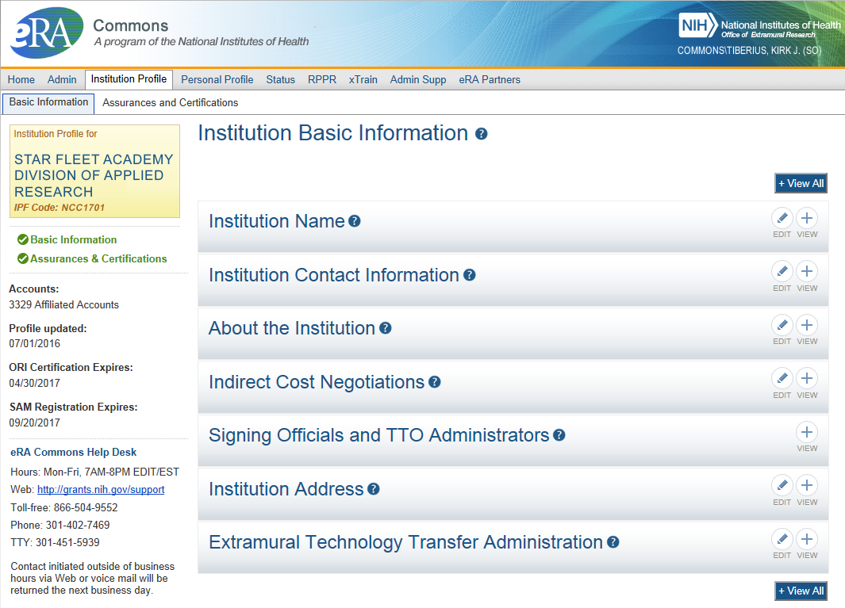
IPF - Basic
Basic: general information about the institution
  Name, address, Institution Contact information, list of Signing Officials, etc.
Only SOs can edit Institution Profile
NEW! SAM Registration Expiration

Slide 17
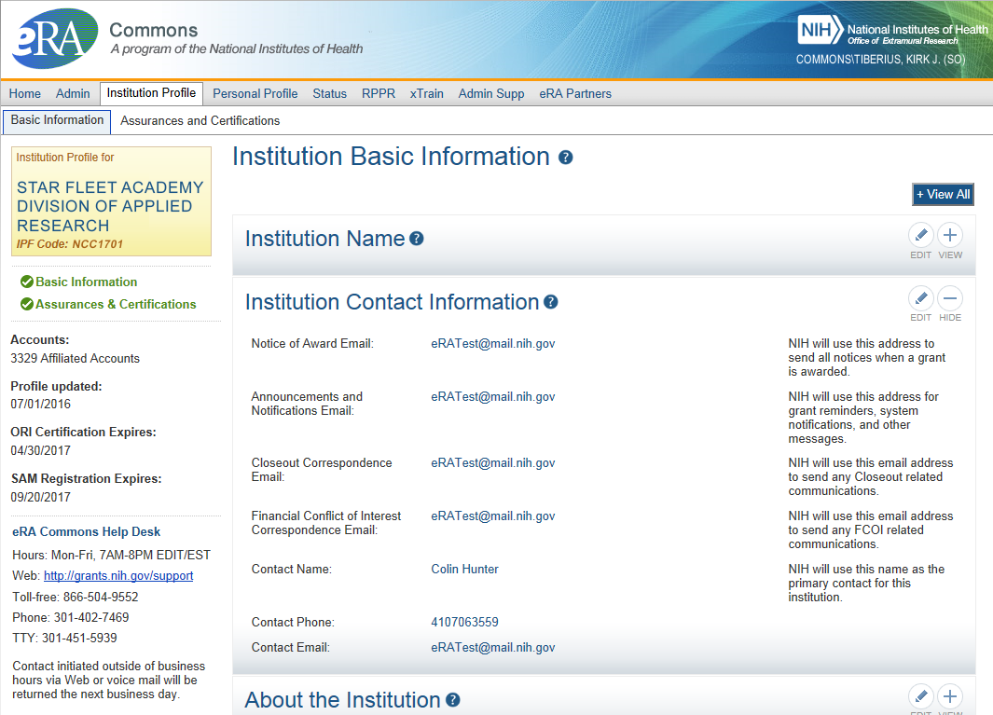
IPF – Institution Contacts
New Contact Fields:
Closeout Correspondence
FCOI Correspondence

Slide 18
Key eRA Commons
Features
Submitting Just-in-time (JIT)
information upon nih Request

Slide 19
Just-In-Time (JIT)
Applicants should never submit JIT info until specifically requested to do so by NIH. A JIT link or request from NIH are not indications that a grant award will be made.
  Other Support File, Budget Upload, Other Upload, Institutional Review Board (IRB) Date, Human Subject Education
  PD/PI can save info in Commons, but only SO can submit JIT info to NIH
  Must be PDF format
Allows an applicant organization to submit additional grant application information after the completion of the peer review, and prior to funding.

Slide 20
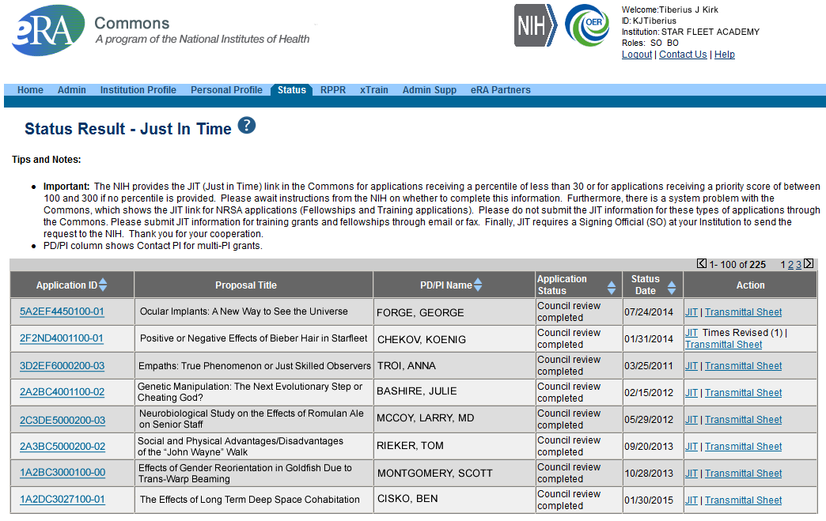
JIT Link on Status Result Screen (SO View)
Select JIT link

Slide 21
Key eRA Commons
Features - NCE
Submitting
a no cost extension (NCE)

Slide 22
NCE
Only SOs can submit the NCE notification
May be submitted no earlier than 90 days before end of project and no later than project end date
Can request extension of 1-12 months, in one-month increments
E-mail notification sent to NIH Grants Management staff when SO processes the extension
Electronically submit a notification to exercise one-time authority to extend without funds the final budget period of a project period of a grant.

Slide 23

Extension link in Status screen

Slide 24
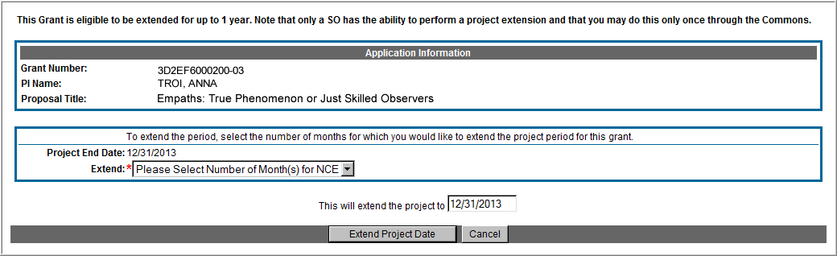
Extension Screen
Choose an extension of 1 to 12 months.
New calculated project end date

Slide 25
Expanded Authority – You Get Just One
No Cost Extension (NCE) part of ‘expanded authorities’
Can only extend once without express approval
Increasing trend of extending in the middle of the project period (i.e. end of year 2 of 5 year grant)
If this is done, the Extension link will NOT appear 90 days from end of project end-date
See June’s 2015 eRA Items of Interest for more:
  https://era.nih.gov/news_and_events/era_item_June_2015.htm#expanded

Slide 26
Key eRA Commons
Features - RPPR
Research Performance
Progress Report (rppr)

Slide 27

RPPR
Describes scientific progress, identify significant changes, report on personnel, and describe plans for the subsequent budget period or year.
  http://grants.nih.gov/grants/rppr/
Now available for all SNAP and non-SNAP progress reports.
Progress Report Additional Material (PRAM) functionality available for publication compliancy explanations and additional information requested by grants management staff.
Annual progress report to document grantee accomplishments and compliance with terms of award.
Hello, RPPR!

Slide 28
RPPR Transition Timeline
Required for SNAP and Fellowship Awards with budget start dates on or after July 1, 2013.
Required for type 5 non-SNAP progress reports as of April 24, 2014.
  Reminder: NIH Requires the Research Performance Progress Report (RPPR) for All Type 5 Progress Reports NOT-OD-15-014

Slide 29
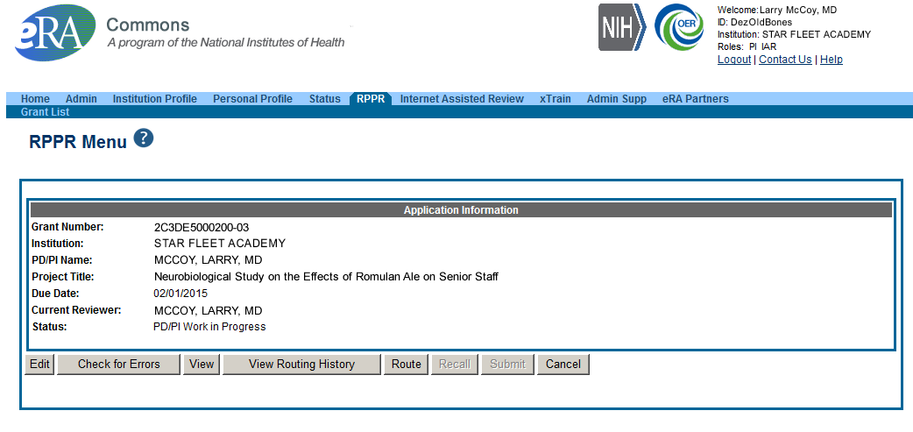
RPPR Menu Screen

Slide 30
RPPR Data Entry
RPPR sections
  Cover Page
  Accomplishments
  Products
  Participants
  Impact
  Changes
  Special Reporting
  Budget (non-SNAP)
Watch for character limits in data entry fields
Ensure uploads are in PDF format
When completing data tables remember to click ‘Add/New’

Slide 31
Progress Report Additional Materials (PRAM)
The PRAM feature provides a means for the grantee to enter, review, route, and submit information to agency following the submission of an RPPR.
  Public Access (PA) PRAM - Generated automatically after an RPPR is submitted with publications that are not compliant with Public Access Policy
  IC (Agency) Requested PRAM – Only available if requested by the Grants Management Specialist (GMS)
PD/PI can enter the PRAM, but can only submit it if they are delegated with Submit Progress Report authority. Otherwise, only the SO can submit the PRAM to Agency.

Slide 32
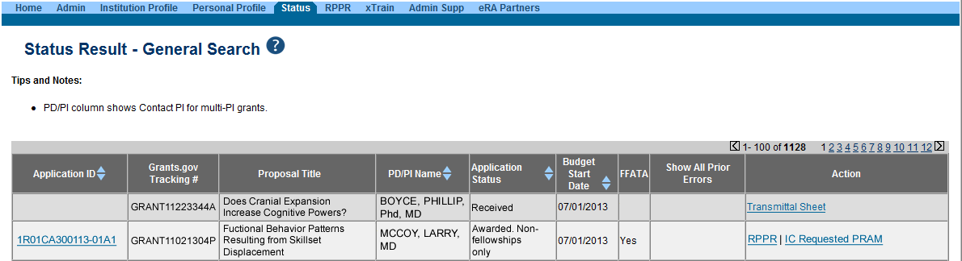
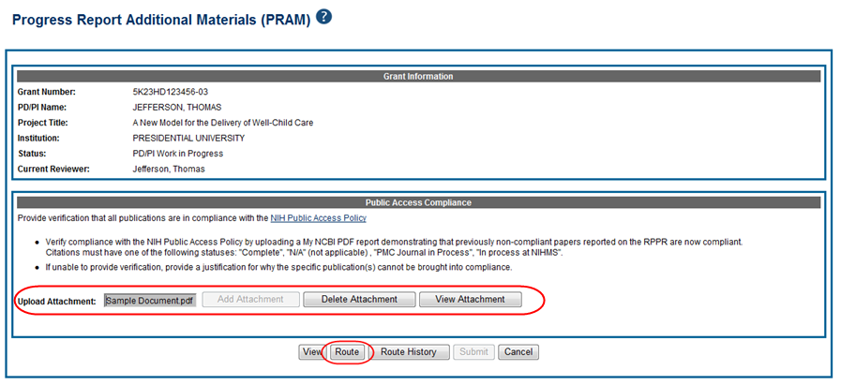
Progress Report Additional Materials - PRAM

Slide 33
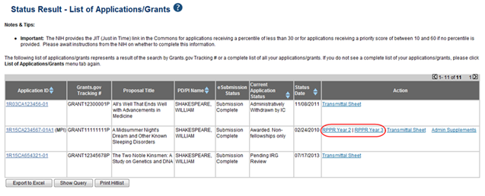
RPPR – Multi-Year RPPR
MYRPPR
  Multi Year Progress Reports now use RPPR format
  Link available under the Action Column in Status

Slide 34
RPPR – Budgets
Submitting progress reports with budgets
  R&R budget and PHS 398 budgets are now available for Non-SNAP RPPR.
  If presented with an option of budget forms, the type that was submitted with the application should be used.
    PHS 398 Budget is available only on training grants.
  Help for R&R Budget and PHS 398 Budget forms can be found in the SF424 R&R User Guides.

Slide 35
RPPR – Complex, Multi-Project
Submitting progress reports for complex, multi-project grants
  After RPPR is initiated, PI will need to identify if RPPR should contain components.
  RPPR should have the same structure as the originally submitted application.
  Some sections are not available on Overall component (i.e. Budget)
  Some sections are not available on component level (i.e. Participants and Publications are reported on Overall)

Slide 36
New Format for PA PRAM
Public Access (PA) PRAM will require an attachment.
  The PA PRAM will no longer contain a free form text box.
  Using My NCBI the institution will need to generate a PDF of their reported publications showing their compliance.
  For instructions on generating the report please see: http://www.nlm.nih.gov/pubs/techbull/nd12/nd12_myncbi_pdf.html

Slide 37
RPPR – What’s New
Use of Updated Inclusion Enrollment Format Now Required for Successful Submission of RPPR. Old formatted inclusion data results in an error.
  NOT-OD-15-078
Use of New Inclusion Management System Required as of October 17, 2014
  NOT-OD-15-005

Slide 38
Key eRA Commons
Features – T3
Submitting an administrative supplement
(type 3s)
Using era Commons

Slide 39
Administrative Supplements
Requested additional costs must be within the scope of the peer reviewed and approved project
Multiple submission methods available:
  SF424 (R&R) application forms & standard Grants.gov submission process¹
    Great for system-to-system users
  Streamlined eRA Commons process¹
    Commons pre-populates much of the data needed for request from awarded grant
  Paper process
A request for additional funds during a current project period to provide for an increase in costs due to unforeseen circumstances.
¹Available for single-project activity codes for which competing applications are submitted through Grants.gov.

Slide 40
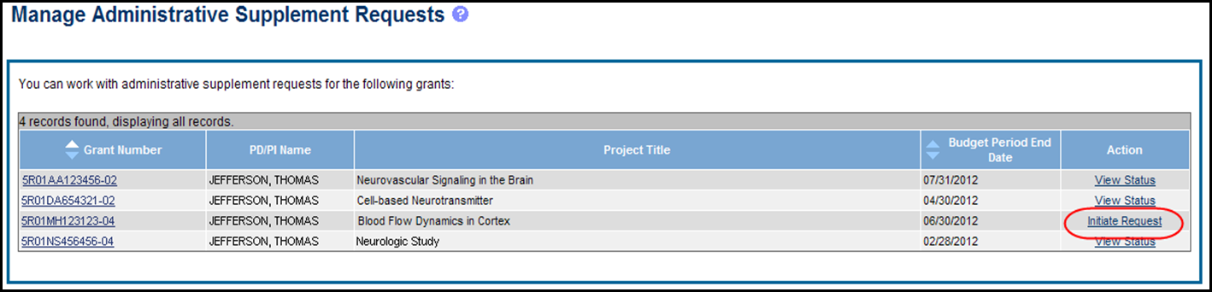
Admin. Supplement Requests - Commons
Starting an Administrative Supplement request in Commons you must find eligible grant and Initiate Request

Slide 41
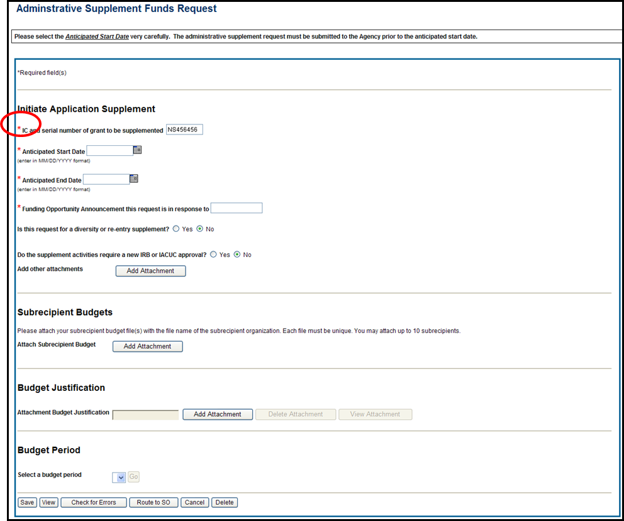
Admin. Supplement Requests - Commons
Complete Form – Required Fields are indicated with red asterisk

Slide 42
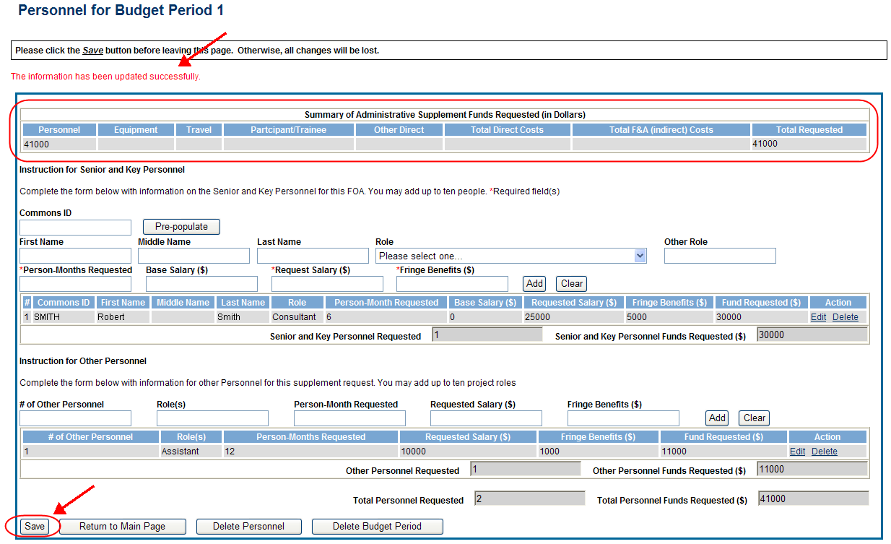
Admin. Supplement Requests - Commons
For each Budget Period enter appropriate sections:
  Personnel, Equipment, Travel, Participant/Trainee, Other Direct, Total F&A (Indirect) Costs
Total Requested will be calculated automatically

Slide 43

Admin. Supplement Requests - Commons
Resources:
  eRA Commons Administrative Supplement Module User Guide
    http://era.nih.gov/files/eRA_Commons_Admin-Supp_UG.pdf
  Administrative Supplements (Type 3s) Frequently Asked Questions
    http://era.nih.gov/commons/faq_commons.cfm#XVIII

Slide 44
Key eRA Commons
Features – Relinquishing Statement
Submitting a relinquishing statement

Slide 45
Relinquishing Statement
Processed in eRA Commons
  To relinquish any awarded grant
Original institution
  Submits relinquishing statement
  Can select new grantee organization or enter contact information if organization is not Commons Registered
New institution
  Receives eNotification from eRA Commons
  Can view in eRA Commons
NIH Awarding Institute
  Reviews and accepts or returns for correction
PHS 3734 form

Slide 46
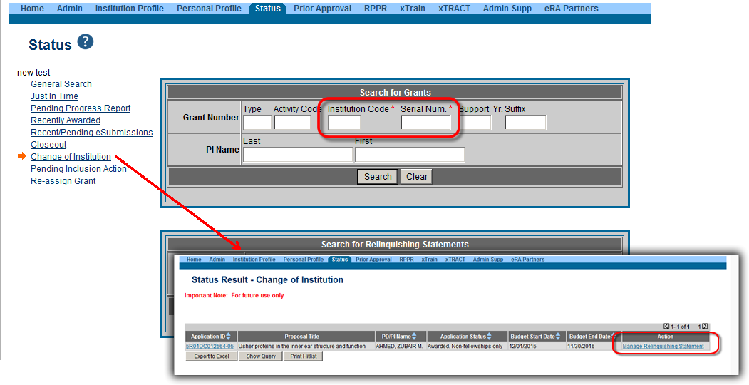
Relinquishing Statement - Search
Use Change of Institution Search
  Must provide at least the Institute Code and Serial Number as search parameters

Slide 47
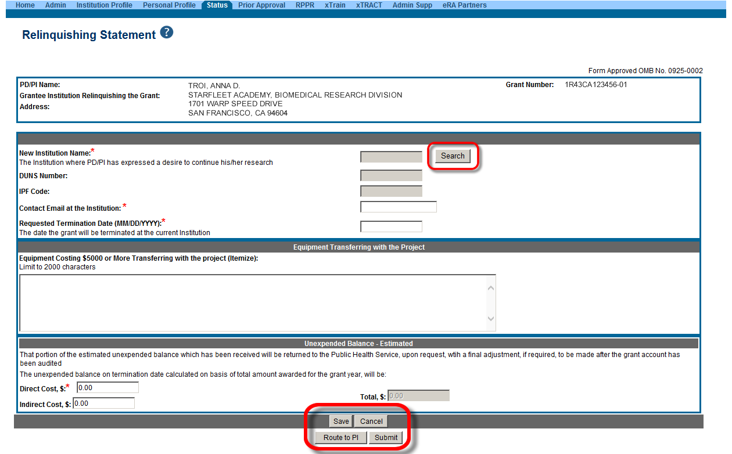
Relinquishing Statement Data Entry Screen
Change of Institution User Guide:
http://era.nih.gov/files/ccoi_userguide.pdf

Slide 48
Key eRA Commons
Features - T7 & T6
Change of institution (type 7)
Change of Organization status (type6)

Slide 49
Change of Grantee (Type 7) Requests
Request for support of a funded project that has been transferred from one grantee or training institution to another.
Also known as Change of Institution or transfer.

Slide 50
Change of Organization Status (Type 6) Request
Request for support of a funded project at an institution where the legal status has been changed.
Formerly known as Successor-In-Interest.

Slide 51

Type 6/7 Requests – Grants.gov
Available for post-award requests for single-project activity codes for which competing applications are submitted through Grants.gov
Though not yet required, applicants are encouraged to use and become familiar with the electronic option
Talk to your awarding Institute prior to submission

Slide 52
Type 6/7 Requests – Grants.gov Application Package
Parent Announcement page has general use FOAs
  http://grants.nih.gov/grants/guide/parent_announcements.htm#post
When completing package…
  Follow all FOA-specific instructions
  Carefully choose appropriate application package
  Use Revision as the Application Type (SF424 RR, item #8)
  Include IC and Serial number of awarded grant as the Federal Identifier (SF424 RR, item #4a)

Slide 53
Type 6/7 Requests & Grants.gov
Similar to competing application process, except:
  Many of the NIH business rule validations for competing applications are not enforced
  Required forms may vary from competing applications for the same activity code
    Modular budget forms not an option; must use R&R Budget forms
    Type 6
      Only a few required forms
        SF424 (R&R) cover, Other Project Information, SR/Key Information
      Optional forms vary by program
    Type 7
      Budget forms added to some Type 7 form packages (e.g., DP1, DP2, DP3)

Slide 54
Type 6/7 Requests – Application Viewing Window
  After the two-day viewing window the request bypasses Receipt & Referral and goes directly to Grants Management staff for consideration
    Requests move to List of Applications for PIs and General Search (for SOs) like competing applications

Slide 55
Re-assign Grants
The option to move a grant from one department to another within the same institution

Slide 56
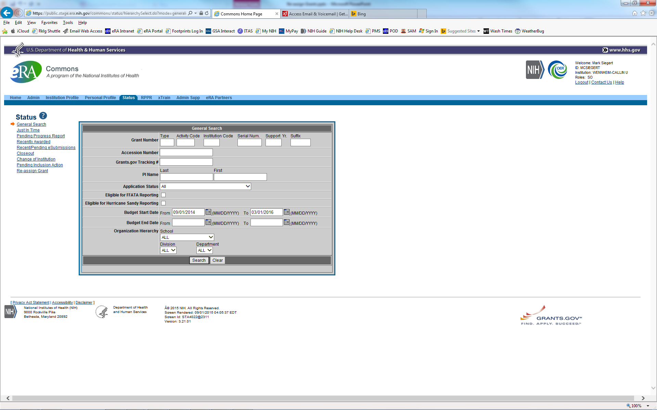
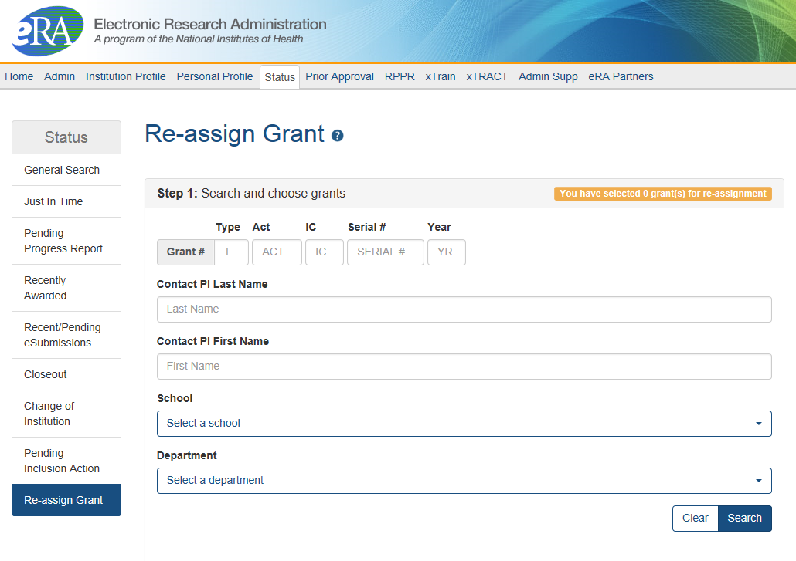
New Function on Commons Status Page

Slide 57
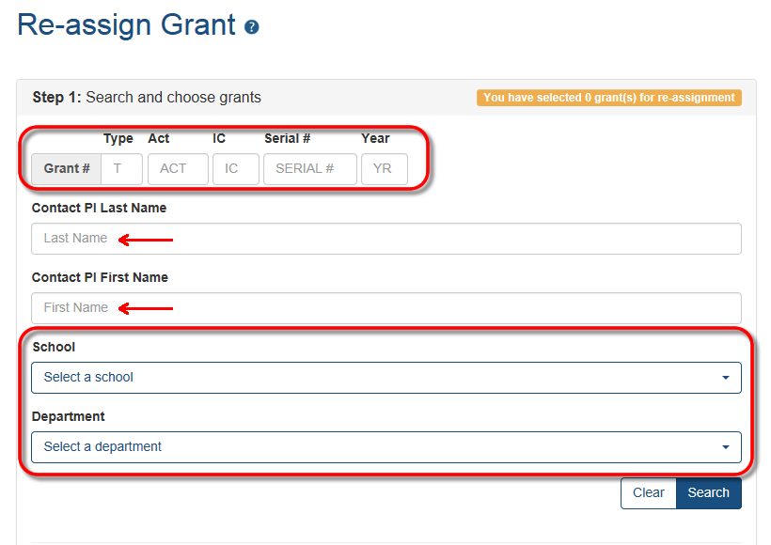
Multiple Search Options
Step 1: Select grant(s) to re-assign.

Slide 58
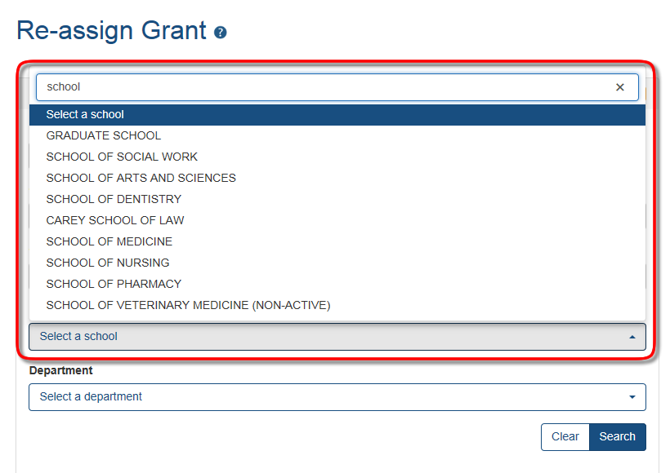
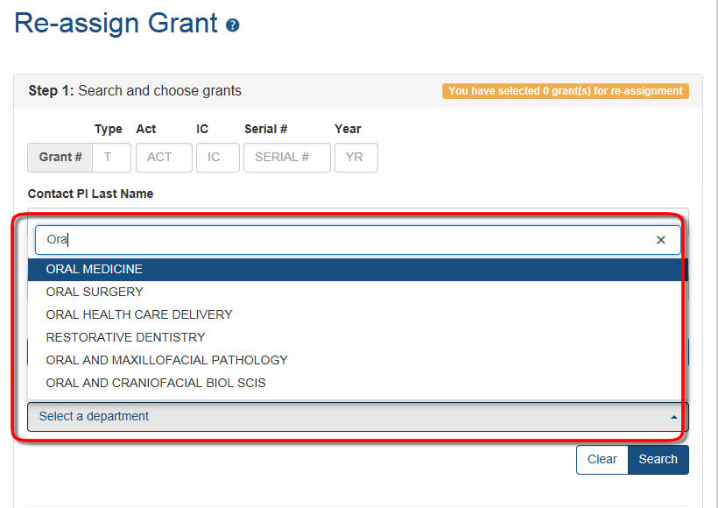
Selecting the School & Department
School drop down menu contains all active major components for the organization (School of Medicine, School of Public Health, etc.)
Department drop down will list all active departments associated with the selected School. No departments are listed if a school has not been selected.

Slide 59
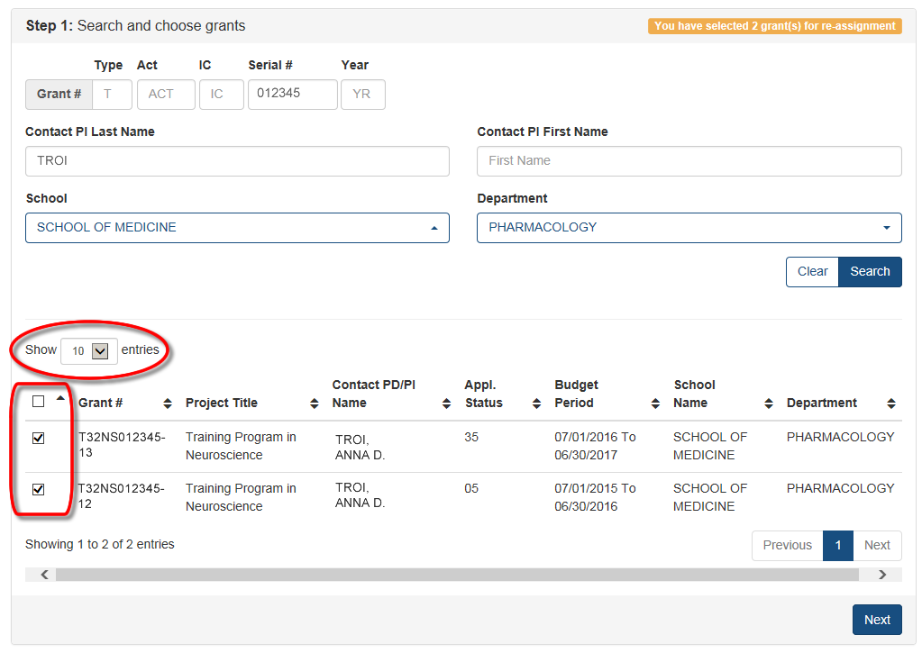
Search Results & Selecting Grants to Move
Number of entries to show in the results list can be configured.
Any or all grants in the results list can be selected to move to the same location.

Slide 60
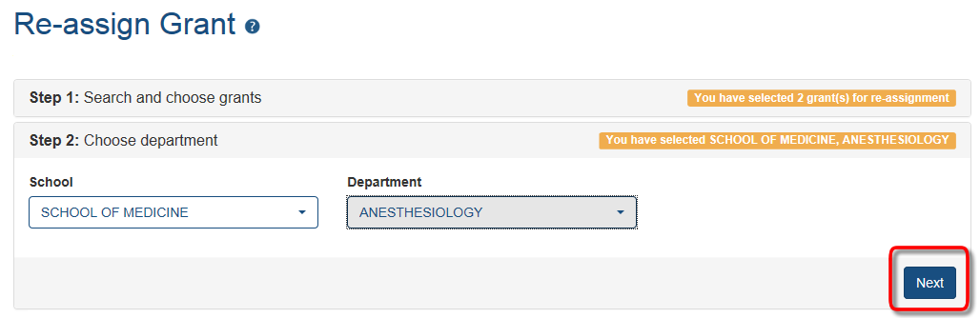
Choose the Target Assignment
Drop downs for School and Department work exactly like the search page drop downs.
Select the target School and Department and click the Next button.

Slide 61
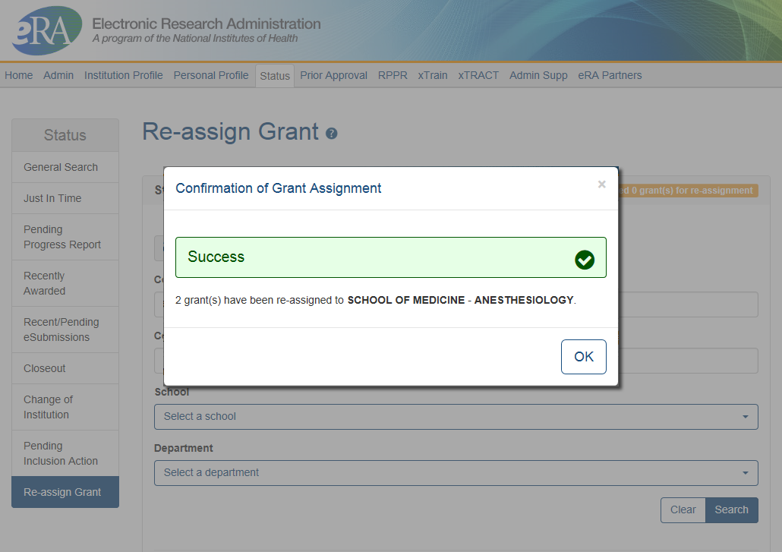
Confirmation of Grant Assignment
Grants have been re-assigned to the School of Medicine – Department of Anesthesiology.

Slide 62
xTRACT
xTRACT creates research training tables for progress reports and institutional training grant applications.

Slide 63
xTRACT
Accessible via eRA Commons
  Used for Training Grants for
    RPPR Submissions
    New applications
  Can access information already in eRA Commons
  Creates Research Training Datasets (RTDs) [Training Tables]
  Tables are formatted, no manual formatting needed
  Accesible by:
    Signing Officials (SOs)
    Principal Investigators (PIs)
    Assistants (ASST)
NIH must mark the grant “ready for close out” for link to appear in Commons
  Contact the Division of Central Grants Processing (DCGP) or assigned Grants Management Specialist (GMS) if link is not appearing
xTRACT stands for
Extramural
Trainee
Reporting
And
Career
Tracking

Slide 64
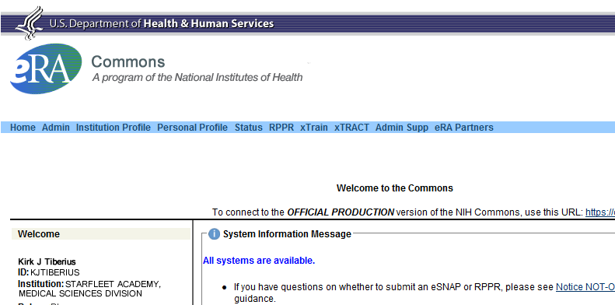
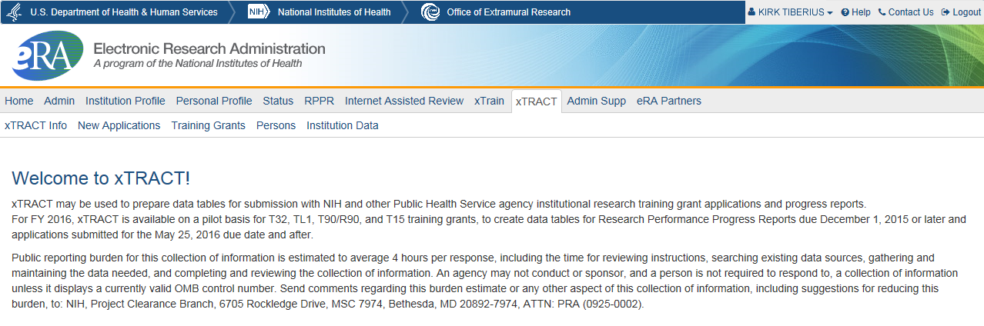
Accessing xTRACT

Slide 65
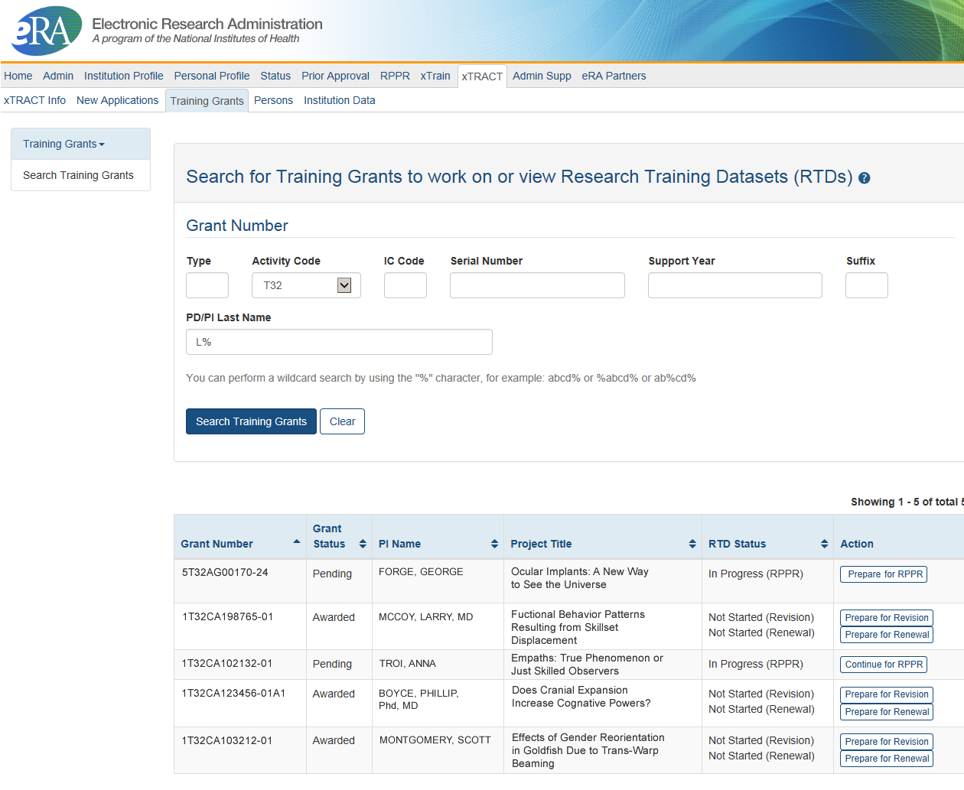
Searching for Training Grants

Slide 66
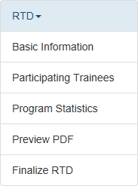
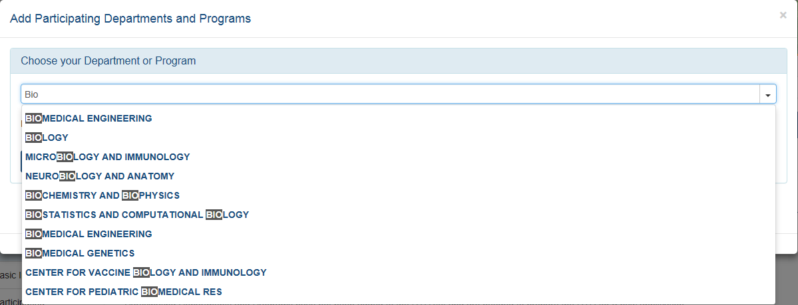
Searching for Training Grants
Edit existing RTDs or
Initiate New RTDs
Easy step by step navigation
Advanced search features

Slide 67
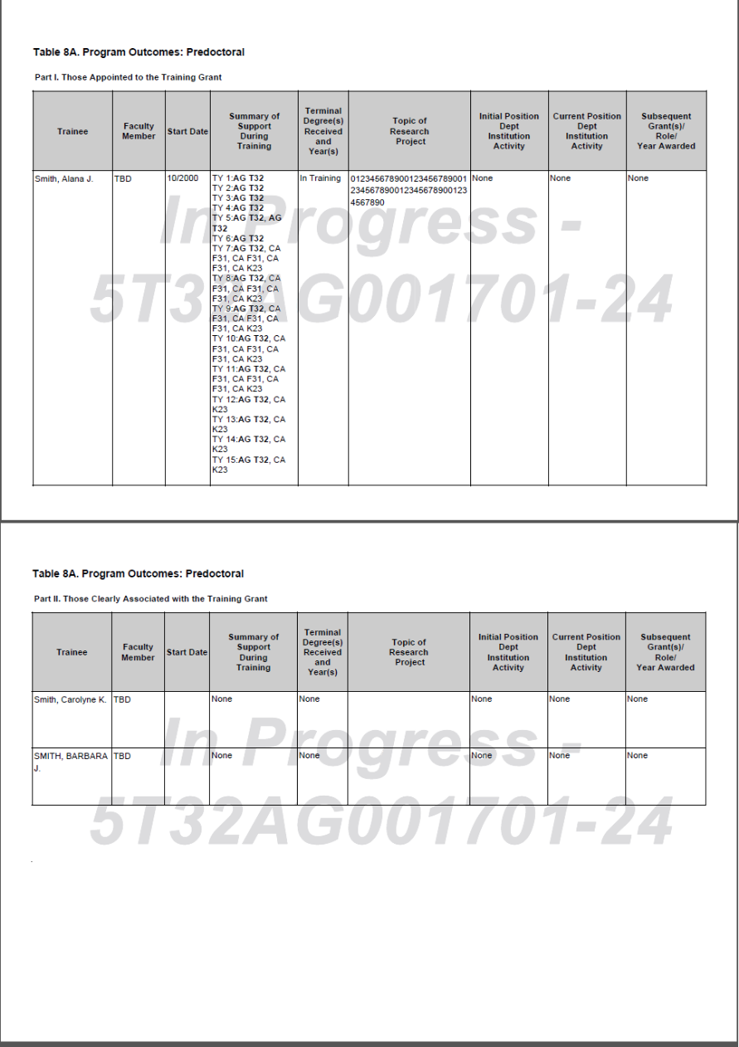
Generate PDFs
Review PDFs before using
  Check for accuracy
Generate Final PDF for
  RPPR
  New Applications
  Attach as you would for manually generated PDFs

Slide 68
xTRACT Resources
Extramural Trainee Reporting And Career Tracking (xTRACT) Web Page
  https://era.nih.gov/services_for_applicants/other/xTract.cfm
Video Tutorials
  https://era.nih.gov/era_training/era_videos.cfm#xTRACT
Online Help
  https://era.nih.gov/erahelp/xtract/
FAQs
  https://era.nih.gov/commons/faq_commons.cfm#XX
User Guide
  https://era.nih.gov/files/xTRACT_userguide.pdf

Slide 69
Key eRA Commons
Features - Closeout
Wrapping up the ‘paperwork’ with closeout

Slide 70
Closeout
Closeout items include:
  Federal Financial Report (FFR)
  Final Progress Report
  Final Invention Statement
NIH must mark the grant “ready for close out” for link to appear in Commons
  Contact the Division of Central Grants Processing (DCGP) or assigned Grants Management Specialist (GMS) if link is not appearing
Electronically submit required Closeout documents for grants in Closeout status

Slide 71
Closeout Capabilities
Identify expiring and terminating grants
Request and track required closeout documents
Track submission of boxed archived paper grant records at the Federal Record Center (FRC)

Slide 72
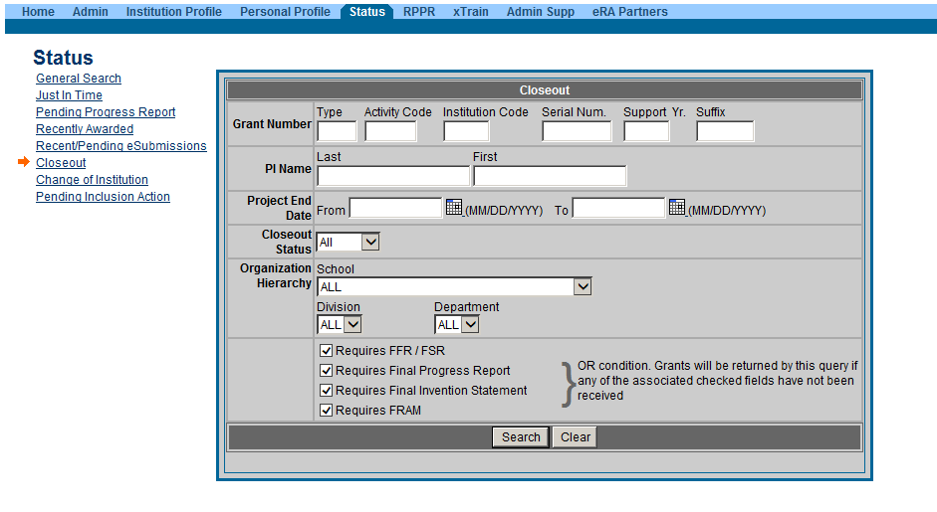
New Closeout Search screen provides additional search criteria

Slide 73
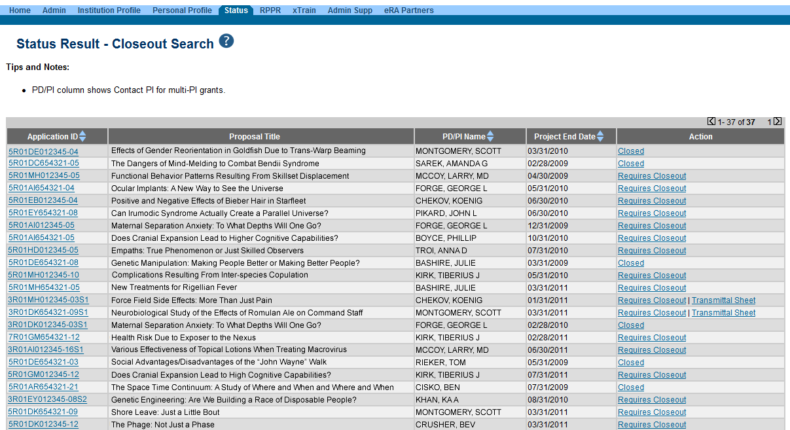
Search screen shows grants that are Closed or Requires Closeout

Slide 74
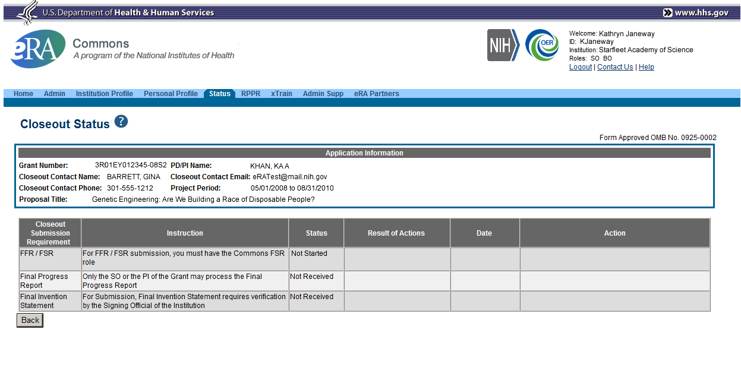
Closeout - FFR
You must have an account with the FSR role to create/submit the FFR/FSR.

Slide 75
Federal Financial Report (FFR)
FFRs must be submitted in eRA Commons via the FFR/FSR module
  Cash transaction data still submitted via Payment Management System
FSR role for users who have the authority to view, enter, and submit an FFR on behalf of institution
Allows grantees to electronically submit a statement of expenditures associated with their grant to NIH via eRA Commons.

Slide 76
FFR
Annual FFR due date: For non-SNAPs, FFR must be submitted within 120 days of the calendar quarter in which the budget period ends
Final FFR due date: based on the Project Period End Date (PPED):
  Pending Status: If the FFR is not submitted and it is within 120 days of the PPED
  Due Status: If the FFR is not submitted and it is between the PPED and 120 days past the PPED
  Late: If the FFR is not submitted and it is more than 120 days past the PPED

Slide 77
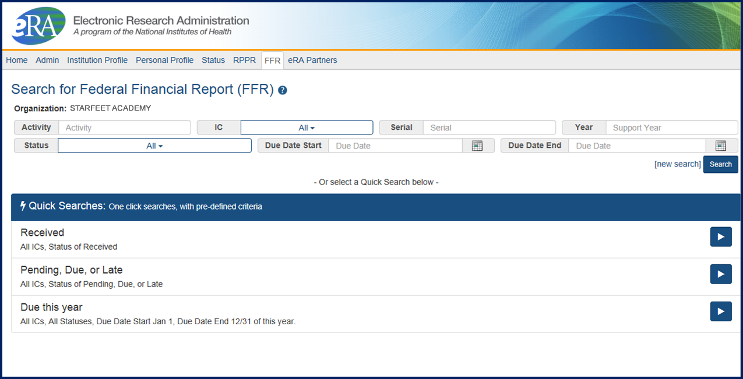
FFR/FSR Screen

Slide 78
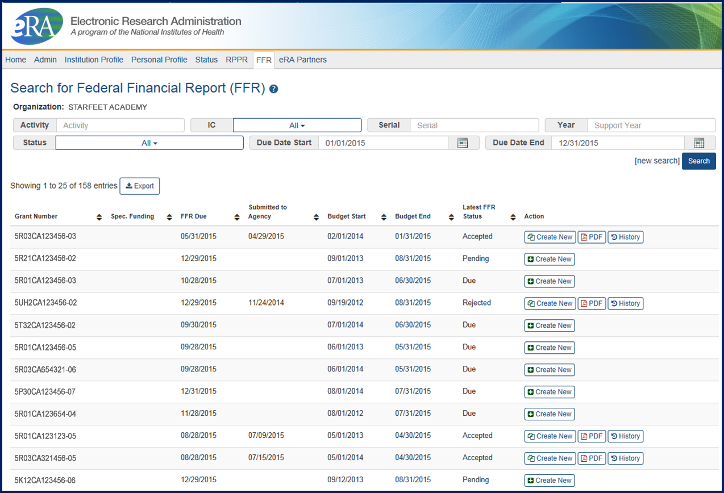
FFR/FSR Screen
The Grant Number is a hyperlink that will take you to the FFR/FSR form.

Slide 79
FFR Details Screen
Clicking the hyperlinked grant number opens the FFR Details screen, which displays:
  FFR Status:
    Received, Accepted, Rejected, In Review, or Revision Pending
  Available Actions:
    Accepted status: View or Create New
    Rejected status: View or Create New
    Received status: View or Correct
    Revision Pending status: View or Edit
    In Review status: View

Slide 80
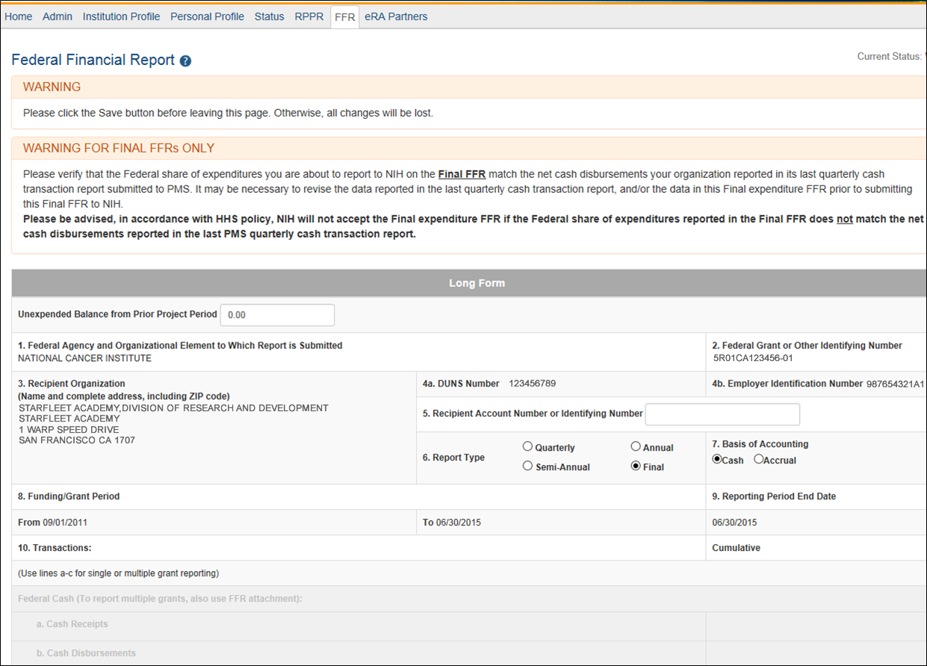
Completing the FFR
As current year entries are completed, calculations are done automatically.

Slide 81
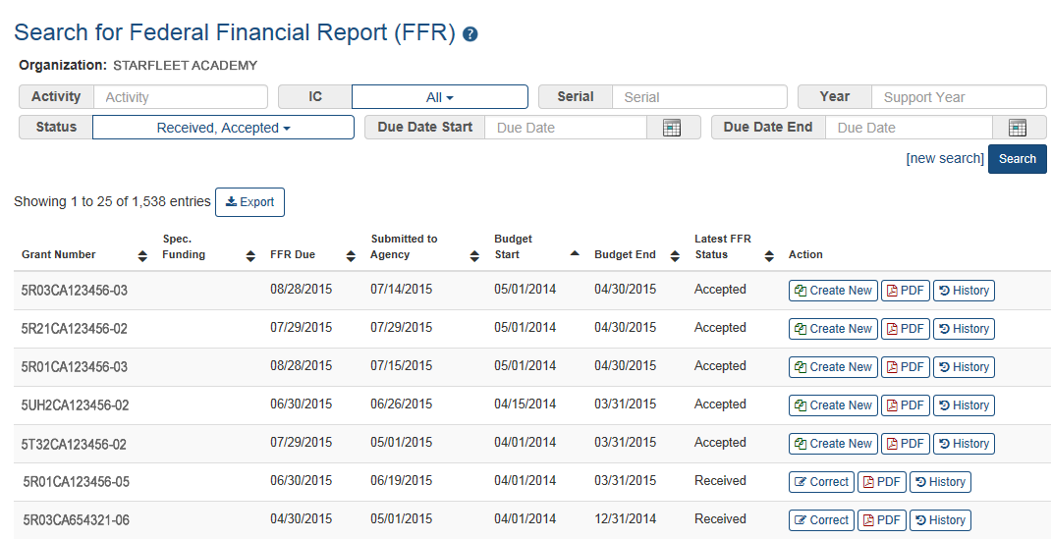
Submission of a FFR
Once FFR/FSR is Submitted, Latest FSR status changes to Received
If a mistake is made on the FFR and the status has changed to In Review, the institution should contact the eRA Service Desk to determine who the OFM staff is that is assigned by the NIH Institute/Center to resolve the issue.

Slide 82
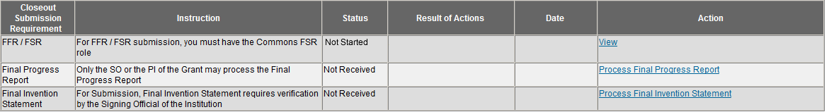
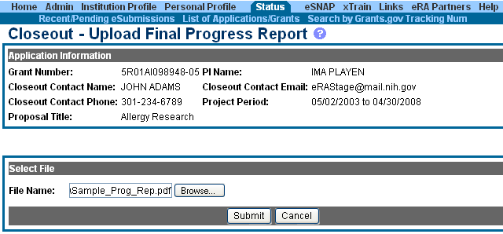
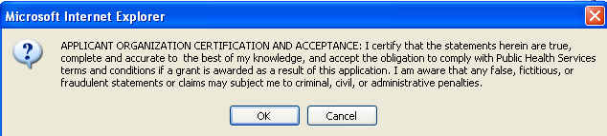
Closeout – Final Progress Report
Either the PI or the SO can create/upload the Final Progress Report.
Browse to select file for upload.
Select Submit.
Read certification information and select OK.

Slide 83
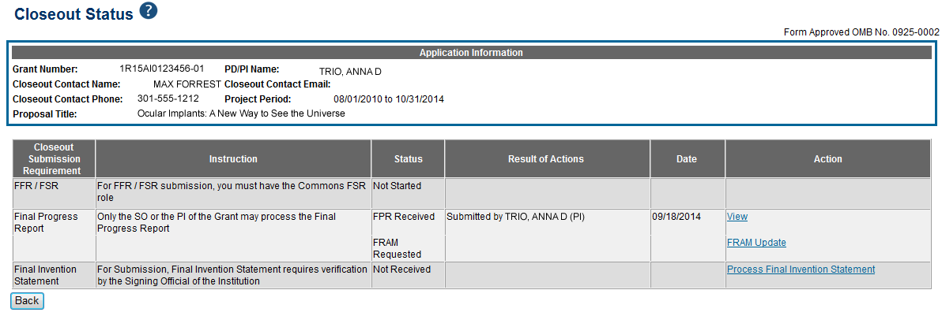
Closeout – Final Report Additional Materials
(FRAM)
FRAM works in same manner as PRAM in RPPR
Awarding IC sets status to FRAM Requested
Awarding IC triggers email for requested information to the SO & PI
The FRAM Update link appears in Action column

Slide 84
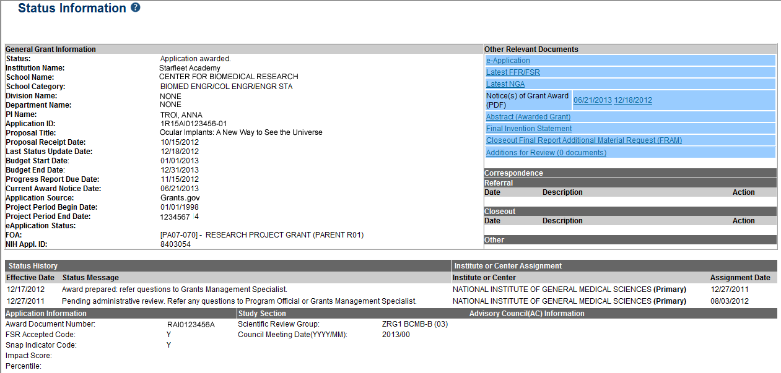
Closeout – Final Report Additional Materials
FRAM
Specifics about the FRAM request can also be found in Relevant
Documents on the Status Information screen.

Slide 85
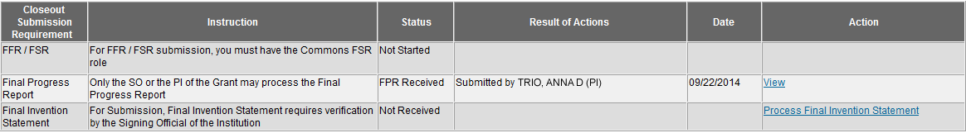
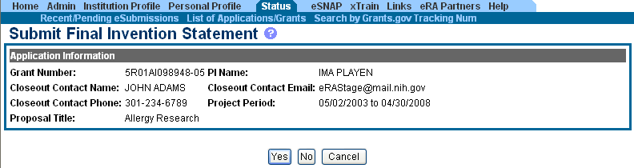
Closeout – Final Invention Statement
If inventions are to be reported, the specific inventions must be listed.
Either the PI or the SO can start the process, but the SO must verify the report before submitting it to the agency.
If Yes is selected, Add Invention screen appears.

Slide 86
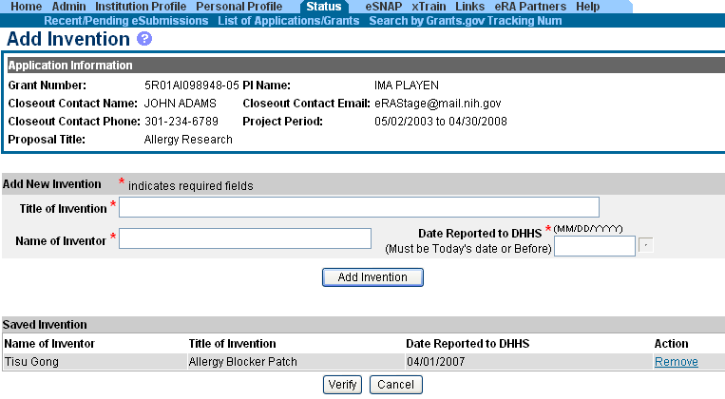
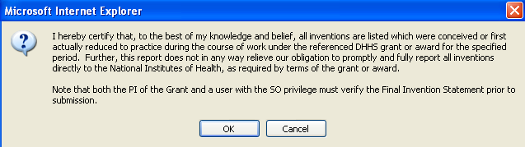
Closeout – Add Invention
Verify saved inventions.
Remove any that do not apply.
Add any that are missing.
Select Verify.
Select OK.

Slide 87
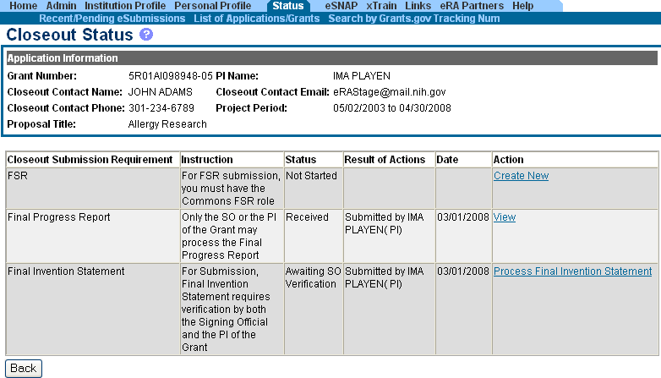
Closeout – Awaiting SO Verification
Status of Final Invention Statement is changed to Awaiting SO Verification. SO can now verify and submit.

Slide 88
Closeout – Unilateral Closeout
To follow HHS Uniform Guidance, NIH will implement Unilateral Closeout on awards that do not complete Closeout reports in a timely manner
New notifications and statuses will alert grantees of impending Unilateral Closeout and what actions need to be taken or who to contact
See Guide Notice NOT-OD-14-084
http://grants.nih.gov/grants/guide/notice-files/NOT-OD-14-084.html

Slide 89
Finding Help
Help Desks
On-line resources &Web sites

Slide 90
Service & Help Desks
eRA Service Desk
Grants.gov Contact
Center
Need Help? website
Web ticketing (preferred method of contact)
Toll-free: 1-866-504-9552
Phone: 301-402-7469
Hours: Monday-Friday (excluding Federal holidays)
Toll-free: 1-800-518-4726
Hours : 24x7 (Except Federal Holidays)
Email : support@grants.gov
Help Resources: http://www.grants.gov/web/grants/support.html

Slide 91

Web Sites
eRA Commons: https://commons.era.nih.gov/commons/
Electronic Research Administration: http://era.nih.gov/
How to Apply – Application Guide: http://grants.nih.gov/grants/how-to-apply-application-guide.htm
NIH About Grants: http://grants.nih.gov/grants/oer.htm

Slide 92

Thank you

