Slide 1



Application Preparation & Submission
Submit!
Ready!
Set!
Sheri Cummins & Laurie Roman
May 2017
New Orleans

Slide 2

Today’s Topics
How to Apply – Application Guide
Prepare to Apply and Register
Format and Write
Submission Process
Finding Help
ASSIST Demo

Slide 3
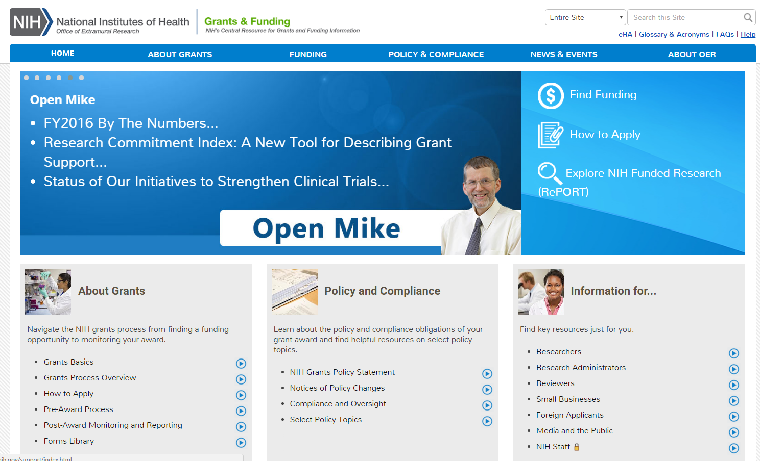
NIH Grants & Funding
How to Apply- Application Guide
Good general information about NIH grant process
http://grants.nih.gov

Slide 4
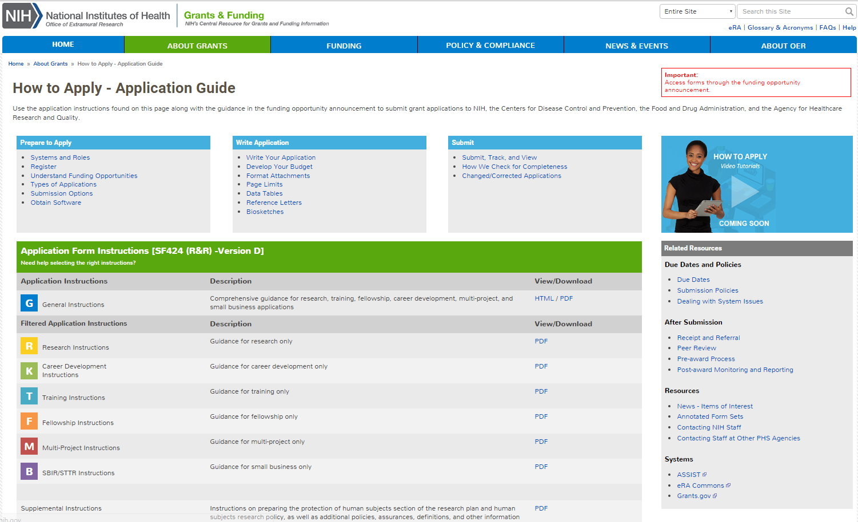
How to Apply – Application Guide
General Application Process Information
Form Instructions
Resources
http://grants.nih.gov/grants/how-to-apply-application-guide.htm

Slide 5
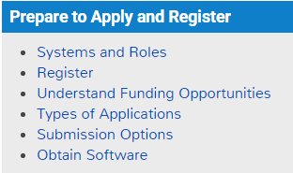

Prepare to Apply and Register
Get Ready!

Slide 6


Make a Submission Plan
Gather team
Verify registrations are in place and active
Determine application preparation responsibilities
Make sure everyone is aware of process
  Sharing applications in progress
  Internal review & approval process
  Internal deadlines
  Post-submission responsibilities
    How to deal with errors/warnings
    Who will verify application in eRA Commons?
Make a plan before you need one!

Slide 7


Understand Key Systems & Roles
Grants.gov
eRA Commons
E-Business Point of Contact (EBiz POC)
Authorized Organization Representative (AOR)
Signing Official (SO)
Principal Investigator (PI)
http://grants.nih.gov/grants/how-to-apply-application-guide/prepare-to-apply-and-register/key-systems-and-roles.htm

Slide 8



Organization Registration
Your organization must be registered in multiple systems to submit. Start early – can take 6 weeks!
DUNS – provides unique organization identifier
SAM (System for Award Management) – needed to do business with government
  Requires annual renewal
Grants.gov – required to submit grants
eRA Commons – required to do business with NIH
SBA (Small Business Administration) – required
for SBIR/STTR applications
http://grants.nih.gov/grants/how-to-apply-application-guide/prepare-to-apply-and-register/registration/org-representative-registration.htm

Slide 9
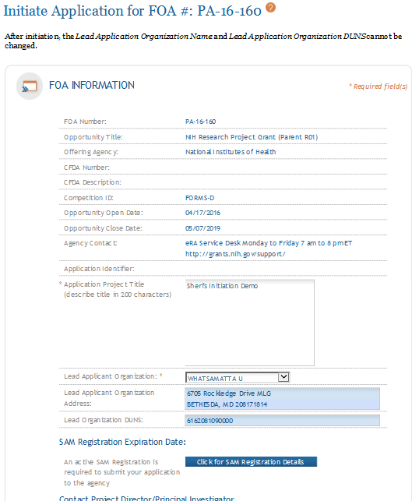
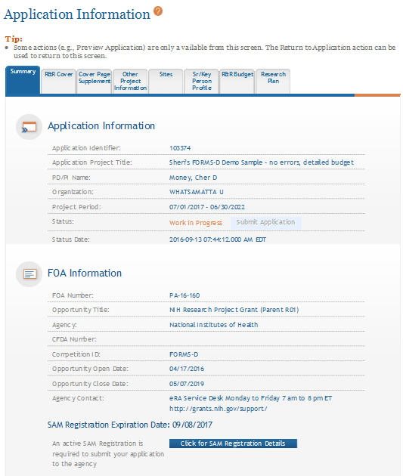
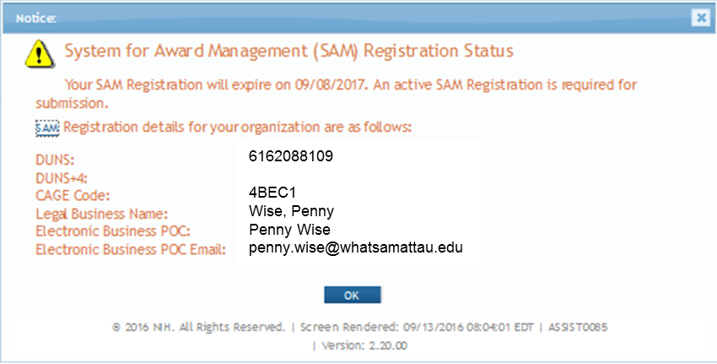
Visibility of SAM Registration Status in ASSIST
Initiate Screen
Application Information Screen

Slide 10
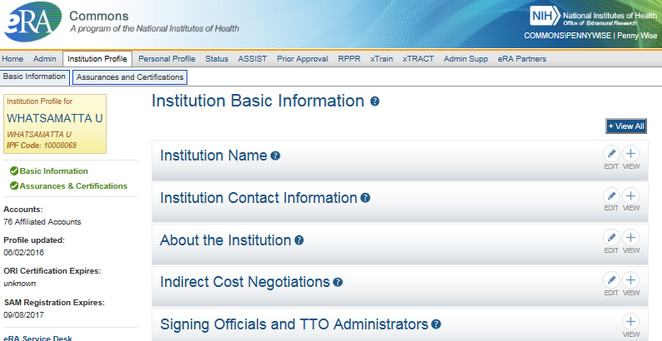
Visibility of SAM Registration Status in eRA Commons

Slide 11

Individual Registrations
Grants.gov
  At least one Authorized Organization Representative (AOR)
eRA Commons
  At least one Signing Official (SO)
  Project Director/Principal Investigator (PD/PI) and any multiple-PD/PIs
  Component leads on a multi-project application
  Sponsor on a fellowship application (NOT-OD-14-129 – Aug. 2014)
  Candidates for diversity and re-entry supplements
  Primary mentor identified on individual mentored career development applications (NOT-OD-16-082 – March 2016)
  Anyone doing data entry in ASSIST
http://grants.nih.gov/grants/how-to-apply-application-guide/prepare-to-apply-and-register/registration/investigators-and-other-users/era-commons-user-registration.htm

Slide 12

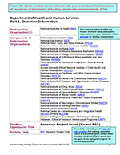
Find & Understand FOAs
NIH posts all funding opportunity announcements (FOAs) in:
  Grants.gov
  NIH Guide for Grants and Contracts
Take a tour of an annotated FOA for tips and key information
  http://grants.nih.gov/grants/Annotated_FOA.pdf
  Section IV. Application and Submission Information
  includes announcement-specific instructions that
  may differ from the application guide instructions
http://grants.nih.gov/grants/how-to-apply-application-guide/prepare-to-apply-and-register/find-and-understand-foas.htm

Slide 13

Follow All Guidance
Notices in the NIH Guide for Grants and contracts
Funding Opportunity Announcement
  Section IV. Application and Submission Information
Application Guide
  Including Supplemental Instructions
Precedence / Importance

Slide 14
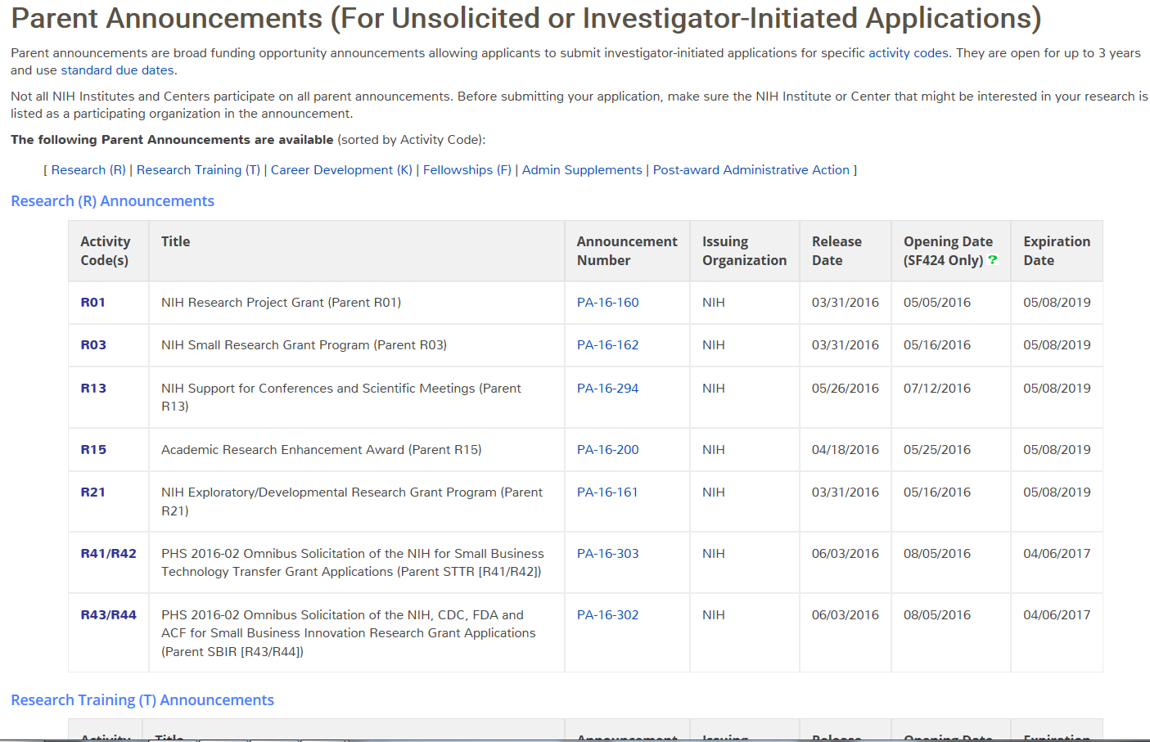

Parent FOAs
Broad announcements allowing applicants to propose research on unsolicited topics.
Select Parent FOA for your chosen grant program
(i.e. R01, R03, R21, etc.).
Parent R01
Not all institutes participate on all parents.
Check for fit, before you submit!
http://grants.nih.gov/grants/guide/parent_announcements.htm

Slide 15
Identify Type of Application Submission
Number Type | Stage/Description
Type 1* | New - Request for support of a project that has not yet been funded.
Type 2* | Renewal - Request for additional funding for a period subsequent to that provided by a current award.
Type 3* | Competitive Revision* – Request for additional funds to expand the scope of a current award. Administrative Supplement – Request for additional funds to cover unforeseen, increased costs to carry out current award.
Type 6 | Change of Organization Status (Successor-in-Interest)
Type 7 | Change of Grantee or Training Institution
* Resubmission - An unfunded application that has been modified following initial review and resubmitted for new consideration.
http://grants.nih.gov/grants/how-to-apply-application-guide/prepare-to-apply-and-register/type-of-application-submission.htm

Slide 16

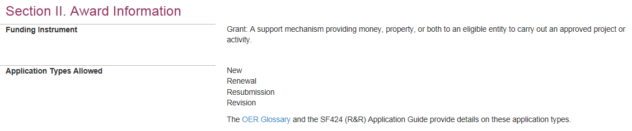
Why is knowing the type of application important?
Potential impact on…
Due dates
  E.g., If submitting to an R01 opportunity with standard due dates, “New” applications have a different due date than “Resubmission”, “Renewal” or “Revision” applications.
Ability to submit to a specific announcement
Application validations
  We enforce different rules based your selection in the “Type of Application” field (#8) of the SF424 (R&R) form.

Slide 17
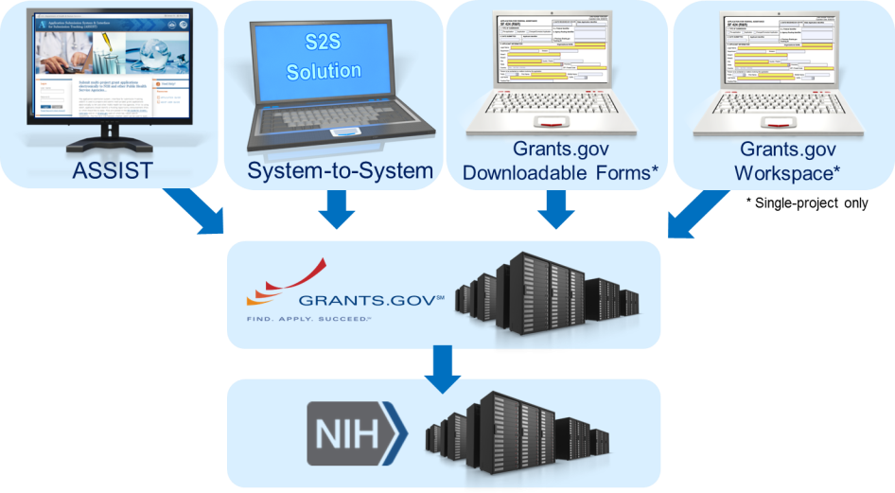
Application Submission Options
http://grants.nih.gov/grants/how-to-apply-application-guide/prepare-to-apply-and-register/choose-a-submission-option.htm

Slide 18


ASSIST
Managed by NIH
Features
  Multi-user access
  Leverages eRA Commons accounts
  Pre-population from eRA Commons profile information
  Pre-submission validations
  Pre-submission preview in agency format
  Tracking application status in a single system
  Ability to copy application data to another opportunity or to a different application package for the same opportunity
    Super handy feature during form updates!

Slide 19
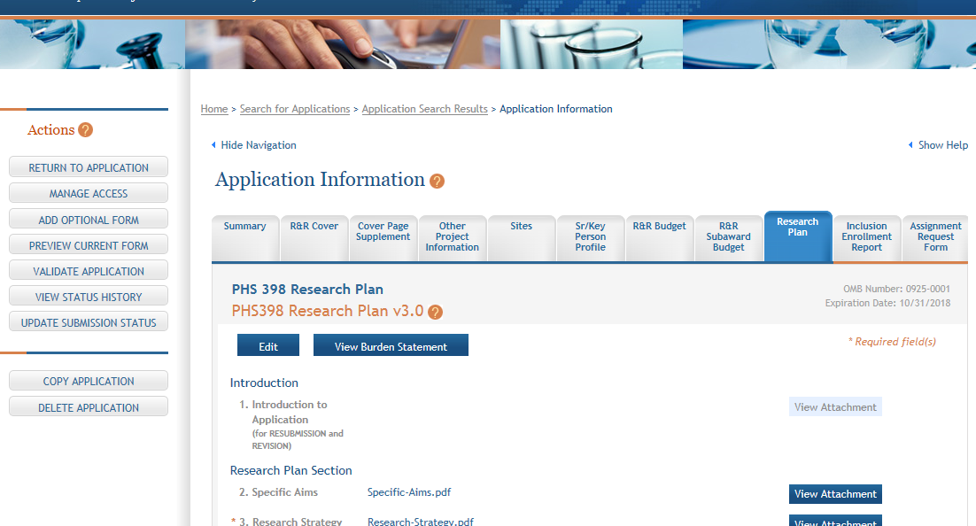
ASSIST Screen – Single-project

Slide 20
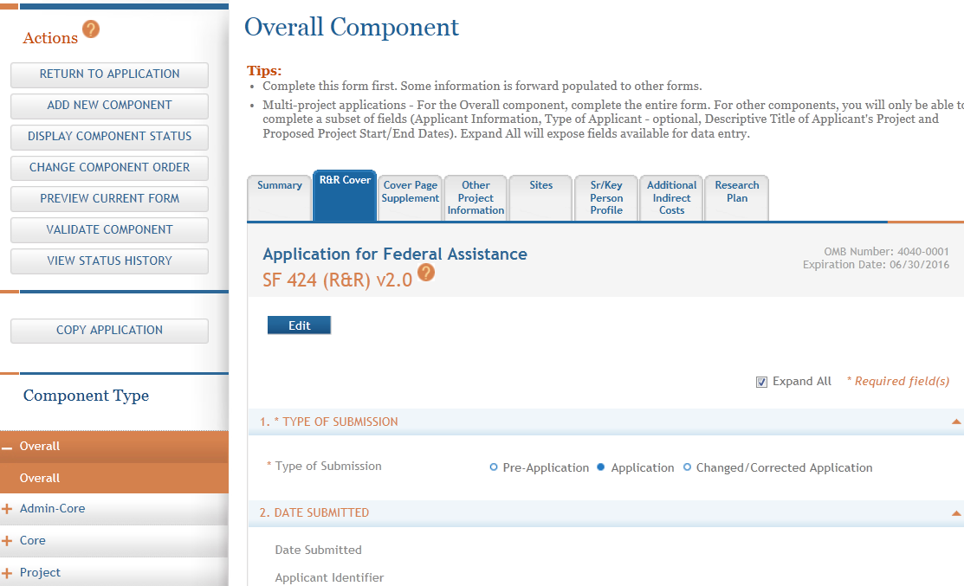
ASSIST Screen – Multi-project

Slide 21

System-to-system (S2S) Solution
Managed by institution or service provider
Typically integrate with other internal systems and databases to reduce data entry
Features vary by solution
  Examples of potential features
    Secure, on-line data entry
    Concurrent user support
    Pre-submission verification of some NIH business rules
    Pre-submission preview of assembled application image in generic or agency format
    eRA Commons application status information

Slide 22



Grants.gov downloadable forms
Managed by Grants.gov
No registration required until submission
Offline data entry
  Good when internet connectivity is unavailable or unreliable
No visibility to agency errors/warnings or application image prior to submission
Must track in multiple systems
“Stitched together” single, downloadable forms
package solution will be retired at end of 2017

Slide 23
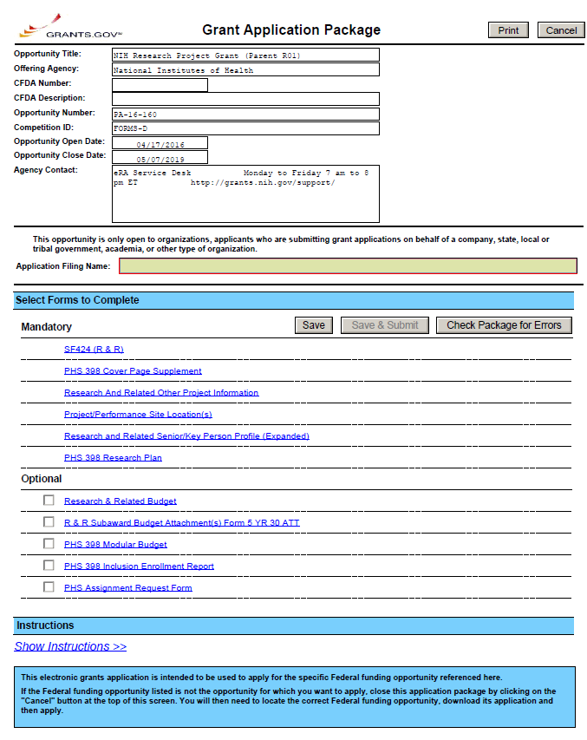
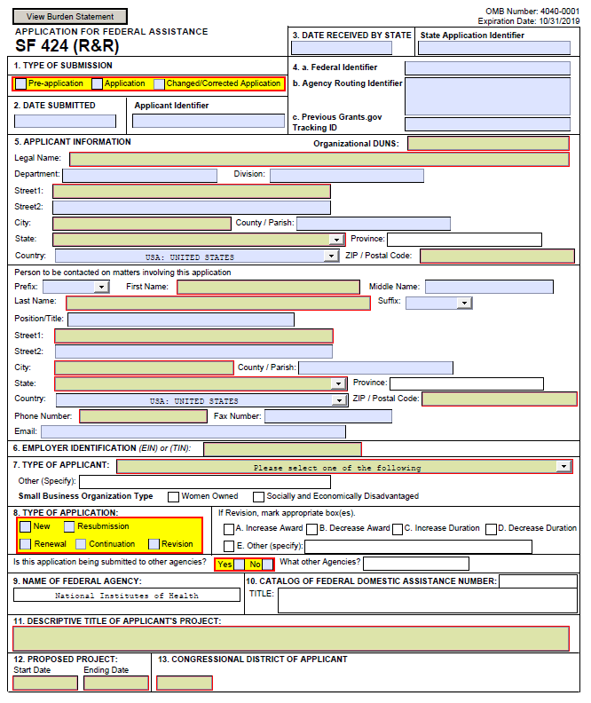
Sample Downloadable Forms

Slide 24
Grants.gov workspace
Managed by Grants.gov
Hybrid of online application management and downloadable forms
  Online forms - 2017
Forms can be completed individually by different users
Forms (same version) can be shared between applications
Option to check NIH errors/warnings and application image prior to submission
Must track in eRA Commons
Does NOT support multi-project applications
Replaces Grants.gov’s single, “stitched together”
downloadable forms model

Slide 25
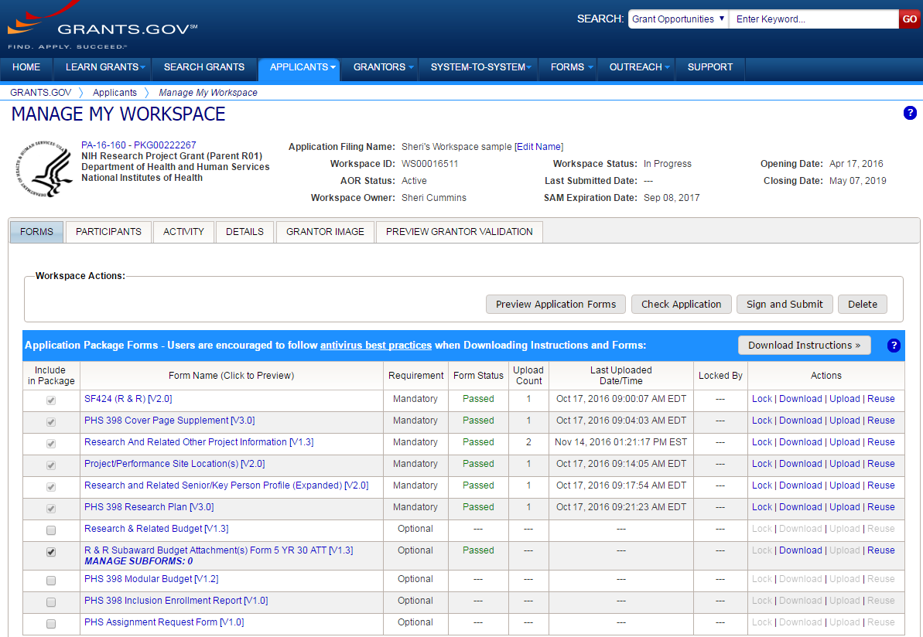
Sample Workspace Screen

Slide 26
Available Options for Application Types
Type | ASSIST | System-to-System Solution¹ | Grants.gov Down-loadable Forms | Grants.gov Workspace | eRA Commons | Paper
Single-project (SP) Competing Applications (Type 1, 2, 3) | ✓ | ✓ | ✓ | ✓
Multi-Project (MP) Competing Applications (Type 1, 2, 3) | ✓ | ✓
Administrative Supplement (Administrative Type 3) | ✓(SP) | ✓(SP) | ✓(SP) | ✓(SP) | ✓(SP) | ✓(SP, MP)
Successor-in-Interest (Administrative Type 6) | ✓(SP) | ✓(SP) | ✓(SP) | ✓(SP) |  | ✓(SP, MP)
Change of Institution (Administrative Type 7) | ✓(SP) | ✓(SP) | ✓(SP) | ✓(SP) | Relinquishing Statement | ✓(SP, MP)
¹Availability varies by applicant organization and S2S solution

Slide 27




Your Application will be…
Subject to the same registration requirements
Completed with the same data items
Routed through Grants.gov
Validated against the same NIH business rules
Assembled in a consistent format for review consideration
Tracked in eRA Commons
…regardless of submission option used.

Slide 28
What Submission Option Are Applicants Using?

Slide 29
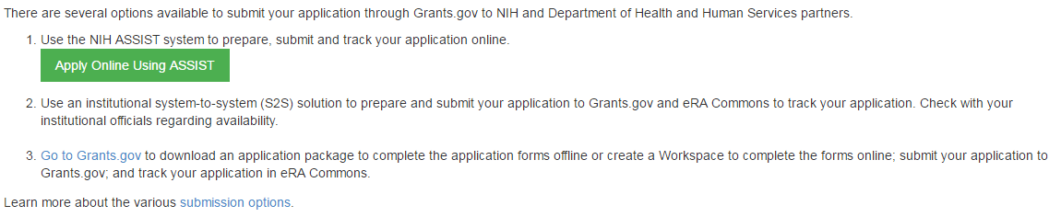
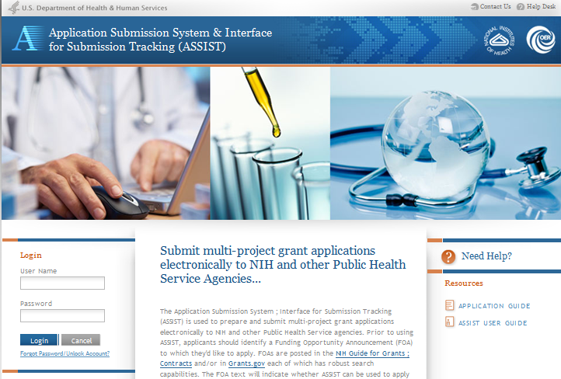
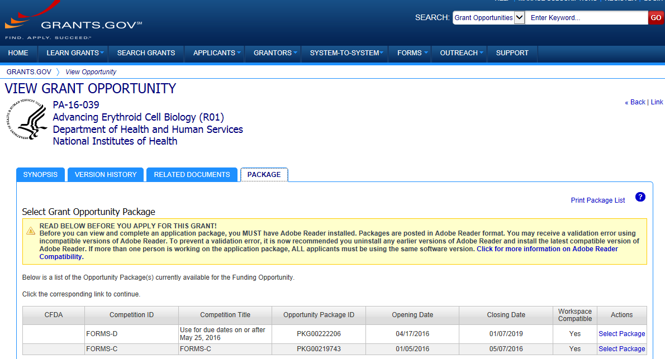
Accessing Application Forms
Excerpt from single-project FOA in NIH Guide…

Slide 30

Obtain Software
Browser
  Latest versions of Internet Explorer, Mozilla Firefox and Google Chrome – fully supported & tested
  Many others work fine
Adobe Reader
  Versions compatible with Grants.gov downloadable forms
    http://www.grants.gov/web/grants/support/technical-support/recommended-software.html
PDF conversion program
  All application attachments must be
  converted to PDF format

Slide 31

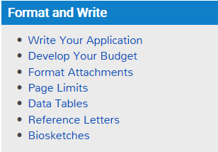
Format and Write
Get set!

Slide 32

Grantsmanship
Tips for developing strong applications & budgets
  How to Apply – Application Guide site
  Institute sites
Your office of sponsored research and colleagues (especially those with review experience)
Listservs
Conferences
http://grants.nih.gov/grants/how-to-apply-application-guide/format-and-write/write-your-application.htm
http://grants.nih.gov/grants/how-to-apply-application-guide/format-and-write/develop-your-budget.htm

Slide 33

Format Attachments
Use simple PDF-formatted files
  Do not use Portfolio or similar feature to bundle multiple files into a single PDF
  Disable security (e.g., password protection, encryption)
Keep filenames to 50 characters or less
Use meaningful filenames
Do not include headers or footers
  Section headings as part of the text
  (e.g., Significance, Innovation, Approach)
  are encouraged
Follow guidelines for fonts and margins
  Updated Jan. 2017 – NOT-OD-17-030
http://grants.nih.gov/grants/how-to-apply-application-guide/format-and-write/format-attachments.htm

Slide 34
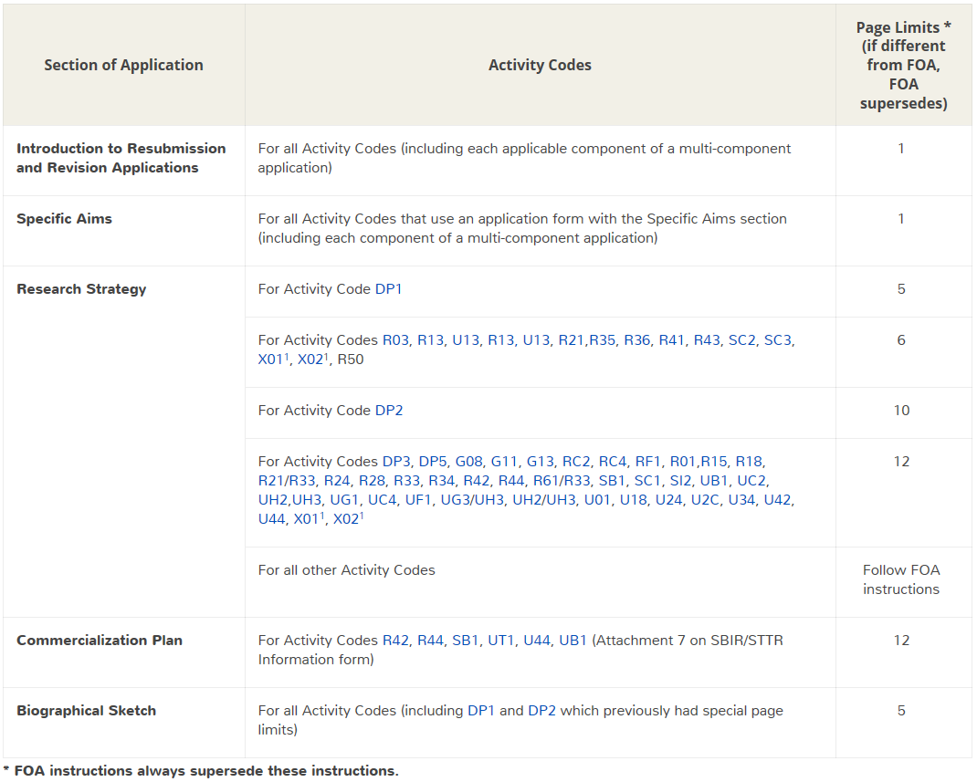

Follow Specified Page Limits
http://grants.nih.gov/grants/how-to-apply-application-guide/format-and-write/table-of-page-limits.htm

Slide 35
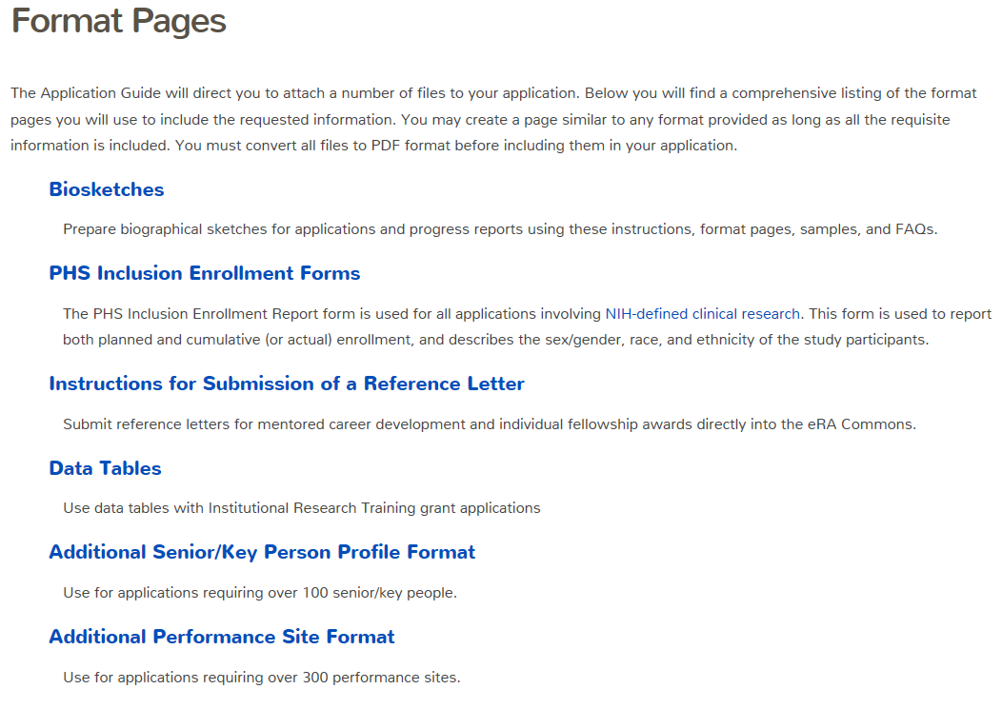


Use Format Pages
http://grants.nih.gov/grants/forms/format-pages.htm

Slide 36
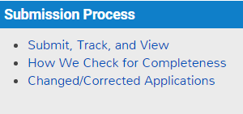

Submission Process
Submit!

Slide 37

Ready to Submit?
At this point you should have:
Verified all required registrations
Identified a funding opportunity announcement
and due date
Chosen a submission method
Prepared your application forms per the
announcement and application guide instructions
Routed your application to the person authorized to
submit (i.e. Grants.gov user with the Authorized
Organization Representative (AOR) role)

Slide 38



Submission Process - High Level
Submit
  AOR submits application to Grants.gov
Track
  Applicant tracks submission status in Grants.gov and eRA Commons
  Applicant addresses all identified errors
    Warnings addressed at applicant’s discretion
View
  Once an error-free application is received, eRA assembles an application image by combining submitted forms and attachments
    Adds: headers, footers, table of contents, bookmarks
  Applicant views assembled application image in eRA Commons
  After 2-business day application viewing window, the application moves forward to receipt and referral staff for further processing

Slide 39





Submission Process – Submit
Grants.gov checks application and records status
AOR submits application to Grants.gov
AOR
checks status in Grants.gov
Validated
(No errors)
Application queued for agency retrieval
Rejected
with Errors
Applicant corrects application errors

Slide 40



Submission Process – Track
eRA checks application and puts status in eRA Commons
eRA system downloads application
Application image generated in eRA Commons
Applicant checks status in eRA Commons
No errors,
Warnings OK
AOR submits changed/correct application to Grants.gov and begins process again
Errors
found
Applicant makes corrections before deadline

Slide 41

Submission Process – View
Happy with
image in eRA Commons?
After 2 business days the application automatically moves forward to Receipt & Referral
Looks
good
Change
desired
Let application move forward without change
Before
deadline?
No
Which option?
SO rejects application in eRA Commons
AOR submits to Grants.gov and begins process again
Apply for
later due date
Yes
SO rejects app in eRA Commons (w/in viewing window) or withdraws app (after) & prepares changed/correct application
Make change and be subject to late policy

Slide 42

On-time Submission
Important reminders:
  NIH recommends submitting early (days, not minutes!) to allow time for correcting any errors found during the application viewing window prior to the due date
  NIH’s late policy does not allow corrections after the due date
  All registrations and SAM renewal must be completed before the due date
Error-free applications must be accepted by Grants.gov with a time stamp on or before 5:00 p.m. local time of the submitting organization on the due date.

Slide 43

Application Checks (Validations)
We really care about the details
Multiple levels of application checks for completeness
  Grants.gov
  eRA systems
  Agency staff
https://grants.nih.gov/grants/how-to-apply-application-guide/submission-process/check-your-application.htm

Slide 44
Validations Done by Grants.gov
Can you think of some examples?
  Active System for Award Management (SAM) registration
  Submitter has AOR role for DUNS on application
  Submission made to active opportunity and application package
  Virus check
  Filenames include only appropriate characters
    A-Z, a-z, 0-9, underscore, hyphen, space, period, parenthesis, curly braces, square brackets, ampersand, tilde, exclamation point, comma, semi colon, apostrophe, at sign, number sign, dollar sign, percent sign, plus sign, and equal sign

Slide 45
Validations Done by eRA Systems
Can you think of some examples?
  Fields required by agency, but not required federal-wide
    R&R Sr/Key form
      Credential for PD/PIs (and a few others)
      Organization name for all sr/key
      Biosketch attachment for all sr/key (Grants.gov only enforces for PD/PI)
    Project/Performance Site Location form
      DUNS for primary site
  Attachments in PDF format
  Adherence to page limits in our Table of Page Limits (unless otherwise specified in the announcement)
  Included appropriate attachments (eRA checks many but not all)

Slide 46
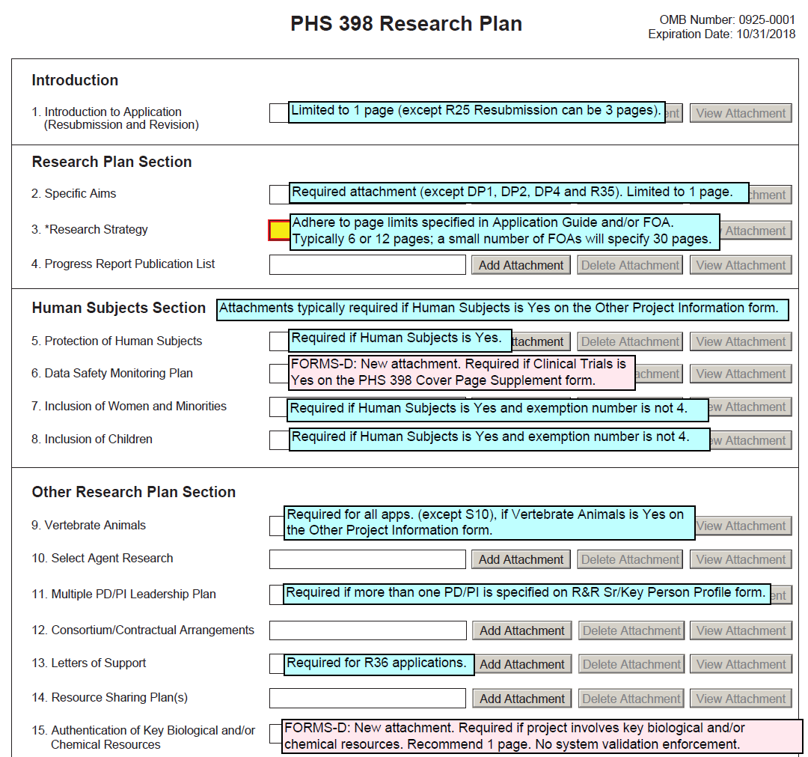

Avoiding Common Errors
Annotated form sets are a great resource to help avoid errors enforced by eRA validation checks.
Annotated form sets:
http://grants.nih.gov/grants/how-to-apply-application-guide/resources/annotated-form-sets.htm

Slide 47

Checks Done by Agency Staff
Can you think of some examples?
  Fit with NIH's and participating institute’s mission
  Eligibility
  “Overstuffing” – application doesn’t include inappropriate information in attachments to get around page limits
  On-time submission
  Simultaneous review of essentially same application
  Adherence to funding opportunity announcement specific instructions
  Correct number of reference letters received by the due date (if applicable)
  Adherence to font and margin guidelines
  Agreement from institute to accept application requesting over $500K in direct costs in any budget period

Slide 48

Dealing with System Issues
You must follow NIH’s standard ‘system issue’ procedure if you run into problems beyond your control that threaten your on-time submission: http://grants.nih.gov/grants/ElectronicReceipt/support.htm#guidelines

Slide 49

Finding Help
Help Desks
On-line resources &Web sites

Slide 50

Help Desks
eRA Commons Help Desk
Grants.gov Contact Center
Web: http://grants.nih.gov/support/
Toll-free: 1-866-504-9552
Phone: 301-402-7469
Hours : Mon-Fri, 7a.m. to 8 p.m. ET
Resources: https://era.nih.gov/modules_user-guides_documentation.cfm
Toll-free: 1-800-518-4726
Phone: 606-545-5035
Hours : 24x7 (Except Federal Holidays)
Email : support@grants.gov
Resources: http://www.grants.gov/help/help.jsp

Slide 51

Online Resources & Websites
How to Apply – Application Guide
http://grants.nih.gov/grants/how-to-apply-application-guide.htm
Annotated form set
http://grants.nih.gov/grants/how-to-apply-application-guide/resources/annotated-form-sets.htm
ASSIST
public.era.nih.gov/assist
ASSIST Online help
era.nih.gov/erahelp/ASSIST/
eRA ASSIST Training page: http://era.nih.gov/era_training/assist.cfm

Slide 52

Live ASSIST Demo
Initiate application
Manage Access
Form navigation & data entry
Pre-submission validation
Pre-submission preview
Tracking Submission Status
And More!
Remaining slides are for notes only. Content will be covered during demo.

Slide 53
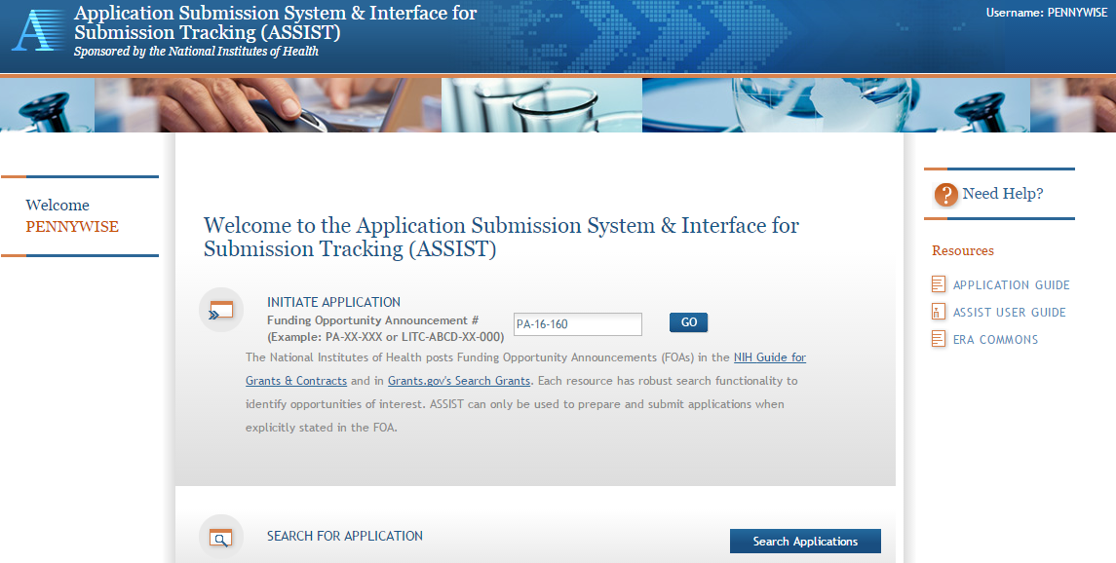
Initiate Application

Slide 54
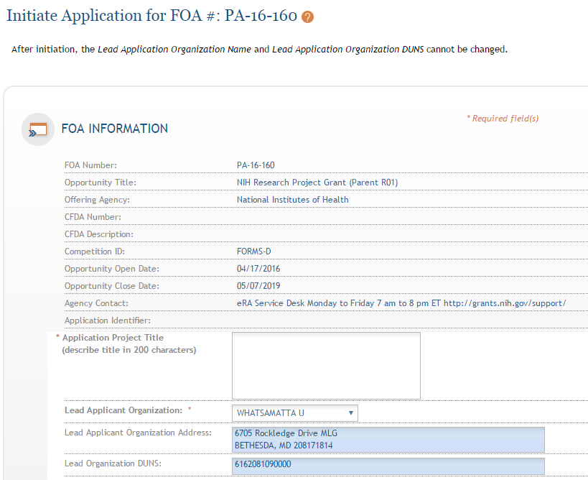
Initiate Screen
FOA information pulled from Grants.gov
Enter Project Title
Drop-down list of organizations affiliated with your eRA Commons account

Slide 55
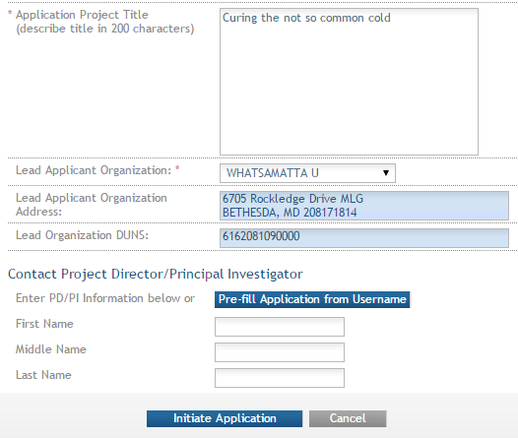
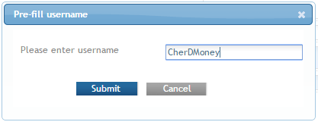
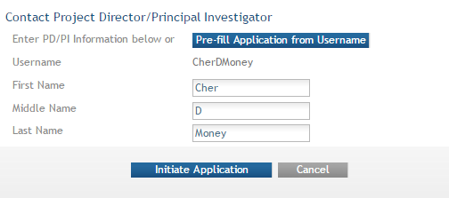
Initiate: Pre-population
Data pre-populated from organization selection
Can manually enter PD/PI information or provide
eRA Commons username to auto-populate

Slide 56
Automatic Application Access
ASSIST automatically provides application access to some individuals based on their Commons roles or role on the application
  Examples:
    Users with Commons accounts that have the Signing Official (SO) or Administrative Official (AO) role have edit access to all applications for their organization
    All PD/PIs (once eRA Commons credentials are provided) have edit access for the entire application
    User who initiates the application has edit access for the entire application
Users with ASSIST_ACCESS_MAINTAINER_ROLE can manage access for all applications at their organization
  Role must be given in eRA Commons by Signing Official

Slide 57
Manage Access
Provides ability to give anyone with a valid eRA Commons account access to an application
Automatically available to users with
  Signing Official (SO) role on eRA Commons account
  ASSIST_ACCESS_MAINTAINER_ROLE role on eRA Commons account
Available on application-by-application basis to
  ASSIST user who has been given the Access Maintainer role by an SO via the Manage Access action

Slide 58
Controlling Application Access
Application access can be controlled across these variables:
  View vs. Edit
  Budget vs. Non-budget data
  Entire application vs. specific
  components (multi-project)

Slide 59
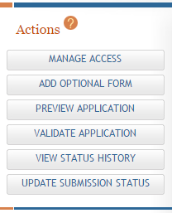
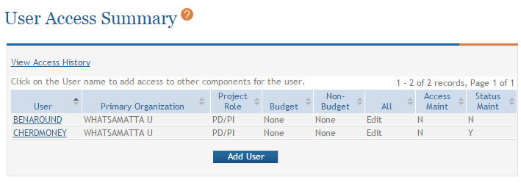
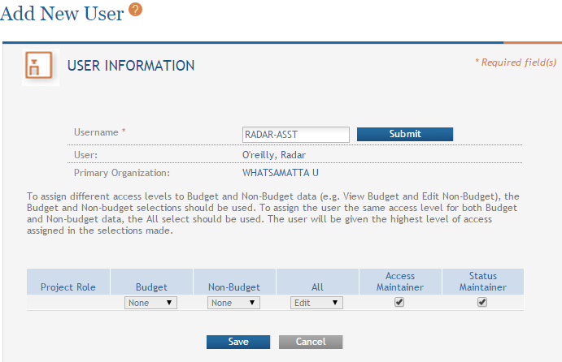
Providing Application Access to a User

Slide 60
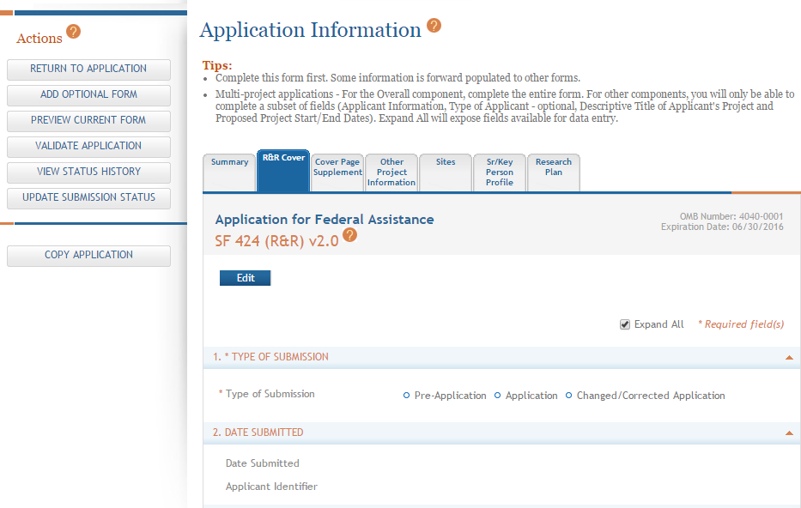
Data Entry
Click each tab to access form data entry screens
Clicking Edit blocks other users from editing form

Slide 61
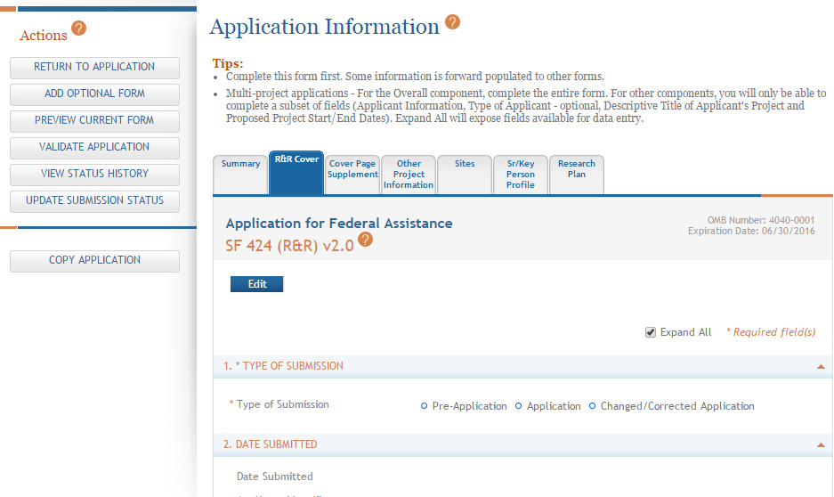
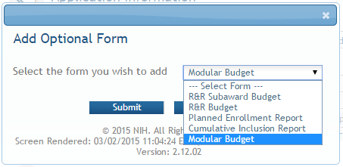
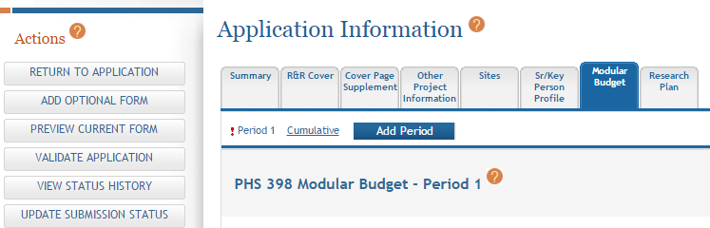
Adding Optional Forms
Select form and click Submit
The form tab is added to navigation

Slide 62
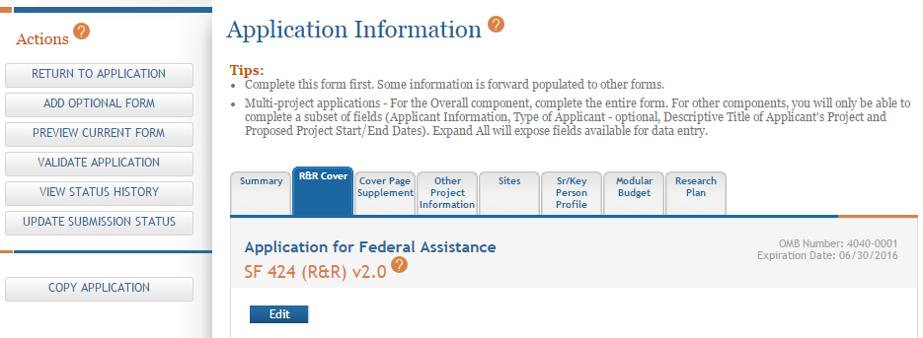
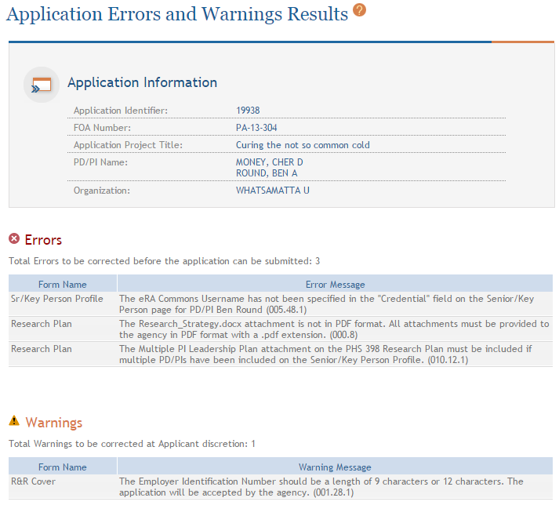
Validate Application
Errors and Warnings are displayed

Slide 63
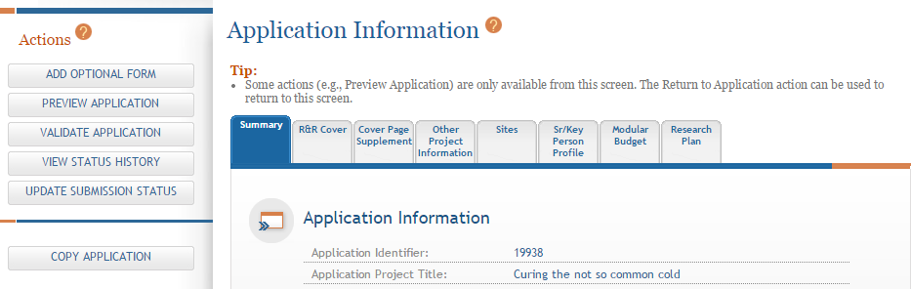
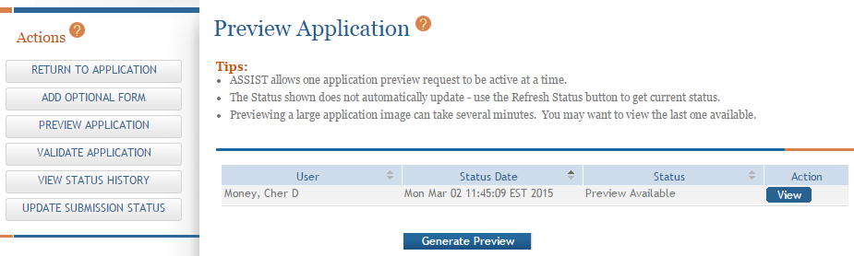
Generating Application Preview
View last preview
Generate new preview

Slide 64
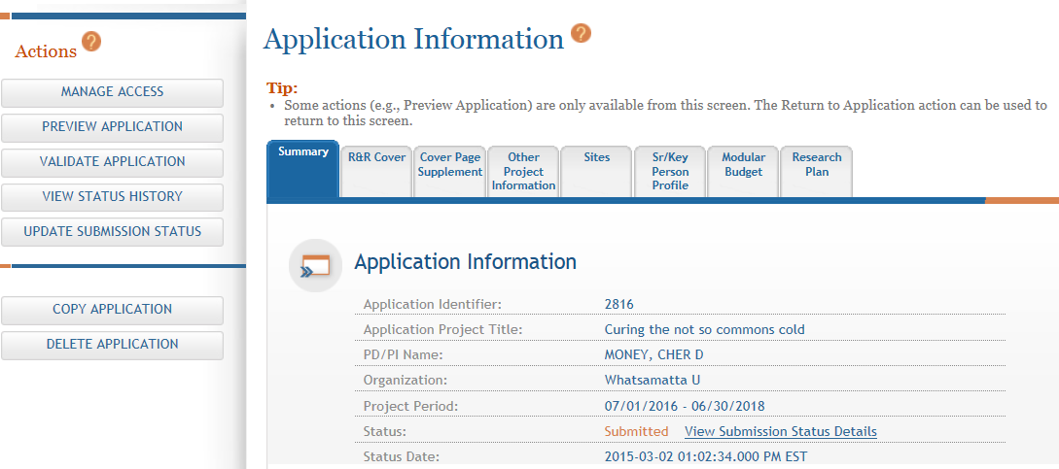
View Submission Status Details
Click View Submission Status Details

Slide 65
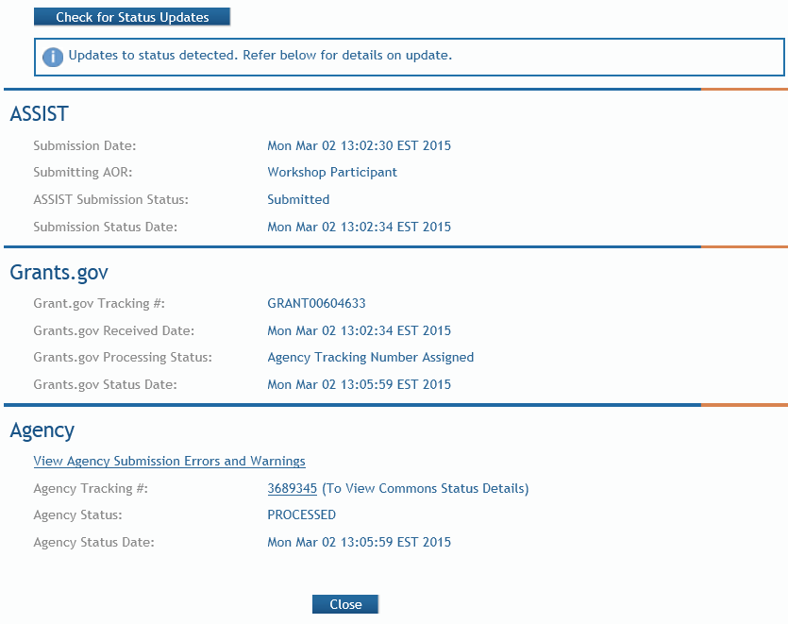
Tracking Submission Status
Happy path…
ASSIST = Submitted
Grants.gov = Agency Tracking Number Assigned
Agency = Processed
Agency Tracking # link brings you to the detailed status screen in eRA Commons

Slide 66
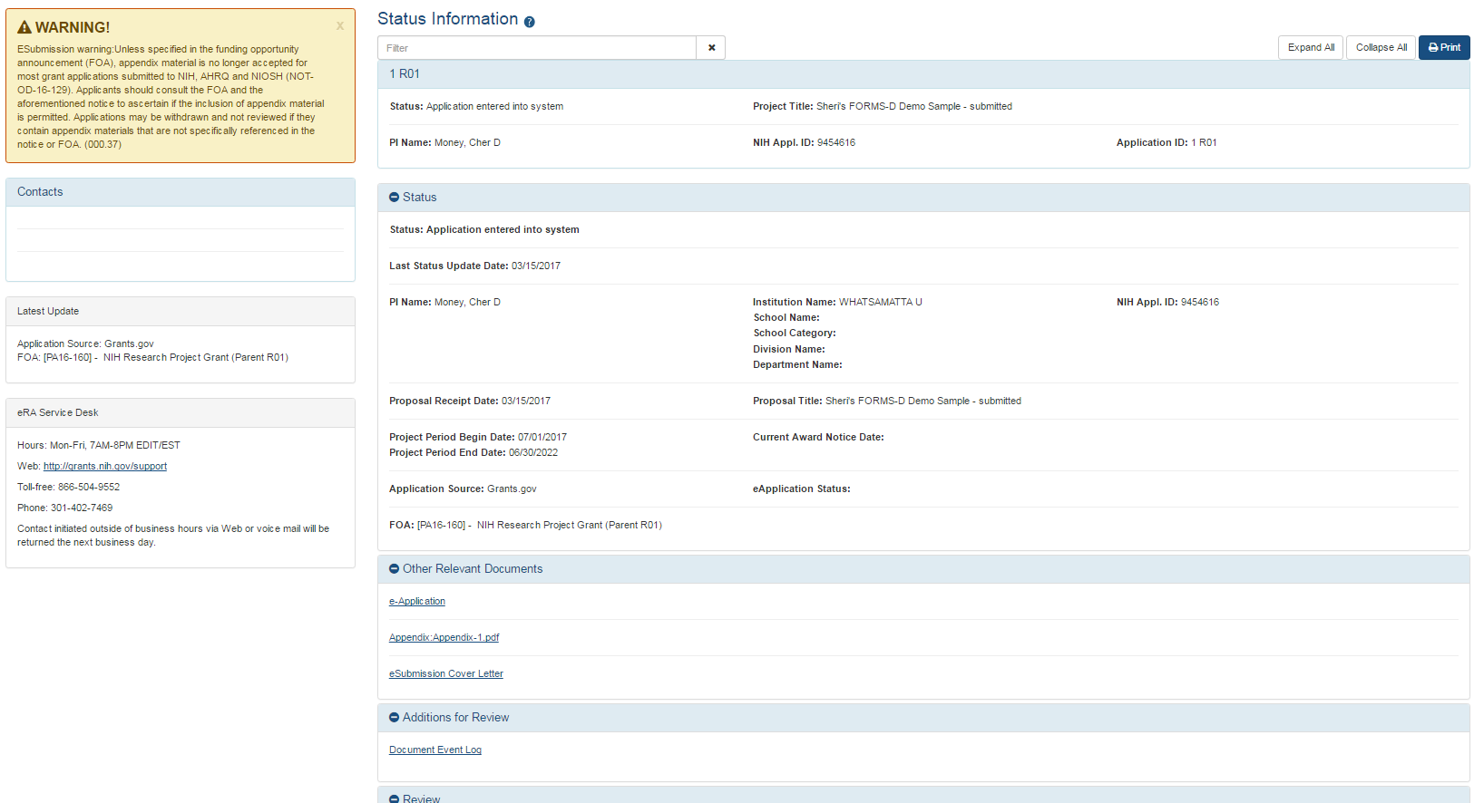
Viewing Your Application in eRA Commons
eApplication is the assembled application image reviewers and staff will see - check it carefully.
You will also want to check the
  Cover Letter,
  PHS Assignment Request Form, and
  Component Appendices
which are stored separate from the image.

Slide 67

Questions?

