Slide 1

Ready, Set, Submit!
GRANT Application Preparation & Submission
Sheri Cummins & Laurie Roman
October 2018

Slide 2

NIH Grants & Funding
How to Apply- Application Guide
https://grants.nih.gov/

Slide 3
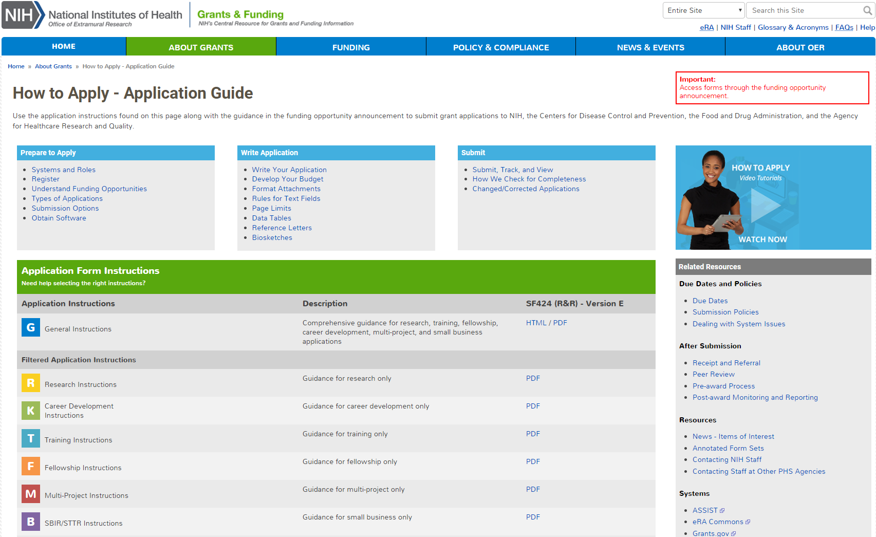
How to Apply – Application Guide
General Application Process Information
Form Instructions
Resources

Slide 4
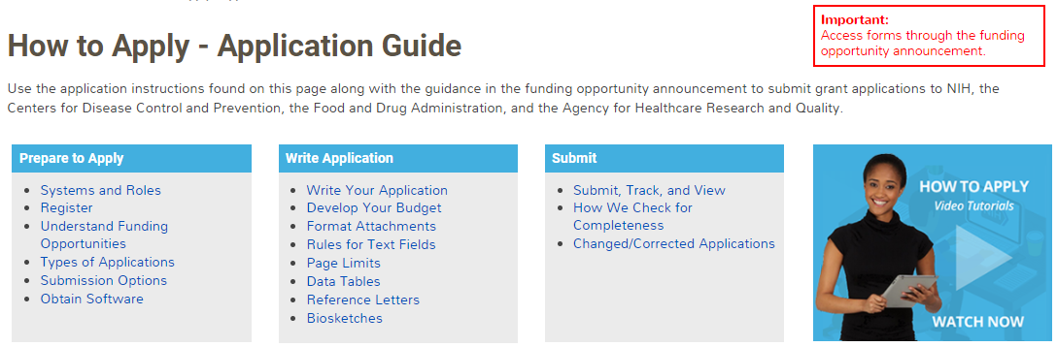
Before Jumping Into the Application Process,
Let’s Cover Some Prepare to Apply Basics

Slide 5
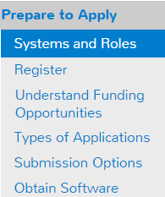


Understand Key Systems & Roles
Grants.gov
eRA Commons
E-Business Point of Contact (EBiz POC)
Authorized Organization Representative (AOR)
Signing Official (SO)
Principal Investigator (PI)
https://grants.nih.gov/grants/how-to-apply-application-guide/prepare-to-apply-and-register/key-systems-and-roles.htm

Slide 6
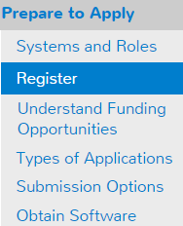


Organization Registration
Your organization must be registered in multiple systems to submit.
Start early – can take 6 weeks!
DUNS – provides unique organization identifier
SAM (System for Award Management) – needed to do business with government
  Requires annual renewal
Grants.gov – required to submit grants
eRA Commons – required to do business with NIH
SBA (Small Business Administration) – required
for SBIR/STTR applications
https://grants.nih.gov/grants/how-to-apply-application-guide/prepare-to-apply-and-register/registration/org-representative-registration.htm

Slide 7
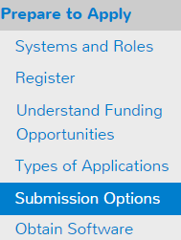




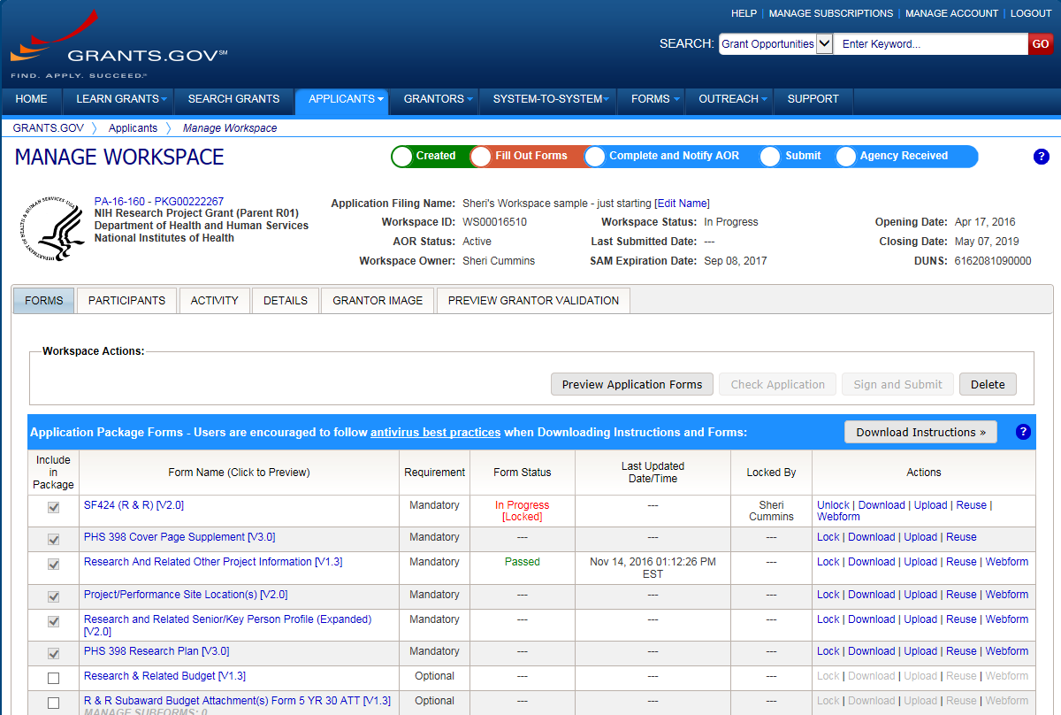




Application Submission Options
ASSIST
System-to-System
Workspace
https://grants.nih.gov/grants/how-to-apply-application-guide/prepare-to-apply-and-register/choose-a-submission-option.htm

Slide 8



Your Application will be…
Subject to the same registration requirements
Completed with the same data items
Routed through Grants.gov
Validated against the same NIH business rules
Assembled in a consistent format for review consideration
Tracked in eRA Commons
…regardless of submission option used.

Slide 9
What Submission Options are NIH Applicants Using?
Monthly Submission Method Percentages
January 2018 – June 2018
Total Submission Method Percentages
January 2018 – June 2018

Slide 10
Comparison of Submission Options
NIH ASSIST
Grants.gov Workspace
Managed by NIH
Multi-user access
Leverages eRA Commons accounts
Pre-population from eRA Commons profiles
Pre-submission validations
Pre-submission preview in agency format
Track application status in a single system
Copy data to different application package
Supports all NIH competing applications
Pull study information from ClinicalTrials.gov
Integrated NIH messaging (tips, system alerts)
Managed by Grants.gov
Multi-user access
Requires additional user registrations
No pre-population from existing profiles
Pre-submission validations
Pre-submission preview in agency format
Must track application in multiple systems
Reuse forms; copy application data
Supports NIH single-project competing applications (no multi-project support)
https://grants.nih.gov/grants/how-to-apply-application-guide/prepare-to-apply-and-register/submission-options/assist.htm
https://www.grants.gov/web/grants/applicants/workspace-overview.html

Slide 11
Application Forms
There is NOT a universal set of application forms that can be downloaded from our form library or websites
You must use the application form package attached to your funding opportunity announcement
  Each application form package includes the customized subset of forms supported by NIH which are needed for that opportunity
Application forms are accessed using your chosen submission method

Slide 12
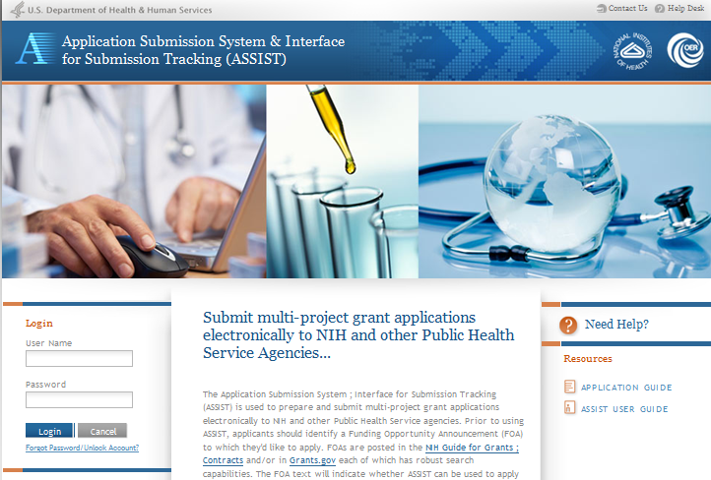
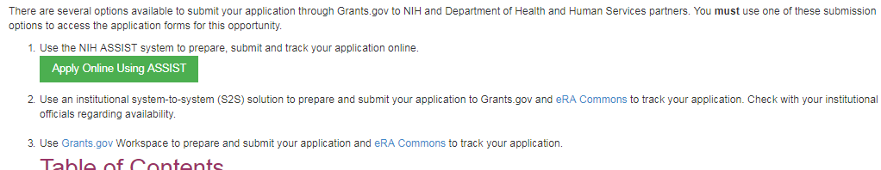
Access Application Forms via ASSIST
Excerpt from single-project FOA in NIH Guide…

Slide 13
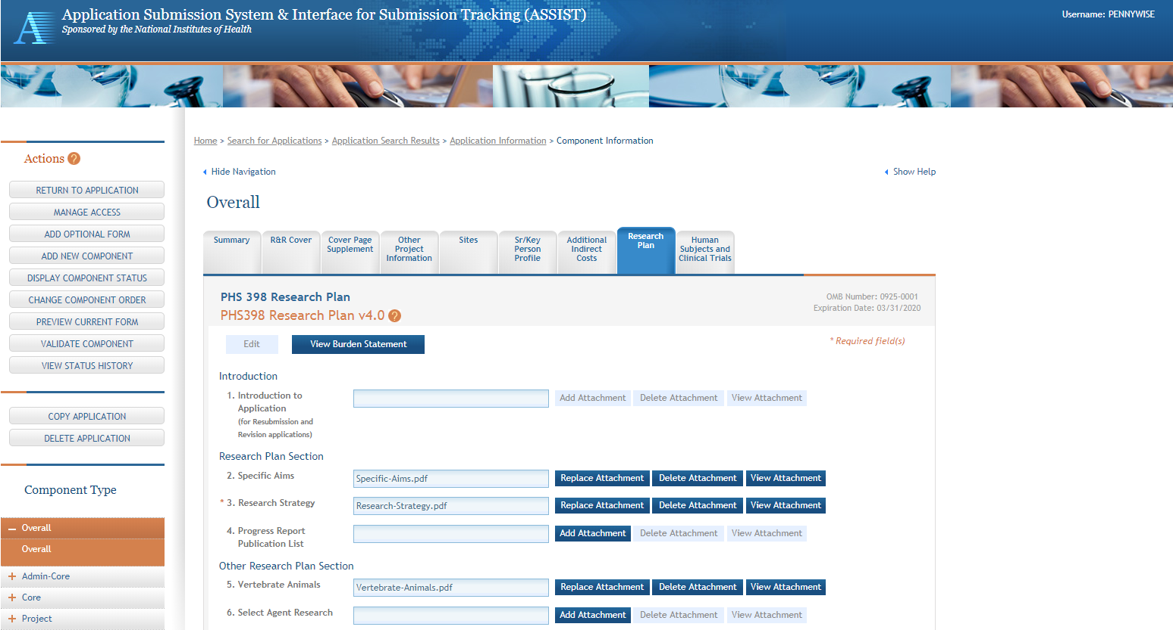
ASSIST Screen – Single-project

Slide 14
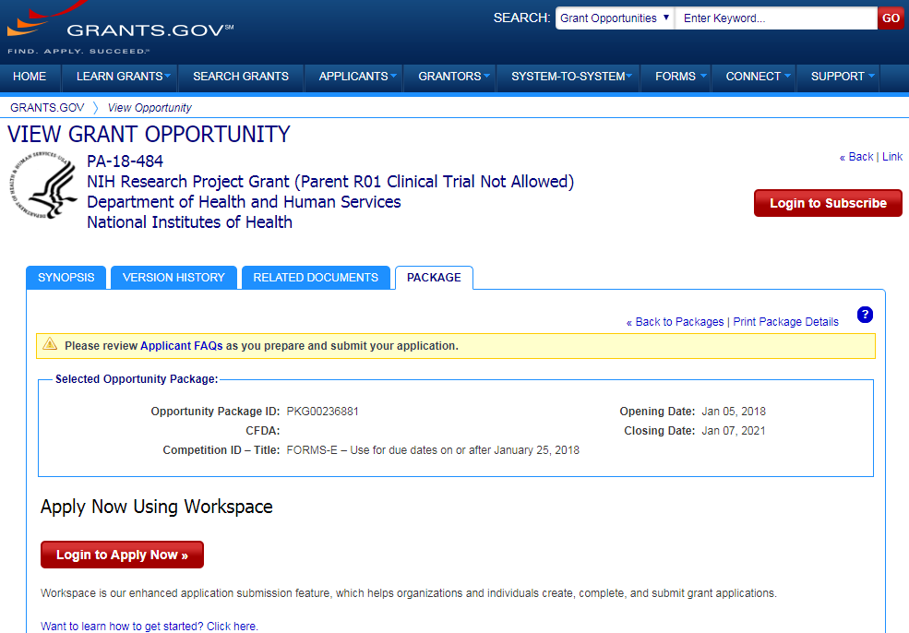
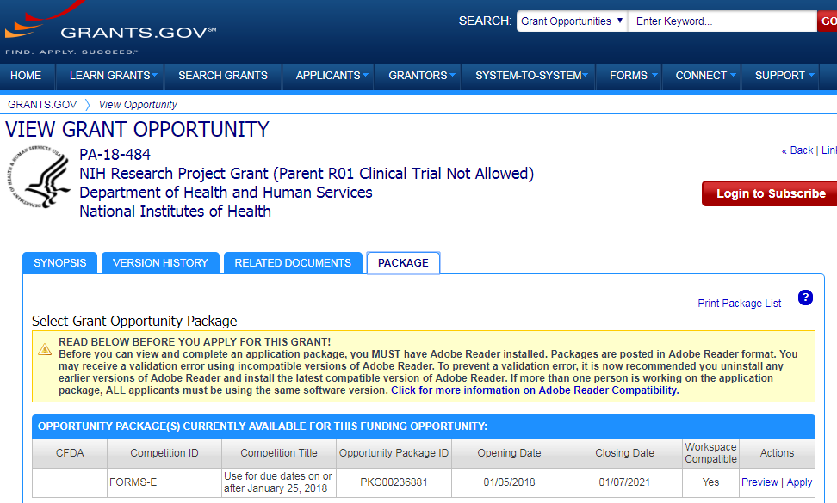
Access Application Forms via Workspace
Excerpt from single-project FOA in NIH Guide…

Slide 15
Sample Workspace Screen

Slide 16








Now Let’s Talk About the Application Process
Step 1: Find
Step 2: Plan
Step 3: Initiate
Step 4: Build team
Step 5: Enter data
Step 6: Finalize
Step 7: Submit
Step 8: Track

Slide 17

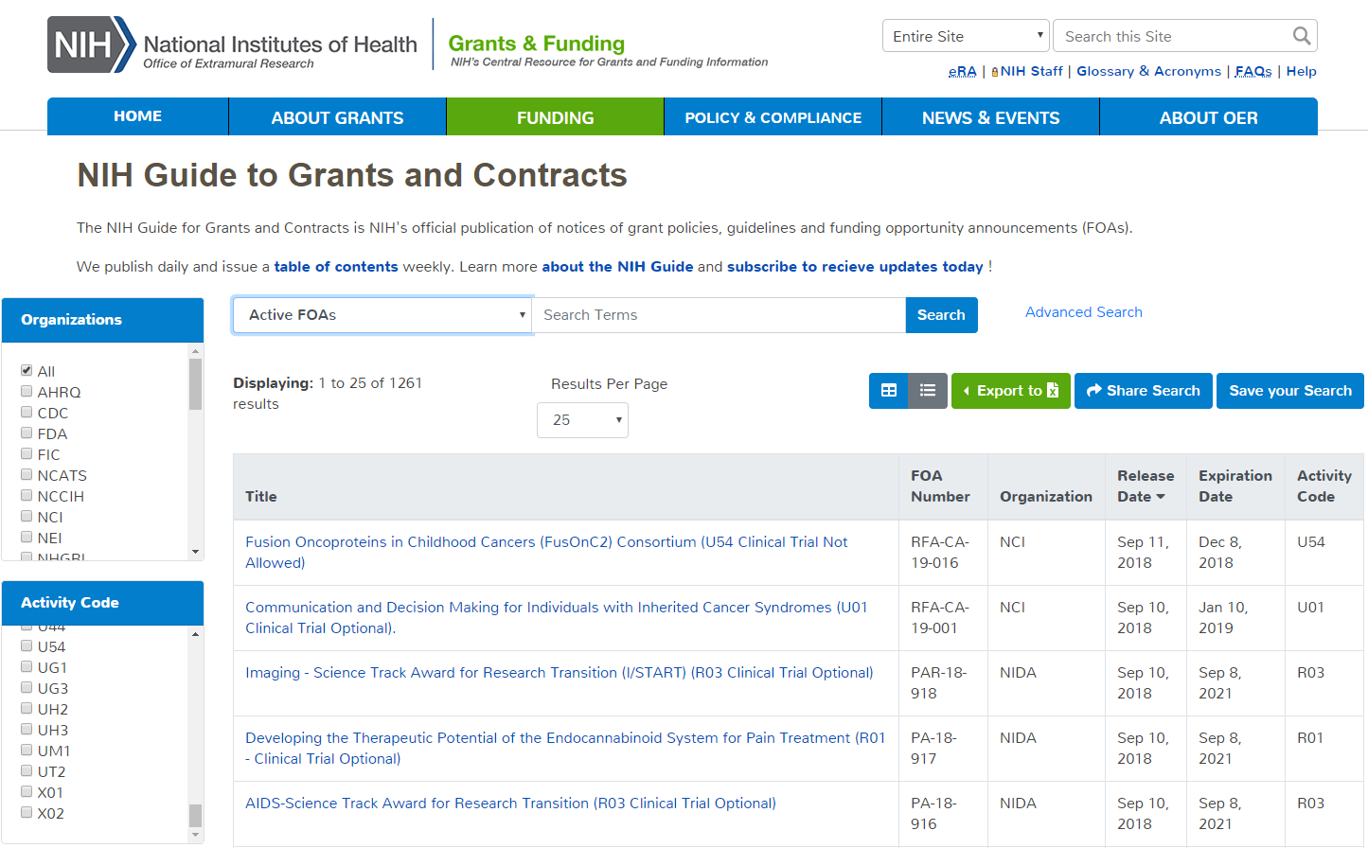
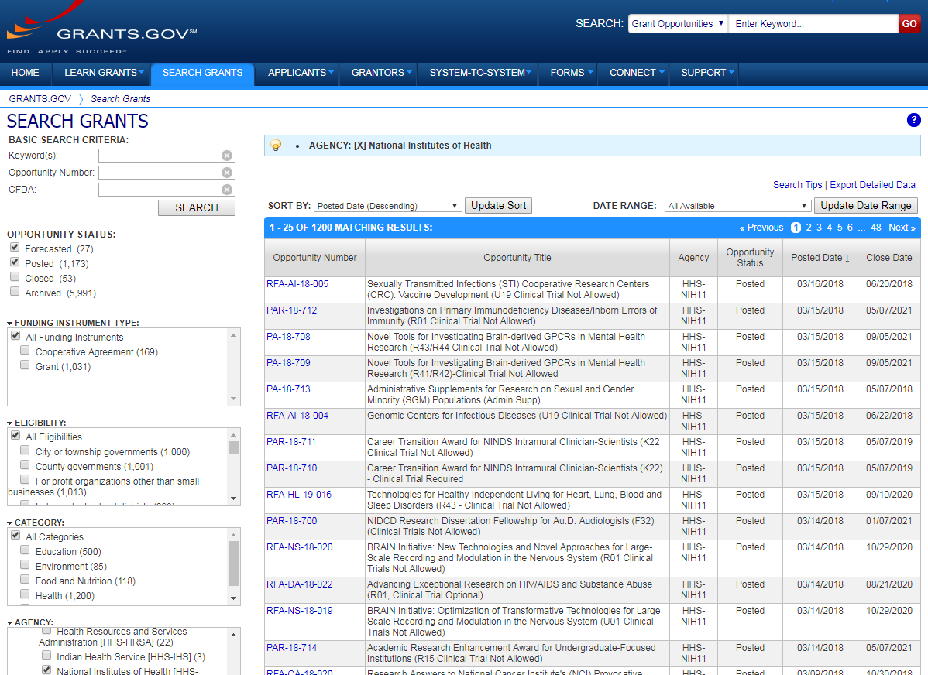
Step 1: Find an Opportunity of Interest
NIH Guide for Grants & Contracts
Grants.gov Search Grants
Each system has robust search capabilities.

Slide 18
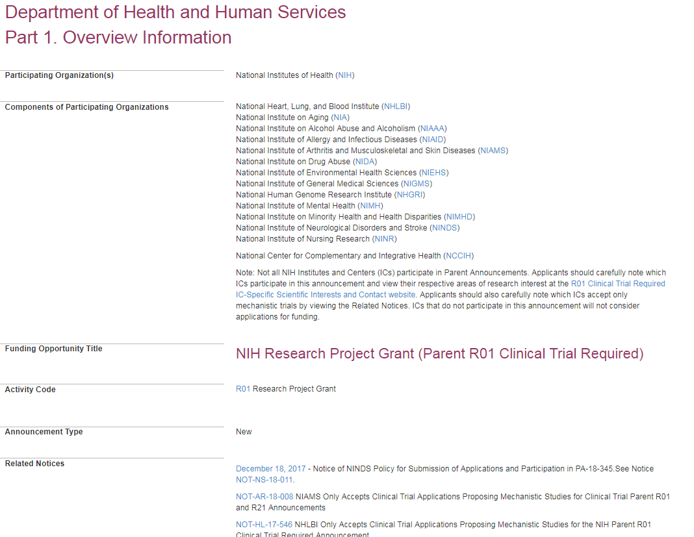
Announcement Text
Carefully read full announcement
Participating Institutes
Check for updates in Related Notices

Slide 19
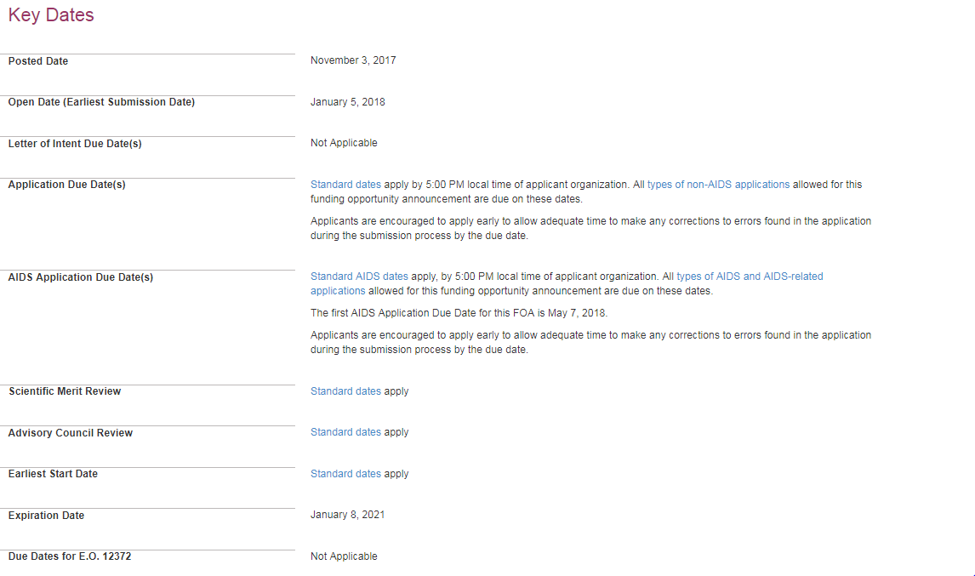
FOA Key Dates
Due Dates section links to standard dates web page or lists specific due dates

Slide 20
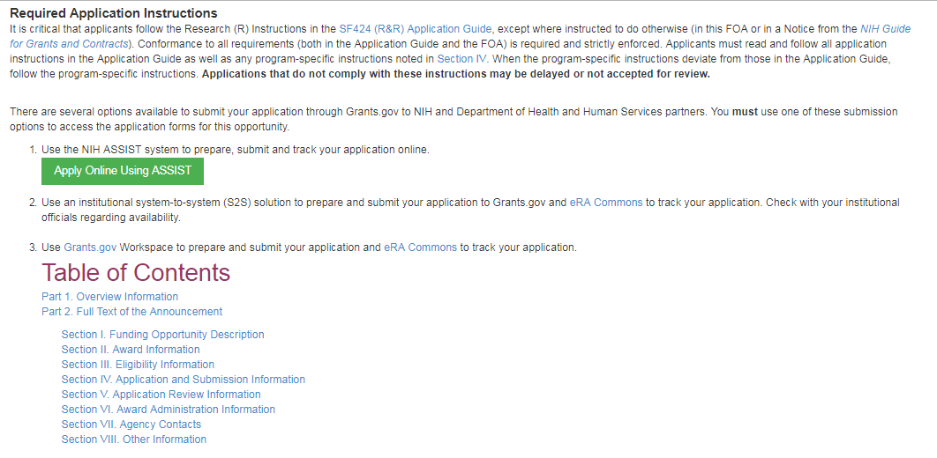
FOA Section IV Application and Submission Information
Link to Application Guide
Section IV. Application and Submission Information
Includes any FOA-specific submission instructions

Slide 21
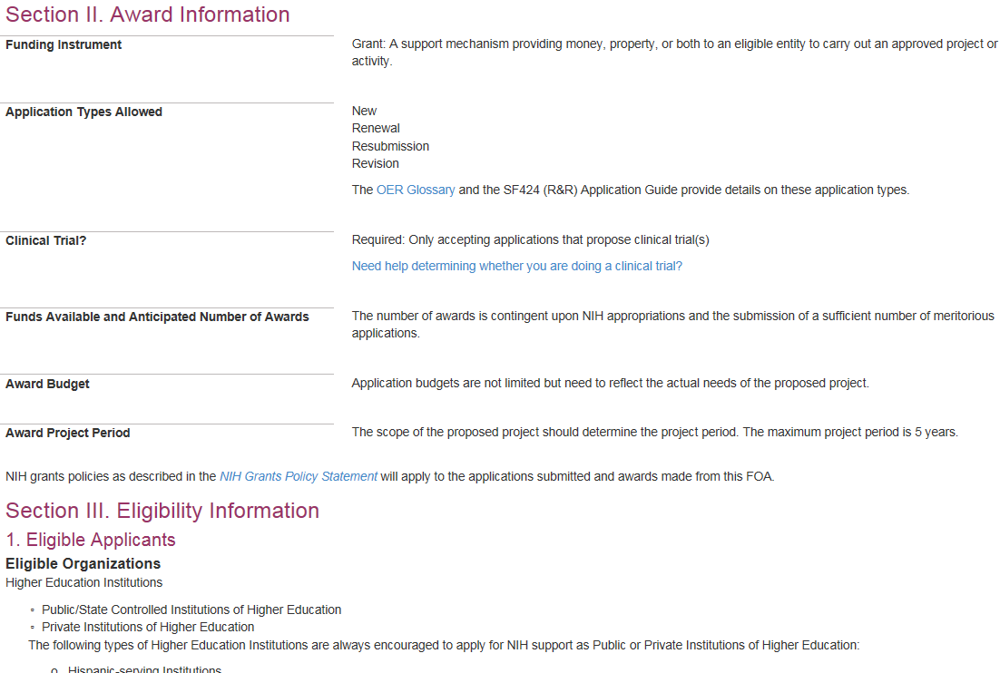
FOA Sections II and III
Application Types
Clinical Trial allowability indicator
Eligibility

Slide 22

Check for fit before you submit!
Program description
  FOA Part 2, Section I Funding Opportunity Description
Participating institutes
  FOA Part 1, Participating Organizations & Components of Participating Organizations
Type of Application – New, Resubmission, Renewal, Revision
  FOA Part 2, Section II Award Information
Clinical trials allowability (for due dates on/after January 25, 2018)
  FOA Part 2, Section II Award Information
Eligibility
  FOA Part 2, Section III Eligibility Information

Slide 23

Step 2: Plan for Your Submission
Identify team members
Verify registrations are in place and active
Choose submission method
Determine application preparation responsibilities
  Who will – prepare budget, gather data, create attachments, do data entry
Make sure everyone is aware of process
  Internal review & approval process
  Post-submission responsibilities
    How to deal with errors/warnings
    Who will verify application in eRA Commons?

Slide 24

Step 3: Initiate Application
Login to your submission system and initiate your application and access the application forms
ASSIST | Workspace
Initiate Application | Create Workspace

Slide 25

Step 4: Build Your Team
Provide application access to appropriate team members
Gather eRA Commons usernames to include in your application for the following individuals
  Project Director/Principal Investigators (PD/PIs)
  Component leads on a multi-project application
  Sponsor on a fellowship application
  Candidates for diversity and re-entry supplements
  Primary mentor on individual mentored career development application
ASSIST | Workspace
Gather eRA Commons usernames and use Manage Access to give folks access | Gather Grants.gov usernames and use Participants tab to give folks access

Slide 26

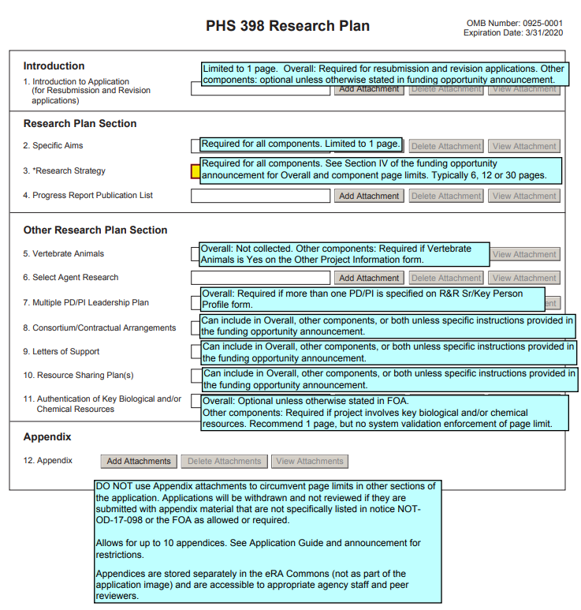
Step 5: Enter Data
Follow All Guidance
Handy Resource
Notices in NIH Guide for Grants & Contracts
Funding Opportunity Announcement
  Section IV. Application and Submission Information
How to Apply - Application Guide
Annotated form sets
Precedence / Importance
https://grants.nih.gov/grants/how-to-apply-application-guide.html

Slide 27
Application Attachments
Use simple PDF-formatted files for all attachments
  Disable security features such as password protection
Keep file names to 50 characters or less
Filenames must be unique within the application
Use meaningful filenames, especially for “Other Attachments”
Do not include headers or footers
  Section headings as part of the text (e.g., Significance, Innovation, Approach) are encouraged
Follow specified page limits
Follow guidelines for fonts and margins
https://grants.nih.gov/grants/how-to-apply-application-guide/format-and-write/format-attachments.htm

Slide 28
Text Fields
Text fields support plain text with limited manual formatting
  To format paragraphs, include a blank line between paragraphs
  To format bulleted lists, start each list item on a new line with a "list item" character, such as a hyphen (-) or an asterisk (*), followed by a space and then the item text
Much of your original formatting (font, bolding, bullets, subscript, superscript) will be lost when you cut and paste
  Take advantage of application preview features if your submission method supports them
Check application form instructions for character limits
  Spaces and punctuation count against the limit
https://grants.nih.gov/grants/how-to-apply-application-guide/format-and-write/rules-for-text-fields.htm

Slide 29
Grantsmanship
Avoid jargon
Be focused - use a clear and concise writing style
Spell out acronyms the first time they are used in each application section/attachment and note the appropriate abbreviation in parentheses
Appeal to the reviewers and the funding ICs by using language that stresses the significance of your proposed work
Align your application with the review criteria to maximize impact
  FOA Section V. Application Review Information
https://grants.nih.gov/grants/how-to-apply-application-guide/format-and-write/format-attachments.htm

Slide 30

Step 6: Finalize Your Application
Action | ASSIST | Workspace
6a. Run a pre-submission validation check | Validate Application | Preview Grantor Validation
6b. Generate a pre-submission image of your assembled application in the NIH format | Preview Application | Grantor Image
6c. Take any additional steps needed to prepare for Submission | Update Submission Status to “Ready to Submit” | Complete and Notify AOR (optional)

Slide 31

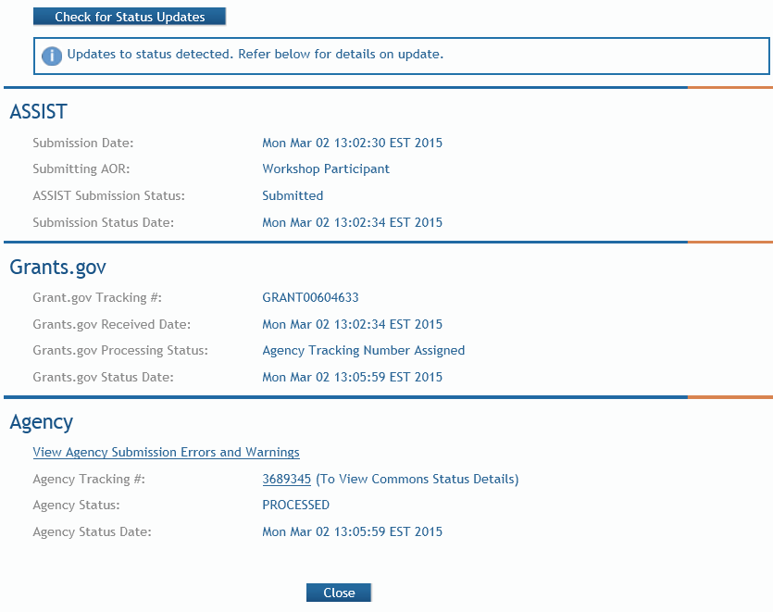
Step 7: Submit Your Application
Follow steps for your submission method
Only folks with Grants.gov AOR (Authorized Organization Representative) credentials can submit
All NIH applications route through Grants.gov
Your Grants.gov timestamp
is used to determine
“on-time” submission
Grants.gov Tracking #
Date/Time Stamp – always recorded in Eastern Time

Slide 32

On-time Submission
Deadline = 5 p.m. local time of submitting organization on the due date
  All registrations and SAM renewal must be completed before the deadline
  Application must be free of all federal system-identified errors (Grants.gov & eRA)
  NIH’s late policy does not allow corrections after the deadline
  NIH recommends submitting early to allow time to correct any unexpected errors or submission issues

Slide 33

Pop Quiz
The appropriate measurement for “early” in the context of application submission is…
Minutes
Hours
Days
Measure early on a calendar not a clock.

Slide 34

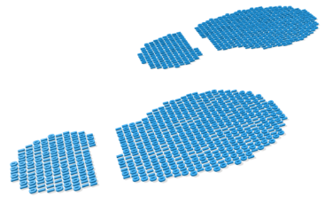
Step 8: Track Your Application
eRA Commons Status is an integral part of your submission
  Applications that pass Grants.gov validations are picked up by eRA Commons and checked against many application guide and opportunity instructions
Authorized users can check eRA Commons Status for processing results
  Signing Officials (SOs)
  Administrative Officials (AOs)
  Principal Investigators (PIs)
  Delegated Assistants (ASSTs)
E-mail notifications sent

Slide 35

Email is Unreliable – Proactively Track Your Application
Many email notifications are sent throughout the process
  DO NOT depend solely on email notifications
  It is YOUR responsibility to proactively check your application status in eRA Commons

Slide 36


Errors & Warnings
Corrective submissions must be made BEFORE the submission deadline and overwrite previous submissions
  Errors stop application processing and must be corrected
  Warnings do not stop application processing and are corrected at your discretion based on your circumstances

Slide 37

Correcting Errors Found After Submission
To correct system-identified errors found after submission:
Make corrections to local copy of the application
Update SF424 (R&R) form
  Check “Changed/Corrected” as “Type of Submission”
  Enter “Previous Grants.gov Tracking ID” (e.g., GRANT12345678) in field 4c
Submit the entire Changed/Corrected application back through Grants.gov before the deadline
Track submission through to eRA Commons
NOTE: Reviewers do not see applicant warnings, nor can they tell how many submission attempts were needed to complete the submission process
https://grants.nih.gov/grants/how-to-apply-application-guide/submission-process/changed-corrected-application.htm

Slide 38
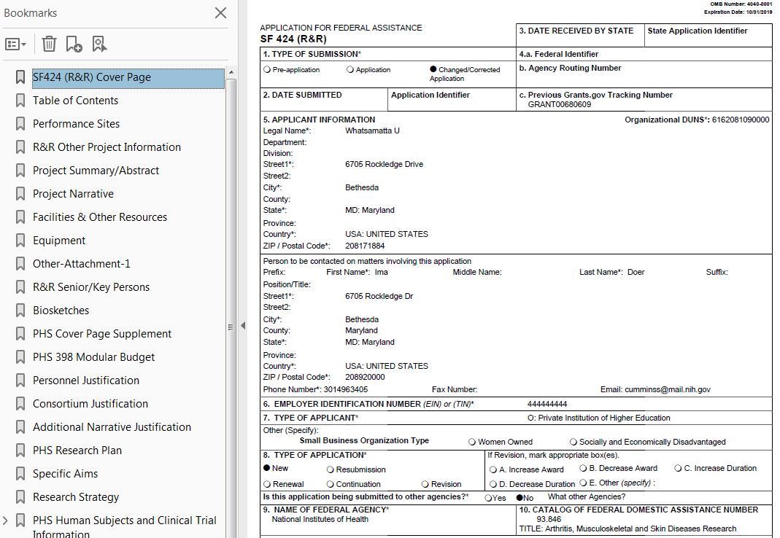
Application Assembled & Posted in eRA Commons
Once an error-free application is received by NIH, the eRA system will:
  Assemble the grant application image
  Insert headers (PI name) and footers (page numbers) on all pages
  Generate Table of Contents and bookmark important sections
  Post the assembled application image in the PD/PI’s eRA Commons account
  Send notifications

Slide 39
Application Viewing Window
Applicants have two (2) business days to view the assembled application image before the application automatically moves forward for further processing
SO can Reject application within viewing window to prevent it
from moving forward to NIH staff
  Can submit a Changed/Corrected application before the submission deadline
ASSIST | Workspace
View Submission Status Details link | Must login to eRA Commons directly and access the application’s detailed status screen
https://public.era.nih.gov/commons

Slide 40
View Application Image (e-Application)
The e-Application in eRA Commons is the same document seen by NIH staff and reviewers.
If you can’t VIEW it, we can’t REVIEW it!

Slide 41

Submission Complete!
If you don’t reject within the two business day viewing window, the application automatically moves forward for further processing at NIH
Any subsequent application changes are subject to the NIH policy on late submission of grant applications and the NIH policy on post-submission application materials

Slide 42

Application Checks (Validations)
We really care about the details
Multiple levels of application checks for completeness
  Grants.gov
  eRA systems
  Agency staff
https://grants.nih.gov/grants/how-to-apply-application-guide/submission-process/check-your-application.htm

Slide 43

Sample Validations
Grants.gov
eRA Systems
Agency Staff
Active System for Award Management (SAM) registration
Submitter has AOR role for DUNS on application
Submission made to active opportunity and application package
Virus check
Filenames include only appropriate characters
Fields required by agency, but not required federal-wide
  R&R Sr/Key form
    Credential for PD/PIs
    Organization name for all sr/key
    Biosketch for all sr/key
  Performance Site form
    DUNS for primary site
Attachments in PDF format
Adherence to page limits in our Table of Page Limits
All appropriate attachments included
Fit with NIH/Institute mission
Eligibility
“Overstuffing”
On-time submission
Adherence to funding opportunity announcement specific instructions
Font and margin guidelines
Simultaneous review of essentially same application

Slide 44
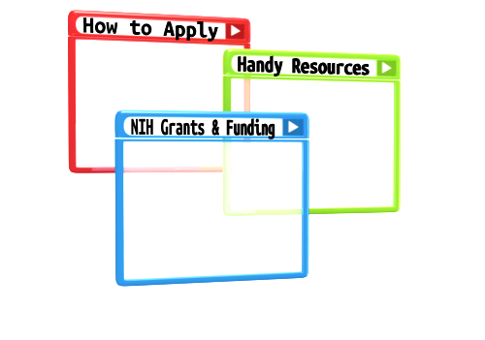
Resources

Slide 45
Help Desks
eRA Service Desk
Grants.gov Contact Center
Web: https://grants.nih.gov/support/
Phone: 1-866-504-9552
Hours : Mon-Fri, 7a.m. to 8 p.m. ET
Toll-free: 1-800-518-4726
Hours : 24x7 (Except Federal Holidays)
Email : support@grants.gov
Resources: https://www.grants.gov/web/grants/support.html

Slide 46
Online Resources & Websites
NIH Grants and Funding
https://grants.nih.gov/grants/oer.htm
How to Apply – Application Guide
https://grants.nih.gov/grants/how-to-apply-application-guide.html
Annotated form set
https://grants.nih.gov/grants/how-to-apply-application-guide/resources/annotated-form-sets.htm
Preparing Your Application Using ASSIST
https://grants.nih.gov/grants/how-to-apply-application-guide/prepare-to-apply-and-register/submission-options/assist.htm

Slide 47

Stay Connected – Subscribe to Listservs
eRA-Information-L
  For administrators, principal investigators and the people that support them
  Used by NIH to notify the community of information related to eRA Commons, ASSIST and eSubmission
NIH_ESUB_SYS2SYS-L
  For technical personnel involved in system-to-system solution development and planning
  Used to exchange information related to the implementation of system-to-system solutions for grant application preparation and submission to NIH

Slide 48
Walk-through of Submission Process
DEMO
(using assist, but steps and concepts apply to all)

Slide 49

Questions?

