Slide 1



Electronic Prior Approval Requests

Slide 2
Prior Approval
NIH Policy allows grantees a certain level of discretion when making changes to their budgeting, or grant related activities. However, some changes require written prior approval.
Prior Approval Requests must be submitted in writing by the AOR/SO of the organization. Each type of request requires different information from the grantee organization.
Requests are reviewed by the awarding IC, which makes the final determination.
The grantee is notified via email of the outcome of their request.

Slide 3
Prior Approval Requests
Currently eRA has internal systems in place for received requests to be formally processed, which include:
  Applications with Direct Cost of $500,000 or more
  Request to withdraw application
However these requests still come through email, which may lead to delay in processing if required information is missing, or the recipient is out of office, etc.
By creating a component within eRA Commons, we will remove guess work for grantees regarding what data to submit, and would allow grantees to know when their request was processed and accepted or rejected.

Slide 4
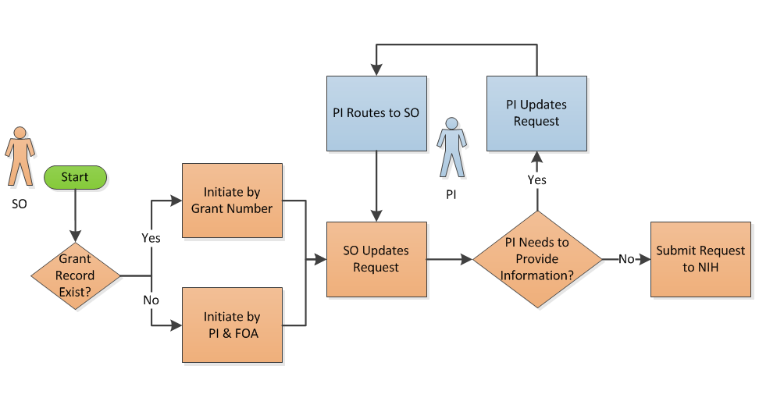
Proposed Prior Approval Flow

Slide 5
Requests for 500k Direct Cost
What is your organization’s current process for submitting a request for 500,000 direct cost application?
  Who is involved?
  Who begins the process for gathering the necessary information?
Other suggestions for systematically simplifying the process?

Slide 6
Other types of Prior Approval Requests
We are currently investigating implementing the following:
  No Cost Extensions (after the initial No-Cost Extension)
  Change of Scope
  Change of PI
  Change in Level of Effort
  Carry Over Requests
With these in mind, are there ones that are a priority?
Are there additional types of requests that would beneficial?

