Slide 1








Preparing, Submitting & Tracking Multi-project Applications Using ASSIST
A
S
T
S
I
S
Sheri Cummins
May 2018

Slide 2

What is ASSIST?
ASSIST is NIH's online system for the
preparation, submission & tracking
of grant applications through
Grants.gov to NIH
ASSIST = Application Submission System & Interface for Submission Tracking

Slide 3






Submission Options – ASSIST & System-to-system
Submission Options Used for NIH Multi-project Applications
March 2017 – February 2018

Slide 4

Before jumping into ASSIST, let’s take some time to get acclimated …

Slide 5

Application Format
All multi-project applications include:
  A single Overall component
  Some number of additional components
  Automatically prepared data summaries

Slide 6







Multi-Project Application: Overall Component
Overall Component
Examples:
P01, P20, P50
PD/PIs: Cher D. Money, Ben A. Round
Organization: A
Project Title: Research Center to Cure the Diseases of the World
Component Type: Admin Core
Component Type: Core
Component Type: Project
Single Overall component
Provides an overview of the entire application
Admin Core-001
Core-001
Project-001
Project Title: Administrative Core
Project Lead: Jed I. Knight
Organization: A
Project Title: Research Core 1
Project Lead: Ben A. Round
Organization: A
Project Title: Fabulous Research Focus 1
Project Lead: Cher D. Money
Organization: A
Subaward Budget
Project-002
Organization: D
Project Title: Fabulous Research Focus 2
Project Lead: Quin T. Sential
Organization: B
Core-002
Project Title: Research Core 2
Project Lead: Abel Tu Lead
Organization: B
Project-003
Project Title: Fabulous Research Focus 3
Project Lead: Ima Doer
Organization: C
Subaward Budget
Organization: A

Slide 7
Multi-Project Application: Component Types
Overall Component
PD/PIs: Cher D. Money, Ben A. Round
Organization: A
Project Title: Research Center to Cure the Diseases of the World
Component Type: Admin Core
Component Type: Core
Component Type: Project
Admin Core-001
Core-001
Project-001
Project Title: Administrative Core
Project Lead: Jed I. Knight
Organization: A
Project Title: Research Core
Project Lead: Ben A. Round
Organization: A
Project Title: Fabulous Research Focus 1
Project Lead: Cher D. Money
Organization: A
Some number of additional component types
Component types vary by opportunity
Funding opportunity announcements indicate the types of components expected in a responsive application
Subaward Budget
Project-002
Organization: D
Project Title: Fabulous Research Focus 2
Project Lead: Quin T. Sential
Organization: B
Core-002
Project Title: Research Core 2
Project Lead: Abel Tu Lead
Organization: B
Project-003
Project Title: Fabulous Research Focus 3
Project Lead: Ima Doer
Organization: C
Subaward Budget
Organization: A

Slide 8
Multi-Project Application: Components
Overall Component
PD/PIs: Cher D. Money, Ben A. Round
Organization: A
Project Title: Research Center to Cure the Diseases of the World
Component Type: Admin Core
Component Type: Core
Component Type: Project
Admin Core-001
Core-001
Project-001
Some number of components within a component type
Announcements indicate the required minimum and/or maximum number of components expected
Project Title: Administrative Core
Project Lead: Jed I. Knight
Organization: A
Project Title: Research Core
Project Lead: Ben A. Round
Organization: A
Project Title: Fabulous Research Focus 1
Project Lead: Cher D. Money
Organization: A
Subaward Budget
Project-002
Organization: D
Project Title: Fabulous Research Focus 2
Project Lead: Quin T. Sential
Organization: B
Core-002
Project Title: Research Core 2
Project Lead: Abel Tu Lead
Organization: B
Project-003
Project Title: Fabulous Research Focus 3
Project Lead: Ima Doer
Organization: C
Subaward Budget
Organization: A

Slide 9
Multi-Project: Application Forms
Overall Component
PD/PIs: Cher D. Money, Ben A. Round
Organization: A
Project Title: Research Center to Cure the Diseases of the World
Required Forms
SF424 (R&R)
Project/Performance Sites
R&R Other Project Info
R&R Senior/Key Persons
PHS 398 Cover Page Supplement
PHS 398 Research Plan
PHS Human Subjects and Clinical Trials Information
Component Type: Admin Core
Component Type: Core
Component Type: Project
Admin Core-001
Core-001
Project-001
Project Title: Administrative Core
Project Lead: Jed I. Knight
Organization: A
Project Title: Research Core
Project Lead: Ben A. Round
Organization: A
Project Title: Fabulous Research Focus 1
Project Lead: Cher D. Money
Organization: A
“Optional” Forms
Required Forms
PHS Additional Indirect Costs
PHS Assignment Request Form
Subaward Budget
SF424 (R&R)
Project/Performance Sites
R&R Other Project Info
R&R Senior/Key Persons
PHS 398 Cover Page Supplement
PHS 398 Research Plan
PHS Human Subjects and Clinical Trials Information
R&R Budget
Project-002
Organization: D
Project Title: Fabulous Research Focus 2
Project Lead: Quin T. Sential
Organization: B
Subaward Budget
Organization: B
Core-002
Project Title: Research Core 2
Project Lead: Abel Tu Lead
Organization: B
Project-003
Project Title: Fabulous Research Focus 3
Project Lead: Ima Doer
Organization: C
“Optional” Forms
Subaward Budget
R&R Subaward Budget
Organization: A

Slide 10
Same Person Serving Multiple Roles on Application
Overall Component
PD/PIs: Cher D. Money, Ben A. Round
Organization: A
Project Title: Research Center to Cure the Diseases of the World
Component Type: Admin Core
Component Type: Core
Component Type: Project
Admin Core-001
Core-001
Project-001
Project Title: Administrative Core
Project Lead: Jed I. Knight
Organization: A
Project Title: Research Core 1
Project Lead: Ben A. Round
Organization: A
Project Title: Fabulous Research Focus 1
Project Lead: Cher D. Money
Organization: A
Subaward Budget
Project-002
Organization: D
Project Title: Fabulous Research Focus 2
Project Lead: Quin T. Sential
Organization: B
Individuals can (and often do) serve as both a PD/PI for the Overall component and the Project Lead for one or more other components.
Core-002
Project Title: Research Core 2
Project Lead: Abel Tu Lead
Organization: B
Project-003
Project Title: Fabulous Research Focus 3
Project Lead: Ima Doer
Organization: C
Subaward Budget
Organization: A

Slide 11
Structure Your Application to Match the Flow of Work,
Not the Flow of Funds
Overall Component
PD/PIs: Cher D. Money, Ben A. Round
Organization: A
Project Title: Research Center to Cure the Diseases of the World
Use PHS Additional Indirect Costs form to account for first $25K in sub-recipient charges for components led by collaborating organizations.
Component Type: Admin Core
Component Type: Core
Component Type: Project
Admin Core-001
Core-001
Project-001
Project Title: Administrative Core
Project Lead: Jed I. Knight
Organization: A
Project Title: Research Core 1
Project Lead: Ben A. Round
Organization: A
Project Title: Fabulous Research Focus 1
Project Lead: Cher D. Money
Organization: A
The organization responsible for the majority of work on a component should lead it.
Subaward Budget
If the applicant organization also works on component led by another organization, their budget is reflected on subaward budget form.
Doesn’t mean the money flows through component lead organization.
Systems use DUNS on forms not Project vs. Subaward form designation to sort out applicant vs. subaward funds.
Organization: D
Project-002
Project Title: Fabulous Research Focus 2
Project Lead: Quin T. Sential
Organization: B
Core-002
Project Title: Research Core 2
Project Lead: Abel Tu Lead
Organization: B
Project-003
Project Title: Fabulous Research Focus 3
Project Lead: Ima Doer
Organization: C
Subaward Budget
Organization: A

Slide 12

Multi-project Application Assembly
Understand how your application image will be assembled
by NIH for funding consideration
  The Overall component is presented first
    Including system-generated data summaries
  Additional component types presented in alphabetical order (e.g., Cores before Projects)
    Components of the same type are grouped together
    Components are identified by type and sequential number (e.g., Core-001, Core-002)
Link to multi-project application image assembly information in Section IV.7 in every multi-project funding opportunity announcement
https://grants.nih.gov/grants/ElectronicReceipt/files/Electronic_Multi-project_Application_Image_Assembly.pdf

Slide 13
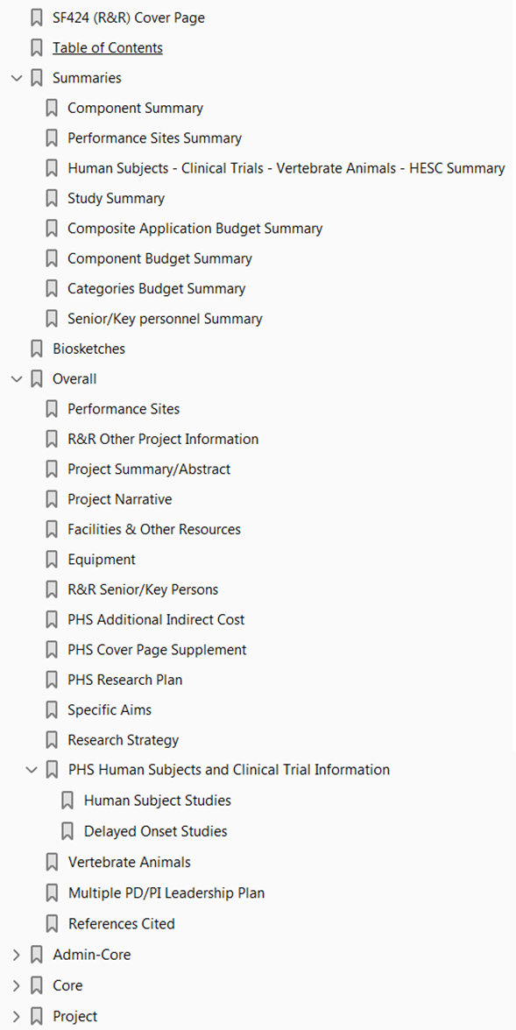
Multi-project Application Image Bookmarks
SF424 (R&R) from Overall component
System-generated summaries based on data in other components
Additional forms from Overall component
Remaining component types in alphabetical order (expandable)

Slide 14








Now Let’s Talk About the Application Process
Step 1: Find
Step 2: Plan
Step 3: Initiate
Step 4: Build team
Step 5: Enter data
Step 6: Finalize
Step 7: Submit
Step 8: Track

Slide 15

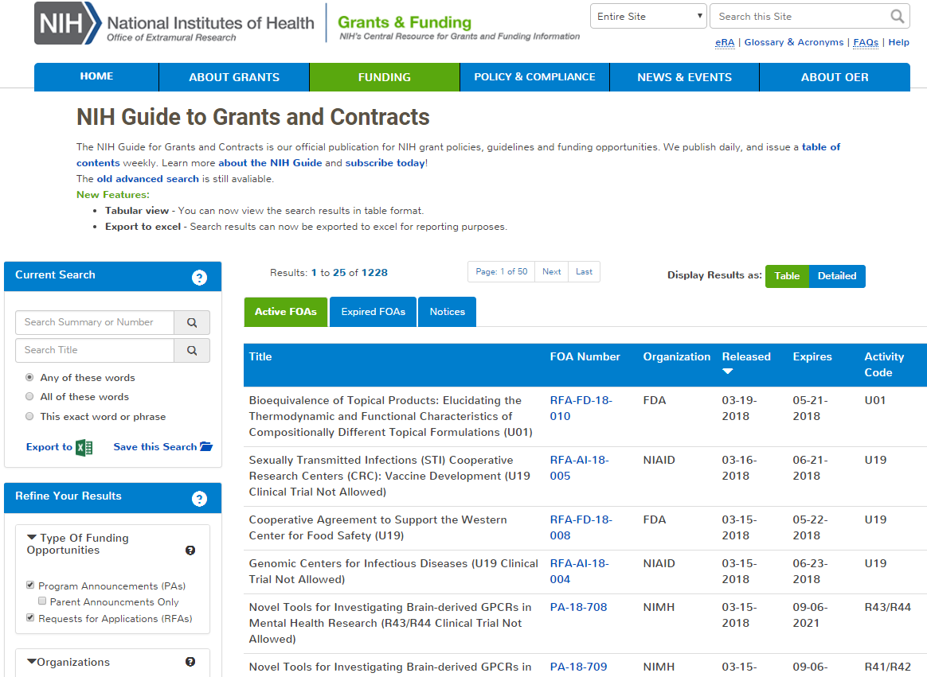
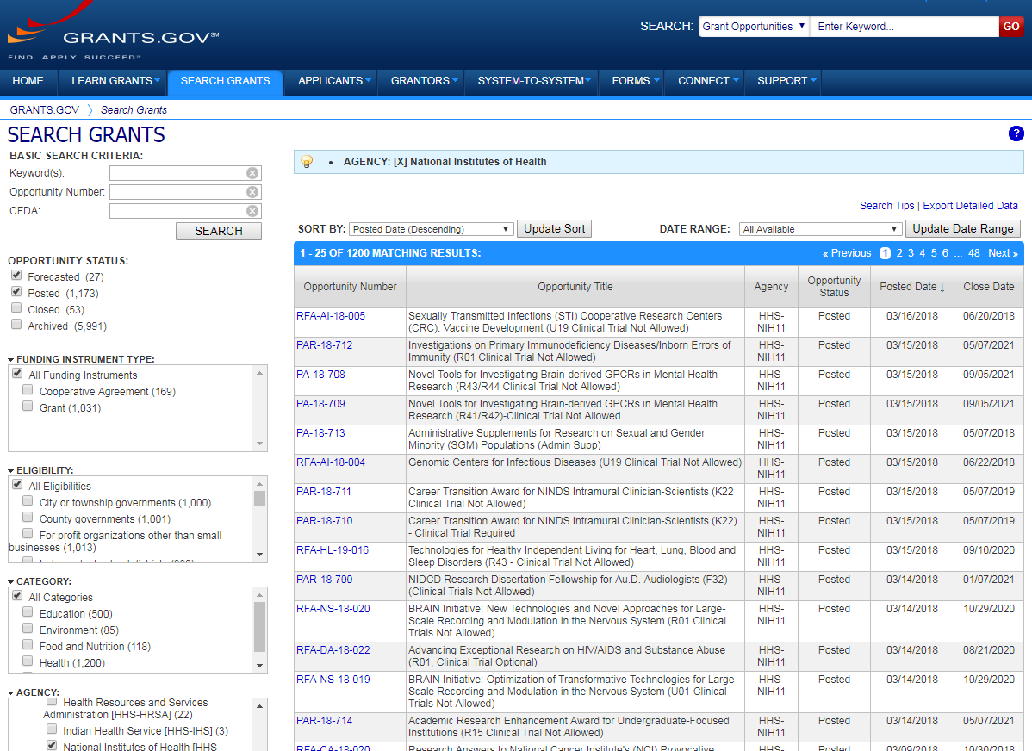
Step 1: Find an Opportunity of Interest
NIH Guide for Grants & Contracts
Grants.gov Search Grants
Each system has robust search capabilities.

Slide 16
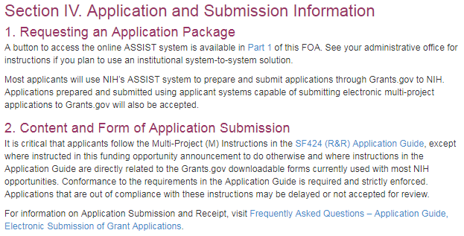
Multi-project FOAs
Section IV. Application and Submission Information of NIH FOAs includes important guidance for preparing your application
SF424 (R&R) Application Guide provides general instructions for completing application forms

Slide 17
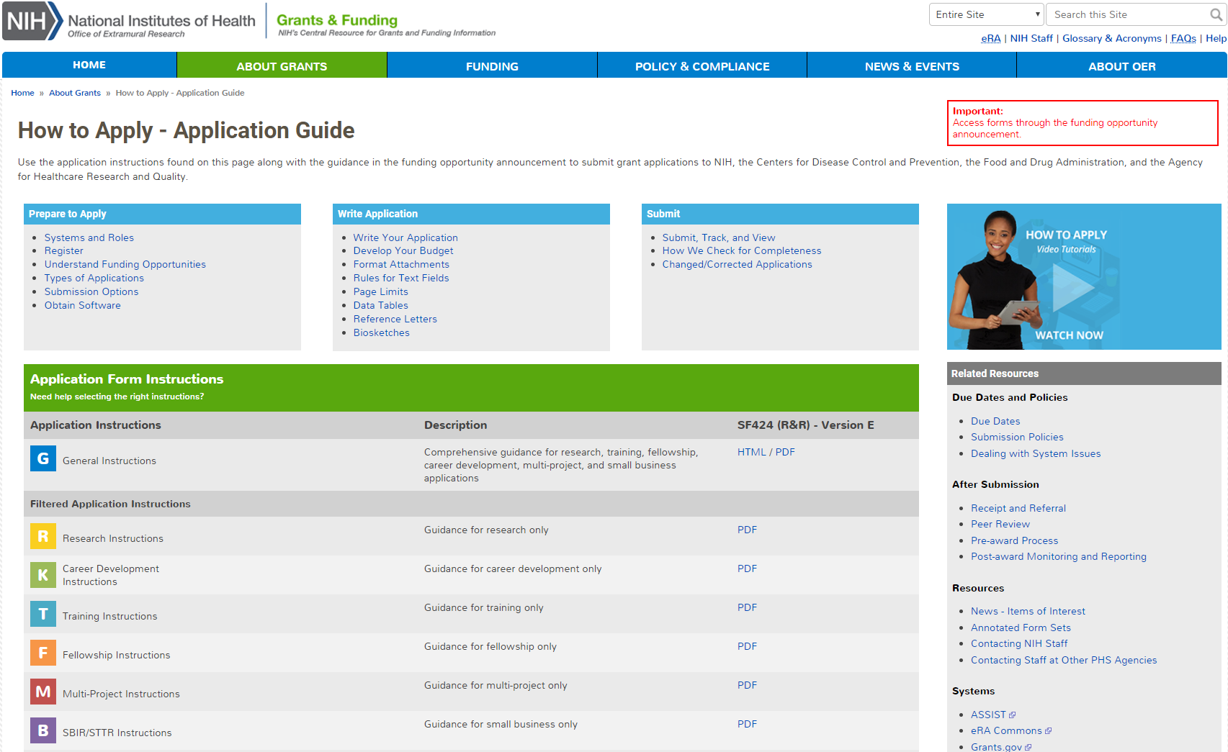
How to Apply – Application Guide
Multi-project filtered view of General Instructions

Slide 18
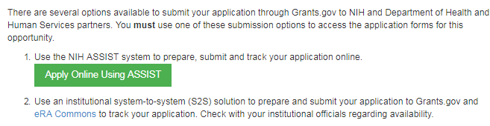
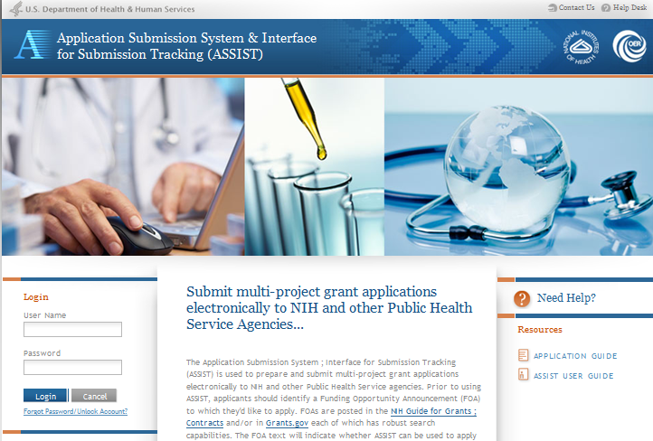
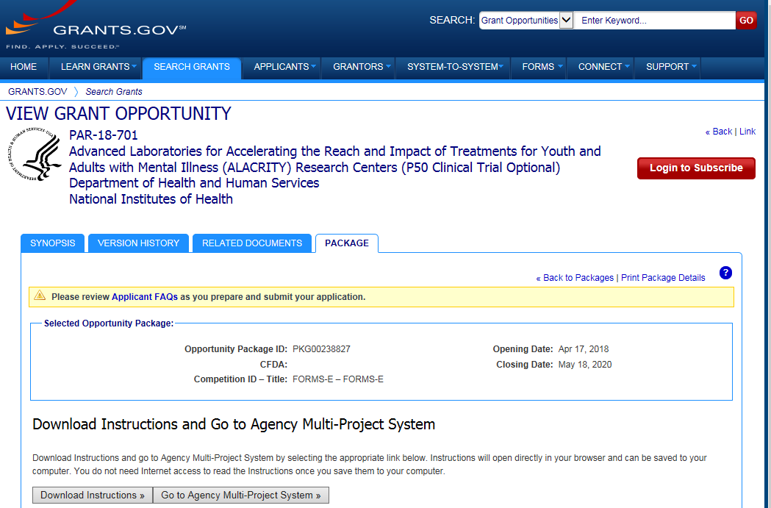
FOAs Link You to ASSIST
NIH Guide for Grants & Contracts
Grants.gov

Slide 19


Step 2: Plan for Your Submission
Ensure all registrations are in place
  All standard requirements apply (DUNS, SAM, Grants.gov, eRA Commons)
    http://grants.nih.gov/grants/how-to-apply-application-guide/prepare-to-apply-and-register/registration.htm
    Decide how to distribute work
  Gather the Commons IDs for everyone who will be working in ASSIST
Carefully read the funding opportunity announcement
  Note allowable types of required/optional components and
  special instructions
  Define the layout of your application (e.g., define components
  and who will lead each)

Slide 20
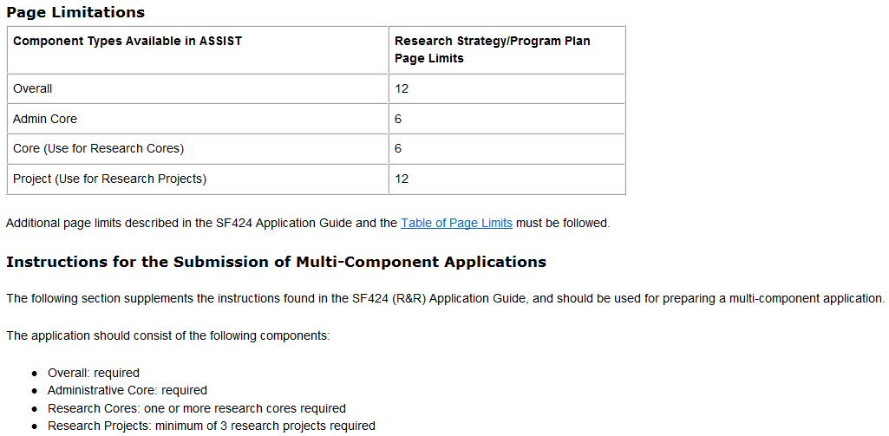
FOA Text – Section IV
Component Types
Research Strategy page limit per component
Number of components for complete application

Slide 21
Sample Application Layout
Overall Component
PD/PIs: Cher D. Money, Ben A. Round
Organization: A
Project Title: Research Center to Cure the Diseases of the World
Component Type: Admin Core
Component Type: Core
Component Type: Project
Admin Core-001
Core-001
Project-001
Project Title: Administrative Core
Project Lead: Jed I. Knight
Organization: A
Project Title: Research Core 1
Project Lead: Ben A. Round
Organization: A
Project Title: Fabulous Research Focus 1
Project Lead: Cher D. Money
Organization: A
Subaward Budget
Project-002
Organization: D
Project Title: Fabulous Research Focus 2
Project Lead: Quin T. Sential
Organization: B
Core-002
Project Title: Research Core 2
Project Lead: Abel Tu Lead
Organization: B
Project-003
Project Title: Fabulous Research Focus 3
Project Lead: Ima Doer
Organization: C
Subaward Budget
Organization: A

Slide 22



Step 3: Initiate Application
Create an application shell by initiating the application and adding the components
  Components can be rearranged, added, deleted or abandoned at any time
    Can rearrange components of the same type (e.g., have the third project entered in ASSIST appear first in the assembled application image)
    Can NOT control the order in which the component types appear
    (e.g., Cores will always be before Projects)

Slide 23

Login to ASSIST
Use your
eRA Commons credentials to access ASSIST
https://public.era.nih.gov/assist

Slide 24
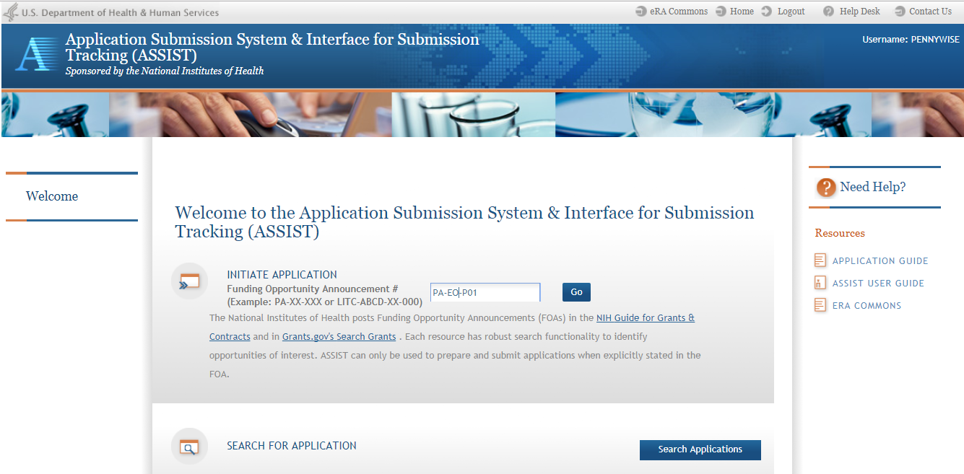
Initiate Application
Enter your FOA number and hit Go

Slide 25
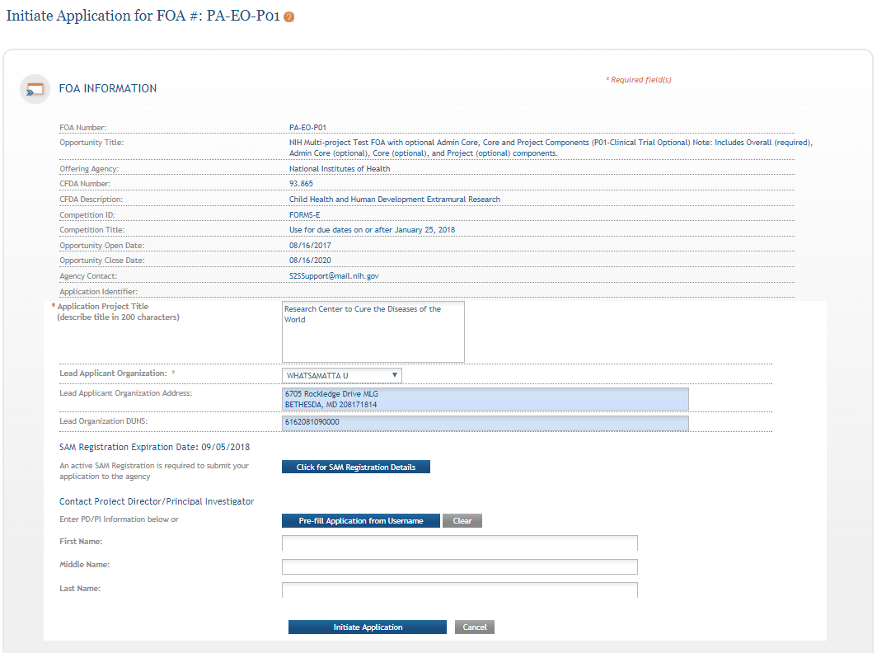
Initiate Screen
FOA information pulled from Grants.gov
Enter Project Title
Drop-down list of organizations affiliated with your eRA Commons account
Data pre-populated from organization selection

Slide 26
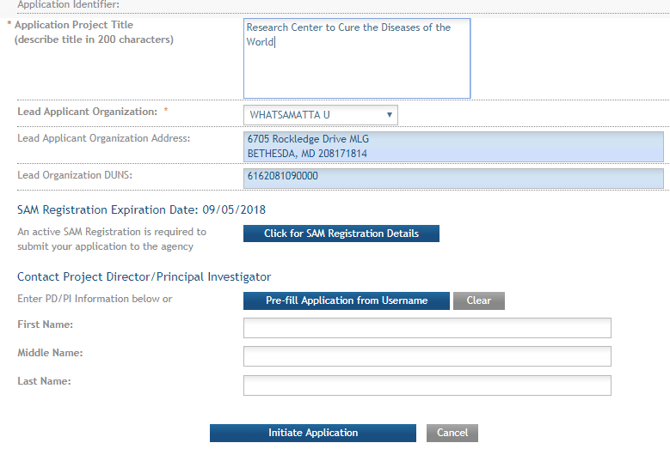
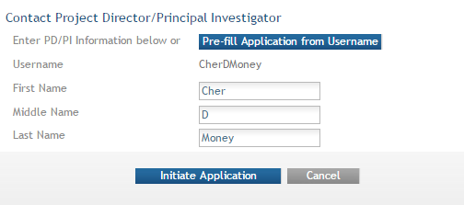
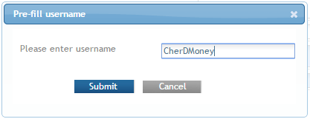
Initiate: Pre-population
Visibility to SAM registration expiration date & details
Can manually enter PD/PI information or provide
eRA Commons username to auto-populate

Slide 27
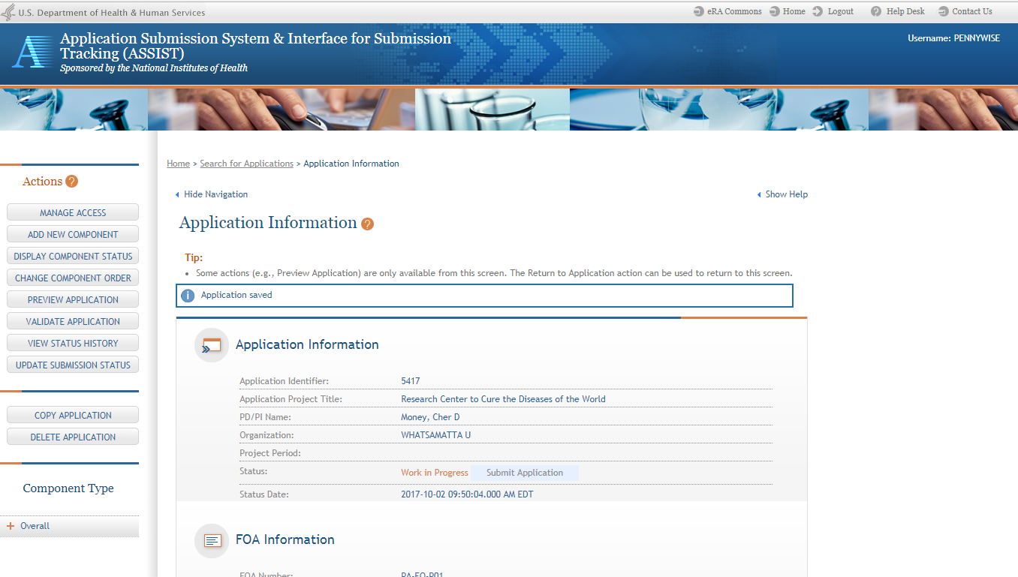
Using ASSIST
Breadcrumb navigation
Access on-line help
Screen tips
ASSIST messages
Available actions vary based on application context and access

Slide 28
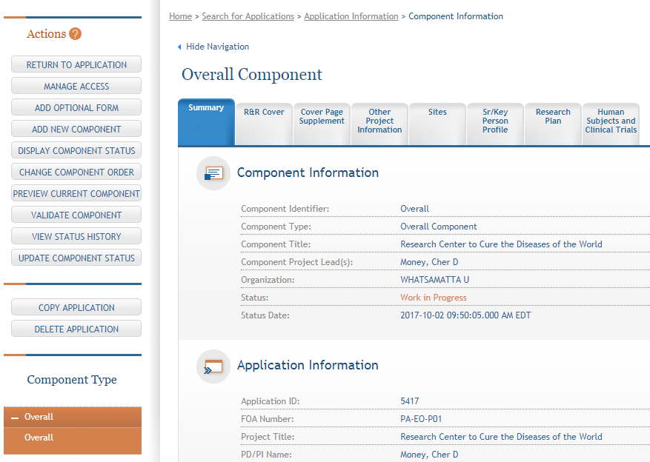
Overall Component
Form navigation for the selected component.
The Overall Component is added to the component navigation.

Slide 29
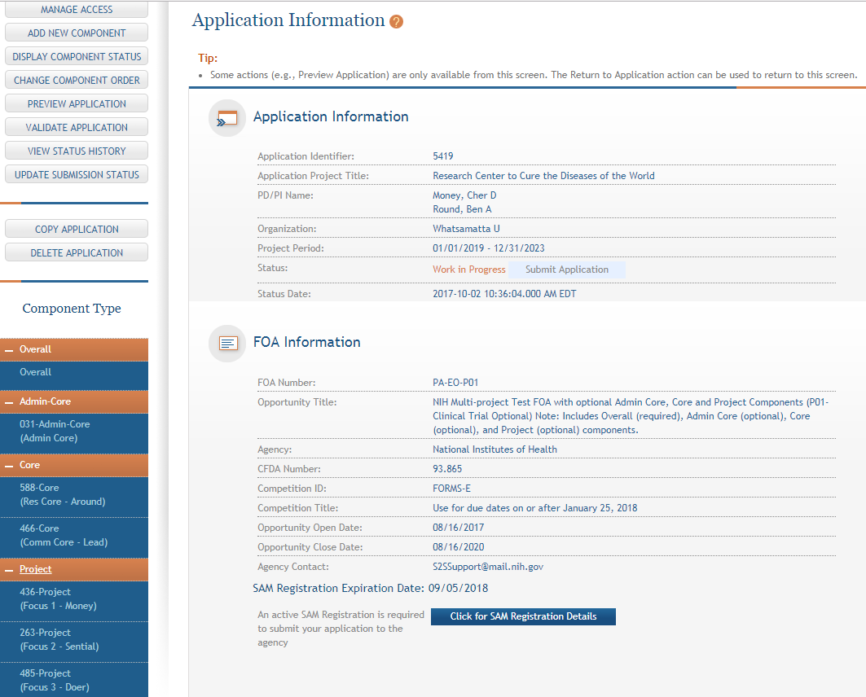
Adding Components
Continue adding components to build out the application shell.

Slide 30


Step 4: Build Your Team
Provide application access to appropriate team members
  ASSIST automatically provides access for some users:
    Based on eRA Commons roles
      All SOs and AOs at the applicant institution have irrevocable edit access for the entire application
      All SOs and AOs at an organization leading a component
      have irrevocable edit access for their component once their DUNS number is provided
    Based on role on the application
      The application initiator has edit access for the entire application
      All PD/PIs listed in the Overall component have edit access for the entire
      application once their eRA Commons usernames are provided
      The component Project Leads have edit access for their components once
      their eRA Commons usernames are provided

Slide 31

Manage Access
Provides ability to give anyone with a valid eRA Commons account access to an application
Automatically available to users with
  Signing Official (SO) role on eRA Commons account
  ASSIST_ACCESS_MAINTAINER_ROLE role on eRA Commons account
Available on application-by-application basis to
  ASSIST user who has been given the Access Maintainer
  role by an SO via the Manage Access action

Slide 32

Access Control
Application access can be controlled across these variables:
  Entire application vs. specific components
  View vs. Edit
  Budget vs. Non-budget data

Slide 33

Signing Officials (SOs)
SOs at the applicant institution can
  Manage application access for other users
  Manage application status all the way to Ready for Submission status
  Delegate Access Maintainer and Status
  Maintainer authority to other users within their
  institution
  Access the Submit action

Slide 34
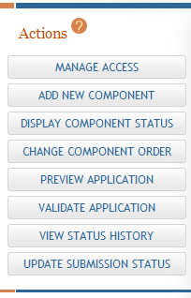
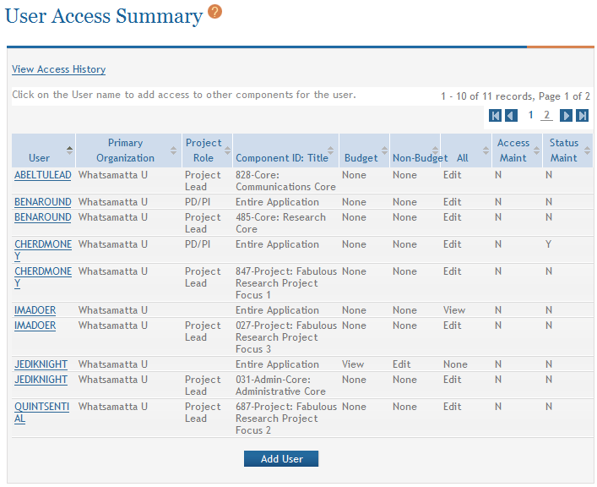
Manage Access Screen
The Manage Access action can be used to provide access to additional users or modify access for existing users.
Modify access for existing user.
Give access to additional users.

Slide 35
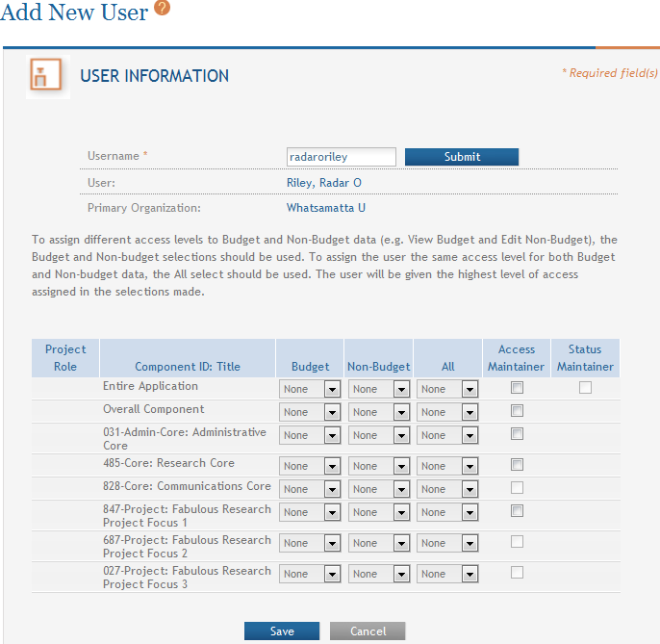
Add User
Provide Commons Username.
Allows user to control who has access to this application.
Allows user to control status changes for this application.
Change View/Edit/None access for the application or components.

Slide 36


Step 5: Enter Data
Overall
  Describe the entire application
  Always completed with applicant organization information
All Other Components
  Reflect the activity in the specific component
  Completed from the perspective of organization leading the component

Slide 37
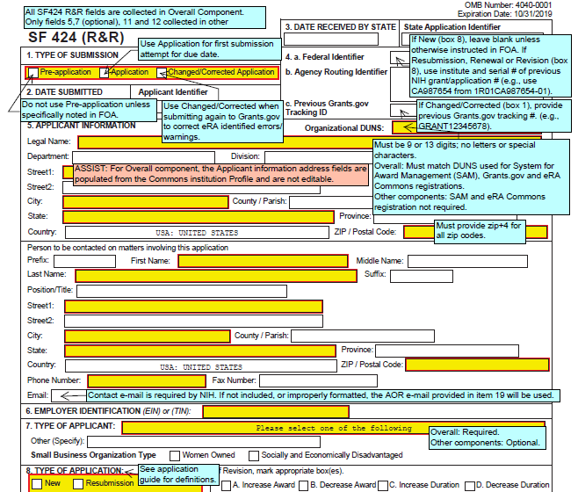
Guidance
Follow All Guidance
Handy Resource
Notices in NIH Guide for Grants & Contracts
Funding Opportunity Announcement
  Section IV. Application and Submission Information
How to Apply - Application Guide
Annotated form sets
Precedence / Importance
https://grants.nih.gov/grants/how-to-apply-application-guide.html

Slide 38
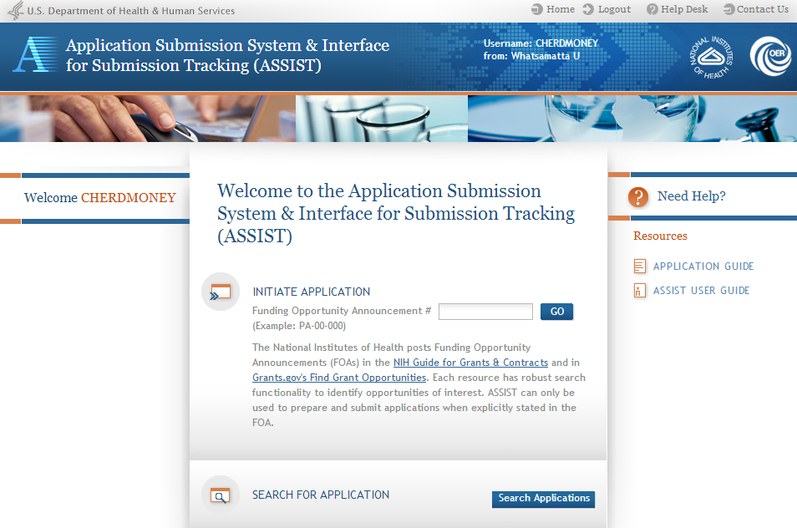
Searching for In-progress Applications
Use Search Applications to access your in progress application.

Slide 39
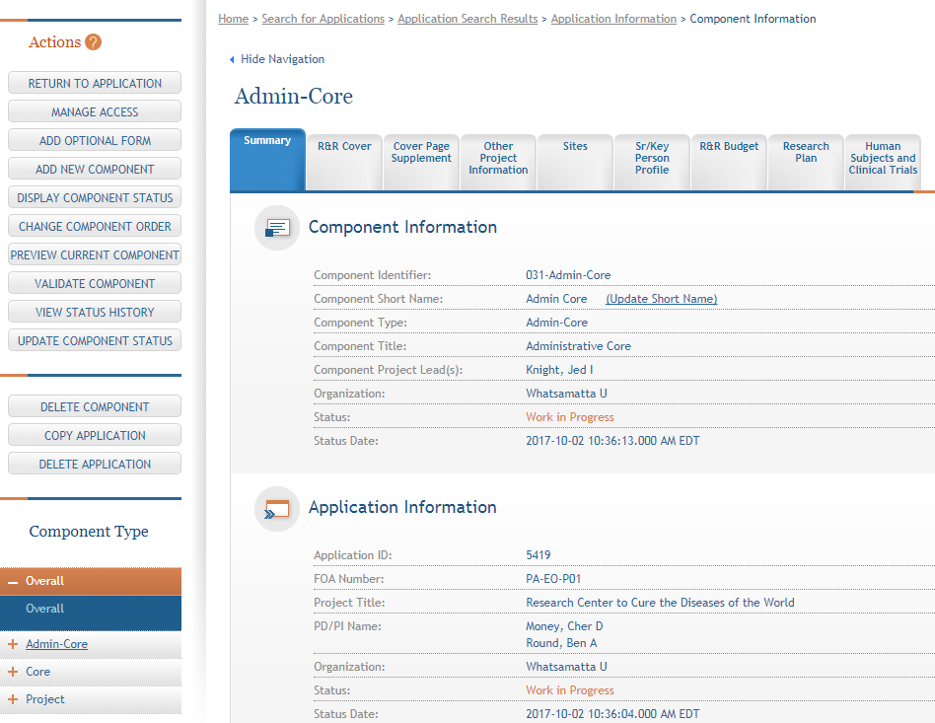
Navigating to a Specific Component
Use the component navigation to identify the component you want to work on.

Slide 40
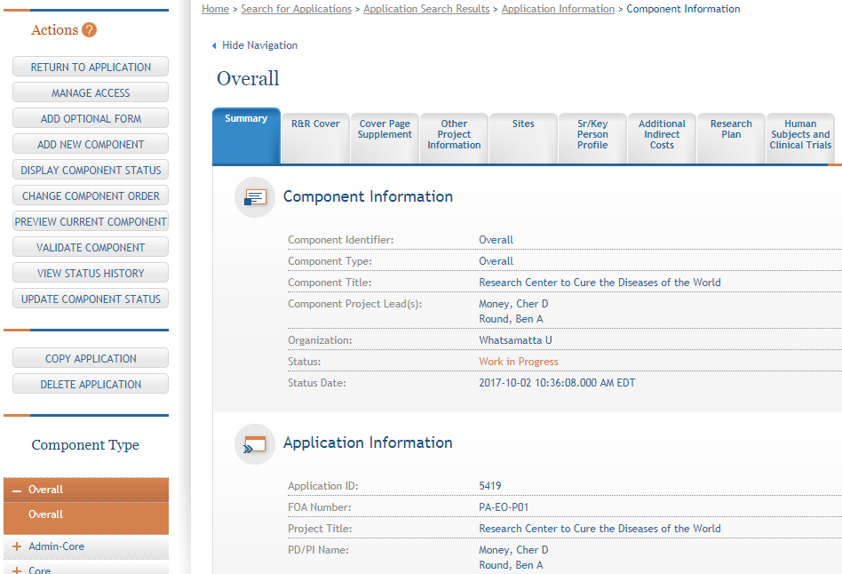
Summary Page
Every component has a Summary page.
Some actions are only available from the Summary page.

Slide 41
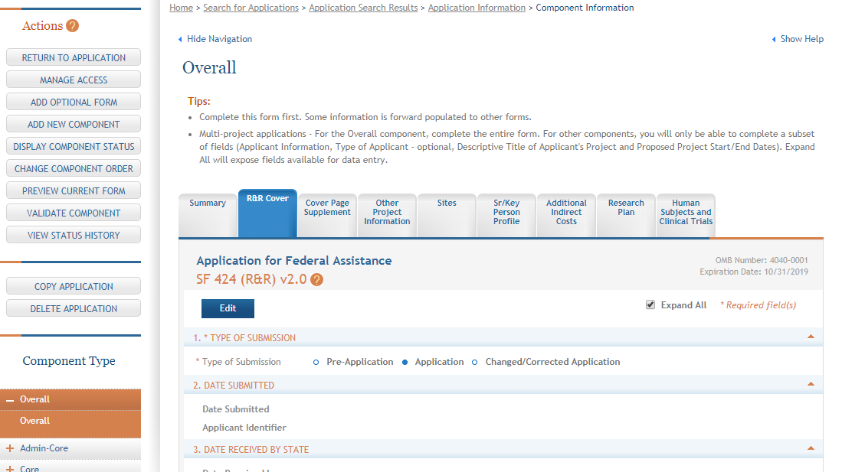
Entering Application Data
Click each tab to access form data entry screens.
Clicking Edit locks form and blocks other users from editing form.

Slide 42
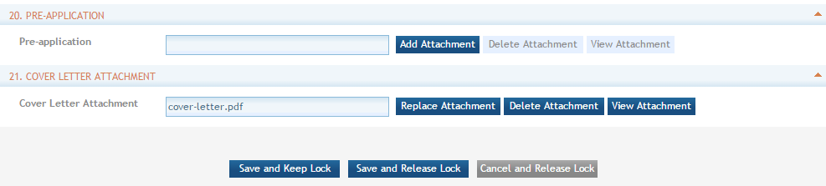
Saving Entered Data
Saves entered data and keeps other users from editing form until you release the lock.
Saves entered data and releases the lock to allow others to edit the form.

Slide 43
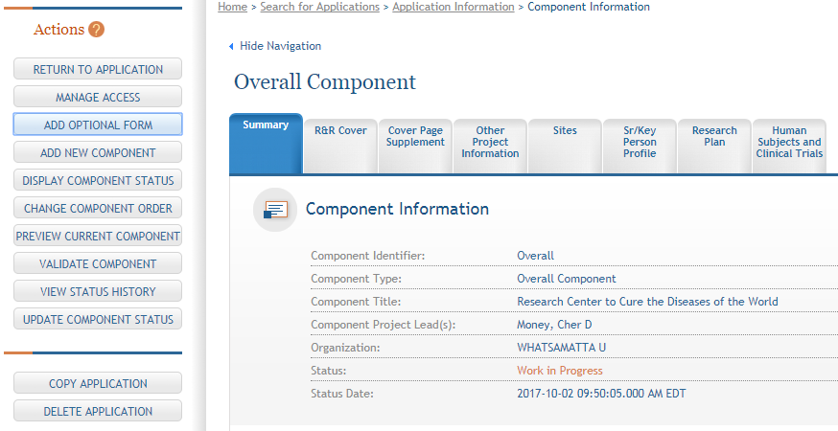
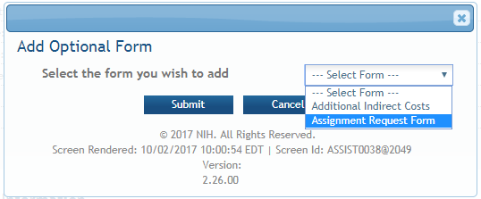
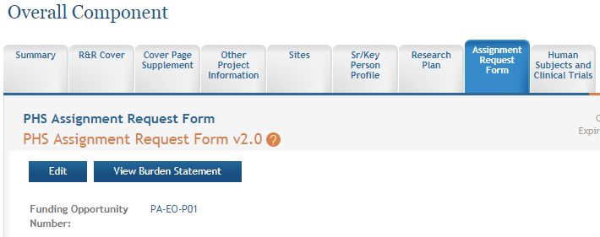
Adding Optional Forms
Add Optional Form.
Select form and click Submit.
Form added to navigation.

Slide 44
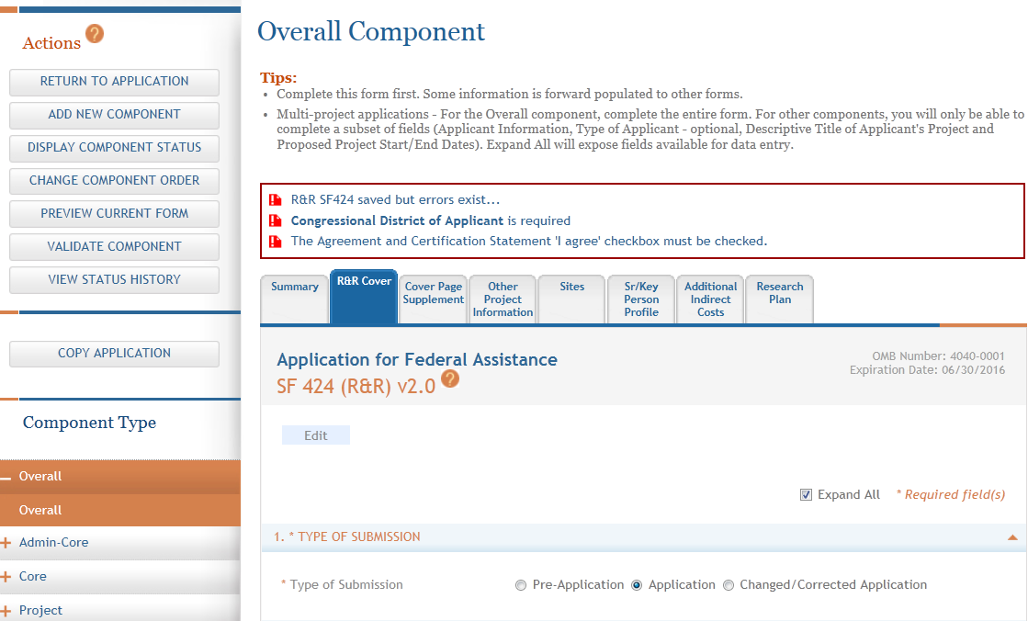
Data Entry Validations
ASSIST checks entered data and provides errors at the top of the screen when you Save. This is a data entry level check (format, field marked required is completed) –
does not check business rules.

Slide 45

Providing Human Subjects Information
If you answer Yes to the Human Subjects Involved question on the R&R Other Project Information form, then your application must include at least one full or delayed onset study record
If submitting to a Clinical Trials Required announcement,
you must include at least one clinical trial study record
within the application
  Full study record with all Clinical Trial questionnaire
  questions = Yes and/or delayed onset study record with
  Anticipated Clinical Trial box checked

Slide 46
Scenario: Studies self-contained in components
No study record needed in Overall for this scenario.
Overall Component
PD/PIs: Cher D. Money, Ben A. Round
Organization: A
Project Title: Research Center to Cure the Diseases of the World
Other Project Info - HS=Yes
We enforce that if any component has HS=Yes, then HS=Yes in Overall component.
Component Type: Admin Core
Component Type: Core
Component Type: Project
Admin Core-001
Core-001
Project-001
Project Title: Research Core 1
Project Lead: Ben A. Round
Organization: A
HS=No
Project Title: Fabulous Research Focus 1
Project Lead: Cher D. Money
Organization: A
HS=Yes
HS/CT form
Project Title: Administrative Core
Project Lead: Jed I. Knight
Organization: A
HS=No
In each (non-Overall) component where HS = Yes, at least one study record is required
Project-001, Study 1 -
CT = Yes
Complete Sections 1, 2, 3, 4, 5
Full, detailed study records.
Subaward Budget
Project-002
HS/CT form
Organization: D
Project Title: Fabulous Research Focus 2
Project Lead: Quin T. Sential
Organization: B
HS=Yes
Project-002, Study 1 -
CT = No
Must complete Sections 1, 2, 3;
4 & 5 blocked via validations
Core-002
HS = Human Subjects
CT = Clinical Trials
CT = Yes when all clinical trial questionnaire questions are answered Yes and FOA allows CTs.
Project Title: Research Core 2
Project Lead: Abel Tu Lead
Organization: B
HS=No
Project-003
HS/CT form
Study can be delayed onset.
Project Title: Fabulous Research Focus 3
Project Lead: Ima Doer
Organization: C
HS=Yes
Project-003, Study 1 –
Delayed Onset Study
Indicate whether CT is anticipated; attach justification;
no other info needed
Subaward Budget
Organization: A

Slide 47
Scenario: Multiple components using same protocol/study
Overall Component
Include details of study in overall. Use Other Requested Information attachment to reference components that share the study.
PD/PIs: Cher D. Money, Ben A. Round
Organization: A
Project Title: Research Center to Cure the Diseases of the World
Other Project Info - HS=Yes
Component Type: Admin Core
Component Type: Core
Component Type: Project
Both projects working on same study. Each project uses Other Requested Information attachment to refer to study in Overall. No other details needed here.
Admin Core-001
Core-001
Project-001
HS/CT form
Project Title: Administrative Core
Project Lead: Jed I. Knight
Organization: A
HS=No
Project Title: Research Core 1
Project Lead: Ben A. Round
Organization: A
HS=No
Project Title: Fabulous Research Focus 1
Project Lead: Cher D. Money
Organization: A
HS=Yes
Shared study record
Use Other Requested Info attachment to refer to CT study in overall
Subaward Budget
Project-002
HS/CT form
Organization: D
Project Title: Fabulous Research Focus 2
Project Lead: Quin T. Sential
Organization: B
HS=Yes
Shared study record
Use Other Requested Info attachment to refer to CT study in overall
Core-002
Project Title: Research Core 2
Project Lead: Abel Tu Lead
Organization: B
HS=No
Project-003
HS = Human Subjects
CT = Clinical Trials
Project Title: Fabulous Research Focus 3
Project Lead: Ima Doer
Organization: C
HS=No
Subaward Budget
Organization: A

Slide 48
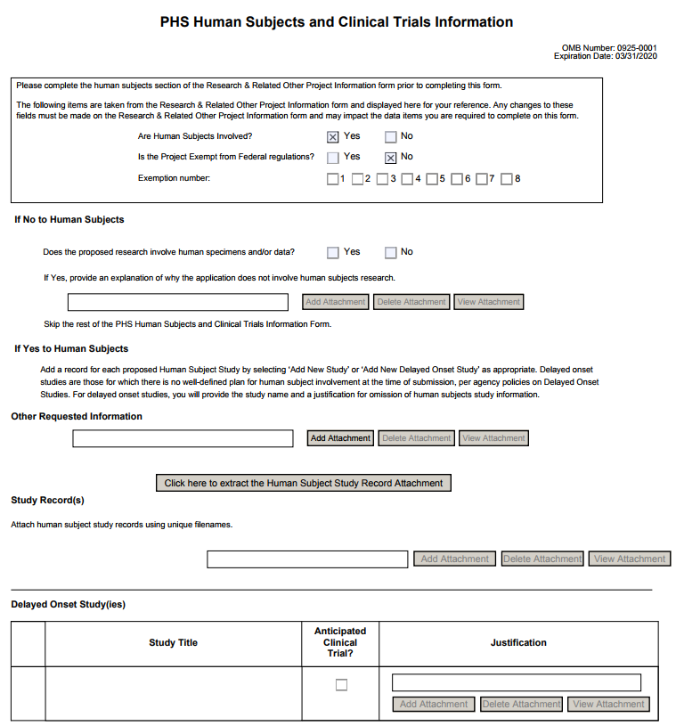
PHS Human Subjects and Clinical Trials Form
Other Requested Information attachment
Full Study Record
Delayed Onset Study

Slide 49

Text Fields
Text fields support plain text with limited manual formatting
  To format paragraphs, include a blank line between paragraphs
  To format bulleted lists, start each list item on a new line with a "list item" character, such as a hyphen (-) or an asterisk (*), followed by a space and then the item text
Much of your original formatting (font, bolding, bullets, subscript, superscript) will be lost when you cut and paste
  Take advantage of application preview features if your submission method supports them
Check application form instructions for character limits
  Spaces and punctuation count against the limit
https://grants.nih.gov/grants/how-to-apply-application-guide/format-and-write/rules-for-text-fields.htm

Slide 50
Component Actions
As component data is entered several actions are available:
  Change Component Order
  Validate Component
  Preview Current Component
  Update Component Status
    Work In Progress – only status that allows editing
    Complete – component data entry is complete
    Final – component has been reviewed by applicant organization and incorporated into the application

Slide 51
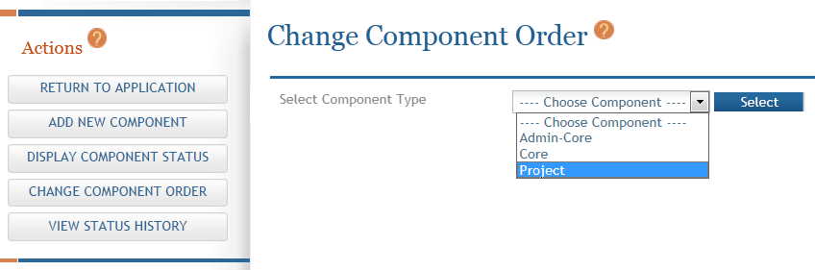
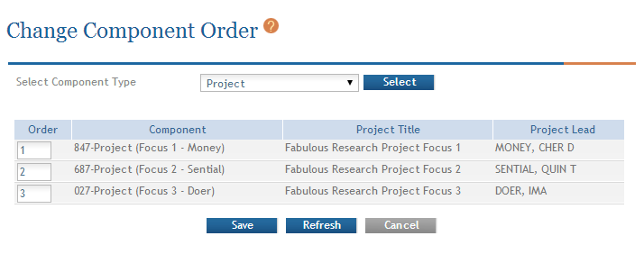
Change Component Order
Select Component Type to reorder.
Provide desired sequence.

Slide 52
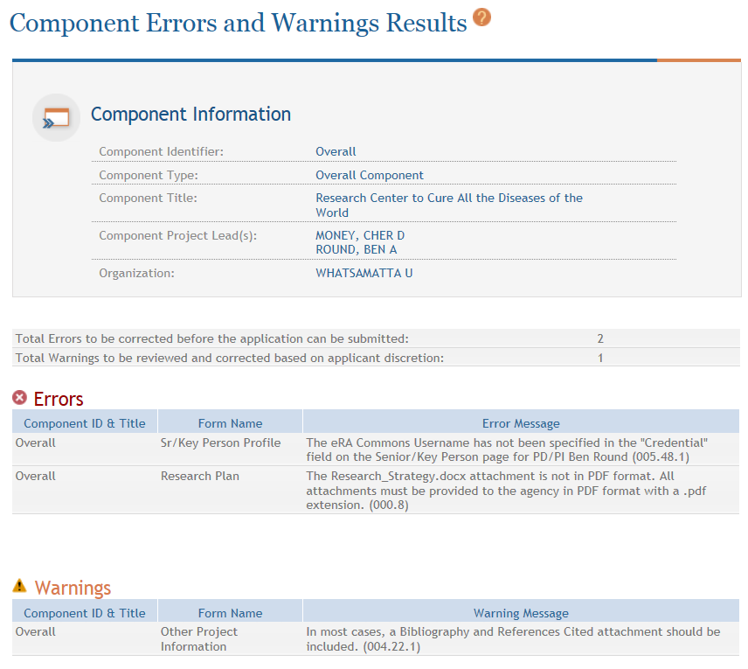
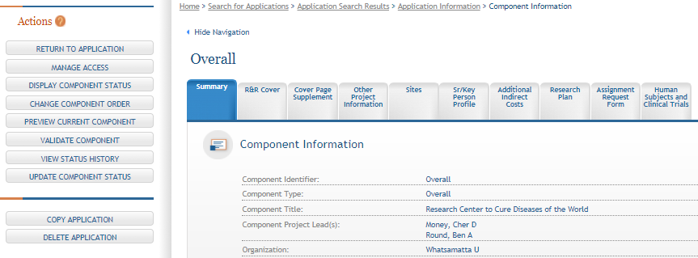
Validating a Component
Errors and Warnings are displayed.

Slide 53


Errors & Warnings
Errors are show-stoppers and must be corrected before you can submit in ASSIST
Warnings do not stop application submission or processing and are corrected at your discretion based
on your circumstances

Slide 54
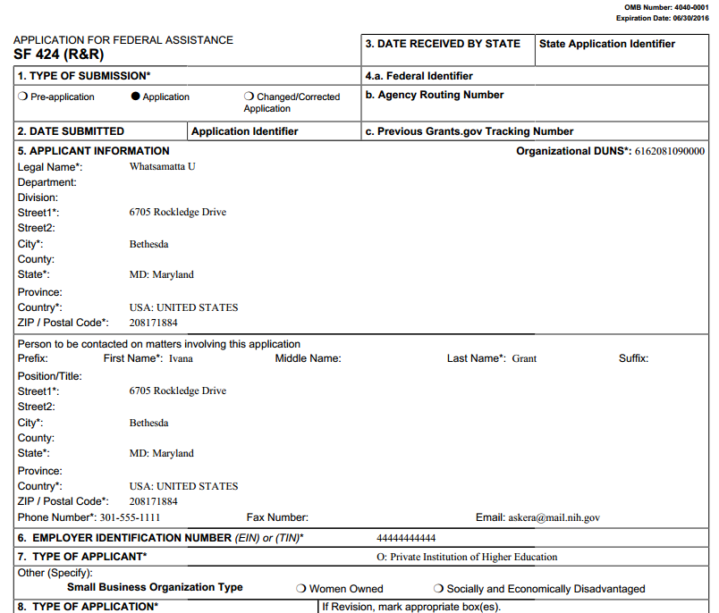
Previewing a Component
Component preview does not include bookmarks, Table of Contents, data summaries or biosketches.

Slide 55
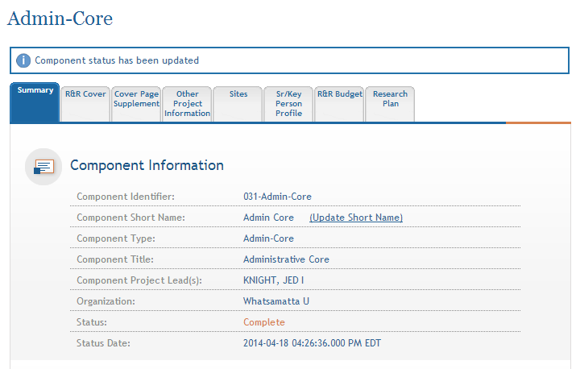
Updating Component Status to Complete
Select status and enter comment for Status History.
Status on Summary page is updated.
Once a component is marked ‘Complete’ no additional edits can be made unless someone with appropriate authority (i.e. AO, SO, Status Maintainer, or Initiator) returns the status to ‘Work in Progress’.

Slide 56

Step 6: Finalize Your Application
As components are marked ‘Complete’, the applicant organization can preview them and incorporate those that are ready into the final application by updating the component status to ‘Final’
  Applicant organization AOs, SOs, users with Status Maintainer authority and application initiators have option to mark a component ‘Final’ directly from ‘Work in Progress’
All components must be marked ‘Final’ before an application can be prepared for submission

Slide 57
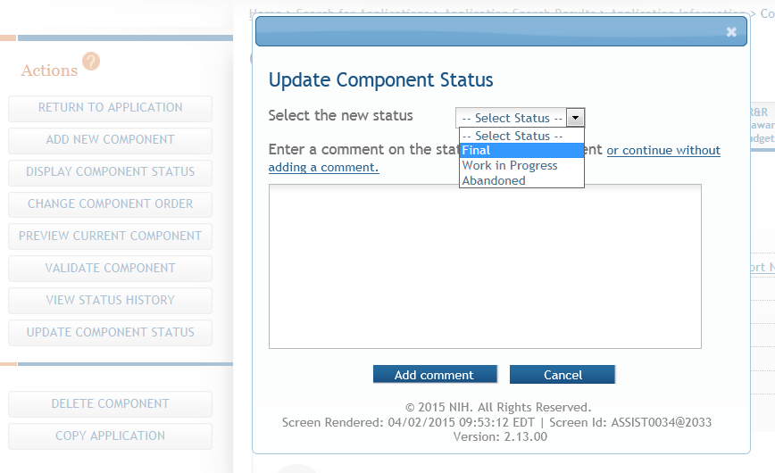
Setting Component Status to Final
Update the component status to Final once you are satisfied that the component is ready to be included in the final application.

Slide 58
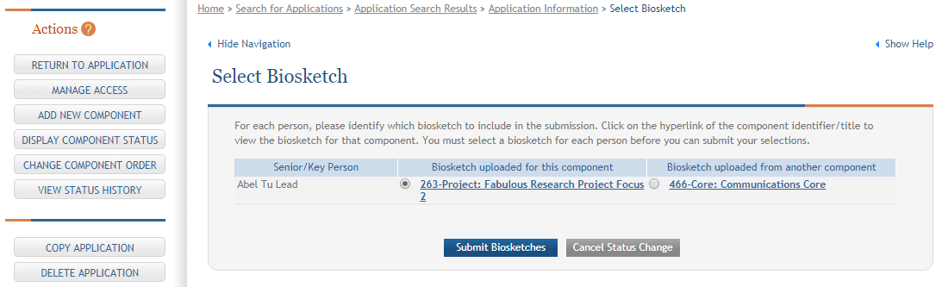
Reconciling Biosketches
ASSIST will check to ensure that only one biosketch is included for every Senior/Key person in the application.
If a biosketch is already included for any Sr/Key, you will have the option to view each biosketch and select the one you wish to keep.

Slide 59
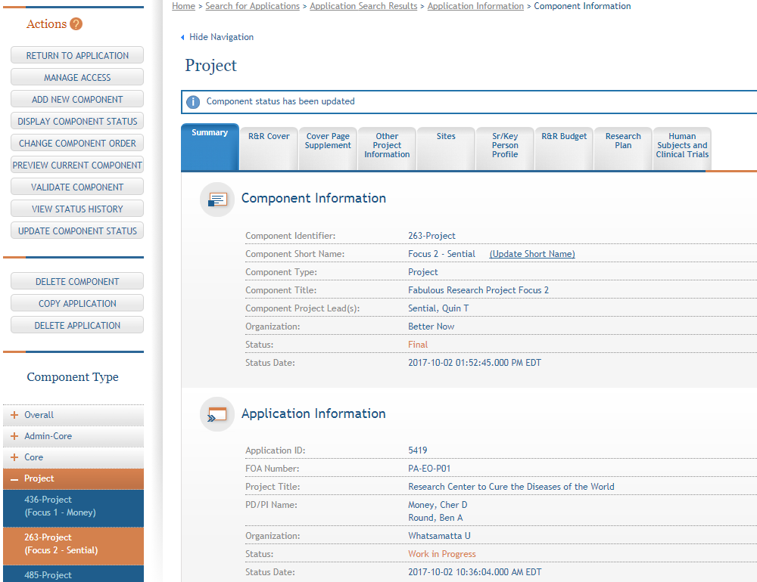
Final Component Status
  After all biosketch issues are reconciled, the component status is set to Final.

Slide 60
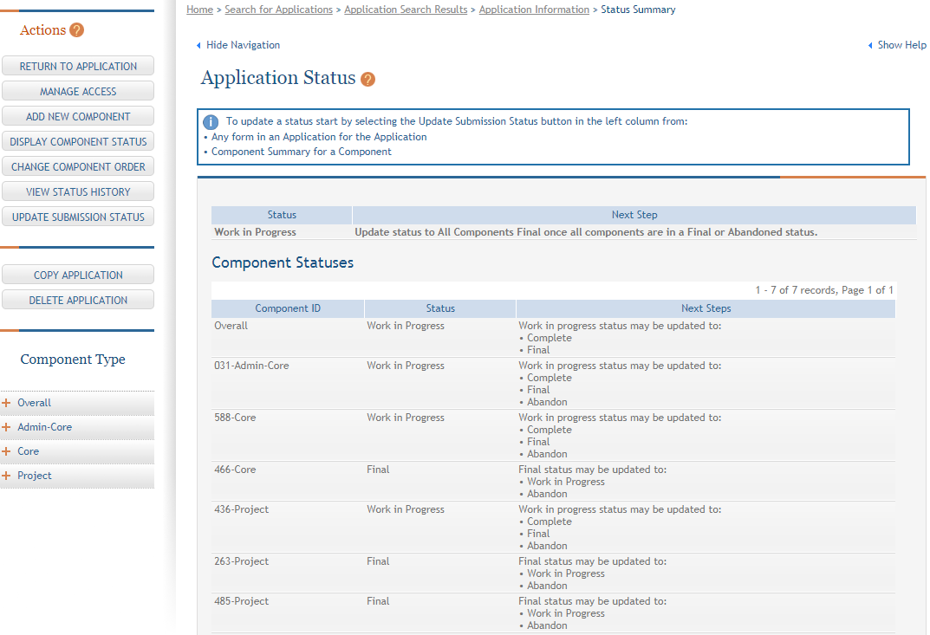
Display Component Status
Provides application and component-level status on a single screen.

Slide 61
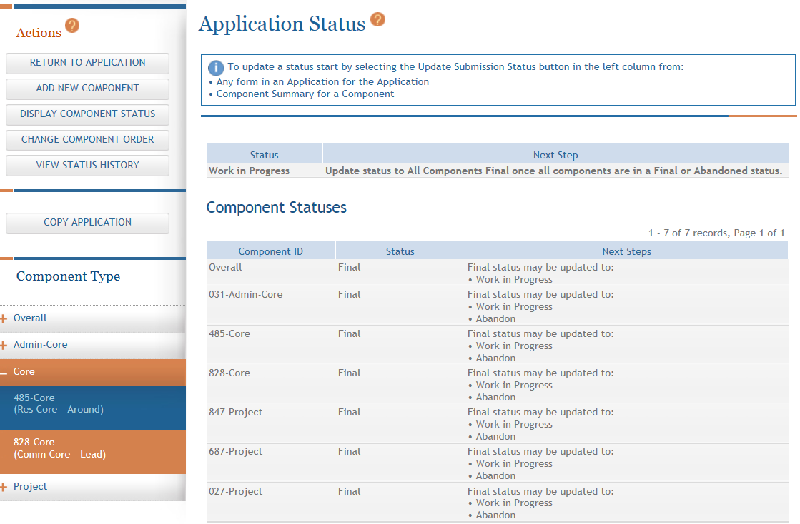
Updating Application Status
Although the Status is set to Final for each component, the Application Information still shows a Status of Work in Progress.

Slide 62

Submission Status Flow
Work In Progress – Allows editing
All Components Final – Can only be updated once each component status is Final
Ready for Submission – Before status is changed, the system does a final validation check on your application
Submitted – Automatically set after submitting to Grants.gov
Before changing your Submission Status, you may want to take another look at your application since you need to be in Work In Progress status to make any changes.

Slide 63
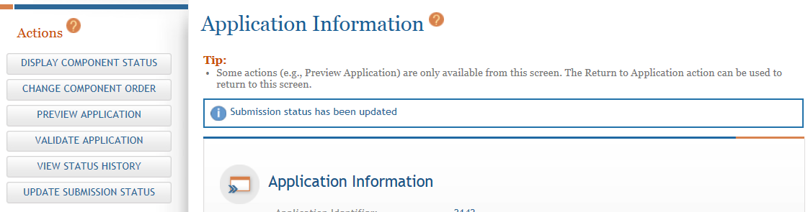
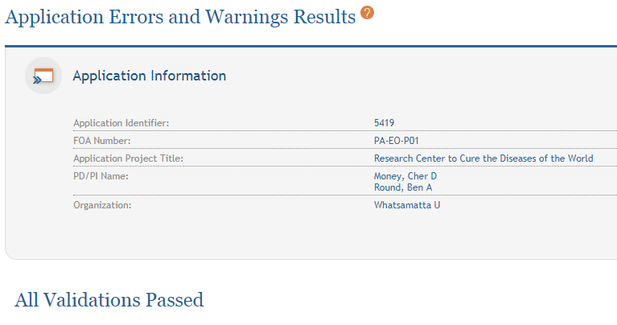
Validate Application

Slide 64
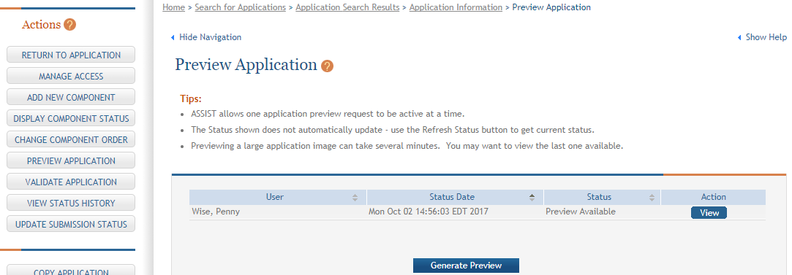
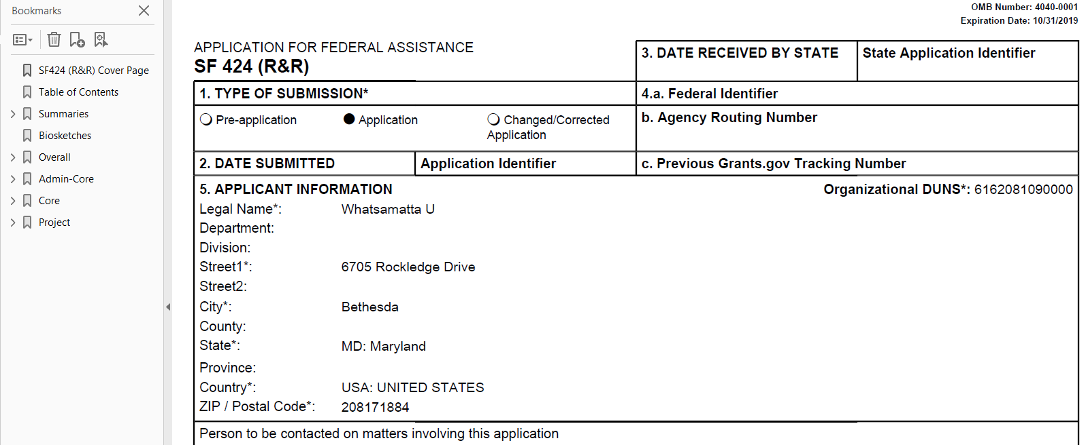
Preview Application
You can view the last preview or generate a new one.
The Preview Status does not automatically update. After you click Generate Preview a Refresh Status button is shown and must be used to get current status.
Application preview does not include Cover Letter, PHS Assignment Request Form or Appendices which are maintained separately post-submission.

Slide 65

How does it look?
If you like what you see, then it’s time to run through your internal approval process and take the final steps to prepare for submission.

Slide 66
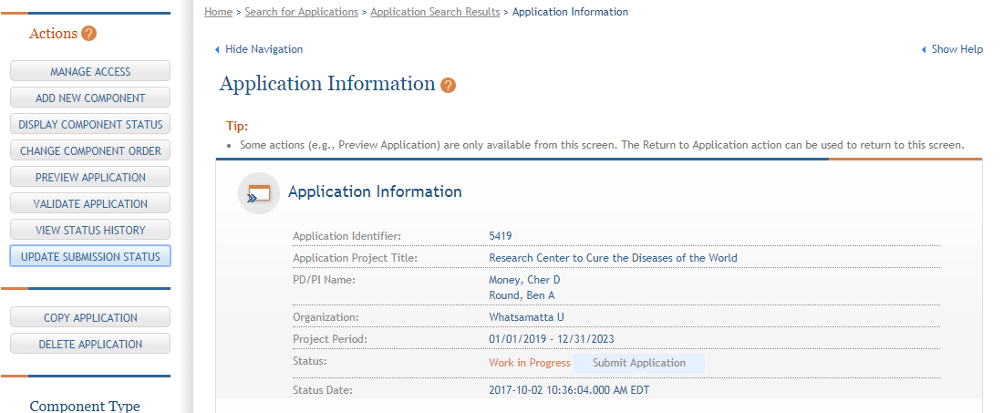
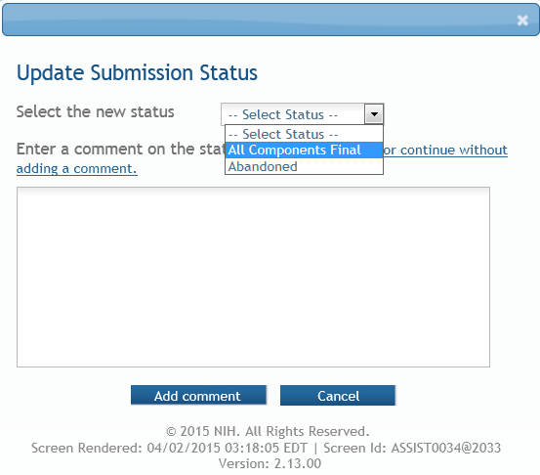
All Components Final
You can prepare your application for submission once the status for all individual components has been set to Final.
Set the application status to All Components Final.

Slide 67
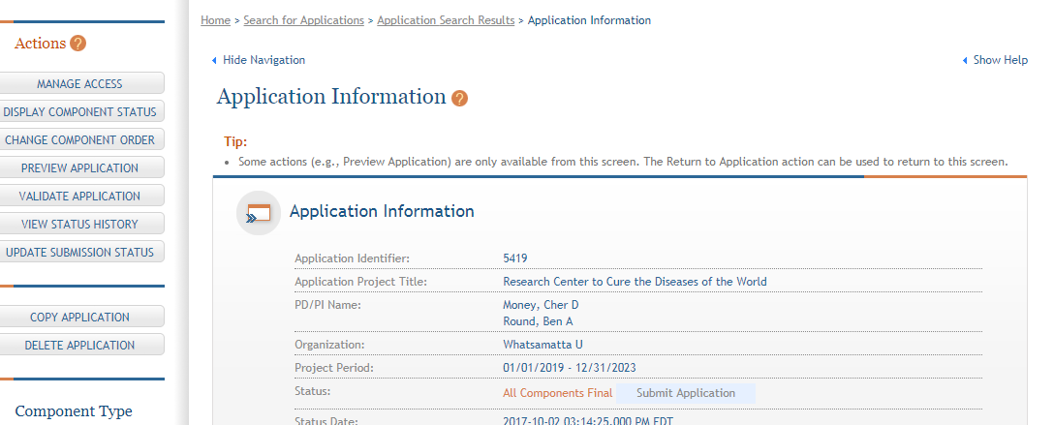
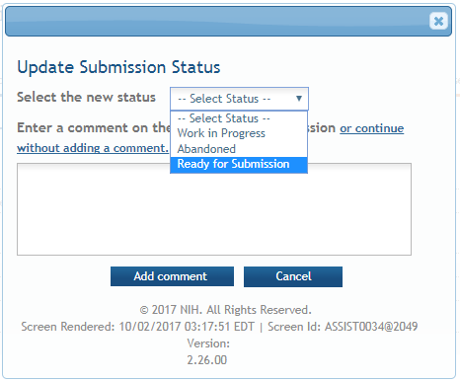
Ready for Submission
Once all internal reviews are complete, update the application status to Ready for Submission.

Slide 68


Final Check for Errors
Before an application is changed to Ready for Submission status, it must pass validations (Warnings are OK).

Slide 69



Step 7: Submit
Error-free submission must be made by 5:00 p.m. local time (of submitting organization) on due date
  It takes time to prepare your application for submission
  Submit early (days, not minutes) to have time to address any unforeseen issues and to view your assembled application
Of course this is 4:50 pm days before due date

Slide 70

Submit Application
Must be a Signing Official (SO) in eRA Commons and an Authorized Organizational Representative (AOR) in Grants.gov to submit.
Application Status must be set to Ready for Submission.

Slide 71

Providing Grants.gov Credentials
Applications are submitted from ASSIST to Grants.gov.
Enter your Grants.gov AOR credentials and click Enter.

Slide 72

ASSIST Screen After Submission
Message will appear indicating the application was sent to Grants.gov.
Submit Application button replaced with link to submission details.
Status changed to Submitted.

Slide 73


Step 8: Track Your Application
ASSIST provides the ability to track both Grants.gov and NIH status
  Links to the eRA Commons Detailed Status Information to view your assembled application
Authorized users can check eRA Commons Status for processing results
  Signing Officials (SOs)
  Administrative Officials (AOs)
  Principal Investigators (PIs)

Slide 74
View Submission Status Details
After submitting to Grants.gov, submission status can be tracked in ASSIST.
Click View Submission Status Details

Slide 75

View Submission Status Details Screen
Top of screen
Who can see this screen?
  Signing Officials (SOs)
  Administrative Officials (AOs)
  PD/PIs
  Application Initiator
  Anyone granted Edit All access via Manage Access Action
You must click Check for Status Updates to force ASSIST to poll Grants.gov and NIH for status.
Continue to update the status until Agency status is available.
ASSIST will indicate if a status change was detected.

Slide 76

ASSIST Provides Status for Multiple Systems
ASSIST, Grants.gov and Agency submission status are available.
Grants.gov status of Agency Tracking Number Assigned and Agency status of Processed is good news!
Agency Tracking # link brings you to the detailed status screen in eRA Commons.

Slide 77

Viewing Your Application in eRA Commons
Who can see this screen?
  Signing Officials (SOs)
  Administrative Officials (AOs)
  PD/PIs
eApplication is the assembled application image reviewers and staff will see - check it carefully.
You will also want to check the
  Component Appendices,
  PHS Assignment Request Form, and
  Cover Letter
which are stored separate from the image.

Slide 78

Application Viewing Window
Applicants have two (2) business days to view the assembled application image in eRA Commons before it automatically moves forward to NIH staff for further processing.
SO can Reject application within viewing window to prevent it
from moving forward to NIH staff
  Can submit a Changed/Corrected application before the submission deadline

Slide 79

If you can’t view it – we can’t review it!
It is your responsibility to carefully review the entire application within the viewing window to ensure it has been process correctly!

Slide 80


Component & Site Summaries

Slide 81


Human Subjects/Clinical Trials/Vertebrate Animals/HESC Summary & Study Summary

Slide 82

Composite Application Budget Summaries
The DUNS numbers on budget forms used to differentiate between applicant organization and subaward costs.

Slide 83


Component & Category Budget Summaries

Slide 84


Senior/Key Personnel Summary & Biosketches
Biosketches are listed in same order as Senior/Key Personnel Summary (i.e., Contact PD/PI, any additional PD/PIs, and other Sr/Key in alphabetical order.

Slide 85

Rejecting the Application
SO can Reject application in eRA Commons within viewing window and submit a Changed/Corrected application prior to the due date
  Action cannot be done within ASSIST

Slide 86

Submission Complete!
If no action is taken to reject the application during the two business day viewing window, the application automatically moves forward to NIH for further processing.

Slide 87

Dealing with System Issues
Follow NIH’s standard ‘system issue’ procedure if you run into problems beyond your control that threaten your on-time submission
  http://grants.nih.gov/grants/ElectronicReceipt/support.htm#guidelines

Slide 88

Making a Copy of Your Application
You can easily make a copy of your application to:
  Work on a Resubmission application
  Move data to a different opportunity
  Move data to a different version of forms during a form update (e.g., FORMS-D to FORMS-E)
  Take a snapshot, before heading in a different direction

Slide 89


Copy Application
Provide target FOA number.
Select target component type for each component.
Check box if you want to copy attachments.

Slide 90

Copy Tips
The copy application feature does a best-effort match
  Carefully review all forms to ensure completeness
Some form clean-up may be needed after the copy
  If you see unexpected “Form is incomplete” messages when you validate your new application, Edit and Save the identified form (don’t need to make any edits) to see if the error clears

Slide 91

Resources

Slide 92

eRA Service Desk
Web: http://grants.nih.gov/support/
Toll-free: 1-866-504-9552
Phone: 301-402-7469
Hours: Mon-Fri, 7a.m. to 8 p.m. Eastern Time (Except for Federal holidays)
Resources: https://era.nih.gov/modules_user-guides_documentation.cfm
ASSIST is a system developed and managed by NIH.
The eRA Service Desk should be your first stop for support.

Slide 93

Links & Resources
ASSIST: public.era.nih.gov/assist
Online help: era.nih.gov/erahelp/ASSIST/
How to Apply – Application Guide
http://grants.nih.gov/grants/how-to-apply-application-guide.htm
Annotated form set
https://grants.nih.gov/grants/how-to-apply-application-guide/resources/annotated-form-sets.htm
Preparing Your Application Using ASSIST https://grants.nih.gov/grants/how-to-apply-application-guide/prepare-to-apply-and-register/submission-options/assist.htm

Slide 94

Questions?

