Slide 1



Interacting Electronically with NIH
Post-submission Processing
May 2018
electronic Research Administration (eRA)
OER, OD, National Institutes of Health

Slide 2
Your Workshop Team
Scarlett Gibb
  eRA Customer Relationship Manager, eRA Commons
Anastasiya Hardison
  eRA Customer Relationship Manager, xTRACT, xTrain
Joe Schumaker
  eRA Communications and Outreach

Slide 3
eRA Commons Status
What is era Commons?
Scarlett

Slide 4
What is eRA Commons?
The eRA Commons is an online interface where grant applicants, grantees and federal staff can access and share administrative information related to grant applications and awarded research grants.
Applications
eSubmission Errors/Warnings
Assurances
Assembled Application Image
Certifications
Review Assignment
Profile Data
Priority Score
Progress Reports
Summary Statement
Financial Reports
Notice of Award
Invention Reports
Training Tables
Post-award Correspondence
Training Appointment Actions
HSCT Data/Integration
ORCID ID

Slide 5
What’s New in eRA Commons
Personal Profile
Scarlett

Slide 6



Personal Profile (PPF)
Individual Commons users are responsible for keeping their profile information accurate
Includes information such as:
  Name
  Demographics
  Employment history
  Education
  Reference Letters
  Publications
Very few staff members at NIH have access to change information (for emergencies only)
Central repository for individual user information
Joe

Slide 7
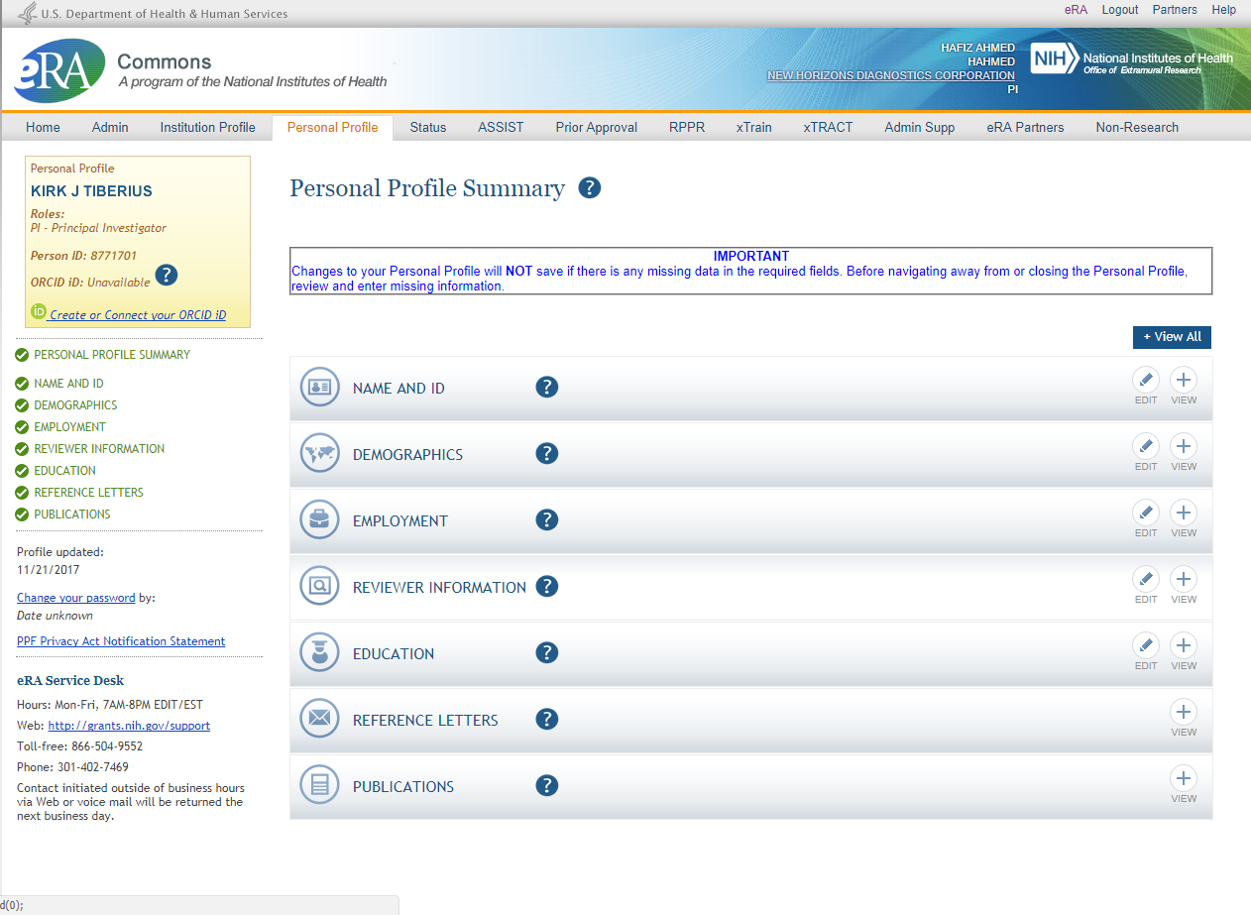
Personal Profile
Joe

Slide 8
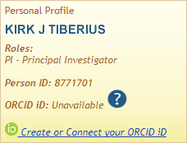
New on the Personal Profile
ORCID ID (Open Researcher and Contributor ID)
a personal digital identifier that distinguishes every researcher
a new link to access ORCID.org added to the Personal Profile.
Allows principal investigators to create an ORCID ID to link to their Commons account, so that their publications can be linked to their grants.
Joe

Slide 9

Personal Profile Information is used to…
Verify information submitted in grant applications
Send you agency notifications
Complete aggregate reporting
Determine eligibility for New Investigator (NI), Early Stage Investigator (ESI), and Early Established Investigator (EEI) status
Determine a reviewer’s eligibility for the Continuous Submission application submission policy
Joe

Slide 10

Terminology Check
New Investigator
  A PD/PI who has not previously competed successfully as a PD/PI for a substantial independent research award.
    See: New Investigator definition
Early Stage Investigator (ESI)
  An individual who has completed their terminal research degree or end of post-graduate clinical training, whichever date is later, within the past 10 years and who has not previously competed successfully as PD/PI for a substantial NIH independent research award.
Early Established Investigator (EEI)
  An individual who is within 10 years of receiving their first substantial, independent competing NIH R01 equivalent research award as an ESI.
    See: Early Stage Investigator definition
Continuous Submission
  As a way of recognizing their service to NIH, reviewers with substantial review service are permitted to submit their research grant applications (R01, R21, or R34) on a continuous basis and to have those applications undergo initial peer review in a timely manner.
    See: Continouos Submission definition
Joe

Slide 11

PPF- Tips
When you change your password, you will be automatically redirected to the Personal Profile tab—take a moment to review and update your information
Be especially diligent about keeping your email addresses current
  Email addresses are used to retrieve forgotten passwords and for communicating grants-related information
Joe

Slide 12
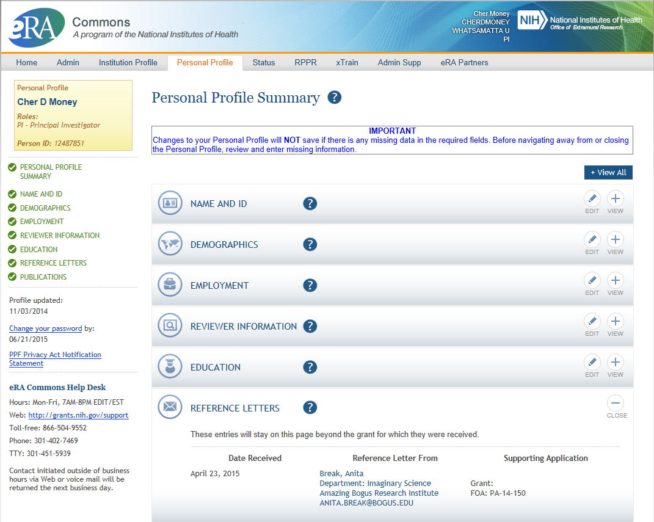
PPF – Reference Letters
Tracking Reference letters
  Shown in Profile
  Can see:
    When it was submitted
    Who submitted it
    What grant it is linked to
  Cannot see the
  actual letter
Joe

Slide 13
What’s New in eRA Commons IPF
Features in
Institution Profile
Joe

Slide 14
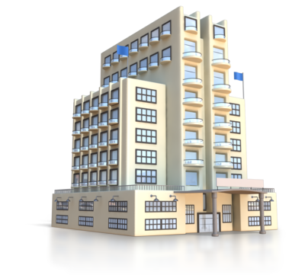
Institutional Profile File (IPF)
Each organization establishes and maintains their organization’s profile data
Depending on their role, users can view and/or update Institution Profile information
  Only SOs can edit IPF information
  IPF displayed as a read-only page for users with all other Commons roles
  Includes two sections: Basic and Assurances & Certifications
Central repository for registered organization information
Terminology Check:
‘Organization’ = ‘Institution’ = ‘Entity’
Joe

Slide 15
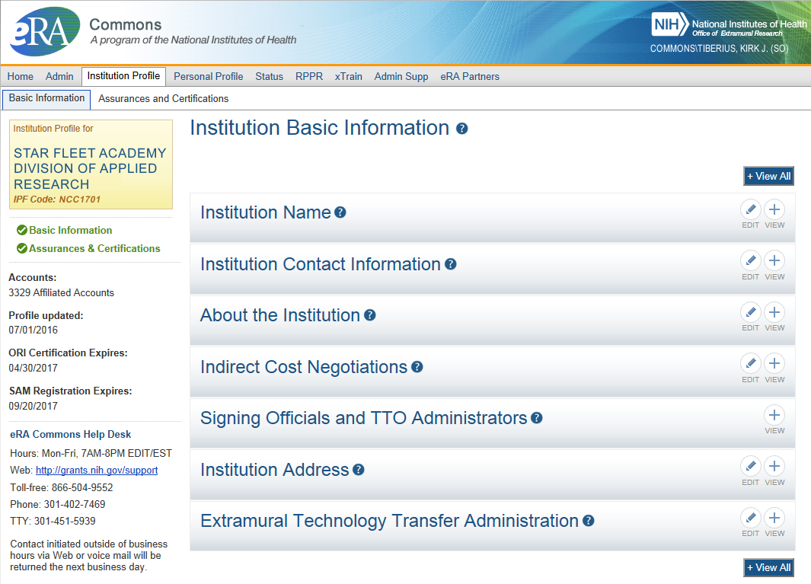
IPF - Basic
Basic: general information about the institution
  Name, address, Institution Contact information, list of Signing Officials, etc.
Only SOs can edit Institution Profile
SAM Registration Expiration
Joe

Slide 16
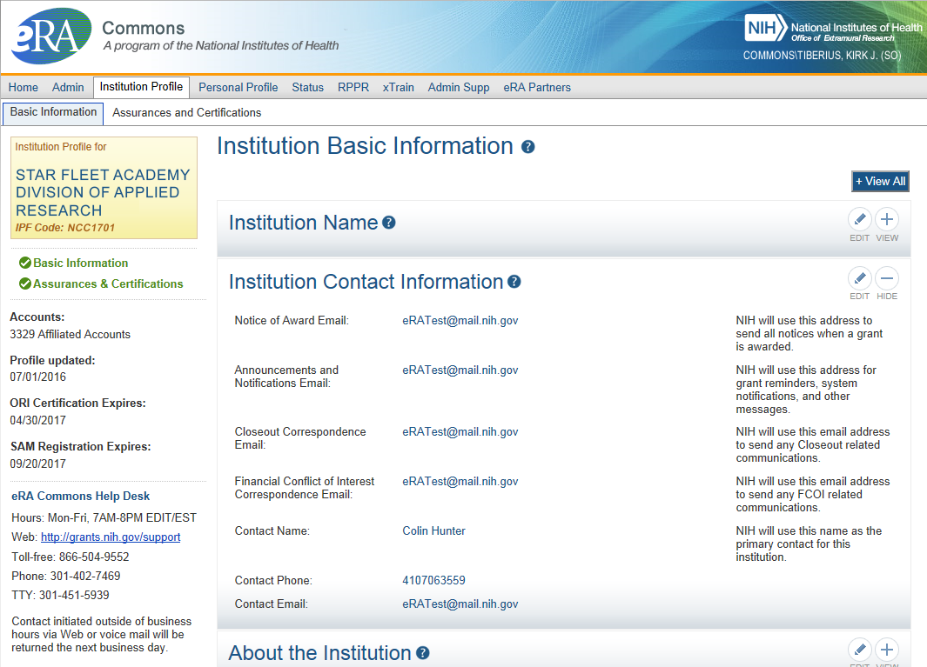
IPF – Institution Contacts
Newer
Contact
Fields:
Closeout Correspondence
FCOI Correspondence
Joe

Slide 17
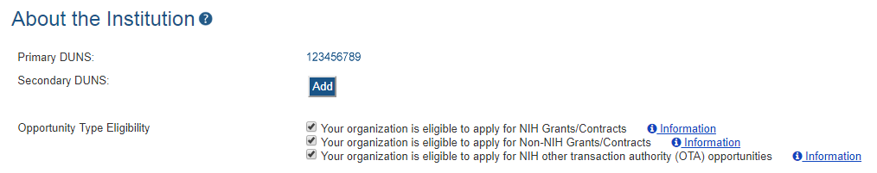

IPF – DUNS
Changes to Institution Basic Information Section
New fields coming soon…
  To support Other Transaction Authority funding opportunities
  To summarize your institution’s eligibility to submit to the different types of opportunities
Joe

Slide 18
What’s New in eRA Commons Status
New Status views
Joe

Slide 19
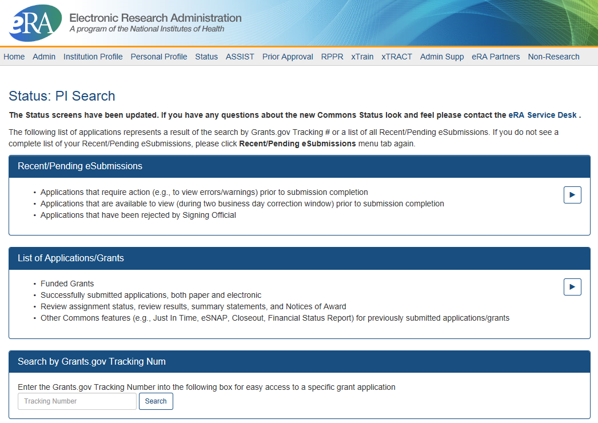
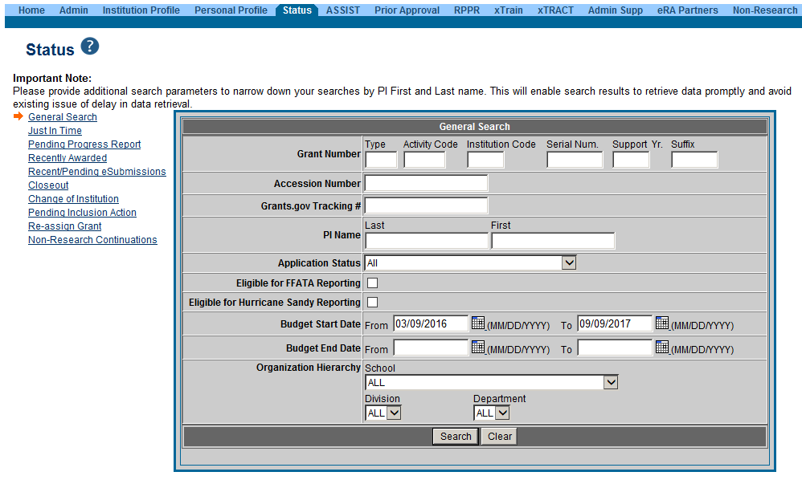
PI & SO Status Views
Principal Investigators can view their Recent/Pending eSubmissions or List of Applications/Grants.
Signing Officials can search/view all submissions for their institution.
Joe

Slide 20
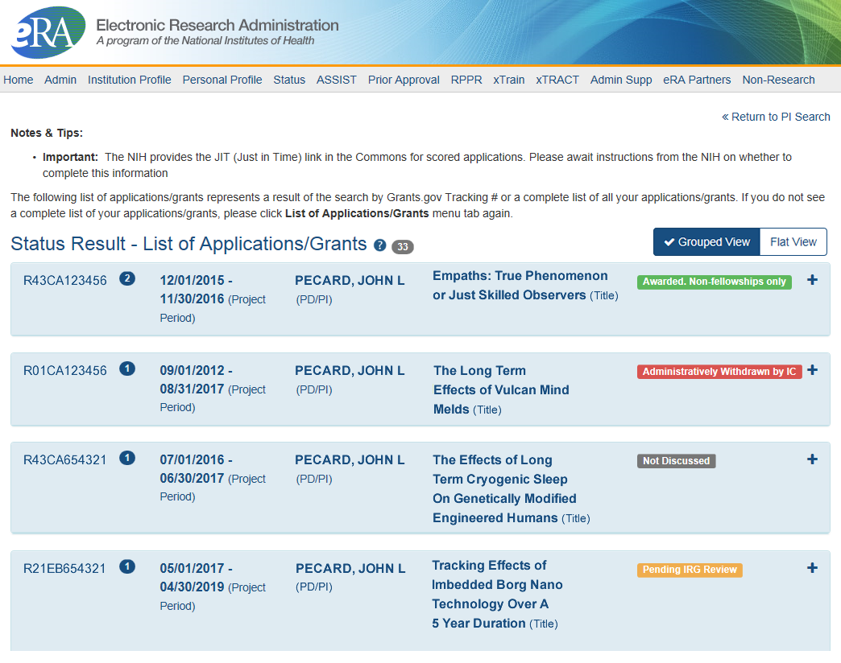
Status Result from General Search for PI
Click anywhere in the blue to get to more information, then select the Application ID link to view detailed status information for that particular application.
Joe

Slide 21
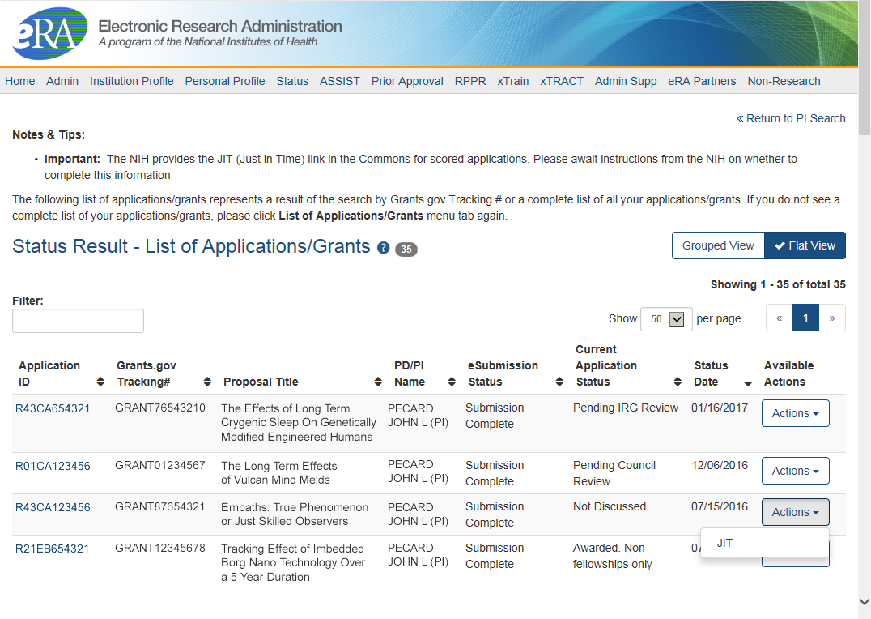
Status Result from General Search for PI
(flat view)
Flat view is more similar to the old view
Joe

Slide 22
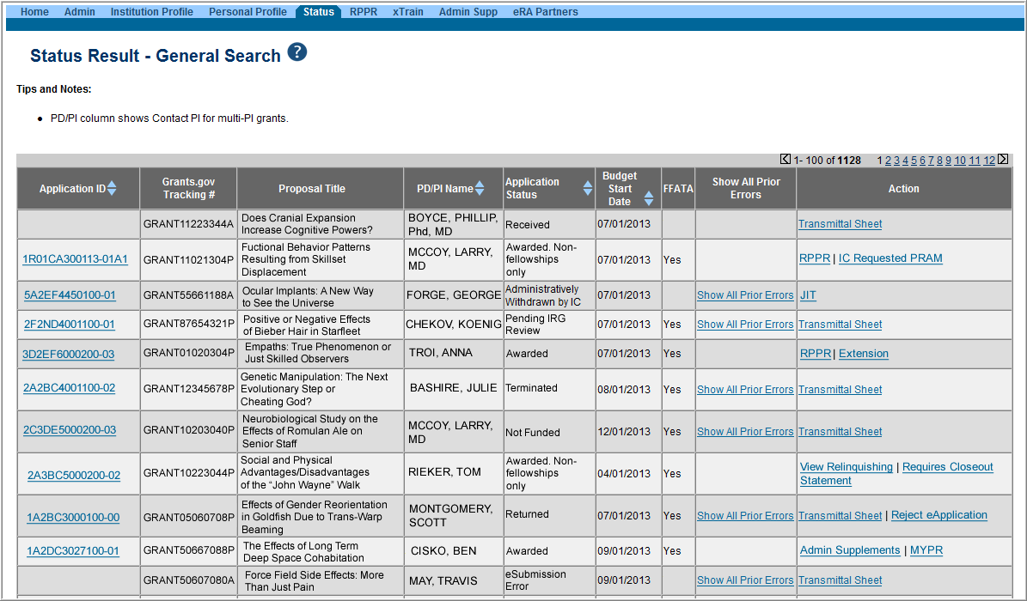
Status Result from General Search for SO
Select the Application ID link to view detailed status information for that particular application.
Joe

Slide 23
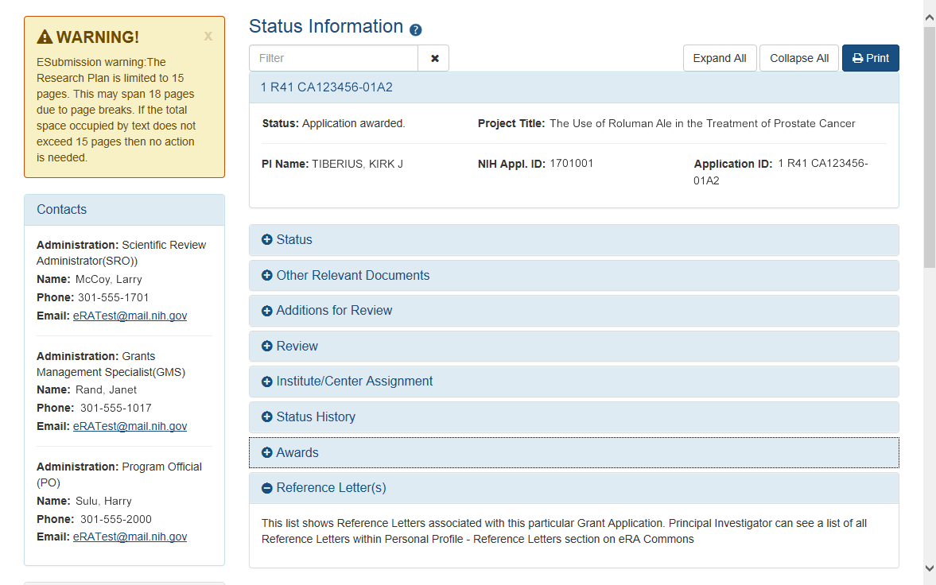
New Status Information Screen
Provides warnings
Control Buttons
Text Filter
“”
All tiles open by default.
eRA Contacts
Joe

Slide 24
Key eRA Commons
Features
Prior Approval Requests
Scarlett

Slide 25
Prior Approval
eRA now supports four activities for Prior Approval Requests.
  Request for No Cost Extension (NCE)
  Request for withdrawal of an application
  Carryover
  Request for Change of PD/PI
Prior Approval is the process in which an applicant or grantee must have written approval by an authorized official to undertake a certain activity.
Scarlett

Slide 26
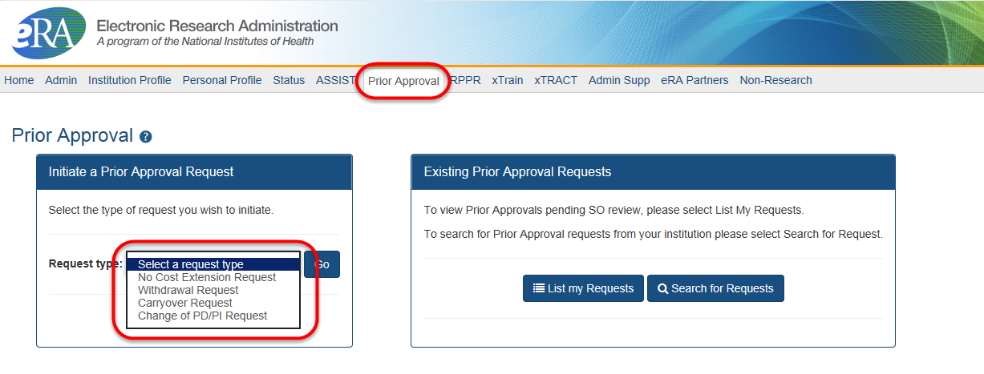
Prior Approval Tab
New navigation tab, Prior Approval
Select the type of request and click Go
List my Requests will display all Prior Approval requests pending Signing Official submission
Search for Request will allow a Signing Official to search for all Prior Approval requests.
Scarlett

Slide 27
Prior Approval – NCE
No-Cost Extension (NCE)
  An extension of time to a project period and/or budget period to complete the work of the grant under that period, without additional Federal funds or competition
Scarlett

Slide 28
Prior Approval – No Cost Extension: When?
When is a grant eligible for a NCE through Prior Approval?
  When you have already used a NCE under expanded authority and you are within 90 days of the project end date.
  When you are not under expanded authority and you are within 90 days of the project end date.
  When the project end date has expired and has not been closed or has not entered unilateral closeout, whichever comes first.
Scarlett

Slide 29
Prior Approval – No Cost Extension: When Not?
When is a grant NOT eligible for a NCE through Prior Approval?
  When you have never requested a NCE under expanded authority and you are within 90 days of the project end date. In this case, the NCE will be processed normally through the Extension link in Status.
  When the grant is closed.
  When the grant is a fellowship grant.
Scarlett

Slide 30
Prior Approval – No Cost Extension: What?
What information will you need to provide?
  The NCE request form consists of 4 parts:
    Request Detail – Here you will be asked such things as the number of months you wish to extend the project end date; the amount of unobligated money still available, etc.
    Three PDF upload fields:
      Progress Report
      Budget Document
      Justification Document
Scarlett

Slide 31
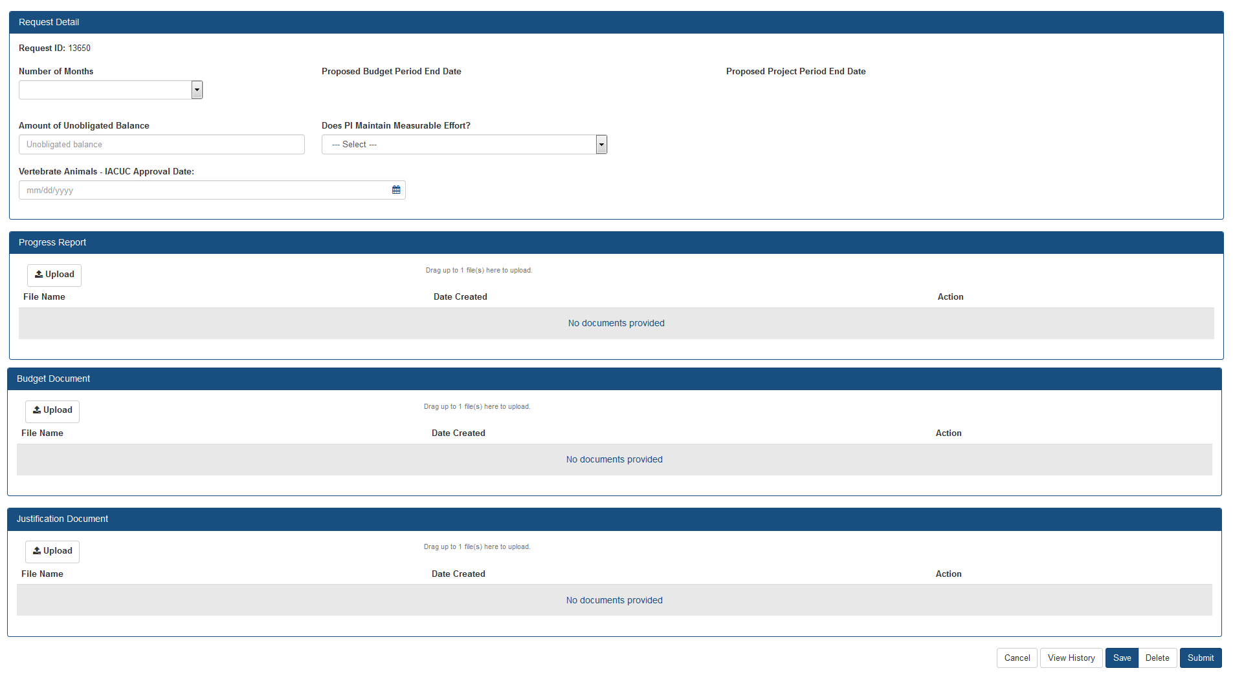
Prior Approval – No Cost Extension Screen
Select number of months, system will calculate proposed end dates.
Only PDF files may be uploaded.
One per each field, not exceeding 5MB.
For more information regarding the desired content of these fields, please contact you Grants Management Specialist.

Slide 32
Prior Approval – Withdrawal
An application that has been removed for consideration of award by the Signing Official/Authorized Organization Representative.
  Initiation of a Withdrawal Request can be done by either the Principal Investigator (PI) or Signing Official (SO)
  Screen supports justification (required) and supporting documents (max 10)
  Only the Signing Official can submit the request
  Signing Officials can search for requests for their institution
  Automatic notifications to the SO and PI upon approval
Scarlett

Slide 33
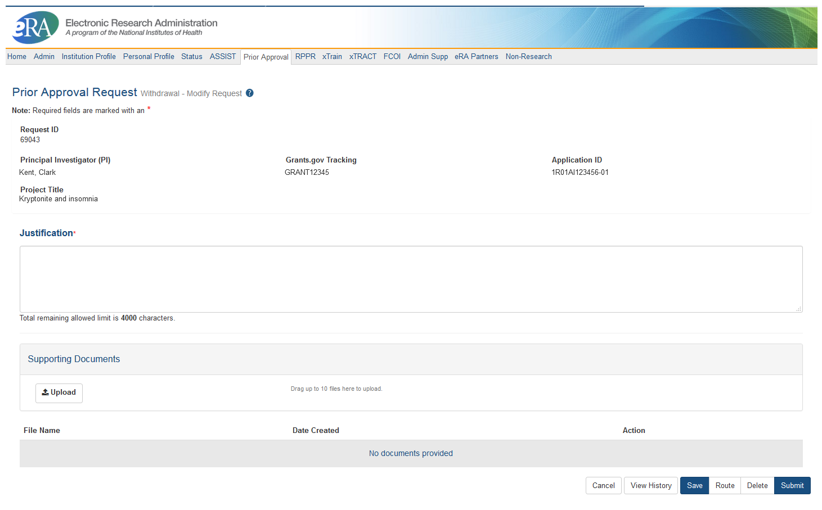
Prior Approval – Withdrawal Request

Slide 34
Prior Approval – Change of PD/PI
Request for an Institution to change the Program Director (PD) or Principal Investigator (PI) on an award.
  Only a Signing Official (SO) can initiate and submit this type of request.
  Request can only be made for a grant year that is currently awarded and in the budget period.
  Biosketch and Other Support documents (PDFs only) are required with the submission when adding a new PD/PI.
  1 PDF for each document requested, each not exceed 5 MB in size
Scarlett

Slide 35
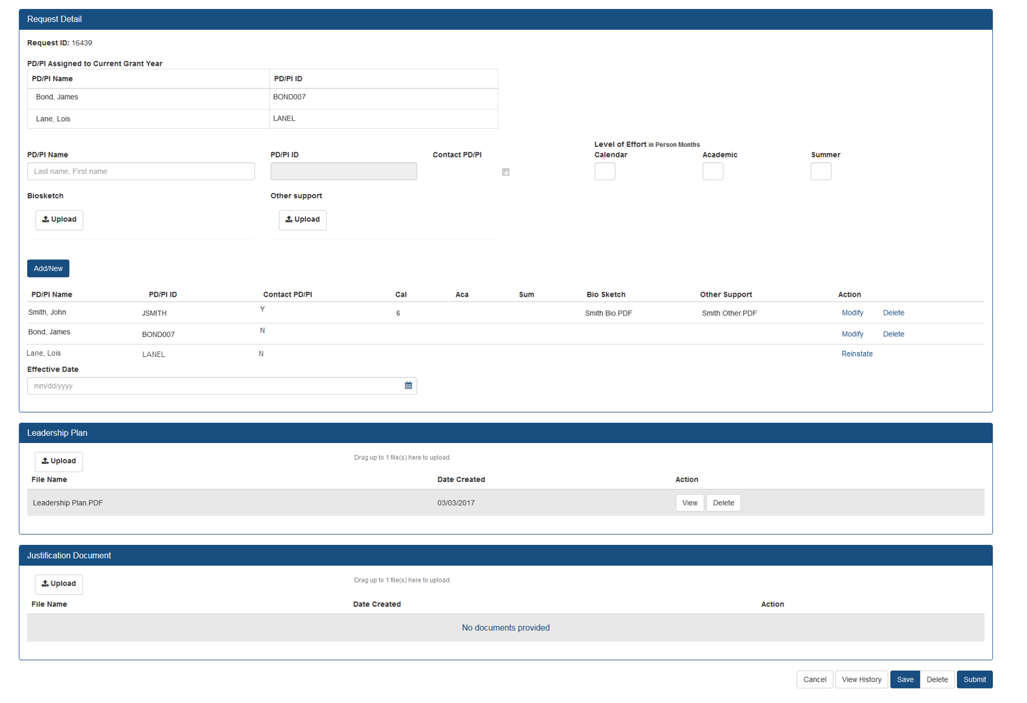
Prior Approval – Change of PD/PI
Screen
The current Principal Investigator(s) (PD/PI) will be displayed.
Select Modify to upload documents, update contact PD/PI Flag and provide level of effort.
You may choose to remove a PD/PI from the grant.
“”
“”
“”
If a PD/PI is on the current grant year and is accidently flagged for removal, you may reinstate them.
Leadership Plan PDF is required if the request will result in a multi-PD/PI grant.
“”

Slide 36
Prior Approval – Carryover
Request for an Institution to Carryover funds for a grant without expanded authority.
  Only a Signing Official (SO) can initiate and submit this type of request.
  Request can only be made for a grant year that is currently awarded and in the budget period.
  SO must provide the unobligated funds to be carried over.
  Explanation of unobligated funds, Budget Justification and Scientific Justification must be submitted in PDF format, each not exceed 5 MB in size.
  If the grant is in the last year, and the project period end date has passed, the grantee will need to request a No Cost Extension to submit a Carryover request.
Scarlett

Slide 37
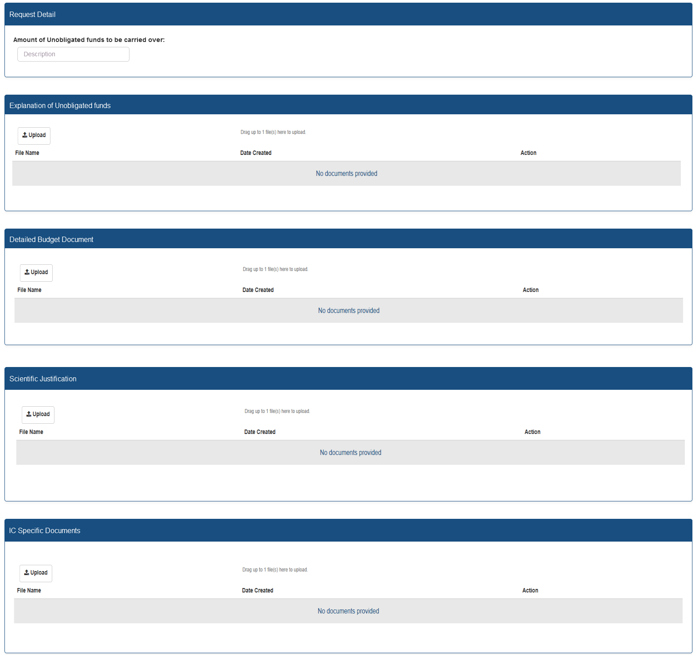
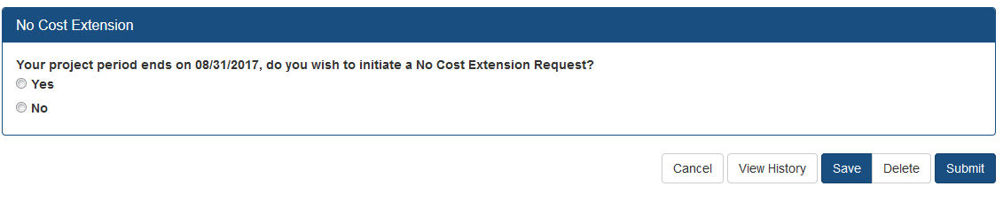
Prior Approval – Carryover Screen
Enter unobligated funds to be carried over
Only PDF files may be uploaded.
One per each field, not exceeding 5MB.
For more information regarding the desired content of these fields, please contact you Grants Management Specialist.
If the grant is eligible for a No Cost Extension, the user will have the option to initiate a No Cost Extension.

Slide 38

Prior Approval – Resources
NIH eRA Items of Interest Articles
  No NCE? No Problem!
  Prior Approval Changes How PIs Change
Video Tutorials
https://era.nih.gov/era_training/era_videos.cfm#eracommons
  Withdrawal of an Application
  Change of PD/PI
  No-Cost Extension
  Carryover
Scarlett

Slide 39
Key eRA Commons
Features
Submitting
a no cost extension (NCE)
Via status screen
Joe

Slide 40
NCE
Only SOs can submit the NCE notification
May be submitted no earlier than 90 days before end of project and no later than project end date
Can request extension of 1-12 months, in one-month increments
E-mail notification sent to NIH Grants Management staff when SO processes the extension
Electronically submit a notification to exercise one-time authority to extend without funds the final budget period of a project period of a grant.
Joe

Slide 41

Extension link in Status screen
Joe

Slide 42
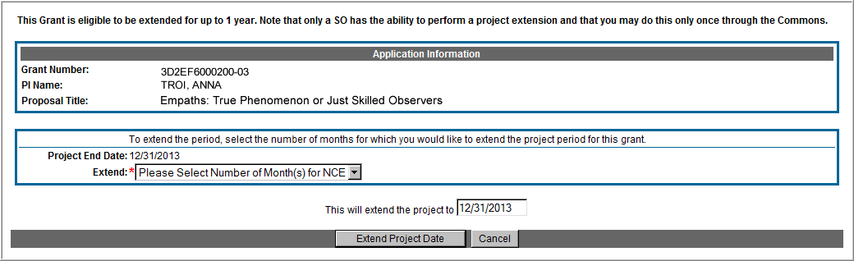
Extension Screen
Choose an extension of 1 to 12 months.
New calculated project end date
Joe

Slide 43
Expanded Authority – You Get Just One
No Cost Extension (NCE) part of ‘expanded authorities’
Can only extend once without express approval
Increasing trend of extending in the middle of the project period (i.e. end of year 2 of 5 year grant)
If this is done, the Extension link will NOT appear 90 days from end of project end-date
See June’s 2015 eRA Items of Interest for more:
  https://era.nih.gov/news_and_events/era_item_June_2015.htm#expanded
Joe

Slide 44
Key eRA Commons
Features
Submitting Just-in-Time (JIT)
Information Upon NIH Request
Scarlett

Slide 45
Just-In-Time (JIT)
Applicants should never submit JIT info until specifically requested to do so by NIH. A JIT link or request from NIH are not indications that a grant award will be made.
  Other Support File, Budget Upload, Other Upload, Institutional Review Board (IRB) Date, Human Subject Education
  PD/PI can save info in Commons, but only SO can submit JIT info to NIH
  Must be PDF format
Allows an applicant organization to submit additional grant application information after the completion of the peer review, and prior to funding.
Scarlett

Slide 46
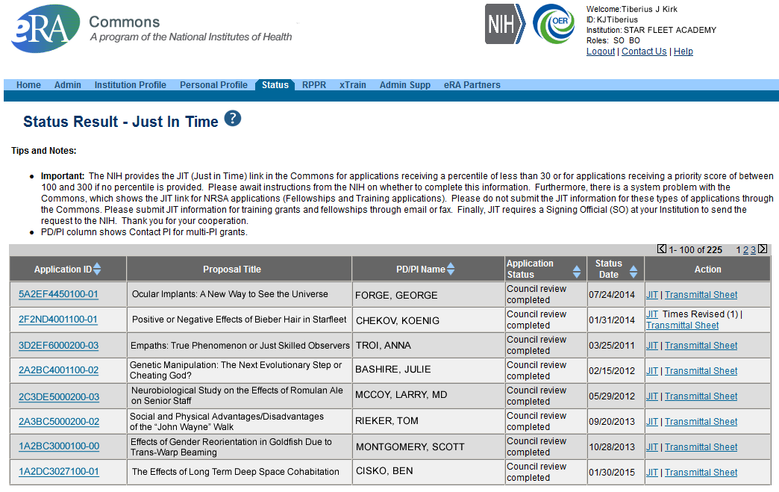
JIT Link on Status Result Screen (SO View)
Select JIT link
Scarlett

Slide 47
Key eRA Commons
Features - RPPR
Research Performance
Progress Report (rppr)
Scarlett

Slide 48

RPPR
Describes scientific progress, identify significant changes, report on personnel, and describe plans for the subsequent budget period or year.
  http://grants.nih.gov/grants/rppr/
Now available for all SNAP and non-SNAP progress reports.
Progress Report Additional Material (PRAM) functionality available for publication compliancy explanations and additional information requested by grants management staff.
Annual progress report to document grantee accomplishments and compliance with terms of award.
Hello, RPPR!
Scarlett

Slide 49
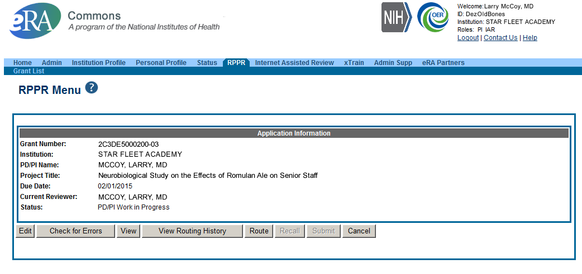
RPPR Menu Screen
Scarlett

Slide 50
RPPR Data Entry
RPPR sections
  Cover Page
  Accomplishments
  Products
  Participants
  Impact
  Changes
  Special Reporting
  Budget (non-SNAP)
Watch for character limits in data entry fields
Ensure uploads are in PDF format
When completing data tables remember to click ‘Add/New’
Scarlett

Slide 51
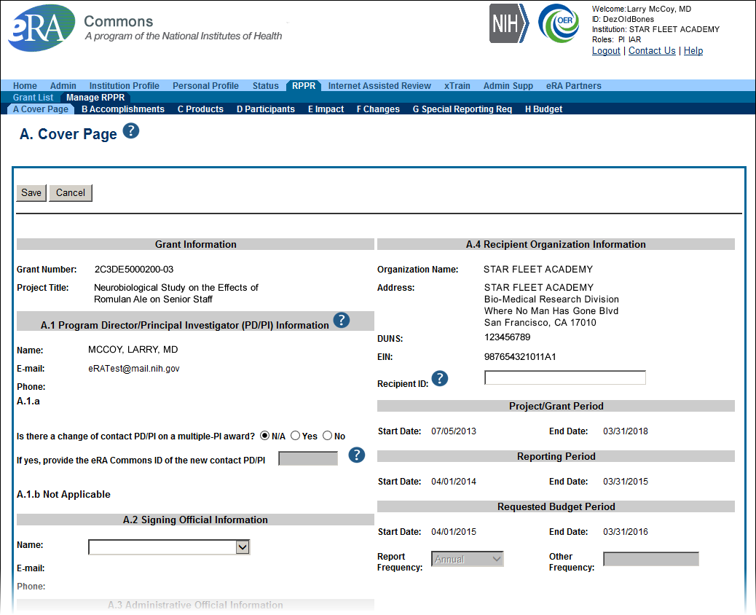
Sample RPPR Screen
Scarlett

Slide 52
RPPR – Complex, Multi-Project
Submitting progress reports for complex, multi-project grants
  After RPPR is initiated, PI will need to identify if RPPR should contain components.
  RPPR should have the same structure as the originally submitted application.
  Some sections are not available on Overall component (i.e. Budget)
  Some sections are not available on component level (i.e. Participants and Publications are reported on Overall)
Scarlett

Slide 53
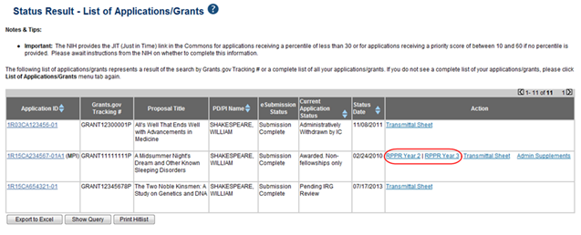
RPPR – Multi-Year RPPR
MYRPPR
  Multi Year Progress Reports now use RPPR format
  Link available under the Action Column in Status
Scarlett

Slide 54
Progress Report Additional Materials (PRAM)
The PRAM feature provides a means for the grantee to enter, review, route, and submit information to agency following the submission of an RPPR.
  Public Access (PA) PRAM - Generated automatically after an RPPR is submitted with publications that are not compliant with Public Access Policy
  IC (Agency) Requested PRAM – Only available if requested by the Grants Management Specialist (GMS)
PD/PI can enter the PRAM, but can only submit it if they are delegated with Submit Progress Report authority. Otherwise, only the SO can submit the PRAM to Agency.
Scarlett

Slide 55
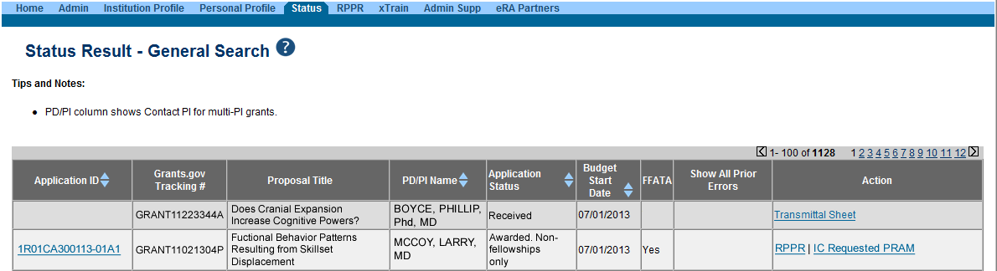
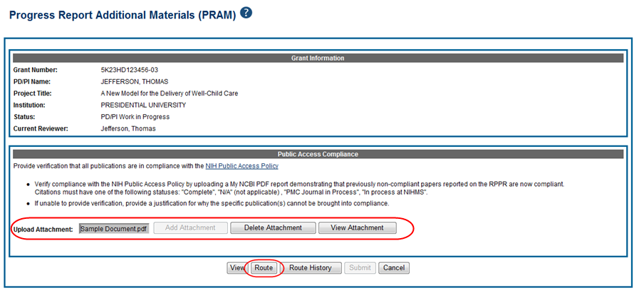
Progress Report Additional Materials - PRAM
Scarlett

Slide 56
New Format for PA PRAM
Public Access (PA) PRAM will require an attachment.
  The PA PRAM will no longer contain a free form text box.
  Using My NCBI the institution will need to generate a PDF of their reported publications showing their compliance.
  For instructions on generating the report please see: http://www.nlm.nih.gov/pubs/techbull/nd12/nd12_myncbi_pdf.html
Scarlett

Slide 57
RPPR – Budgets
Submitting progress reports with budgets
  R&R budget and PHS 398 budgets are now available for Non-SNAP RPPR.
  If presented with an option of budget forms, the type that was submitted with the application should be used.
    PHS 398 Budget is available only on training grants.
  Help for R&R Budget and PHS 398 Budget forms can be found in the SF424 R&R User Guides.
Scarlett

Slide 58
Key eRA Commons
Features
Submitting Administrative Supplements
(Type 3s)
Using eRA Commons
Joe

Slide 59
Administrative Supplements
Requested additional costs must be within the scope of the peer reviewed and approved project
Multiple submission methods available:
  Streamlined eRA Commons process¹
    Commons pre-populates much of the data needed for request from awarded grant
  SF424 (R&R) application forms & standard Grants.gov submission process¹
    Great for system-to-system users
  Paper process for multi-project Type 3/6/7s and Diversity Supplements
    (Diversity Supplements scheduled to go electronic January 2018)
A request for additional funds during a current project period to provide for an increase in costs due to unforeseen circumstances.
¹Available for single-project activity codes for which competing applications are submitted through Grants.gov.

Slide 60
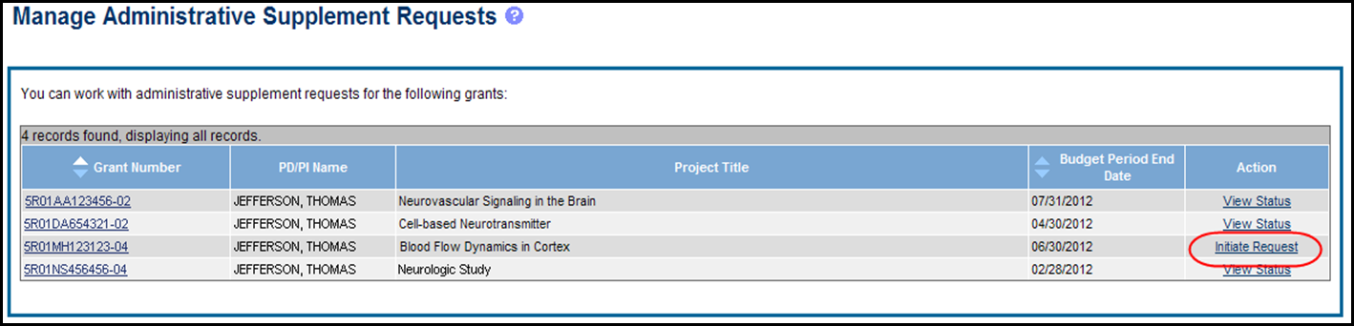
Admin. Supplement Requests - Commons
Starting an Administrative Supplement request in Commons you must find eligible grant and Initiate Request
Joe

Slide 61
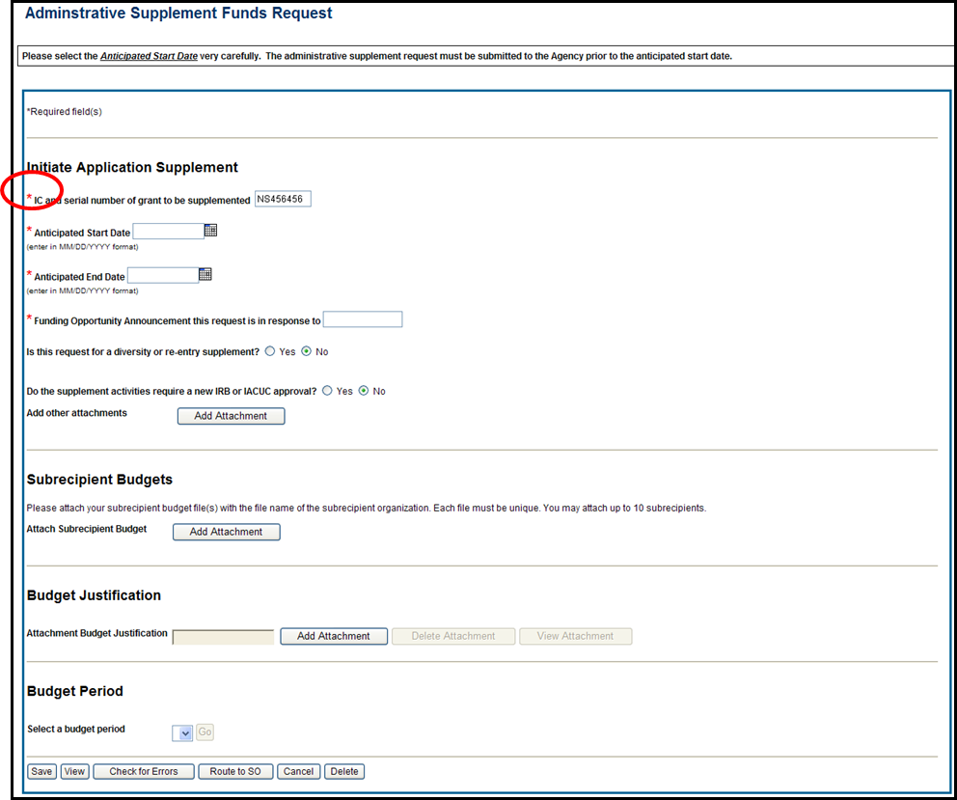
Admin. Supplement Requests – Commons 1
Complete Form – Required Fields are indicated with red asterisk
Joe

Slide 62
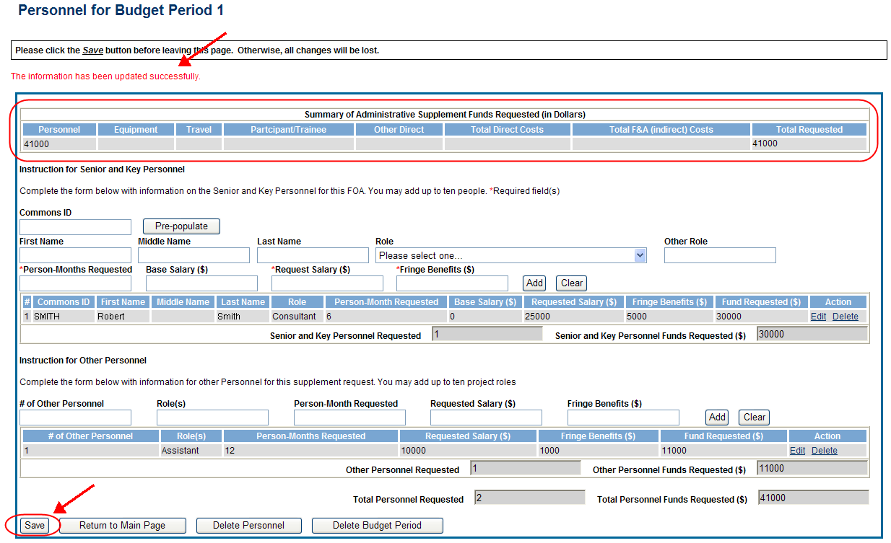
Admin. Supplement Requests – Commons 2
For each Budget Period enter appropriate sections:
  Personnel, Equipment, Travel, Participant/Trainee, Other Direct, Total F&A (Indirect) Costs
Total Requested will be calculated automatically
Joe

Slide 63

Admin. Supplement Requests – Commons 3
Resources:
  eRA Commons Administrative Supplement Module User Guide
    http://era.nih.gov/files/eRA_Commons_Admin-Supp_UG.pdf
  Administrative Supplements (Type 3s) Frequently Asked Questions
    http://era.nih.gov/commons/faq_commons.cfm#XVIII
Joe

Slide 64
Key eRA Commons
Features
Wrapping Up the ‘paperwork’ with Closeout
Scarlett

Slide 65
Closeout
Closeout items include:
  Final Research Performance Progress Report (FRPPR)
  Federal Financial Report (FFR)
  Final Invention Statement
NIH must mark the grant “ready for close out” for link to appear in Commons
  Contact the Division of Central Grants Processing (DCGP) or assigned Grants Management Specialist (GMS) if link is not appearing
Electronically submit required Closeout documents for grants in Closeout status
Scarlett

Slide 66
Closeout Capabilities
Identify expiring and terminating grants
Request and track required closeout documents
Track submission of boxed archived paper grant records at the Federal Record Center (FRC)
Scarlett

Slide 67
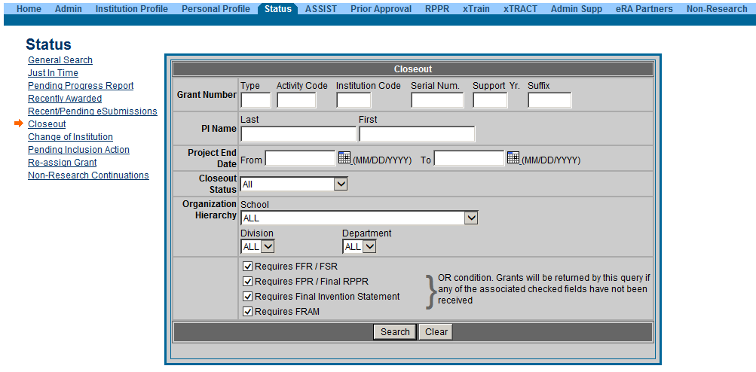
New Closeout Search screen provides additional search criteria
Scarlett

Slide 68
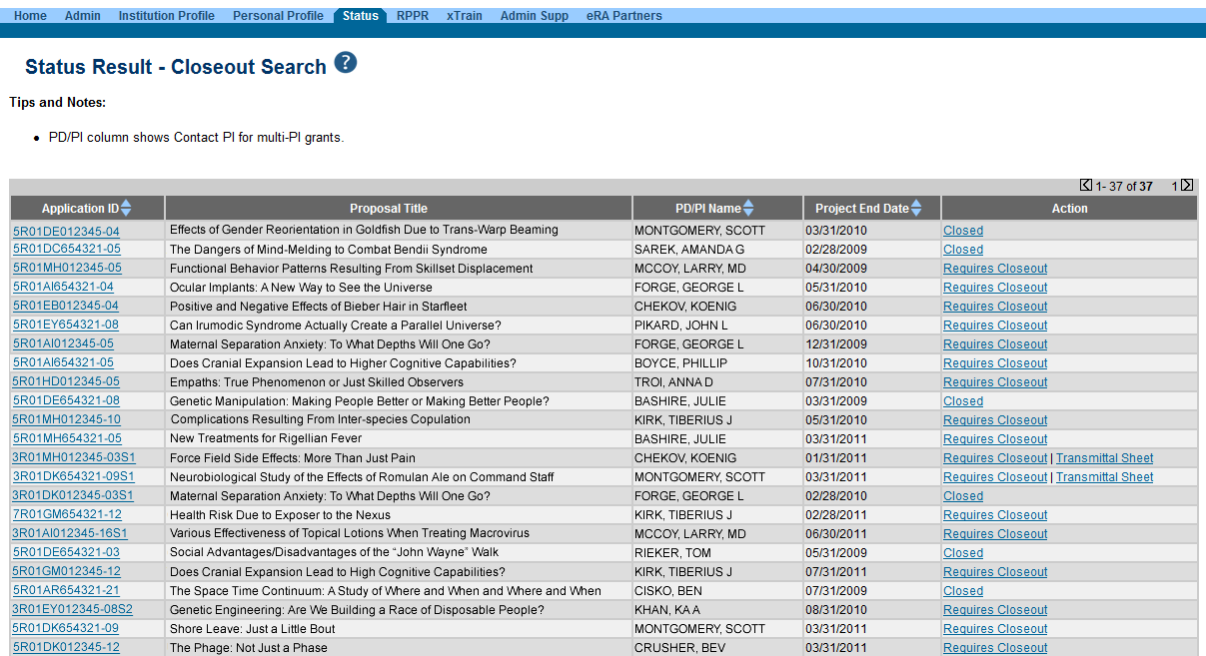
Search screen shows grants that are Closed or Requires Closeout
Scarlett

Slide 69
Interim Research Performance Progress Report (IRPPR)
Effective February 9, 2017
  If the recipient organization has submitted a Competing Renewal application (Type 2) on or before the date by which a Final Research Performance Progress Report (Final-RPPR) would be required for the current competitive segment, then submission of an "Interim RPPR" via eRA Commons is now required.

Slide 70
IRPPR vs FRPPR
(Interim vs Final RPPR)
IRPPR
  The Interim RPPR link will made available to the SO and the PI in the Status screen when a grant is eligible for submission of a Competing Renewal application.
  Only Section D.1 of Participants is required
  Sections F: Changes and Section H: Budget are not part of the Interim RPPR
  Section I: Outcomes is new. Section I is required for the Interim RPPR
FRPPR
  The Final RPPR is only available as part of the Closeout process and the Process Final RPPR link only appears on the Closeout Status screen.
  Only Section D.1 of Participants is required
  Sections F: Changes and Section H: Budget are not part of the Final RPPR
  Section I: Outcomes is new. Section I is required for the Final RPPR

Slide 71
Interim RPPR Scenarios
Since a renewal application is competitive, there is no guarantee it will be funded. Therefor the following scenarios should be noted:
Completing Renewal Application Status | Action
Not submitting a Competing Renewal application | Submit a Final RPPR no later than 120 days from the project period end date
Submitting a Competing Renewal application | Submit an Interim RPPR no later than 120 days from the project period end date
 | Funded | Not Funded
 | The Interim RPPR is accepted as the annual RPPR | The Interim RPPR is accepted as the Final RPPR

Slide 72
Permissions for Interim RPPR
  Interim and Final RPPR work in the same manner as the old Final Progress Report (FPR).
  Both SOs and PIs can initiate and/or submit to agency.
  They can also route the report back and forth for review and edits. All of this done without the need to delegate any authority.
  No delegations needed for the initiation and submission of either version of these RPPRs.

Slide 73

Delegations
Progress Report
Sponsor
Status
PPF
Submit
xTrain
eRA Commons allows users to give other users permission to do specific actions on their behalf
Scarlett

Slide 74
Delegations Chart
Type (Name) | By | To | What it does
Progress Report | SO, AA, AO | PI on behalf of a PI | Enables the delegated PI to work on progress reports of another PI – includes Interim and Final RPPR
Progress Report | PI | User within Institution | Enables the authorized user to work on progress reports for the PI – includes Interim and Final RPPR
Sponsor | SO, AA (on behalf of Sponsor) | ASST | Allows the ASST to access the xTrain module
Status | PI | ASST | Allows the ASST to work with the Status module
PPF | All Users | User within Institution | Enables another user to edit someone else's personal profile
Submit | SO, BO | PI | Enables the PI to submit RPPR and MYPR reports – now needed for PI if they are to submit Interim and Final RPPR
xTrain | PI, Sponsor | ASST | Enables the ASST to work with the xTrain module and xTRACT
Scarlett

Slide 75
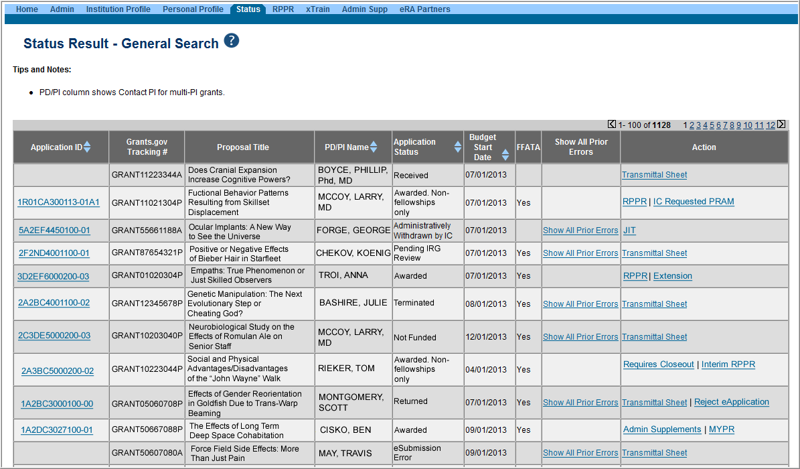
Selecting Interim RPPR
  Select Interim RPPR link from Status search results (SO view shown)

Slide 76
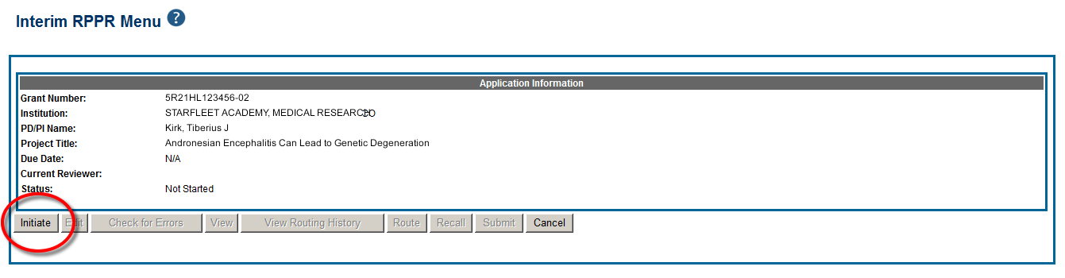
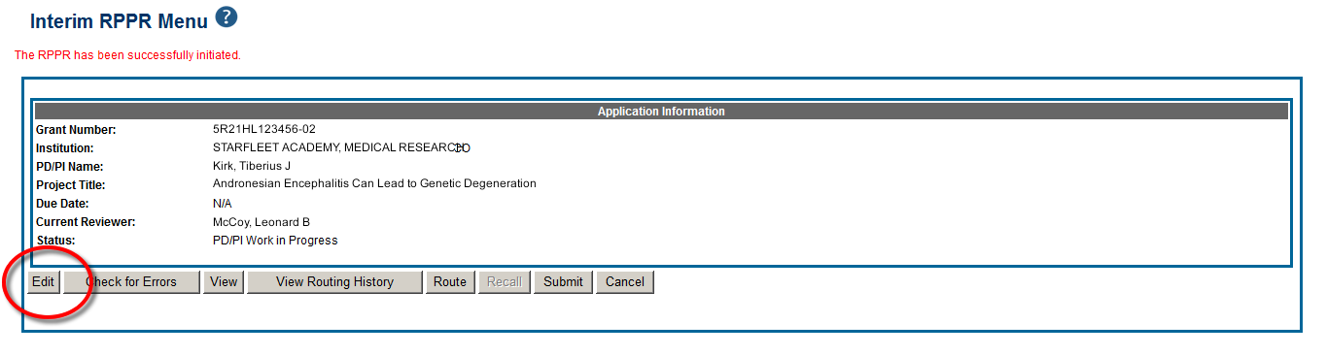
Initiate Interim RPPR
  Select Initiate from the Interim RPPR Menu screen
  Select Edit from the Interim RPPR Menu screen

Slide 77
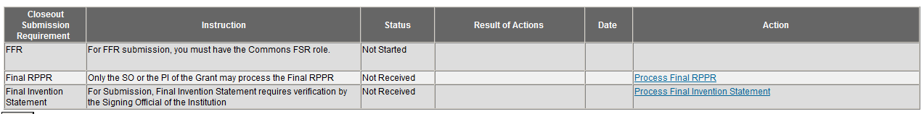
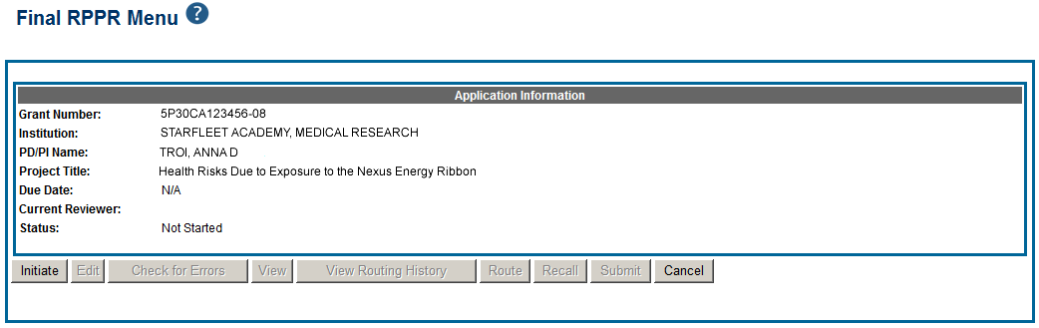
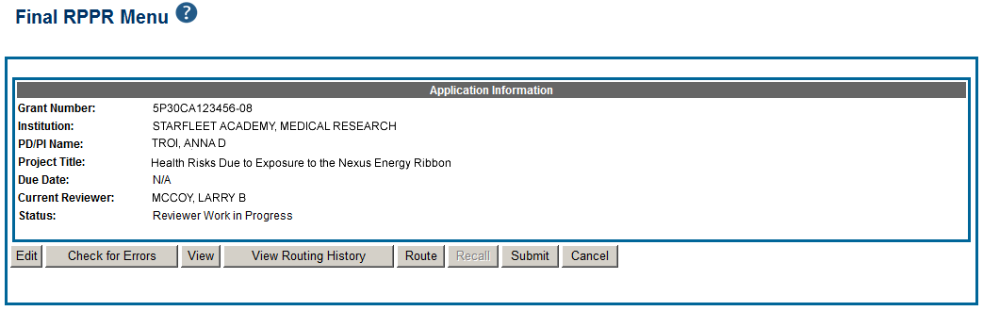
Initiate Final Research Performance Progress Report (FRPPR)
The Final RPPR has the same permissions and delegations as the Final Progress Report (FPR). Both SOs and PIs can initiate or submit to agency.

Slide 78
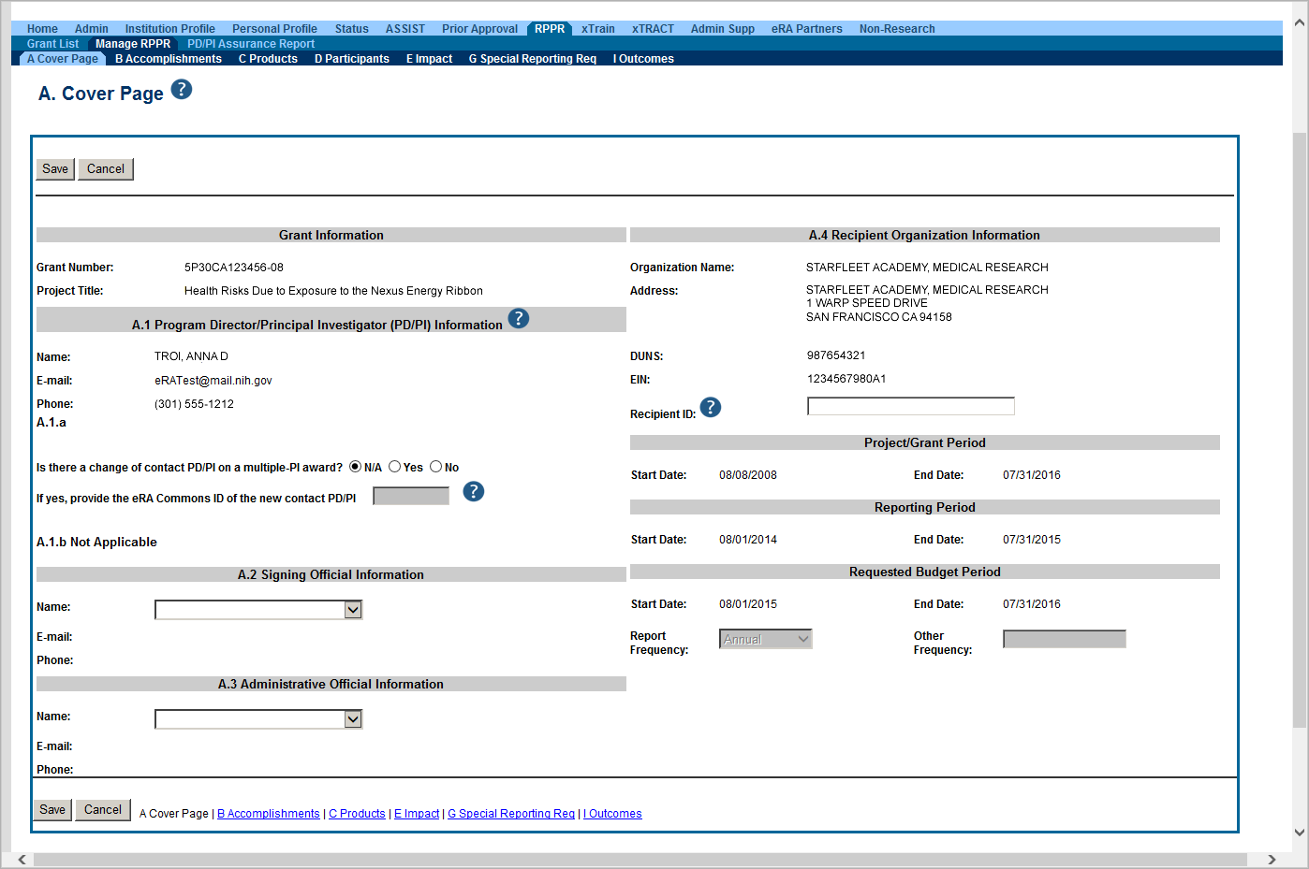
IRPPR and FRPPR Sections
Similar navigation tabs as the annual RPPR.
A new section called Outcomes has been added.

Slide 79
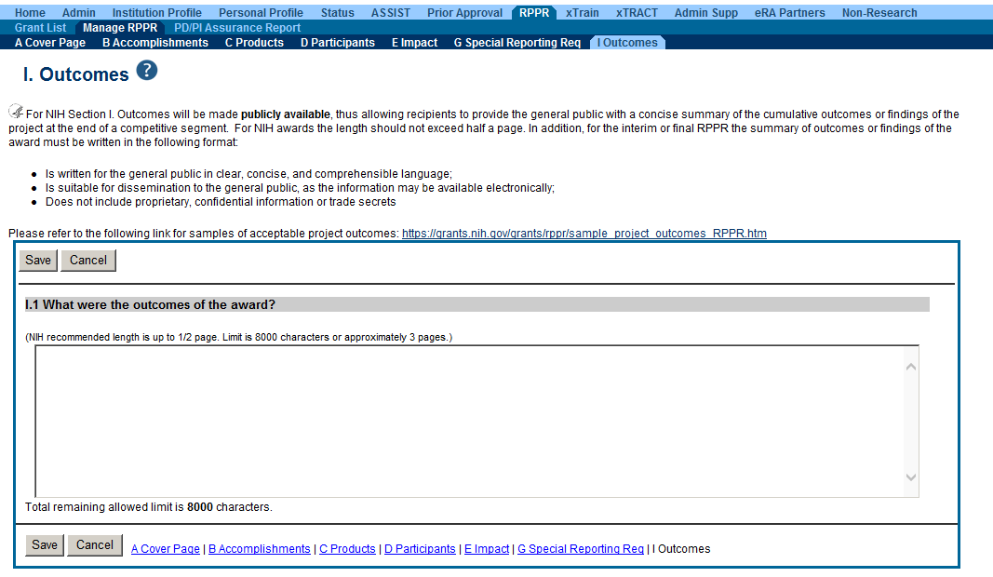
Outcomes
Information in Outcomes will be publically available. It should be written as a high level and in plain language.

Slide 80
Closeout – Outcomes Requirements
A new section of the RPPR specifically designed to be made publicly available by the agency (analogous to the abstract in the competing application)
Reporting in the Outcomes section is limited (by the federal-wide RPPR format) to 8,000 characters
The Outcomes should provide a concise summary of the findings of the award written in lay language for the general public
In an effort to increase transparency NIH will make the Outcomes data available in RePORTER

Slide 81
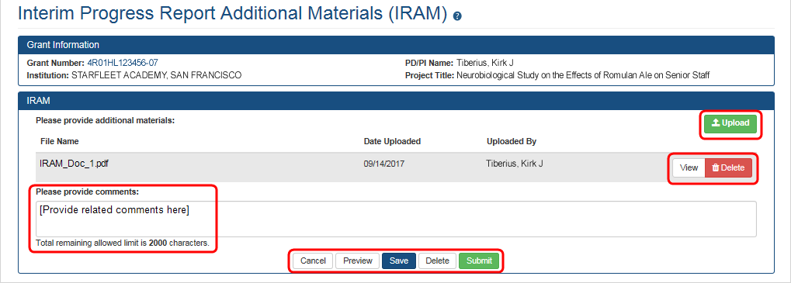
Requesting/ Receiving Revised Project Outcomes
Requests for revised project outcomes for F-RPPR and I-RPPR will be made by the PO and submitted by the recipient using the applicable additional material functionality (FRAM or IRAM)
  Note: The full automation for the Additional Material functionality for the I-RPPR was implemented in mid-September
Both modules will be enhanced in order to capture revised project outcomes in a format that could be reported out to the public
Scarlett

Slide 82

Project Outcomes Resources
There has been some confusion as to what constitutes an effective Project Outcome.
Please see the following resources for more information
  Sample Project Outcomes Summary – RPPR
    Link to Sample Project Outcome
Items of Interest, November 2017
  Technical Jargon? Not for Project Outcomes
    Link to November 2017 Items of Interest
Scarlett

Slide 83
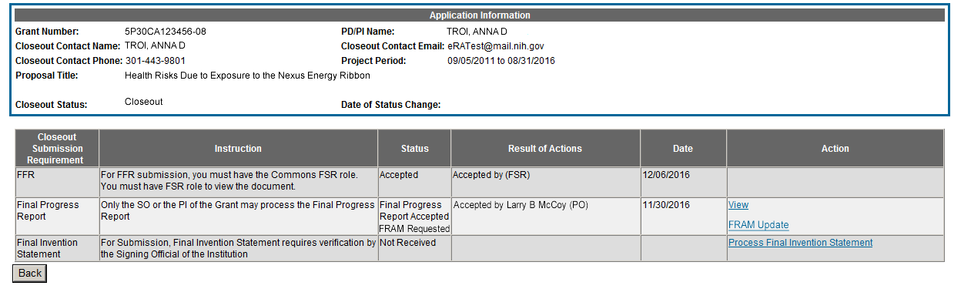
Closeout – Final Report Additional Materials
(FRAM)
FRAM works in same manner as PRAM in RPPR
Awarding IC sets status to FRAM Requested
Awarding IC triggers email for requested information to the SO & PI
The FRAM Update link appears in Action column
Scarlett

Slide 84
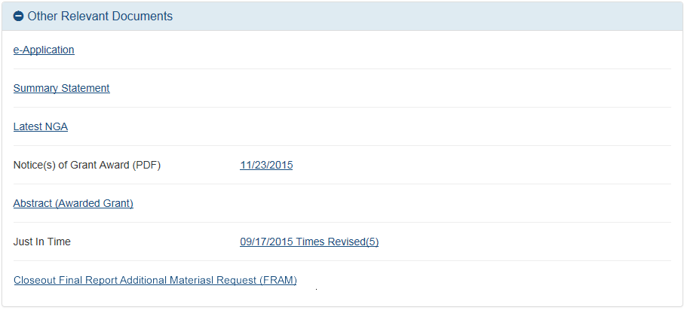
Closeout – Final Report Additional Materials
(FRAM) 2
Specifics about the FRAM request can also be found in Other Relevant
Documents section of the Status Information screen.

Slide 85
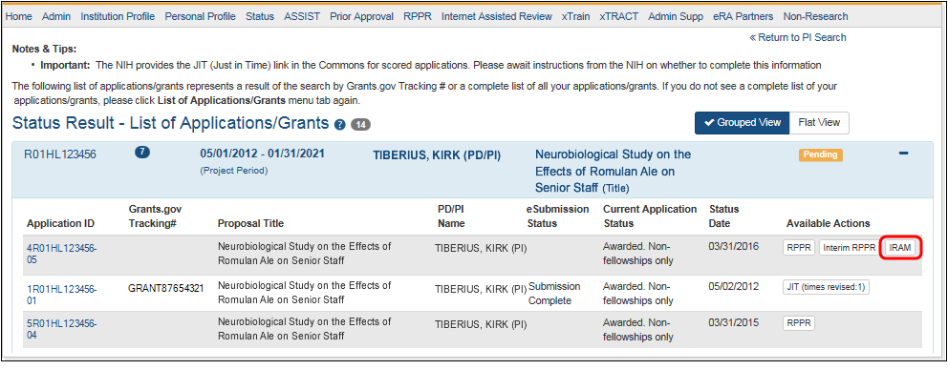
Closeout – Interim Report Additional Materials
(IRAM) Link
IRAM works in same manner as PRAM in for RPPR
Awarding IC sets status to IRAM Requested
Awarding IC triggers email for requested information to the SO & PI
The IRAM Update link appears in Action column
Scarlett

Slide 86
Federal Financial Report (FFR)
FFRs must be submitted in eRA Commons via the FFR/FSR module
  Cash transaction data still submitted via Payment Management System
FSR role for users who have the authority to view, enter, and submit an FFR on behalf of institution
Allows grantees to electronically submit a statement of expenditures associated with their grant to NIH via eRA Commons.
Scarlett

Slide 87
FFR
Annual FFR due date: For non-SNAPs, FFR must be submitted within 120 days of the calendar quarter in which the budget period ends
Final FFR due date: based on the Project Period End Date (PPED):
  Pending Status: If the FFR is not submitted and it is within 120 days of the PPED
  Due Status: If the FFR is not submitted and it is between the PPED and 120 days past the PPED
  Late: If the FFR is not submitted and it is more than 120 days past the PPED
Scarlett

Slide 88
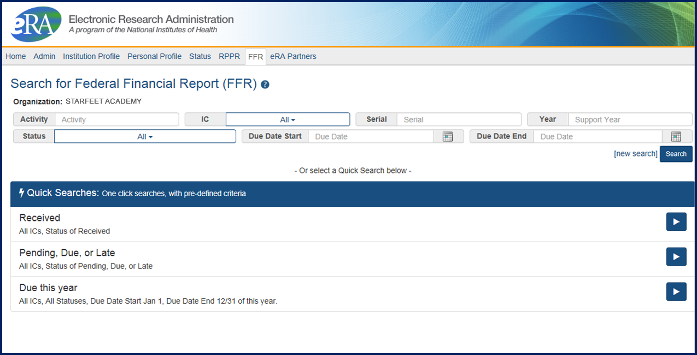
FFR/FSR Search Screen
Scarlett

Slide 89
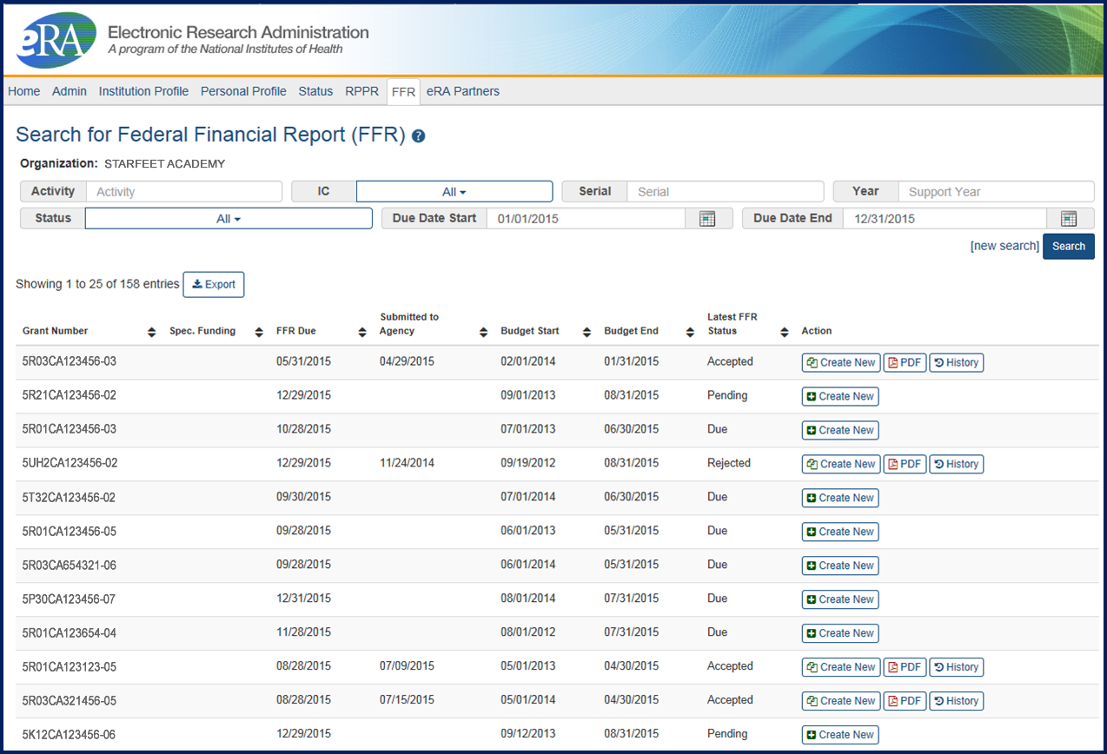
FFR/FSR Screen
The Grant Number is a hyperlink that will take you to the FFR/FSR form.

Slide 90
FFR Details Screen
Clicking the hyperlinked grant number opens the FFR Details screen, which displays:
  FFR Status:
    Received, Accepted, Rejected, In Review, or Revision Pending
  Available Actions:
    Accepted status: View or Create New
    Rejected status: View or Create New
    Received status: View or Correct
    Revision Pending status: View or Edit
    In Review status: View
Scarlett

Slide 91
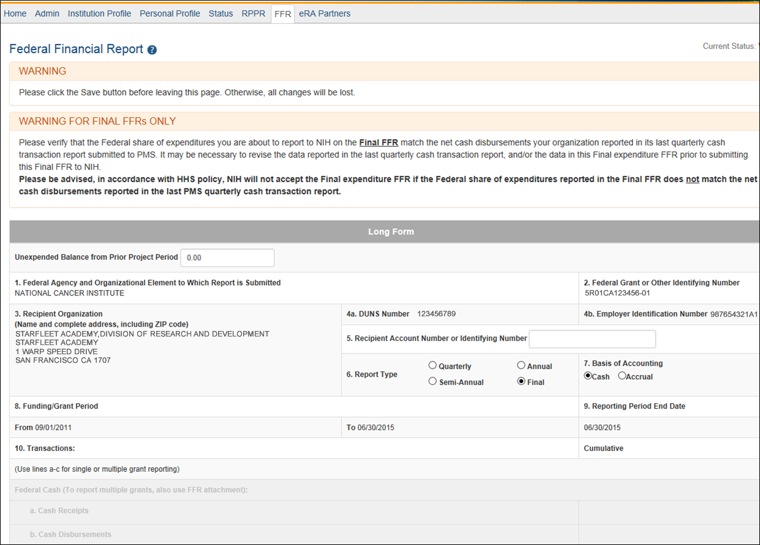
Completing the FFR
As current year entries are completed, calculations are done automatically.

Slide 92
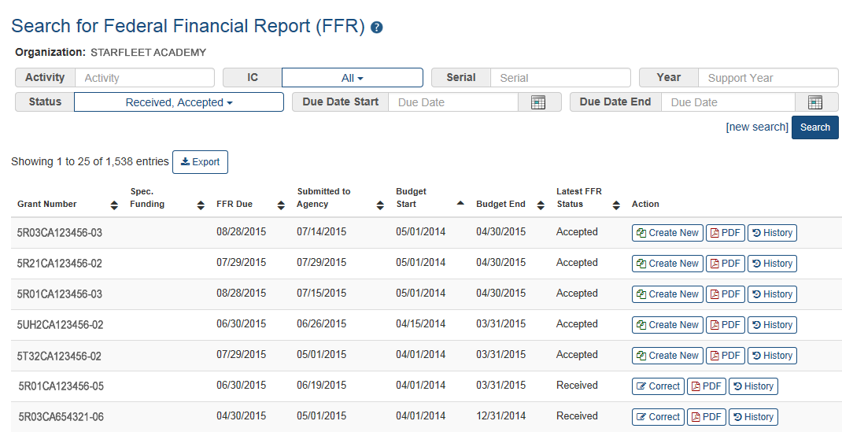
Submission of a FFR
Once FFR/FSR is Submitted, Latest FSR status changes to Received
If a mistake is made on the FFR and the status has changed to In Review, the institution should contact the eRA Service Desk to determine who the OFM staff is that is assigned by the NIH Institute/Center to resolve the issue.

Slide 93
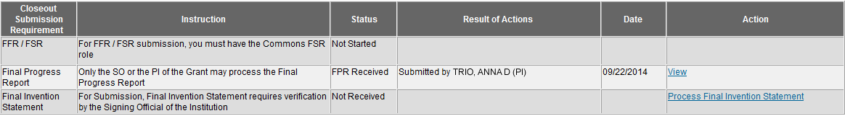
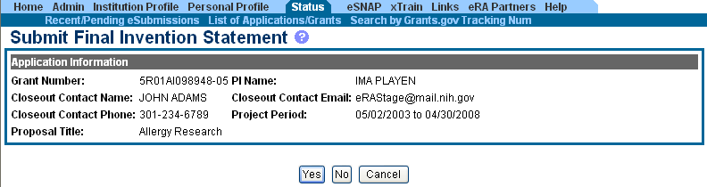
Closeout – Final Invention Statement
If inventions are to be reported, the specific inventions must be listed.
Either the PI or the SO can start the process, but the SO must verify the report before submitting it to the agency.
If Yes is selected, Add Invention screen appears.

Slide 94
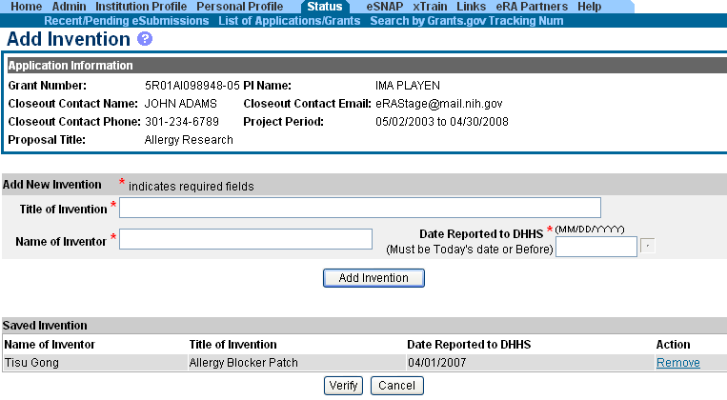

Closeout – Add Invention
Verify saved inventions.
Remove any that do not apply.
Add any that are missing.
Select Verify.
Scarlett
Select OK.

Slide 95

Closeout – Awaiting SO Verification
Status of Final Invention Statement is changed to Awaiting SO Verification. SO can now verify and submit.
Scarlett

Slide 96
Finding Help
Help Desks
On-line resources &Web sites

Slide 97
Service & Help Desks
eRA Service Desk
Grants.gov Contact
Center
Need Help? website
Web ticketing (preferred method of contact)
Toll-free: 1-866-504-9552
Phone: 301-402-7469
Hours: Monday-Friday (excluding Federal holidays)
Toll-free: 1-800-518-4726
Hours : 24x7 (Except Federal Holidays)
Email : support@grants.gov
Help Resources: http://www.grants.gov/web/grants/support.html

Slide 98

Web Sites
eRA Commons:
  https://commons.era.nih.gov/commons/
Electronic Research Administration:
http://era.nih.gov/
How to Apply – Application Guide: http://grants.nih.gov/grants/how-to-apply-application-guide.htm
NIH About Grants:
http://grants.nih.gov/grants/oer.htm

Slide 99

Thank you

