Slide 1
How Well Do You Know eRA Systems…

Slide 2
Sponsored by Your Good Friends at eRA:
Sheri Cummins
OER Communications & Outreach: Chief, Grants Information
Scarlett Gibb
eRA Customer Relationship Manager, eRA Commons
Laurie Roman,
eRA Customer Relationship Manager, eSubmission
Anastasiya Hardison,
eRA Customer Relationship Manager, xTrain, xTRACT, FCOI
Joseph Schumaker,
eRA Communication Specialist

Slide 3
eRA Commons 1
A new tab was added to Commons called Prior Approval. This tab now provides the option to submit 4 types of requests electronically.
What 4 requests?

Slide 4
eRA Commons Answer 1
1. Carryover
2. Withdrawal of an application
3. No Cost Extension
4. Change of PD/PI
A new tab was added to Commons called Prior Approval. This tab now provides the option to submit 4 types of requests electronically.
What 4 requests?

Slide 5
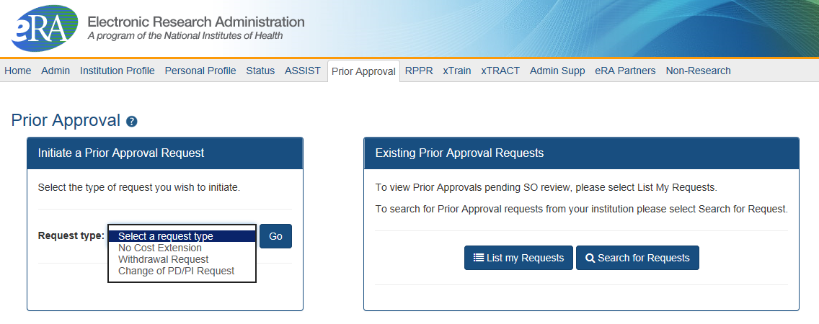
Prior Approval
eRA now supports four activities for Prior Approval Requests.
  Request for withdrawal of an application
  Request for No Cost Extension (NCE)
  Request for Change of PD/PI
  Request or Carryover of funds

Slide 6
eRA Commons 2
What is the name of the system that provides to the ability to create training tables for progress reports and institutional training grant applications?

Slide 7
eRA Commons Answer 2
xTRACT
Extramural Trainee Reporting And Career Tracking
What is the name of the system that provides to the ability to create training tables for progress reports and institutional training grant applications?

Slide 8
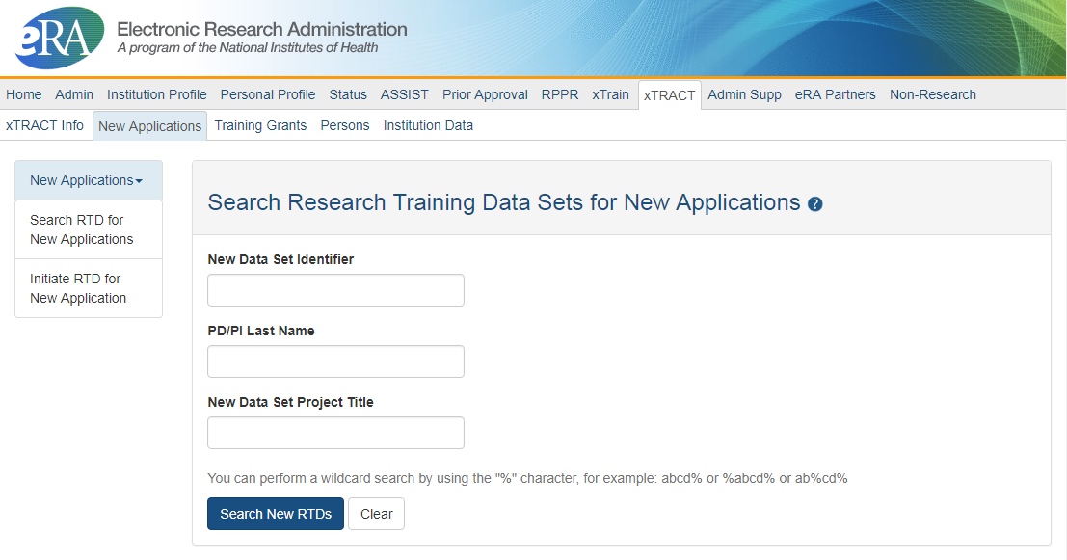
xTRACT
Advanced Notice! beginning in early FY 2020, NIH and AHRQ intend to require the use of the xTRACT system in the eRA Commons to prepare the required data tables for certain types of training grant applications.
See NOT-OD-18-133 for more information
Used for Training Grants for
  RPPR Submissions
  New applications
Can access information already in eRA Commons
Creates Research Training Datasets (RTDs) [Training Tables]
Tables are formatted, no manual formatting needed
Accessible by:
  Signing Officials (SOs)
  Principal Investigators (PIs)
  Assistants (ASST)

Slide 9
eRA Commons 3
There are now 3 types of Research Performance Progress Reports (RPPRs).
What are they and when is each used?

Slide 10
eRA Commons Answer 3
There are now 3 types of Research Performance Progress Reports (RPPRs).
What are they and when is each used?
Annual RPPR
Interim RPPR
Final RPPR

Slide 11
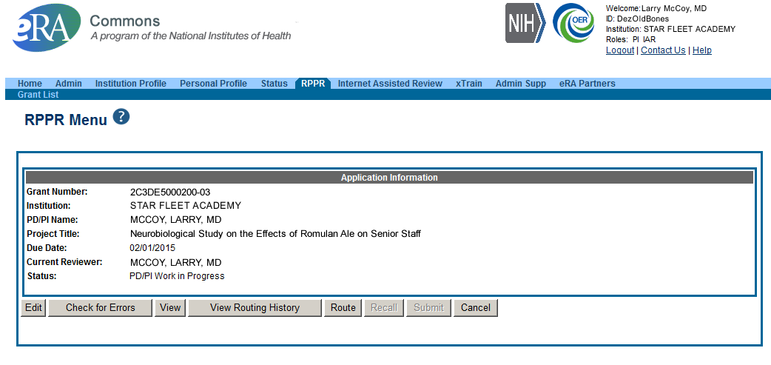
Research Performance Progress Report
Final RPPR Implemented January 1, 2017
  Very similar to that of the annual RPPR.
  Includes new Section I. Project Outcomes
  Accessed through Closeout
Interim RPPR Implemented February 9, 2017
  Identical to Final RPPR
  Accessed through Status

Slide 12
eRA Commons 4
When is the Interim RPPR used and how does NIH use it to reduce your burden?

Slide 13
eRA Commons Answer 4
I-RPPR is used when the recipient organization has submitted a Competing Renewal application (Type 2) on or before the date by which a Final Research Performance Progress Report (F-RPPR) would be required for the current competitive segment.
When is the Interim RPPR used and how does NIH use it to reduce your burden?

Slide 14
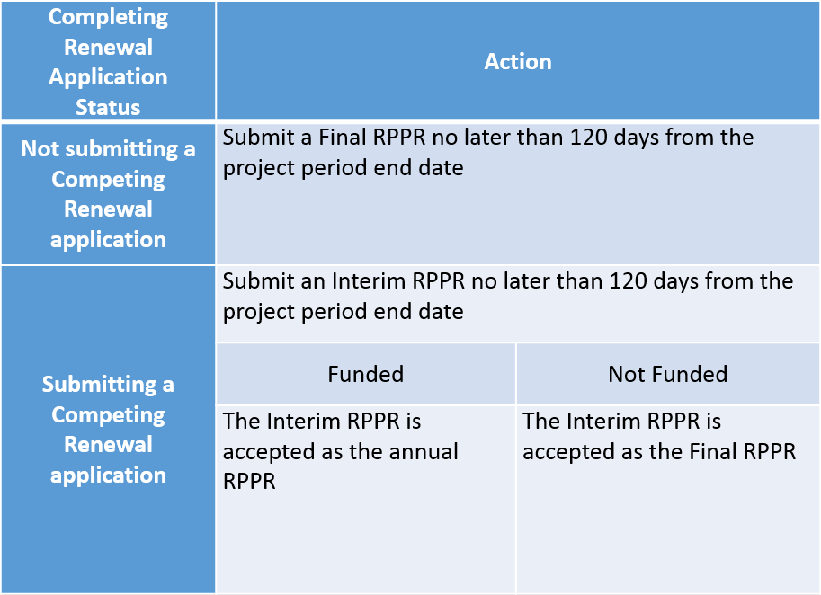
Interim RPPR

Slide 15
eSubmission 5
Name 3 registrations that every organization must complete to submit a grant application to NIH.

Slide 16
eSubmission Answer 5
Name 3 registrations that every organization must complete to submit a grant application to NIH.
DUNS
SAM
Grants.gov
eRA Commons
SBA

Slide 17
Required Registrations
DUNS
  Provides unique organization identifier
SAM (System for Award Management)
  Needed to do business with government
Grants.gov
  Required to submit grants
eRA Commons
  Required to do business with NIH
SBA (Small Business Administration)
  Required for SBIR/STTR applications

Slide 18
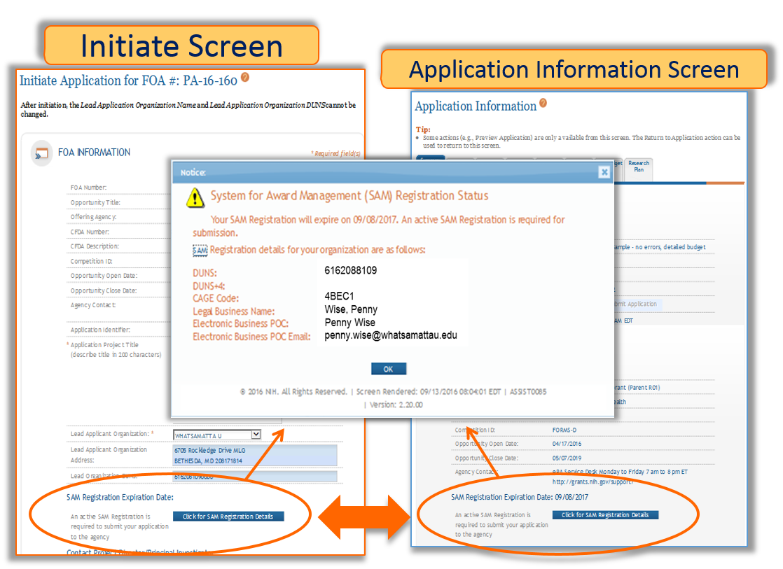
System for Award Management
SAM (System for Award Management)
  Needed to do business with government
  Must be renewed yearly
  Visibility of SAM Status in ASSIST

Slide 19
eSubmission 7
Name 2 of the 5 individuals who must have a valid eRA Commons ID used in the Credential field on the R&R Sr/Key Person Profile form for an NIH grant application.

Slide 20
eSubmission Answer 7
PD/PIs
Component Leads
Sponsors
Mentors
Diversity & Re-entry supplement candidates
Name 2 of the 5 individuals who must have a valid eRA Commons ID used in the Credential field on the R&R Sr/Key Person Profile form for an NIH grant application.

Slide 21
Who Needs a Commons ID?
Project Director/Principal Investigator (PD/PI) and any multiple-PD/PIs
Component leads on a multi-project application
Sponsor on a fellowship application (NOT-OD-14-129 – August 2014)
Primary mentor identified on individual mentored career development applications (NOT-OD-16-082 – March 2016)
Candidates for diversity and re-entry supplements

Slide 22
Clinical Trials 8
How can you tell if an FOA allows clinical trial applications?

Slide 23
Clinical Trials Answer 8
2 indicators:
Clinical Trial Allowability Indicator in Section 2 of the FOA
In the title of most new FOAs
How can you tell if an FOA allows clinical trial applications?

Slide 24
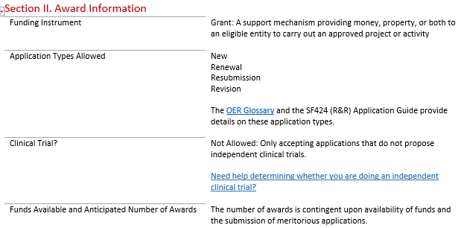
Section II. Award Information
Section II of each FOA will include one of these statements
Not allowed: Only accepting applications that do not propose clinical trials
Required: Only accepting applications that propose clinical trial(s)
Optional: Accepting applications that either propose or do not propose clinical trial(s)

Slide 25
Examples of Allowability in FOA Titles
NIH Research Project Grant (Parent R01 – Clinical Trial Not Allowed)
Exploratory Clinical Trial Grants in Arthritis and Musculoskeletal and Skin Diseases (R21 – Clinical Trial Allowed)
Administrative Supplements to Existing NIH Grants and Cooperative Agreements (Admin Supp – Clinical Trial Optional)

Slide 26
Clinical Trials 2
True or False:
My proposal does not involve human subjects, I can ignore the Human Subjects Clinical Trials Information form.

Slide 27
Clinical Trials Answer 2
True or False:
My proposal does not involve human subjects, I can ignore the Human Subjects Clinical Trials Information form.
False:
You must still answer the first question concerning the involvement of human subjects.

Slide 28
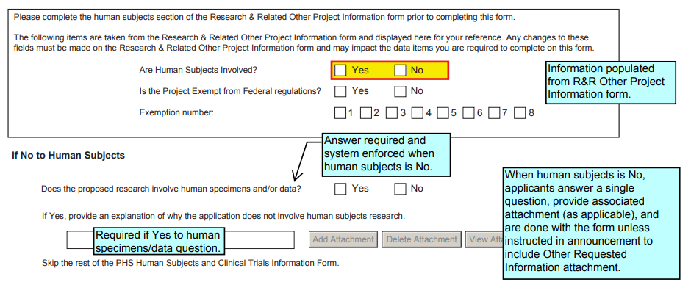
Human Subjects Involvement
Carried over from Question 1. and 1.a. on R&R Other Project Information
“”
Must answer this question on Human Subjects and Clinical Trials Information form, and provide attachment if required by the FOA.

Slide 29
eSubmission 100
Name two submission options available to prepare and submit an R01 grant application to NIH?

Slide 30
eSubmission Answer 10
Name two submission options available to prepare and submit an R01 grant application to NIH?
ASSIST
System-to-System
Grants.gov Workspace

Slide 31
eSubmission Options
Your Application Will Be…
  Subject to the same registration requirements
  Completed with the same data items
  Routed through Grants.gov
  Validated against the same NIH business rules
  Assembled in a consistent format for review consideration
  Tracked in eRA Commons
Regardless of the submission option used.
NOTE:
The use of downloadable PDF is no longer a valid submission option.

Slide 32
eSubmission 110
When application instructions in a funding opportunity announcement conflict with the instructions in the application guide, which should I follow?

Slide 33
eSubmission Answer 110
Funding Opportunity Announcement
When application instructions in a funding opportunity announcement conflict with the instructions in the application guide, which should I follow?

Slide 34
Application Instructions
Follow All Guidance
  Notices in the NIH Guide for Grants and contracts
  Funding Opportunity Announcement
  Section IV. Application and Submission Information
  Application Guide
Precedence / Importance

Slide 35
eSubmission 120
How does NIH define an “on time” application submission?

Slide 36
eSubmission Answer 120
Error-free applications must be accepted by Grants.gov with a time stamp on or before 5:00 p.m. local time of the submitting organization on the due date.
How does NIH define an “on time” application submission?

Slide 37
On-time Application Submission
Important Reminders
  NIH recommends submitting early to allow time for correcting any errors found during the application viewing window prior to the due date
  NIH’s late policy does not allow corrections after the due date
  All registrations and SAM renewal must be completed before the due date

Slide 38
eSubmission 130
The appropriate measurement for “early” in the context of application submission is…?

Slide 39
eSubmission Answer 130
The appropriate measurement for “early” in the context of application submission is…?
Minutes
Hours
Days
Weeks

Slide 40
eSubmission 180
Funding Opportunity Announcements include a lot of important information. Name 3 things you should check in the FOA to ensure a good fit before preparing and submitting your application.

Slide 41
eSubmission Answer 18
  Participating IC matches the area of science
  Due date
  Program Description (Section I)
  Section II Award Information (application types, Clinical Trial Allowability, budget and project period limits)
  Eligibility (Section III)
  Section IV special requirement (Budget, page or project period exceptions
  Section V special review considerations
Funding Opportunity Announcements include a lot of important information. Name 3 things you should check in the FOA to ensure a good fit before preparing and submitting your application.

Slide 42
eRA Commons140
The Account Management System (AMS) added a new feature in March 2016.
What reporting feature was that?

Slide 43
eRA Commons Answer140
The Account Management System (AMS) added a new feature in March 2016.
What reporting feature was that?
All Users Report

Slide 44
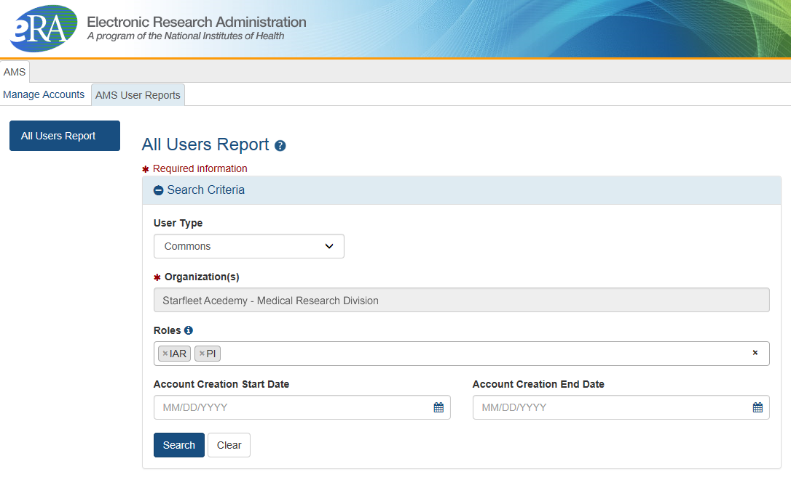
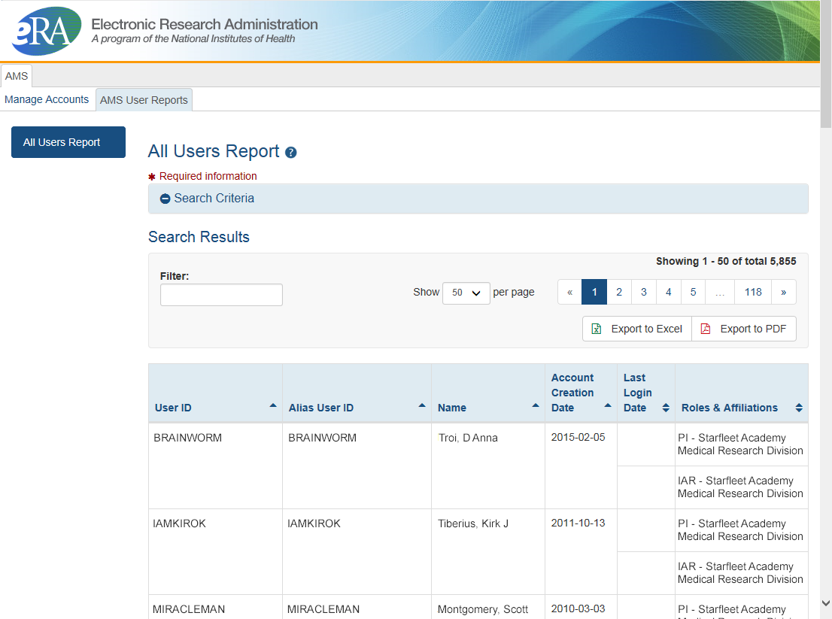
All Users Report
Search on one eRA Commons role or multiple roles
Search by role or multiple roles
Limited to users only at your institution
Unlike other search features with a limit of 500 hits, there is no limit to number of users returned in report search
Result can be exported as a spread sheet or PDF document
View and export options

Slide 45
eSubmission 150
True or False:
NIH systems catch all errors that could potentially keep my application from going to review.

Slide 46
eSubmission Answer 150
True or False:
NIH systems catch all errors that could potentially keep my application from going to review.
False:
Multiple levels of application checks for completeness
Grants.gov
eRA systems
Agency staff

Slide 47
Sample Validations
Grants.gov
eRA Systems
Agency Staff
Active System for Award Management (SAM) registration
Submitter has AOR role for DUNS on application
Submission made to active opportunity and application package
Virus check
Filenames include only appropriate characters
Fields required by agency, but not required federal-wide
  R&R Sr/Key form
    Credential for PD/PIs
    Organization name for all sr/key
    Biosketch for all sr/key
  Performance Site form
    DUNS for primary site
Attachments in PDF format
Adherence to page limits in our Table of Page Limits
All appropriate attachments included
Fit with NIH/Institute mission
Eligibility
“Overstuffing”
Appropriateness of appendices
On-time submission
Adherence to funding opportunity announcement specific instructions
Fonts and margin guidelines
Simultaneous review of essentially same application

Slide 48
eRA Commons14a0
Delegations allow eRA Commons users to give other Commons users permission to do specific actions on their behalf.
Name three of the 6 types of delegations.

Slide 49
eRA Commons Answer14a0
Delegations allow eRA Commons users to give other Commons users permission to do specific actions on their behalf.
Name three of the 6 types of delegations.
Progress Report
Sponsor
Status
PPF
Submit
xTrain

Slide 50
Delegations
Progress Report delegation now applies to Interim RPPR and Final RPPR to anyone with the Assistant (ASST) role.
Type (Name) | By | To | What it does
Progress Report | SO, AA, AO | PI on behalf of a PI | Enables the delegated PI to work on progress reports of another PI
Progress Report | PI | User within Institution | Enables the authorized user to work on progress reports for the PI
Sponsor | SO, AA (on behalf of Sponsor) | ASST | Allows the ASST to access the xTrain module
Status | PI | ASST | Allows the ASST to work with the Status module
PPF | All Users | User within Institution | Enables another user to edit someone else's personal profile
Submit | SO, BO | PI | Enables the PI to submit RPPR and MYPR reports
xTrain | PI, Sponsor | ASST | Enables the ASST to work with the xTrain module

Slide 51
eSubmission 160
How long do applicants have to check their application image in eRA Commons before it moves forward for further processing by NIH staff?

Slide 52
eSubmission Answer 160
How long do applicants have to check their application image in eRA Commons before it moves forward for further processing by NIH staff?
Two (2) business days

Slide 53
Application Review
Applicants have two (2) business days to view the assembled application image before the application automatically moves forward for further processing
  Known as application viewing window
Signing official can Reject application in eRA Commons within viewing window and submit a Changed/Corrected application before the submission deadline

Slide 54
eSubmission 17
What should you do if you encounter an issue with a federal system that threatens your ability to submit on-time?

Slide 55
eSubmission Answer 17
What should you do if you encounter an issue with a federal system that threatens your ability to submit on-time?
You must follow NIH’s standard ‘system issue’ procedure if you run into problems beyond your control that threaten your on-time submission

Slide 56
Non-System Issues
Examples of events that would not be considered ‘System Issues’:
Failure to follow funding opportunity instructions
Failure to follow application guide instructions
Failure to follow related notices in the NIH Guide for Grants and Contracts
Failure to complete required registrations prior to deadline
Failure to correct Grants.gov or eRA identified errors/warnings by the deadline
Local internet problem at institution
Grants.gov AOR not authorized to submit for organization
Forgot credentials
Discovered application image issue after the application viewing window
Failure to notify the eRA Service Desk of submission issues by deadline or of application image issues within application viewing window.
Rejected/Refused an application by accident
Did not receive Grants.gov or eRA notification emails, but status available in Grants.gov and eRA Commons

Slide 57
Dealing with System Issues
You MUST follow the instructions:
Contact the appropriate system support desk
Open a ticket with the eRA Service Desk to document your good faith effort to submit
Document in your application cover letter the confirmed system issue, support desk ticket numbers, and the actions taken to resolve the issue

Slide 58
Thank You!

