Slide 1
Welcome to eRA’s Jeopardy Race-Derby!
How Well Do You Know eRA Systems?
Your pit-crew for today:
Sheri “Crash” Cummins
OER Communications & Outreach: Chief, Grants Information
“Speedy” Scarlett Gibb
eRA Customer Relationship Manager, eRA Commons
Laurie “Rocket” Roman,
eRA Customer Relationship Manager, eSubmission
“Junkyard” Joe Schumaker,
eRA Communication Specialist
Cole “WonderKid” Dwyer
Special Assistant to Director of Outreach

Slide 2
The Rules of the Road!
4
Instructions:
Listen / Read the question.
Raise your hand to answer.
If the answer is correct, the spinner determines which car moves next.
5 correct answers gets the car to the finish line!
1
3
2
Let’s Go Racing!

Slide 3
Race Car Performance Spinner
To the Track!

Slide 4
The Track!
Back to The Board

Slide 5
The Board: Categories & Questions
HS
&
Stuff
Wrap It Up!
A & I & F
Let Me Give You a Hand
How Ya Doin’?
Misc.
1
1
1
1
1
1
2
2
2
2
2
2
3
3
3
3
3
3
4
4
4
4
4
4
5
5
5
5
5
5
Notes:
CLICK ON A NUMBER TO GO TO A QUESTION
Topics:
HSS = Human Subject, Clinical Trials
Wrap It Up = Closeout
A & I & F = RPPRs
Let Me Give You a Hand = ASSIST and Assistance
How Ya Doin’? = Status Information, Delegations, Roles
Misc! = Miscellanious

Slide 6
How can you tell if an FOA allows clinical trial applications?
1
2 indicators:
Clinical Trial Allowability Indicator in Section 2 of the FOA
In the title of most new FOAs
Notes:
CLICK ON THE QUESTION BOX TO REVEAL THE ANSWER

Slide 7
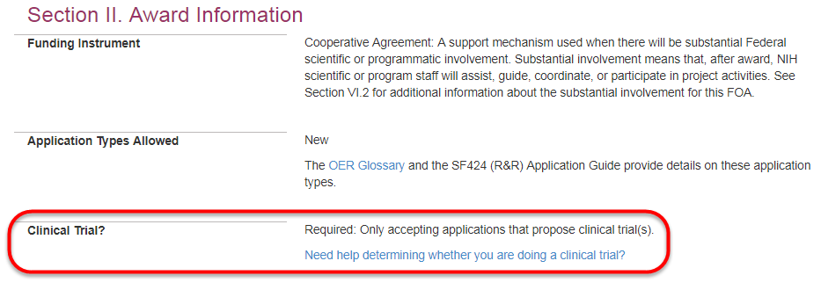
Section II. Award Information
Section II of each FOA will include one of these statements
Not allowed: Only accepting applications that do not propose [independent] clinical trials
Required: Only accepting applications that propose clinical trial(s)
Optional: Accepting applications that either propose or do not propose clinical trial(s)

Slide 8
Special Considerations for Programs Focused on Early Career Stages
Fellowship (Fs)
Training (Ts)
Career Development (Ks)
All FOAs are Independent Clinical Trial Not Allowed
Fellows can still play an active role and gain experience in clinical trials led by a sponsor/co-sponsor as part of their research training
All FOAs are Independent Clinical Trial Not Allowed
Appointed Trainees can still play an active role and gain experience in clinical trials led by a mentor or co-mentor
Some FOAs are Independent Clinical Trial Not Allowed
Candidates can still play an active role and gain experience in clinical trials led by a mentor/co-mentor as part of their research career development
Others are Clinical Trial Required
Allow independent clinical trials
Why aren’t fellows and trainees allowed to lead an independent clinical trial?
Fellows and trainees may not yet possess the skills to independently lead a clinical trial and navigate all the components, complexities, and reporting requirements
Fellowship and training grants do not include sufficient research funds to support the majority, if not all types, of clinical trials

Slide 9
Examples of Allowability in FOA Titles
NIH Research Project Grant (Parent R01 – Clinical Trial Not Allowed)
Exploratory Clinical Trial Grants in Arthritis and Musculoskeletal and Skin Diseases (R21 – Clinical Trial Allowed)
Administrative Supplements to Existing NIH Grants and Cooperative Agreements (Admin Supp – Clinical Trial Optional)
NIH FOAs that do not include a clinical trial allowability indicator in the title are “Clinical Trial Not Allowed”
Back to The Board
To the Spinner!

Slide 10
True or False:
My proposal does not involve human subjects, I can ignore the Human Subjects Clinical Trials Information form.
2
False:
You must still answer the first question concerning the involvement of human subjects.
Notes:
CLICK ON THE QUESTION BOX TO REVEAL THE ANSWER
CLICK ON THE ANSWER BOX TO RETURN TO THE MAIN MENU

Slide 11
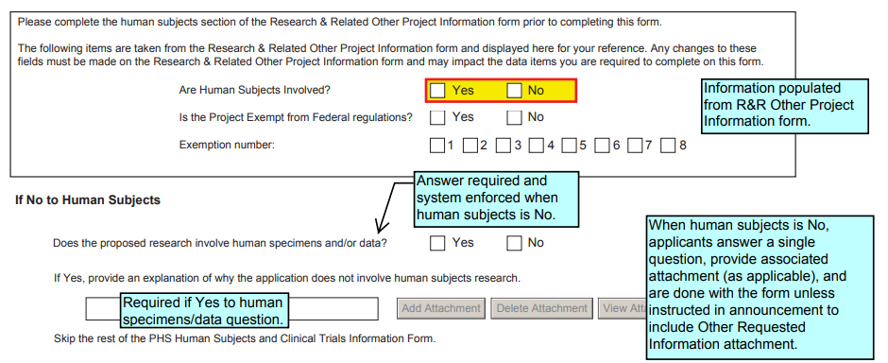
Human Subjects Involvement
Carried over from Question 1. and 1.a. on R&R Other Project Information
Must answer this question on Human Subjects and Clinical Trials Information form, and provide attachment if required by the FOA.
Back to The Board
To the Spinner!

Slide 12
What eRA Commons system was replaced by the Humans Subjects System (HSS)?
3
The Inclusion Management System (IMS) was replaced by HSS on June 9, 2018.
Notes:
CLICK ON THE QUESTION BOX TO REVEAL THE ANSWER
CLICK ON THE ANSWER BOX TO RETURN TO THE MAIN MENU

Slide 13
What Is The Human Subjects System?
HSS is a shared system that enables grant recipients to electronically report and update their data on human subjects and clinical trials to NIH. The system will also allow NIH agency staff to monitor and manage the data.
What are the features?
Add/update study information
Create new enrollment reports or view/edit/update existing enrollment data
Make off-cycle corrections or updates after application or Research Performance Progress Report (RPPR) submission
Convert a delayed onset study to a full study record, once detailed study information is available
Provide interim data as requested by NIH staff, in the funding opportunity announcement, or in the terms and conditions of award
Inform NIH of ClinicalTrials.gov registration

Slide 14
HSS In eRA Commons – RPPR
Principal Investigators, their delegates, and Signing Officials will see a Human Subjects link in section G.4.b of the Research Performance Progress Report (RPPR).
The RPPR Human Subjects link will only be displayed if the award involves human subjects.
Back to The Board
To the Spinner!

Slide 15
What delegation permits either another PI, or a user with the ASST role, the ability to initiate, and edit an HSS record?
4
The Progress Report Delegation
Notes:
CLICK ON THE QUESTION BOX TO REVEAL THE ANSWER
CLICK ON THE ANSWER BOX TO RETURN TO THE MAIN MENU

Slide 16
Progress Report Delegation
Type (Name) | By | To | What it does
Progress Report | SO, AA, AO | PI on behalf of a PI | Enables the delegated PI to work on progress reports of another PI – includes Interim and Final RPPR and HSS requests
Progress Report | PI | User within Institution | Enables the authorized user to work on progress reports for the PI – includes Interim and Final RPPR and HSS requests
Sponsor | SO, AA (on behalf of Sponsor) | ASST | Allows the ASST to access the xTrain module
Status | PI | ASST | Allows the ASST to work with the Status module
PPF | All Users | User within Institution | Enables another user to edit someone else's personal profile
Submit | SO, BO | PI | Enables the PI to submit RPPR and MYPR reports – now needed for PI if they are to submit Interim and Final RPPR, and HSS requests
xTrain | PI, Sponsor | ASST | Enables the ASST to work with the xTrain module and xTRACT
Progress Report delegation now applies to Interim RPPR and Final RPPR to a specified PI and/or anyone with the Assistant (ASST) role.
It permits a specified PI and/or anyone with the Assistant (ASST) role to initiate and edit HSS records.
Back to The Board
To the Spinner!

Slide 17
True or False:
The HSS is automatically populated by human subjects and clinical trial data entered on the Human Subjects and Clinical Trial Information form.
5
True!
Notes:
CLICK ON THE QUESTION BOX TO REVEAL THE ANSWER
CLICK ON THE ANSWER BOX TO RETURN TO THE MAIN MENU

Slide 18
HSS Pre-Population of Data
The HSS is automatically populated by human subjects and clinical trial data entered on the Human Subjects and Clinical Trial Information form in applications submitted for due dates of January 25, 2018 and beyond.
Back to The Board
To the Spinner!

Slide 19
List the 3 reports required to complete the Closeout process.
1
Closeout items include:
Final Research Performance Progress Report
(F-RPPR)
Federal Financial Report (FFR)
Final Invention Statement
Notes:
CLICK ON THE QUESTION BOX TO REVEAL THE ANSWER
CLICK ON THE ANSWER BOX TO RETURN TO THE MAIN MENU

Slide 20
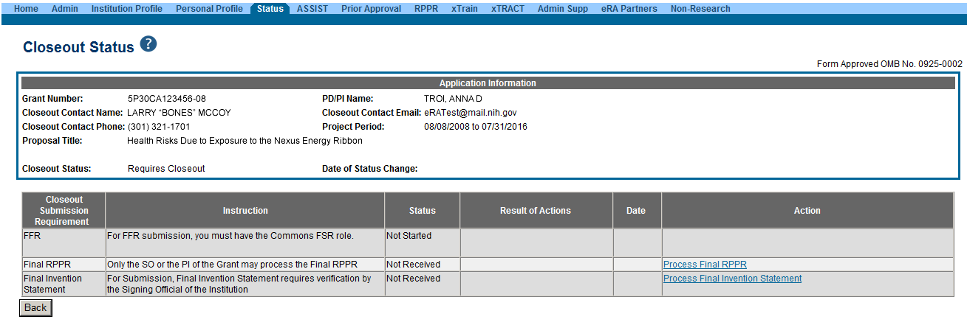
Closeout Screen
The FSR (Financial Status Report) role is required to view, edit, and submit the FFR on behalf of the institution.
Closeout now uses the Final RPPR format, which replaced the Final Progress Report (FPR).
Final Invention Statement: Either the PI or the SO can start the process, but the SO must verify the report before submitting it to the agency.
Back to The Board
To the Spinner!

Slide 21
What process allows an awarding IC to request additional information during Closeout?
2
FRAM
Final Report Additional Materials
Notes:
CLICK ON THE QUESTION BOX TO REVEAL THE ANSWER
CLICK ON THE ANSWER BOX TO RETURN TO THE MAIN MENU

Slide 22
Closeout - FRAM
FRAM works in the same manner as PRAM in RPPR
Awarding IC sets status to FRAM Requested
Awarding IC triggers email for requested information to the SO & PI
The FRAM Update link appears in Action column

Slide 23
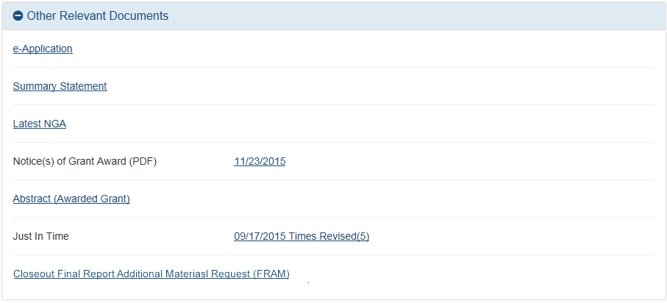
Closeout – FRAM in Other Relevant Documents
Specifics about the FRAM request can also be found in Other Relevant
Documents section of the Status Information screen.
Back to The Board
To the Spinner!

Slide 24
Select the correct number of days past the Project Period End Date (PPED) that you have to submit the FFR.
A) 75 B) 90 C) 120 D) 260
3
120 Days
Notes:
CLICK ON THE QUESTION BOX TO REVEAL THE ANSWER
CLICK ON THE ANSWER BOX TO RETURN TO THE MAIN MENU

Slide 25
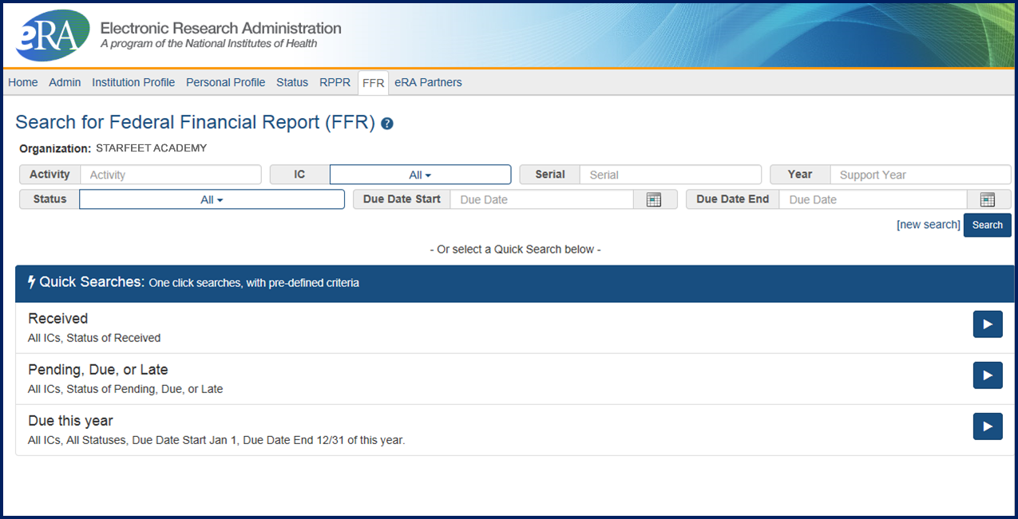
FFR Due Date
Final FFR due date: based on the Project Period End Date (PPED):
Pending Status: If the FFR is not submitted and it is within 120 days of the PPED
Due Status: If the FFR is not submitted and it is between the PPED and 120 days past the PPED
Late: If the FFR is not submitted and it is more than 120 days past the PPED
Back to The Board
To the Spinner!

Slide 26
What new section of the Final RPPR was added that is not in the Annual RPPR?
4
Section I: Outcomes
Notes:
CLICK ON THE QUESTION BOX TO REVEAL THE ANSWER
CLICK ON THE ANSWER BOX TO RETURN TO THE MAIN MENU

Slide 27
Section I: Outcomes
A new section of the RPPR specifically designed to be made publicly available by the agency (analogous to the abstract in the competing application)
Reporting in the Outcomes section is limited (by the federal-wide RPPR format) to 8,000 characters
The Outcomes should provide a concise summary of the findings of the award written in lay language for the general public
In an effort to increase transparency NIH will make the Outcomes data available in RePORTER

Slide 28
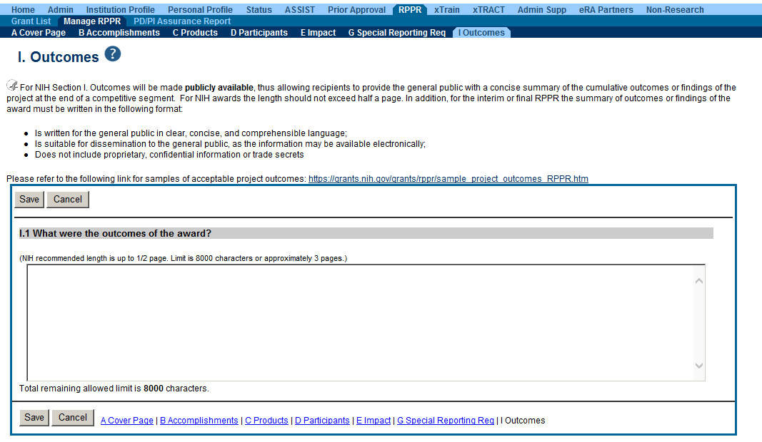
Section I: Outcomes Screen
Information in Outcomes will be publically available. It should be written as a high level and in plain language.
Back to The Board
To the Spinner!

Slide 29
What two conditions must be met to make the Closeout link appear in Commons?
5
The project period end date has passed,
and
A Type 2 application has not been submitted
Notes:
CLICK ON THE QUESTION BOX TO REVEAL THE ANSWER
CLICK ON THE ANSWER BOX TO RETURN TO THE MAIN MENU

Slide 30
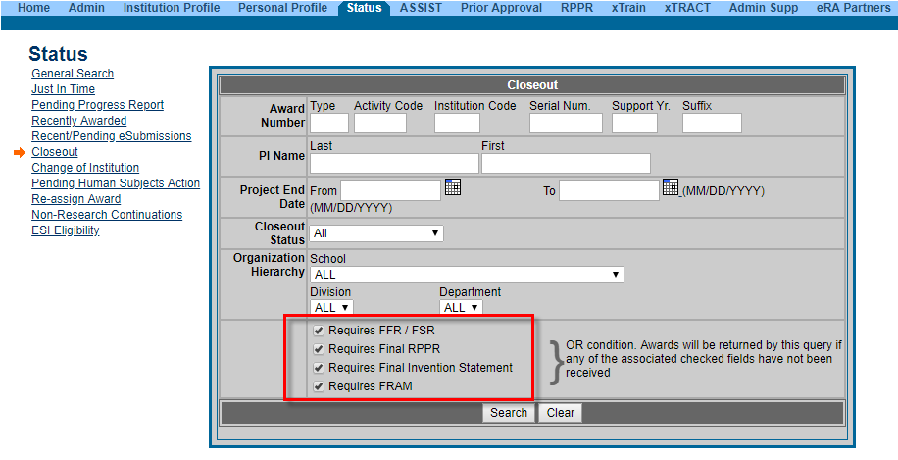
Closeout Search screen provides additional search criteria
Back to The Board
To the Spinner!

Slide 31
Name the 3 variations of the Research Performance Progress Report (RPPR)
1
Annual RPPR
Interim RPPR (I-RPPR)
Final RPPR (F-RPPR)
Notes:
CLICK ON THE QUESTION BOX TO REVEAL THE ANSWER
CLICK ON THE ANSWER BOX TO RETURN TO THE MAIN MENU

Slide 32
The RPPRs
Annual RPPR – Use to describe a grant’s scientific progress, identify significant changes, report on personnel, and describe plans for the subsequent budget period or year.
Final RPPR – Use as part of the grant closeout process to submit project outcomes in addition to the information submitted on the annual RPPR, except budget and plans for the upcoming year.
Interim RPPR – Use when submitting a renewal (Type 2) application. If the Type 2 is not funded, the Interim RPPR will serve as the Final RPPR for the project. If the Type 2 is funded, the Interim RPPR will serve as the annual RPPR. The data elements collected on the Interim RPPR are the same as for the Final RPPR, including project outcomes.
Back to The Board
To the Spinner!

Slide 33
What highly requested functionality was recently added to the Effort Reporting Field in the RPPR?
2
The Effort Reporting Field now supports decimals.
Notes:
CLICK ON THE QUESTION BOX TO REVEAL THE ANSWER
CLICK ON THE ANSWER BOX TO RETURN TO THE MAIN MENU

Slide 34
RPPR and Level Of Effort
Notice Number: NOT-OD-18-202
NIH Synchronizes Institutional Delegations and Now Allows Decimals in Effort Reporting Field in Research Performance Progress Reports (RPPR)
https://grants.nih.gov/grants/guide/notice-files/NOT-OD-18-202.html
Back to The Board
To the Spinner!

Slide 35
When HSS data is set to the status “Ready to submit,”
who gets notified?
3
It depends…
Notes:
CLICK ON THE QUESTION BOX TO REVEAL THE ANSWER
CLICK ON THE ANSWER BOX TO RETURN TO THE MAIN MENU

Slide 36
Focused Notifications
Focused notifications will be sent when a user changes the status of updates to human subjects or clinical trial information to ‘ready to submit’ in HSS:
Only the Authorized Organizational Representative (AOR) listed on the original submission of the competitive application (type 1 and 2) or change of institution (type 7) will receive these email notifications.
For HSS changes made on non-competitive years (type 5), the SO associated with the Research Performance Progress Report (RPPR) will be notified.
If we are unable to identify an email address using either of these choices, notifications will be sent to the institutional contact listed in the Institutional Profile in eRA Commons.
Back to The Board
To the Spinner!

Slide 37
When is the Interim RPPR used and how does NIH use it to reduce your burden?
4
I-RPPR is used when the recipient organization has submitted a Competing Renewal application (Type 2) on or before the date by which a Final Research Performance Progress Report (F-RPPR) would be required for the current competitive segment.
Notes:
CLICK ON THE QUESTION BOX TO REVEAL THE ANSWER
CLICK ON THE ANSWER BOX TO RETURN TO THE MAIN MENU

Slide 38
Interim RPPR
Competing Renewal Application Status | Action
Not Submitting a Competing Renewal Application | Submit a Final RPPR no later than 120 days from the project period end date.
Submitting a Competing Renewal Application | Submit an Interim RPPR no later than 120 days from the project period end date.
 | Funded | Not Funded
 | The Interim RPPR is automatically accepted as an Annual RPPR. | The Interim RPPR is automatically accepted s the Final RPPR.
Back to The Board
To the Spinner!

Slide 39
What feature of the RPPR permits NIH to request additional information regarding a submitted RPPR?
5
PRAM –
Progress Report Additional Materials
Notes:
CLICK ON THE QUESTION BOX TO REVEAL THE ANSWER
CLICK ON THE ANSWER BOX TO RETURN TO THE MAIN MENU

Slide 40
Progress Report Additional Materials (PRAM)
The PRAM feature provides a means for the grantee to enter, review, route, and submit information to agency following the submission of an RPPR.
Public Access (PA) PRAM - Generated automatically after an RPPR is submitted with publications that are not compliant with Public Access Policy
IC (Agency) Requested PRAM – Only available if requested by the Grants Management Specialist (GMS)
PD/PI can enter the PRAM, but can only submit it if they are delegated with Submit Progress Report authority. Otherwise, only the SO can submit the PRAM to Agency.

Slide 41
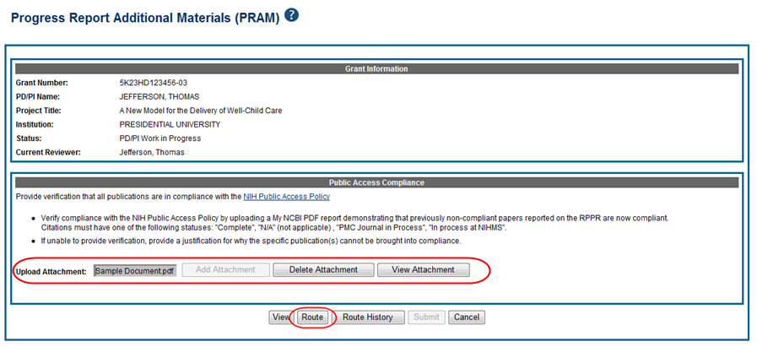
Accessing PRAM

Slide 42
Format for PA PRAM
Public Access (PA) PRAM will require an attachment.
The PA PRAM will no longer contain a free form text box.
Using My NCBI the institution will need to generate a PDF of their reported publications showing their compliance.
For instructions on generating the report please see:
https://www.nlm.nih.gov/pubs/techbull/nd12/nd12_myncbi_pdf.html
Back to The Board
To the Spinner!

Slide 43
Name two of three submission options available to prepare and submit an R01 grant application to NIH?
1
ASSIST
System-to-System
Grants.gov Workspace
Notes:
CLICK ON THE QUESTION BOX TO REVEAL THE ANSWER
CLICK ON THE ANSWER BOX TO RETURN TO THE MAIN MENU

Slide 44
eSubmission Options
Your Application Will Be…
Subject to the same registration requirements
Completed with the same data items
Routed through Grants.gov
Validated against the same NIH business rules
Assembled in a consistent format for review consideration
Tracked in eRA Commons
Regardless of the submission option used.
NOTE:
The use of downloadable PDF is no longer a valid submission option.

Slide 45
What Submission Options Are Applicants Using?
Back to The Board
To the Spinner!

Slide 46
The Inclusion Across Life Span initiative will eventually require what information for RPPRs starting after January 25, 2019?
2
Age at the time of enrollment
Notes:
CLICK ON THE QUESTION BOX TO REVEAL THE ANSWER
CLICK ON THE ANSWER BOX TO RETURN TO THE MAIN MENU

Slide 47
Inclusion Across Live Span Initiative
To ensure individuals are included in clinical research in a manner appropriate to the scientific question under study so that the knowledge gained from NIH-funded research is applicable to all those affected by the researched diseases/conditions.
Policy requires individual-level participant data, including age at enrollment
Data will be required for the first RPPRs for all applications submitted on and after January 25, 2019
Will replace the Inclusion Enrollment report for the RPPR
Feature allowing csv file upload Forms are is available now, just not required
Back to The Board
To the Spinner!

Slide 48
Which of the required registrations for application submission must be renewed yearly?
3
SAM
System of Award Management
Notes:
CLICK ON THE QUESTION BOX TO REVEAL THE ANSWER
CLICK ON THE ANSWER BOX TO RETURN TO THE MAIN MENU

Slide 49
Required Registrations
DUNS
Provides unique organization identifier
SAM (System for Award Management)
Needed to do business with government
Must be renewed yearly!
Grants.gov
Required to submit grants
eRA Commons
Required to do business with NIH
SBA (Small Business Administration)
Required for SBIR/STTR applications
August 1, 2018 – NIH no longer allows late submissions for SAM registration delays based on new notarized letter requirement (NOT-OD-18-215).

Slide 50
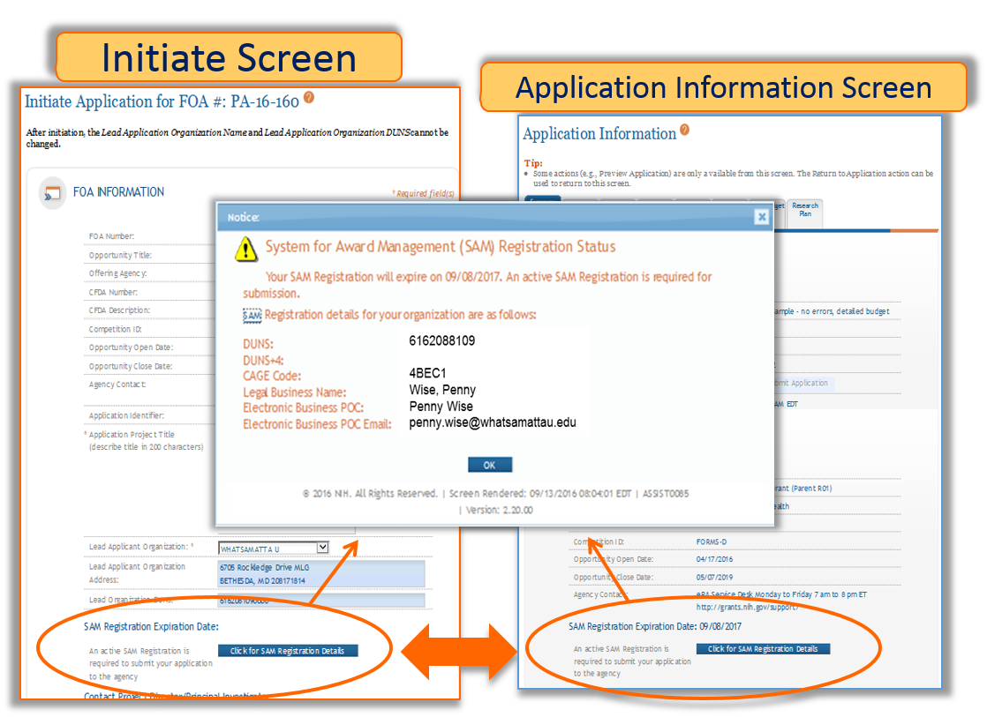
SAM and ASSIST
Visibility in ASSIST
Button on the Initiate screen
Button on Application Information screen
Both open the SAM Registration Status screen

Slide 51
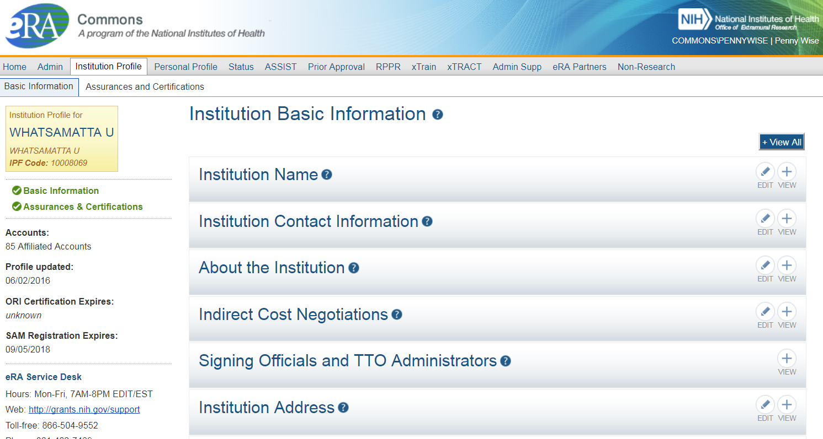
SAM and eRA Commons
Visibility of SAM on the Institutional Profile Screen
Back to The Board
To the Spinner!

Slide 52
If you forget your eRA Commons password, who do you call?
4
Not the Ghostbusters!
Notes:
CLICK ON THE QUESTION BOX TO REVEAL THE ANSWER
CLICK ON THE ANSWER BOX TO RETURN TO THE MAIN MENU

Slide 53
What to do to Reset Your Password
Do not call the eRA Service Desk
They cannot reset passwords or change personal data.
Go to the Forgot Password/Unlock Account? link on the Commons home page and follow the prompts
This only works if you know and have access to the email address you entered on your personal profile.
If you don’t have access to that email account, contact your SO or AA and ask them to change the email address to an account you have access to.
The complete Forgot Password/Unlock Account? process
A temporary password will be sent to the email address. Use that to login. You will then be prompted to provide a new email address.

Slide 54
Account Password Policy
Passwords must:
Contain at least eight (8) characters: no more than 16; no blank spaces
Contain a combination of at least 3 of the following:
Upper case letters
Lower case letters
Numbers, not at beginning or end of the password
Special characters: ! # $ % - _ = + < >
The following special characters are NOT allowed:
@ ^ & ( ) | " \ ' { } [ ] : ; ` ? , . /
Not begin or end with a number
Not contain username
Not be reused within eight (8) years, or 24 passwords cycles
Be changed every 120 days
Passwords created or changed by the Institute and/or Center (IC) Account Administrators must be changed at first login.
Accounts are locked after six (6) consecutive unsuccessful login attempts. Users can click the Forgot Password/Unlock Account? link under the login fields of the Commons homepage to unlock their account(s). Be advised that a temporary password will be forwarded to the account owner's email address and is active for only 48 hours.
Back to The Board
To the Spinner!

Slide 55
What should you do if you encounter an issue with a federal system that threatens your ability to submit on-time?
5
You must follow NIH’s standard ‘system issue’ procedure if you run into problems beyond your control that threaten your on-time submission.
Notes:
CLICK ON THE QUESTION BOX TO REVEAL THE ANSWER
CLICK ON THE ANSWER BOX TO RETURN TO THE MAIN MENU

Slide 56
Dealing with System Issues
You MUST follow the instructions:
Contact the appropriate system support desk
Open a ticket with the eRA Service Desk to document your good faith effort to submit
Document in your application cover letter the confirmed system issue, support desk ticket numbers, and the actions taken to resolve the issue
Dealing with System Issues
https://grants.nih.gov/grants/how-to-apply-application-guide/due-dates-and-submission-policies/dealing-with-system-issues.htm

Slide 57
Non-System Issues
Examples of events that would not be considered ‘System Issues’:
Failure to follow funding opportunity instructions
Failure to follow application guide instructions
Failure to follow related notices in the NIH Guide for Grants and Contracts
Failure to complete required registrations prior to deadline
Failure to correct Grants.gov or eRA identified errors/warnings by the deadline
Local internet problem at institution
Grants.gov AOR not authorized to submit for organization
Forgot credentials
Discovered application image issue after the application viewing window
Failure to notify the eRA Service Desk of submission issues by deadline or of application image issues within application viewing window.
Rejected/Refused an application by accident
Did not receive Grants.gov or eRA notification emails, but status available in Grants.gov and eRA Commons
eRA Service Desk:
https://grants.nih.gov/support/index.html
Back to The Board
To the Spinner!

Slide 58
Name the 2 places a PI can see information regarding reference letters?
1
On the Personal Profile form
The Status Information Screen
Notes:
CLICK ON THE QUESTION BOX TO REVEAL THE ANSWER
CLICK ON THE ANSWER BOX TO RETURN TO THE MAIN MENU

Slide 59
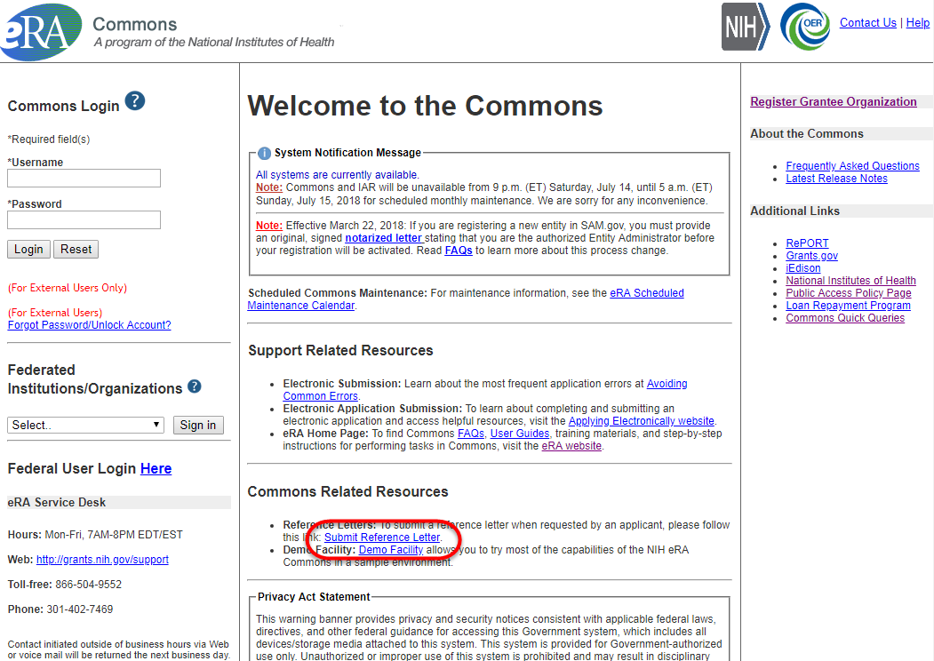
Reference Letters
NOT part of the application through Grants.gov
Submitted directly by the referee through eRA Commons
Commons registration not required by referee
Can be submitted in advance of application submission
Due by the application submission deadline
Applicants can track the submission of reference letters in the Commons, but cannot view the actual letter
Fellowship reference letters no longer have a required format – just a letter
Applicant MUST provide to referee the FOA number and their eRA Commons Username

Slide 60
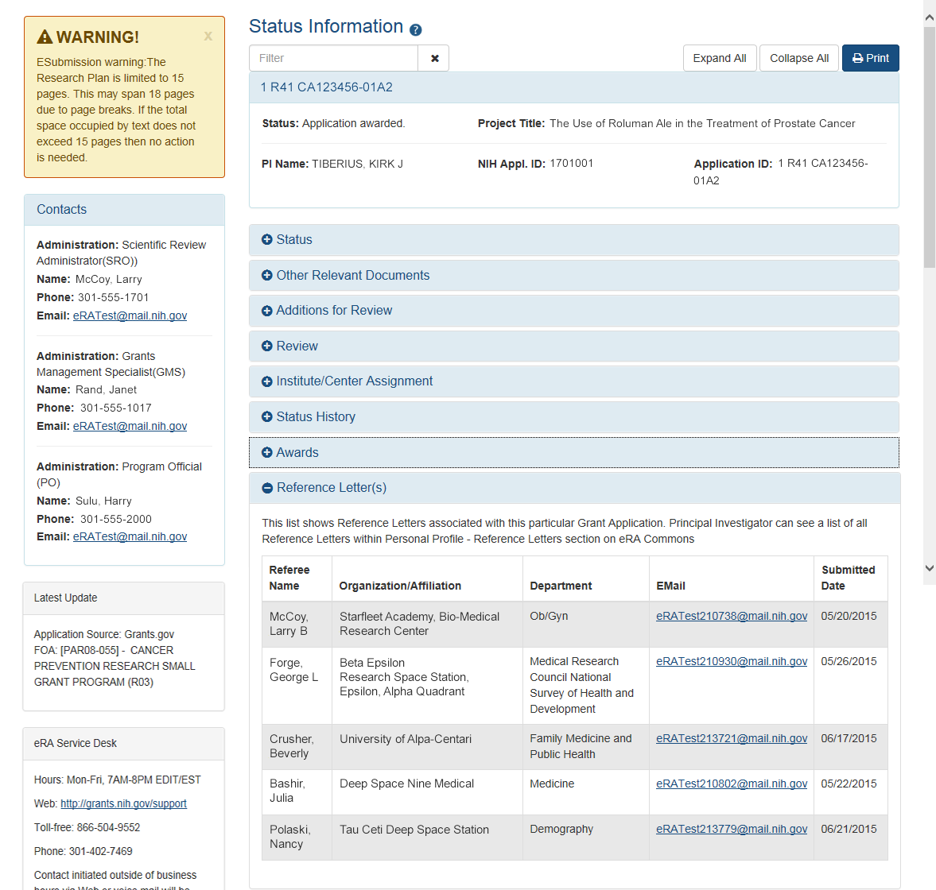
Reference Letters - Status Information
Reference Letters section on the Status Information screen are for a specific application.
Applicant sees:
Name of referee
Name of referee’s institution
Department
Email Address
Date of submission
Applicant does not see actual letter

Slide 61
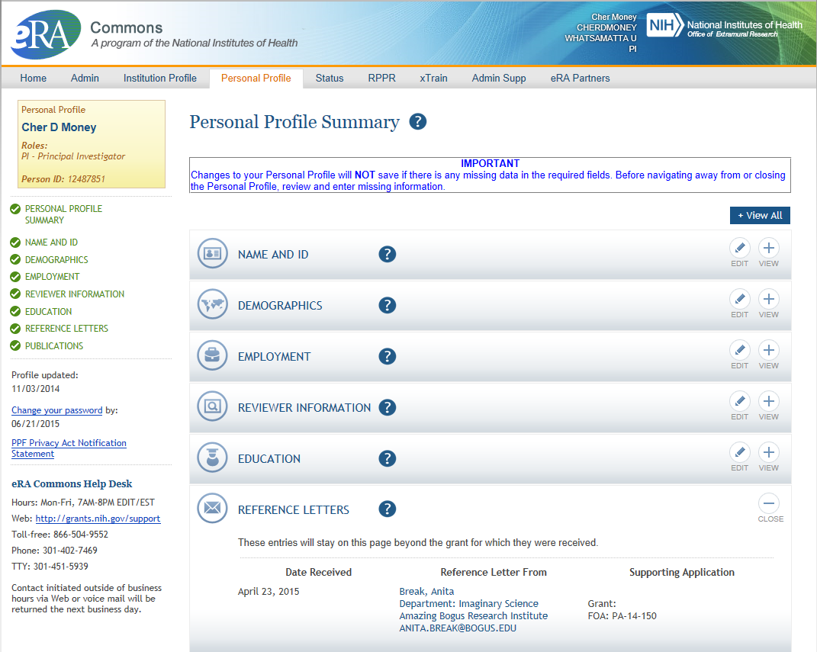
Reference Letters – Personal Profile Screen
Reference Letters section on the Status Information screen are a summary of all letters received.
Grantee can see:
When it was submitted
Who submitted it
What grant it is linked to
Grantee does not see actual letter
Back to The Board
To the Spinner!

Slide 62
Who can see the Status Information screen?
2
The Principal Investigator
The Signing Official
A person with the PPF Delegation
Notes:
CLICK ON THE QUESTION BOX TO REVEAL THE ANSWER
CLICK ON THE ANSWER BOX TO RETURN TO THE MAIN MENU

Slide 63
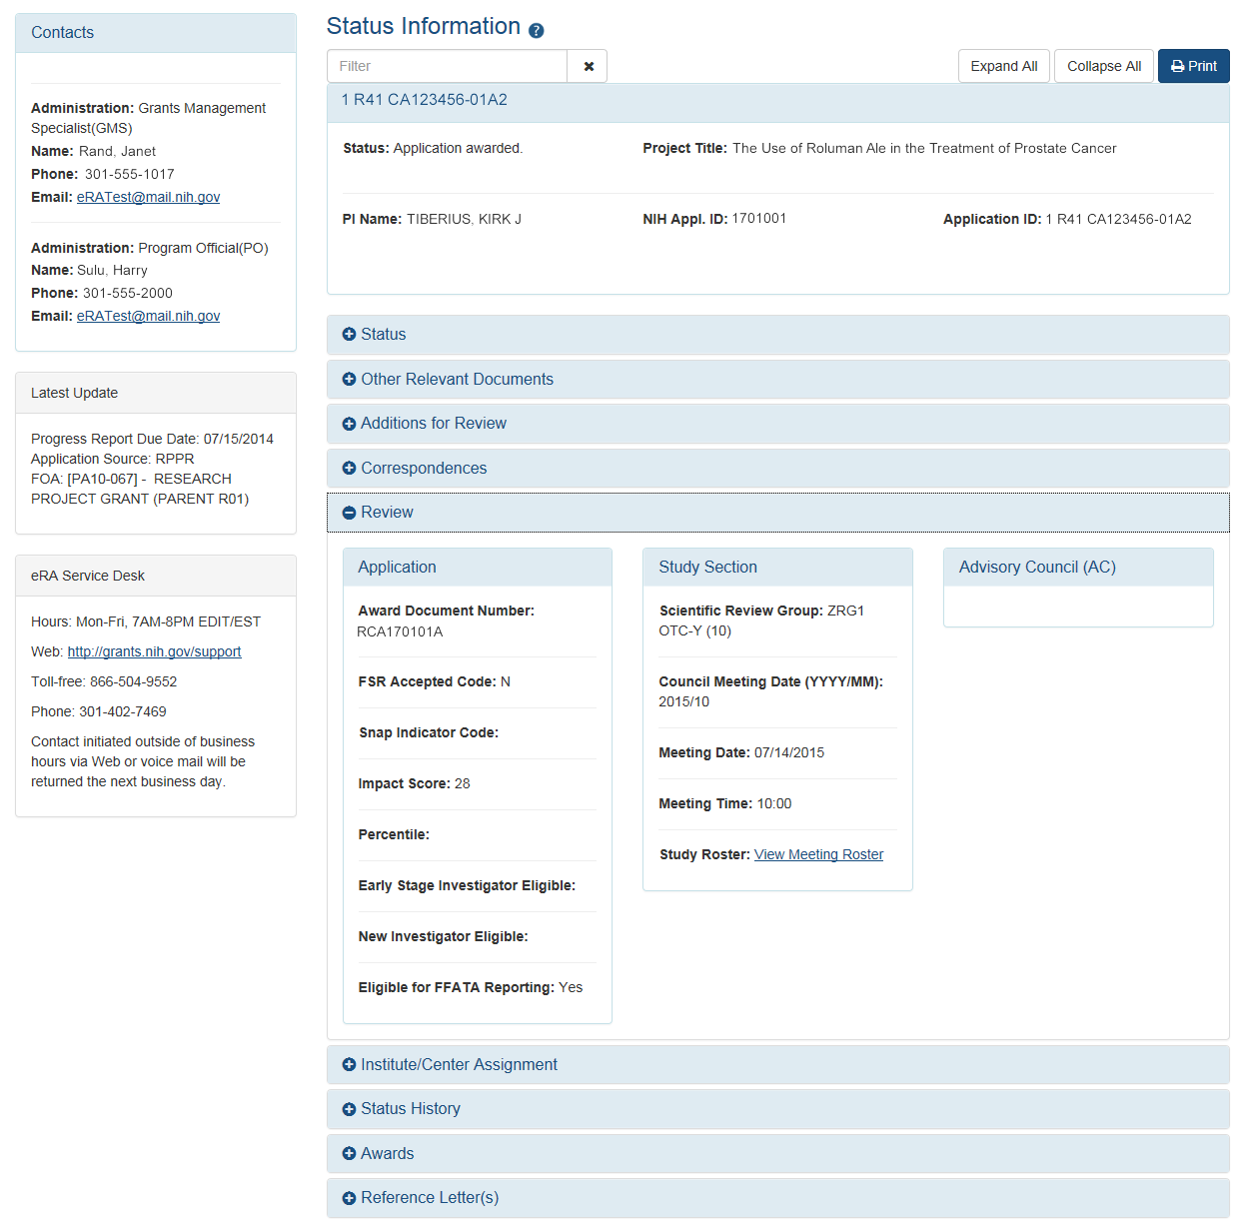
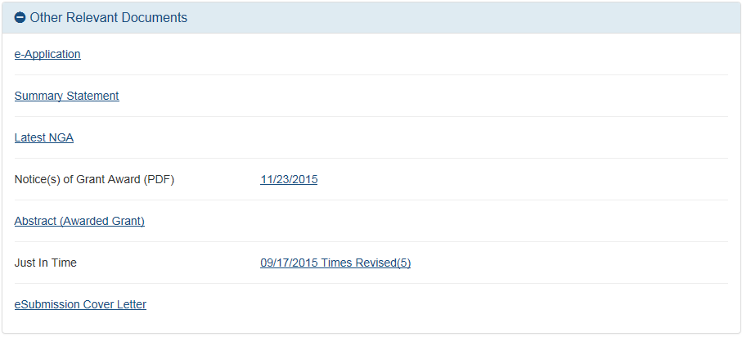
Detailed Information on Status Screen
Screen includes information on:
NIH Contact
Application Status
Relevant Documents
Review Information
Scores
Study Section
Advisor Council
ESI & NI Status
Assigned IC
Award Information
And more..
Only the PI sees the Summary Statement and Scores

Slide 64
Personal Profile Delegation
Type (Name) | By | To | What it does
Progress Report | SO, AA, AO | PI on behalf of a PI | Enables the delegated PI to work on progress reports of another PI – includes Interim and Final RPPR and HSS requests
Progress Report | PI | User within Institution | Enables the authorized user to work on progress reports for the PI – includes Interim and Final RPPR and HSS requests
Sponsor | SO, AA (on behalf of Sponsor) | ASST | Allows the ASST to access the xTrain module
Status | PI | ASST | Allows the ASST to work with the Status module
PPF | All Users | User within Institution | Enables another user to edit someone else's personal profile
Submit | SO, BO | PI | Enables the PI to submit RPPR and MYPR reports – now needed for PI if they are to submit Interim and Final RPPR
xTrain | PI, Sponsor | ASST | Enables the ASST to work with the xTrain module and xTRACT
Back to The Board
To the Spinner!

Slide 65
True or False:
Both PIs and SOs access the new Human Subjects System through the RPPR screens only.
3
False!
Notes:
CLICK ON THE QUESTION BOX TO REVEAL THE ANSWER
CLICK ON THE ANSWER BOX TO RETURN TO THE MAIN MENU

Slide 66
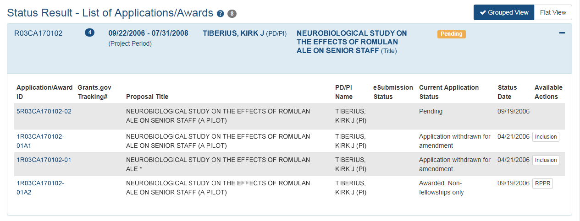
HSS In eRA Commons – PI Status View
Principal Investigators will no longer see “Inclusion” links as an action option, but instead will see “Human Subjects” links on the Status Result search screens

Slide 67
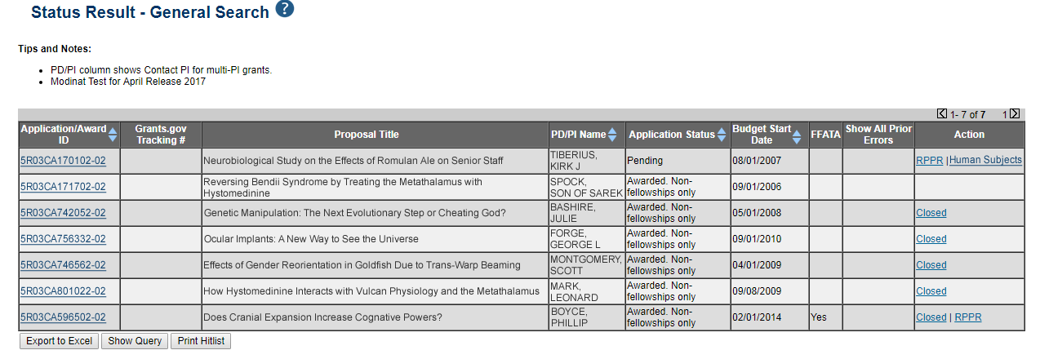
HSS In eRA Commons – SO Status View
Signing Officials will no longer see “Inclusion” links as an action option, but instead will see “Human Subjects” links on the Status Result search screens
Back to The Board
To the Spinner!

Slide 68
Which eRA Commons role works with a variety of delegations?
4
The ASST (Assistant) Role
Notes:
CLICK ON THE QUESTION BOX TO REVEAL THE ANSWER
CLICK ON THE ANSWER BOX TO RETURN TO THE MAIN MENU

Slide 69
eRA Commons Roles
The functions that a user can perform in the Commons are based on the role(s) assigned to his or her Commons account
Can’t combine scientific roles with administrative or other roles on the same account
Other combinations are fine (e.g., PI and IAR; AO and FSR)
A person needing both scientific and administrative roles should have two separate accounts (one for scientific roles and another for other roles)
Full, printable list of eRA Commons roles: http://era.nih.gov/files/eRA_Commons_Roles.pdf

Slide 70
Roles
Administrative
AA – Account Administrator
AO – Administrative Official
ASST – Assistant
BO – Business Official
SO – Signing Official
ASSIST Access Maintainer Role
Scientific
Graduate Student
IAR – Internet Assisted Review
PI - Principal Investigator
Post-Doc
Project Personnel
Scientist
Sponsor
Trainee
Undergraduate
Other
FCOI (Financial Conflict of Interest)
FCOI_ASST
FCOI_VIEW
FSR (Financial Status Reporter)
PACR (Public Access Compliance Reporting)
OLAW (Reporting Animal Welfare)
NEWEST!
Permits user to manage access to all ASSIST applications in their institution.
Back to The Board
To the Spinner!

Slide 71
The Account Management System (AMS) added a new feature in March 2016.
What reporting feature was that?
5
The All Users Report
Notes:
CLICK ON THE QUESTION BOX TO REVEAL THE ANSWER
CLICK ON THE ANSWER BOX TO RETURN TO THE MAIN MENU

Slide 72
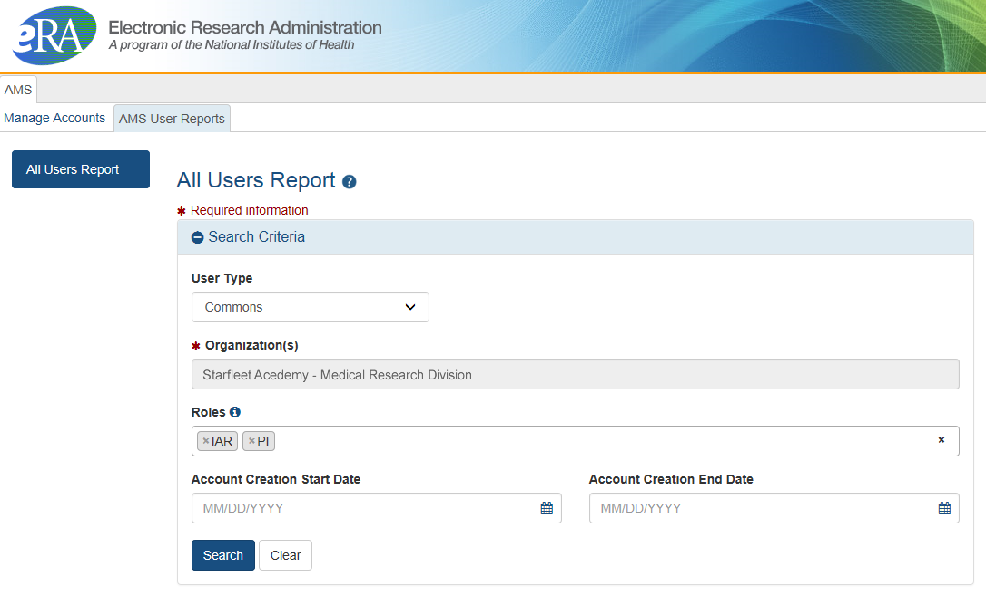
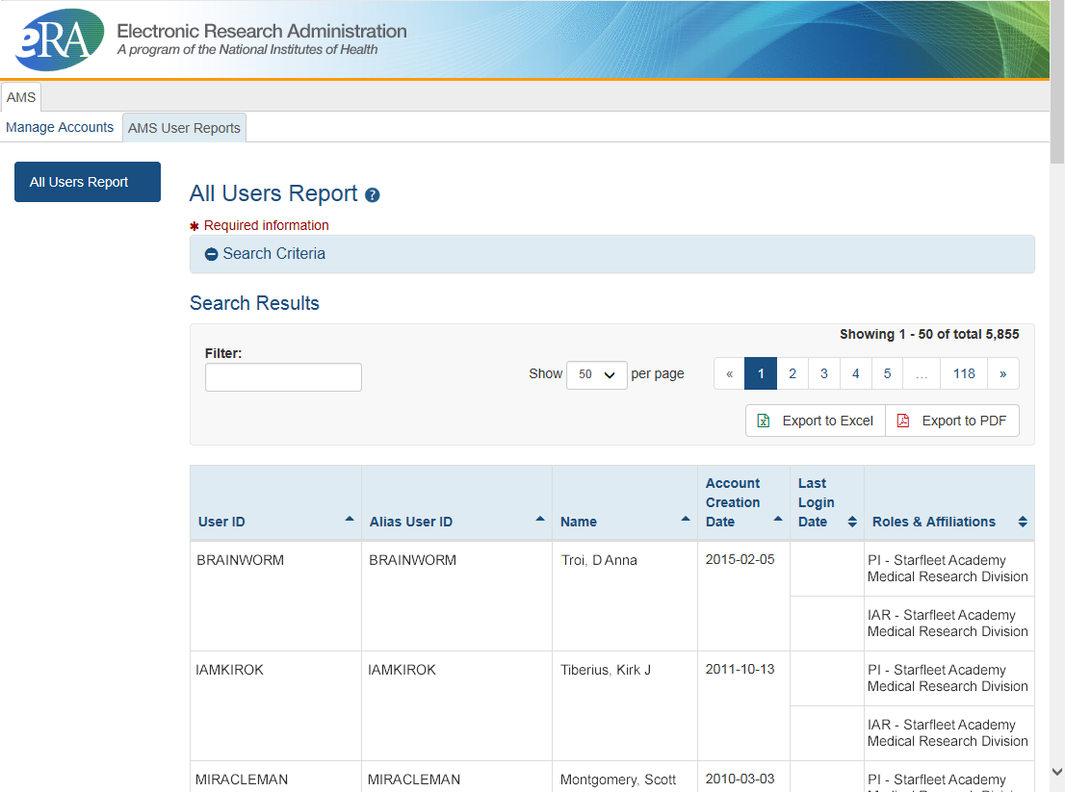
All Users Report
Search on one eRA Commons role or multiple roles
Accessed from Admin > Accounts > Accounts Management
Search by role or multiple roles
Limited to users only at your institution
Unlike other search features with a limit of 500 hits, there is no limit to number of users returned in report search
Result can be exported as a spread sheet or PDF document
View and export options
Back to The Board
To the Spinner!

Slide 73
True or False:
NIH systems catch all errors that could potentially keep my application from going to review.
1
False:
Multiple levels of application checks for completeness
Grants.gov.
eRA systems
Agency staff
Notes:
CLICK ON THE QUESTION BOX TO REVEAL THE ANSWER
CLICK ON THE ANSWER BOX TO RETURN TO THE MAIN MENU

Slide 74
Sample Validations
Grants.gov | eRA Systems | Agency Staff
Active System for Award Management (SAM) registration Submitter has AOR role for DUNS on application Submission made to active opportunity and application package Virus check Filenames include only appropriate characters | Fields required by agency, but not required federal-wide R&R Sr/Key form Credential for PD/PIs Organization name for all sr/key Biosketch for all sr/key Performance Site form DUNS for primary site Attachments in PDF format Adherence to page limits in our Table of Page Limits All appropriate attachments included | Fit with NIH/Institute mission Eligibility “Overstuffing” Appropriateness of appendices On-time submission Adherence to funding opportunity announcement specific instructions Fonts and margin guidelines Simultaneous review of essentially same application
Back to The Board
To the Spinner!

Slide 75
How does NIH define an “on time” application submission?
2
Error-free applications must be accepted by Grants.gov with a time stamp on or before 5:00 p.m. local time of the submitting organization on the due date.
Notes:
CLICK ON THE QUESTION BOX TO REVEAL THE ANSWER
CLICK ON THE ANSWER BOX TO RETURN TO THE MAIN MENU

Slide 76
On-time Application Submission
Important Reminders
NIH recommends submitting early to allow time for correcting any errors found during the application viewing window prior to the due date
NIH’s late policy does not allow corrections after the due date
All registrations and SAM renewal must be completed before the due date
Back to The Board
To the Spinner!

Slide 77
What is the name of the system that provides the ability to create training tables for progress reports and institutional training grant applications?
3
xTRACT:
Extramural Trainee Reporting And Career Tracking
Notes:
CLICK ON THE QUESTION BOX TO REVEAL THE ANSWER
CLICK ON THE ANSWER BOX TO RETURN TO THE MAIN MENU

Slide 78
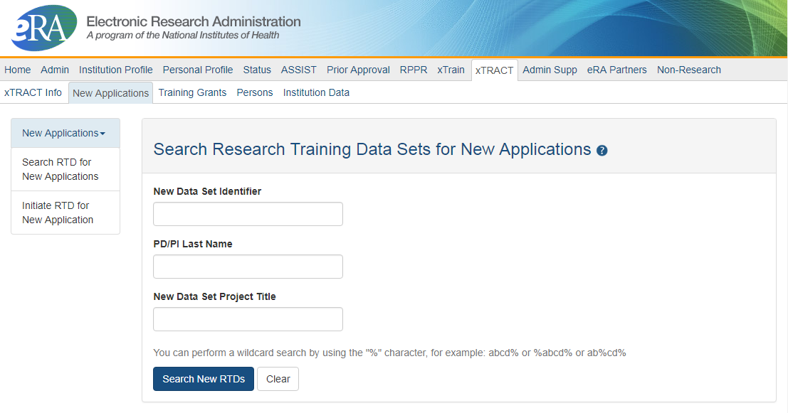
xTRACT
Advanced Notice! Beginning in early FY 2020, NIH and AHRQ intend to require the use of the xTRACT system in the eRA Commons to prepare the required data tables for certain types of training grant applications.
See NOT-OD-18-133 for more information
Used for Training Grants for
RPPR Submissions
New applications
Can access information already in eRA Commons
Creates Research Training Datasets (RTDs) [Training Tables]
Tables are formatted, no manual formatting needed
Accessible by:
Signing Officials (SOs)
Principal Investigators (PIs)
Assistants (ASST)
Back to The Board
To the Spinner!

Slide 79
How to you request a No Cost Extension at the end of year two for a 5 year award?
4
Use the Prior Approval module, selecting the No Cost Extension option.
Notes:
CLICK ON THE QUESTION BOX TO REVEAL THE ANSWER
CLICK ON THE ANSWER BOX TO RETURN TO THE MAIN MENU

Slide 80
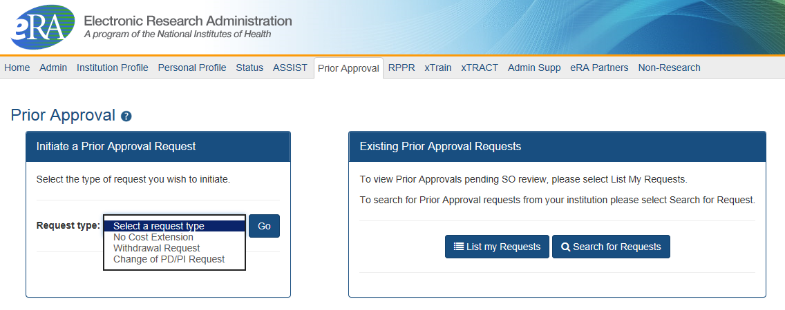
Prior Approval
eRA now supports four activities for Prior Approval Requests.
Request for withdrawal of an application
Request for No Cost Extension (NCE)
Request for Change of PD/PI
Request or Carryover of funds

Slide 81
No Cost Extension (NCE)
An extension of time to a project period and/or budget period to complete the work of the grant under that period, without additional Federal funds or competition.
When is a grant eligible for a NCE through Prior Approval?
When you have already used a NCE under expanded authority and you are within 90 days of the project end date.
When you are not under expanded authority and you are within 90 days of the project end date.
When the project end date has expired and has not been closed or has not entered unilateral closeout, whichever comes first.
Back to The Board
To the Spinner!

Slide 82
List 3 places where you can find very cool resources to guide you through all these processes.
5
There are soooo many places…
Notes:
CLICK ON THE QUESTION BOX TO REVEAL THE ANSWER
CLICK ON THE ANSWER BOX TO RETURN TO THE MAIN MENU

Slide 83
Resources
eRA Modules, User Guides, and Documentation
https://era.nih.gov/modules_user-guides_documentation.cfm
eRA Video Tutorials
https://era.nih.gov/era_training/era_videos.cfm
Grants.NIH.gov Information for…
https://grants.nih.gov/grants/information-for.htm
Annotated Forms Sets
https://grants.nih.gov/grants/how-to-apply-application-guide/resources/annotated-form-sets.htm
YouTube: NIH Channel
https://www.youtube.com/user/NIHgrants
How to Apply – Application Guide
https://grants.nih.gov/grants/how-to-apply-application-guide.html#resources
NIH Day / Seminar Handouts
https://era.nih.gov/about_era/nih_day.cfm
Back to The Board
To the Spinner!

Slide 84
Back to The Board
To the Spinner!

