Slide 1




Accessing IAR
From New eRA Commons Screens
eRA Communications & Documentation Team
April 2021

Slide 2
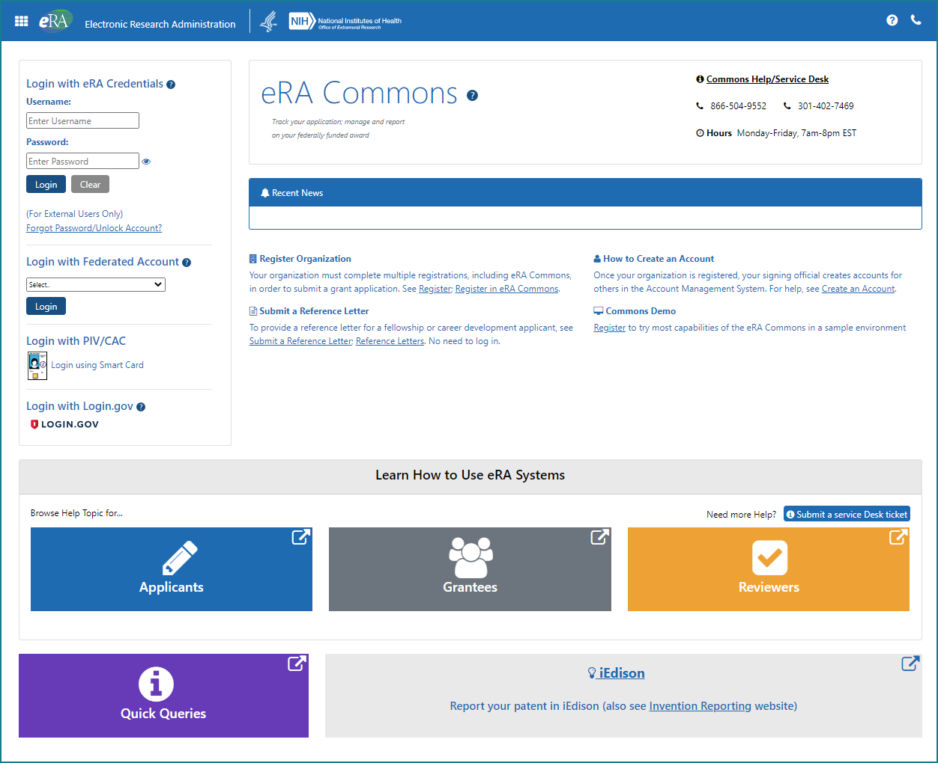
eRA Commons Home Screen
Home screen (log-in screen)

Slide 3
A CLOSE-UP

Slide 4
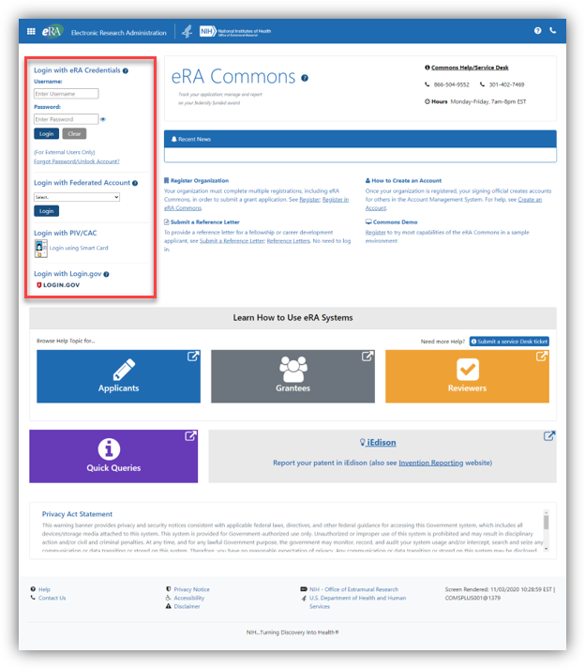
Login.gov info
Log in to eRA Commons
Note: Reviewers will be required to use login.gov to access eRA Commons/IAR.
Starting Dec, 14, 2020, this requirement began to be phased in for reviewers, meeting by meeting, effective for review meetings Feb. 1, 2021 and beyond.
As reviewers are enabled for meetings (including recruitment phase), their accounts will be transitioned to require login.gov to access IAR.

Slide 5
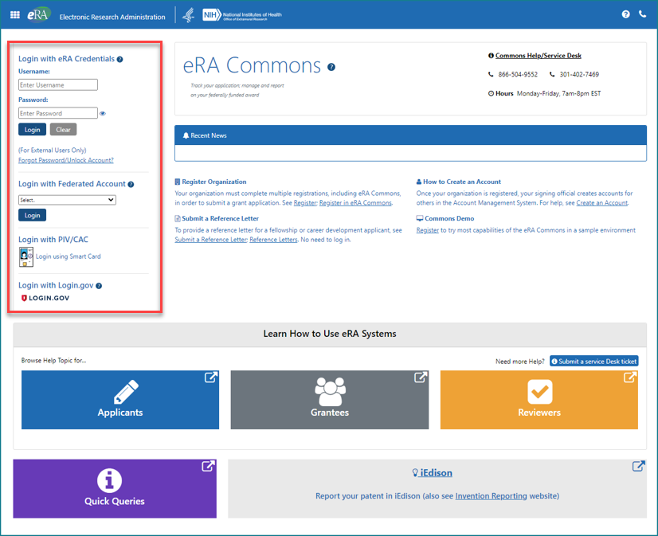
A CLOSE-UP

Slide 6
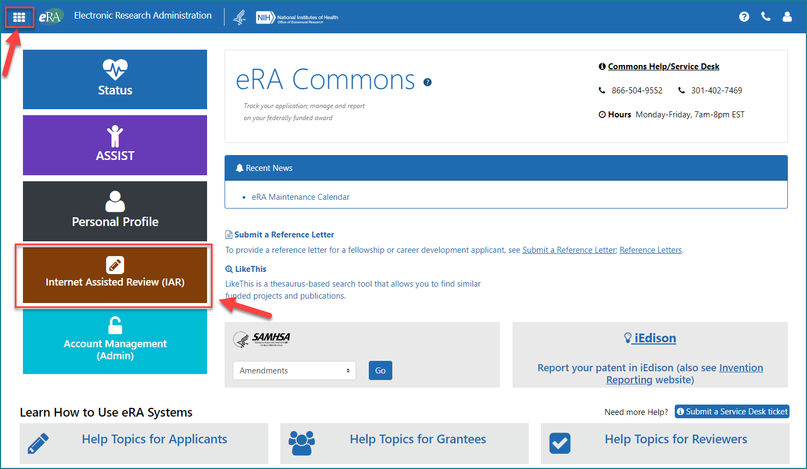
Two Ways to Access IAR on Landing Screen (After Log In)
TWO WAYS TO ACCESS IAR:
1. Click the prominent Internet Assisted Review (IAR) button to access IAR
OR
2. Click the 9-square apps menu icon in the top left corner for a dropdown menu where you can select IAR
(See slide 8 for the dropdown menu)

Slide 7
A CLOSE-UP

Slide 8
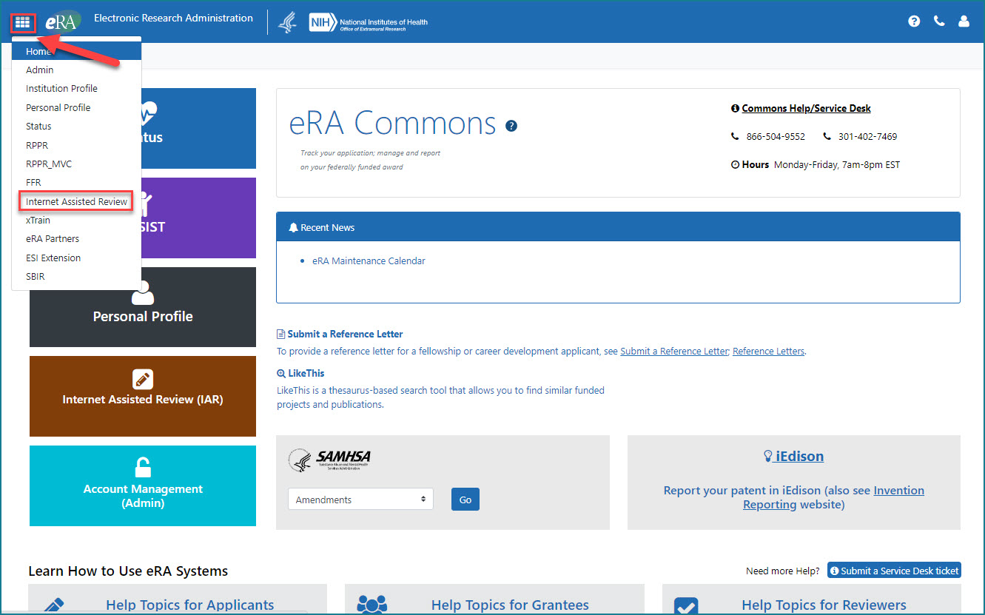
Apps Icon to Navigate to IAR
Dropdown Menu from Apps Icon to Navigate to IAR
Apps Icon
Clicking on the apps menu icon will present a dropdown menu to navigate to other eRA modules, including IAR.
Note: Only the modules to which a user has authorized access will be displayed on the drop-down menu

Slide 9
A CLOSE-UP

Slide 10
Resources
Webpage: Take a Sneak Peek: Redesigned eRA Commons Home Screen Coming in 2021
Video Tutorial: New eRA Commons Login and Landing Screens
Login.gov resource:
Webpage: Access eRA Modules Via Login.gov

