Slide 1




NIH eRA Workshop Day
How Does eRA Commons Fit in the Grant Process Puzzle?
May 2019
electronic Research Administration (eRA)
OER, OD, National Institutes of Health

Slide 2
Your Puzzle Masters
Scarlett Gibb
  eRA Customer Relationship Manager, eRA Commons
Joe Schumaker
  eRA Communications and Outreach

Slide 3


















The Grants Puzzle

Slide 4

Federal Funding Agencies
Who has money to give?

Slide 5

Lots of Federal Agencies Provide Grants
There are many agencies within the federal government that have grant programs; from the Department of Education, to the Department of Defense; from Health and Human Services (HHS), to the Nuclear Regulatory Commission.

Slide 6
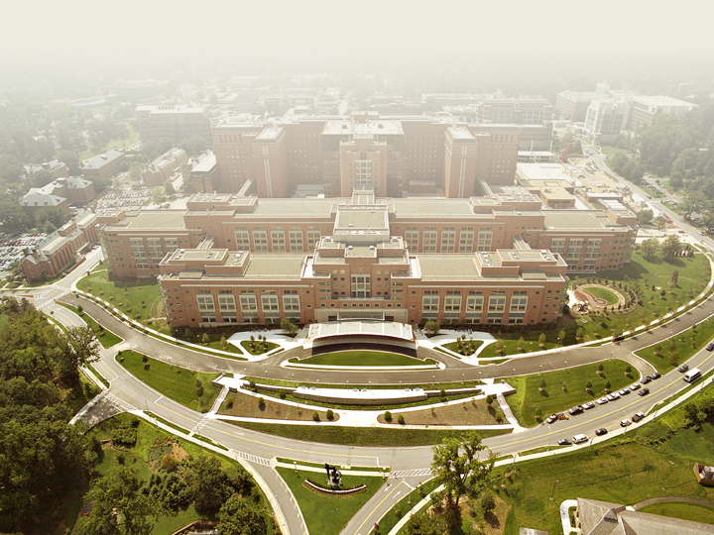
National Institutes of Health
Where does the National Institutes of Health (NIH) sit within all those agencies?
There are 11 OpDivs that make up HHS
NIH is an Operating Division (OpDiv) of HHS
NIH is made up of 27 Institutes and Centers (ICs)
Of these, 24 award grants and contracts to support the NIH mission

Slide 7





eRA Partners eRA Commons is used by more agencies than just NIH

Slide 8









What is the Role of Grants.gov
There are many agencies within the federal government that have grant programs; from the Department of Education, to the Department of Defense; from Health and Human Services (HHS), to the Nuclear Regulatory Commission.
Regardless of the agency, all applications are funneled through Grants.gov for initial validation.
In the case of NIH opportunities, applications are passed from Grants.gov to eRA Commons.

Slide 9

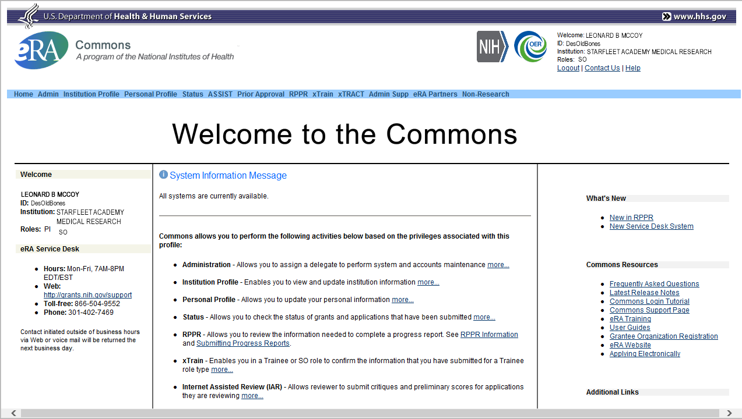
What Does eRA Commons Do?
The eRA Commons is an online interface where grant applicants, grantees and federal staff can access and share administrative information related to grant applications and awarded research grants.
ORCID ID
Applications
Progress
Reports
eSub Errors
Warnings
Application
Image
Institutional
Profile
Profile
Data
Assurances
Summary
Statement
Priority
Score
Prior
Approval
Reference
Letter
Notice
of
Award
Certifications
Publication
Data
Financial
Reports
Invention
Reports
Post-award
Correspondence
NCE
JIT
Training
Tables
Training
Appointments
Review
Assignment
HSS Data /
Integration
Relinquishing
Statement

Slide 10



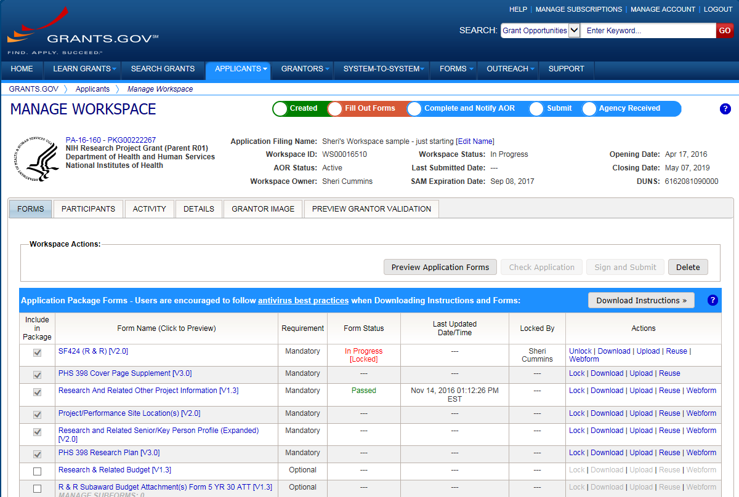

Submission Options for NIH Opportunities
There are three options for submitting NIH funding opportunities through Grants.gov
Grants.gov’s Workspace
eRA’s ASSIST
System-to-System (S2S) Solutions

Slide 11

Applicants & Grantees
Who are the key people
&
How are accounts managed?

Slide 12


Understand Key Systems & Roles
Grants.gov
eRA Commons
E-Business Point of Contact (EBiz POC)
Authorized Organization Representative (AOR)
Signing Official (SO)
Principal Investigator (PI)

Slide 13

Signing Official (SO)
During Commons registration, an applicant organization designates a Signing Official (SO)
  SO has authority to legally bind the organization in grants administration matters
  Equivalent to the Authorized Organization Representative (AOR) in Grants.gov
  SO is responsible for:
    maintaining institutional information
    submitting documents that require signature
    authority to act on behalf of the organization
    managing accounts

Slide 14
Signing Official (SO) & Managing Accounts
Signing Officials (and Account Administrators) have a responsibility to ensure duplicate accounts are not created for users.
  Users with Scientific roles should only have one (1) eRA Commons account for their entire career
    NIH needs to track funded researchers
    Used for reviewers to determine Continuous Submission status
    Used to determine New/Early Stage Investigator status
  Before creating new accounts, search across all eRA Commons accounts using AMS
  For more information, see:
    https://era.nih.gov/news_and_events/era-item-Oct2017.htm

Slide 15

Account Tips
Designate more than one Signing Official
  Certain Commons actions can only be taken by users with the SO role and you will want a back-up
Administrators should always check to see if a user already has a Commons account before creating a new account with a scientific role
  Ask the person if they already have an account, or search within the Commons
    If a user already has an account with a different organization,
    the SO should affiliate the existing account with the user’s
    new organization

Slide 16
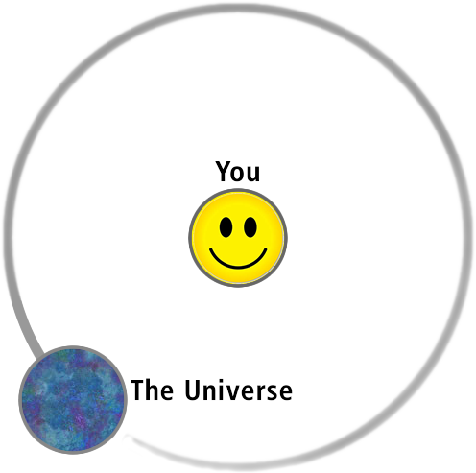
Personal Profile
A page dedicated to you

Slide 17



Personal Profile (PPF)
Individual Commons users are responsible for keeping their profile information accurate
Includes information such as:
  Name
  Demographics (important for Trainees)
  Employment history (important for COI)
  Education (important for NSI & ESI)
  Reference Letters
  Publications
Very few staff members at NIH have access to change information
Central repository for individual user information

Slide 18
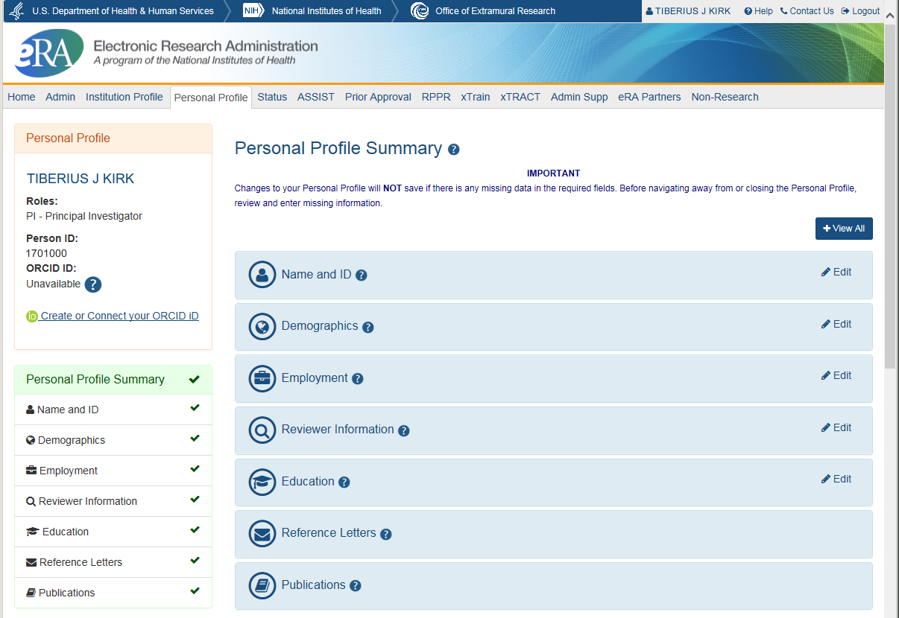
Personal Profile Screen

Slide 19
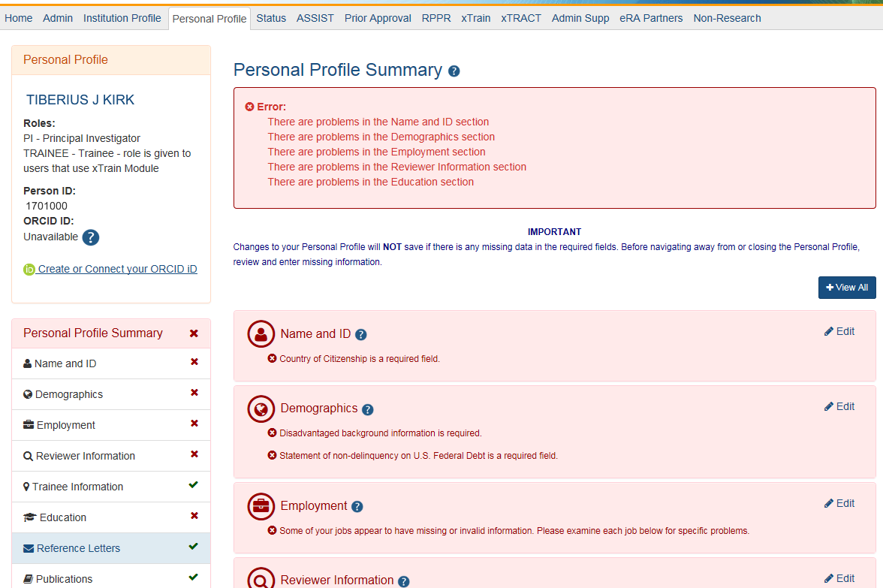
Saving Your Personal Profile
The PPF will show areas that need attention.
No data will be saved if required information is missing.
Do not navigate away from page until all required information is completed.
Leaving the page before all required information is completed, means changes will be lost.

Slide 20

Personal Profile Information is used to…
Verify information submitted in grant applications
Send you agency notifications
Complete aggregate reporting
Determine eligibility for New Investigator and Early Stage Investigator (ESI) status
Determine a reviewer’s eligibility for the Continuous Submission application submission policy

Slide 21

Personal Profile & ESI Extension
PD/PI’s with ESI status can request for extension of their ESI period for various reasons, including medical concerns, disability, extended periods of clinical training, natural disasters, active duty military service etc. All these requests will be reviewed on a case by case basis.

Slide 22
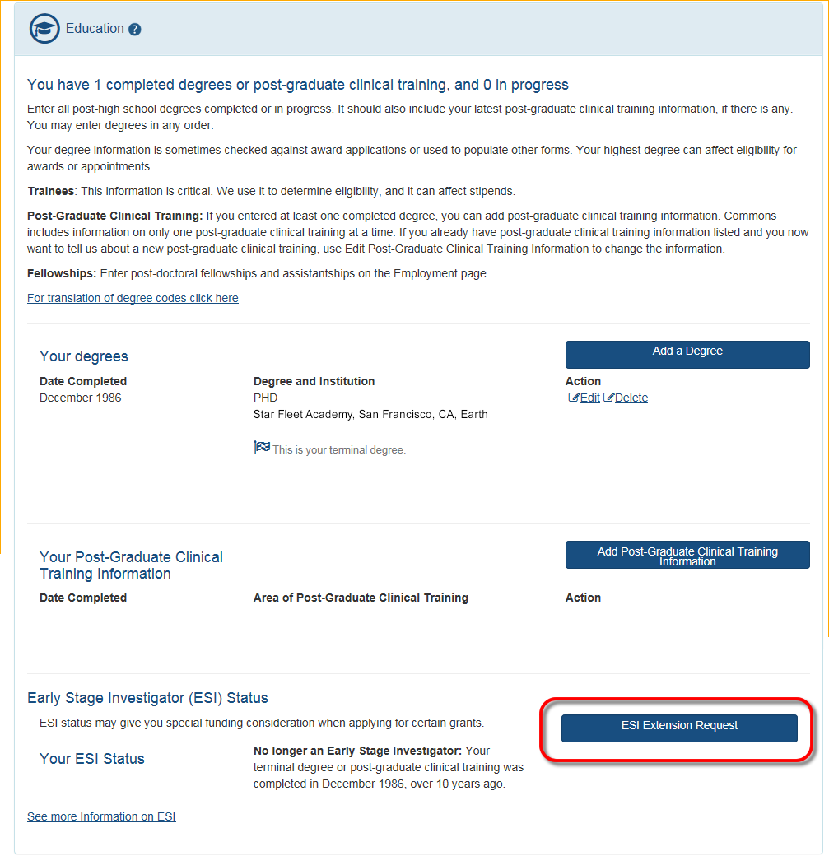
ESI Extension Under Education
ESI Extension Link will be available
Following link opens ESI Extension Request form
PI completes the information and submits for approval.
The PPF displays the date the extension request was submitted.

Slide 23
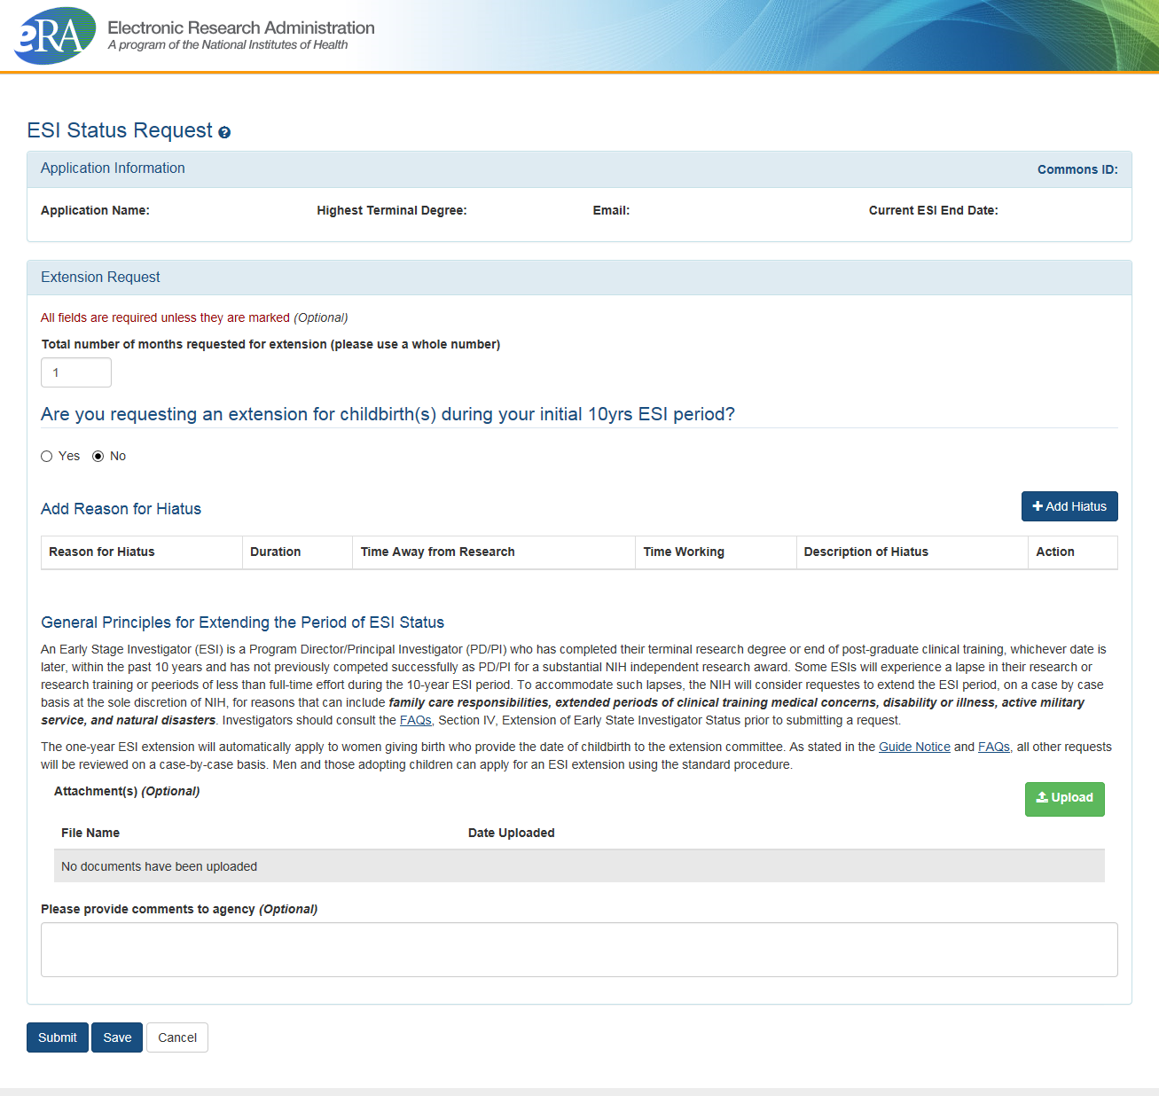
ESI Extension Screen
The number of months for the extension can be requested
If the reason for the request is the birth of a child, complete the requested information
The Add Hiatus button permits the selection of additional reasons for the request
Supporting documentation can be uploaded

Slide 24
Reference Letters
NOT part of the application through Grants.gov
Submitted directly by the referee through eRA Commons
Commons registration not required
Can be submitted in advance of application submission
Due by the application submission deadline
Applicants can track the submission of reference letters in the Commons, but cannot view the actual letter
Fellowship reference letters no longer have a required format – just a letter
Some NIH grant programs require the submission of reference letters in addition to the grant application (e.g., Mentored Career Development program)
Note:
Reference Letters are not the same as Letters of Support. Letters of Support indicate an institution’s commitment to the project.

Slide 25
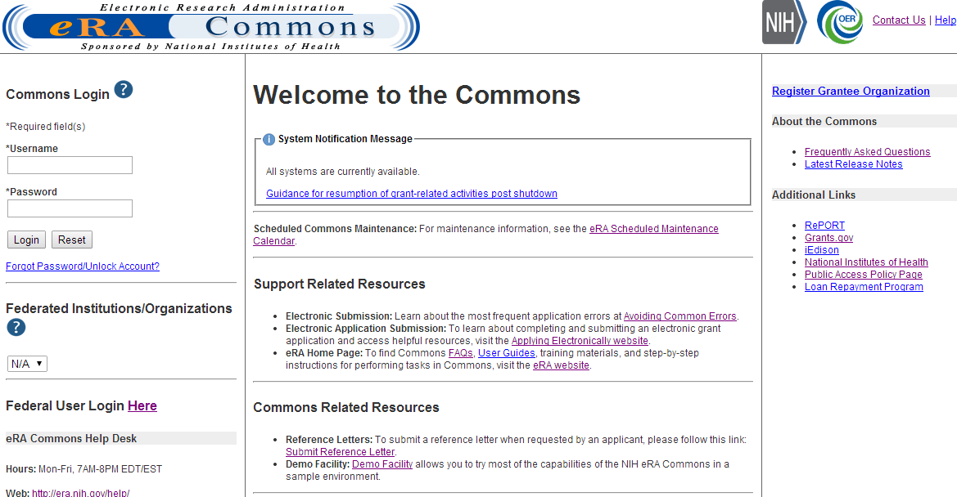
Reference Letters Links
Referees do not need to login to Commons to submit.

Slide 26
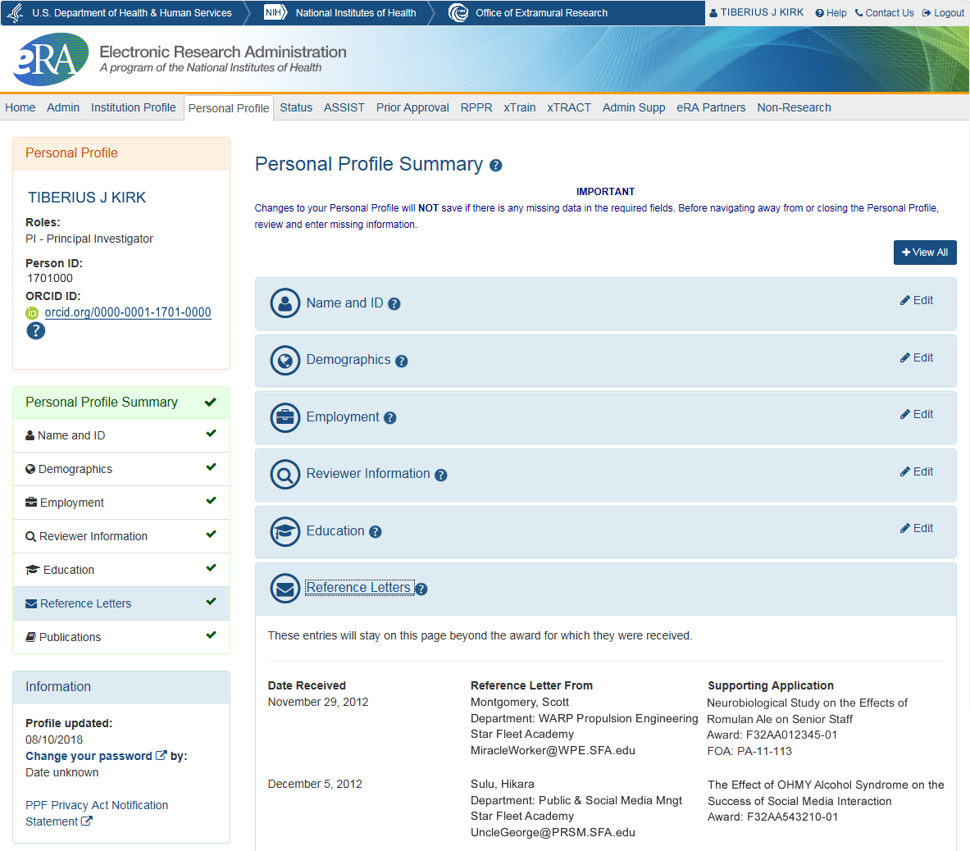
PPF – Reference Letters
Reference letters are typically
requested for Fellowship
and mentored Career
Development programs
Tracking Reference letters
  Shown in Profile
  Can see:
    When it was submitted
    Who submitted it
    What grant it is linked to
  Cannot see the actual
  letter
Reference Letters FAQs: https://grants.nih.gov/grants/ElectronicReceipt/faq_full.htm#12

Slide 27
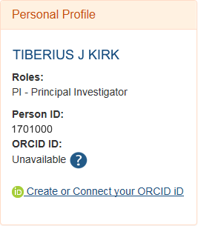
ORCID iD
ORCID iD (Open Researcher and Contributor ID)
a personal digital identifier that distinguishes every researcher
a new link to access ORCID.org added to the Personal Profile.
Allows principal investigators to create an ORCID ID to link to their Commons account, so that their publications can be linked to their grants.

Slide 28
ORCID iD Requirement
The requirement, starting October 2019, will be for:
T03, T15, T32, T34, T35, T37, T42, T90/R90, TL1, TL4, TU2, K12/KL2, R25, R38, RL5, RL9
At the time of appointment, the xTrain system will check whether appointees have ORCID iDs and appointments will be not be accepted for agency review unless an ORCID iD is linked to the individual's eRA Commons Personal Profile.
See Guide Notice NOT-OD-19-109

Slide 29
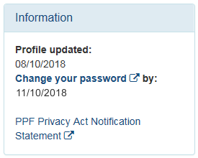
PPF and Your Password
Password policy:
  http://era.nih.gov/files/NIH_eRA_Password_Policy.pdf
  Passwords must:
  Contain at least eight (8) characters: no more than 16; no blank spaces
  Contain a combination of at least 3 of the following:
    Upper case letters
    Lower case letters
    Numbers, not at beginning or end of the password
    Special characters: ! # $ % - _ = + < >
    The following special characters are NOT allowed:
    @ ^ & ( ) | " \ ' { } [ ] : ; ` ? , . /
    Not contain username
  Not be reused within eight (8) years,
  In other words, 24 password cycles
  Be changed every 120 days

Slide 30
PPF Tips
Each year, on the anniversary of the date the account was created, you will receive a reminder email to make sure your profile is up-to-date and accurate.
When you change your password, you will be automatically redirected to the Personal Profile tab—take a moment to review and update your information
Be especially diligent about keeping your email addresses current
  Email addresses are used to retrieve forgotten passwords
  and for communicating grants-related information

Slide 31

Two Factor Authentication
eRA is working towards 2-Factor Authentication using the federal system Login.gov
Starting the process with a pilot group of Internet Assisted users next calendar year.
eRA will be working with users and UX (User Experience) team to create the eRA interface (login screens) and mapping process

Slide 32

Institutional Profile (IPF)
Like you,
your institution has a dedicated page

Slide 33

Institutional Profile File (IPF)
Each organization establishes and maintains their organization’s profile data
Depending on their role, users can view and/or update Institution Profile information
  Only SOs can edit IPF information
  IPF displayed as a read-only page for users with all other Commons roles
  Includes two sections: Basic and Assurances & Certifications
Central repository for registered organization information

Slide 34
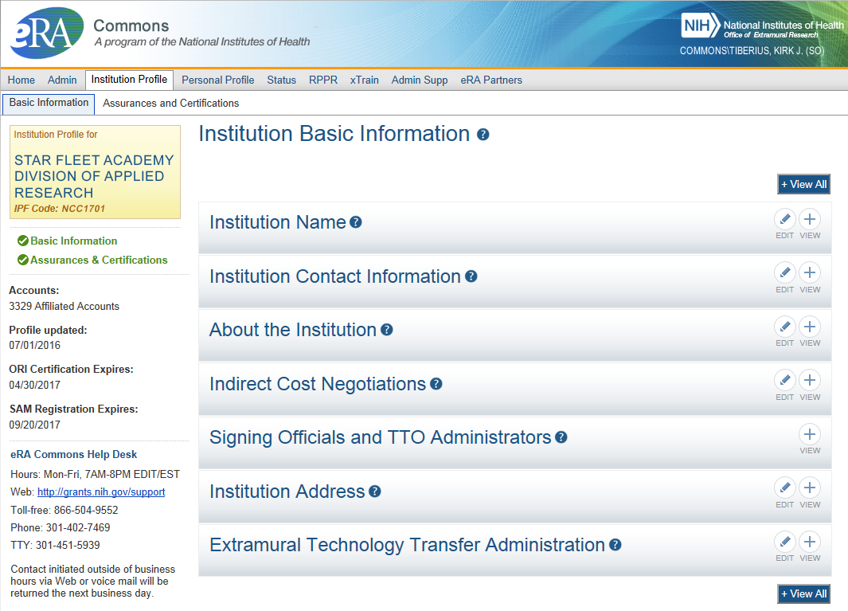
IPF Basic Information
Basic: general information about the institution
  Name, address, Institution Contact information, list of Signing Officials, etc.
Only SOs can edit Institution Profile
SAM Registration Expiration

Slide 35
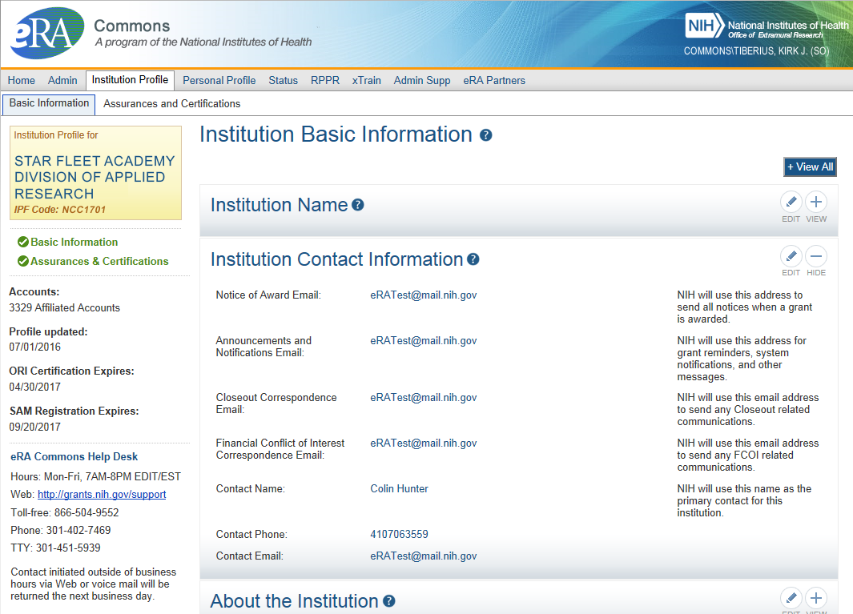
IPF Institution Contacts
Newer
Contact
Fields:
Closeout Correspondence
FCOI Correspondence

Slide 36
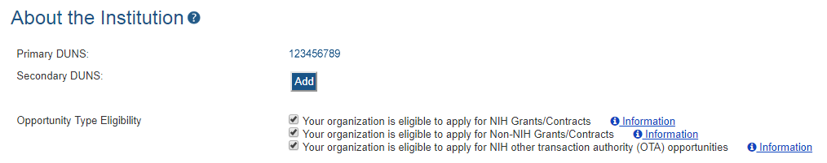

IPF DUNS
“”
Changes to Institution Basic Information Section
New fields…
  To support Other Transaction Authority funding opportunities
  To summarize your institution’s eligibility to submit to the different types of opportunities

Slide 37
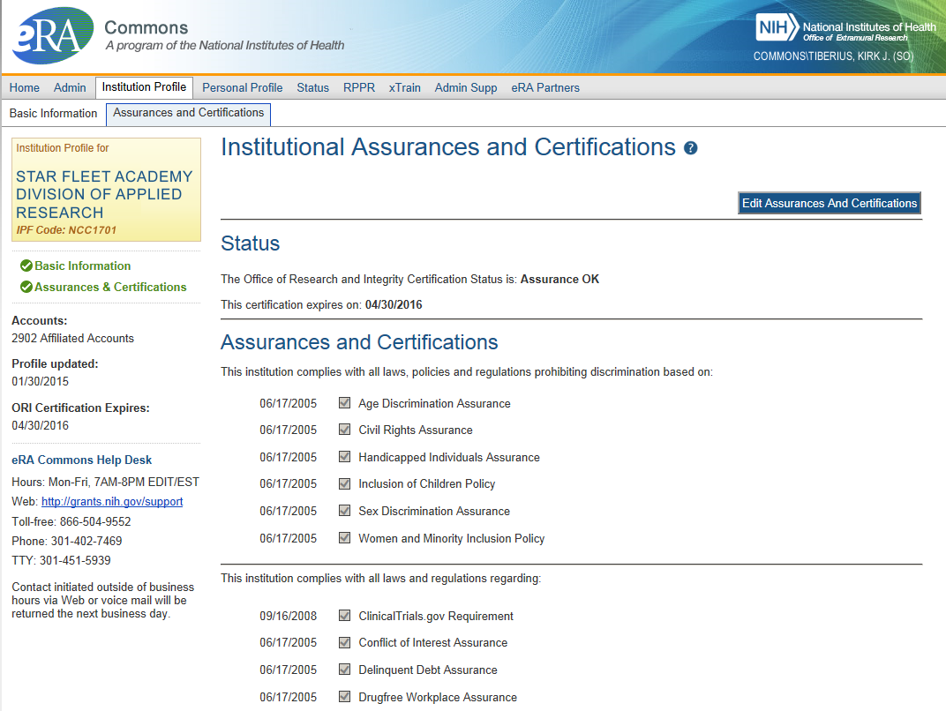
IPF Assurances and Certifications
Assurances and Certifications: data elements that comprise assurance/certification information about an institution
  List of certifications
  (e.g., Financial Conflict of
  Interest, Human Subjects
  Research, Vertebrate
  Animals, etc.)

Slide 38
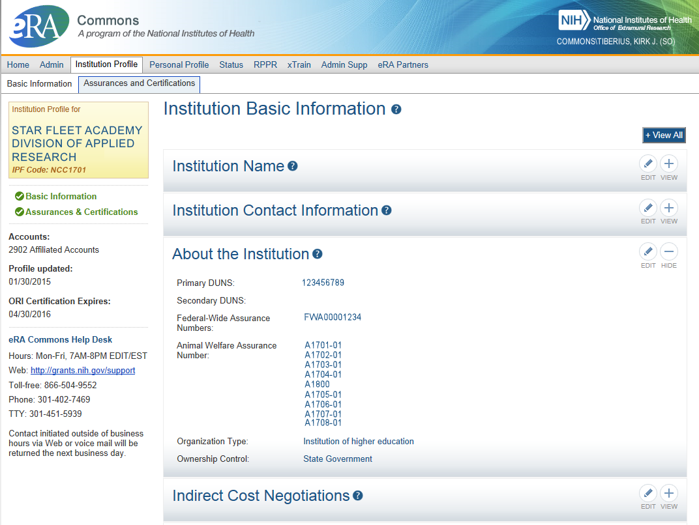
IPF OLAW
Integration with Office of Laboratory Animal Welfare’s (OLAW) Animal Assurance Number
  IPF will pull OLAW’s
  Animal Assurance Number
  Under the About the
  Institution tile
  Will also update:
    Animal Subject Code
    IACUC Date
  Can not be edited via IPF

Slide 39
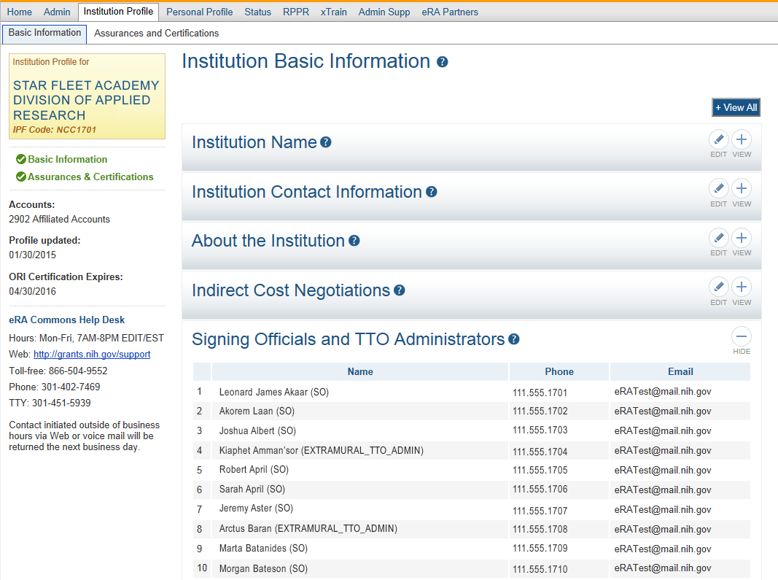
IPF SOs & TTOs
Signing
Officials
&
Technology Transfer Officers
(TTO)

Slide 40

Application Tracking
There is more to do after clicking submit

Slide 41
What’s Next?
SUBMISSION
After an error free submission of an application, the application “image” (PDF) is generated. This is followed by a 2 day review window. After those 2 (business) days, the application moves forward.
PEER REVIEW
A Scientific Review Officer (SRO) from the assigned IC coordinates and facilitates the peer review process. They write the summary statement and post scores to eRA Commons.
CSR TAKES OVER
The Division of Receipt and Referral (DRR) in the Center for Scientific Review (CSR) take the applications and complete final validations, then assign the application to an IC and Study Section.
IC REVIEW & AWARD
The application then goes to the assigned IC where it is reviewed there. Recommendations are made, and the IC Director makes the final decision concerning the funding of the proposal.

Slide 42
Using Status to Track the Application

Slide 43
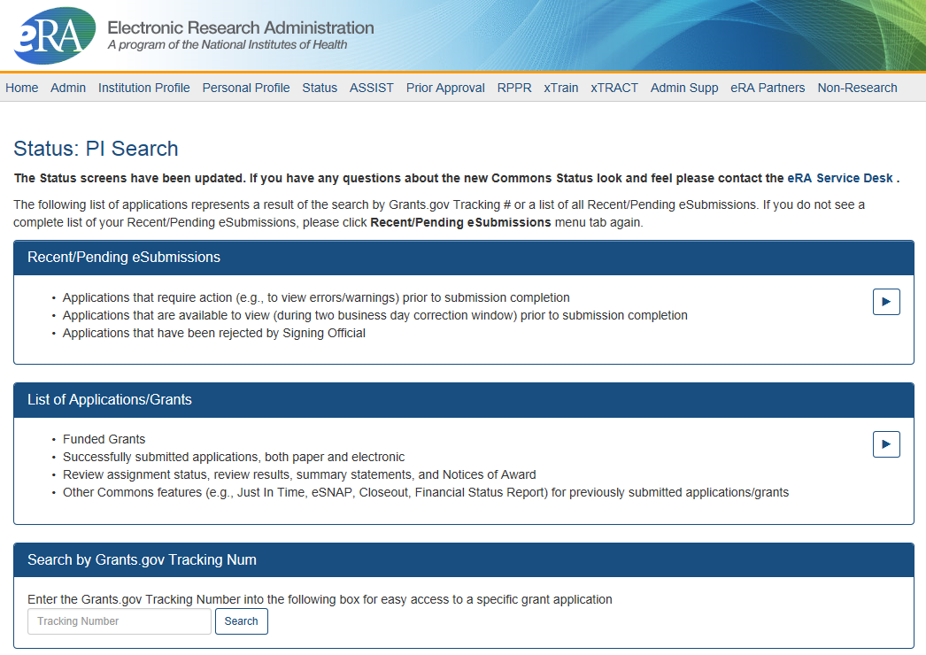
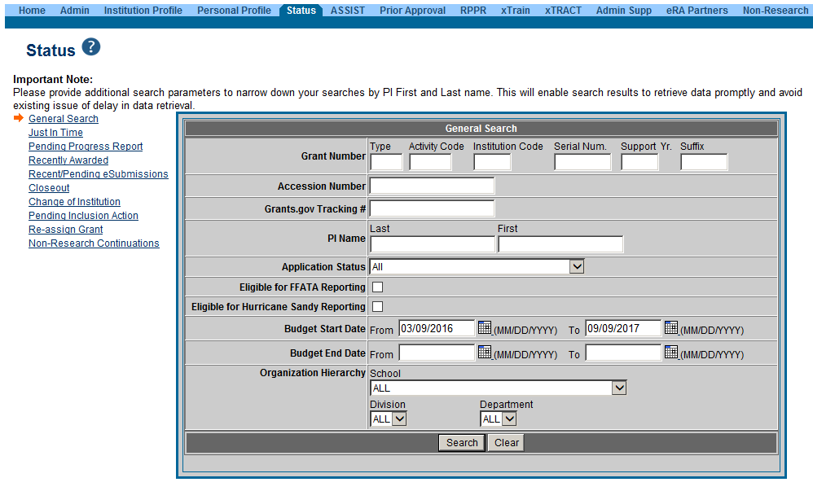
PI Status vs SO Status
Principal Investigators can view their Recent/Pending eSubmissions or List of Applications/Grants.
Signing Officials can search/view all submissions for their institution.

Slide 44
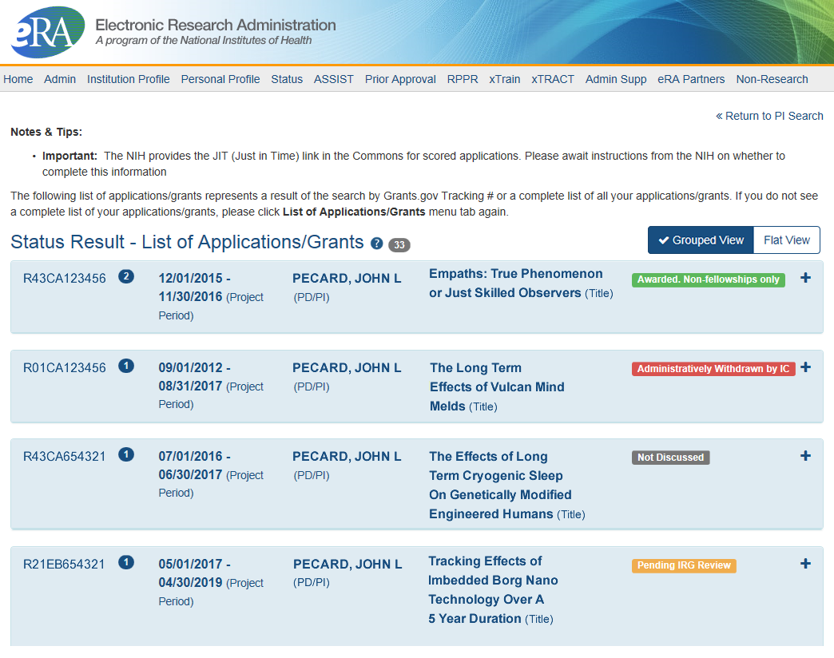
Status Result from General Search for PI
Click anywhere in the blue to get to more information, then select the Application ID link to view detailed status information for that particular application.

Slide 45
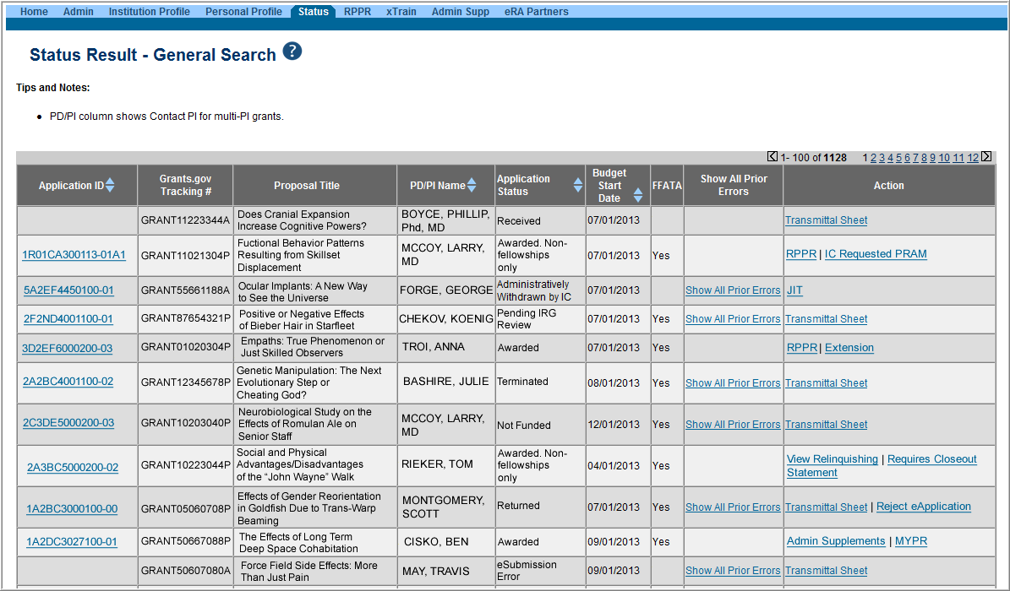
Status Result from General Search for SO
Select the Application ID link to view detailed status information for that particular application.

Slide 46
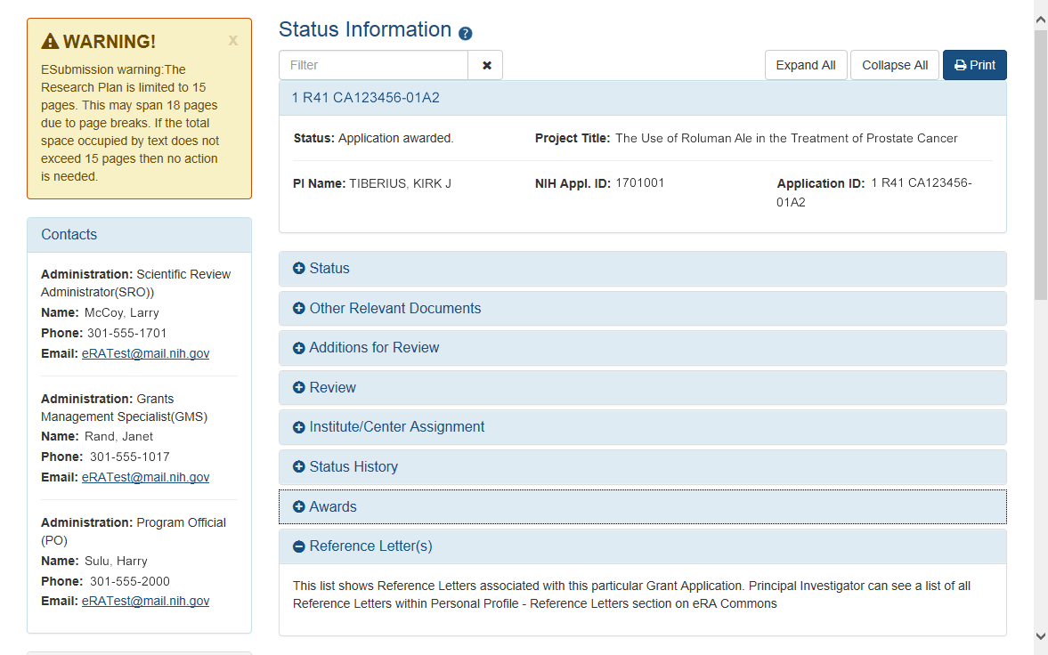
Detailed Status Information Screen
Provides warnings
Control Buttons
Text Filter
All tiles open by default.
eRA Contacts

Slide 47
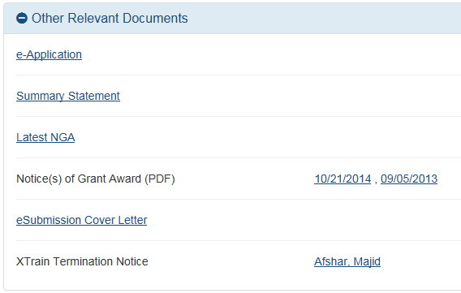
Checking Application Image
The application image will be found in the Other Relevant Documents section as a link called e-Application.

Slide 48
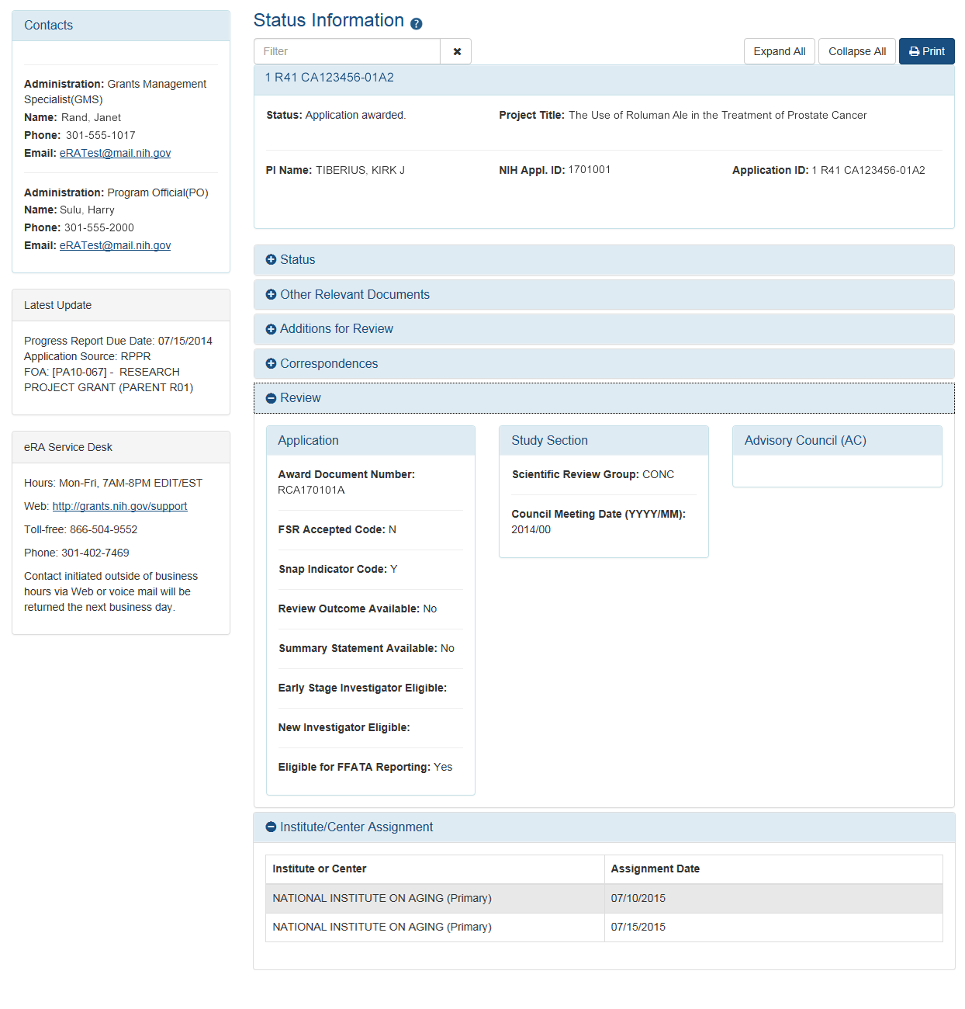
Check Review Assignments
Study Section assignment
Institute or Center assignment

Slide 49
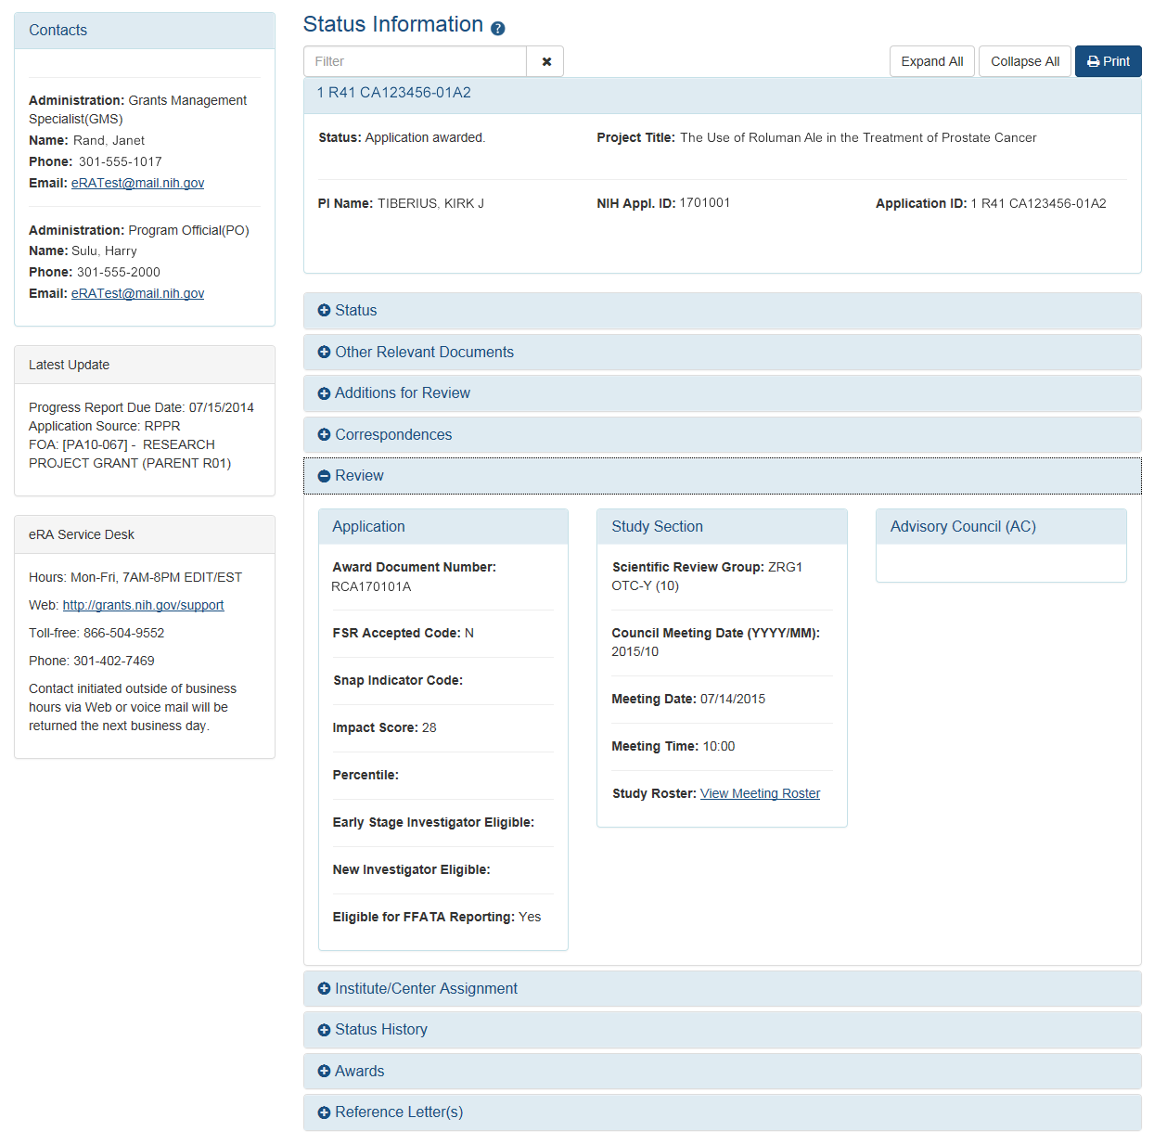
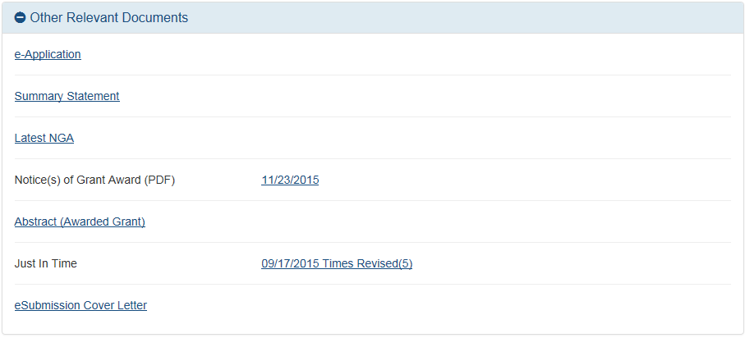
Check Review Outcomes
Only the PI sees the Summary Statement and Scores

Slide 50
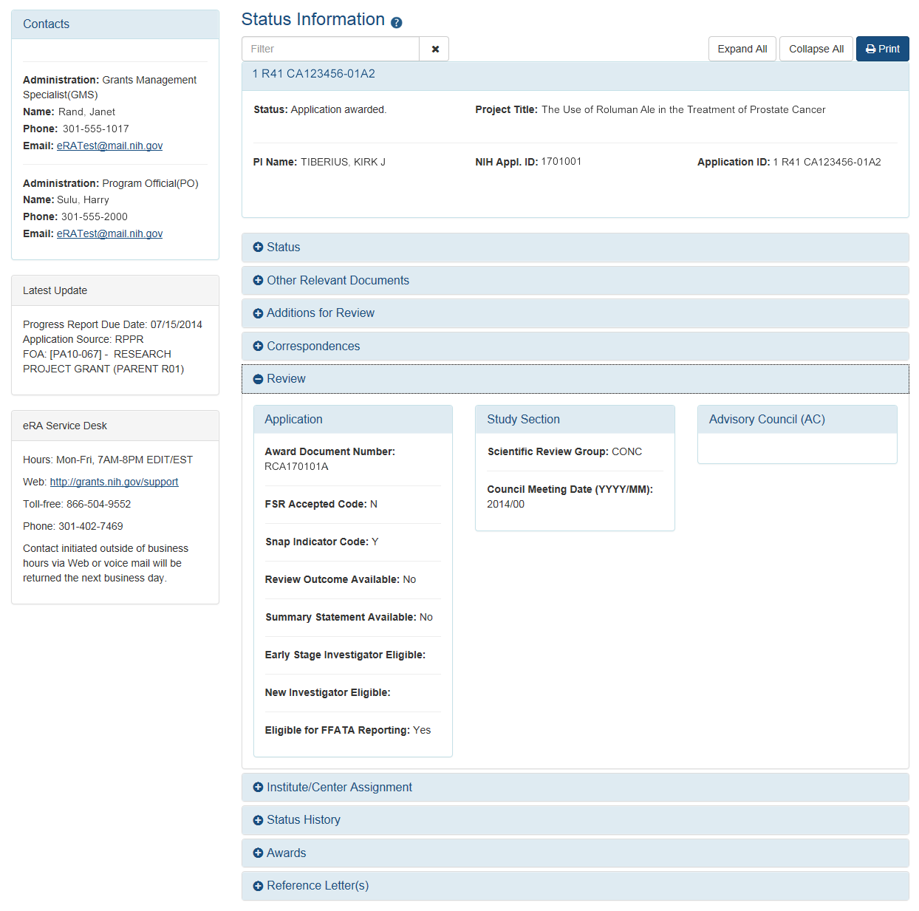
Verifying NI & ESI Application Status
Reflects a snapshot of Early Stage Investigator (ESI) and New Investigator status at time of application submission.

Slide 51
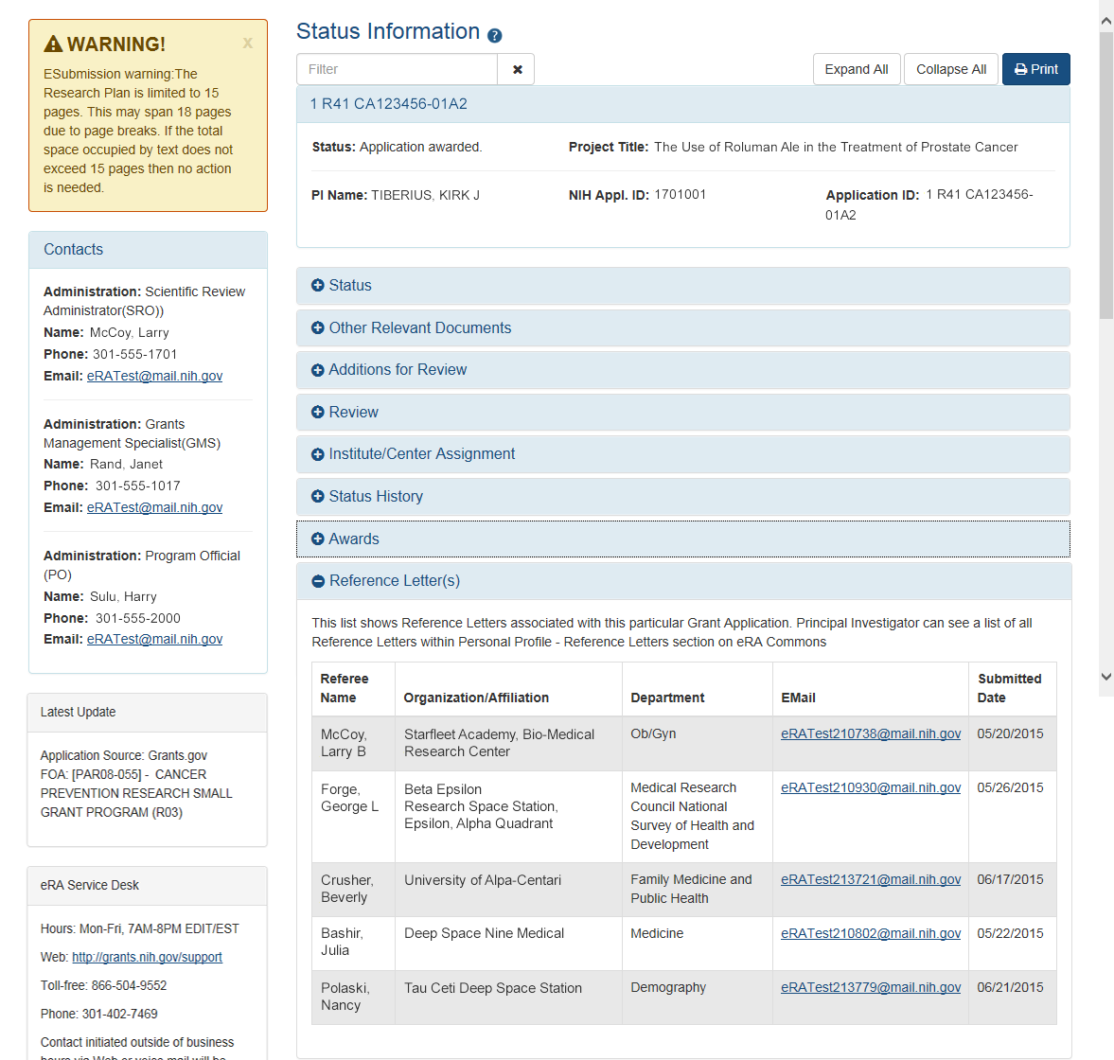
Reference Letters Status Information

Slide 52
Just-in-Time (JIT) Link
Also in Other Relevant Documents, you will see JIT information.

Slide 53
Just-In-Time (JIT)
Applicants should never submit JIT info until specifically requested to do so by NIH. A JIT link or request from NIH are not indications that a grant award will be made.
  Other Support File, Budget Upload, Other Upload, Institutional Review Board (IRB) Date, Human Subject Education
  PD/PI can save info in Commons, but only SO can submit JIT info to NIH
  Must be PDF format
Allows an applicant organization to submit additional grant application information after the completion of the peer review, and prior to funding.

Slide 54
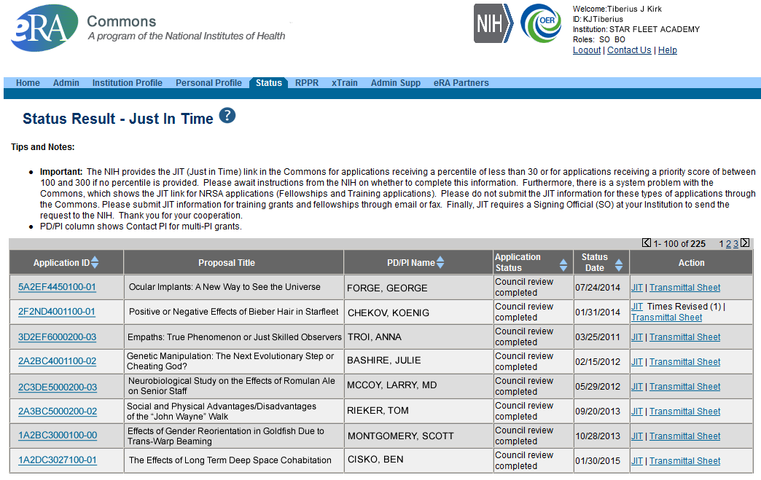
JIT Link on Status Result Screen (SO View)
Select JIT link

Slide 55
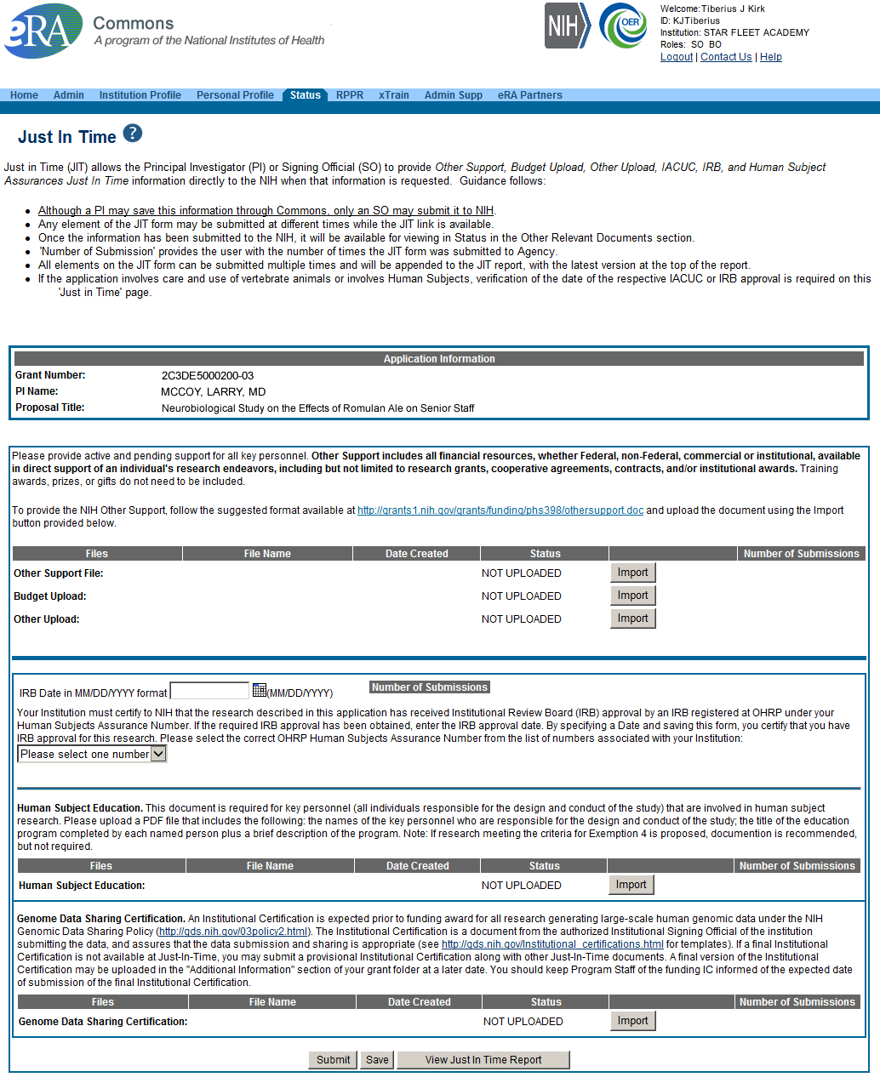
Just-In-Time Screen
PDF document with Other Support documentation is required. Use the Import button to begin the upload.
IRB Approval Date should be within the last 12 months.

Slide 56
Notice of Award (NoA)
Contains or refers to all terms and conditions of the grant
Is posted in the Other Relevant Documents section of the Status Information page
Official document notifying the grantee and others that a grant has been awarded

Slide 57

Roles
&
Responsibilities
Who does what…

Slide 58
eRA Commons Roles
The functions that a user can perform in the Commons are based on the role(s) assigned to his or her Commons account
Full, printable list of eRA Commons roles:
  https://era.nih.gov/files/eRA-Commons-Roles-10-2019.pdf

Slide 59

Summary of Roles
IAR
PI
AA
FSR
SO
AO
Administrative
  SO – Signing Official
  AO – Administrative Official
  AA – Account Administrator
  BO – Business Official
  ASST – Assistant
  ASSIST Access Maintainer Role
  SBIR CAP*
Scientific
  Graduate Student
  IAR – Internet Assisted Review
  PI - Principal Investigator
  Post-Doc
  Project Personnel
  Scientist
  Sponsor
  Trainee
  Undergraduate
Other
  FCOI (Financial Conflict of Interest)
  FCOI_ASST
  FCOI_VIEW
  FSR (Financial Status Reporter)
  PACR (Public Access Compliance Role)
  OLAW (Reporting Animal Welfare)
*New! For the Small Business Innovation Research (SBIR) Commercialization Accelerator Program.
Permits access to the SBIR CAP tab in Commons to initiate, complete, and submit tracking forms.

Slide 60
Role - Tips
Can’t combine scientific roles with administrative or other roles on the same account
  Other combinations are fine (e.g., PI and IAR; AO and FSR)
  A person needing both scientific and administrative roles should have two separate accounts (one for scientific roles and another for other roles)

Slide 61

Delegations
Many hands make light work

Slide 62

Delegations
Summary
Progress Report (SO, AO, AA to PI)
Progress Report (PI to ASST)
Sponsor
Status
Personal Profile
Submit
xTrain
eRA Commons allows users to give other users permission to do specific actions on their behalf

Slide 63
Delegations Chart
Type (Name) | By | To | What it does
Progress Report | SO, AA, AO | PI on behalf of a PI | Enables the delegated PI to work on progress reports of another PI – includes Interim and Final RPPR, and HSS requests
Progress Report | PI | User within Institution with ASST or AO role | Enables the authorized user to work on progress reports for the PI – includes Interim and Final RPPR, and HSS requests
Sponsor | SO, AA (on behalf of Sponsor) | ASST | Allows the ASST to access the xTrain module
Status | PI | ASST | Allows the ASST to work with the Status module
PPF | All Users | User within Institution | Enables another user to edit someone else's personal profile
Submit | SO | PI | Enables the PI to submit RPPR and MYPR reports – now needed for PI if they are to submit Interim RPPR, Final RPPR, and HSS Data
xTrain | PI, Sponsor | ASST | Enables the ASST to work with the xTrain module and xTRACT

Slide 64
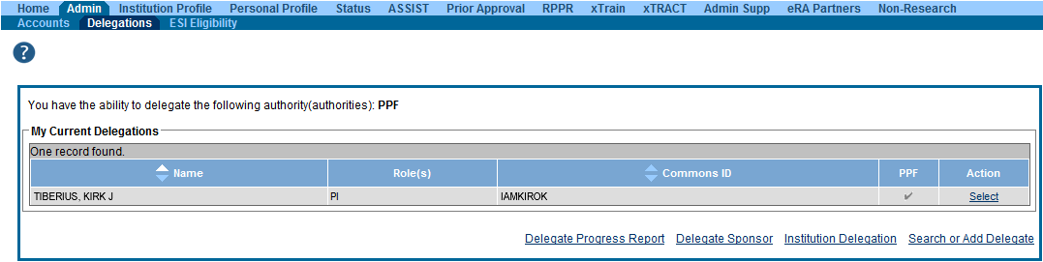
Delegation (SO)
‘
The SO can only delegate their PPF as My Current Delegations through the
Search or Add Delegation link.
The Progress Report and Sponsor links allow the SO to assign those
delegations to a selected user.
The Institution Delegation link allows the SO to assign the Submit Progress
Report delegation to multiple selected users at one time.

Slide 65
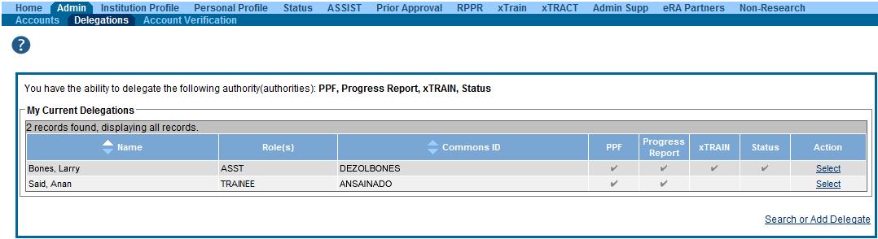
Delegation Menu (PI)
Screen shows users who are currently delegated actions.
Clicking Select lets you edit or delete current delegation.
Clicking Search or Add Delegate lets you add a new delegation.

Slide 66
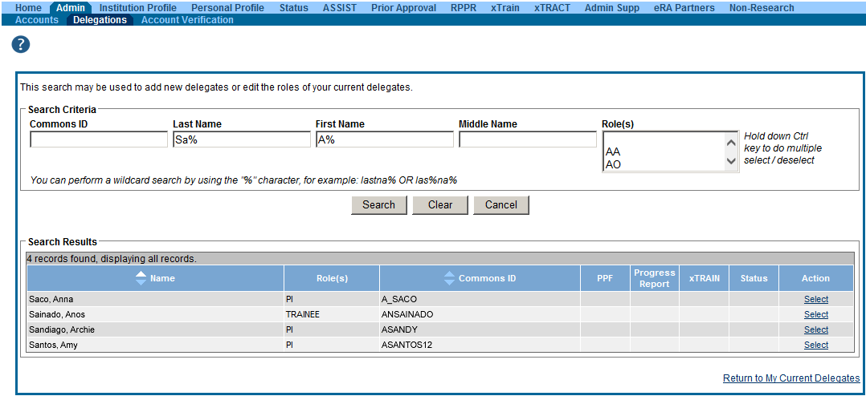
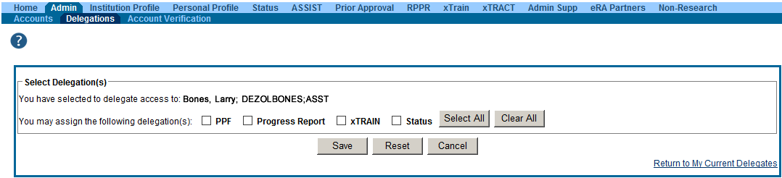
Delegation Selection (PI)
Delegates (eRA Commons users) search screen
Select Delegations screen

Slide 67


Award Monitoring
Keeping an eye on things

Slide 68
Managing the Prior Approval Options
The Prior Approval tab provides one way to manage you’re application or award.
Prior Approval is the process in which an applicant or grantee must have written approval by an authorized official to undertake a certain activity.
eRA now supports four activities for Prior Approval Requests.
  Request for No Cost Extension (NCE)
  Request for withdrawal of an application
  Carryover
  Request for Change of PD/PI

Slide 69
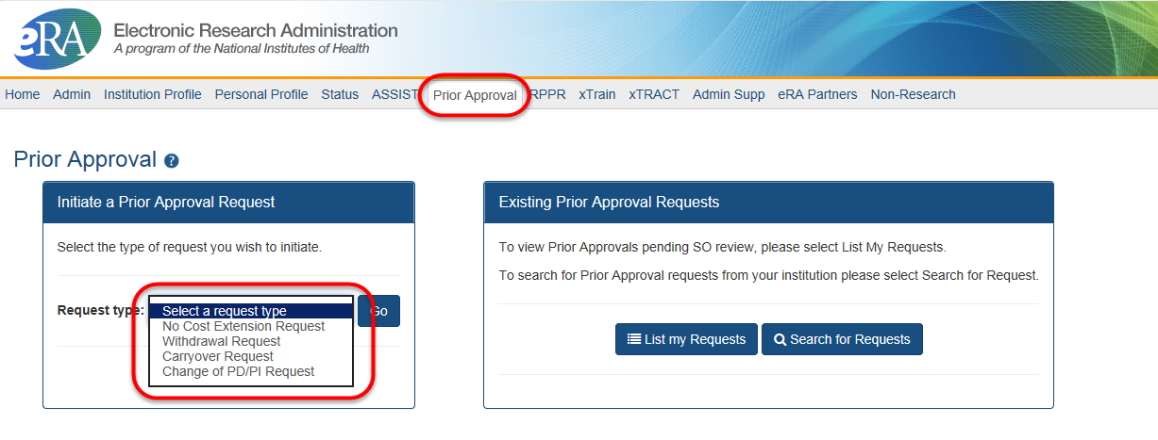
Prior Approval Tab
Prior Approval Tab
Select the type of request and click Go
List my Requests will display all Prior Approval requests pending Signing Official submission
Search for Request will allow a Signing Official to search for all Prior Approval requests.

Slide 70
Prior Approval – Withdrawal
An application that has been removed for consideration of award by the Signing Official/Authorized Organization Representative.
  Initiation of a Withdrawal Request can be done by either the Principal Investigator (PI) or Signing Official (SO)
  Screen supports justification (required) and supporting documents (max 10)
  Only the Signing Official can submit the request
  Signing Officials can search for requests for their institution
  Automatic notifications to the SO and PI upon approval

Slide 71
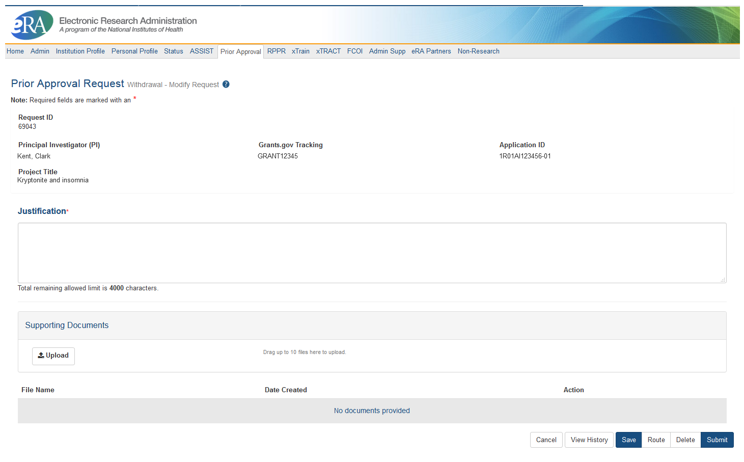
Prior Approval – Withdrawal Request

Slide 72
Prior Approval – Carryover
Request for an Institution to Carryover funds for a grant without expanded authority.
  Only a Signing Official (SO) can initiate and submit this type of request.
  Request can only be made for a grant year that is currently awarded and in the budget period.
  SO must provide the unobligated funds to be carried over.
  Explanation of unobligated funds, Budget Justification and Scientific Justification must be submitted in PDF format, each not exceed 5 MB in size.
  If the grant is in the last year, and the project period end date has passed, the grantee will need to request a No Cost Extension to submit a Carryover request.

Slide 73
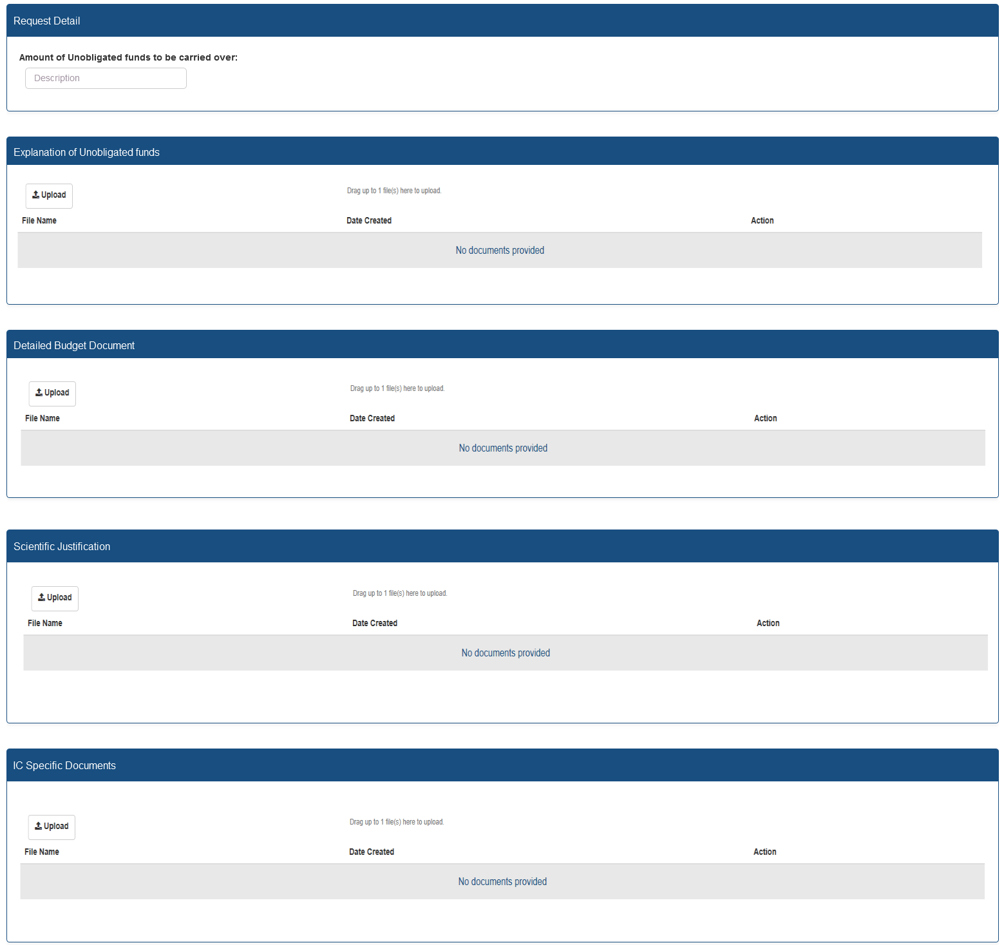
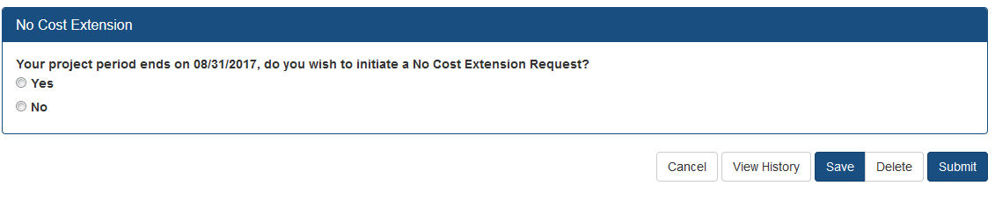
Prior Approval – Carryover Screen
Enter unobligated funds to be carried over
Only PDF files may be uploaded.
One per each field, not exceeding 5MB.
For more information regarding the desired content of these fields, please contact you Grants Management Specialist.
If the grant is eligible for a No Cost Extension, the user will have the option to initiate a No Cost Extension.

Slide 74
Prior Approval – Change of PD/PI
Request for an Institution to change the Program Director (PD) or Principal Investigator (PI) on an award.
  Only a Signing Official (SO) can initiate and submit this type of request.
  Request can only be made for a grant year that is currently awarded and within the budget period.
  Biosketch and Other Support documents (PDFs only) are required with the submission when adding a new PD/PI.
  1 PDF for each document requested, each not exceed 5 MB in size

Slide 75
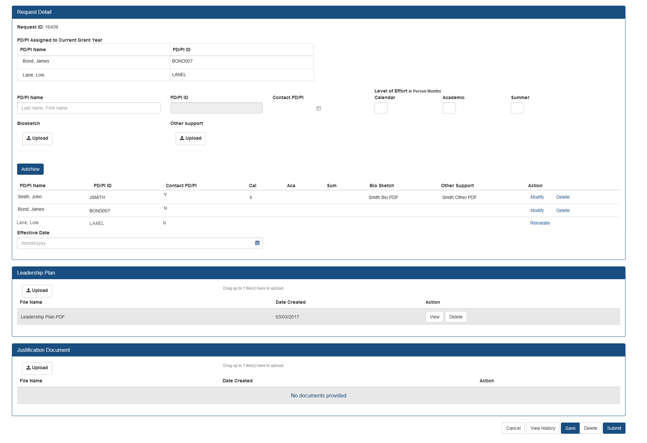
Prior Approval – Change of PD/PI
Screen
The current Principal Investigator(s) (PD/PI) will be displayed.
Select Modify to upload documents, update contact PD/PI Flag and provide level of effort.
You may choose to remove a PD/PI from the grant.
“”
If a PD/PI is on the current grant year and is accidently flagged for removal, you may reinstate them.
Leadership Plan PDF is required if the request will result in a multi-PD/PI grant.

Slide 76
Prior Approval – NCE
No-Cost Extension (NCE)
  An extension of time to a project period and/or budget period to complete the work of the grant under that period, without additional Federal funds or competition

Slide 77
Prior Approval – No Cost Extension: When?
When is a grant eligible for a NCE through Prior Approval?
  When you have already used a NCE under expanded authority and you are within 90 days of the project end date.
  When you are not under expanded authority and you are within 90 days of the project end date.
  When the project end date has expired and has not been closed or has not entered unilateral closeout, whichever comes first.

Slide 78
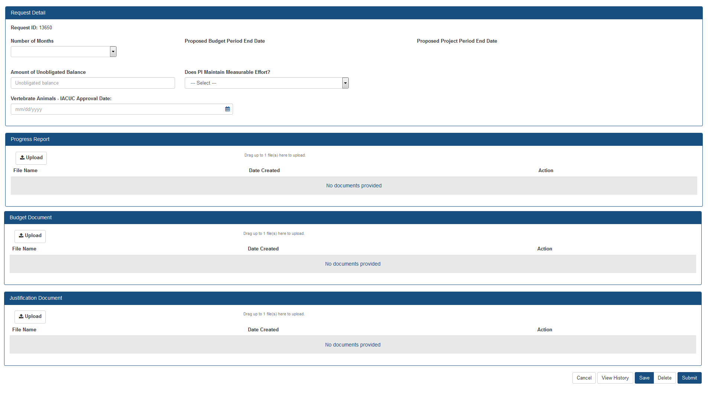
Prior Approval – No Cost Extension Screen
Select number of months, system will calculate proposed end dates.
Only PDF files may be uploaded.
One per each field, not exceeding 5MB.
For more information regarding the desired content of these fields, please contact you Grants Management Specialist.

Slide 79

No Cost Extension Part II
Submitting an NCE via status

Slide 80
NCE
Only SOs can submit the NCE notification
May be submitted no earlier than 90 days before end of project and no later than project end date
Can request extension of 1-12 months, in one-month increments
E-mail notification sent to NIH Grants Management staff when SO processes the extension
Electronically submit a notification to exercise one-time authority to extend without funds the final budget period of a project period of a grant.

Slide 81

NCE Another Way
Extension link appears in the SO Status Search Results Screen

Slide 82
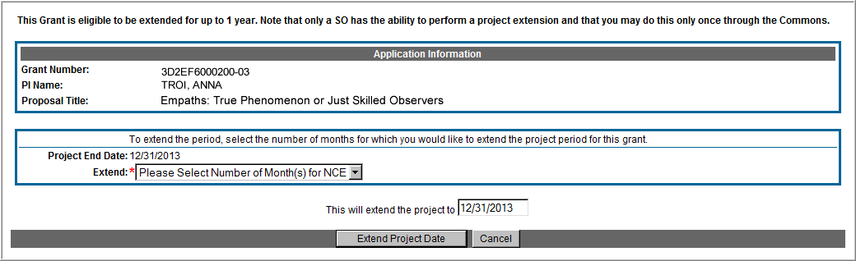
Extension Screen
Choose an extension of 1 to 12 months.
New calculated project end date

Slide 83
Expanded Authority – You Get Just One
No Cost Extension (NCE) part of ‘expanded authorities’
Can only extend once without express approval
Increasing trend of extending in the middle of the project period (i.e. end of year 2 of 5 year grant)
  If this is done, the Extension link will NOT appear 90 days from end of project end-date
  If in need of an NCE, submit Prior Approval NCE request
See June’s 2015 eRA Items of Interest for more:
  https://era.nih.gov/news-and-events/era-item-June-2015.htm

Slide 84

Administrative Supplements
(Type 3) Request
Please, sir, I want some more…

Slide 85
What Are Admin Supps?
A request for additional funds during a current project period to provide for an increase in costs due to unforeseen circumstances.
Requested additional costs must be within the scope of the peer reviewed and approved project
Streamlined eRA Commons process
  Commons pre-populates much of the data needed for request from awarded grant

Slide 86
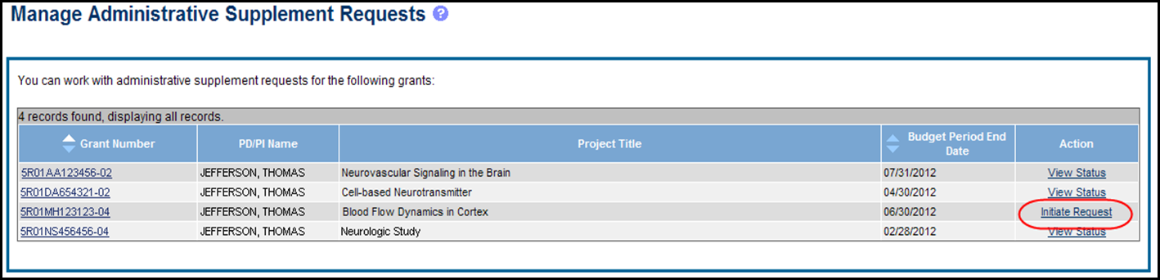
Admin. Supplement Requests – Initiate Request
Starting an Administrative Supplement request in Commons you must find eligible grant and Initiate Request

Slide 87
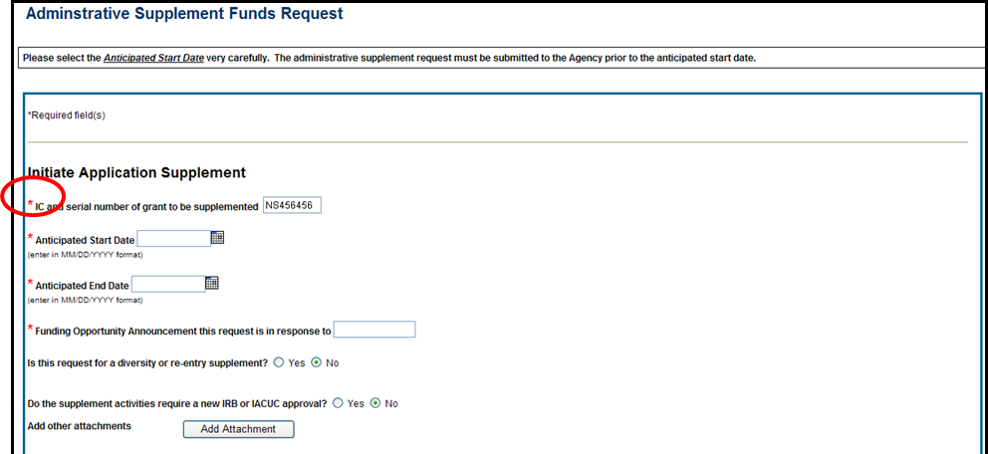
Admin. Supplement Requests – Required Fields
Complete Form – Required Fields are indicated with red asterisk

Slide 88
Admin. Supplement Changes Coming
eRA will soon* allow the electronic submission of administrative supplements for complex (multi-project) applications
The submission would work very similarly to a single project activity code
Eventually we see this process as a requirement for all administrative supplements.
*as of the development of this presentation

Slide 89

Change of Institution
On the Move…

Slide 90
How Does This Work?
Change of Institution Request
When you want to move an award from one institution to another.
Remember, NIH awards to institutions, not individuals.
The process has 2 parts:
  Relinquishing institution submits a Relinquishing Statement – it identifies the accepting institution
  The accepting institution must be registered in eRA Commons
  The accepting institution must complete and submit an error free application through Grants.gov so the change request can be evaluated by NIH
  NIH

Slide 91
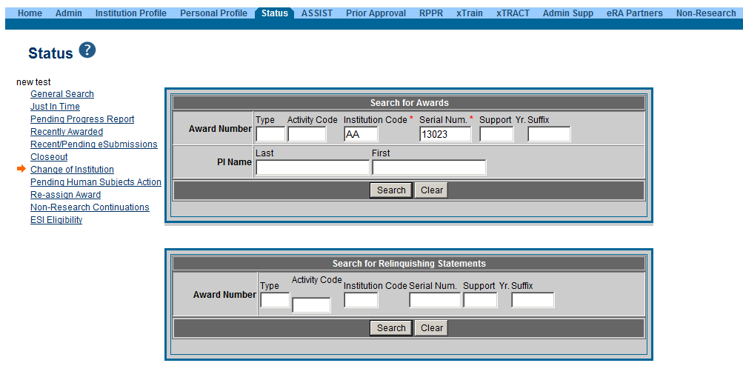
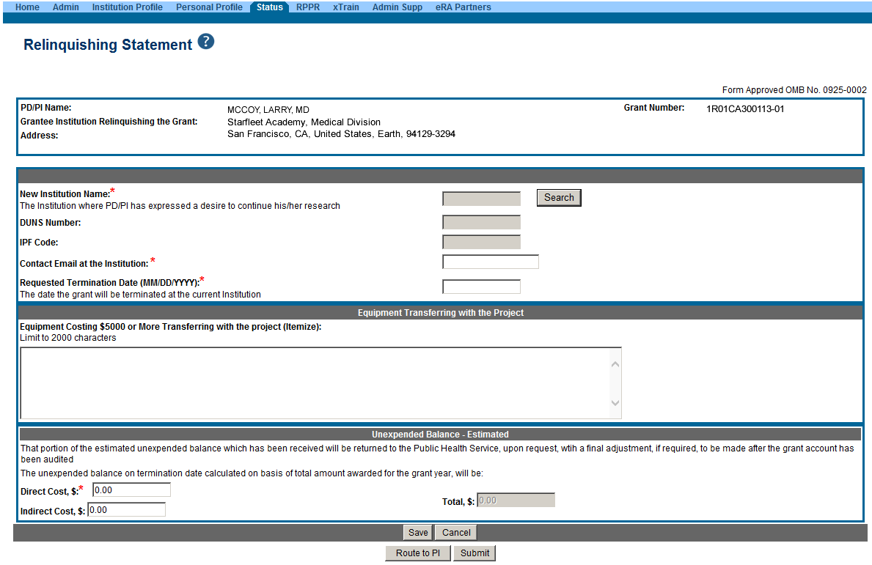
Relinquishing Statement
SO completes all required fields.
Initiated by the Signing Official via the Status Screen
NIH maintains the right to deny the request.

Slide 92
The X Files
The X Files
How xTrain and xtract help you manage trainees

Slide 93
What is xTrain?
xTrain is an application that allows program directors and/or principal investigators (PD/PI), university administrators, and trainees to electronically prepare and submit PHS 2271 Statement of Appointment Forms (2271) and PHS 416-7 Termination Notices (TN) associated with institutional research training grants, institutional career development awards, individual fellowships, and research education awards.
Agency staff also uses xTrain to review and process the appointments and termination notices that are submitted electronically
Notes:
xTrain a web based program that allows users to electronically process appointments and other required paperwork associated with Kirschstein-NRSA training grants.
NIH developed xTrain as an electronic management tool for NRSA training grants to improve its efficiency in capturing research training appointments
Adds some additional measure of flexibility in submitting forms and guarantees a base standard for both the NIH and the submitting institution.

Slide 94


Example Work Flow in xTrain
PD/PI or ASST completes and routes form to the Trainee for electronic signature.
PD/PI or ASST
TRAINEE
Trainee fills out required information and routes the form back to PD/PI
PD/PI reviews form and routes it to BO
Routing captures the user’s electronic signature.
BO routes form to Agency
BO
Agency

Slide 95
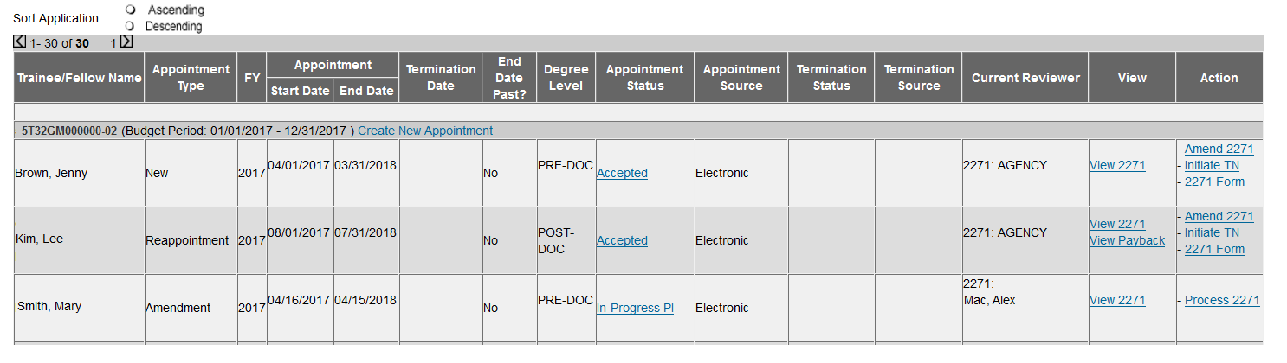
View Trainee Roster
Locate trainees to be appointed to the grant.
Available actions for the appointment.
Status hyperlink will take you to the routing history.

Slide 96
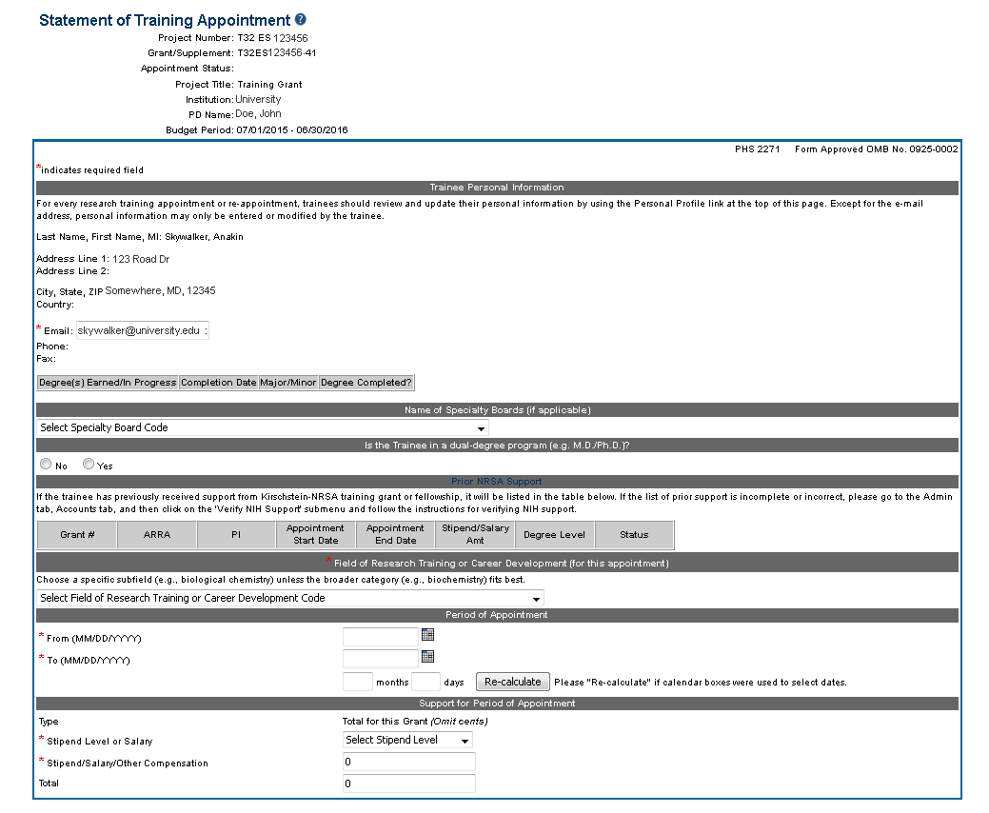
Appointment Form (2271)
Required by Training Grants (T) and Career Development Grants (K/R).
Initiated by PD/PI or ASST.
Must be electronically signed by the Trainee/ Appointee.
Prepopulates Trainee’s information, such as Prior NRSA Support and Address.
Submitted by PD/PI.
F grants do not use the 2271.
Address is populated from the Trainee’s PPF
Stipend level amounts are dictated by the Fiscal Year of the appointment.

Slide 97
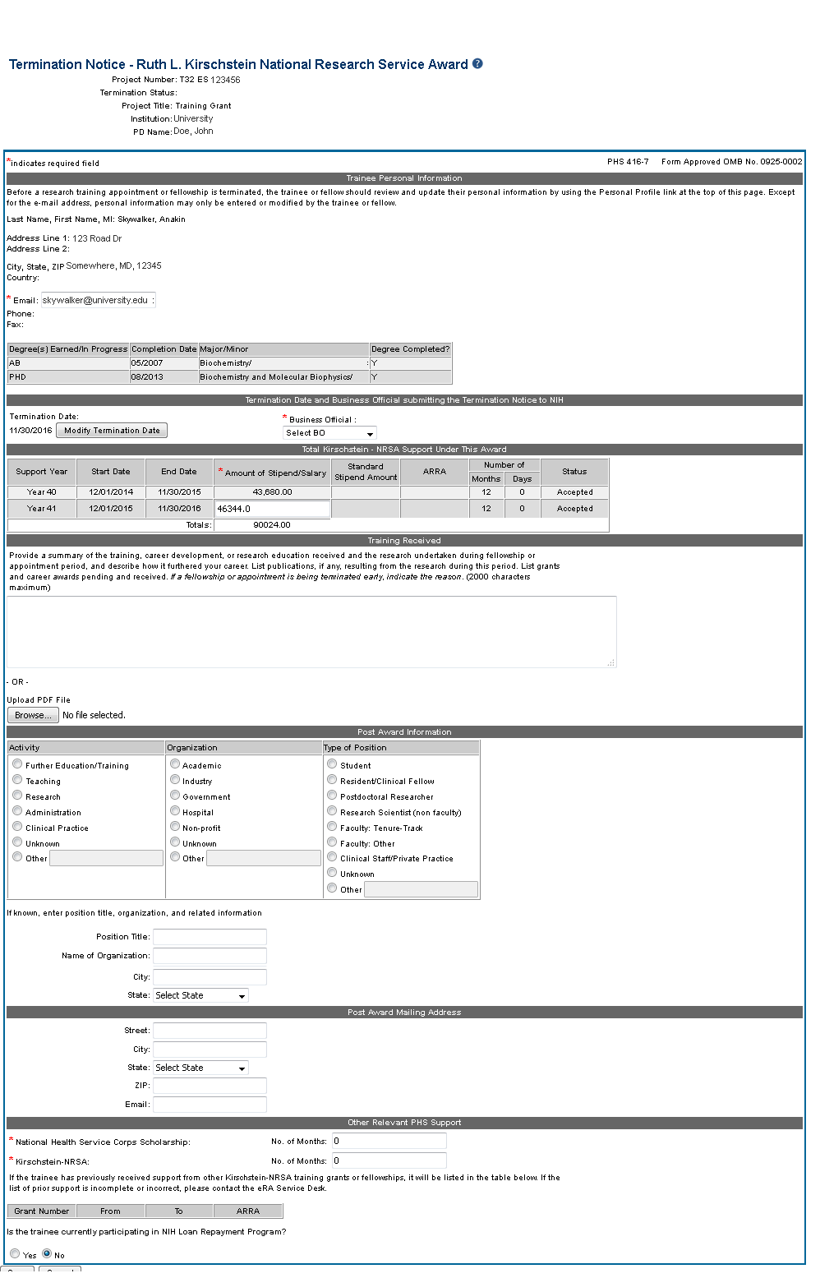
Termination Form
The PD/PI, ASST, BO may initiate a TN at any time for a Training (T) grant.
The PD/PI, SPONSOR or BO may initiate a TN at any time for a Fellowship (F).
The PD/PI or ASST may initiate a TN at any time for a Career (K/R) grant.
The BO must submit the TN for T and F grants. PD/PI submits the TN for K/R grants.
A Business Official must be selected from the dropdown.
If a Trainee leaves the appointment early, modify the Termination Date.
Stipend may only be modified if the Termination Date is changed.

Slide 98
What is xTRACT?
The Extramural Trainee Reporting And Career Tracking (xTRACT) system is a module in the eRA Commons that allows applicants, grantees, and assistants to create research training tables for NIH progress reports and institutional training grant applications.
Because xTRACT is integrated with eRA Commons, some training data will be prepopulated in the system, including trainee names, selected characteristics, institutions, grant numbers, and subsequent NIH and other HHS awards.
In addition, xTRACT allows institutions to create profiles for participating faculty that do not require access to eRA Commons, create institutional programs, and non-NIH funding sources; which can be retrieved for future use.

Slide 99
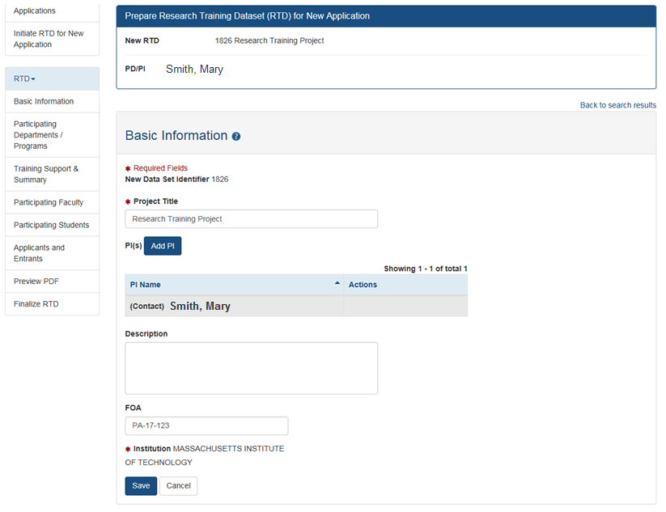
Prepare for a New Application
You may create Programs, define non-NIH Funding Sources, and update Person data that can be reused for other RTDs.
xTRACT also populates data based on a person’s grants, and personal profile.
Users may upload data, such as Participating Students, to xTRACT using tab-delimited files.
The PD/PI that initiated the RTD will be marked as Contact PI.

Slide 100

Prepare RTD for the RPPR
If you have previously created Research Training Data (RTD) tables for this grant, xTRACT will prompt you to copy the previous RTD data.
The Research Performance Progress Report (RPPR) RTD requires the following data:
Participating Trainees.
Program Statistics.
Notes:
Data can come from old info, prior to xTRACT, if it is in the database, or even if the user does not have a Commons ID. Reporting must go back 15 years (from time of training end date?)

Slide 101

RTD for RPPR
Once the RTD is finalized, the PDF containing the applicable training tables may be uploaded to the RPPR.
RPPR question B4 now has an additional PDF upload for K12, KL2, R90, RL9, T15, T32, T34, T35, T37, T90, TL1, KM1 activity codes.
Grantees should provide training tables to the second upload as applicable.
Other information should be provided to the first upload.

Slide 102
Notice of Transition to the xTRACT System for Preparing Research Training Data Tables
Current Notice Number: NOT-OD-19-108 (https://grants.nih.gov/grants/guide/notice-files/NOT-OD-19-108.html)
Beginning with RPPRs due on or after October 1, 2019 and applications submitted for due dates on or after January 25, 2020, NIH and AHRQ anticipate that they will mandate that required training data tables submitted with T32, TL1, T90/R90, and T15 applications and progress reports be created via the xTRACT system.
System validations in Grants.gov and the RPPR module will check to ensure that tables were created via xTRACT, and applications and RPPRs that are not in compliance will be rejected.

Slide 103

Reporting
So, how you doin’?

Slide 104
What is the RPPR?
RPPR is the Research Performance Progress Report
A federally mandated report format used across all agencies that provide research grants and contracts
Used to document grantee accomplishments and compliance with the terms of the award
Describes the scientific progress, identifies significant changes, reports on personnel, and describes plans for subsequent budget period or year (annual reports only)

Slide 105
RPPR Data Entry
Initiation of RPPR by
  Principal Investigator
  ASST with the RPPR Delegation
RPPR sections (Annual)
  Cover Page
  Accomplishments
  Products
  Participants
  Impact
  Changes
  Special Reporting
  Budget (non-SNAP)
Watch for character limits in data entry fields
Ensure uploads are in PDF format
When completing data tables remember to click ‘Add/New’
RPPR sections (Interim & Final)
  Cover Page
  Accomplishments
  Products
  Participants (only section D.1)
  Impact
  Special Reporting
  Outcomes

Slide 106
The 3 variations of RPPR
Annual RPPR Interim RPPR Final RPPR
RPPR Type | How to Access RPPR Link | When Does the Link Appear? | When is the RPPR Due? | Who Can Initiate | Who Can Edit | Who Routes to the SO | Who Submits
Annual | Status Search Results Screen or RPPR tab | 1 day after the project segment end date | SNAP Awards due within 45 days of the next budget period start date Non-SNAP due within 60 days of the next budget period start date | Principal Investigator Or User within Institution with the ASST Role* | Signing Official Or Principal Investigator Or User within Institution with the ASST Role* | Principal Investigator | Signing Official Or Principal Investigator if assigned the Submit Delegation
Interim | Status Search Results Screen | Once the grant becomes eligible for submission of a Type 2 application, and the grant is not in Closeout | 120 days from period of performance end date for the competitive segment | Signing Official or Principal Investigator | Signing Official Or Principal Investigator Or User within Institution with the ASST Role* | Principal Investigator | Signing Official Or Principal Investigator if assigned the Submit Delegation
Final | Closeout Status Screen | Once the grant becomes eligible for closeout | 120 days from period of project end date | Signing Official or Principal Investigator | Signing Official Or Principal Investigator Or User within Institution with the ASST Role* | Principal Investigator | Signing Official Or Principal Investigator if assigned the Submit Delegation

Slide 107
Interim RPPR Scenarios
Since a renewal application is competitive, there is no guarantee it will be funded. Therefor the following scenarios should be noted:
Completing Renewal Application Status | Action
Not submitting a Competing Renewal application | Submit a Final RPPR no later than 120 days from the project period end date
Submitting a Competing Renewal application | Submit an Interim RPPR no later than 120 days from the project period end date
 | Funded | Not Funded
 | The Interim RPPR is accepted as the annual RPPR | The Interim RPPR is accepted as the Final RPPR

Slide 108
IRPPR vs FRPPR
(Interim vs Final RPPR)
I-RPPR
  The Interim RPPR link will made available to the SO and the PI in the Status screen when a grant is eligible for submission of a Competing Renewal application.
  Only Section D.1 of Participants is required
  Sections F: Changes and Section H: Budget are not part of the Interim RPPR
  Section I: Outcomes is new. Section I is required for the Interim RPPR
F-RPPR
  The Final RPPR is only available as part of the Closeout process and the Process Final RPPR link only appears on the Closeout Status screen.
  Only Section D.1 of Participants is required
  Sections F: Changes and Section H: Budget are not part of the Final RPPR
  Section I: Outcomes is new. Section I is required for the Final RPPR

Slide 109
Permissions for
I-RPPR and F-RPPR
  Interim and Final RPPR work in the same manner as the old Final Progress Report (FPR).
  Both SOs and PIs can initiate
  They can also route the report back and forth for review and edits. All of this done without the need to delegate any authority.
  If an ASST has been delegated Progress Report Authority they will be able to initiate, edit and route.
  SO may submit, PI will need Submit delegation to submit

Slide 110

Selecting Interim RPPR
  Select Interim RPPR link from Status search results (SO view shown)

Slide 111


Initiate Interim RPPR
  Select Initiate from the Interim RPPR Menu screen
  Select Edit from the Interim RPPR Menu screen

Slide 112



Initiate Final Research Performance Progress Report (F-RPPR)

Slide 113

I-RPPR and F-RPPR Sections
Similar navigation tabs as the annual RPPR.
A new section called Outcomes has been added.

Slide 114

Outcomes
Information in Outcomes will be publically available. It should be written as a high level and in plain language.

Slide 115
Outcomes Requirements
Outcomes are specifically designed to be made publicly available by the agency (analogous to the abstract in the competing application)
Reporting in the Outcomes section is limited (by the federal-wide RPPR format) to 8,000 characters
The Outcomes should provide a concise summary of the findings of the award written in lay language for the general public
In an effort to increase transparency NIH will make the Outcomes data available in RePORTER

Slide 116

Requesting Revised Project Outcomes
Requests for revised project outcomes for F-RPPR and I-RPPR will be made by the PO and submitted by the recipient using the applicable additional material functionality (FRAM or IRAM)
  Note: The full automation for the Additional Material functionality for the I-RPPR was implemented in mid-September
Both modules will be enhanced in order to capture revised project outcomes in a format that could be reported out to the public

Slide 117
RPPR & Human Subjects System (HSS)
HSS is the electronic system to manage human subjects and clinical trials information.
Allows principal investigators and signing officials to access and update all the human subjects and clinical trials data associated with their grants in one place.
  update participant information
  enrollment information
  inform NIH of ClinicalTrials.gov registration
  and revise other human subjects-related information as necessary, just-in-time for award or after a grant award is made.

Slide 118

RPPR & Accessing HSS
The most common use of the Human Subjects System is for updates needed to the RPPR
You will find the Human Subjects link in Section G.4.b Inclusion Enrollment Data of the RPPR
The human subjects link is visible only for NIH applications and grants involving human subjects.

Slide 119

New! HSCT & RPPRs
Due to the addition of the Human Subjects Clinical Trials (HSCT) form for applications involving human subject research, the content and the format of the RPPR has changed.
You will find the study record summary in Section G.4.b. and complete individual study records later in the RPPR pdf.
Section 6 for Clinical Trials.
The Clinical Trial Milestone Plan (Section 6 of the HSCT form) is required to be filled out by grantees who are conducting clinical trials and who submitted their last competing application on January 25, 2018 or later, otherwise the RPPR will trigger an error.

Slide 120

Multi-Year RPPR
MYRPPR
  Multi Year Progress Reports now use RPPR format
  Link available under the Action Column in Status

Slide 121
Complex, Multi-Project RPPR
Submitting progress reports for complex, multi-project grants
  After RPPR is initiated, PI will need to identify if RPPR should contain components.
  RPPR should have the same structure as the originally submitted application.
  Some sections are not available on Overall component (i.e. Budget)
  Some sections are not available on component level (i.e. Participants and Publications are reported on Overall)

Slide 122
Progress Report Additional Materials (PRAM)
The PRAM feature provides a means for the grantee to enter, review, route, and submit information to agency following the submission of an RPPR.
  Public Access (PA) PRAM - Generated automatically after an RPPR is submitted with publications that are not compliant with Public Access Policy
  Agency Requested PRAM – Only available if requested by the Grants Management Specialist (GMS)
PD/PI can enter the PRAM, but can only submit it if they are delegated with Submit Progress Report authority. Otherwise, only the SO can submit the PRAM to Agency.

Slide 123


Accessing PRAM

Slide 124
Format for PA PRAM
Public Access (PA) PRAM will require an attachment.
  The PA PRAM will no longer contain a free form text box.
  Using My NCBI the institution will need to generate a PDF of their reported publications showing their compliance.
  For instructions on generating the report please see:
    http://www.nlm.nih.gov/pubs/techbull/nd12/nd12_myncbi_pdf.html

Slide 125


RPPR Publications
When selecting/deselecting publications for RPPR submissions
  Users will see a gold lock icon next to those publications added to their grant into NIHMS.
  Users see a silver lock icon for publications that have been reported on a previous RPPR.
  Neither can be removed on the RPPR, both need manual intervention.
  To delete a publication with a gold lock, users will need to contact the NIHMS help desk through their web form, which is accessible at http://www.nihms.nih.gov/.
  To delete a publication with a silver lock please contact the PublicAccess@nih.gov

Slide 126
RPPR Budgets
Submitting progress reports with budgets
  R&R budget and PHS 398 budgets are now available for Non-SNAP RPPR.
  If presented with an option of budget forms, the type that was submitted with the application should be used.
    PHS 398 Budget is available only on training grants.
  Help for R&R Budget and PHS 398 Budget forms can be found in the SF424 R&R User Guides.

Slide 127

Reporting Financial Conflicts of Interest
I’m conflicted about antiques made daily

Slide 128
What is the FCOI Regulation?
The 2011 revised regulation promotes objectivity in research by establishing standards that provide a reasonable expectation that the design, conduct, and reporting of research performed under NIH grants or cooperative agreements will be free from bias resulting from Investigator financial conflicts of interest.
This regulation is commonly referred to as the Financial Conflict of Interest (FCOI) regulation.
http://www.gpo.gov/fdsys/pkg/FR-2011-08-25/pdf/2011-21633.pdf

Slide 129
Financial Conflict of Interest (FCOI)
Initiate and prepare a FCOI report on awarded grant year
Submit the report, any necessary supporting documents, and comments (optional) to the agency
Search and view previously submitted FCOI reports (those submitted via Commons only)
Edit or rescind submitted reports (rescinding involves agency involvement)
Access the history of actions
Initiate, prepare, and submit FCOI notification and supporting documents electronically to NIH

Slide 130

Initiating FCOI
System provides Contact PD/PI name after initial save. Provides additional info to check that the correct grant # is entered.
System will pull the latest Support Year of the grant.

Slide 131
Wrapping it up with
Closeout
Finishing the “paperwork” at
The end of the Project

Slide 132

Closeout
Closeout items for NIH include*:
  Final Research Performance Progress Report (F-RPPR)
  Federal Financial Report (FFR)
  Final Invention Statement
NIH automatically marks the grant “ready for close out,” making the link appear in Commons when:
  The project period end date has passed, and
  No Typ2 application has been submitted
Electronically submit required Closeout documents for grants in Closeout status
*Agency partners may require additional information

Slide 133
Closeout for Partner Agencies
Partner Agencies (CDC, FDA, SAMHSA, etc.) have different business requirements and may use different reports for closeout.
For example some use the Tangible Personal Property Report (SF-428), referred to as TPPR
Or the FPR vs the RPPR for some agencies

Slide 134
Closeout Capabilities
Identify expiring and terminating grants
Request and track required closeout documents
Track submission of boxed archived paper grant records at the Federal Record Center (FRC)

Slide 135

New Closeout Search screen provides additional search criteria

Slide 136

Search screen shows grants that are Closed or Requires Closeout

Slide 137

Final Report Additional Materials
(FRAM)
FRAM works in same manner as PRAM in RPPR
Awarding IC sets status to FRAM Requested
Awarding IC triggers email for requested information to the SO & PI
The FRAM Update link appears in Action column

Slide 138

Final Report Additional Materials
(FRAM) in Other Relevant Documents
Specifics about the FRAM request can also be found in Other Relevant
Documents section of the Status Information screen.

Slide 139

Interim Report Additional Materials
(IRAM) Link
IRAM works in same manner as PRAM in for RPPR
Awarding IC sets status to IRAM Requested
Awarding IC triggers email for requested information to the SO & PI
The IRAM Update link appears in Action column

Slide 140

Interim Report Additional Materials
(IRAM) Screen
As with the RPPR, a PD/PI (or Contact PI, in the case of multiple PIs) can enter the IRAM. However, only the SO can submit an IRAM to the agency.

Slide 141

Federal Financial Report
Show me the FFR!

Slide 142

Federal Financial Report (FFR)
FFRs must be submitted in eRA Commons via the FFR/FSR module
  Cash transaction data still submitted via Payment Management System
FSR role for users who have the authority to view, enter data, and submit an FFR on behalf of institution
Allows grantees to electronically submit a statement of expenditures associated with their grant to NIH via eRA Commons.

Slide 143
FFR Details
Annual FFR due date: For non-SNAPs, FFR must be submitted within 120 days of the calendar quarter in which the budget period ends
Final FFR due date: based on the Project Period End Date (PPED):
  Pending Status: If the FFR is not submitted and it is within 120 days of the PPED
  Due Status: If the FFR is not submitted and it is between the PPED and 120 days past the PPED
  Late: If the FFR is not submitted and it is more than 120 days past the PPED

Slide 144

FFR Search Screen

Slide 145

FFR Link
The Grant Number is a hyperlink that will take you to the FFR/FSR form.

Slide 146
FFR Data
Clicking the hyperlinked grant number opens the FFR Details screen, which displays:
  FFR Status:
    Received, Accepted, Rejected, In Review, or Revision Pending
  Available Actions:
    Accepted status: View or Create New
    Rejected status: View or Create New
    Received status: View or Correct
    Revision Pending status: View or Edit
    In Review status: View

Slide 147

Completing the FFR
As current year entries are completed, calculations are done automatically.

Slide 148

Submission of the FFR
Once FFR/FSR is Submitted, Latest FSR status changes to Received
If a mistake is made on the FFR and the status has changed to In Review, the institution should contact the eRA Service Desk to determine who the OFM staff is that is assigned by the NIH Institute/Center to resolve the issue.

Slide 149

Final
Invention Report
When research results
in a new gadget (or process)

Slide 150


Final Invention Statement
If inventions are to be reported, the specific inventions must be listed.
Either the PI or the SO can start the process, but the SO must verify the report before submitting it to the agency.
If Yes is selected, Add Invention screen appears.

Slide 151


Add Invention
Verify saved inventions.
Remove any that do not apply.
Add any that are missing.
Select Verify.
Select OK.

Slide 152

Awaiting SO Verification
Status of Final Invention Statement is changed to Awaiting SO Verification. SO can now verify and submit.

Slide 153

Thank you

Slide 154

Finding Help
Service Desks
On-line resources &Web sites

Slide 155
Service Desks
eRA Commons
Service Desk
Grants.gov Contact
Center
Web:
  https://grants.nih.gov/support/index.html
  Phone: 1-866-504-9552
Hours : Mon-Fri, 7a.m. to 8 p.m. ET
Toll-free: 1-800-518-4726
Hours : 24x7 (Except Federal Holidays)
Email : support@grants.gov
Help Resources: https://www.grants.gov/web/grants/support.html

Slide 156

Web Sites
eRA Commons:
  https://public.era.nih.gov/commons/
Electronic Research Administration:
http://era.nih.gov/
How to Apply – Application Guide: http://grants.nih.gov/grants/how-to-apply-application-guide.htm
NIH About Grants:
http://grants.nih.gov/grants/oer.htm

Slide 157

Additional Resources
&
Information

Slide 158

Terminology Check
New Investigator
  A PD/PI who has not previously competed successfully as a PD/PI for a substantial independent research award.
    See: https://grants.nih.gov/grants/new_investigators/index.htm
Early Stage Investigator (ESI)
  An individual who has completed their terminal research degree or end of post-graduate clinical training, whichever date is later, within the past 10 years and who has not previously competed successfully as PD/PI for a substantial NIH independent research award.
    See: https://grants.nih.gov/policy/early-investigators/index.htm
Continuous Submission
  As a way of recognizing their service to NIH, reviewers with substantial review service are permitted to submit their research grant applications (R01, R21, or R34) on a continuous basis and to have those applications undergo initial peer review in a timely manner.
    See: https://grants.nih.gov/grants/peer/continuous_submission.htm

Slide 159

Reference Letter Resources
Frequently Asked Questions
  http://grants.nih.gov/grants/ElectronicReceipt/faq_full.htm
Submitting Reference Letters through eRA Commons (Demo)
  http://era.nih.gov/era_training/tutorials/NIH_Reference_Letter/NIH Reference Letter.htm

Slide 160
User Account Resources
Four Tutorial Videos on Registration and Account Creation
  Institutional Registration: How to Register an Institution (Updated 04/09/2018)
  How Signing Officials (SOs) Create Accounts
  How Trainees Get Accounts
  Access all the eRA Videos at:
  https://era.nih.gov/era-training/era-videos.htm

Slide 161
Administrative / Research Support Roles
IAR
PI
AA
FSR
SO
AO
SO – Signing Official
  Top account, initially created at time of registration
  Can create any type of account in eRA Commons (including other SOs)
  Can affiliate existing eRA Commons accounts to institution
  Reviews, edits and submits reports and documentation to agency
  Edit Institutional Profile
AO – Administrative Official
  Can create any type of account except SO, BO, FCOI accounts, IAR
  Can affiliate existing eRA Commons accounts to institution
  Reviews, edits, most reports and documentation, but DOES NOT submit to agency
AA – Account Administrator
  Can create any type of account except SO, BO, FCOI accounts, IAR
  Can affiliate existing eRA Commons accounts to institution
BO – Business Official (used with xTrain)
  Can create any type of account except SO, BO, FCOI accounts, IAR
  Can view xTrain related items
  Can initiate, update, route, and submit Termination Notices
ASST – Assistant
  Works with various delegations
ASSIST Access Maintainer Role
  Manage access to all applications at the organization level

Slide 162
Research / Scientific Roles
IAR
PI
AA
FSR
SO
AO
PI - Principal Investigator
  Delegate PPF (Edit Personal Profile)
  View application status, including scores/Summary Statement
  Delegate Progress Report to another PI
  Delegate Status to ASST user
  Delegate xTrain
  Initiate RPPRs
  Can be affiliated with multiple institutions
IAR – Internet Assisted Review
  Assigned by NIH IC
  Does not require an affiliation
  Access IAR tab for review information/activities
Trainee
  Used with xTrain
  View Appointments / Amendments / Terminations and their routing history
  Update Appointments / Amendments / Terminations
Sponsor
  User with xTrain
  View Training Rosters
  Review and route Termination Notices
  Initiate Termination Notices for fellows who have left the institution
Graduate Student
Post-Doc
Project Personnel
Scientist
Undergraduate
Used for reporting in RPPRs

Slide 163
Special Reporting / Other Roles
IAR
PI
AA
FSR
SO
AO
FCOI (Financial Conflict of Interest)
  Initiate, edit, submit, revise, view, and delete records and documents concerning FCOI
FCOI_ASST
  Initiate, edit, view, and delete records and documents concerning FCOI
FCOI_VIEW
  Search and view records and documents concerning FCOI
FSR (Financial Status Reporter)
  Submit Financial Status Reports on behalf of the institution.
PACR (Public Access Compliance Role)
  Assigned through eRA Commons, provides access to Public Access compliance reports for their institution generated outside of eRA Commons.
OLAW – Office of Laboratory Animal Welfare
  Reporting Animal Welfare Information
SBIR CAP - Small Business Innovation Research (SBIR) Commercialization Accelerator Program
  Permits access to the SBIR CAP tab in Commons to initiate, complete, and submit tracking forms.

Slide 164

Prior Approval Resources
NIH eRA Items of Interest Articles
  https://era.nih.gov/news_and_events/era_item_February_2017.htm
Video Tutorials
  Withdrawal of an Application
  Change of PD/PI
  No-Cost Extension
  Carryover
  https://era.nih.gov/era-training/era-videos.htm

Slide 165
Admin. Supplement Requests Resources
Resources:
  Administrative Supplement Web Page
    https://grants.nih.gov/grants/administrative-supplements.htm
  Administrative Supplements (Type 3s) Frequently Asked Questions
    https://era.nih.gov/faqs.htm#XVIII

Slide 166

Project Outcomes Resources
There has been some confusion as to what constitutes an effective Project Outcome.
Please see the following resources for more information
  Sample Project Outcomes Summary – RPPR
    https://grants.nih.gov/grants/rppr/sample_project_outcomes_RPPR.htm
Items of Interest, November 2017
  Technical Jargon? Not for Project Outcomes
    https://era.nih.gov/news-and-events/era-item-Nov2017.htm

Slide 167
FFR Related Policy Notices
NOT-OD-14-103
  Revised Timeline for Administrative Changes to NIH Domestic Awards to Transition to Payment Management System Subaccounts
  http://grants.nih.gov/grants/guide/notice-files/NOT-OD-14-103.html
NOT-OD-14-093
  Administrative Changes to NIH Domestic Awards Transition to Payment Management System Subaccounts
  http://grants.nih.gov/grants/guide/notice-files/NOT-OD-14-093.html
NOT-OD-14-084
  NIH Updating Grant Closeout Policies and Procedures to Align with New HHS Requirements
  http://grants.nih.gov/grants/guide/notice-files/NOT-OD-14-084.html

Slide 168
Closeout Resources
Guide Notice NOT-OD-14-084
  NIH Updating Grant Closeout Policies and Procedures to Align with New HHS Requirements
  http://grants.nih.gov/grants/guide/notice-files/NOT-OD-12-152.html
Closeout FAQs
  http://grants.nih.gov/grants/closeout/faq_grants_closeout.htm

