Slide 1




NIH Regional Seminar
How Does eRA Commons Fit in the Grant Process Puzzle?
May 2019
electronic Research Administration (eRA)
OER, OD, National Institutes of Health

Slide 2
Your Un-Puzzle Masters
Scarlett Gibb
  eRA Customer Relationship Manager, eRA Commons
Joe Schumaker
  eRA Communications and Outreach

Slide 3


















The Grants Puzzle
normal
^

Slide 4


















Our Un-Puzzle

Slide 5

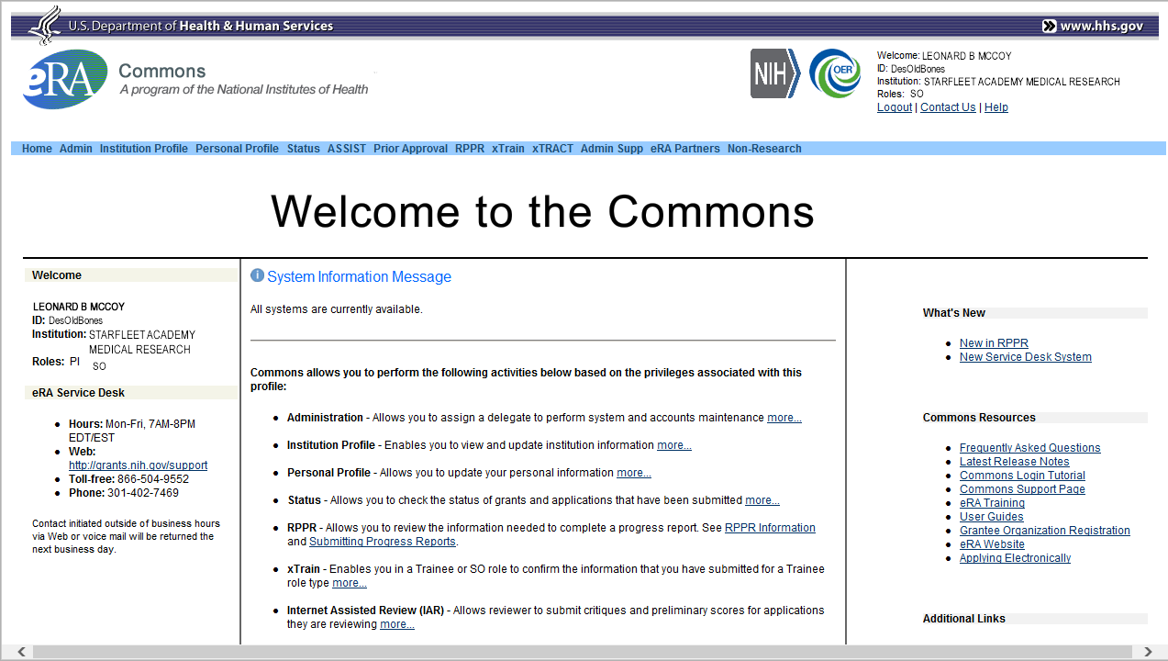
What Does eRA Commons Do?
The eRA Commons is an online interface where grant applicants, grantees and federal staff can access and share administrative information related to grant applications and awarded research grants.
ORCID ID
Applications
Progress
Reports
eSub Errors
Warnings
Application
Image
Institutional
Profile
Profile
Data
Assurances
Summary
Statement
Priority
Score
Prior
Approval
Reference
Letter
Notice
of
Award
Certifications
Publication
Data
Financial
Reports
Invention
Reports
Post-award
Correspondence
NCE
JIT
Training
Tables
Training
Appointments
Review
Assignment
HSS Data /
Integration
Relinquishing
Statement

Slide 6





eRA Partners eRA Commons is used by more agencies than just NIH

Slide 7










What is the Role of Grants.gov
There are many agencies within the federal government that have grant programs; from the Department of Education, to the Department of Defense; from Health and Human Services (HHS), to the Nuclear Regulatory Commission.
Regardless of the agency, all applications are funneled through Grants.gov for initial validation.
In the case of NIH opportunities, applications are passed from Grants.gov to eRA Commons.

Slide 8
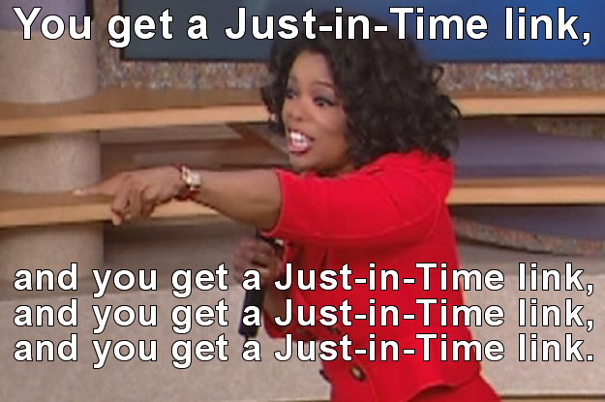
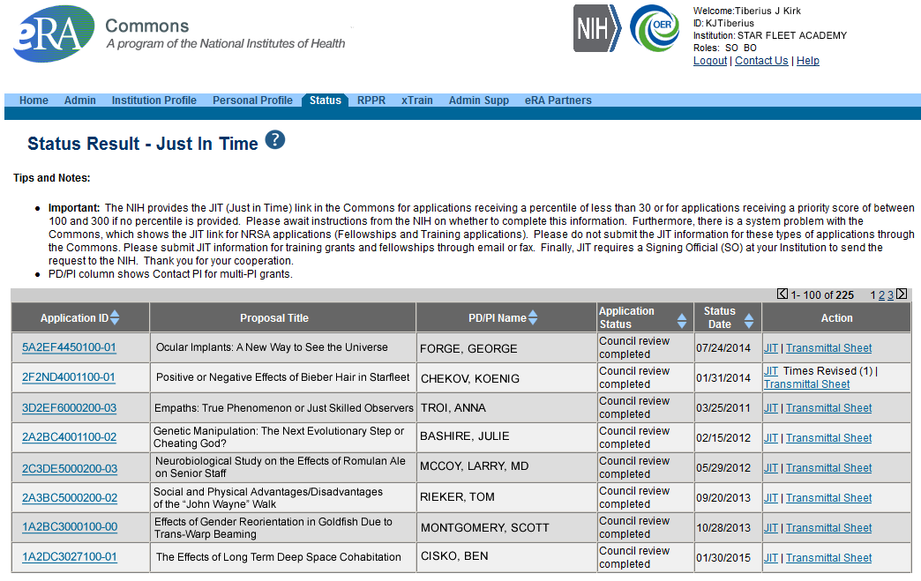
JIT Link (SO View)
Select JIT link

Slide 9
Just-In-Time (JIT)
Applicants should never submit JIT info until specifically requested to do so by NIH. A JIT link or request from NIH are not indications that a grant award will be made.
  Other Support File, Budget Upload, Other Upload, Institutional Review Board (IRB) Date, Human Subject Education
  PD/PI can save info in Commons, but only SO can submit JIT info to NIH
  Must be PDF format
Allows an applicant organization to submit additional grant application information after the completion of the peer review, and prior to funding.

Slide 10



Personal Profile (PPF)
Individual Commons users are responsible for keeping their profile information accurate
Includes information such as:
  Name
  Demographics (important for Trainees)
  Employment history (important for COI)
  Education (important for NSI & ESI)
  Reference Letters
  Publications
Very few staff members at NIH have access to change information
Central repository for individual user information

Slide 11
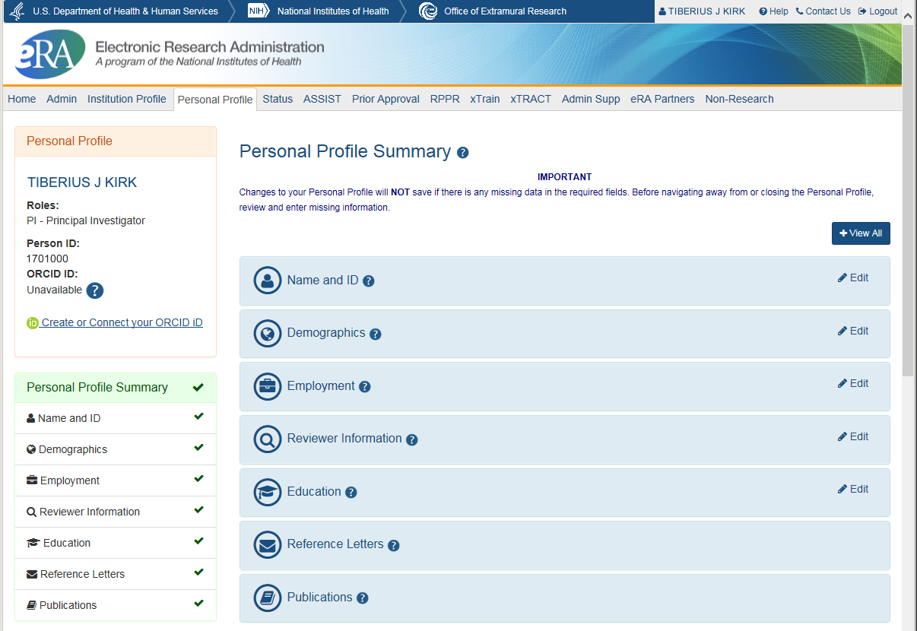
Personal Profile Screen

Slide 12
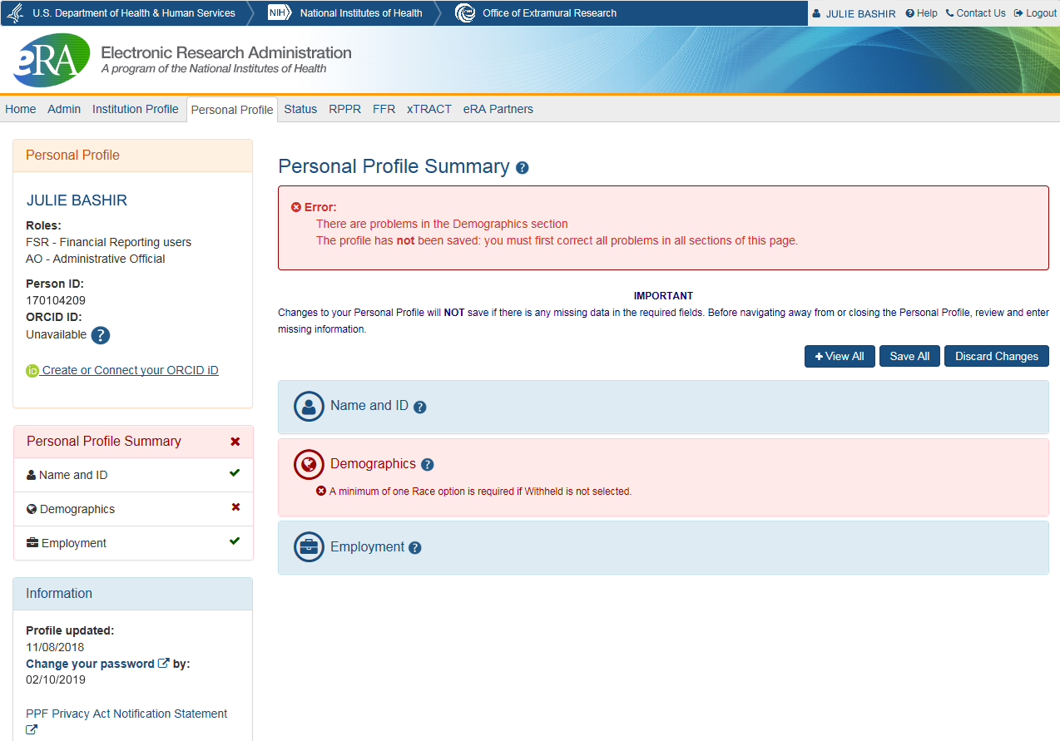
Saving Your Personal Profile
The PPF will show areas that need attention.
No data will be saved if required information is missing.
Do not navigate away from page until all required information is completed.
Leaving the page before all required information is completed, means changes will be lost.

Slide 13

Personal Profile Information is used to…
Verify information submitted in grant applications
Send you agency notifications
Complete aggregate reporting
Determine eligibility for New Investigator and Early Stage Investigator (ESI) status
Determine a reviewer’s eligibility for the Continuous Submission application submission policy

Slide 14
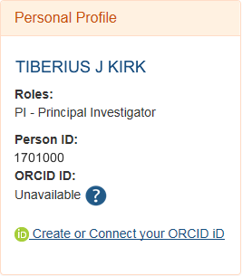
ORCID ID
ORCID ID (Open Researcher and Contributor ID)
a personal digital identifier that distinguishes every researcher
a new link to access ORCID.org added to the Personal Profile.
Allows principal investigators to create an ORCID ID to link to their Commons account, so that their publications can be linked to their grants.

Slide 15
ORCID iD Requirement
The requirement, starting October 2019, will be for:
T03, T15, T32, T34, T35, T37, T42, T90/R90, TL1, TL4, TU2, K12/KL2, R25, R38, RL5, RL9
At the time of appointment, the xTrain system will check whether appointees have ORCID iDs and appointments will be not be accepted for agency review unless an ORCID iD is linked to the individual's eRA Commons Personal Profile.
See Guide Notice NOT-OD-19-109

Slide 16

Institution Profile (IPF)
Each organization establishes and maintains their organization’s profile data
Depending on their role, users can view and/or update Institution Profile information
  Only SOs can edit IPF information
  IPF displayed as a read-only page for users affiliated to the institution
  Includes two sections: Basic and Assurances & Certifications
Central repository for registered organization information

Slide 17
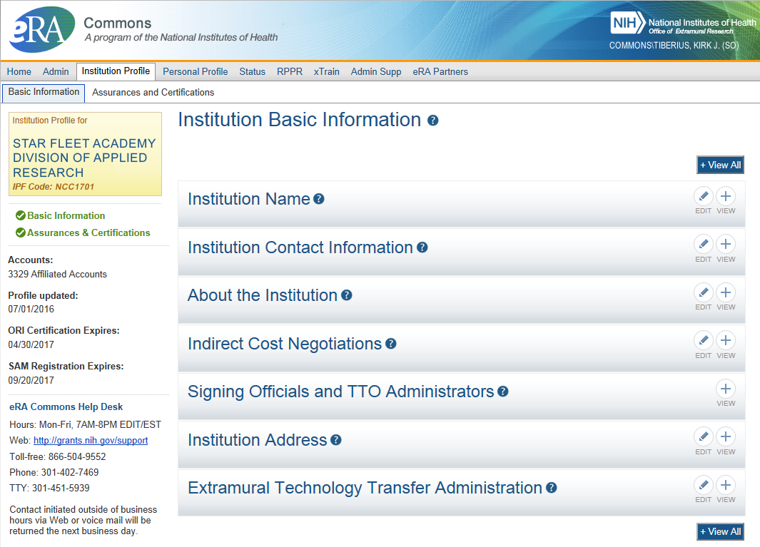
IPF Basic Information
Basic: general information about the institution
  Name, address, Institution Contact information, list of Signing Officials, etc.
SAM Registration Expiration

Slide 18
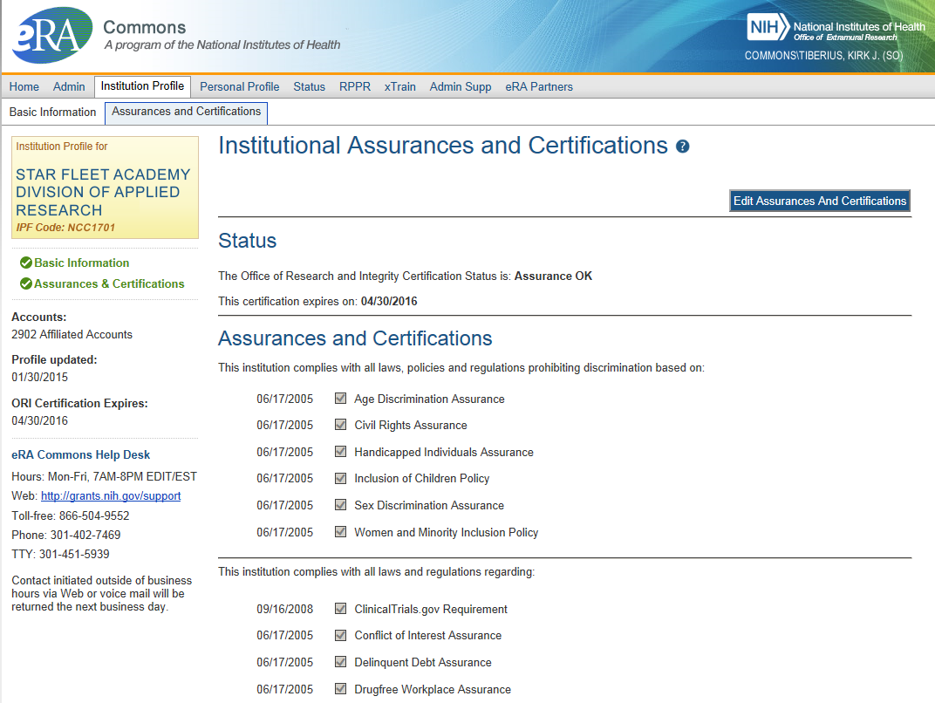
IPF Assurances and Certifications
Assurances and Certifications: data elements that comprise assurance/certification information about an institution
  List of certifications
  (e.g., Financial Conflict of
  Interest, Human Subjects
  Research, Vertebrate
  Animals, etc.)

Slide 19
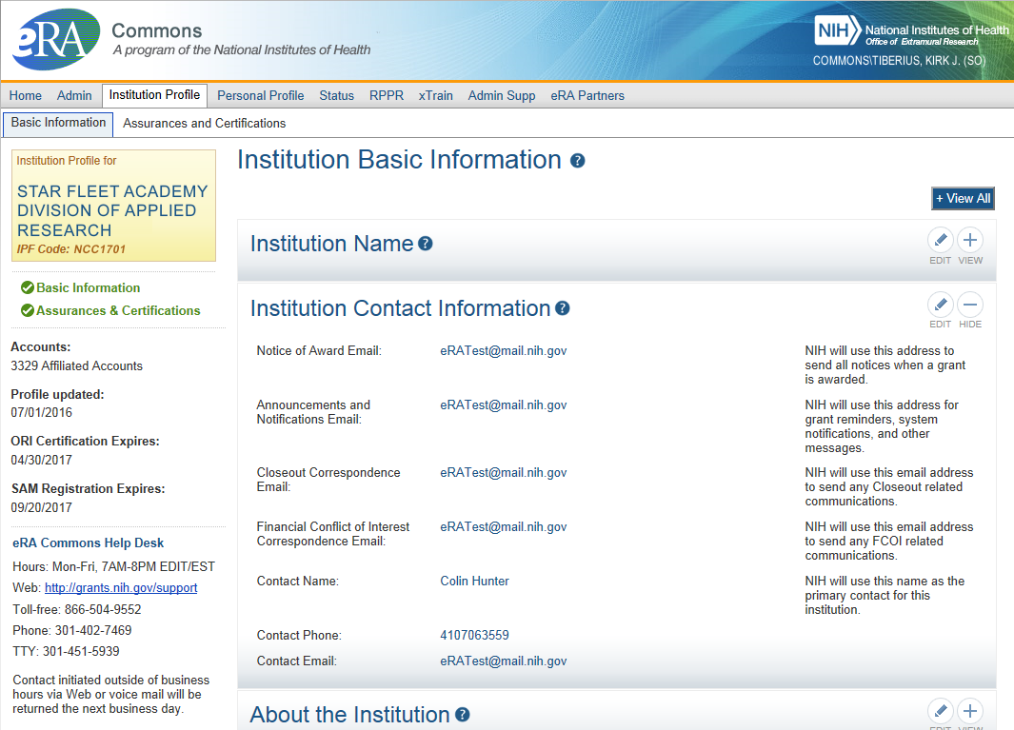
IPF Institution Contacts
Newer
Contact
Fields:
Closeout Correspondence
FCOI Correspondence

Slide 20
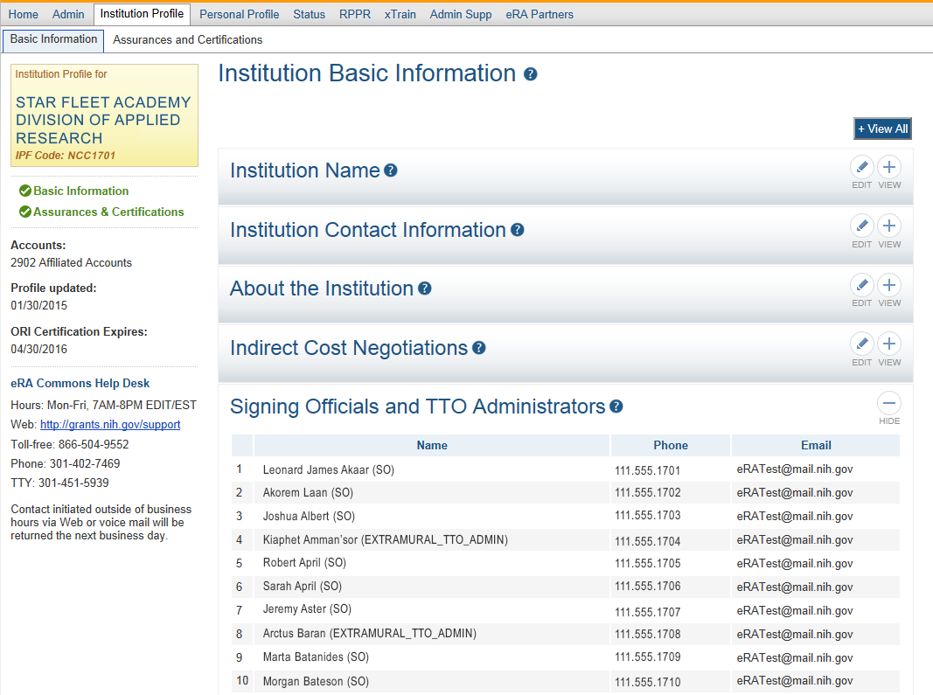
IPF SOs & TTOs
Signing
Officials
&
Technology Transfer Officers
(TTO)

Slide 21
What is the RPPR?
RPPR is the Research Performance Progress Report
A federally mandated report format used across all agencies that provide research grants and contracts
Used to document grantee accomplishments and compliance with the terms of the award
Describes the scientific progress, identifies significant changes, reports on personnel, and describes plans for subsequent budget period or year (annual reports only)

Slide 22
RPPR Data Entry
Initiation of RPPR by
  Principal Investigator
  ASST with the RPPR Delegation
RPPR sections (Annual)
  Cover Page
  Accomplishments
  Products
  Participants
  Impact
  Changes
  Special Reporting
  Budget (non-SNAP)
Watch for character limits in data entry fields
Ensure uploads are in PDF format
When completing data tables remember to click ‘Add/New’
RPPR sections (Interim & Final)
  Cover Page
  Accomplishments
  Products
  Participants (only section D.1)
  Impact
  Special Reporting
  Outcomes

Slide 23
RPPR Budgets
Submitting progress reports with budgets
  R&R budget and PHS 398 budgets are now available for Non-SNAP RPPR.
  If presented with an option of budget forms, the type that was submitted with the application should be used.
    PHS 398 Budget is available only on training grants.
  Help for R&R Budget and PHS 398 Budget forms can be found in the SF424 R&R User Guides.

Slide 24
RPPR & Human Subjects System (HSS)
HSS is the electronic system to manage human subjects and clinical trials information.
Allows principal investigators and signing officials to access and update all the human subjects and clinical trials data associated with their grants in one place.
  update participant information
  enrollment information
  inform NIH of ClinicalTrials.gov registration
  and revise other human subjects-related information as necessary, just-in-time for award or after a grant award is made.

Slide 25
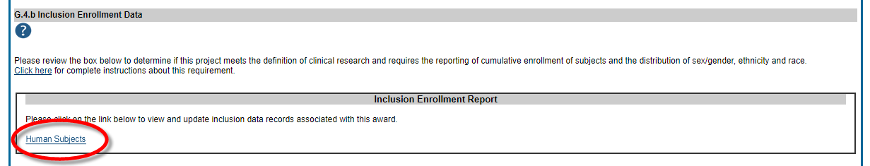
RPPR & Accessing HSS
The most common use of the Human Subjects System is for updates needed to the RPPR
You will find the Human Subjects link in Section G.4.b Inclusion Enrollment Data of the RPPR
The human subjects link is visible only for NIH applications and grants involving human subjects.

Slide 26
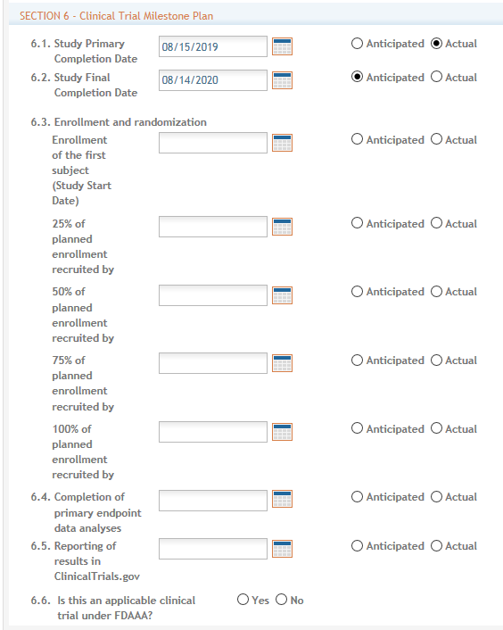
New! HSCT & RPPRs
Due to the addition of the Human Subjects Clinical Trials (HSCT) form for applications involving human subject research, the content and the format of the RPPR has changed.
You will find the study record summary in Section G.4.b. and complete individual study records later in the RPPR pdf.
Section 6 for Clinical Trials.
The Clinical Trial Milestone Plan (Section 6 of the HSCT form) is required to be filled out by grantees who are conducting clinical trials and who submitted their last competing application on January 25, 2018 or later, otherwise the RPPR will trigger an error.

Slide 27
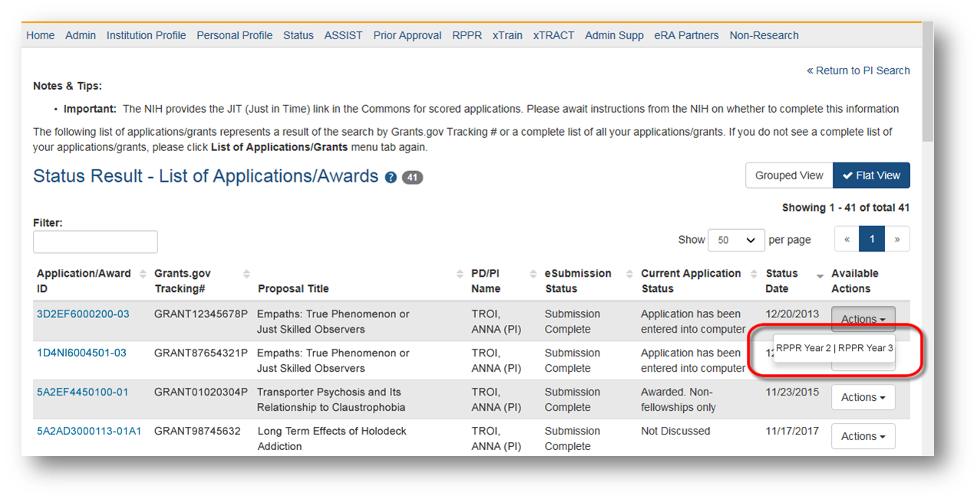
Multi-Year RPPR
MYRPPR
  Multi Year Progress Reports now use RPPR format
  Link available under the Action Column in Status

Slide 28
Complex, Multi-Project RPPR
Submitting progress reports for complex, multi-project grants
  After RPPR is initiated, PI will need to identify if RPPR should contain components.
  RPPR should have the same structure as the originally submitted application.
  Some sections are not available on Overall component (i.e. Budget)
  Some sections are not available on component level (i.e. Participants and Publications are reported on Overall)

Slide 29
eRA Commons Roles
The functions that a user can perform in the Commons are based on the role(s) assigned to his or her Commons account
Full, printable list of eRA Commons roles with descriptions:
  https://era.nih.gov/files/eRA-Commons-Roles-10-2019.pdf

Slide 30

Signing Official (SO)
During Commons registration, an applicant organization designates a Signing Official (SO)
  SO has authority to legally bind the organization in grants administration matters
  Equivalent to the Authorized Organization Representative (AOR) in Grants.gov
  SO is responsible for:
    maintaining institutional information
    submitting documents that require signature
    authority to act on behalf of the organization
    managing accounts

Slide 31
Signing Official (SO) & Managing Accounts
Signing Officials (and Account Administrators) have a responsibility to ensure duplicate accounts are not created for users.
  Users with Scientific roles should only have one (1) eRA Commons account for their entire career
    NIH needs to track funded researchers
    Used for reviewers to determine Continuous Submission status
    Used to determine New/Early Stage Investigator status
  Before creating new accounts, search across all eRA Commons accounts using AMS
  For more information, see:
    https://era.nih.gov/news_and_events/era-item-Oct2017.htm

Slide 32

Account Tips
Designate more than one Signing Official
  Certain Commons actions can only be taken by users with the SO role and you will want a back-up
Administrators should always check to see if a user already has a Commons account before creating a new account with a scientific role
  Ask the person if they already have an account, or search within the Commons
    If a user already has an account with a different organization,
    the SO should affiliate the existing account with the user’s
    new organization

Slide 33

Summary of Roles
IAR
PI
AA
FSR
SO
AO
Administrative
  SO – Signing Official
  AO – Administrative Official
  AA – Account Administrator
  BO – Business Official
  ASST – Assistant
  ASSIST Access Maintainer Role
Scientific
  Graduate Student
  IAR – Internet Assisted Review
  PI - Principal Investigator
  Post-Doc
  Project Personnel
  Scientist
  Sponsor
  Trainee
  Undergraduate
Other
  FCOI (Financial Conflict of Interest)
  FCOI_ASST
  FCOI_VIEW
  FSR (Financial Status Reporter)
  PACR (Public Access Compliance Role)
  OLAW (Reporting Animal Welfare)
  SBIR CAP*
*New! For the Small Business Innovation Research (SBIR) Commercialization Accelerator Program.
Permits access to the SBIR CAP tab in Commons to initiate, complete, and submit tracking forms.

Slide 34

Delegations
Summary
Progress Report (SO, AO, AA to PI)
Progress Report (PI to ASST)
Sponsor
Status
Personal Profile
Submit
xTrain
eRA Commons allows users to give other users permission to do specific actions on their behalf

Slide 35
Delegations Chart
Type (Name) | By | To | What it does
Progress Report | SO, AA, AO | PI on behalf of a PI | Enables the delegated PI to work on progress reports of another PI – includes Interim and Final RPPR, and HSS requests
Progress Report | PI | User within Institution with ASST or AO role | Enables the authorized user to work on progress reports for the PI – includes Interim and Final RPPR, and HSS requests
Sponsor | SO, AA (on behalf of Sponsor) | ASST | Allows the ASST to access the xTrain module
Status | PI | ASST | Allows the ASST to work with the Status module
PPF | All Users | User within Institution | Enables another user to edit someone else's personal profile
Submit | SO | PI | Enables the PI to submit RPPR and MYPR reports – now needed for PI if they are to submit Interim RPPR, Final RPPR, and HSS Data
xTrain | PI, Sponsor | ASST | Enables the ASST to work with the xTrain module and xTRACT

Slide 36
The 3 variations of RPPR
Annual RPPR Interim RPPR Final RPPR
RPPR Type | How to Access RPPR Link | When Does the Link Appear? | When is the RPPR Due? | Who Can Initiate | Who Can Edit | Who Routes to the SO | Who Submits
Annual | Status Search Results Screen or RPPR tab | 1 day after the project segment end date | SNAP Awards due within 45 days of the next budget period start date Non-SNAP due within 60 days of the next budget period start date | Principal Investigator Or User within Institution with the ASST Role* | Signing Official Or Principal Investigator Or User within Institution with the ASST Role* | Principal Investigator | Signing Official Or Principal Investigator if assigned the Submit Delegation
Interim | Status Search Results Screen | Once the grant becomes eligible for submission of a Type 2 application, and the grant is not in Closeout | 120 days from period of performance end date for the competitive segment | Signing Official or Principal Investigator | Signing Official Or Principal Investigator Or User within Institution with the ASST Role* | Principal Investigator | Signing Official Or Principal Investigator if assigned the Submit Delegation
Final | Closeout Status Screen | Once the grant becomes eligible for closeout | 120 days from period of project end date | Signing Official or Principal Investigator | Signing Official Or Principal Investigator Or User within Institution with the ASST Role* | Principal Investigator | Signing Official Or Principal Investigator if assigned the Submit Delegation

Slide 37
Interim RPPR Scenarios
Since a renewal application is competitive, there is no guarantee it will be funded. Therefor the following scenarios should be noted:
Completing Renewal Application Status | Action
Not submitting a Competing Renewal application | Submit a Final RPPR no later than 120 days from the project period end date
Submitting a Competing Renewal application | Submit an Interim RPPR no later than 120 days from the project period end date
 | Funded | Not Funded
 | The Interim RPPR is accepted as the annual RPPR | The Interim RPPR is accepted as the Final RPPR

Slide 38
I-RPPR vs F-RPPR
(Interim vs Final RPPR)
I-RPPR
  The Interim RPPR link will made available to the SO and the PI in the Status screen when a grant is eligible for submission of a Competing Renewal application.
  Only Section D.1 of Participants is required
  Sections F: Changes and Section H: Budget are not part of the Interim RPPR
  Section I: Outcomes is new. Section I is required for the Interim RPPR
F-RPPR
  The Final RPPR is only available as part of the Closeout process and the Process Final RPPR link only appears on the Closeout Status screen.
  Only Section D.1 of Participants is required
  Sections F: Changes and Section H: Budget are not part of the Final RPPR
  Section I: Outcomes is new. Section I is required for the Final RPPR

Slide 39
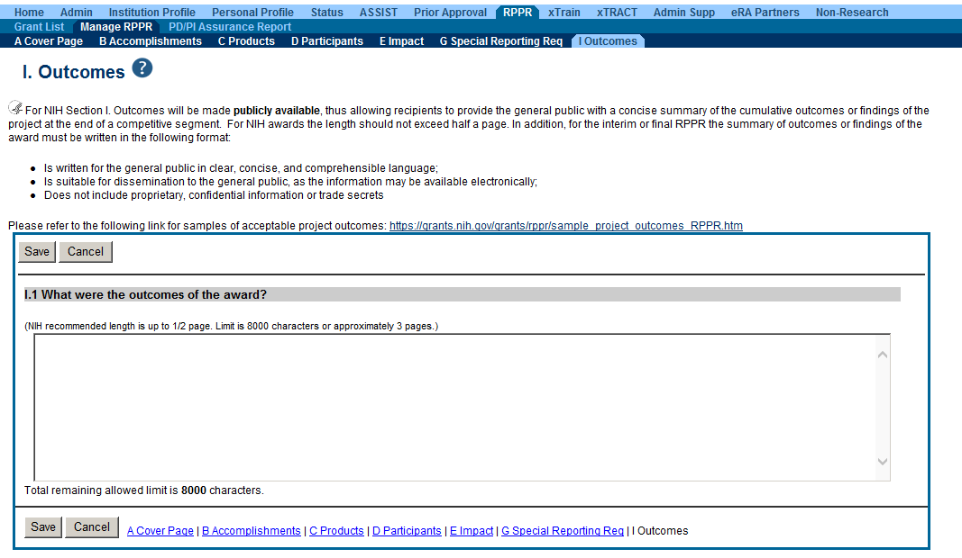
Outcomes
Information in Outcomes will be publically available. It should be written as a high level and in plain language.

Slide 40
Outcomes Requirements
Outcomes are specifically designed to be made publicly available by the agency (analogous to the abstract in the competing application)
Reporting in the Outcomes section is limited (by the federal-wide RPPR format) to 8,000 characters
The Outcomes should provide a concise summary of the findings of the award written in lay language for the general public
In an effort to increase transparency NIH will make the Outcomes data available in RePORTER

Slide 41
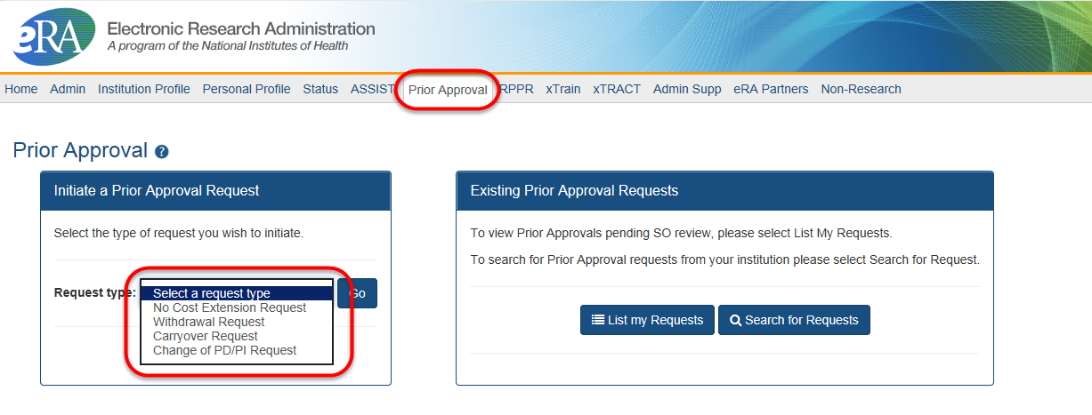
Managing the Prior Approval Options
The Prior Approval tab provides one way to manage you’re application or award.
Prior Approval is the process in which an applicant or grantee must have written approval by an authorized official to undertake a certain activity.
eRA now supports four activities for Prior Approval Requests.
  Request for No Cost Extension (NCE)
  Request for withdrawal of an application
  Carryover
  Request for Change of PD/PI

Slide 42
What is xTRACT?
The Extramural Trainee Reporting And Career Tracking (xTRACT) system is a module in the eRA Commons that allows applicants, grantees, and assistants to create research training tables for NIH progress reports and institutional training grant applications.
Because xTRACT is integrated with eRA Commons, some training data will be prepopulated in the system, including trainee names, selected characteristics, institutions, grant numbers, and subsequent NIH and other HHS awards.
In addition, xTRACT allows institutions to create profiles for participating faculty that do not require access to eRA Commons, create institutional programs, and non-NIH funding sources; which can be retrieved for future use.

Slide 43
Notice of Transition to the xTRACT System for Preparing Research Training Data Tables
Current Notice Number: NOT-OD-19-108 (https://grants.nih.gov/grants/guide/notice-files/NOT-OD-19-108.html)
Beginning with RPPRs due on or after October 1, 2019 and applications submitted for due dates on or after January 25, 2020, NIH and AHRQ anticipate that they will mandate that required training data tables submitted with T32, TL1, T90/R90, and T15 applications and progress reports be created via the xTRACT system.
System validations in Grants.gov and the RPPR module will check to ensure that tables were created via xTRACT, and applications and RPPRs that are not in compliance will be rejected.

Slide 44
What is xTrain?
xTrain is an application that allows program directors and/or principal investigators (PD/PI), university administrators, and trainees to electronically prepare and submit PHS 2271 Statement of Appointment Forms (2271) and PHS 416-7 Termination Notices (TN) associated with institutional research training grants, institutional career development awards, individual fellowships, and research education awards.
Agency staff also uses xTrain to review and process the appointments and termination notices that are submitted electronically
And recall that xTrain requires the ORCID iD for appointments starting October 2019

Slide 45


Example Work Flow in xTrain
PD/PI or ASST
PD/PI or ASST completes and routes form to the Trainee for electronic signature.
TRAINEE
Trainee fills out required information and routes the form back to PD/PI
PD/PI reviews form and routes it to BO
Routing captures the user’s electronic signature.
BO routes form to Agency
BO
Agency

Slide 46
Progress Report Additional Materials (PRAM)
The PRAM feature provides a means for the grantee to enter, review, route, and submit information to agency following the submission of an RPPR.
  Public Access (PA) PRAM - Generated automatically after an RPPR is submitted with publications that are not compliant with Public Access Policy
  Agency Requested PRAM – Only available if requested by the Grants Management Specialist (GMS)
PD/PI can enter the PRAM, but can only submit it if they are delegated with Submit Progress Report authority. Otherwise, only the SO can submit the PRAM to Agency.

Slide 47
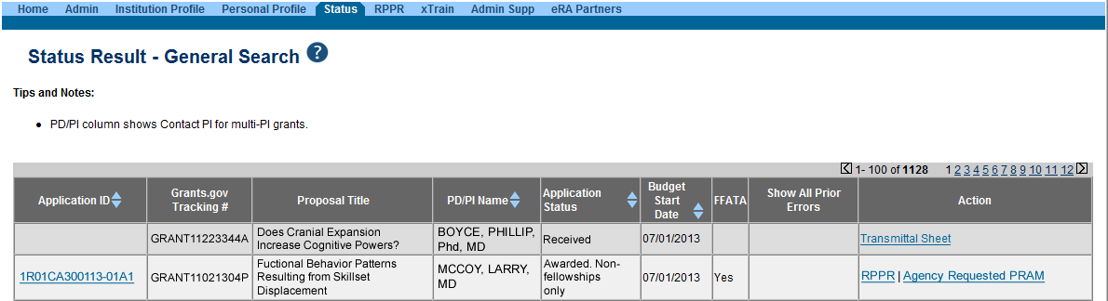
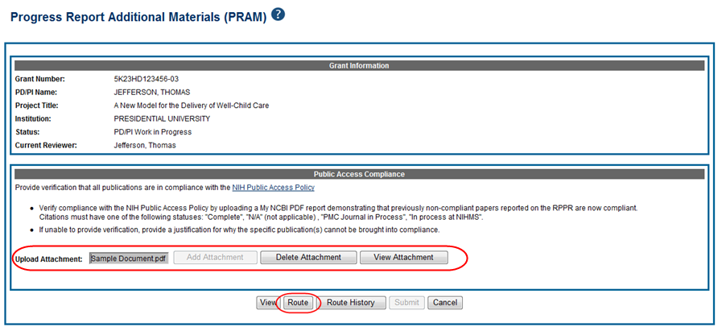
Accessing PRAM

Slide 48
Format for PA PRAM
Public Access (PA) PRAM will require an attachment.
  The PA PRAM will no longer contain a free form text box.
  Using My NCBI the institution will need to generate a PDF of their reported publications showing their compliance.
  For instructions on generating the report please see:
    http://www.nlm.nih.gov/pubs/techbull/nd12/nd12_myncbi_pdf.html

Slide 49


RPPR Publications
When selecting/deselecting publications for RPPR submissions
  Users will see a gold lock icon next to those publications added to their grant into NIHMS.
  Users see a silver lock icon for publications that have been reported on a previous RPPR.
  Neither can be removed on the RPPR, both need manual intervention.
  To delete a publication with a gold lock, users will need to contact the NIHMS help desk through their web form, which is accessible at http://www.nihms.nih.gov/.
  To delete a publication with a silver lock please contact the PublicAccess@nih.gov

Slide 50

Closeout
Closeout items for NIH include*:
  Final Research Performance Progress Report (F-RPPR)
  Federal Financial Report (FFR)
  Final Invention Statement
NIH automatically marks the grant “ready for close out,” making the link appear in Commons when:
  The project period end date has passed, and
  No Typ2 application has been submitted
Electronically submit required Closeout documents for grants in Closeout status
*Agency partners may require additional information

Slide 51
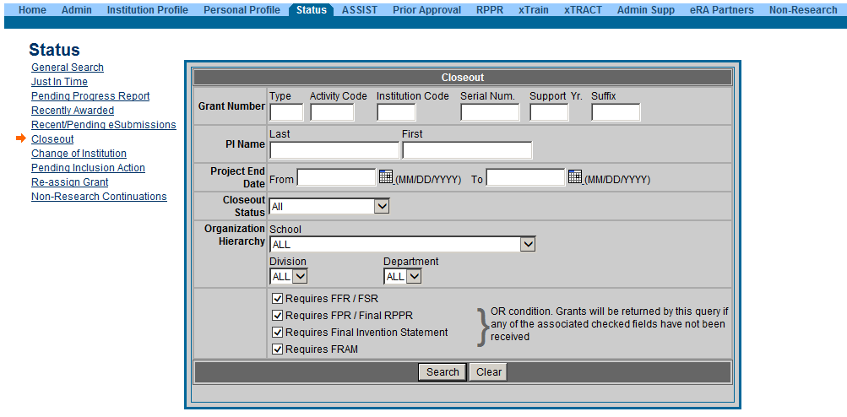
New Closeout Search screen provides additional search criteria

Slide 52
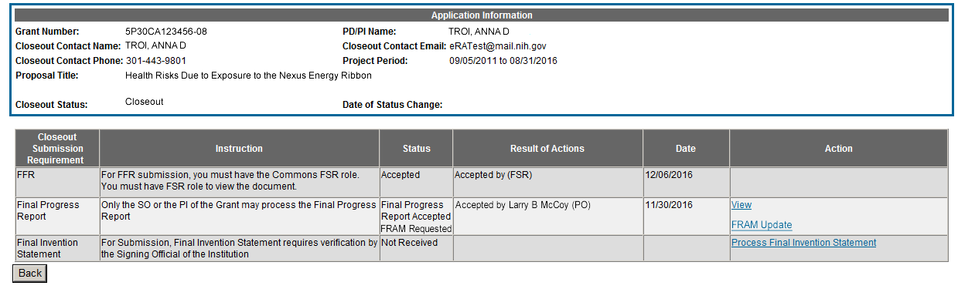
Final Report Additional Materials
(FRAM)
FRAM works in same manner as PRAM in RPPR
Awarding IC sets status to FRAM Requested
Awarding IC triggers email for requested information to the SO & PI
The FRAM Update link appears in Action column

Slide 53
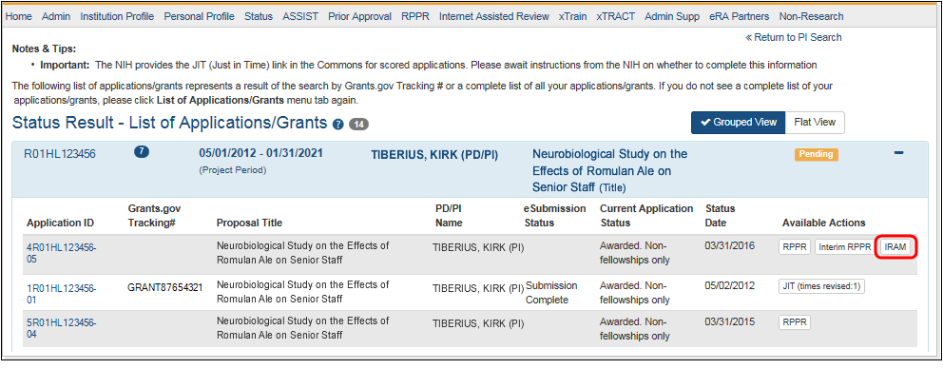
Interim Report Additional Materials
(IRAM) Link
IRAM works in same manner as PRAM in for RPPR
Awarding IC sets status to IRAM Requested
Awarding IC triggers email for requested information to the SO & PI
The IRAM Update link appears in Action column

Slide 54
What Are Admin Supps?
A request for additional funds during a current project period to provide for an increase in costs due to unforeseen circumstances.
Requested additional costs must be within the scope of the peer reviewed and approved project
Streamlined eRA Commons process
  Commons pre-populates much of the data needed for request from awarded grant

Slide 55
Admin. Supplement Changes Coming
eRA will soon* allow the electronic submission of administrative supplements for complex (multi-project) applications
The submission would work very similarly to a single project activity code
Eventually we see this process as a requirement for all administrative supplements.
*as of the development of this presentation

Slide 56
Prior Approval – NCE
No-Cost Extension (NCE)
  An extension of time to a project period and/or budget period to complete the work of the grant under that period, without additional Federal funds or competition

Slide 57
Prior Approval – No Cost Extension: When?
When is a grant eligible for a NCE through Prior Approval?
  When you have already used a NCE under expanded authority and you are within 90 days of the project end date.
  When you are not under expanded authority and you are within 90 days of the project end date.
  When the project end date has expired and has not been closed or has not entered unilateral closeout, whichever comes first.

Slide 58
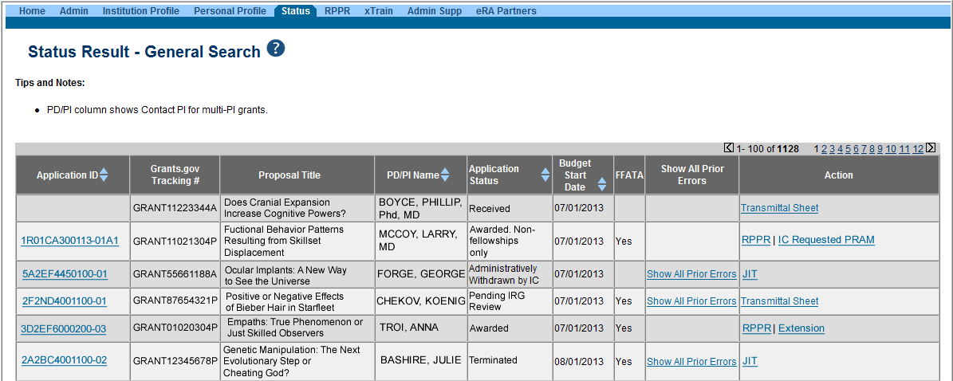
NCE Another Way
Extension link appears in the SO Status Search Results Screen

Slide 59
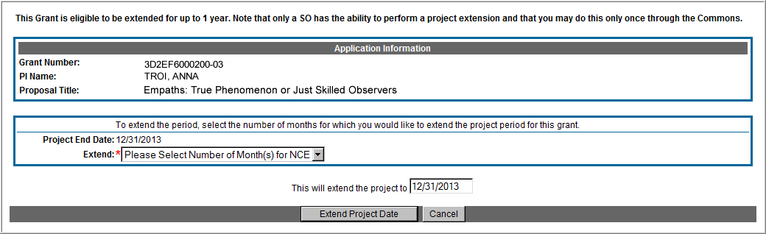
Extension Screen
Choose an extension of 1 to 12 months.
New calculated project end date

Slide 60
NCE
Only SOs can submit the NCE notification
May be submitted no earlier than 90 days before end of project and no later than project end date
Can request extension of 1-12 months, in one-month increments
E-mail notification sent to NIH Grants Management staff when SO processes the extension
Electronically submit a notification to exercise one-time authority to extend without funds the final budget period of a project period of a grant.

Slide 61
Expanded Authority – You Get Just One
No Cost Extension (NCE) part of ‘expanded authorities’
Can only extend once without express approval
Increasing trend of extending in the middle of the project period (i.e. end of year 2 of 5 year grant)
  If this is done, the Extension link will NOT appear 90 days from end of project end-date
  If in need of an NCE, submit Prior Approval NCE request
See June’s 2015 eRA Items of Interest for more:
  https://era.nih.gov/news_and_events/era_item_June_2015.htm#expanded

Slide 62

Personal Profile & ESI Extension
PD/PI’s with ESI status can request for extension of their ESI period for various reasons, including medical concerns, disability, extended periods of clinical training, natural disasters, active duty military service etc. All these requests will be reviewed on a case by case basis.

Slide 63
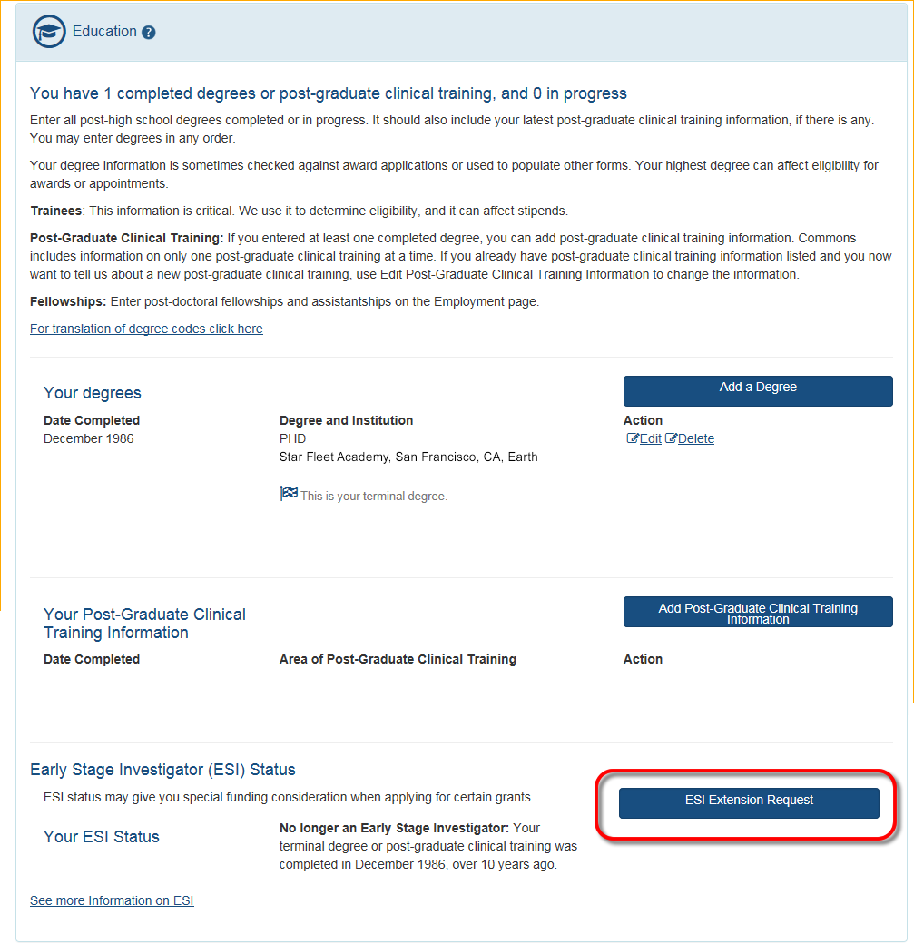
ESI Extension Under Education
ESI Extension Link will be available
Following link opens ESI Extension Request form
PI completes the information and submits for approval.
The PPF displays the date the extension request was submitted.

Slide 64
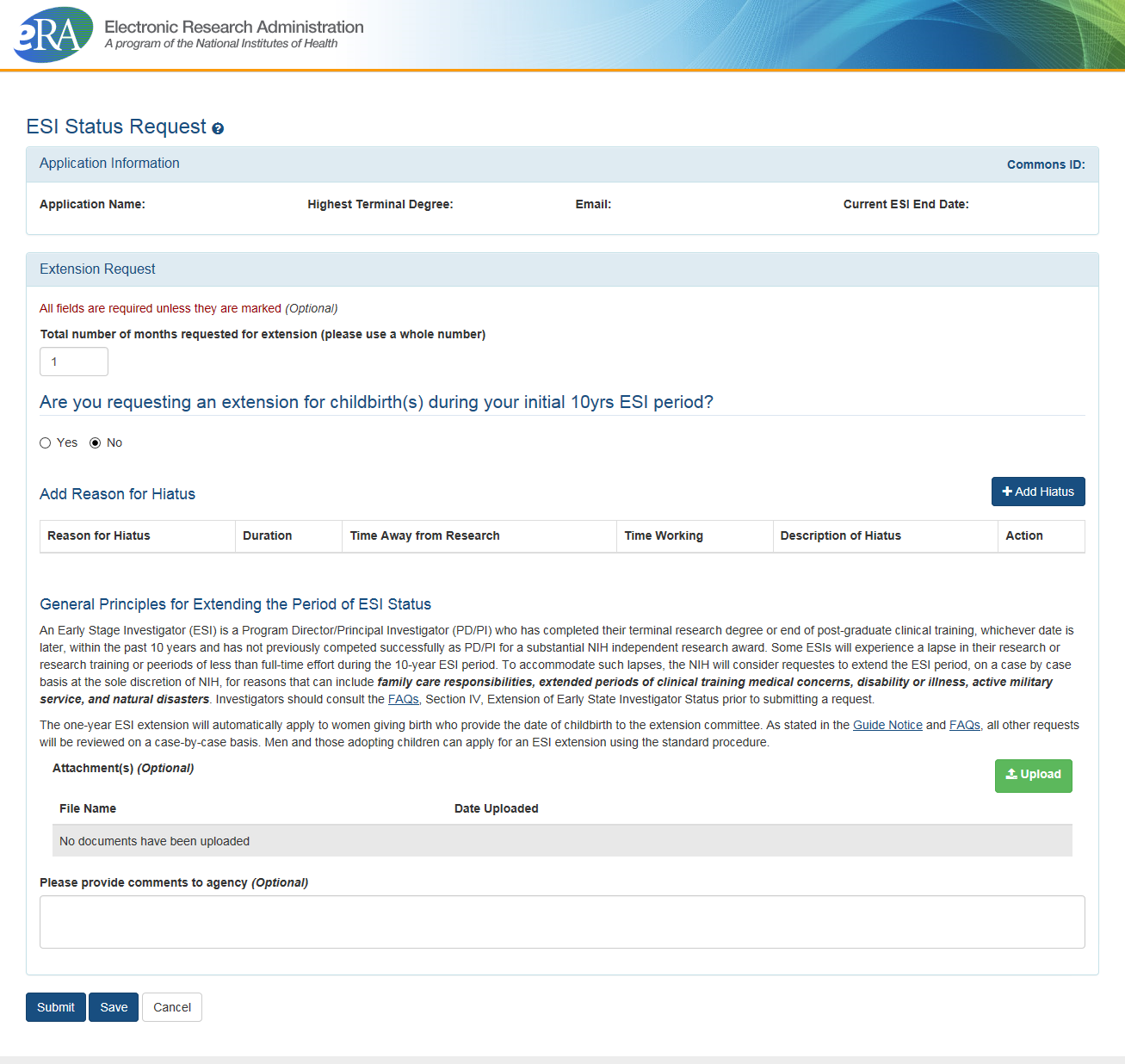
ESI Extension Screen
The number of months for the extension can be requested
If the reason for the request is the birth of a child, complete the requested information
The Add Hiatus button permits the selection of additional reasons for the request
Supporting documentation can be uploaded

Slide 65
Using Status to Track the Application

Slide 66
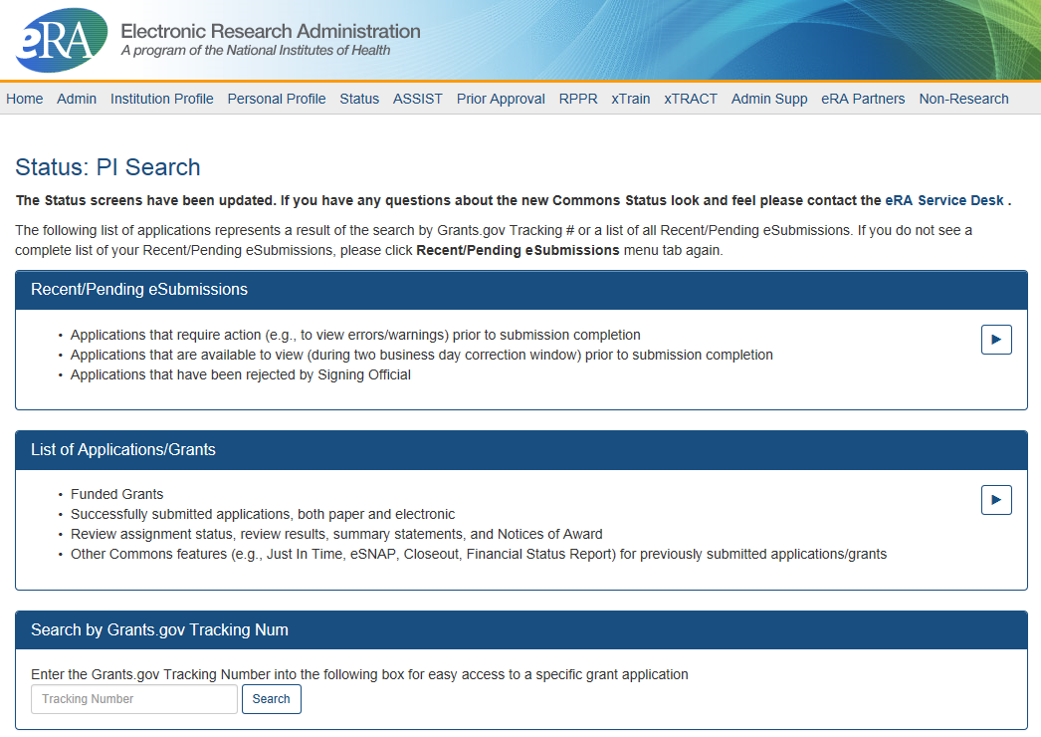
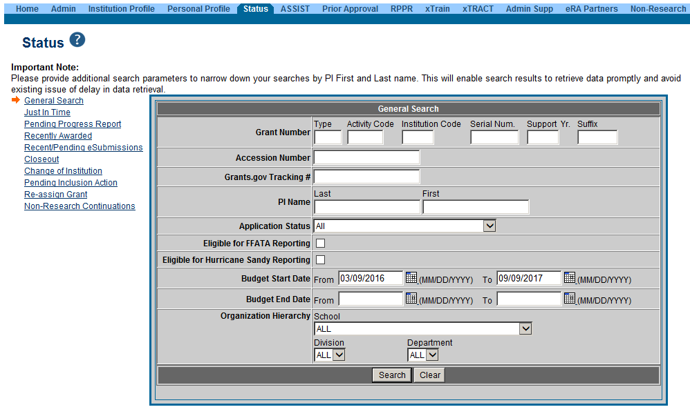
PI Status vs SO Status
Principal Investigators can view their Recent/Pending eSubmissions or List of Applications/Grants.
Signing Officials can search/view all submissions for their institution.

Slide 67
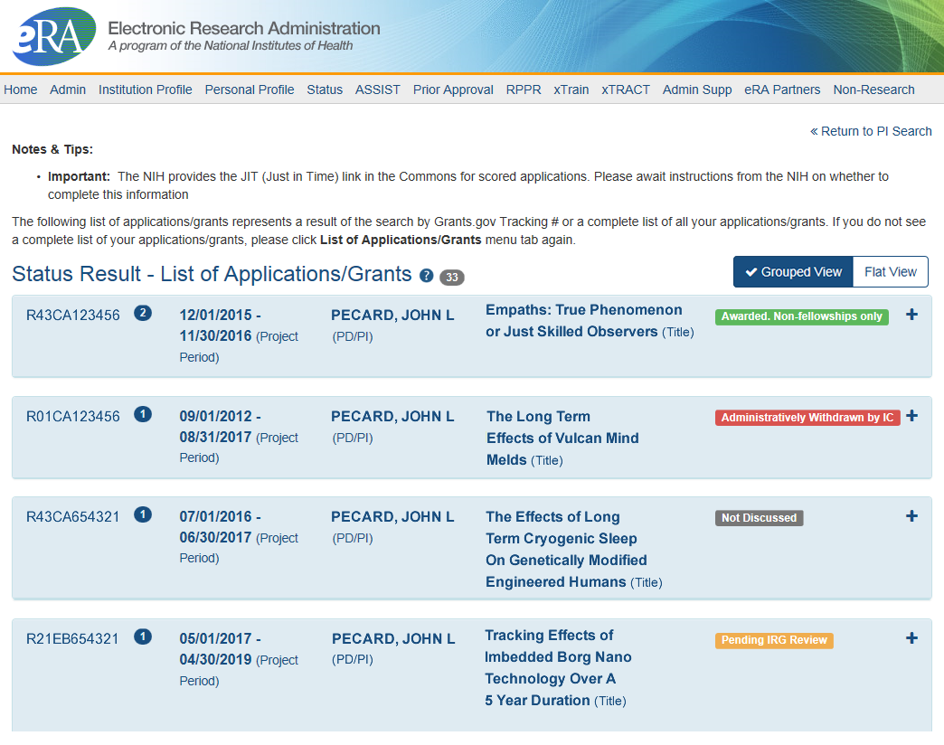
Status Result from General Search for PI
Click anywhere in the blue to get to more information, then select the Application ID link to view detailed status information for that particular application.

Slide 68

Status Result from General Search for SO
Select the Application ID link to view detailed status information for that particular application.

Slide 69
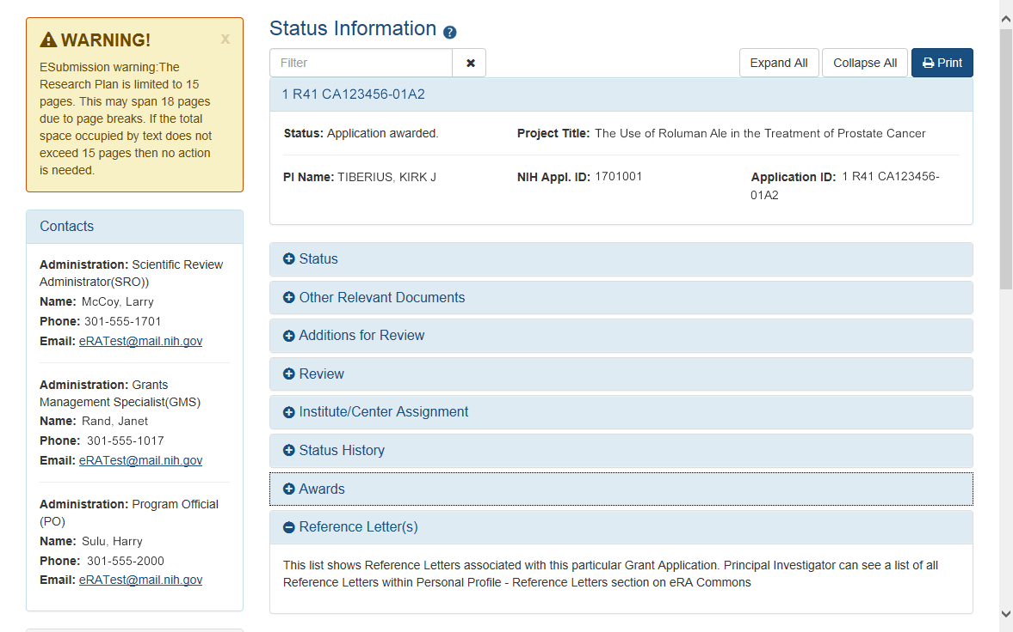
Detailed Status Information Screen
Provides warnings
Control Buttons
Text Filter
eRA Contacts

Slide 70
Detailed Status Information Screen
Provides Access to…
Check the Application Image
Check Review Information and IC Assignments
Check Review Outcomes
  Summary Statement
  Impact Score
  Percentile Score
Verify NI & ESI status at time of application submission
Check Reference Letters for Application
The Notice of Award
Just-in-Time Documents
Only visible only to PD/PI

Slide 71

Thank you

Slide 72
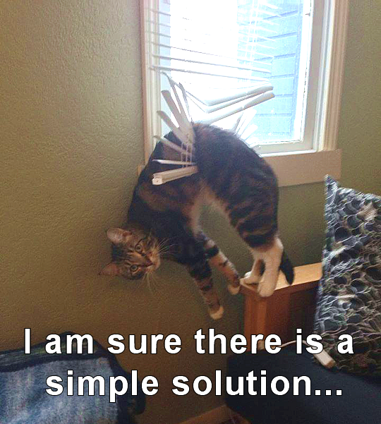
Finding Help
Service Desks
On-line resources &Web sites

Slide 73
Service Desks
eRA Commons
Service Desk
Grants.gov Contact
Center
Web:
  https://grants.nih.gov/support/index.html
  Phone: 1-866-504-9552
Hours : Mon-Fri, 7a.m. to 8 p.m. ET
Toll-free: 1-800-518-4726
Hours : 24x7 (Except Federal Holidays)
Email : support@grants.gov
Help Resources: https://www.grants.gov/web/grants/support.html

Slide 74

Web Sites
eRA Commons:
  https://public.era.nih.gov/commons/
Electronic Research Administration:
http://era.nih.gov/
How to Apply – Application Guide: http://grants.nih.gov/grants/how-to-apply-application-guide.htm
NIH About Grants:
http://grants.nih.gov/grants/oer.htm

Slide 75

Additional Resources
&
Information

Slide 76

Terminology Check
New Investigator
  A PD/PI who has not previously competed successfully as a PD/PI for a substantial independent research award.
    See: https://grants.nih.gov/grants/new_investigators/index.htm
Early Stage Investigator (ESI)
  An individual who has completed their terminal research degree or end of post-graduate clinical training, whichever date is later, within the past 10 years and who has not previously competed successfully as PD/PI for a substantial NIH independent research award.
    See: https://grants.nih.gov/policy/early-investigators/index.htm
Continuous Submission
  As a way of recognizing their service to NIH, reviewers with substantial review service are permitted to submit their research grant applications (R01, R21, or R34) on a continuous basis and to have those applications undergo initial peer review in a timely manner.
    See: https://grants.nih.gov/grants/peer/continuous_submission.htm

Slide 77

Reference Letter Resources
Frequently Asked Questions
  http://grants.nih.gov/grants/ElectronicReceipt/faq_full.htm
Submitting Reference Letters through eRA Commons (video)
  https://era.nih.gov/era-training/era-videos.htm#refletters

Slide 78
eRA Commons Roles Resources
Four Tutorial Videos on Registration and Account Creation
  Institutional Registration: How to Register an Institution
  How Signing Officials (SOs) Create Accounts
  How Trainees Get Accounts
  Access all the eRA Videos at:
  https://era.nih.gov/era-training/era-videos.htm

Slide 79

Prior Approval Resources
NIH eRA Items of Interest Articles
  https://era.nih.gov/news_and_events/era_item_February_2017.htm
Video Tutorials
  Withdrawal of an Application
  Change of PD/PI
  No-Cost Extension
  Carryover
  https://era.nih.gov/era-training/era-videos.htm

Slide 80
Admin. Supplement Requests Resources
Resources:
  Administrative Supplement Web Page
    https://grants.nih.gov/grants/administrative-supplements.htm
  Administrative Supplements (Type 3s) Frequently Asked Questions
    https://era.nih.gov/faqs.htm#XVIII

Slide 81

Project Outcomes Resources
There has been some confusion as to what constitutes an effective Project Outcome.
Please see the following resources for more information
  Sample Project Outcomes Summary – RPPR
    https://grants.nih.gov/grants/rppr/sample_project_outcomes_RPPR.htm
Items of Interest, November 2017
  Technical Jargon? Not for Project Outcomes
    https://era.nih.gov/news-and-events/era-item-Nov2017.htm

Slide 82
FFR Related Policy Notices
NOT-OD-14-103
  Revised Timeline for Administrative Changes to NIH Domestic Awards to Transition to Payment Management System Subaccounts
  http://grants.nih.gov/grants/guide/notice-files/NOT-OD-14-103.html
NOT-OD-14-093
  Administrative Changes to NIH Domestic Awards Transition to Payment Management System Subaccounts
  http://grants.nih.gov/grants/guide/notice-files/NOT-OD-14-093.html
NOT-OD-14-084
  NIH Updating Grant Closeout Policies and Procedures to Align with New HHS Requirements
  http://grants.nih.gov/grants/guide/notice-files/NOT-OD-14-084.html

Slide 83
Closeout Resources
Guide Notice NOT-OD-14-084
  NIH Updating Grant Closeout Policies and Procedures to Align with New HHS Requirements
  http://grants.nih.gov/grants/guide/notice-files/NOT-OD-12-152.html
Closeout FAQs
  http://grants.nih.gov/grants/closeout/faq_grants_closeout.htm

