Slide 1
Letters Home: What I Learned at Camp NIH About Application Submission & eRA Commons
Sheri Cummins & Joe Schumaker
August 2016

Slide 2
Stuff Worth Writing Home About
eRA Mobile,
Account Management,
Delegations,
RPPR for Publications, &
Final RPPR
Registrations,
Application Submission Options &
Application Process

Slide 3
Letter Home
Dear Mom,
We’re learning how to register to submit grant applications.
Before we started we all had to go to Arts & Crafts to make swear jars. We thought it was silly, but by the time we got through the SAM registration we all understood.
They think of everything here.
Love,
Richard
P.S. Please send cash!

Slide 4
Organization Registration
Your organization must be registered in multiple systems to submit. Start early – can take 6 weeks!
DUNS – provides unique organization identifier
SAM (System for Award Management) – needed to do business with government
Requires annual renewal
Grants.gov – required to submit grant applications
eRA Commons – required to do business with NIH
SBA (Small Business Administration) – required for SBIR/STTR applications
http://grants.nih.gov/grants/how-to-apply-application-guide/prepare-to-apply-and-register/registration/org-representative-registration.htm

Slide 5
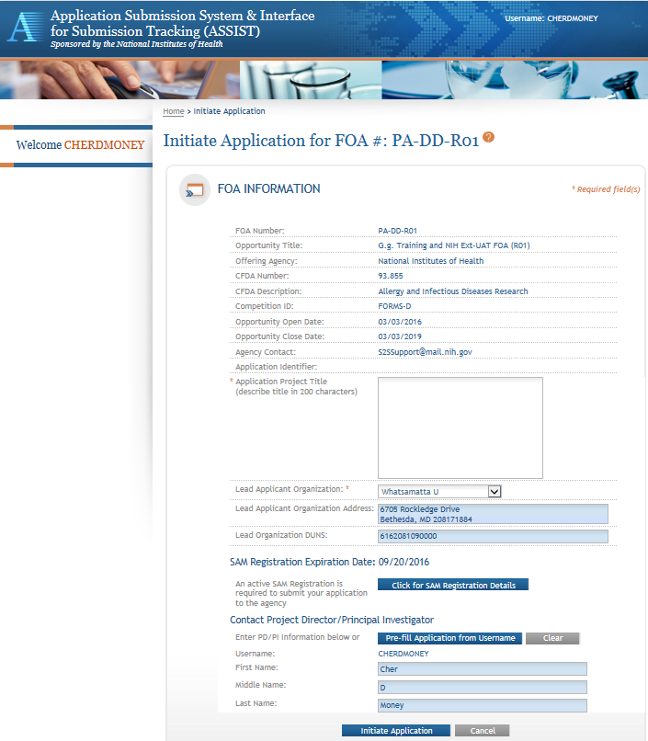
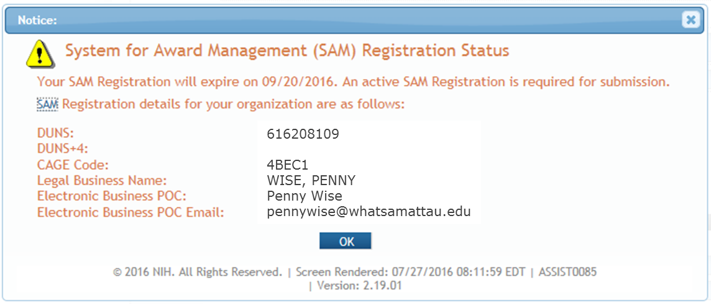
Visibility of SAM Registration Status in ASSIST
SAM registration expiration date & details visible in Initiate Application screen.
Coming This Summer
SAM registration expiration date always visible in FOA Information screen.

Slide 6
Pending SAM Expiration Validation
eRA will provide a Warning if your SAM registration is within 14 days of expiration
Pre-submission
Visible when you use the Validate Application action in ASSIST
Post-submission
Included in list of errors/warnings in eRA Commons upon submission through Grants.gov using any submission method
Coming This Fall
Error if your SAM registration has expired.

Slide 7
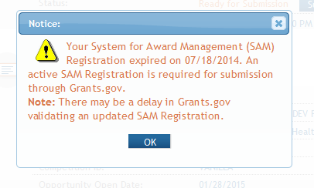
ASSIST Pop-up For Expired SAM Registration
ASSIST pop-up will appear if you try to submit and your SAM registration has expired
Informational only - does not prevent submission
Coming This Fall
Active SAM registration will be required to submit using ASSIST.

Slide 8
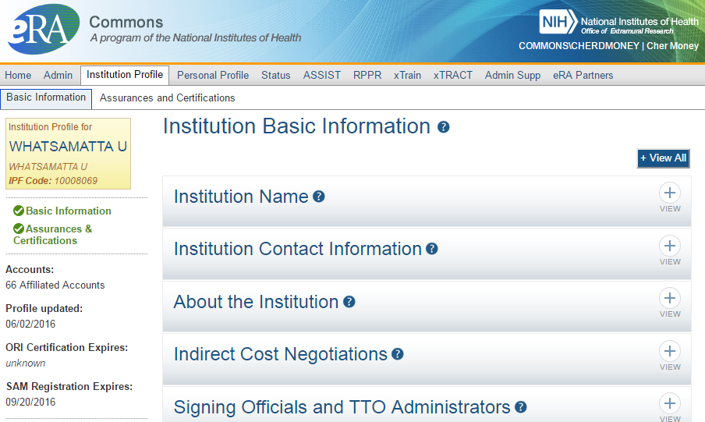
Visibility of SAM Registration Status in eRA Commons

Slide 9
Individual Registrations
Grants.gov
At least one Authorized Organization Representative (AOR)
eRA Commons
At least one Signing Official (SO)
Project Director/Principal Investigator (PD/PI) and any multiple-PD/PIs
Component leads on a multi-project application
Sponsor on a fellowship application (NOT-OD-14-129 – August 2014)
Candidates for diversity and re-entry supplements
Primary mentor identified on individual mentored career development applications (NOT-OD-16-082 – March 2016)
http://grants.nih.gov/grants/how-to-apply-application-guide/prepare-to-apply-and-register/registration/investigators-and-other-users/era-commons-user-registration.htm

Slide 10
Letter Home – submission options
Dear Mom & Dad,
Camp NIH is great. I’m learning all sorts of stuff.
You wouldn’t believe how many ways there are to submit a grant application these days.
ASSIST is my favorite. Even though you have to provide all the same stuff, the neat tools make the process so much easier.
Love,
Faith
P.S. Please send lots of chocolate!

Slide 11
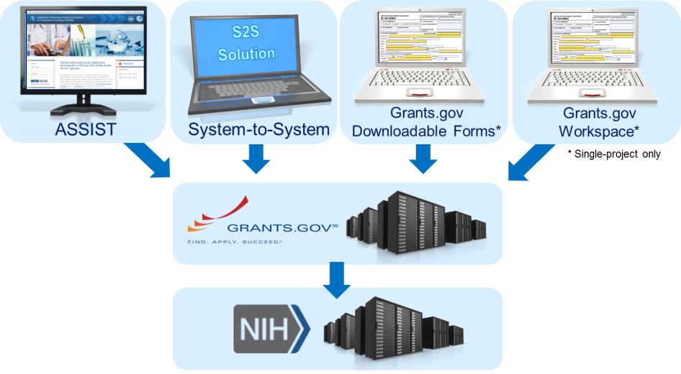
Application Submission Options
http://grants.nih.gov/grants/how-to-apply-application-guide/prepare-to-apply-and-register/choose-a-submission-option.htm

Slide 12
ASSIST
Managed by NIH
Features
Multi-user access
Pre-population from eRA Commons profile information
Pre-submission validations
Pre-submission preview in agency format
Tracking in a single system
NIH support personnel can (securely) see what you see when troubleshooting issues
Ability to copy application data to another opportunity or to a different application package for the same opportunity
Super handy feature during form updates!

Slide 13
System-to-system (S2S) Solution
Managed by institution or service provider
Features vary by solution
Examples of potential features
Secure, on-line data entry
Concurrent user support
Integration with institutional databases and grant systems to reduce data entry
Pre-submission verification of some NIH business rules
Pre-submission preview of assembled application image in generic or agency format
Visibility to eRA Commons application status information

Slide 14
Grants.gov Downloadable Forms
Managed by Grants.gov
No registration required until submission
Offline data entry
Good when internet connectivity is unavailable or unreliable
No visibility to agency errors/warnings or application image prior to submission
Must track in multiple systems

Slide 15
Grants.gov Workspace
Managed by Grants.gov
Hybrid of online application management and downloadable forms
Allows forms to be completed individually by different users
No visibility to agency errors/warnings or application image prior to submission
Must login to multiple systems to track application status (Grants.gov & eRA Commons)

Slide 16
Available Options for Application Types
Type | ASSIST | System-to-System Solution¹ | Grants.gov Down-loadable Forms | Grants.gov Workspace | eRA Commons | Paper
Single-project (SP) Competing Applications | ✓ | ✓ | ✓ | ✓
Multi-Project (MP) Competing Applications | ✓ | ✓
Administrative Supplement (Admin Type 3) | ✓(SP) | ✓(SP) | ✓(SP) | ✓(SP) | ✓(SP) | ✓(SP, MP)
Successor-in-Interest (Type 6) | ✓(SP) | ✓(SP) | ✓(SP) | ✓(SP) |  | ✓(SP, MP)
Change of Institution (Type 7) | ✓(SP) | ✓(SP) | ✓(SP) | ✓(SP) | Relinquishing Statement | ✓(SP, MP)
¹Availability varies by applicant organization and S2S solution

Slide 17
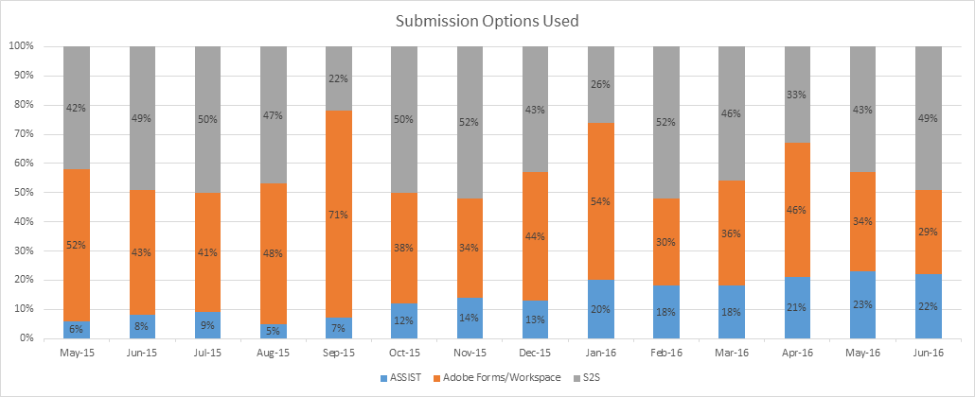
What Submission Option Are Applicants Using?
More and more Grants.gov Downloadable Forms/Workspace users switching to ASSIST

Slide 18
Your Application will be…
Subject to the same registration requirements
Completed with the same data items
Routed through Grants.gov
Validated against the same NIH business rules
Assembled in a consistent format for review consideration
Tracked in eRA Commons
…regardless of submission option used.

Slide 19
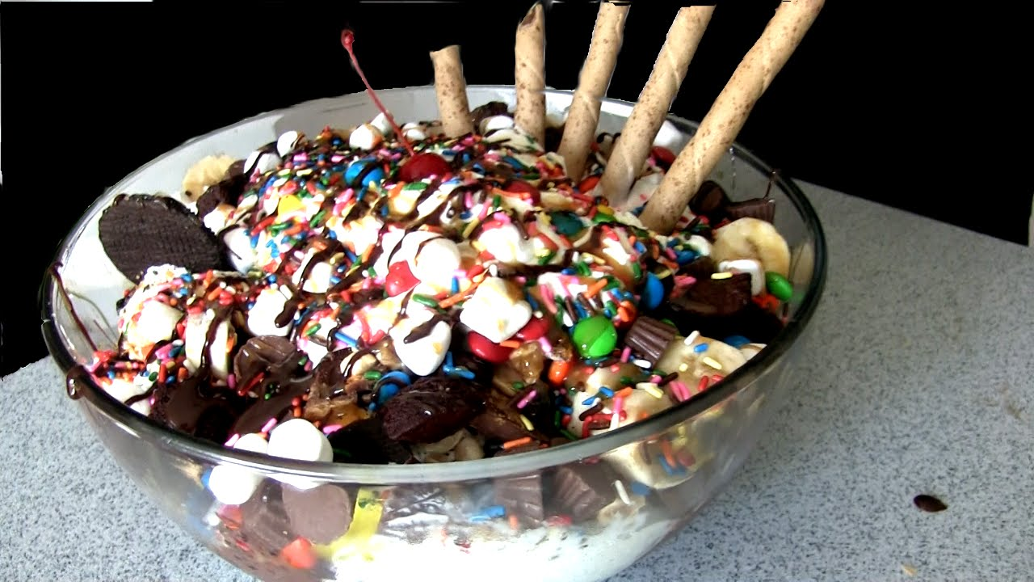
Letter Home – process
Dear Dad,
We ran the application submission obstacle course Monday. My team was the first one to successfully submit.
We had all week to complete it, but decided to start early. Boy were we glad we did.
Some folks waited until the last minute thinking it would be as easy as ordering something on-line. It wasn’t!
All the finishers got to make ice-cream sundaes – yum!
Nancy

Slide 20
Ready to Submit?
You are ready to submit once you have:
Verified all required registrations
Identified a funding opportunity announcement and due date
Chosen a submission method
Prepared your application forms per the announcement and application guide instructions
Routed your application to the person authorized to submit (i.e. Grants.gov user with the Authorized Organization Representative (AOR) role)

Slide 21
Application Process – Submit
AOR submits application to Grants.gov
Grants.gov checks application and records status
AOR checks status in Grants.gov
Validated
(No errors)
Application queued for agency retrieval
Rejected
with Errors
Applicant corrects application errors

Slide 22
Application Process – Track
eRA checks application and puts status in eRA Commons
eRA system downloads application
Application image generated in eRA Commons
Applicant checks status in eRA Commons
No errors,
Warnings OK
AOR submits changed/correct application to Grants.gov and begins process again
Errors found
Applicant makes corrections before deadline

Slide 23
Application Process – View
Happy with image in eRA Commons?
After 2 business days the application automatically moves forward to Receipt & Referral
Looks
good
Change desired
Let application move forward without change
Before
deadline?
No
Which option?
SO rejects application in eRA Commons
AOR submits to Grants.gov and begins process again
Apply for later due date
Yes
SO rejects app in eRA Commons (w/in viewing window) or withdraws app (after) & prepares changed/correct application
Make change and be subject to late policy

Slide 24
Letter Home - Joe
Dear Betty,
I got to play eRA Commons trivia today. They put us in teams and assigned a counselor to each team.
Guess who was on my team - Joe!
He is sooooo cute and funny and he like knows everything so of course we won. Tracy was really jealous. It was awesome!
Miss you!
Sherri

Slide 25
Letter Home – eRA Mobile
Dear mom and dad,
Camp is great. We get one hour a day to use our phones.
Thanks to the new eRA Mobile friendly design, I was able to check on my grant.
The biggest issue is there is only one place on the campground that gets a signal. ☹ Love, Billy

Slide 26
eRA Mobile Executive Summary
Develop an eRA Mobile Strategy
Develop corresponding policies for use
Identify needs based on current mobile traffic
Focus on a mobile capable website vs. a traditional platform specific application
Get feedback and customer input

Slide 27
Purpose of eRA Mobile Development Initiative
Better support a diverse user community
Ensures that eRA provides efficient solutions for mobile platforms
Ensures a positive end user experience while using a variety of devices (i.e., iPhone, androids, tablets)

Slide 28
Commons Mobile Features
Track grant application status through the submission process
View Basic Info
Status
Score/percentile
SRG
View grant image
View summary statements

Slide 29
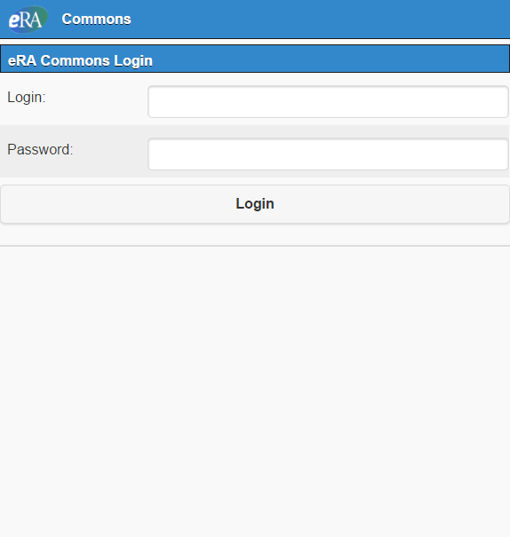
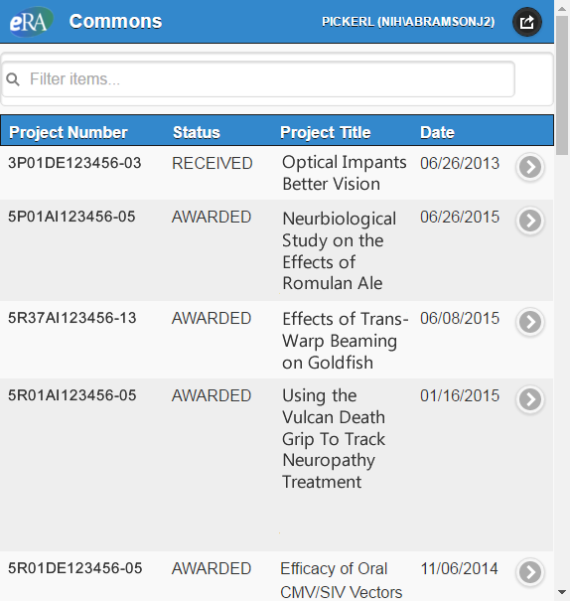
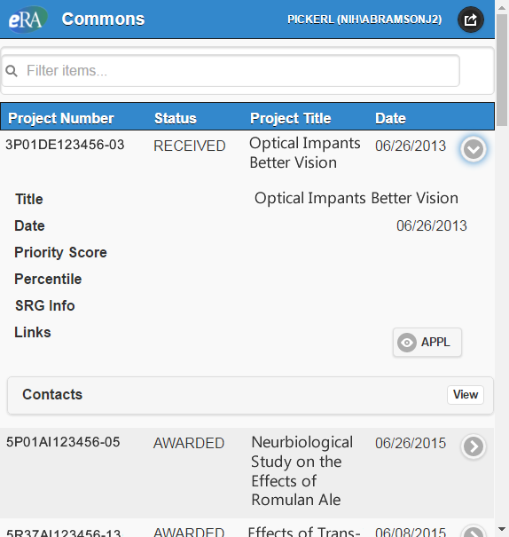
Commons Mobile
Mobile devices access Status through a dedicated URL:
https://m.era.nih.gov/cmb

Slide 30
Letter Home - AMS
Dear Mom,
Camp is fun. But sometimes it is kinda hard to tell the campers from the counselors…
Luckily, the new AMS lets us run reports to show everyone’s role here.
See you soon.
Send cookies!
Love Joanne

Slide 31
Account Management Redesign
Updated the current Account Management System (AMS) functions to support external, NIH, and other agency accounts in a single system
Enhanced usability of AMS functionality

Slide 32
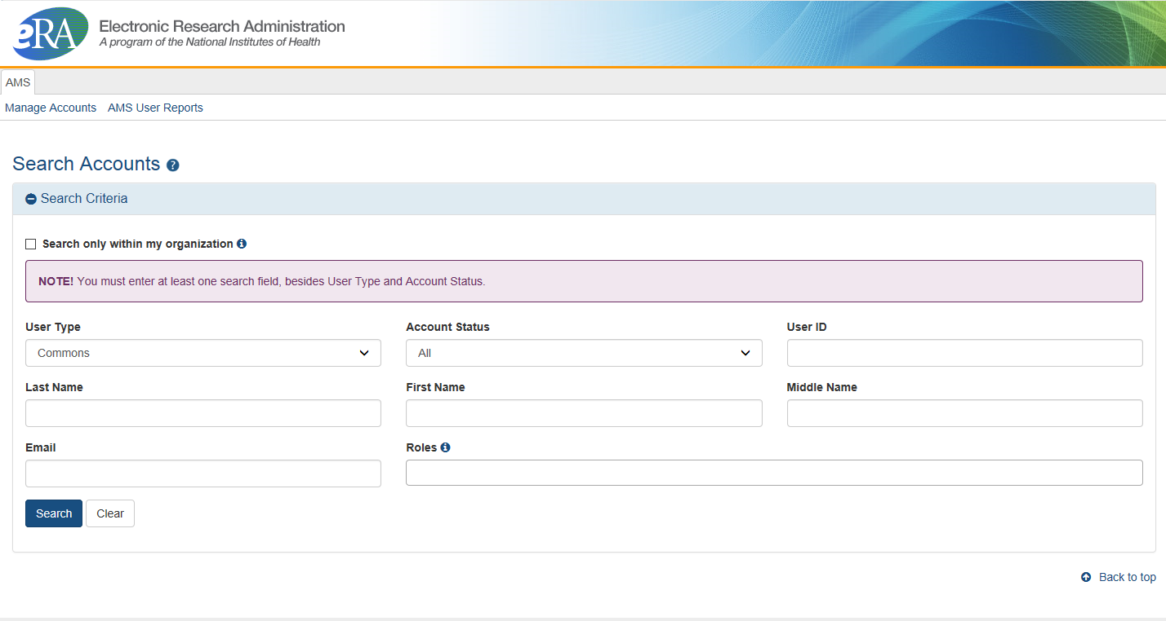
What Changed?
New Look and Feel
eRA User Interface Standard

Slide 33
Create Account Process
Search screen remains the AMS landing page
Can create account without searching
Based on data statistics, most users are searching without criteria to get to the Create Account screen
Same validations will be provided to prevent duplicate account creation
After account creation is completed, user is able to
Manage the newly created account
Create another account
Go back to Search Page to perform search

Slide 34
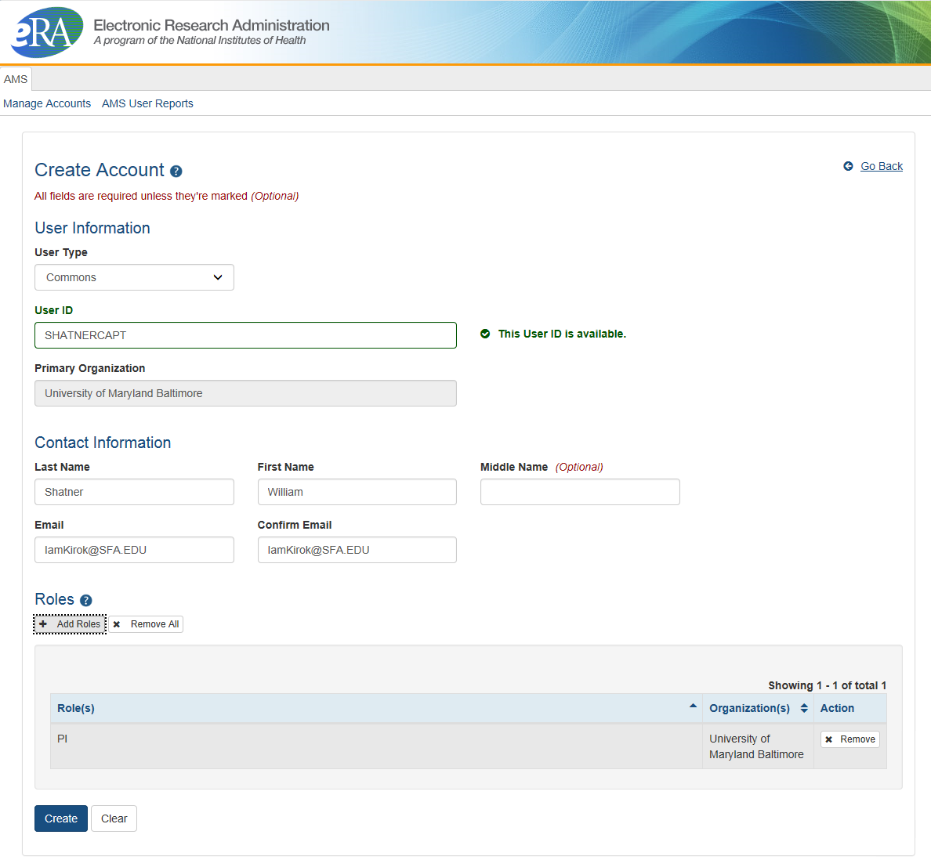
Create Account Process (Cont’d)
Checks User ID as you type it
Add user roles when you create the account or
manage the account after it is created

Slide 35
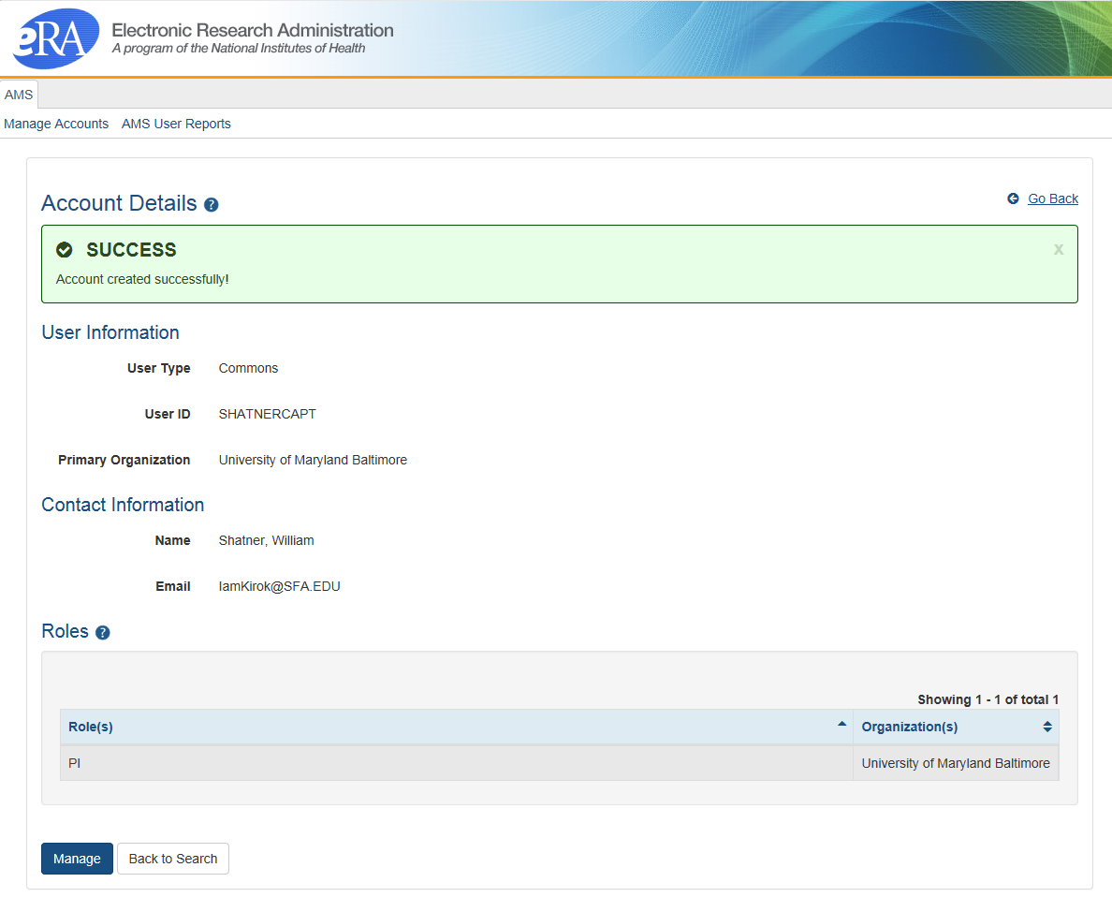
Create Account Process (Cont’d)

Slide 36
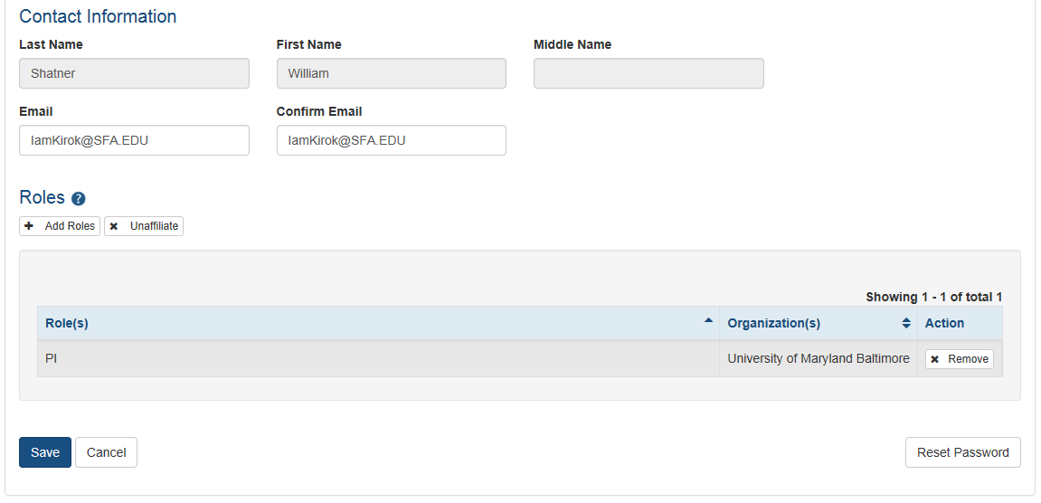
Manage Account Process
You can:
Update email address
Add and remove roles easily
Reset Password
“”

Slide 37
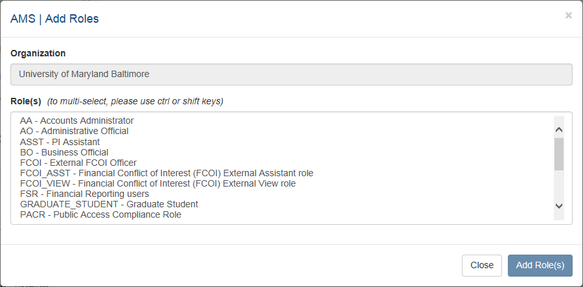
Assign Roles Process
System provides:
A clear indication of assigned user roles
Ability to select several roles at the same time
Capability to easily remove the selected roles

Slide 38
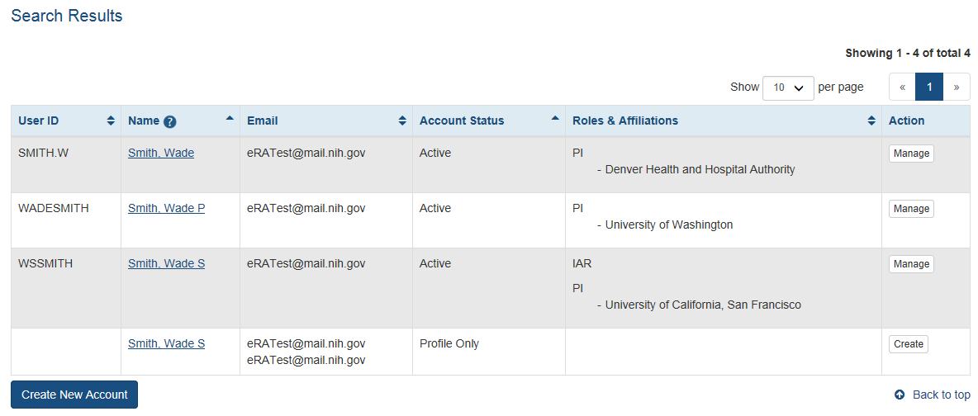
Search
Defaults to search inside AND outside your organization
Capability to view funding history

Slide 39
Reports
All Users Report - List of accounts with role(s) selection
List of accounts with incomplete profiles (future)

Slide 40
All User Report Screen

Slide 41
All User Report Results Screen

Slide 42
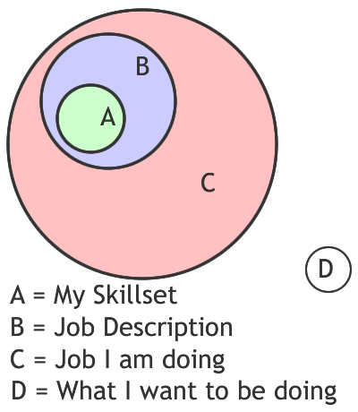
Letter Home - Delegation
Dear Parental Units –
I am pleased to inform you that as an assistant to the Counselors, I have been delegated numerous responsibilities.
However, based on the Venn Diagram attached, I am not sure I am a viable choice for the job.
Lovingly, Rick
PS: Please send clean underwear

Slide 43
Delegations
eRA Commons allows users to give other permission to do specific actions on their behalf

Slide 44
Delegations
Status
Any PI can delegate the ability to check for application errors/warnings and to view the PI’s assembled application image
Ability to view application summary statements and scores is specifically withheld
New Feature!
If several PIs delegate Status to the same assistant, the PI selection for whom the assistant is working on will remain throughout their connection to Commons unless they specifically change the selection

Slide 45
Delegations
PPF
Any user can delegate to any other user at their institution the ability to edit their Personal Profile information
Submit
SOs and BOs can delegate to a PI the ability to submit their own progress reports to agency
The PI will be listed as the authorized submitter on the submission

Slide 46
Delegations
Progress Report
Any SO or a PI can delegate the ability to complete progress report information for the PI’s grants
Remember: SOs register assistants in Commons
Ability to Route and Submit is specifically withheld
This now includes the ability to update inclusion data for Progress Reports and in the Inclusion Management System (IMS)

Slide 47
Delegations
xTrain
A PI can delegate authority to perform most actions within xTrain on their behalf
Ability to Submit appointments to agency is specifically withheld
Sponsor
A SO or Sponsor can delegate to any user at their institution the ability to initiate and facilitate termination of a fellow
Ability to Submit a termination is specifically withheld

Slide 48
Letter Home – Gold Locks
Yo Moms and Pops!
Like what is happenin’ at the home front?
Learned sumpin’ new today!
Did you know, Goldielocks, golden locks, and gold locks are all different things?
Wild yea?
To celebrate, we gave a chipmunk a new “do” ☺
Stylin!
Love, Bella

Slide 49
RPPR for Publications
New Feature!
Identifying publications that cannot be removed from an RPPR

Slide 50
RPPR for Publications
New Feature!
When selecting/deselecting publications for Research Performance Progress Report (RPPR) submissions, users will see a gold lock icon next to those publications which cannot be removed from the RPPR
To remove the grant affiliation from the publication with a gold lock, users will need to contact the NIHMS (NIH Manuscript System) help desk through their web form, which is accessible at http://www.nihms.nih.gov/
Cool Resource: http://publicaccess.nih.gov/my-bibliography-faq.htm#I.4.Deletingunwantedcitations

Slide 51
RPPR for Publications

Slide 52
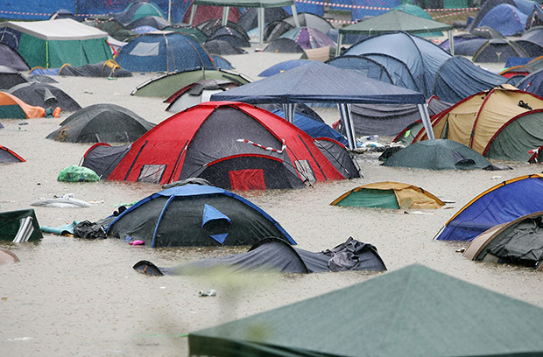
Letter Home - FRPPR
Dear Mom,
Guess what?!
I am FINALLY ready to come home (see pic).
This will be my
FINAL
RESEARCH PERFORMANCE PROGRESS
REPORT
to you before you pick me up.
With Love, Jerry
(please bring towels)

Slide 53
FINAL RPPR
Coming soon!
Final research progress report
(FRPPR)
{Ferper?}

Slide 54
FINAL RPPR
** This is work in progress, details may change **
Similar format and process as the current RPPR
FRPPR link will appear in Closeout for Signing Officials
This will replace the current Final Progress Report in the Closeout Process
Final RPPR will be integrated with the Inclusion Management System for Closeout

Slide 55
FINAL RPPR (cont’d)
** This is work in progress, details may change **
Three sections of RPPR will NOT be part of the FRPPR:
Section D: Participants
Section F: Changes
Section H: Budget
The Final RPPR will be due 120 days after project period end date
Once the final RPPR is submitted it will no longer be accessible to be edited

Slide 56
Support
NIH eRA Service Desk
Web: http://grants.nih.gov/support/
Toll-free: 1-866-504-9552
Phone: 301-402-7469
Hours: Mon-Fri, 7a.m. to 8 p.m. Eastern Time (Except for Federal holidays)
Get Connected
Subscribe to eRA listservs at:
http://era.nih.gov/about_era/get_connected.cfm

