Slide 1
Internet Assisted Review (IAR) A Reviewer’s Perspective
April 2023
eRA Communications & Documentation Team

Slide 2
IAR – Slide Topics
Log-in and Access (Slides 3 to 10)
Accessing the Applications and Review Materials (Slides 11 to 15)
Submitting Scores and Critiques (Slides 16 to 22)
Read Phase (Slides 23 to 28)
Edit Phase (Slides 29 to 31)
Final Scoring (Slides 32 to 34)
Pre and Post Meeting Conflict of Interest (Slides 35 to 37)
Virtual Meeting (VM) (Slides 38 to 40)
Online Critique Template (OCT) (Slides 41 to 48)
SRG Minutes/Budget Form (Slides 49 to 50)
Personal Profile (Slides 51 to 52)
Resources for Reviewers (Slides 53 to 55)
Feedback? (Slide 56)

Slide 3
Log-in and Access

Slide 4
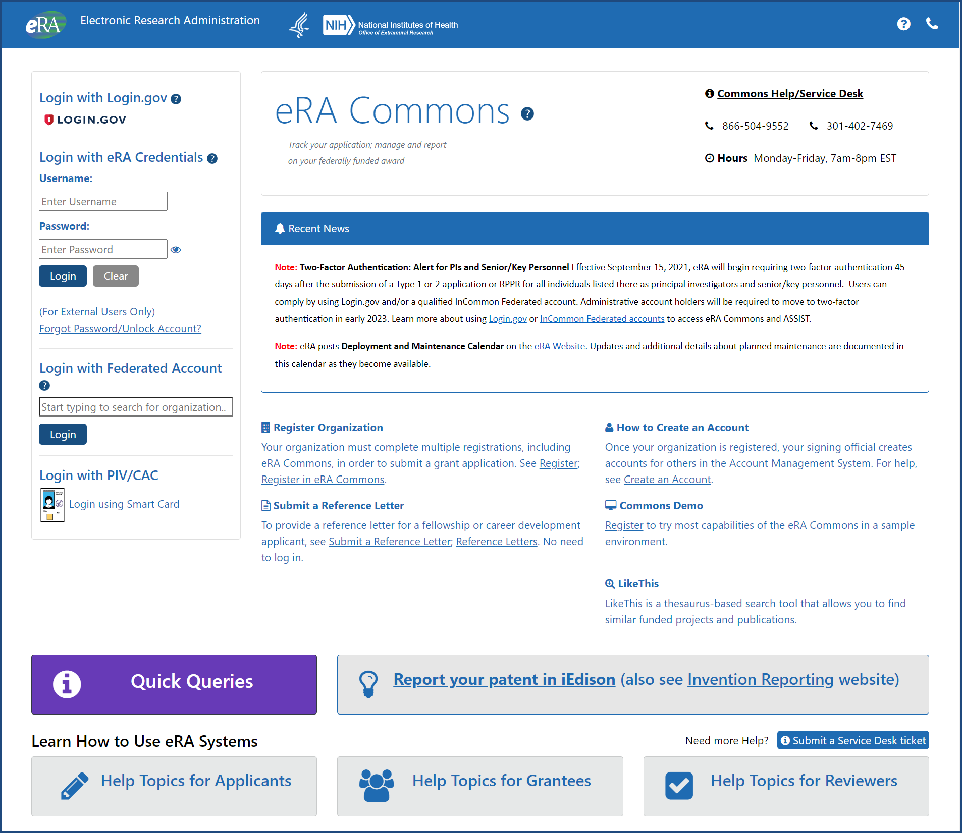
Log in to eRA Commons to Access IAR https://public.era.nih.gov/commons/

Slide 5
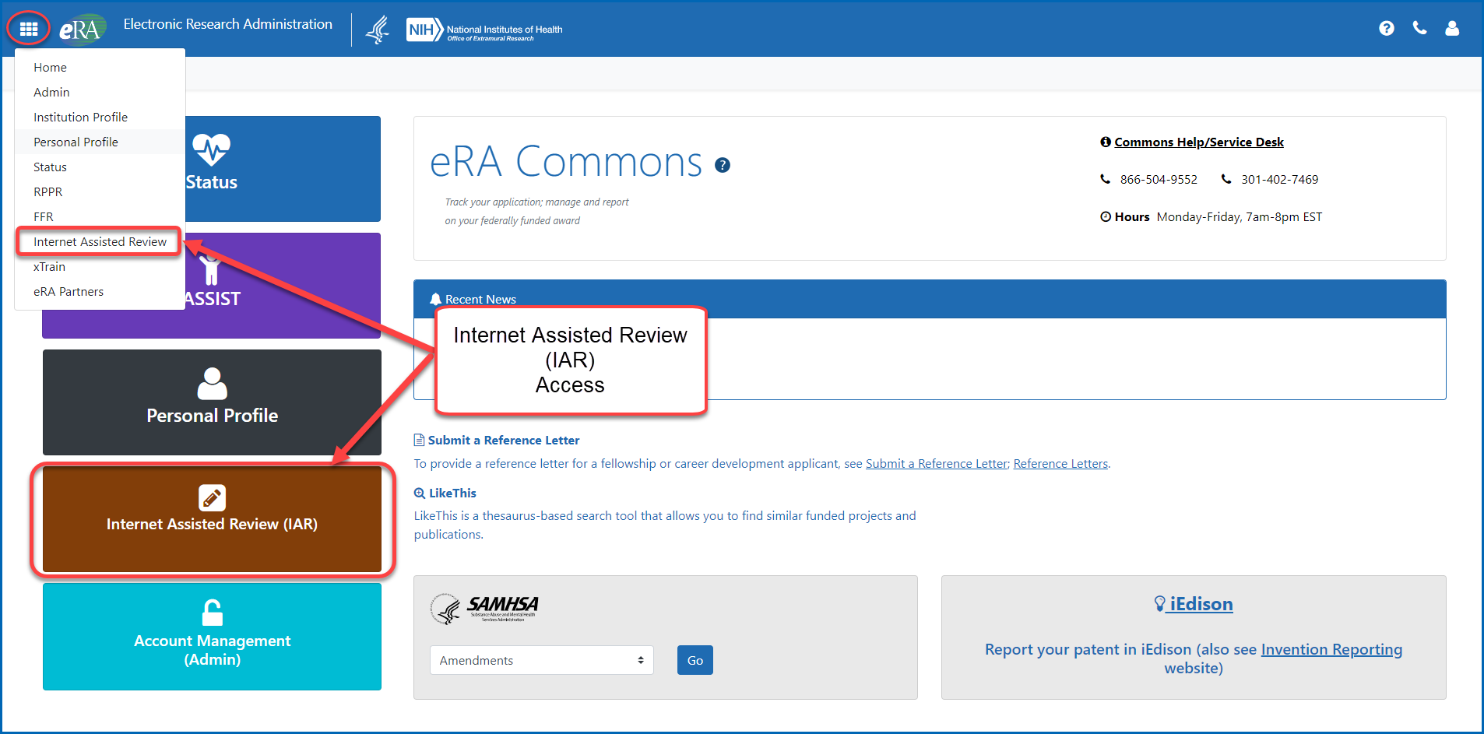
Landing Screen for Reviewers After Log-in IAR Access

Slide 6
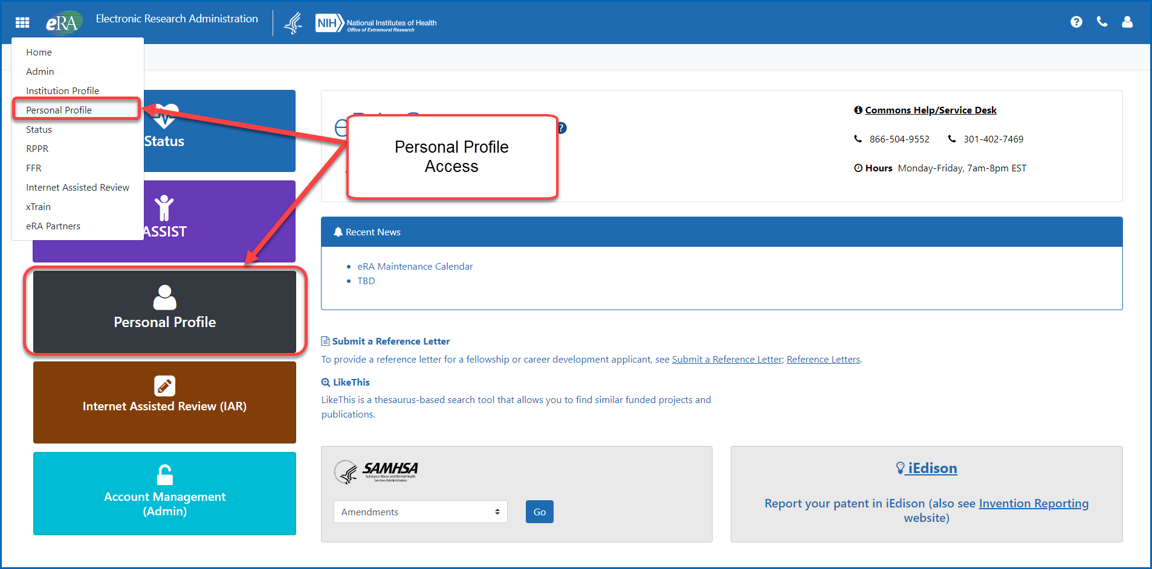
Landing Screen for Reviewers After Log-in Personal Profile Access

Slide 7
Landing Screen for Reviewers After Log-in to Older Screens
Personal Profile
Internet Assisted Review

Slide 8
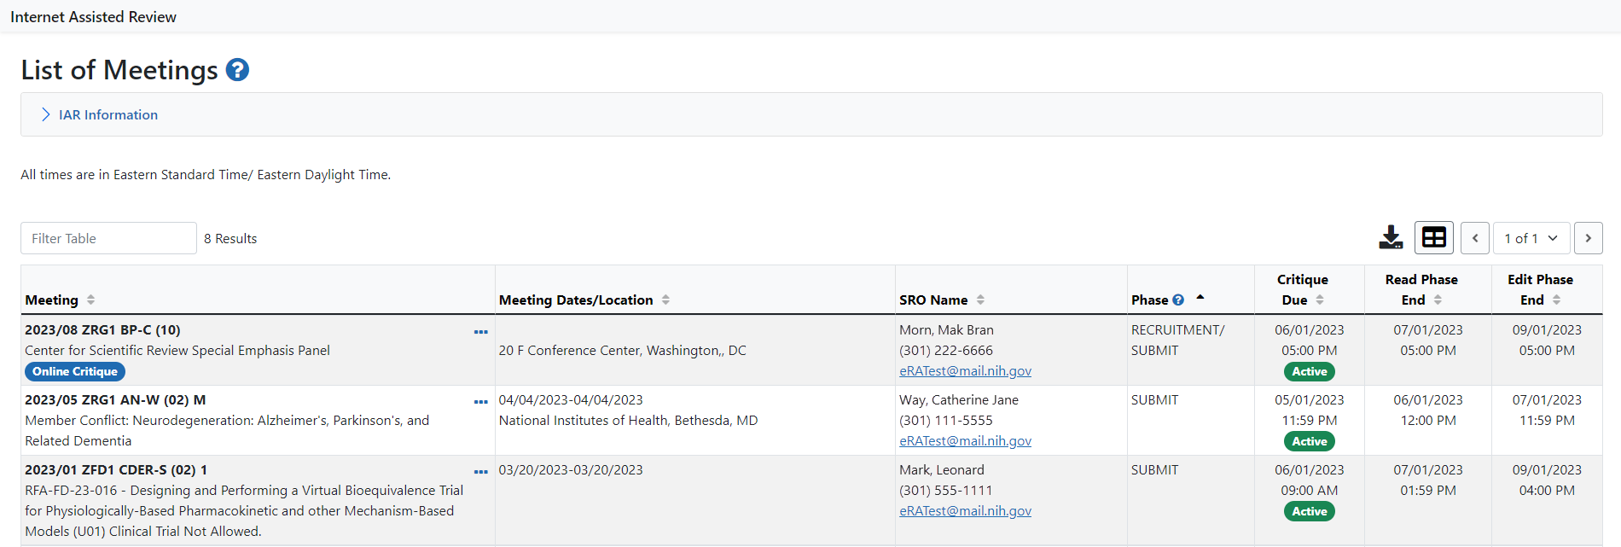
List of Meetings

Slide 9
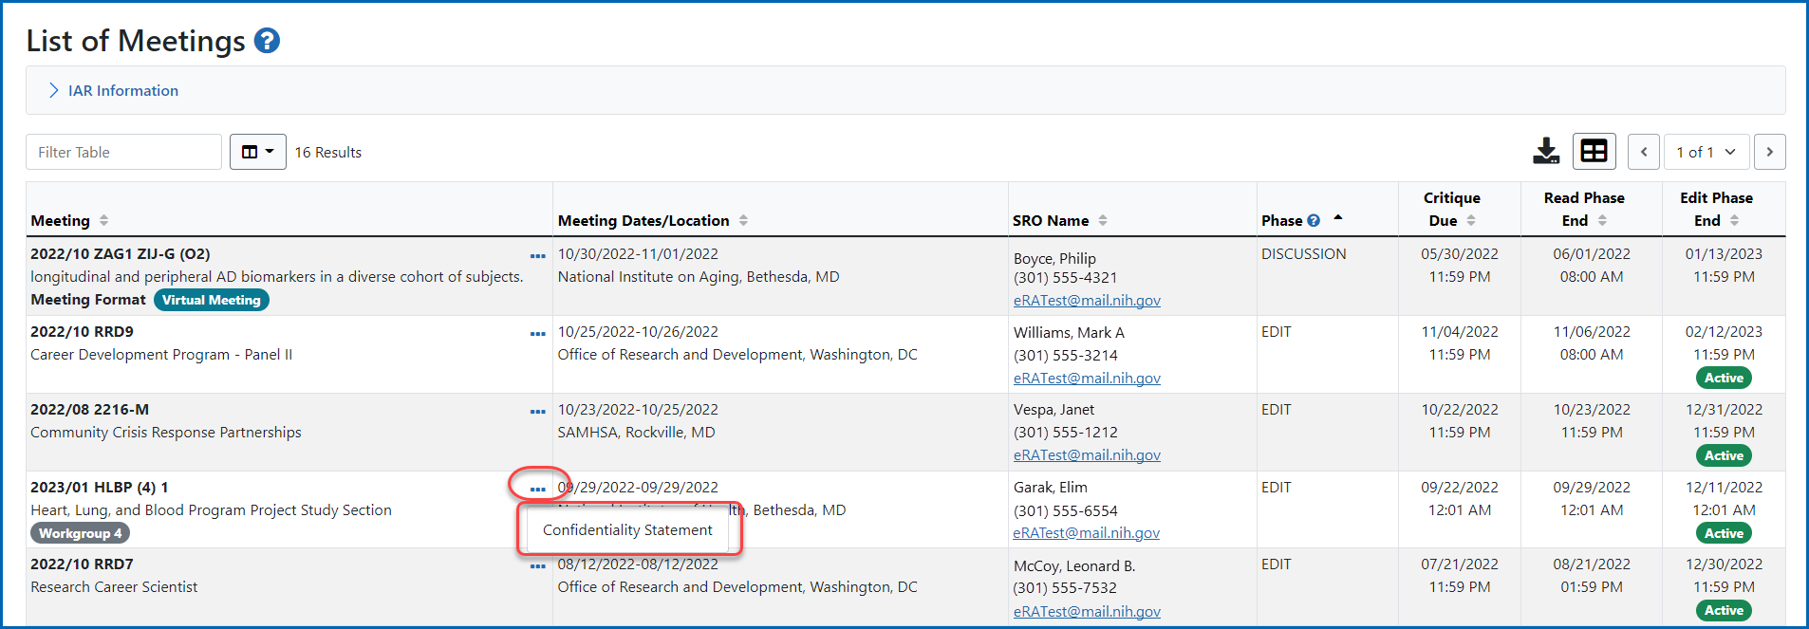
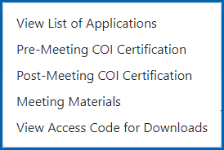
Confidentiality Statement Link
Pre-Meeting COI Certification, View List of Applications, and other actions within IAR are available to reviewers once the confidentiality statement has been completed

Slide 10
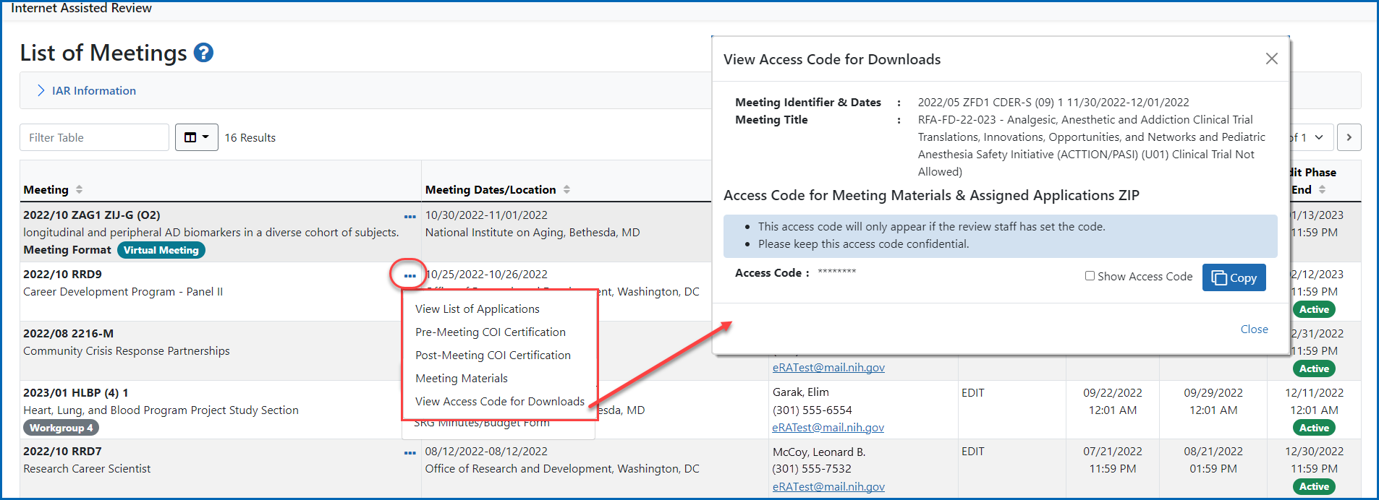
Access Code for Downloads Link

Slide 11
Accessing the Applications and Review Materials

Slide 12
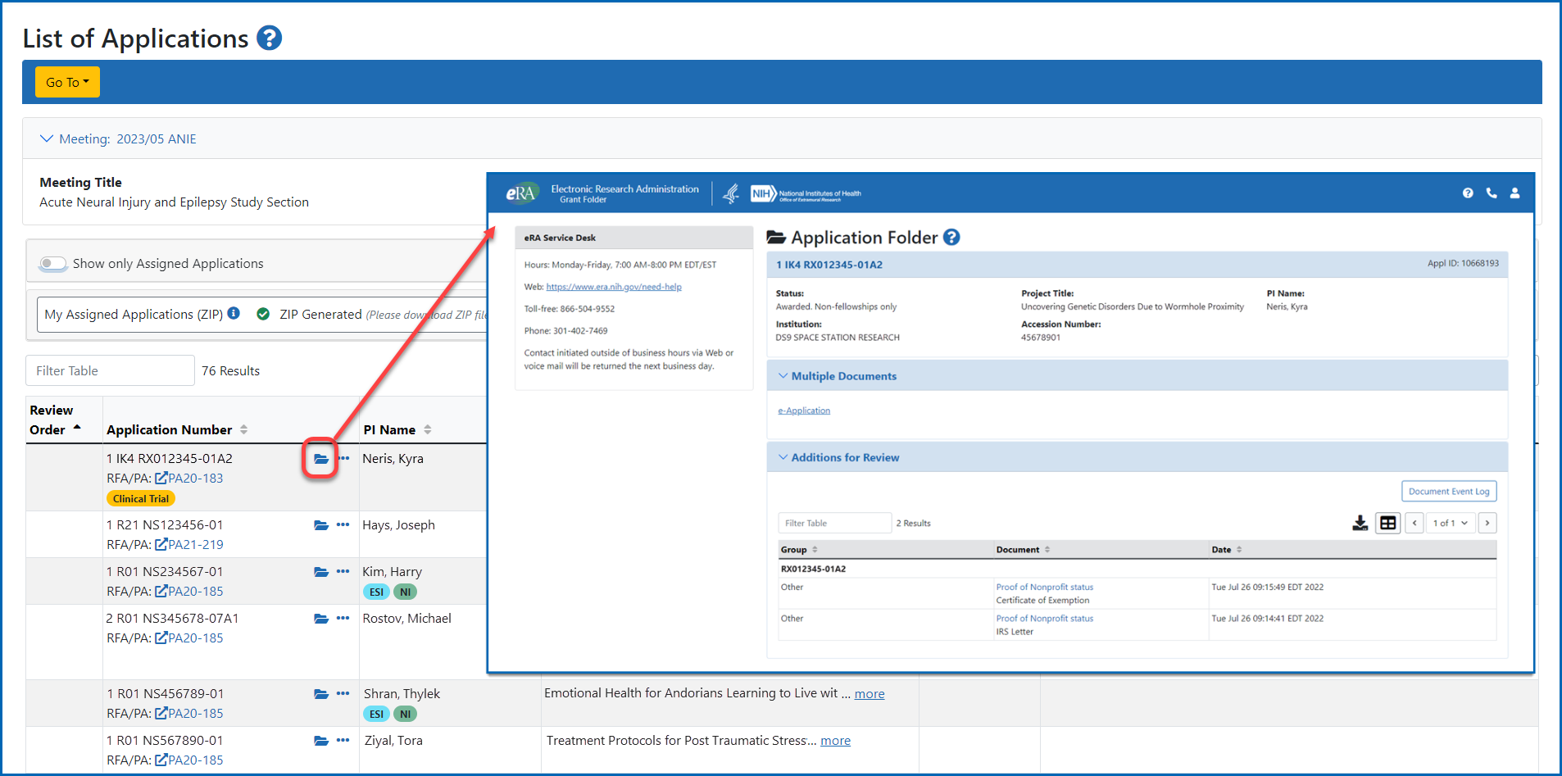
Viewing the Grant Folder

Slide 13
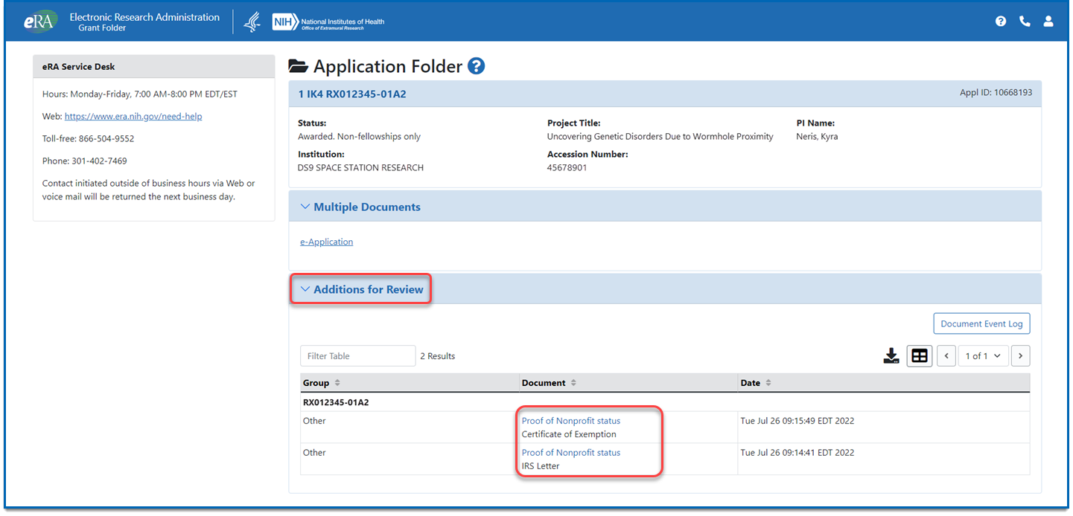
Viewing Additions for Review From the Grant Folder
Expand the Additions for Review and click on the description in the Document column to open the document

Slide 14
Access Additional Materials from Application List

Slide 15
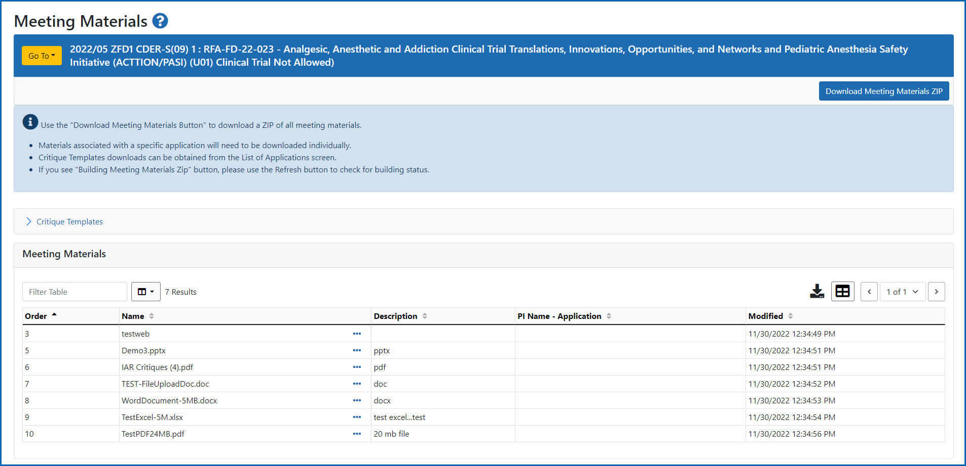
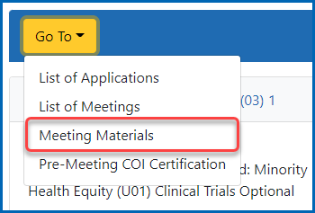
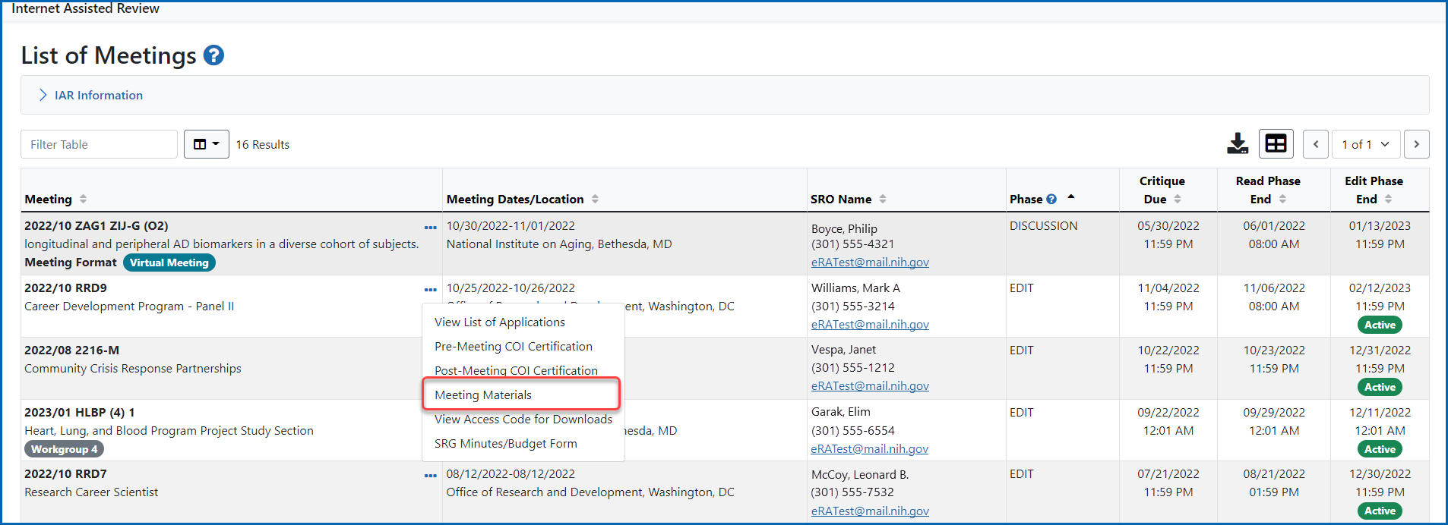
Meeting Materials

Slide 16
Submitting Scores and Critiques

Slide 17
SUBMIT Phase Default Screen: List of My Assigned Applications

Slide 18
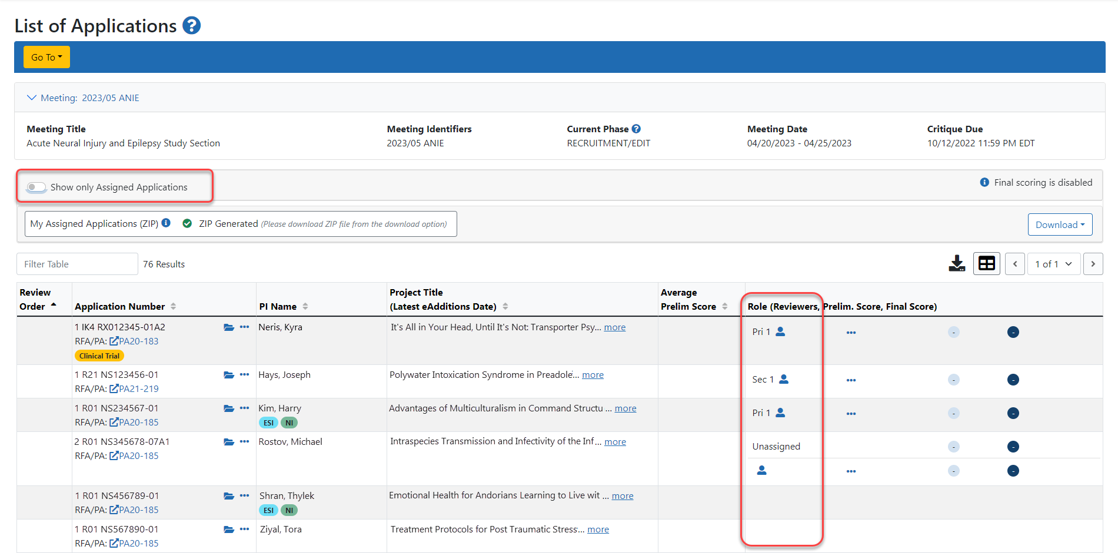
Viewing Unassigned Applications – List of Applications

Slide 19
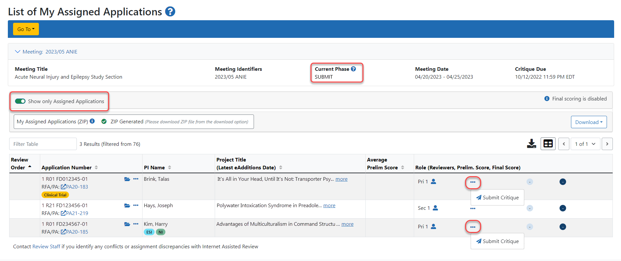
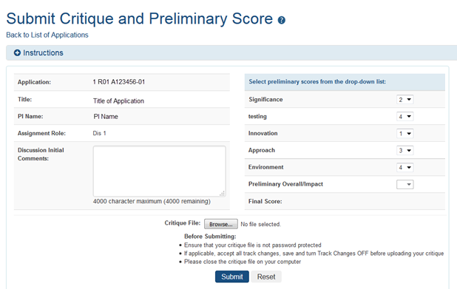
Submitting Critiques and Preliminary Scores

Slide 20
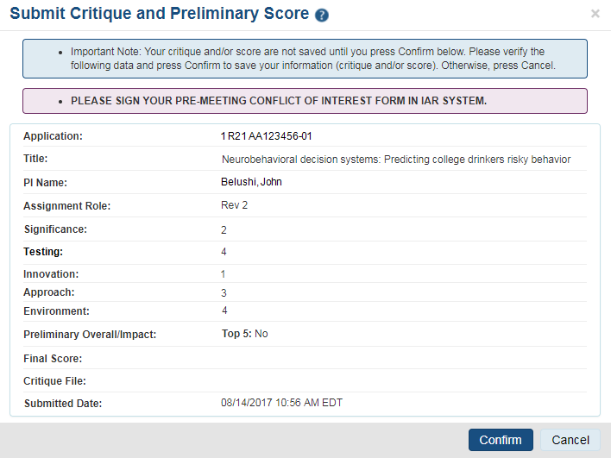
Critique/Score Submission Confirmation
Important: Pay attention to the notes and reminders at the top of the screen.
If you navigate away from this screen before clicking “Confirm,” all changes will be lost.
Additionally, if your Pre-Meeting COI has not been signed, you will be reminded to do that.

Slide 21
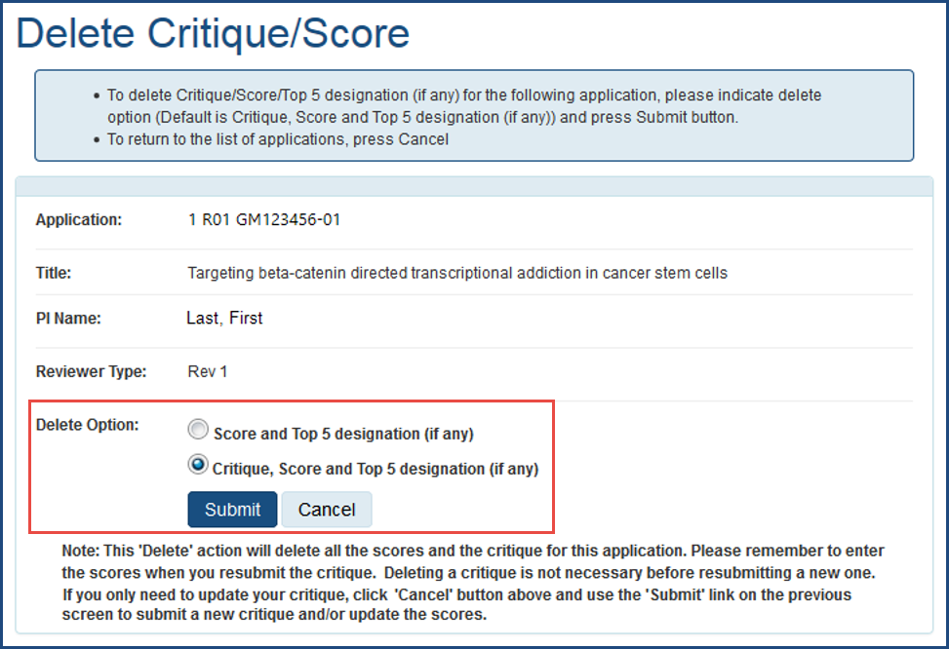
SUBMIT Phase – Deleting Critiques/Scores

Slide 22
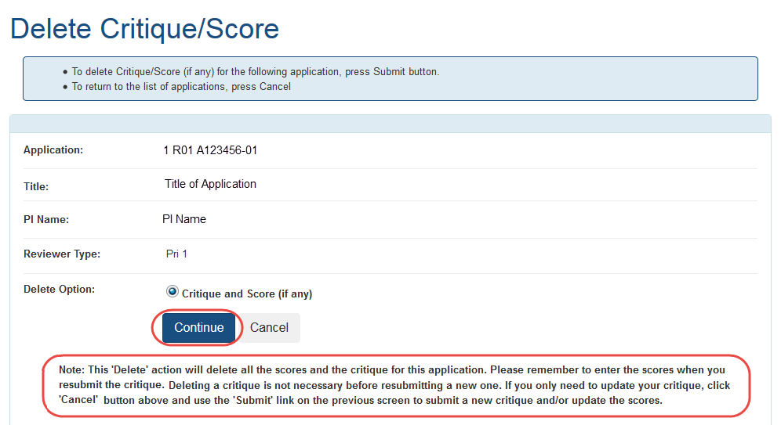
SUBMIT Phase – Deleting Critiques/Scores (Cont’d)
NOTE - If scores or critiques are deleted, use the Submit Critique & Preliminary Score screen to upload the correct information

Slide 23
Read Phase

Slide 24
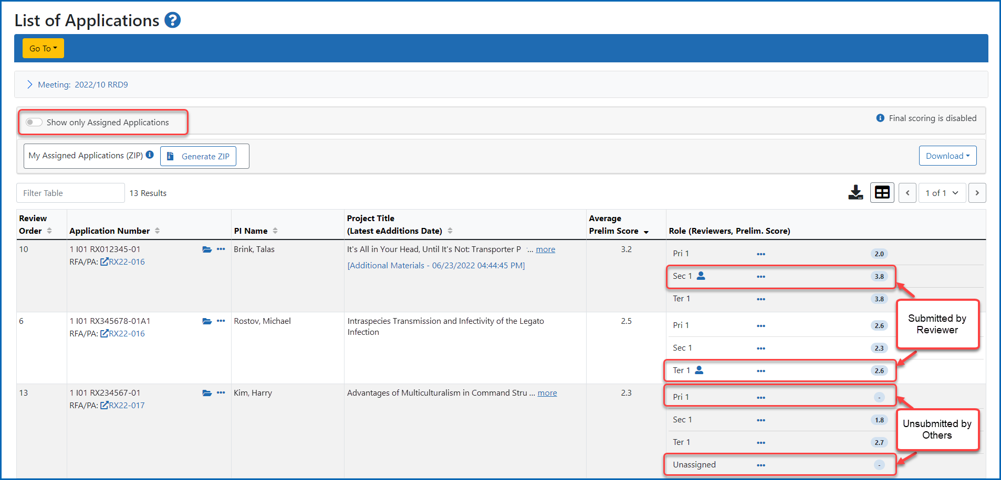
READ Phase – List of Applications (All critiques submitted by reviewer but some missing for other reviewers)

Slide 25
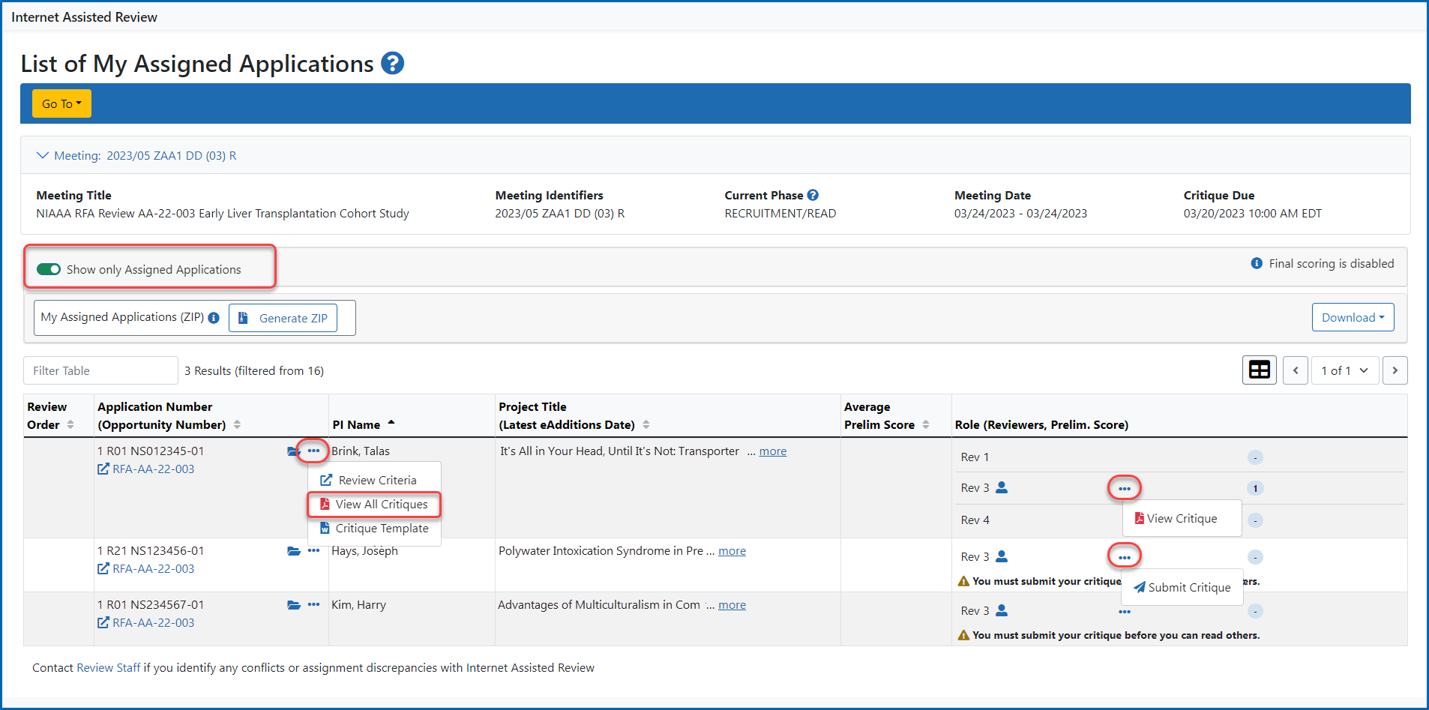
READ Phase – List My Assignments Applications

Slide 26
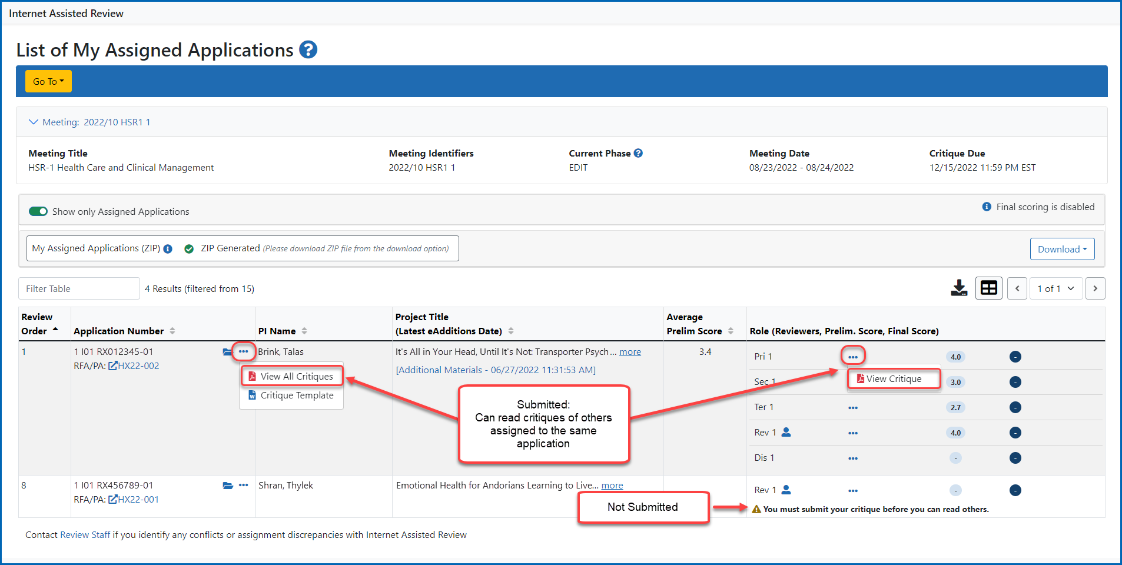
READ Phase – List My Applications Only (Reviewer has not yet submitted all critiques)
Select Submit Critique from action icon.

Slide 27
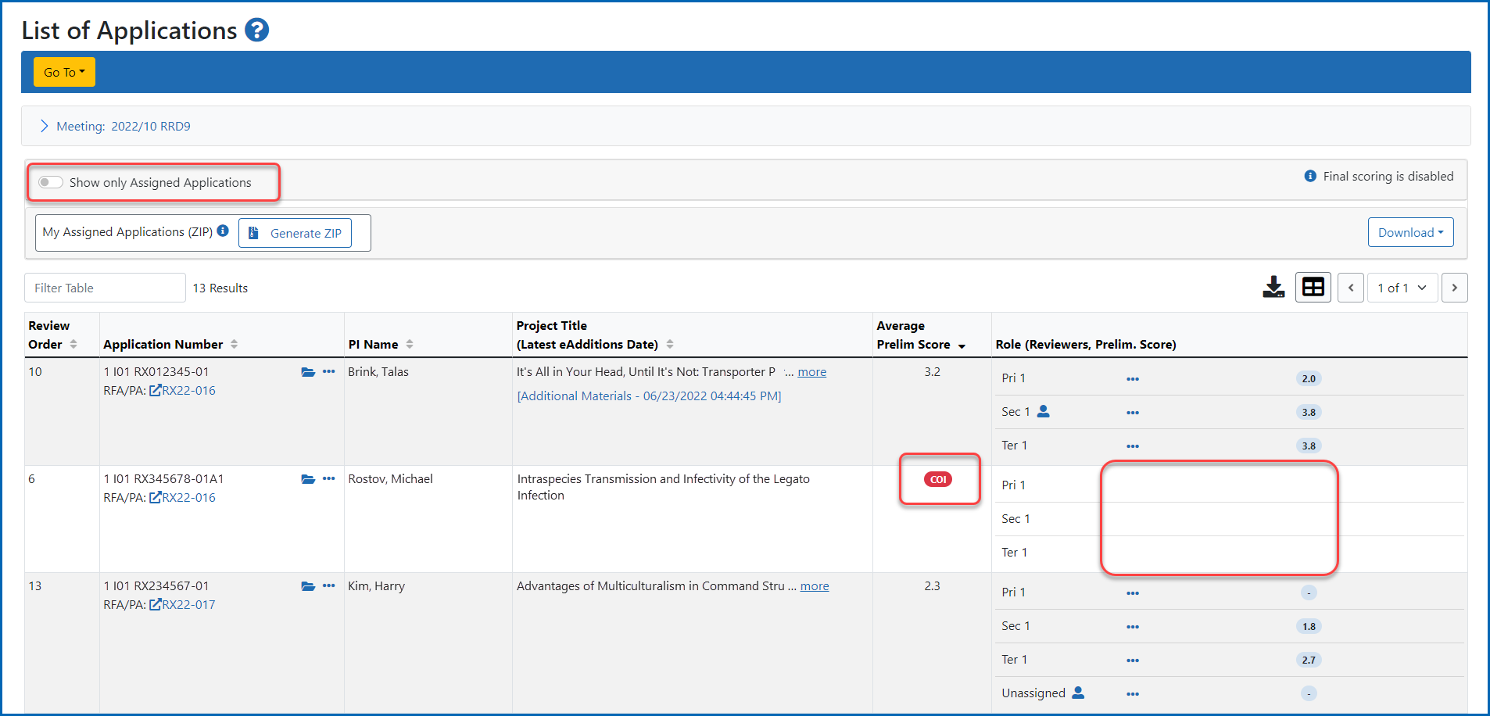
READ Phase – List of Applications
Due to a conflict of interest, the identified application does not provide options to submit or to view critiques

Slide 28
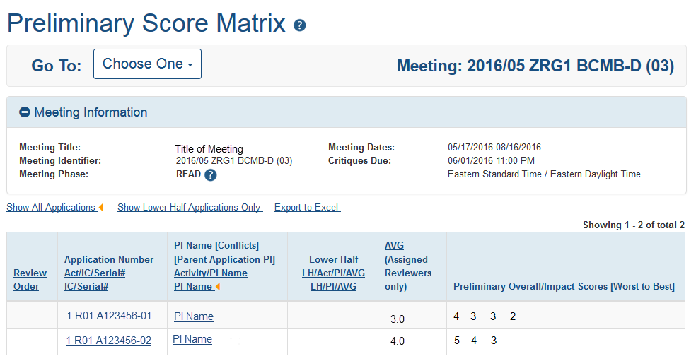
READ Phase – Preliminary Score Matrix

Slide 29
Edit Phase

Slide 30
EDIT Phase – List of Meetings

Slide 31
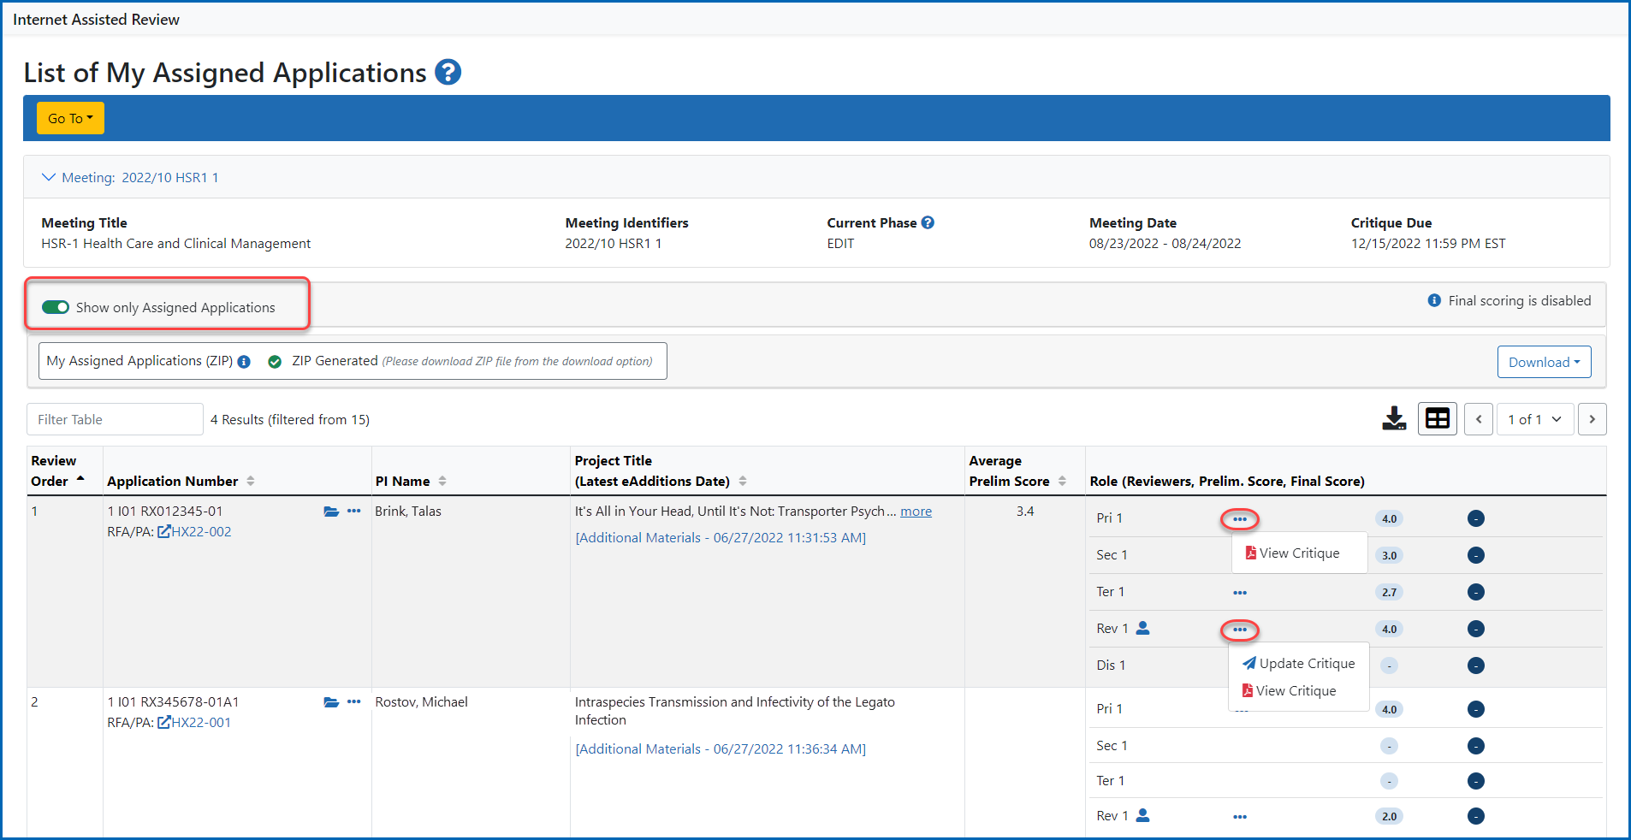
EDIT Phase – Editing Scores/Critiques

Slide 32
Final Scoring

Slide 33
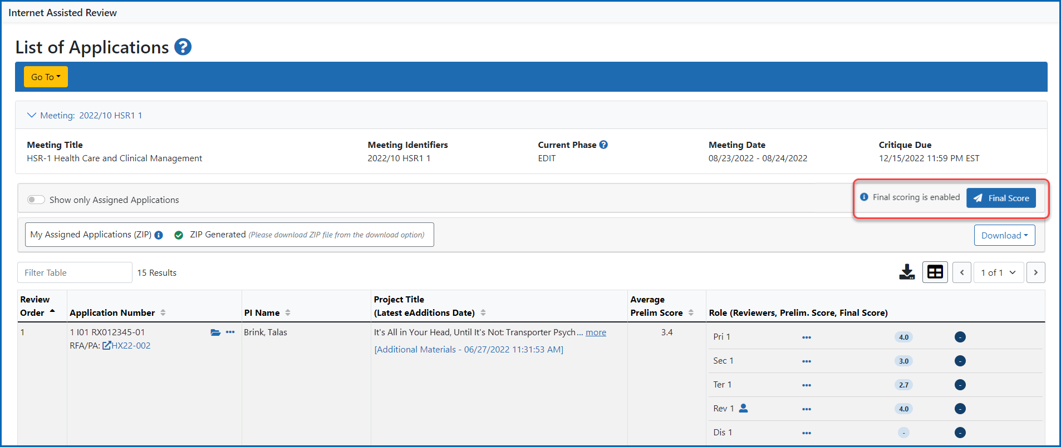
IAR Final Scoring – Final Score Sheet button

Slide 34
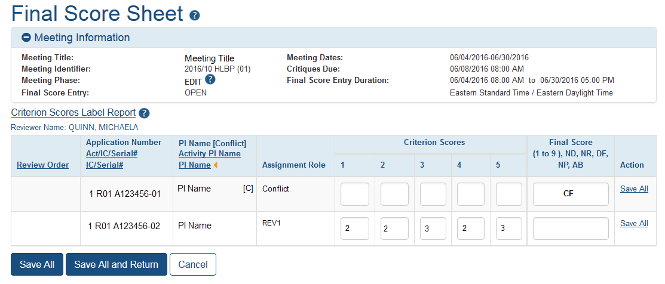
Final Score Sheet

Slide 35
Pre and Post Meeting COI

Slide 36
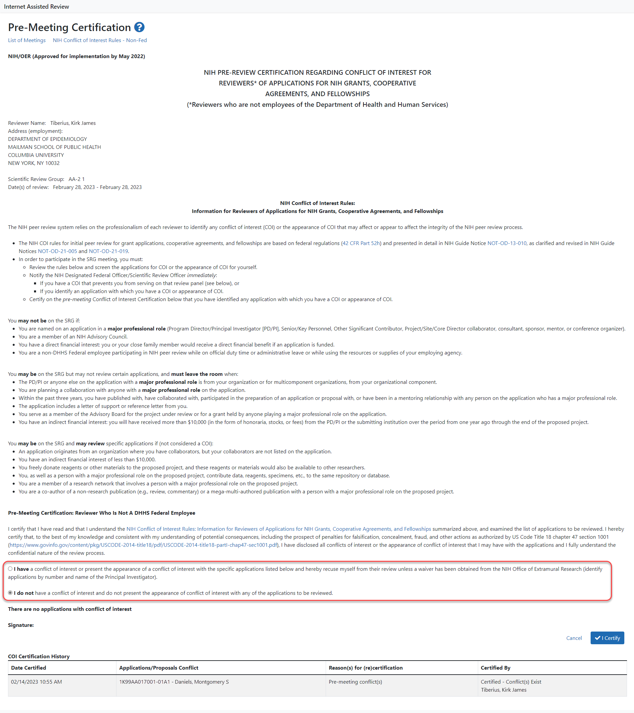
Pre-meeting COI Certification

Slide 37
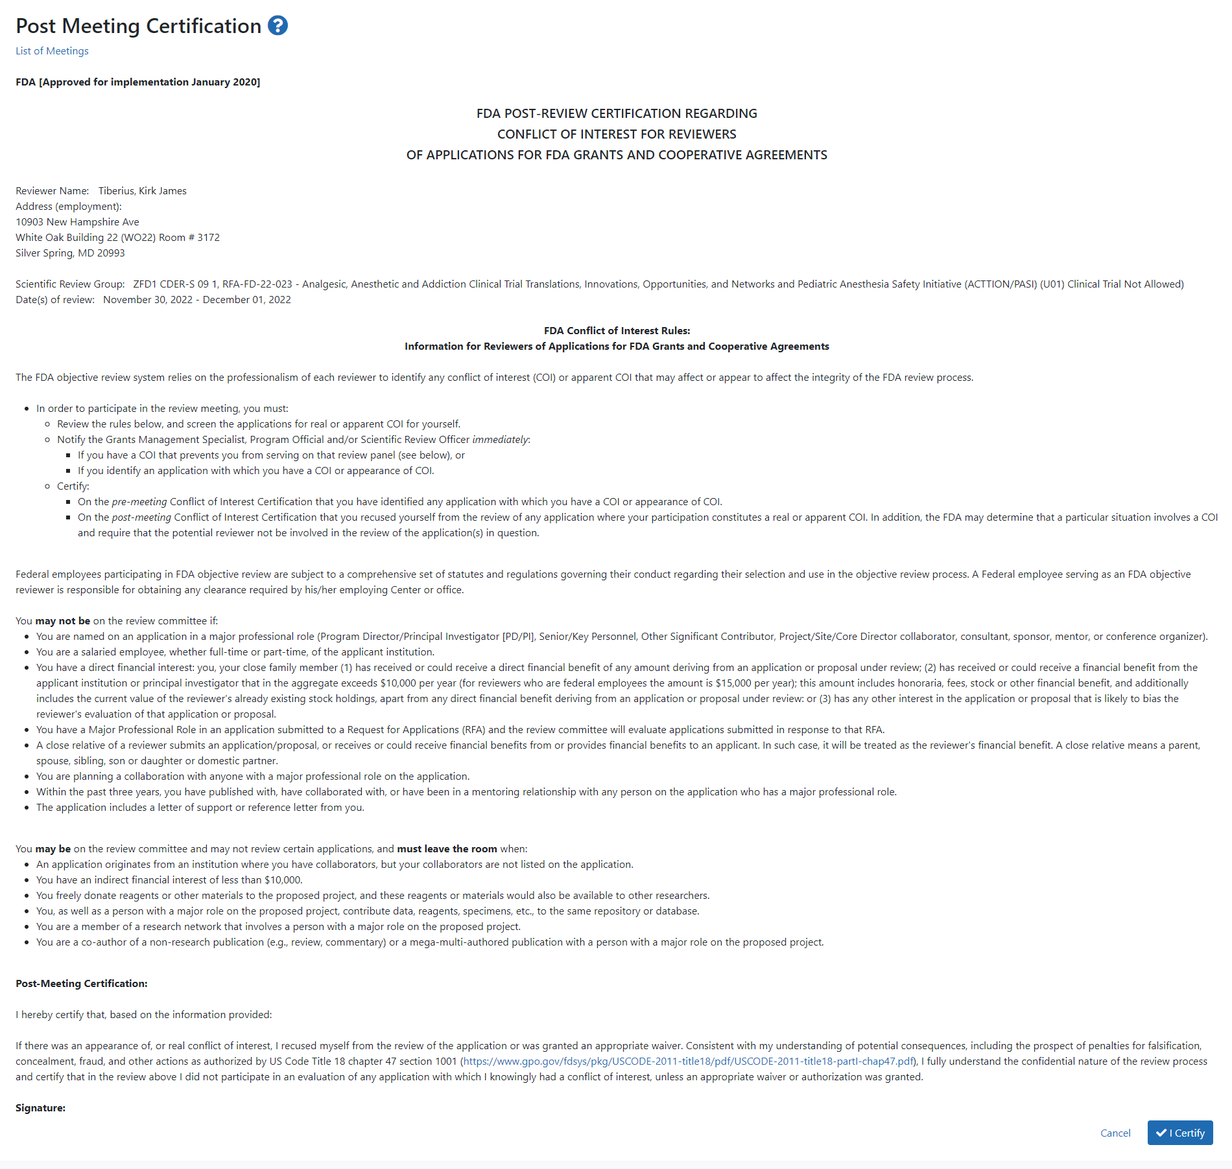
Post-Meeting COI Form

Slide 38
Virtual Meeting

Slide 39
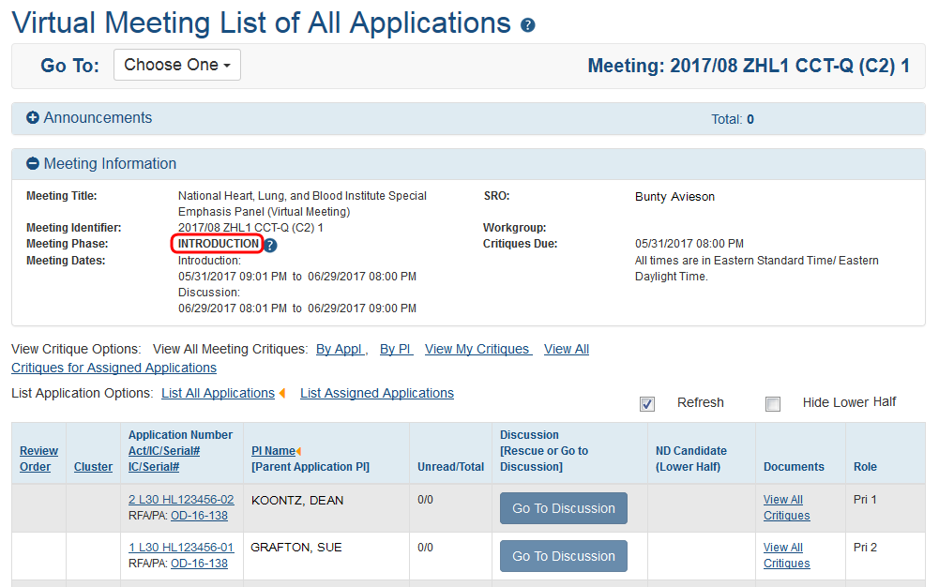
Virtual Meeting – INTRODUCTION Phase

Slide 40
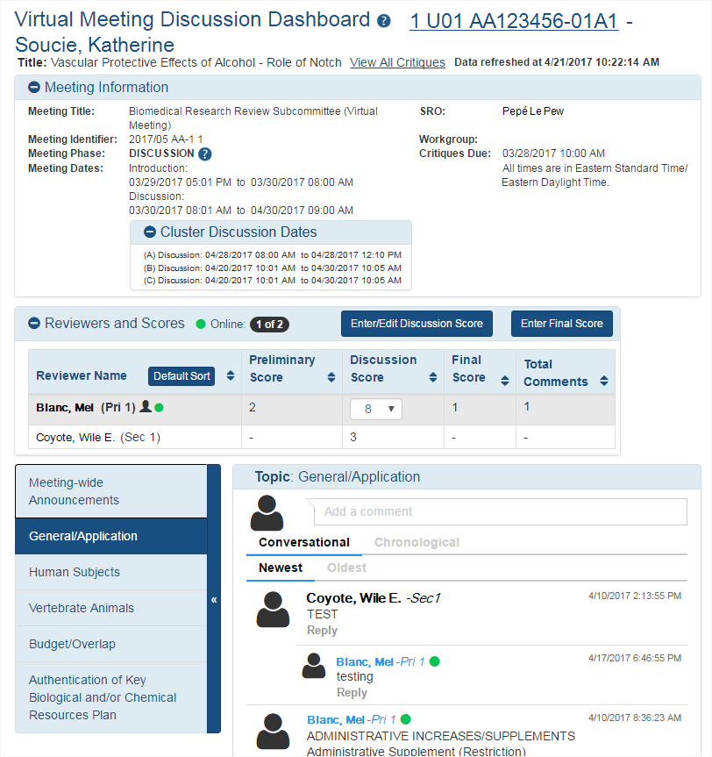
Virtual Meeting – DISCUSSION Phase Discussion Dashboard

Slide 41
Online Critique Template (OCT)

Slide 42
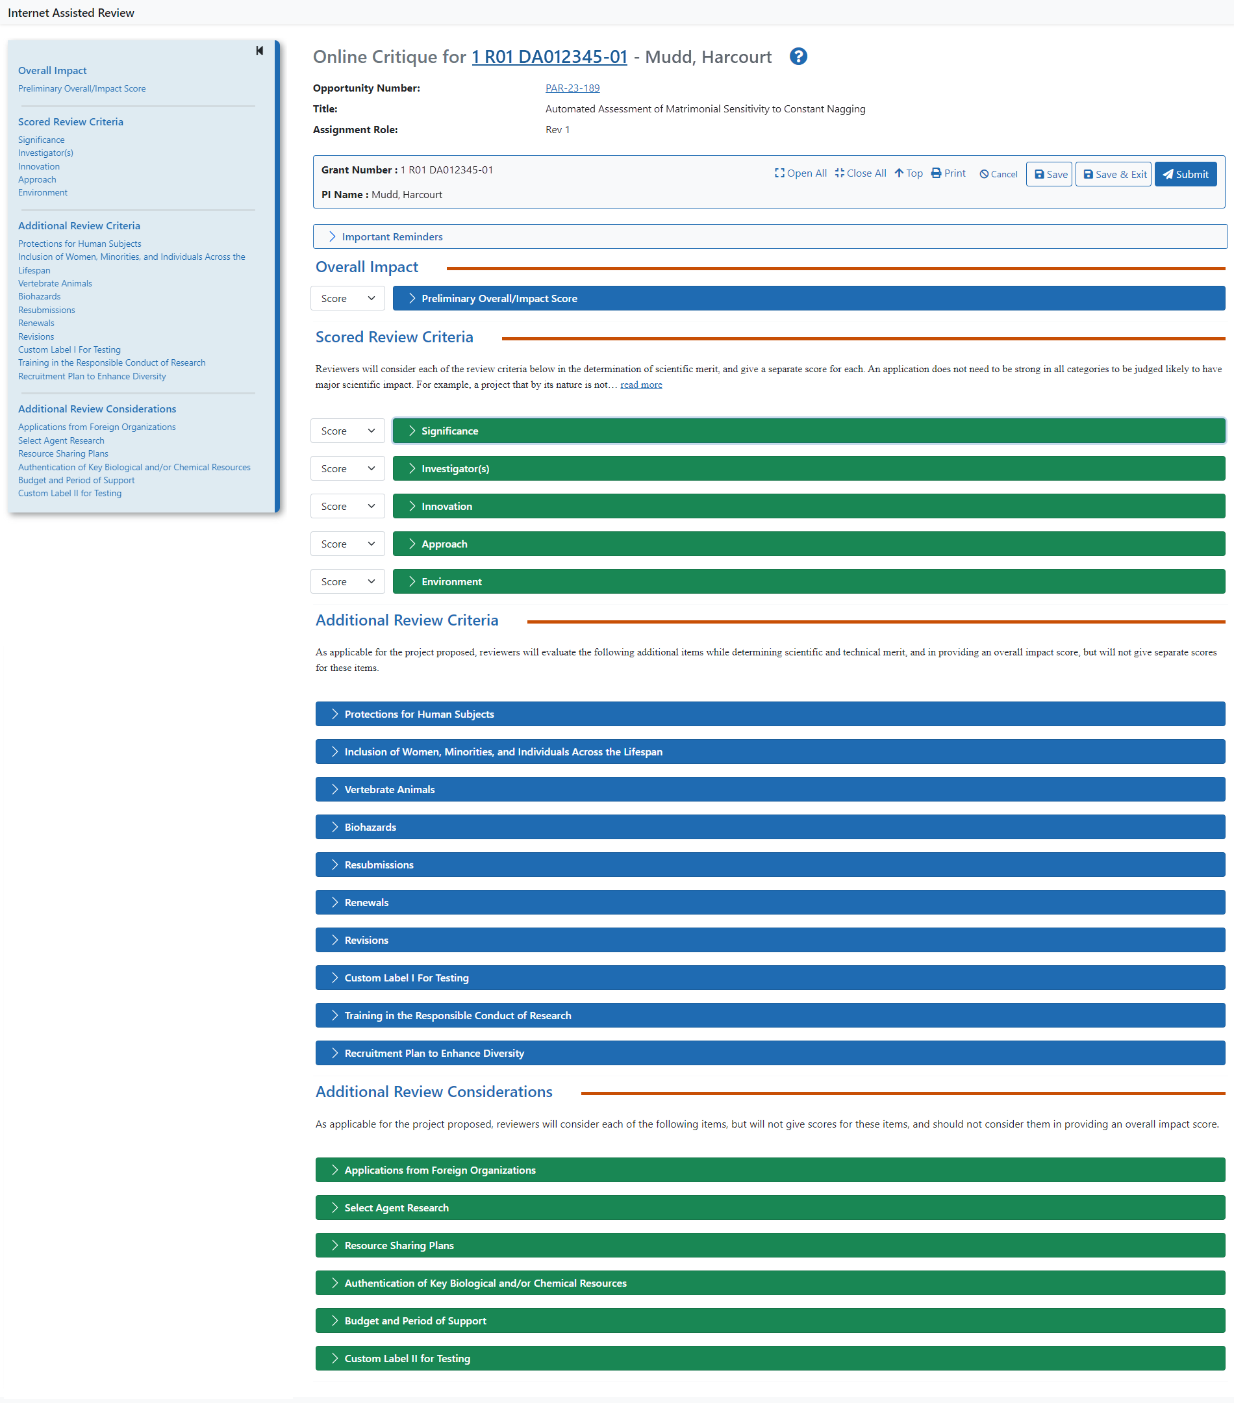
Online Critique – Full Screen

Slide 43
OCT List of Meetings – Reviewer View

Slide 44
OCT List of Applications – Reviewer View

Slide 45
OCT - Overall Impact Section

Slide 46
OCT – Scored Review Criteria Section

Slide 47
OCT – Additional Review Criteria Section

Slide 48
OCT – Additional Review Considerations Section

Slide 49
SRG Minutes/Budget Form

Slide 50
SRG Minutes / Budget Form for Chairperson

Slide 51
Personal Profile

Slide 52
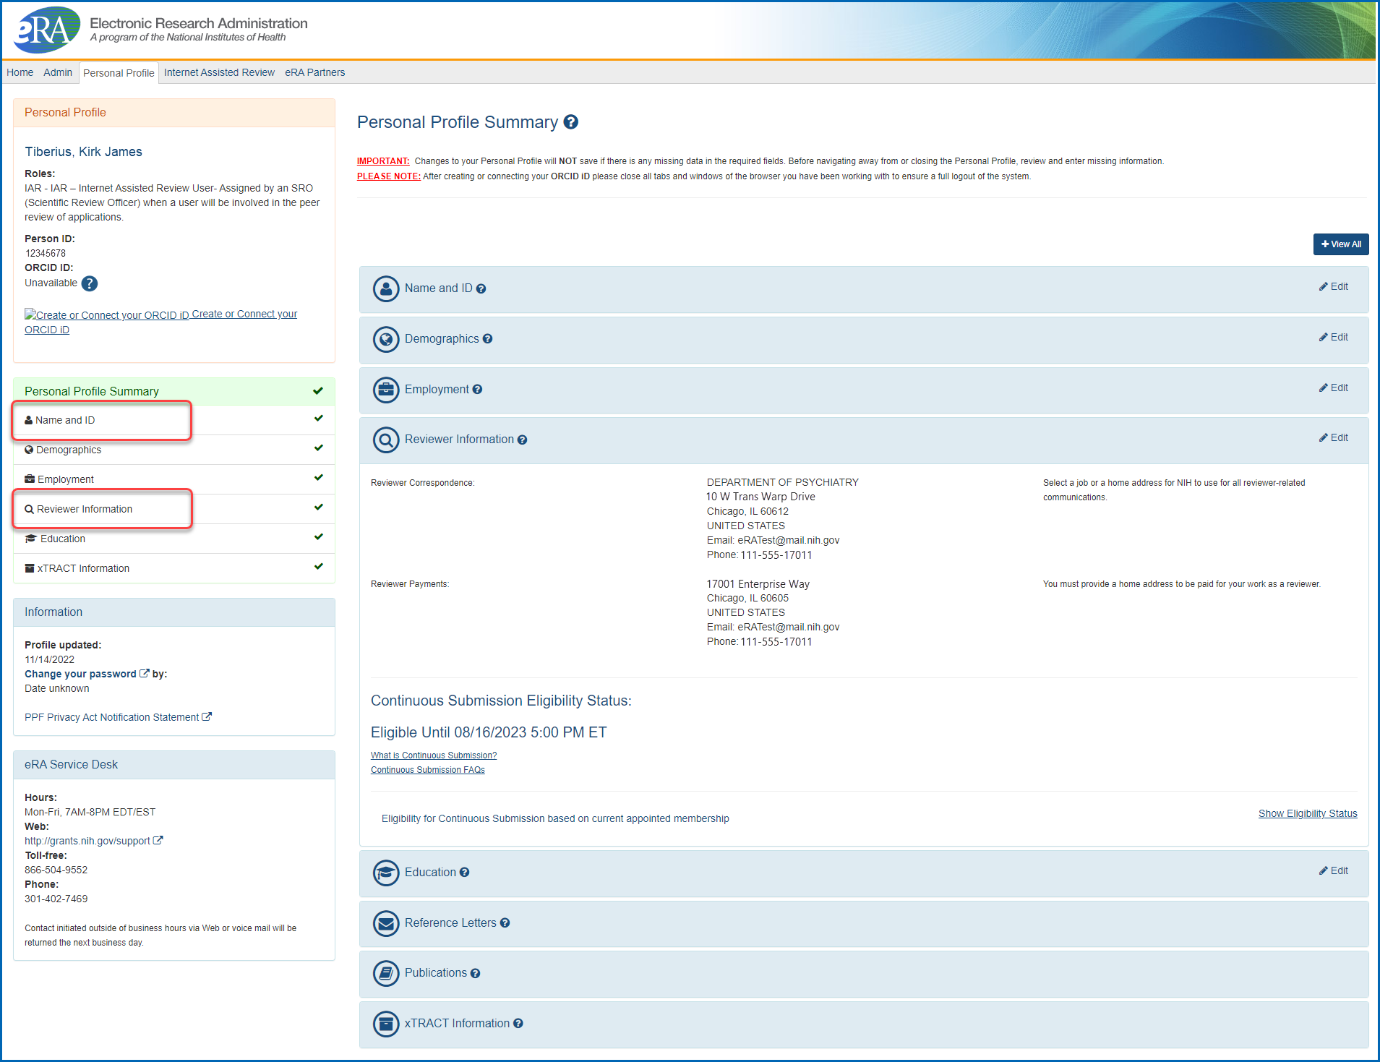
Reviewer Personal Profile

Slide 53
Resources for Reviewers

Slide 54
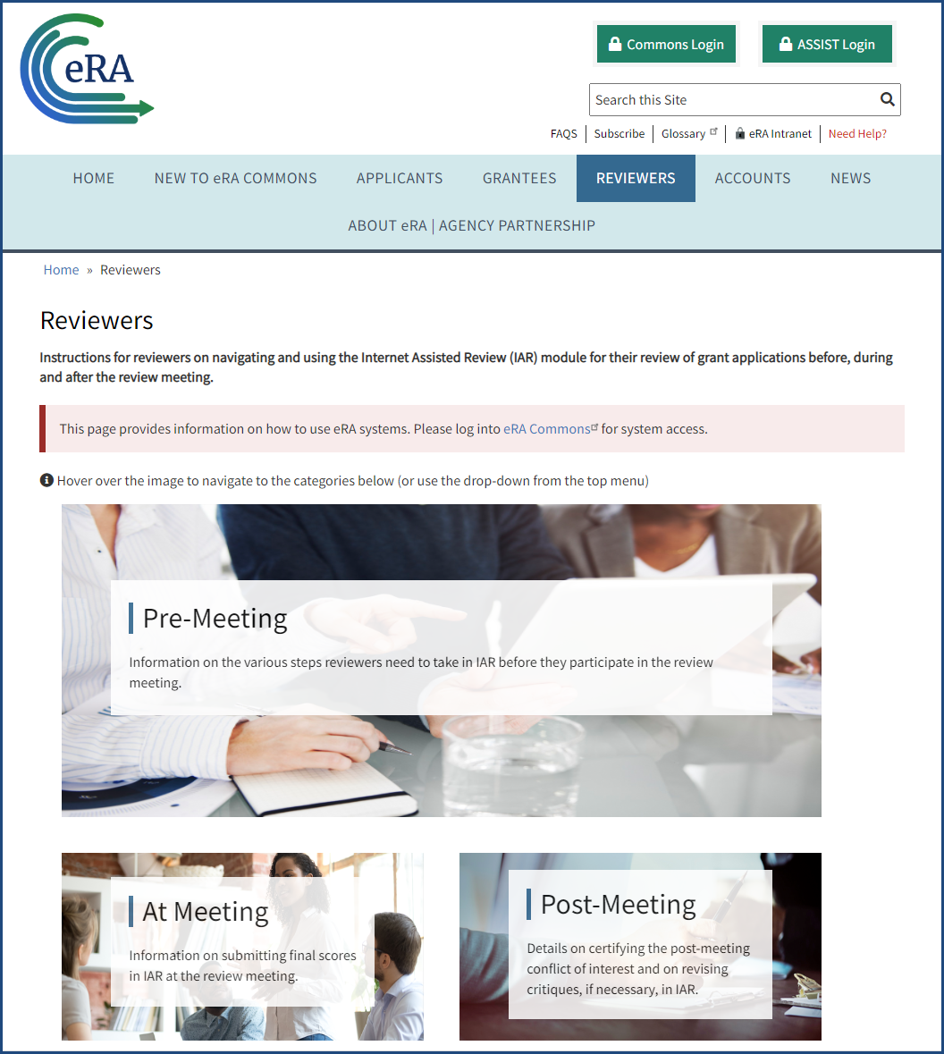
eRA: Reviewers website https://www.era.nih.gov/reviewers

Slide 55
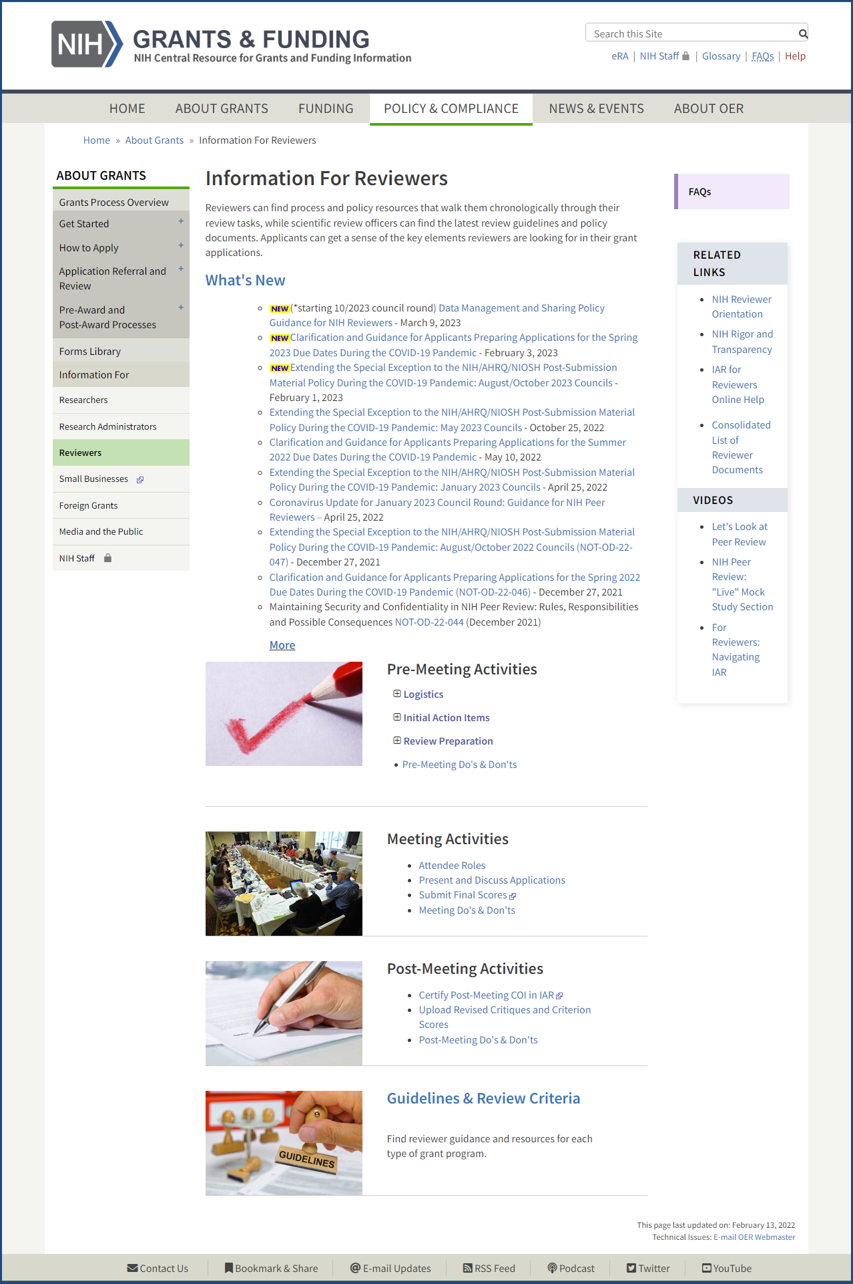
Information for Reviewers website https://grants.nih.gov/grants/policy/review.htm

Slide 56
Feedback? Email eracommunications@mail.nih.gov

