Slide 1
xTRACT Overview
electronic Research Administration (eRA)
OER, OD, National Institutes of Health

Slide 2
What is xTRACT?
The Extramural Trainee Reporting And Career Tracking (xTRACT) system is a module in the eRA Commons that allows applicants, grantees, and assistants to create Research Training Data (RTD) tables for NIH progress reports and institutional training grant applications.
Because xTRACT is integrated with eRA Commons, some training data will be prepopulated in the system, including trainee names, selected characteristics, institutions, grant numbers, and subsequent NIH and other HHS awards.
In addition, xTRACT allows institutions to create profiles for participating faculty that do not require access to eRA Commons, create institutional programs, and non-NIH funding sources; which can be retrieved for future use.

Slide 3
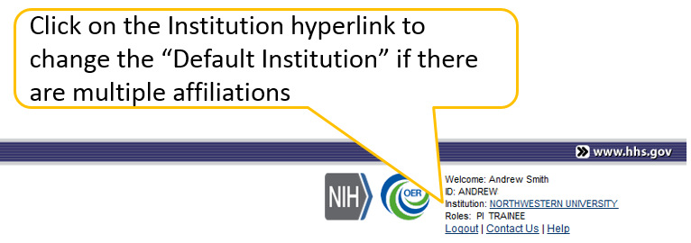
xTRACT Users
PD/PI accounts may have multiple affiliations. xTRACT will display grants based on the users current default institution.
Signing Official (SO)
Program Director/Principal Investigator (PD/PI)
PD/PI Delegate (ASST)
xTRACT delegation is granted when the PD/PI delegates xTrain to an ASST.

Slide 4
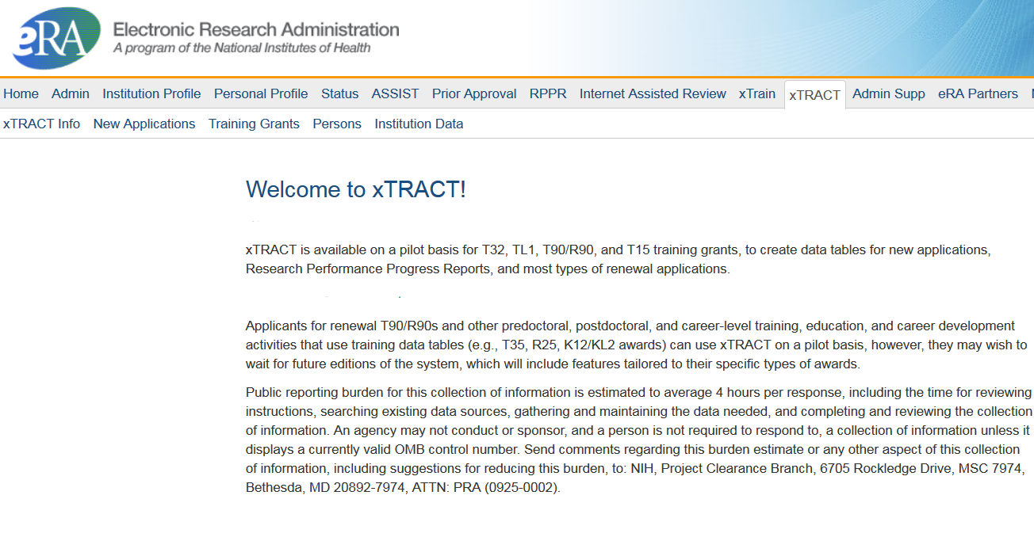
Main Menu

Slide 5
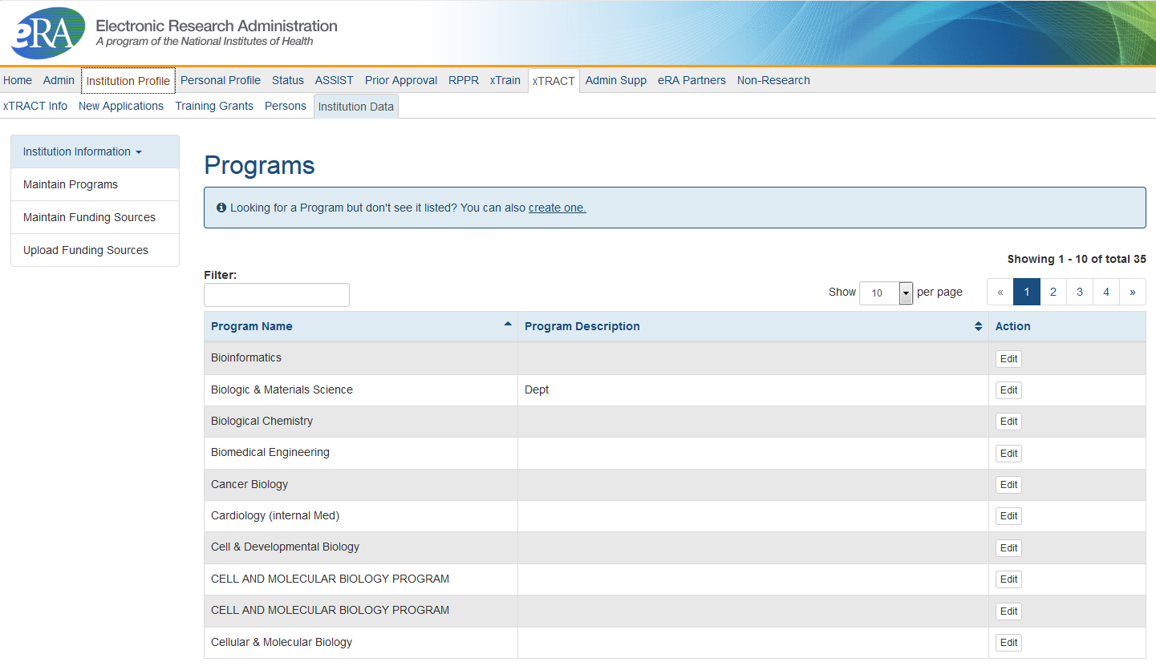
Institution Data: Maintain Programs
Institutionally-defined, interdepartmental programs.
Programs names are used in a variety of places including, Census Tables and in Applicants, Entrants, and Characteristics: Pre-doc Table.
Edit will allow you to modify the Program Name, and enter a Description.

Slide 6
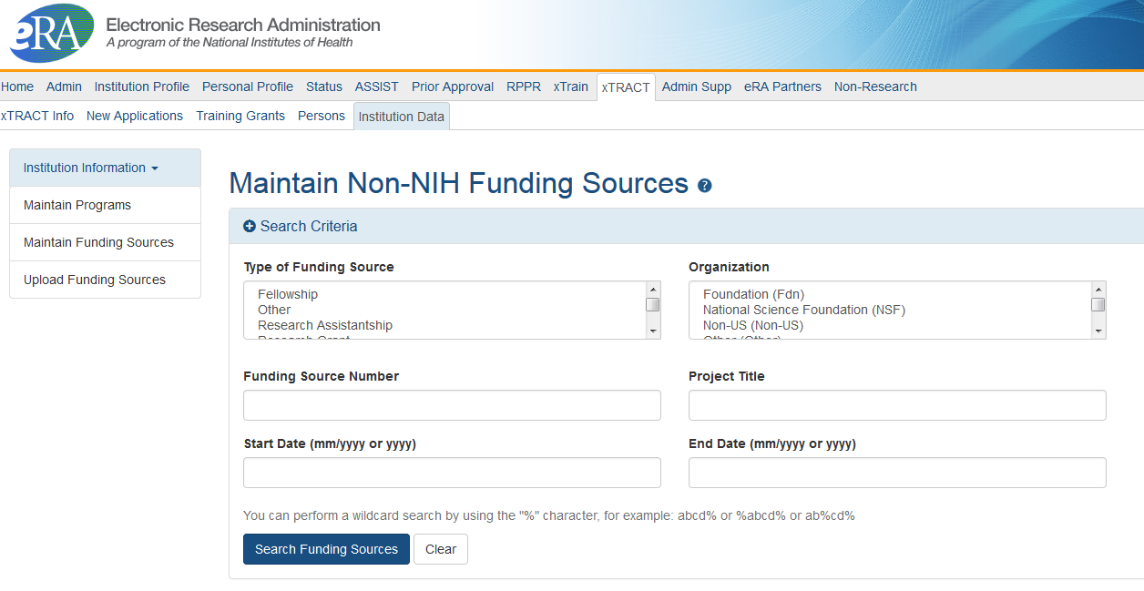
Institution Data: Maintain Funding Sources
Non-NIH Funding Sources are entered and maintained by the Institution.
Search for funding source, if one does not exist, you will have the option to create a new one.
You may also upload funding sources using tab-delimited file.

Slide 7
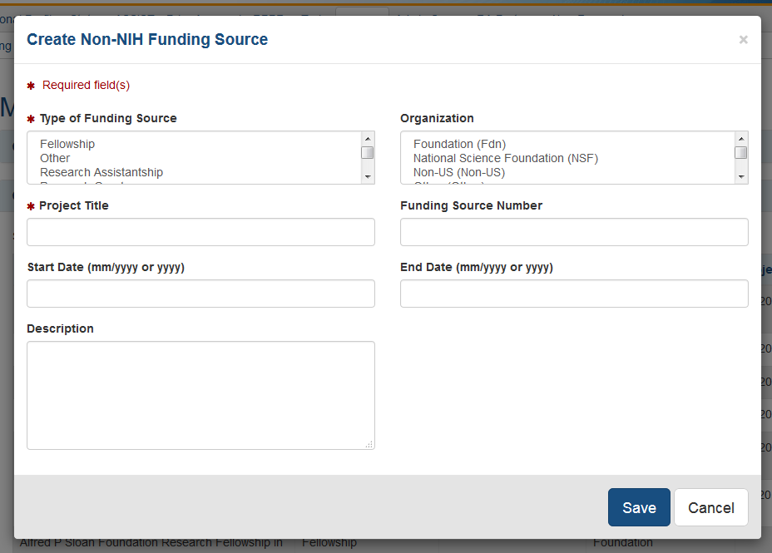
Institution Data: Maintain Funding Sources Cont.
Types of Funding Sources:
Fellowship
Other
Research Assistantship
Research Grant
Scholarship
Teaching Assistantship
Training Grant
User may modify a funding source.
Type of Funding Source and Project Title are required; user may also provide:
Organization
Funding Source Number
Start and End Date
Description
Organization:
Foundation
National Science Foundation
Non-US
Other
Other Federal
University

Slide 8
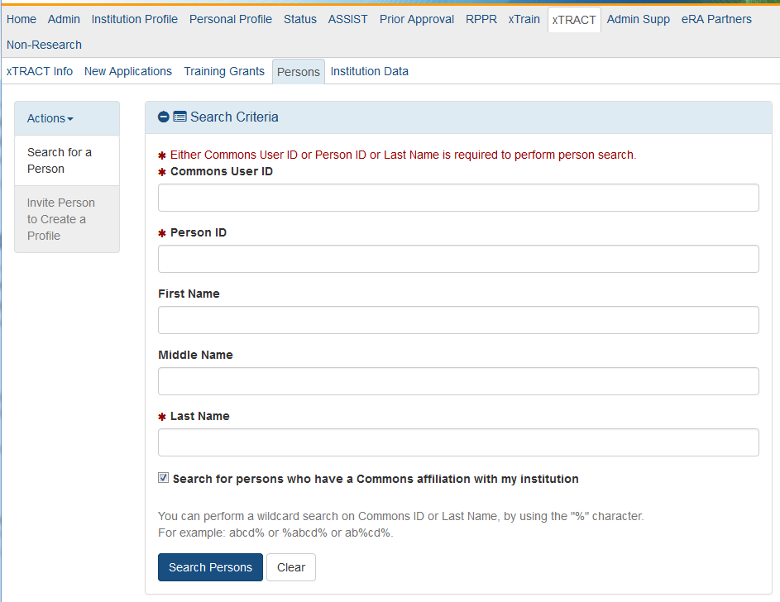
Persons
Search for an existing person record.
If the person does not have an eRA Commons account or an xTRACT Profile, you may create an xTRACT Profile.
To locate a user with only an xTRACT Profile that does not have an eRA Commons account, uncheck “Search for persons who have a Commons affiliations with my institution”.

Slide 9
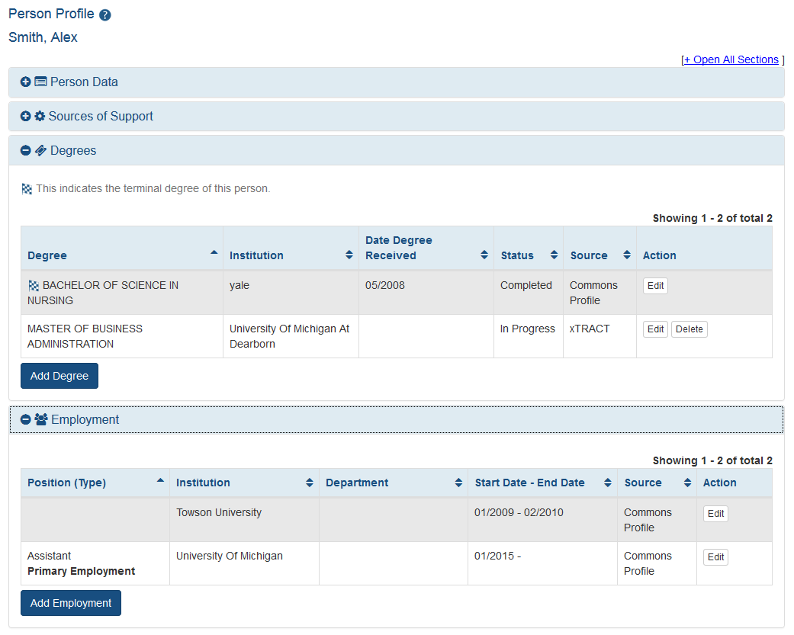
Persons: Edit Person Profile
If data was added in xTRACT, you may delete it.
Edit Person Profile will pull data from Personal Profile (PPF) in eRA Commons.
If employment, or degree information is missing, you may add it in xTRACT.
Data entered in xTRACT will NOT be updated in PPF.
Sources of support are updated in the context of an RTD.
Data pulled from PPF may only be deleted from PPF. You may make changes to the data, these changes will not reflect in the user’s PPF.

Slide 10
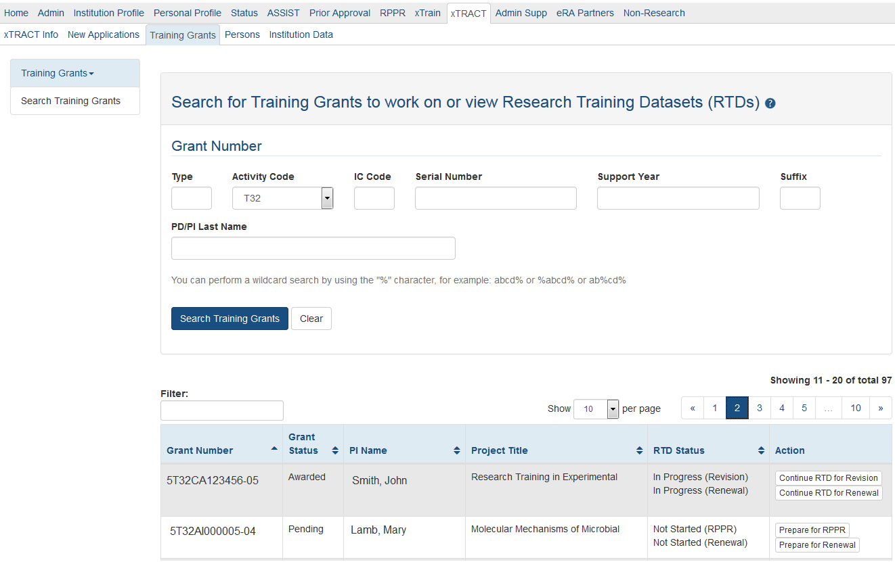
Training Grants
From the Training Grants tab, search for the grant that needs an RTD generated.
To perform a wildcard search use the “%” character.
PD/PI, ASST, or SO may prepare or continue an RTD for a Revision, Renewal or RPPR.

Slide 11
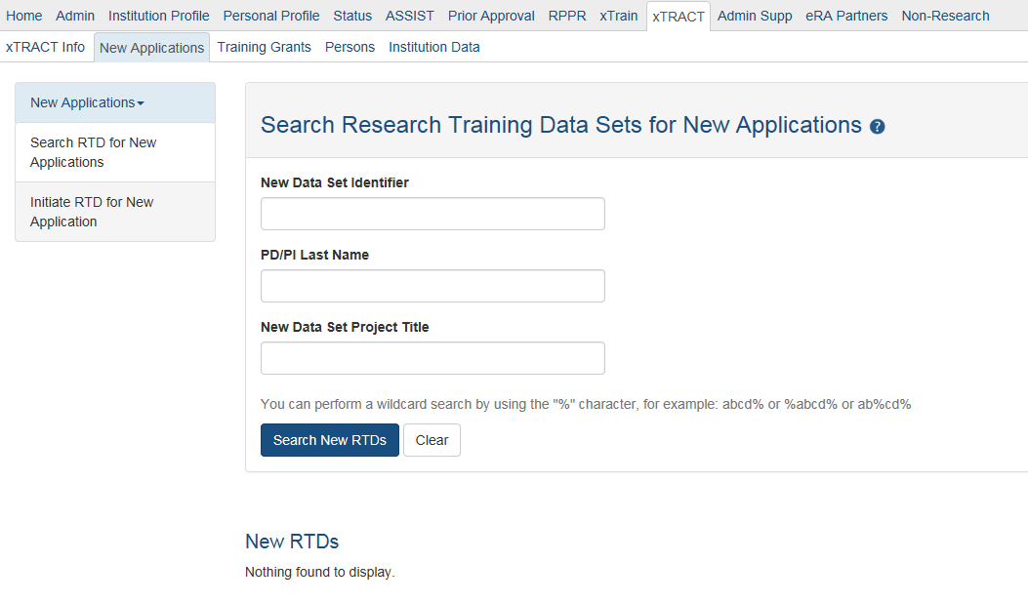
New Applications
To create an RTD for a new application, use the New Application tab.
If an RTD has already been started, you may use the search function locate it.
To perform a wildcard search use the “%” character.
Only PD/PI or ASST may create a new RTD.

Slide 12
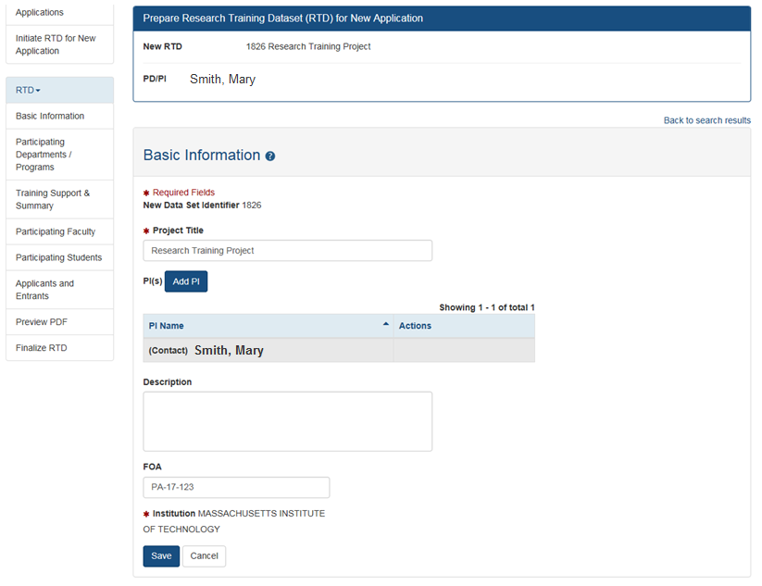
New Application RTD
The PD/PI that initiated the RTD will be marked as Contact PI.
An RTD for a New Application requires the following information:
Participating Departments/Programs
Training Support & Summary
Participating Faculty
Participating Students
Applicants and Entrants

Slide 13
Revision or Renewal RTD
An RTD For a Revision or Renewal you will need to complete the following:
Participating Departments/Programs
Training Support & Summary
Participating Faculty
Participating Students
Participating Trainees
Program Statistics
Applicants and Entrants
Appointments

Slide 14
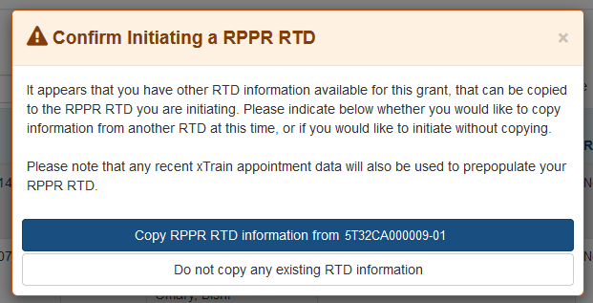
RPPR RTD
If you have previously created RTDs for this grant, xTRACT will prompt you to copy the previous RTD data.
The RPPR RTD requires the following data:
Participating Trainees.
Program Statistics.

Slide 15
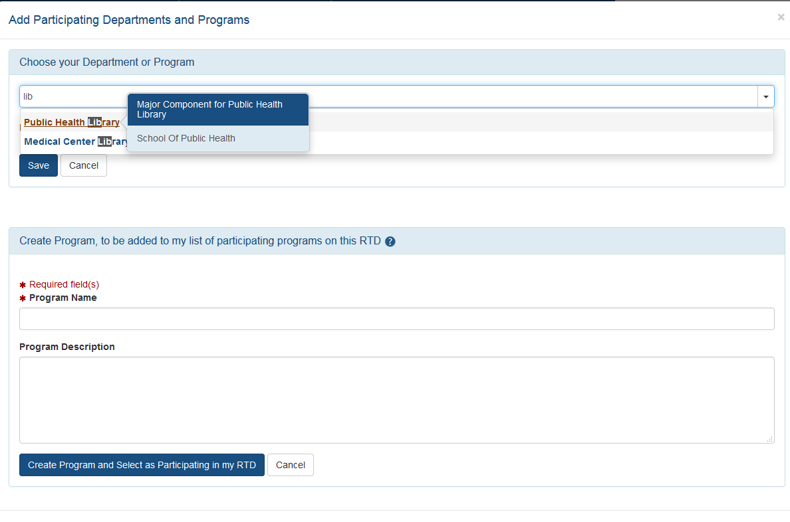
Modify RTD: Departments
Type ahead, xTRACT will bring up suggestions for existing Departments or Programs for your organization. Departments will specify their school when hovered over.
Utilize for New, Renewal or Revision RTDs.
User may create a Program for the institution in xTRACT.
xTRACT will pull Departments based on those in existence for the organization.
If the program does not exist, you may create a new one from this screen.

Slide 16
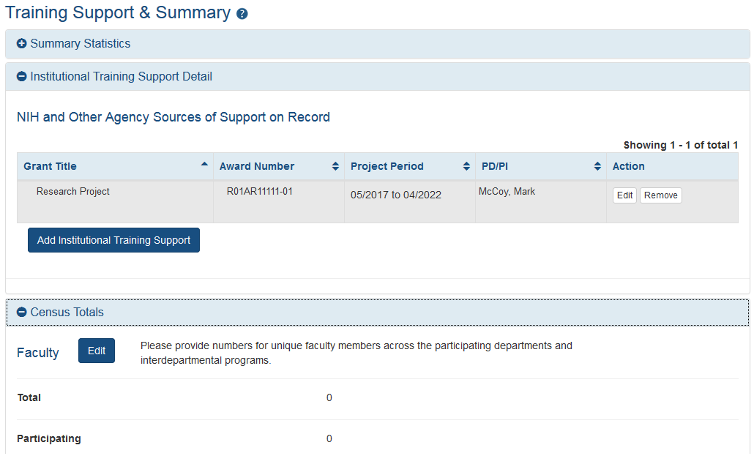
Modify RTD: Training Support
Add Institutional Training Support that will include overlapping faculty.
Utilize for New, Renewal or Revision RTDs.
Calculates and displays summary data entered for Faculty Research Support and Institutional Training Grants.
Census Totals display for Predocs and Postdocs across participating departments and programs.
Enter total and participating faculty manually; as some faculty may participate in multiple programs or departments.

Slide 17
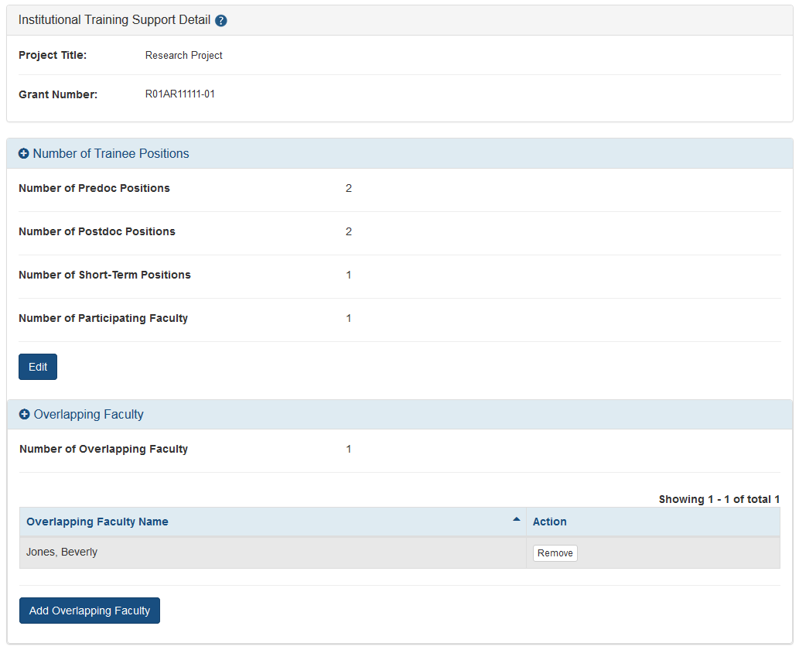
Modify RTD: Training Support
Edit chosen Institution Training Support will allow you to:
Enter the number of trainee positions under this Training Support
Identify Overlapping Faculty
xTRACT allow you to select from the faculty that you have added to the RTD.

Slide 18
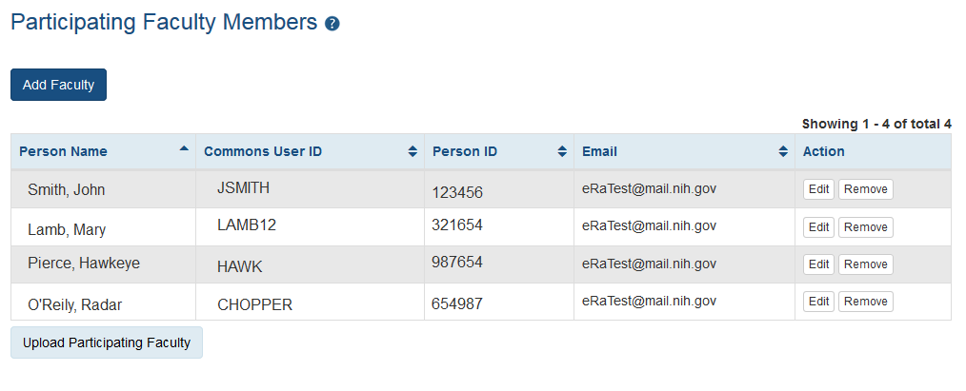
Modify RTD: Participating Faculty
Edit will allow you to update:
Faculty Member Data
Faculty Degree
Other Sources of Support
Mentoring Record
System will populate Degree Data from PPF, and NIH Research Support data.
Add Faculty opens up the Search for Faculty screen.
Utilize for New, Renewal or Revision RTDs.
To add a Faculty member, they must have an eRA Commons ID, or an xTRACT Profile.
If the faculty member does not have an xTRACT Profile, you will have the option to create one after you’ve performed a search.
You may also upload Participating Faculty using tab-delimited file.

Slide 19
Modify RTD: Participating Students
Add Student button will open the Search for Student screen.
If the Student does not have an xTRACT Profile, you will have the option to create one after you’ve performed a search.
Utilize for:
New Applications
Predoctoral Renewal/Revision Applications requesting an expansion to postdoctoral support
Postdoctoral Renewal/Revision Applications requesting an expansion to predoctoral support
Edit will open the Participating Student Screen.
You may also upload Participating Students using a tab-delimited file.

Slide 20
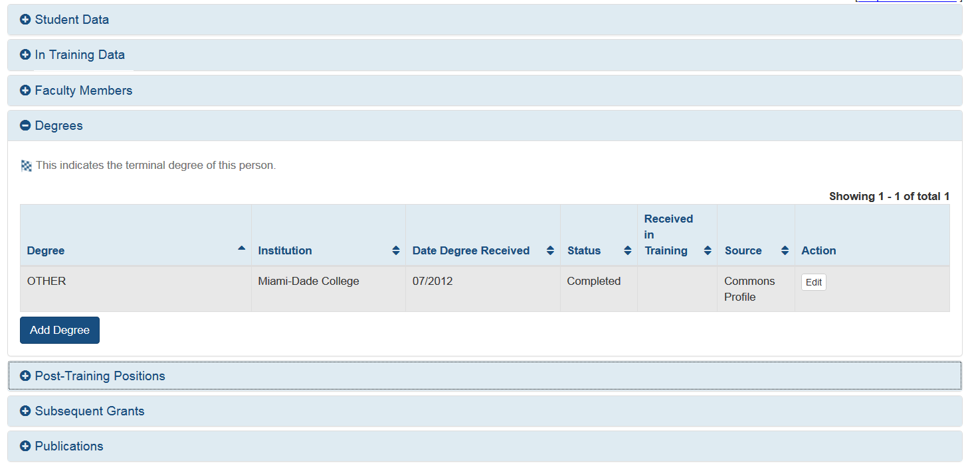
Modify RTD: Participating Students cont.
Degrees will populate from the PPF when available.
You may update:
In Training Data
Faculty Members
Degrees
Post-Training Positions
Subsequent Grants
Publications
Subsequent Grants and Post-Training Data will pre-populate when available.

Slide 21
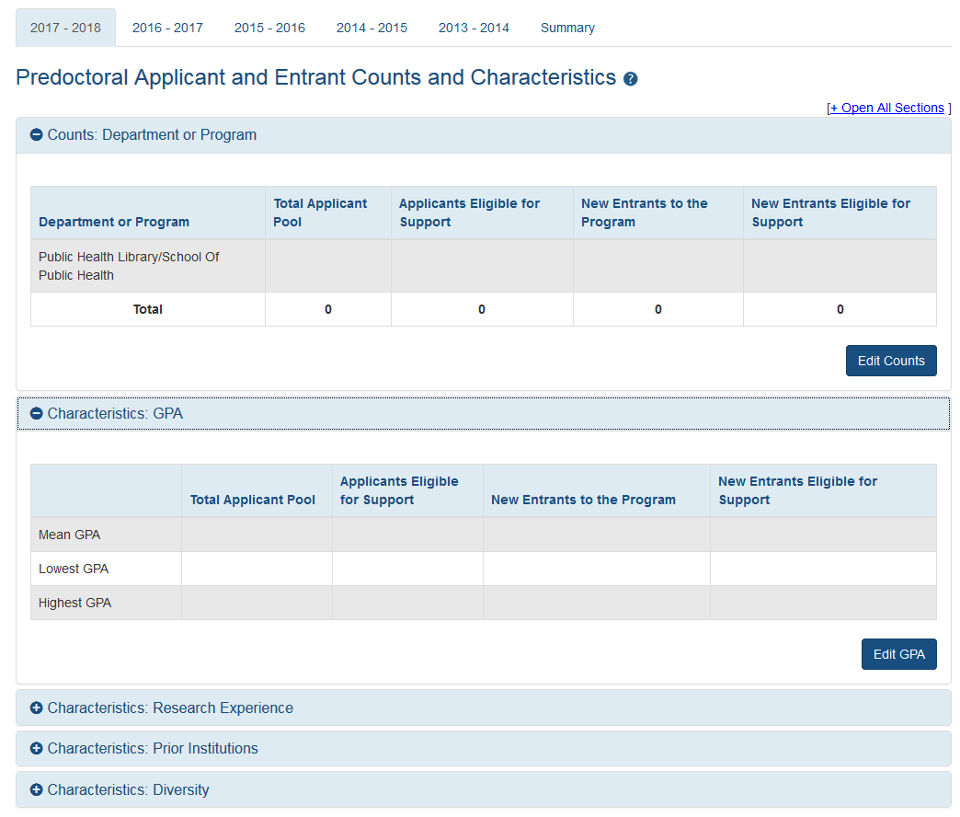
Modify RTD: Applicants and Entrants
Select the Applicant and Entrant category to provide counts and characteristics.
Utilize for New, Renewal or Revision RTDs.
Entering Start year of the most recently completed academic year sets up the last 5 academic years.
You will be given the option to enter data for Pre-Docs and Post-Docs.

Slide 22
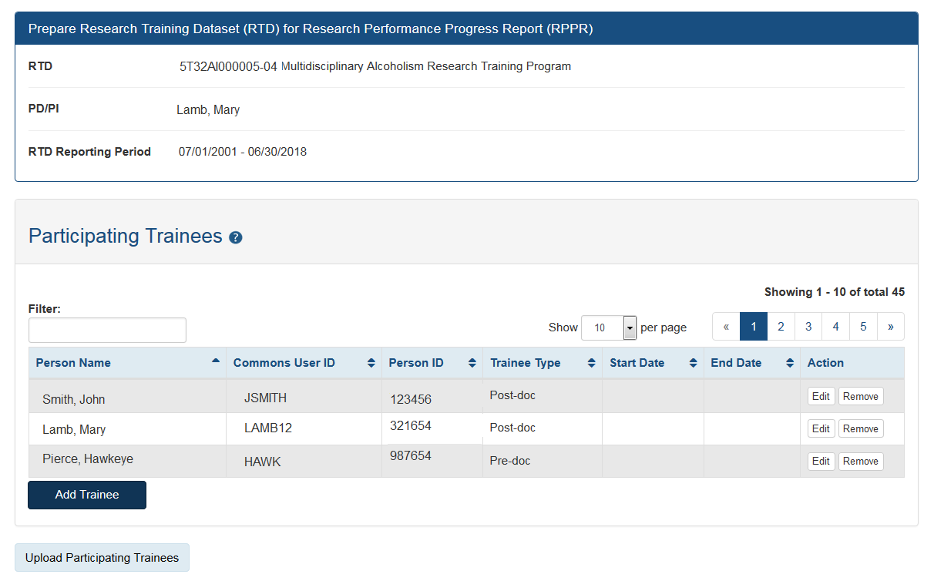
Modify RTD: Participating Trainees
Available for Revisions and Renewal and RPPR RTDs only.
The initial list of trainees will populated from xTrain.
Edit will allow you to update:
In-Training Data
Faculty Members
Degrees
Subsequent Grants
Support During Training
Post Training Positions
Publications
You may also upload Participating Trainees using a tab-delimited file.

Slide 23
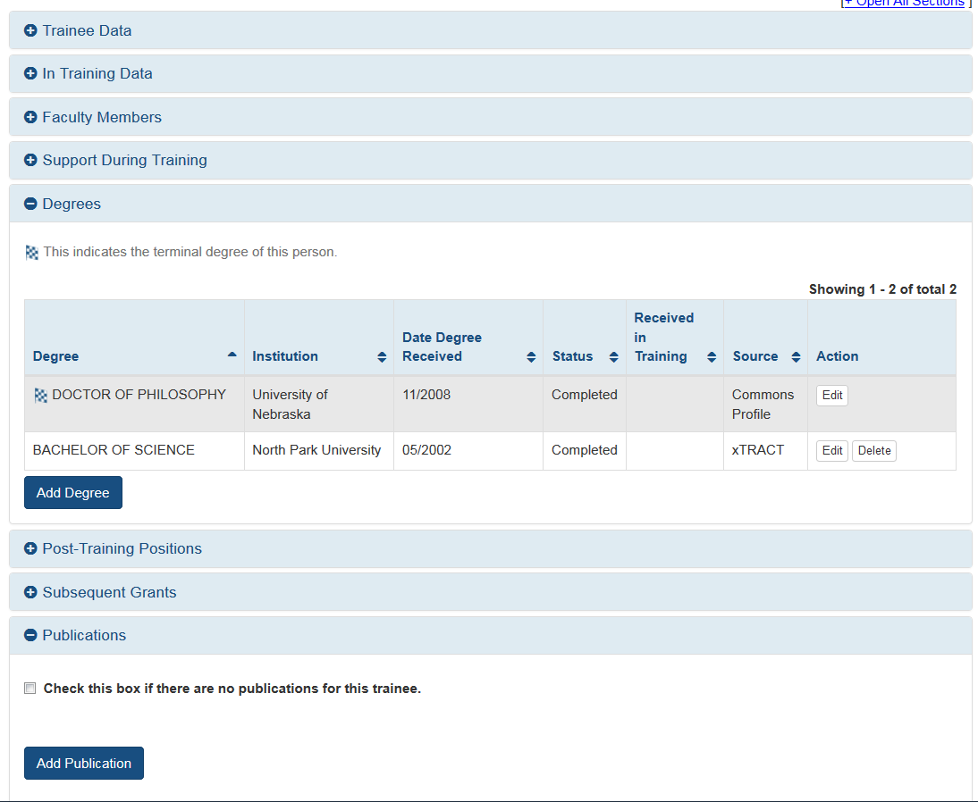
Edit Participating Trainee
Data populated from PPF or from other systems cannot be deleted in xTRACT; only modified.
If the data is modified, the delete option will only delete those changes made in xTract, not the data populated from other modules.
You may update:
In Training Data
Mentoring Faculty Members
Support During Training
Degrees
Post-Training Positions
Subsequent Grants
Publications

Slide 24
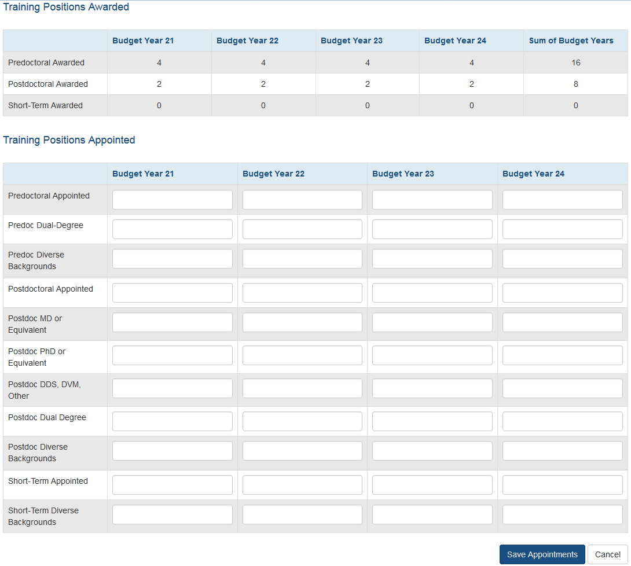
Modify RTD: Appointments
Utilize for Renewal or Revision RTDs.
Awarded Positions displayed as read-only from eRA database.
User enters Appointed Positions.

Slide 25
Finalize RTD
Only the PD/PI or ASST may finalize the RTD.
Review the PDF for accuracy by utilizing the Preview PDF Feature.
After an RTD is finalized, it is ready for submission.
PD/PI or ASST may utilize the “Unfinalize New Application” button in the New RTD Search to enable editing. You will have to finalize the RTD again to generate the PDF.

Slide 26
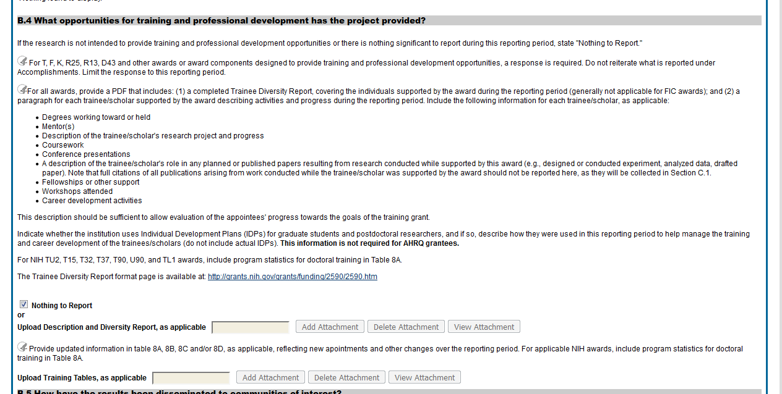
Upload RTD to RPPR
RPPR question B4 now has an additional PDF upload for K12, KL2, R90, RL9, T15, T32, T34, T35, T37, T90, TL1, KM1 activity codes.
Grantees should provide training tables to the second upload as applicable.
All other information should be provided to the first upload.

Slide 27
Notice of Transition to the xTRACT System for Preparing Research Training Data Tables
Notice Number: NOT-OD-18-133 (https://grants.nih.gov/grants/guide/notice-files/NOT-OD-18-133.html )
Beginning with RPPRs due on or after October 1, 2019 and applications submitted for due dates on or after January 25, 2020, NIH and AHRQ anticipate that they will mandate that required training data tables submitted with T32, TL1, T90/R90, and T15 applications and progress reports be created via the xTRACT system. System validations in Grants.gov and the RPPR module will check to ensure that tables were created via xTRACT, and applications and RPPRs that are not in compliance will be rejected.

Slide 28
xTRACT Resource Links
xTRACT Online Help: https://era.nih.gov/erahelp/xtract/
xTRACT User Guide: https://era.nih.gov/files/_userguide.pdf
Training Tables: https://grants.nih.gov/grants/funding/datatables/Consolidated_Training_Tables.pdf
Instructional videos: https://era.nih.gov/era_training/era_videos.cfm#xTRACT

Slide 29
Need help?
The eRA Service Desk can assist with technical issues related to xTRACT.
Hours: Mon-Fri, 7 a.m. to 8 p.m. Eastern Time (closed on federal holidays)
Toll-free: 1-866-504-9552
Phone: 301-402-7469
You may also submit a ticket online at: http://grants.nih.gov/support/index.html

